Slide 1
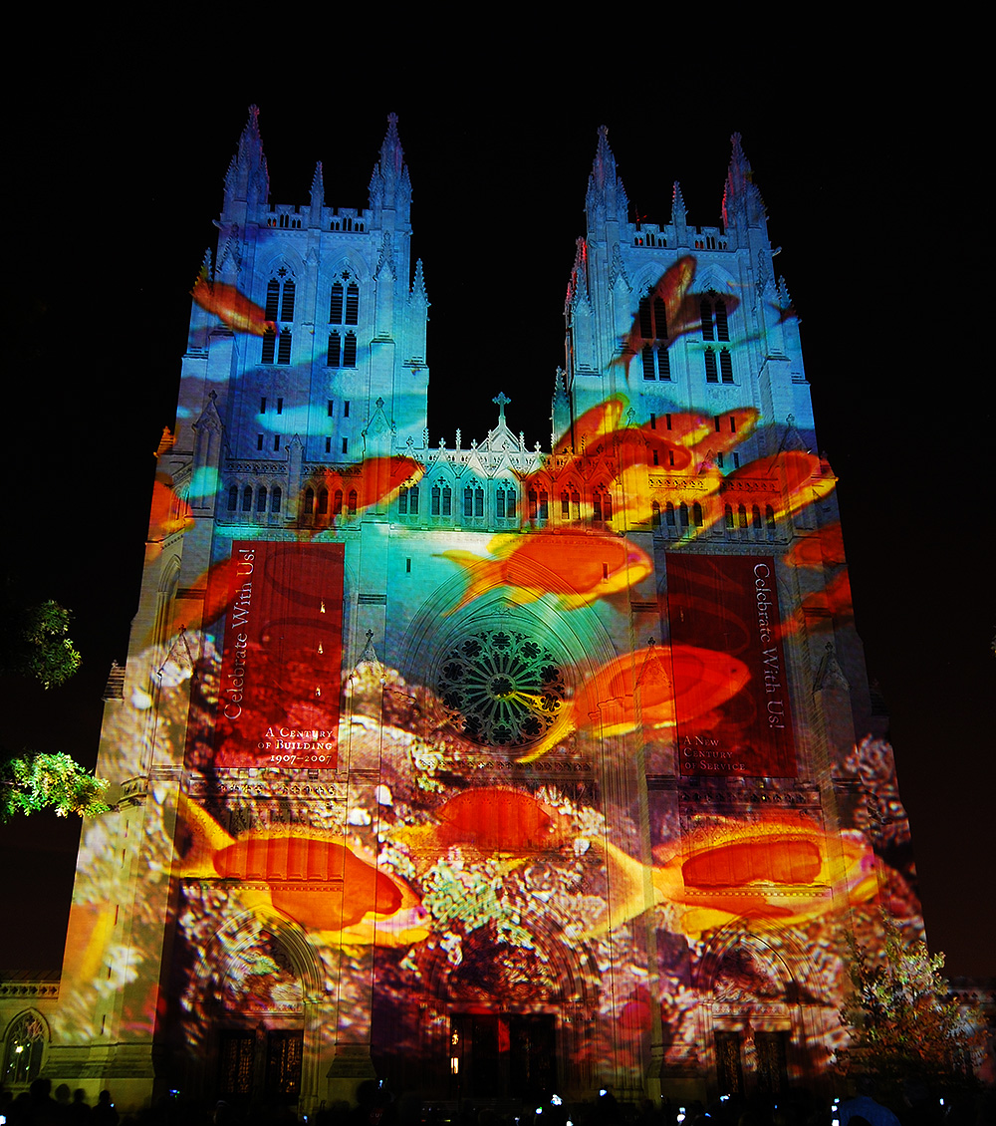
Tuesday of Holy Week
Year A
Isaiah 49:1-7 • Psalm 71:1-14 • 1 Corinthians 1:18-31
John 12:20-36

Slide 2
And now the LORD says … “I will give you as a light to the nations, that my salvation may reach to the end of the earth."
Isaiah 49:5a, 6b

Slide 3
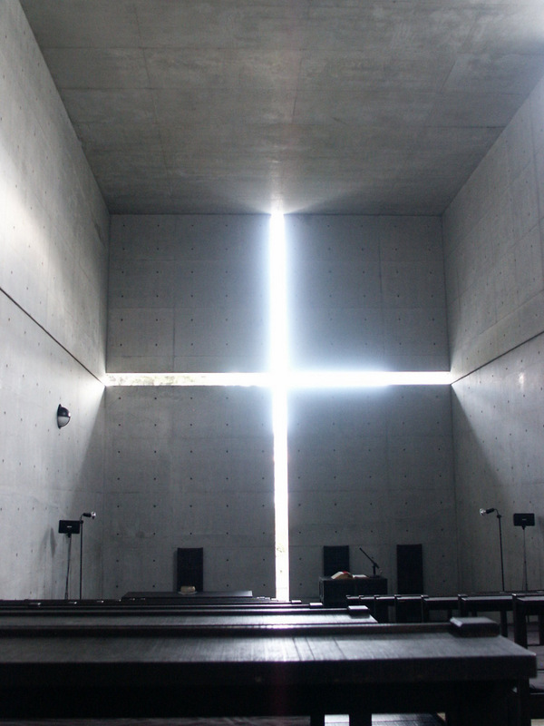
Interior of the Church of the Light
Tadao Ando
Ibaraki, Japan

Slide 4
For you, O Lord, are my hope…
From my birth I have leaned upon you, my protector since my mother's womb.
Psalm 71:5a, 6a

Slide 5
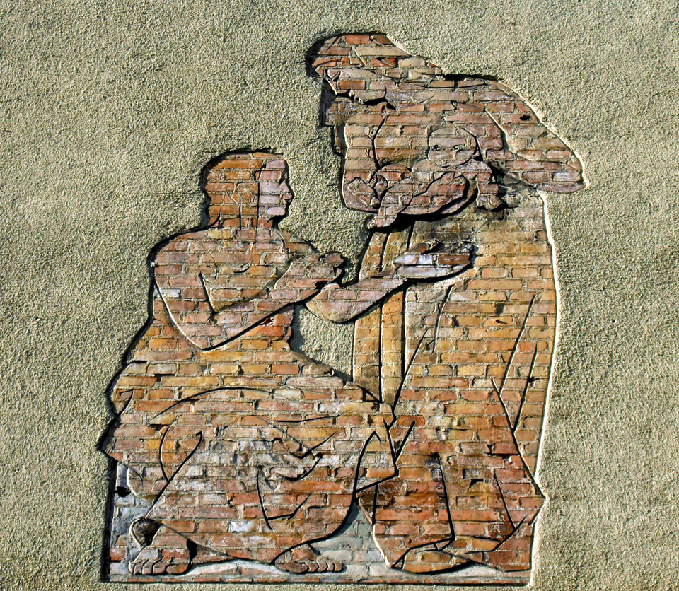
Childbirth
Mural in brick and stucco
Gdansk, Poland

Slide 6
God chose what is low and despised in the world, … so that no one might boast in the presence of God.
1 Corinthians 1:28a, 29

Slide 7
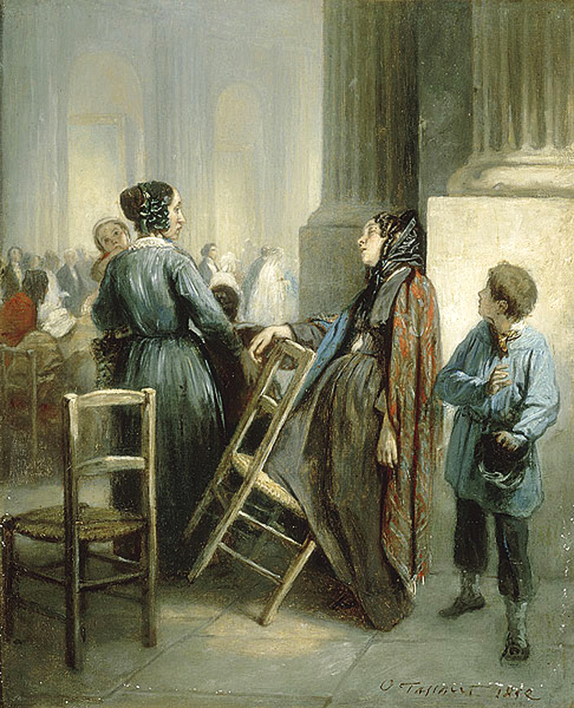
Abandoned
Octave Tassaert
Musee Fabre
Montpellier, France

Slide 8
… unless a grain of wheat falls into the earth and dies, it remains just a single grain; but if it dies, it bears much fruit.
John 12:24b

Slide 9

Cross with Wheat
Benton Chapel
Vanderbilt Divinity School
Nashville, TN

Slide 10
Jesus said to them, "The light is in you for a little longer.”
John 12:35a

Slide 11
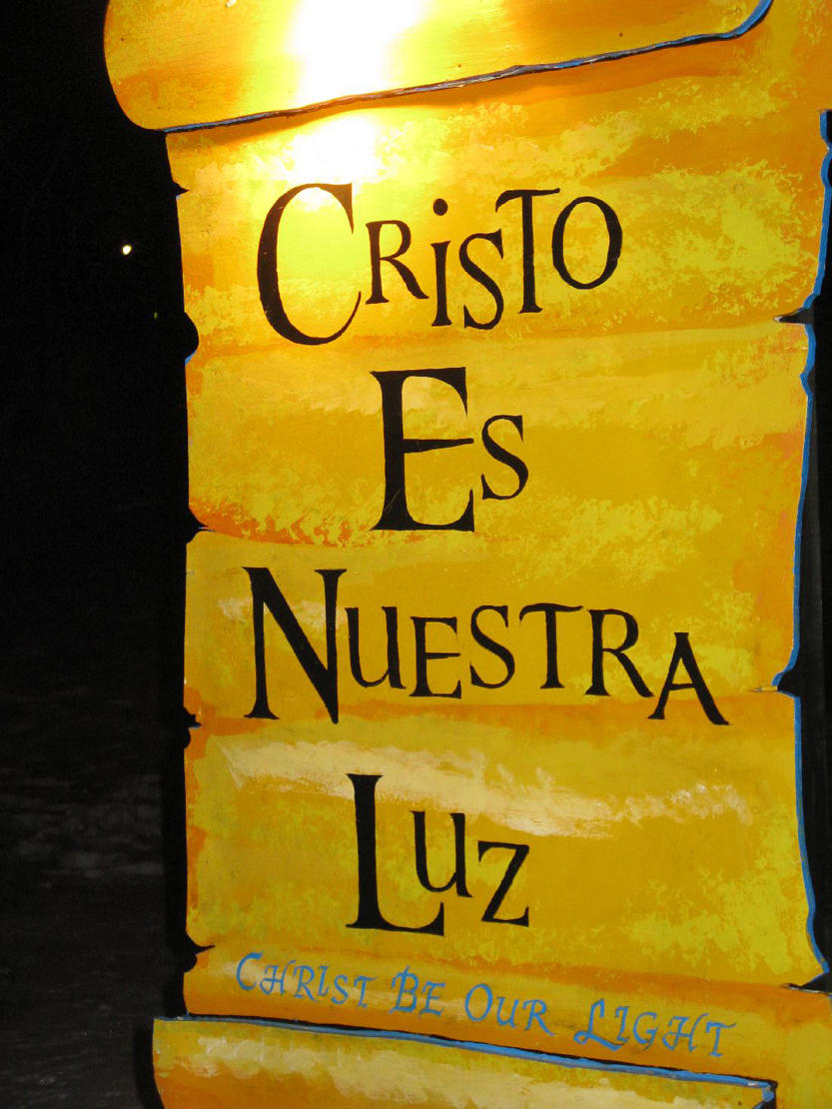
Cristo Es Nuestra Luz
LaSalette Festival of Light
Attleboro, MA

Slide 12
“Walk while you have the light, so that the darkness may not overtake you.”
John 12:35b

Slide 13
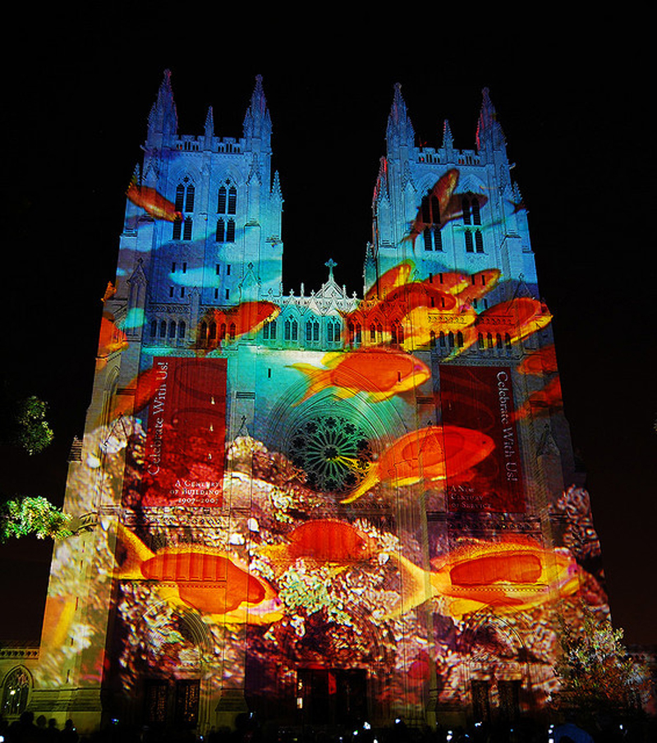
Light upon the Cathedral
Gerry Hofstetter
Washington Cathedral Washington, DC

Slide 14
“While you have the light, believe in the light, so that you may become children of light."
John 12:36

Slide 15

We Are the Children of Light
Poster on building in Williamsburg Brooklyn, NY

Slide 16
Credits
New Revised Standard Version Updated Edition Bible, copyright 2022, Division of Christian Education of the National Council of the Churches of Christ in the United States of America. Used by permission. All rights reserved.
http://commons.wikimedia.org/wiki/File:Church_of_Light.JPG
http://commons.wikimedia.org/wiki/File:Gda%C5%84sk_aleja_Hallera_17_(detal).JPG
http://commons.wikimedia.org/wiki/File:Octave_TASSAERT_The_Waif_-L%27abandonn%C3%A9e.jpg
http://diglib.library.vanderbilt.edu/act-imagelink.pl?RC=46037
http://www.flickr.com/photos/heartlover1717/4141462290/
http://www.flickr.com/photos/prsphoto/3035138704/
http://www.flickr.com/photos/lilomoony/6560430275/
Additional descriptions can be found at the Art in the Christian Tradition image library, a service of the Vanderbilt Divinity Library, http://diglib.library.vanderbilt.edu/. All images available via Creative Commons 3.0 License.

