Slide 1
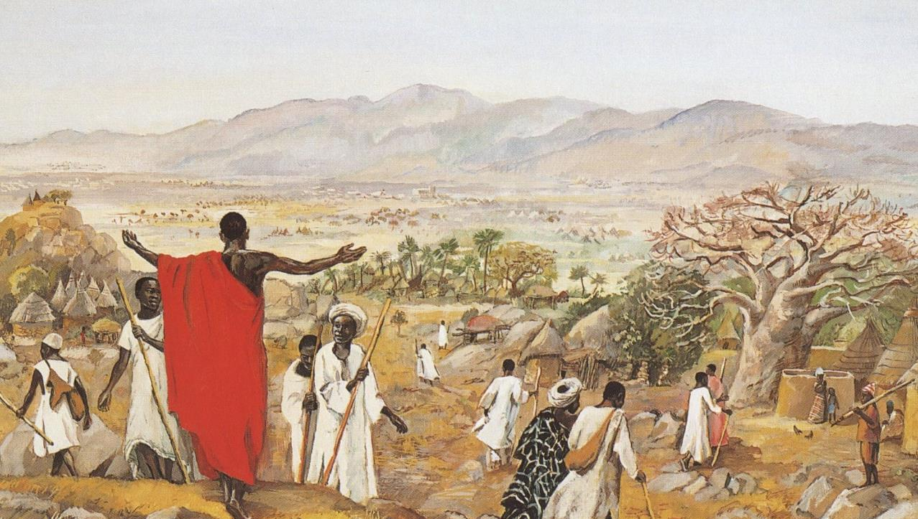
TRINITY SUNDAY
Year C
Proverbs 8:1-4, 22-31 and Psalm 8 • Romans 5:1-5
John 16:12-15

Slide 2
Does not wisdom call, and does not understanding raise her voice?
Proverbs 8:1

Slide 3
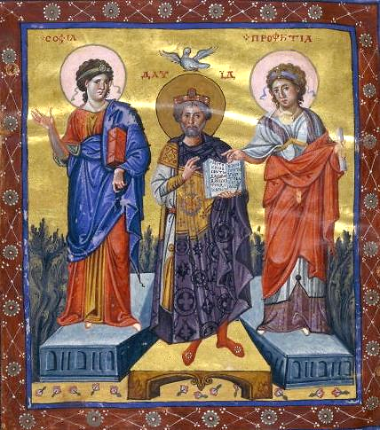
Wisdom and Prophecy with King David
Bibliothèque nationale
Paris, France

Slide 4
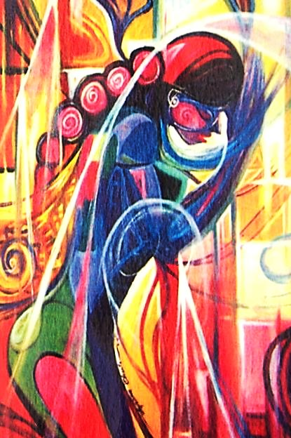
Wisdom
Ayibiowu Olusola David

Slide 5
… at the crossroads she takes her stand; beside the gates in front of the town, at the entrance of the portals she cries out:
Proverbs 8:2b-3

Slide 6
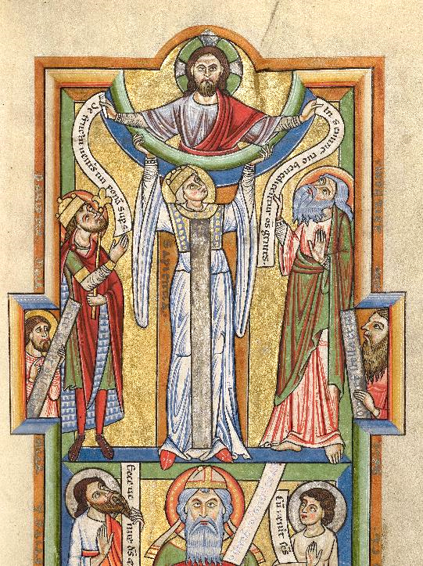
Seat of Wisdom
Manuscript Leaf
Getty Center
Los Angeles, CA

Slide 7
"The LORD created me at the beginning of his work, the first of his acts of long ago.
Proverbs 8:22

Slide 8
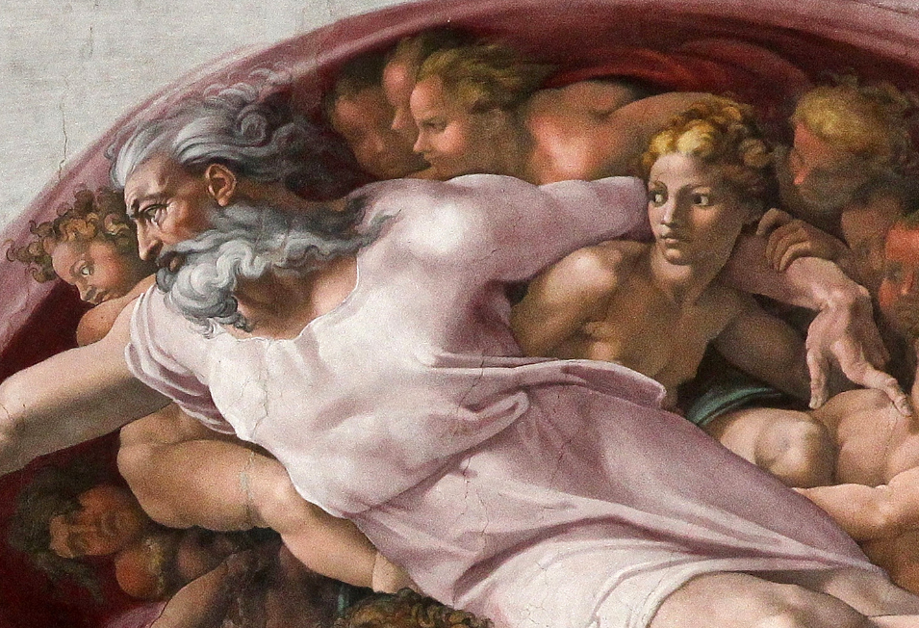
Creation of Adam, detail -- Michelangelo, Sistine Chapel, Vatican City

Slide 9
Before the mountains had been shaped, before the hills, I was brought forth--
when he had not yet made earth and fields, or the world's first bits of soil.
Proverbs 8:25-26

Slide 10
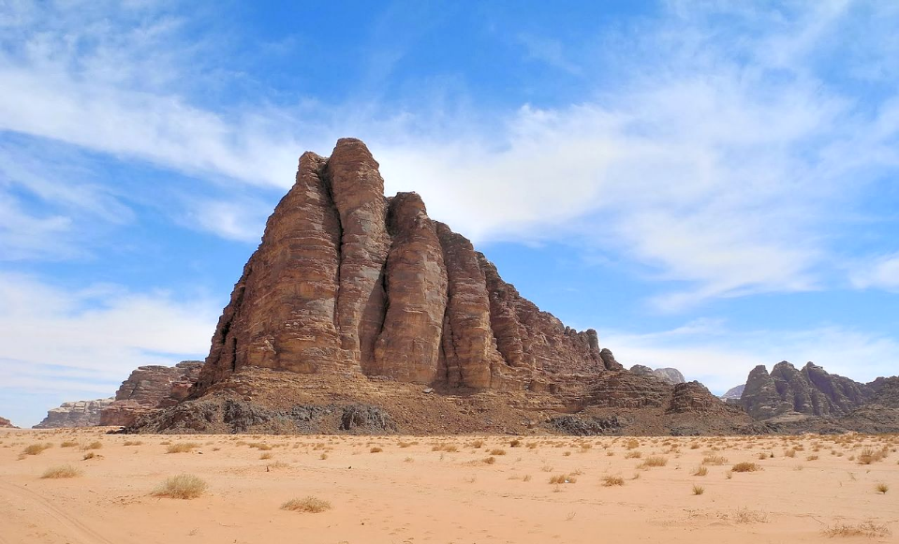
The Seven Pillars of Wisdom -- Jordan desert

Slide 11
When he established the heavens,
I was there, when he drew a circle
on the face of the deep, when he made firm the skies above …
Proverbs 8:27-28a

Slide 12
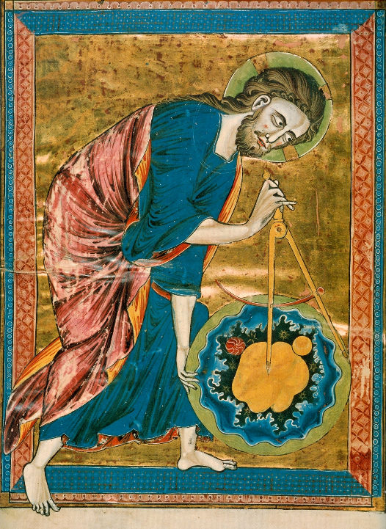
God as Architect
Bible Moralisée
Austrian National Library
Vienna, Austria

Slide 13
I was beside him, like a master worker; and I was daily his delight, playing before him always, playing in his inhabited world and delighting in the human race."
Proverbs 8:30-31

Slide 14
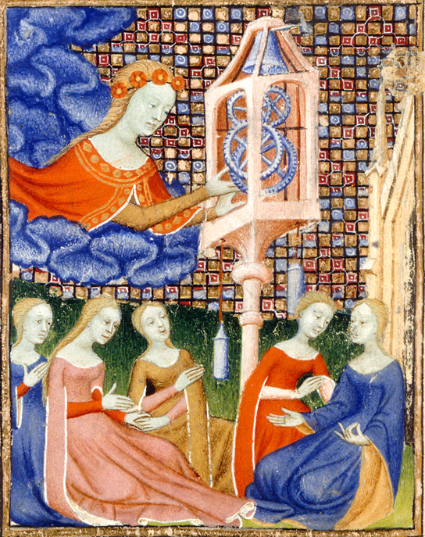
Wisdom, Prudence and Knowledge
Othea's Epistle
15th c.
British Library
London, England

Slide 15
When I look at your heavens, the work of your fingers, the moon and the stars that you have established;
what are human beings that you are mindful of them …?
Psalm 8:3-4

Slide 16
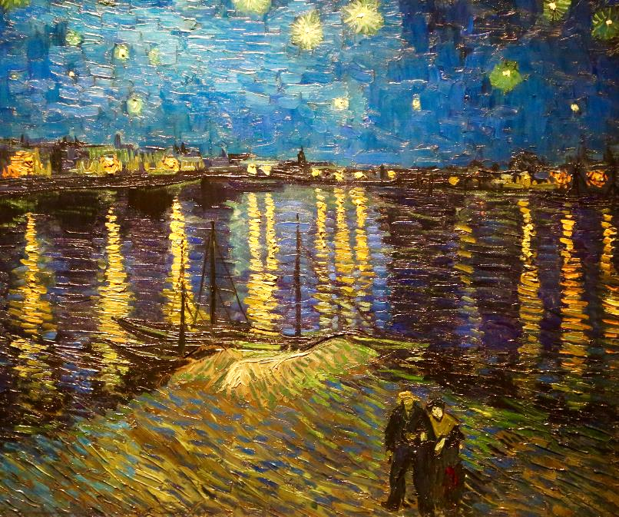
Starry Night -- Vincent van Gogh, Musee D'Orsay, Paris, France

Slide 17
… we have peace with God through our Lord Jesus Christ, through whom we have obtained access to this grace in which we stand …
Romans 5:1b-2a

Slide 18
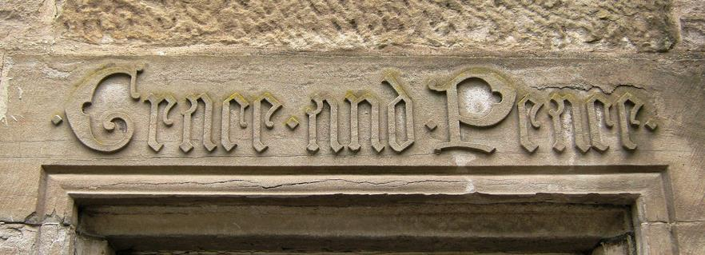
Grace and Peace -- Entry doorway to home in Perth, Scotland

Slide 19
… endurance produces character, and character produces hope … because God's love has been poured into our hearts through the Holy Spirit …
Romans 5:4-5a

Slide 20
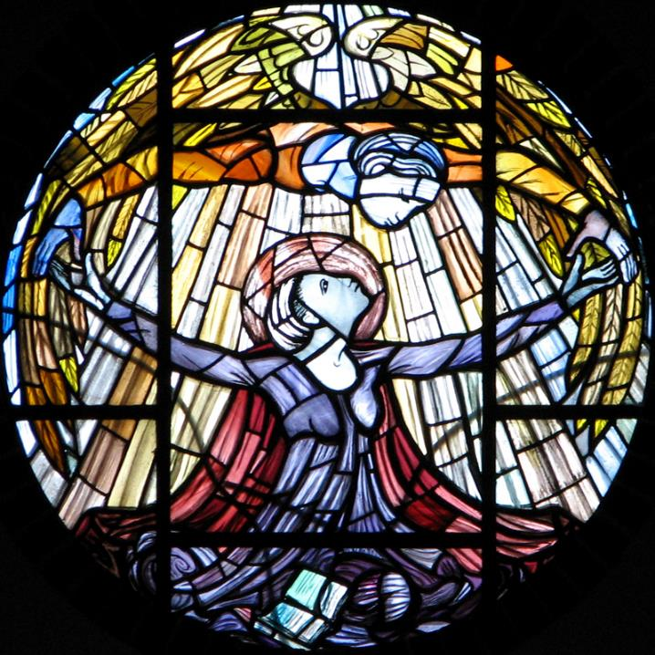
Holy Spirit Appearing to Mary
Our Lady of Pity
Swaffam, England

Slide 21
"I still have many things to say to you, but you cannot bear them now.
John 16:12

Slide 22
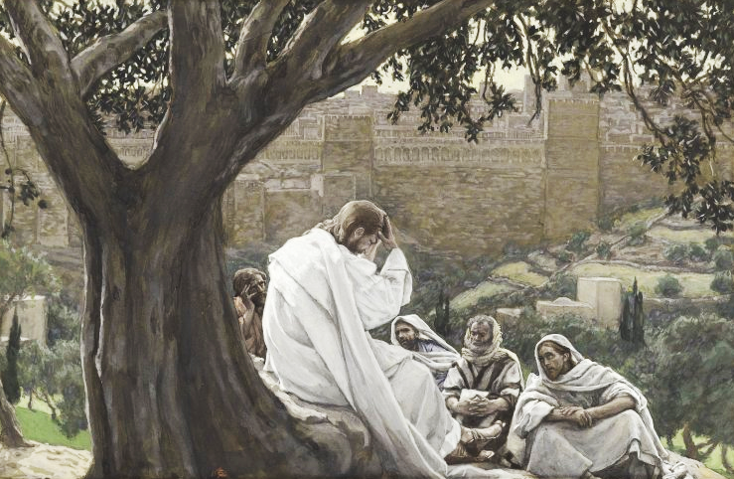
Prophecy of the Destruction of the Temple -- James Tissot, Brooklyn Museum, New York, NY

Slide 23
When the Spirit of truth comes, he will guide you … and he will declare to you the things that are to come.
John 16:13ac

Slide 24
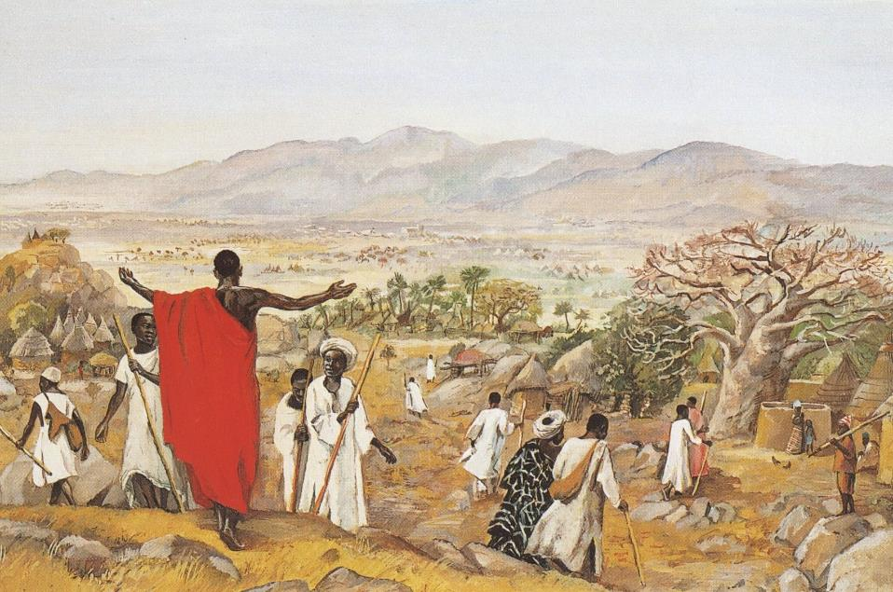
Mission to the World -- JESUS MAFA, Cameroon

Slide 25
Credits
New Revised Standard Version Updated Edition Bible, copyright 2022, Division of Christian Education of the National Council of the Churches of Christ in the United States of America. Used by permission. All rights reserved.
https://commons.wikimedia.org/wiki/File:Paris_psaulter_gr139_fol7v.jpg
https://commons.wikimedia.org/wiki/File:Artist_Olusola_David_Ayibiowu_Title_WISDOM.jpg
http://commons.wikimedia.org/wiki/File:Wisdom_-_Google_Art_Project.jpg
https://commons.wikimedia.org/wiki/File:%27Adam%27s_Creation_Sistine_Chapel_ceiling%27_by_Michelangelo_JBU33cut.jpg - Jörg Bittner Unna
https://commons.wikimedia.org/wiki/File:06_The_Seven_Pillars_of_Wisdom_-_The_Seven_Pillars_of_Wisdom_-_panoramio.jpg
https://commons.wikimedia.org/wiki/File:God_the_Geometer.jpg
https://commons.wikimedia.org/wiki/File:Othea%27s_Epistle_(Queen%27s_Manuscript)_02.jpg
https://www.flickr.com/photos/ugardener/35192475055
https://www.flickr.com/photos/28120556@N08/4653609664/
https://www.flickr.com/photos/paullew/2052404610/ - Fr Lawrence Lew, O.P.
https://commons.wikimedia.org/wiki/File:Brooklyn_Museum_-_The_Prophecy_of_the_Destruction_of_the_Temple_(La_pr%C3%A9dication_de_la_ruine_du_Temple)_-_James_Tissot.jpg
http://diglib.library.vanderbilt.edu/act-imagelink.pl?RC=48314
Additional descriptions can be found at the Art in the Christian Tradition image library, a service of the Vanderbilt Divinity Library, http://diglib.library.vanderbilt.edu/. All images available via Creative Commons 3.0 License.

