Slide 1
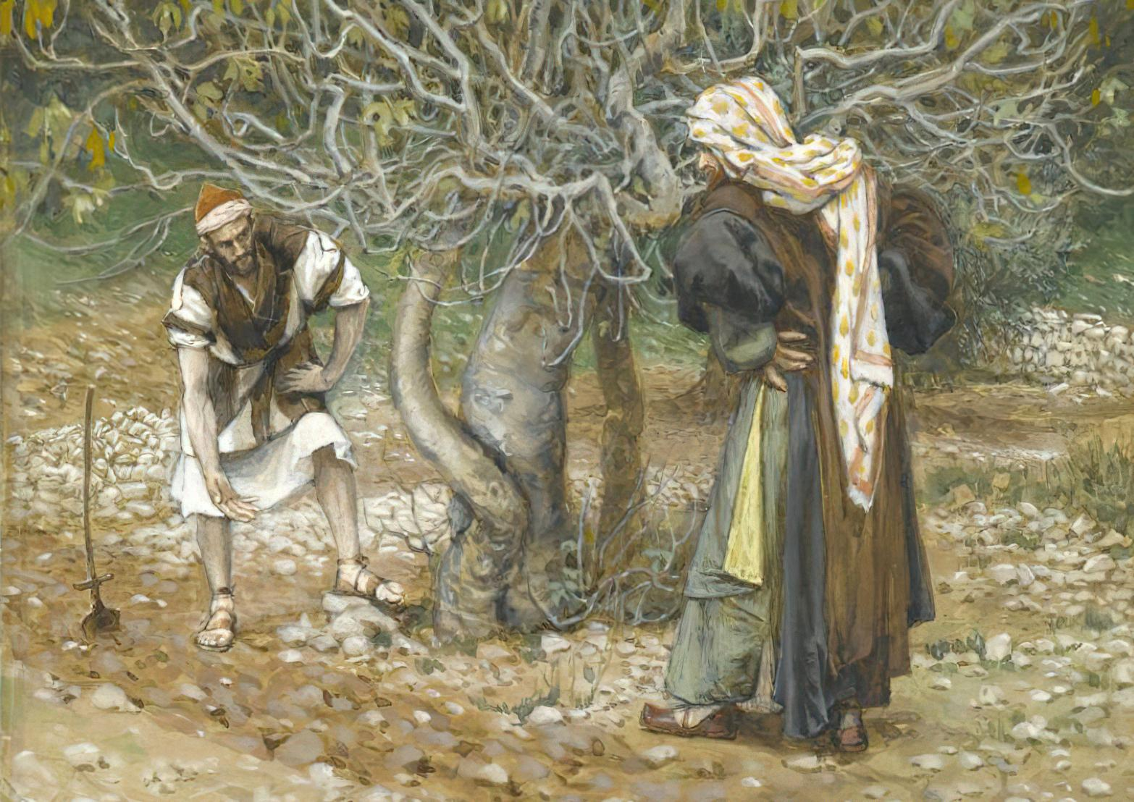
THIRD SUNDAY IN LENT
Year C
Isaiah 55:1-9 • Psalm 63:1-8
1 Corinthians 10:1-13 • Luke 13:1-9

Slide 2
Ho, everyone who thirsts, come to the waters; and you that have no money, come, buy and eat! Come, buy wine and milk without money and without price.
Isaiah 55:1

Slide 3
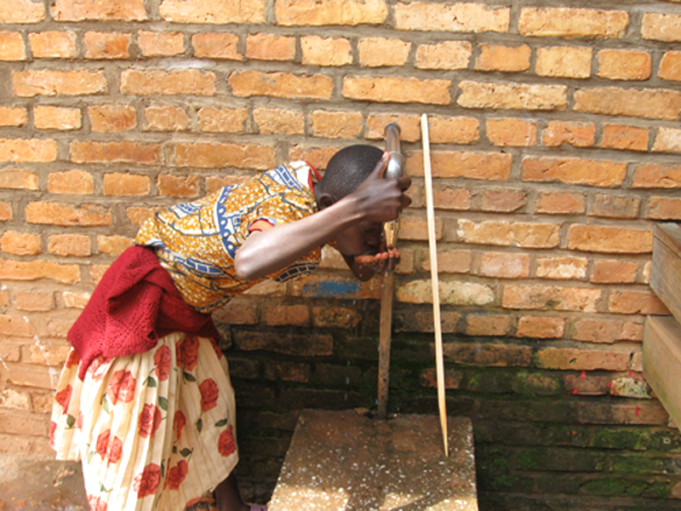
Girl drinking clean water in Rwanda (from Partners in Health initiative)

Slide 4
Why do you spend your money for that which is not bread, and your earnings for that which does not satisfy?
Isaiah 55:2a

Slide 5
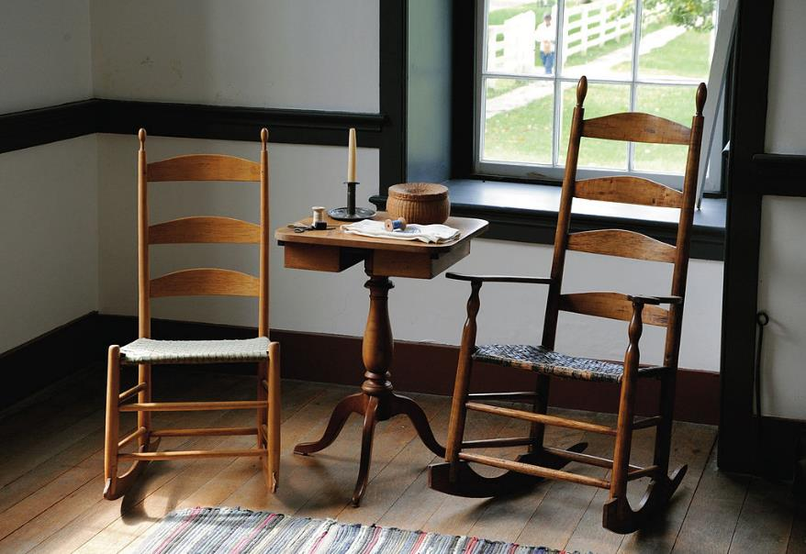
Handmade Rockers in the Shaker Village -- Harrodsburg, KY

Slide 6
My soul is satisfied as with a rich feast … you have been my help, and in the shadow of your wings I sing for joy.
Psalm 63:5a, 7

Slide 7
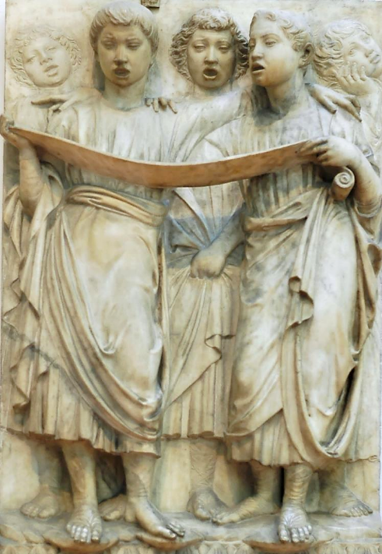
Boys Singing Psalms
Luca della Robbia
Museo dell'Opera del Duomo
Florence, Italy

Slide 8
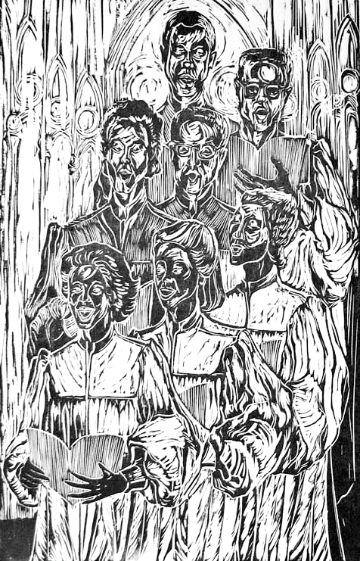
Choir
Annette Gandy Fortt

Slide 9
brothers and sisters … our ancestors … all passed through the sea, and all were baptized into Moses …
1 Corinthians 10:1b, 2

Slide 10
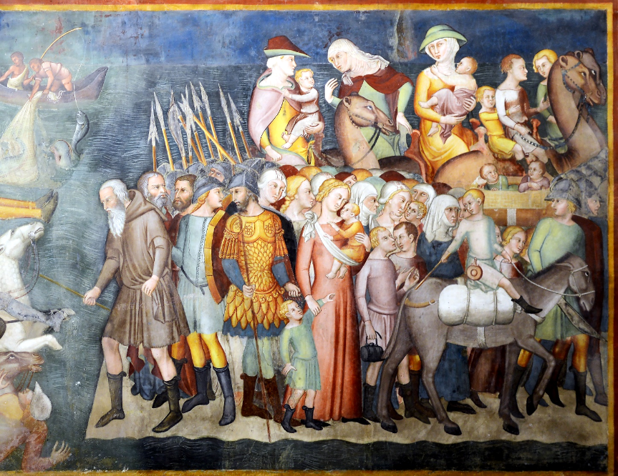
Crossing of the Red Sea -- Bartolo di Fredi, Collegiate Church, San Gimignano, Italy

Slide 11
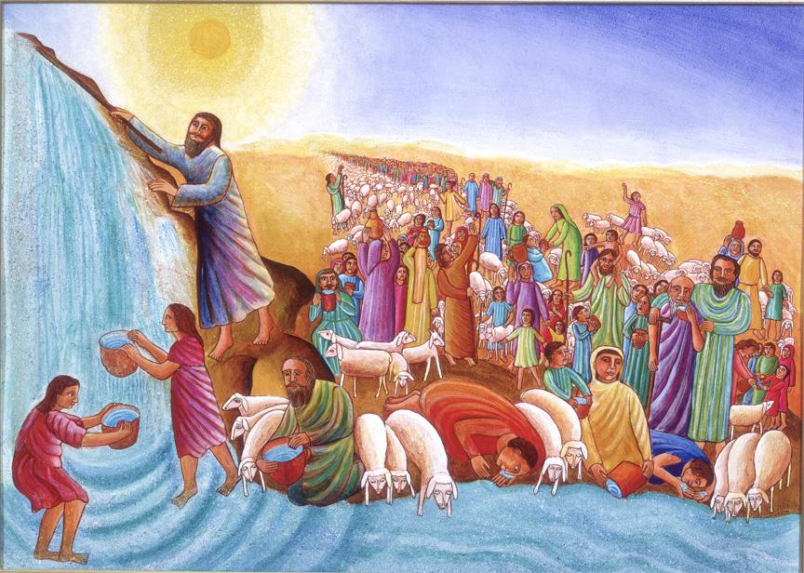
Moses -- John August Swanson

Slide 12
... and all ate the same spiritual food, and all drank the same spiritual drink. For they drank from the spiritual rock that followed them, and the rock was Christ.
1 Corinthians 10:3-4

Slide 13
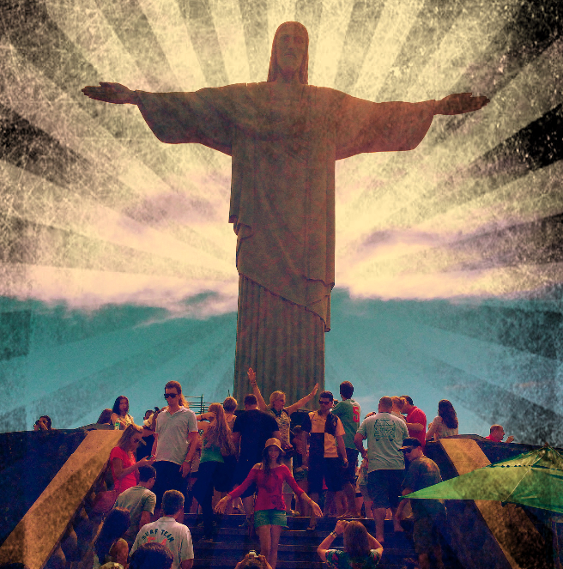
Christ the Redeemer
photographic interpretation
Babak Fakhamzadeh

Slide 14
Then he told this parable: "A man had a fig tree planted in his vineyard; and he came looking for fruit on it and found none.
Luke 13:6

Slide 15
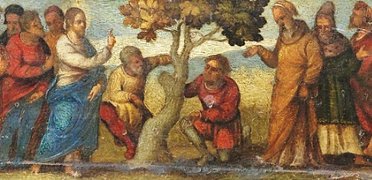
Parable of the Barren Fig Tree -- Ludovico Mazzolino, Rijksmuseum, Amsterdam, Netherlands

Slide 16
So he said to the worker in the vineyard, 'See here! For three years I have come looking for fruit on this fig tree, and still I find none. Cut it down! Why should it be wasting the soil?'
Luke 13:7

Slide 17
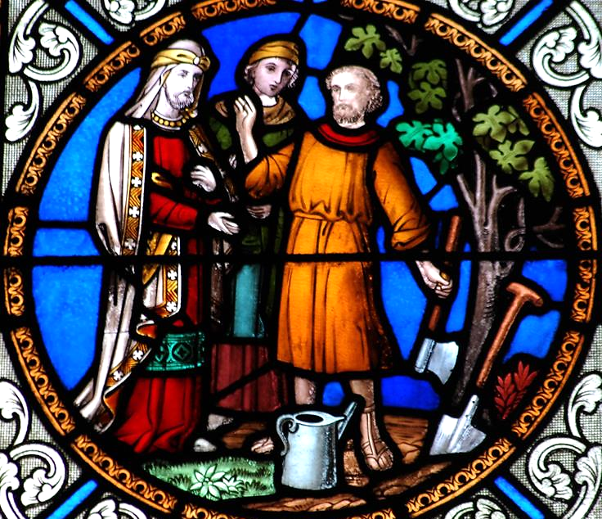
The Gardener and the Fig Tree
Dungarvan,
Waterford
Ireland

Slide 18
He replied, 'Sir, let it alone for one more year, until I dig around it and put manure on it.
Luke 13:8

Slide 19
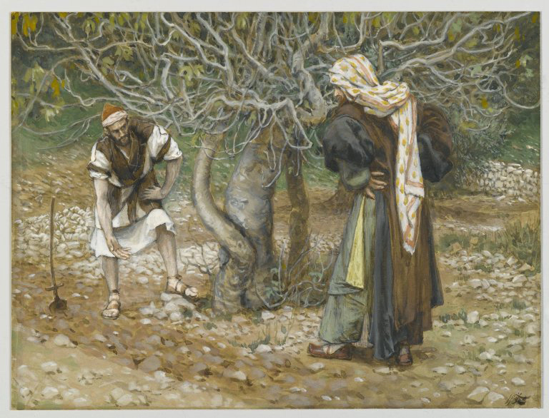
The Vine Dresser and the Fig Tree -- James Tissot, Brooklyn Museum, New York, NY

Slide 20
If it bears fruit next year, well and good; but if not, you can cut it down.'"
Luke 13:9

Slide 21
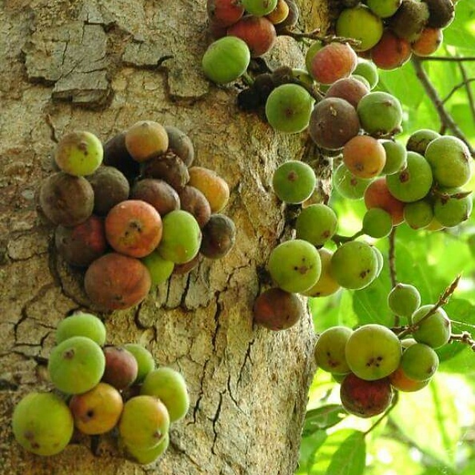
A Fig Tree
Islamabad, Pakistan

Slide 22
Credits
New Revised Standard Version Updated Edition Bible, copyright 2022, Division of Christian Education of the National Council of the Churches of Christ in the United States of America. Used by permission. All rights reserved.
http://www.flickr.com/photos/jongos/2824416129/
https://commons.wikimedia.org/wiki/File:Rockers_in_the_Shaker_Village_at_Pleasant_Hill.jpg
https://commons.wikimedia.org/wiki/File:Cantoria_Della_Robbia_OPA_Florence_5.jpg – Jastrow
https://annettefortt.com/
https://commons.wikimedia.org/wiki/File:The_army_of_Pharaoh_are_drowned_in_the_Red_Sea_in_Duomo_(San_Gimignano).jpg
https://www.flickr.com/photos/mastababa/12745694075 - Babak Fakhamzadeh
https://commons.wikimedia.org/wiki/File:Ludovico_Mazzolino_-_Mozes_en_de_tafelen_der_Wet.jpg
www.JohnAugustSwanson.com - copyright 1983 by John August Swanson
http://www.flickr.com/photos/feargal/3923006489/
https://commons.wikimedia.org/wiki/File:Brooklyn_Museum_-_The_Vine_Dresser_and_the_Fig_Tree_(Le_vigneron_et_le_figuier)_-_James_Tissot.jpg
https://commons.wikimedia.org/wiki/File:Fig_Tree_with_Figs_coming_out_of_the_trunk.jpg -Naveedanjumkhan
Additional descriptions can be found at the Art in the Christian Tradition image library, a service of the Vanderbilt Divinity Library, http://diglib.library.vanderbilt.edu/. All images available via Creative Commons 3.0 License.

