Slide 1
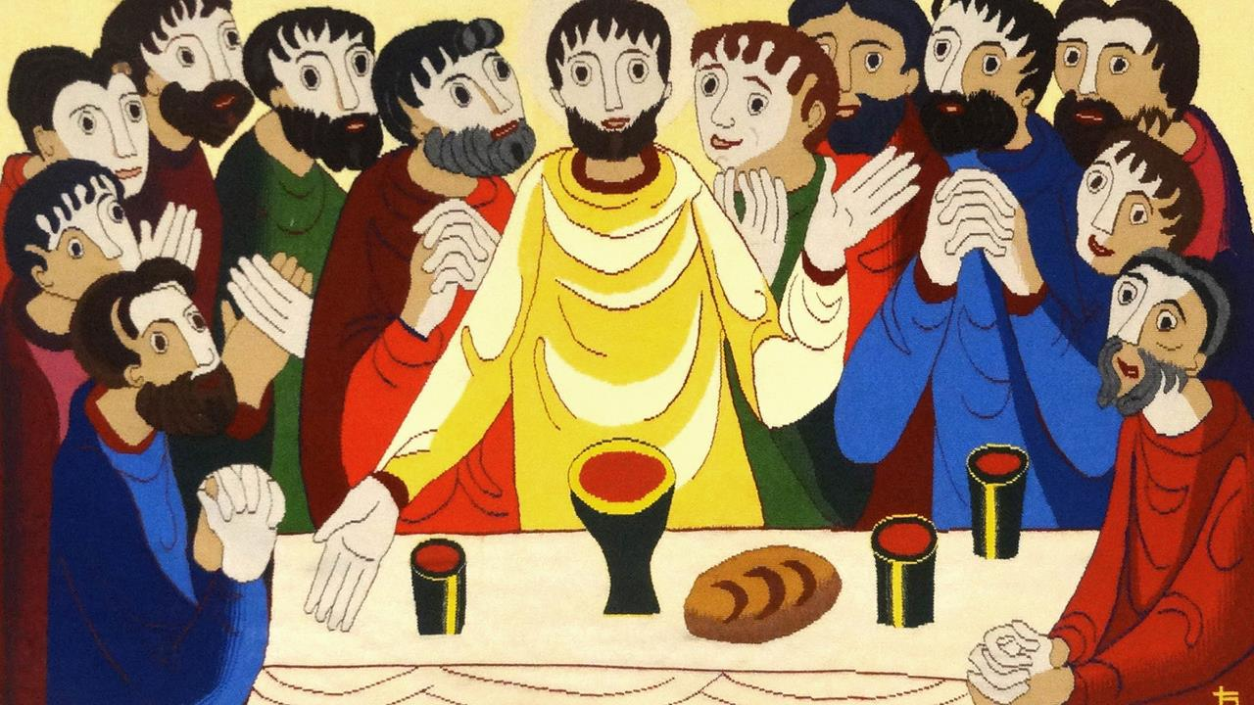
Thanksgiving Day
Year C
Deuteronomy 26:1-11 and Psalm 100
Philippians 4:4-9 • John 6:25-35

Slide 2
… you shall take some of the first of all the fruit of the ground … and you shall put it in a basket and go to the place that the LORD your God will choose as a dwelling for his name.
Deuteronomy 26:2ac

Slide 3
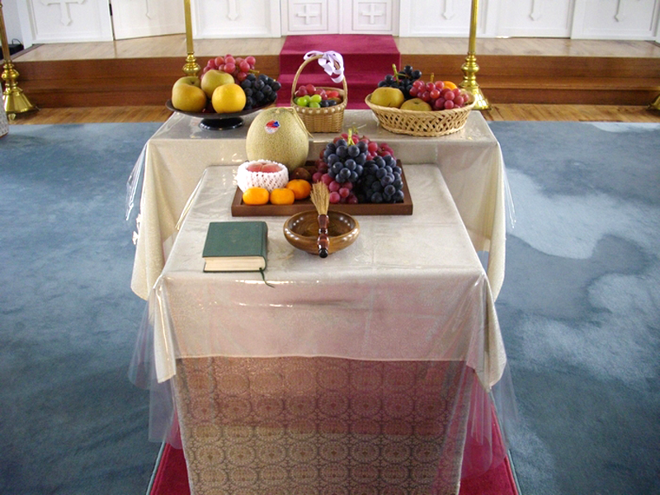
Altar Offering of First Fruits, Japanese Orthodox Holy Resurrection Cathedral, Tokyo, Japan

Slide 4
Make a joyful noise to the LORD, all the earth …
Psalm 100:1

Slide 5
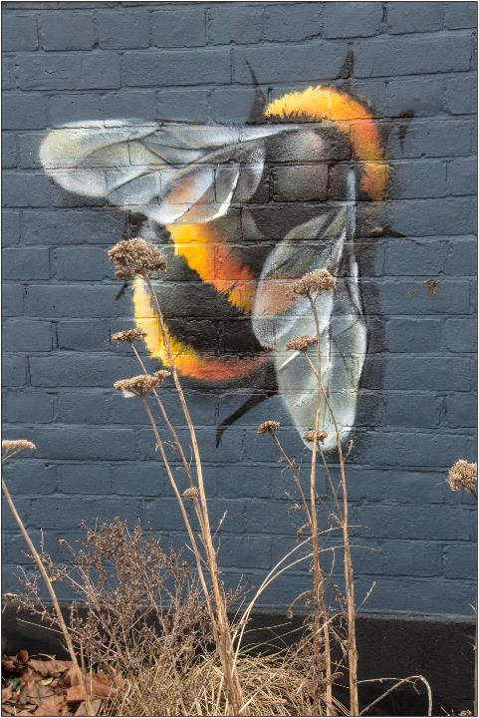
Bee Mural
Weareskyhigh
Kingston on the Thames,
England

Slide 6
Worship the LORD with gladness; come into his presence with singing.
Psalm 100:2

Slide 7
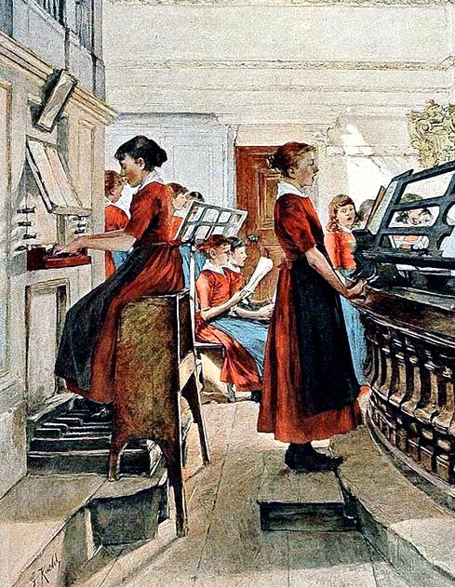
A Mighty Fortress is Our God
Gotthardt Kuehl
print, c. 1900

Slide 8
Know that the LORD is God. It is he that made us, and we are his; we are his people, and the sheep of his pasture.
Psalm 100:3

Slide 9
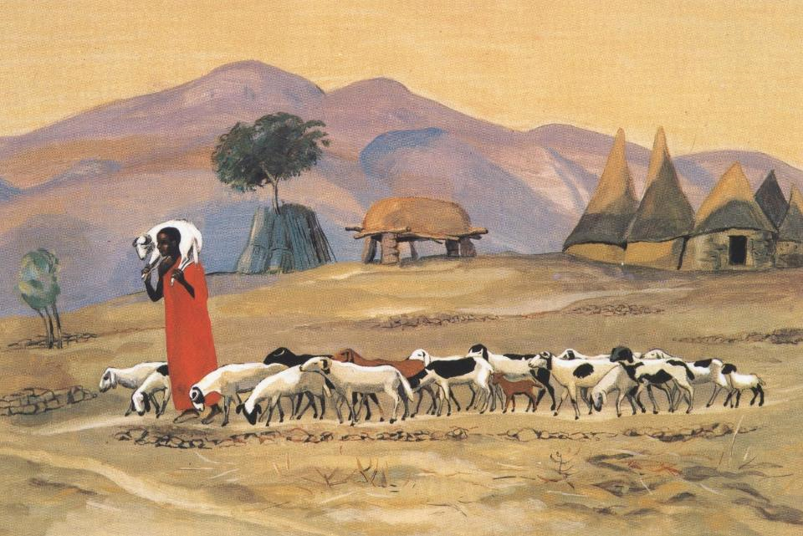
The Good Shepherd -- JESUS MAFA, Cameroon

Slide 10
Enter his gates with thanksgiving, and his courts with praise. Give thanks to him, bless his name.
Psalm 100:4

Slide 11
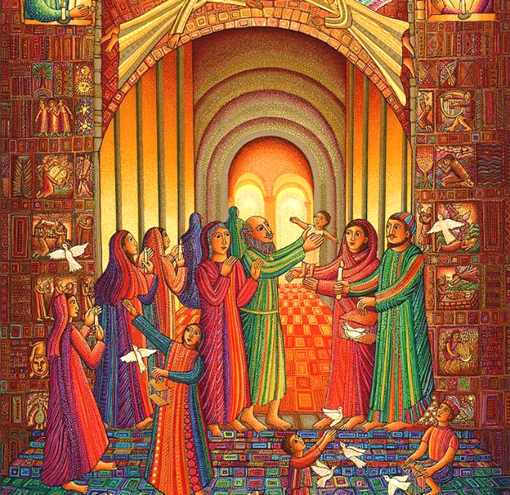
Presentation in the Temple -- John August Swanson

Slide 12
For the LORD is good; his steadfast love endures forever, and his faithfulness to all generations.
Psalm 100:5

Slide 13
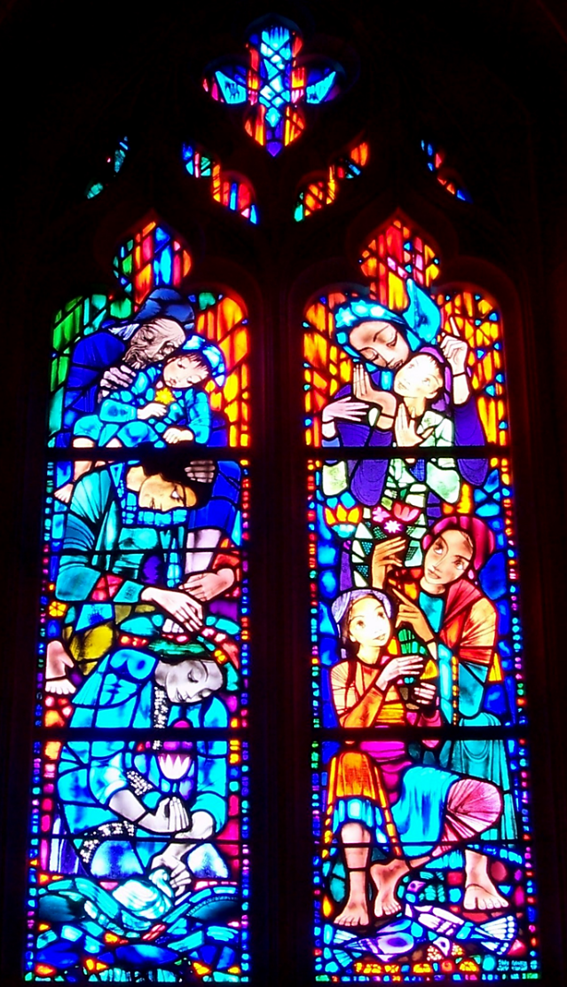
Family
National Cathedral
Washington, DC

Slide 14
Rejoice in the Lord always … Do not be anxious about anything … but in everything by prayer and supplication with thanksgiving let your requests be made known to God.
Philippians 4:4a, 6ac

Slide 15
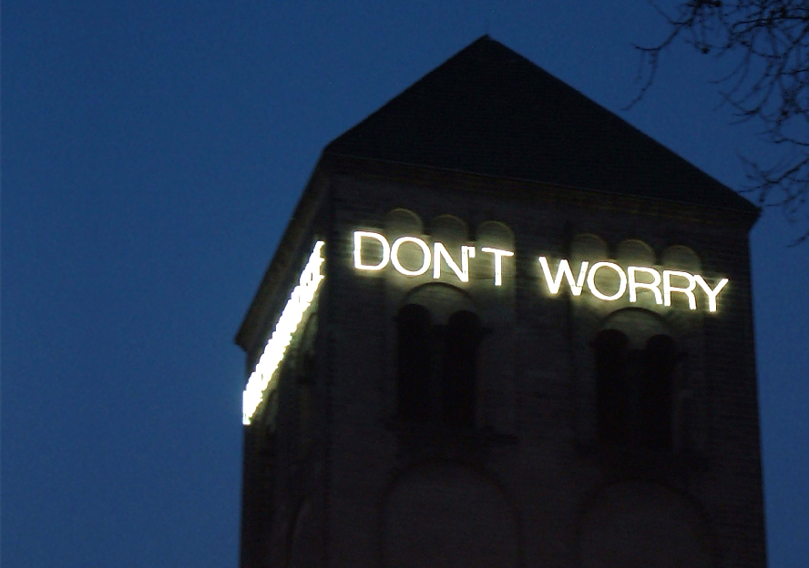
Don't Worry -- Martin Creed, permanent installation, St. Peter's Cathedral, Cologne, Germany

Slide 16
Jesus answered them … "Do not work for the food that perishes, but for the food that endures for eternal life …"
John 6:26a, 27a

Slide 17
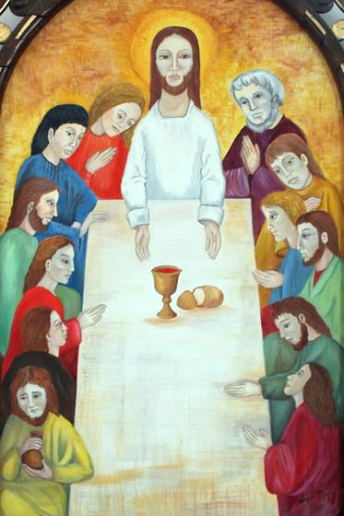
Last Supper
Cathedral of Sancti Spiritus
Sancti Spiritus,
Cuba

Slide 18
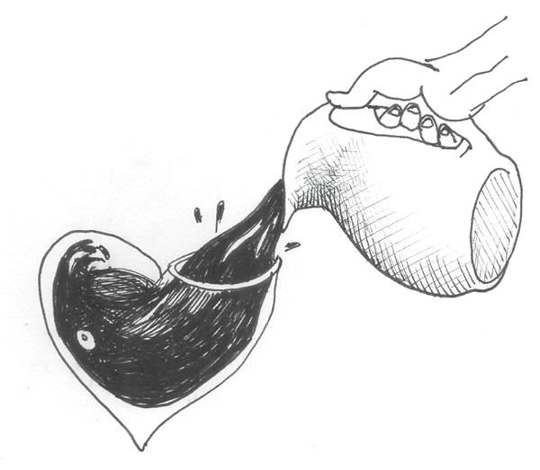
Fill Me
Liz Valente
Vicosa, Brazil

Slide 19
For the bread of God is that which comes down from heaven and gives life to the world."
John 6:33

Slide 20
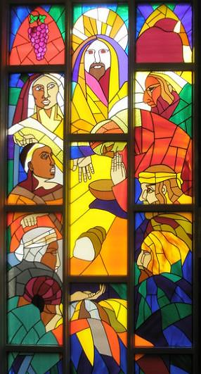
The Last Supper
Richard Jarczyk
St. Thomas Church
Emsworth, England

Slide 21
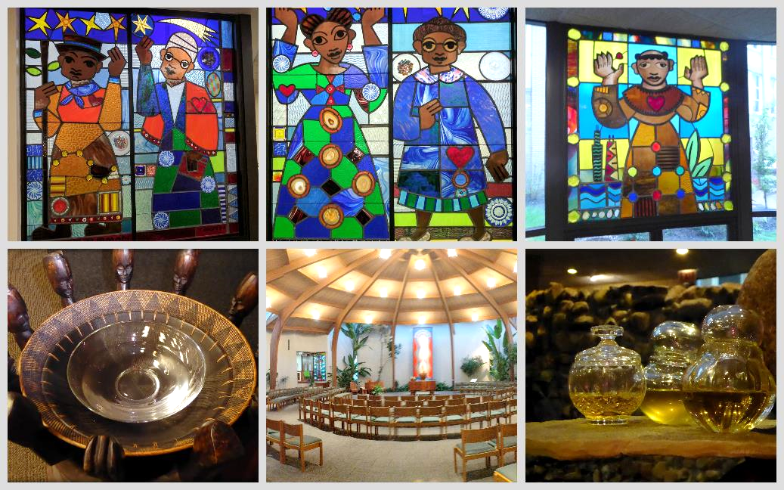
St. Benedict the African Catholic Church, Chicago, IL

Slide 22
They said to him, "Sir, give us this bread always."
John 6:34

Slide 23
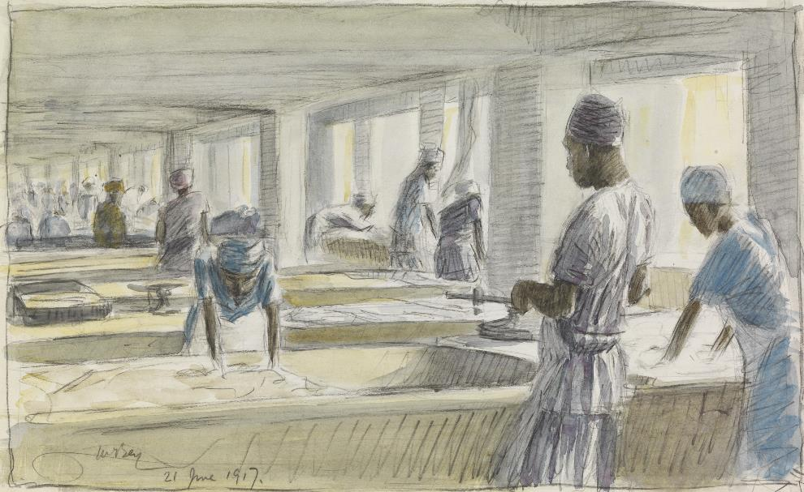
Making Bread -- James McBey

Slide 24
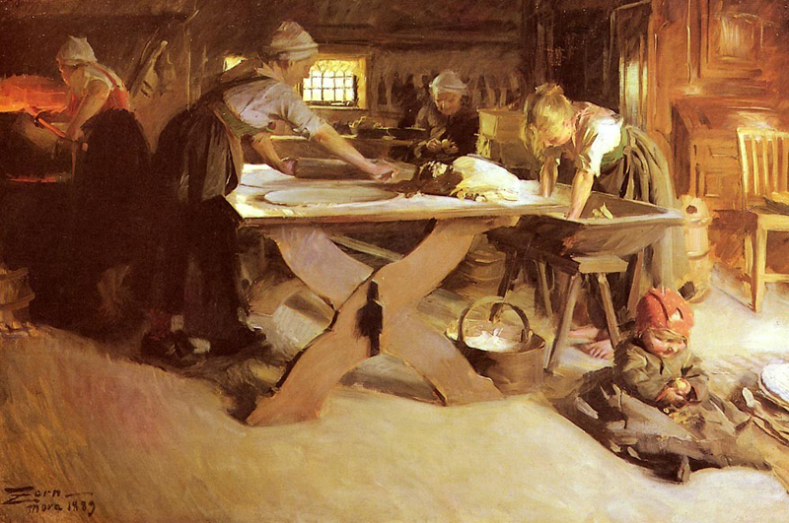
Bread Baking -- Anders Zorn

Slide 25
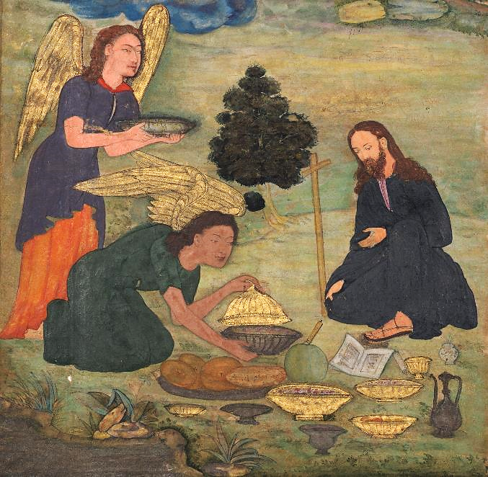
Angels Bring Bread to Jesus in the Wilderness -- India, early 17th c.

Slide 26
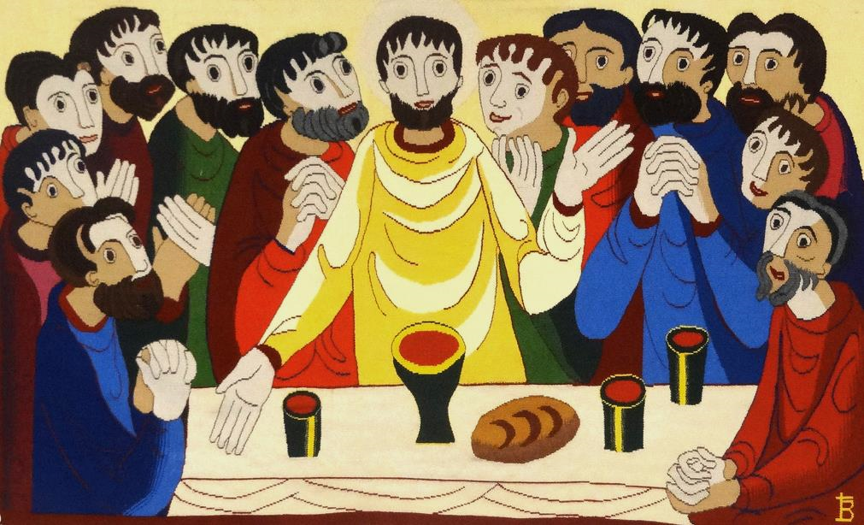
The Last Supper -- Bose Monastery, Bose, Italy

Slide 27
Jesus said to them, "I am the bread of life. Whoever comes to me will never be hungry, and whoever believes in me will never be thirsty."
John 6:35

Slide 28
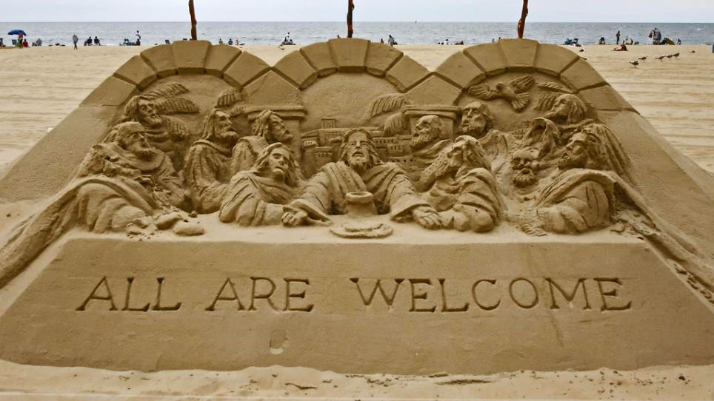
All Are Welcome in the Kingdom of God -- Sand sculpture, Ocean City, MD

Slide 29
Credits
New Revised Standard Version Updated Edition Bible, copyright 2022, Division of Christian Education of the National Council of the Churches of Christ in the United States of America. Used by permission. All rights reserved.
https://commons.wikimedia.org/wiki/File:Fruits_Transfiguration_jp.jpg
https://www.flickr.com/photos/maureen_barlin/38824836800 - Maureen Barlin
http://commons.wikimedia.org/wiki/File:Gotthardt_Kuehl_Ein_feste_Burg_ist_unser_Gott_crop_balance.jpg
http://diglib.library.vanderbilt.edu/act-imagelink.pl?RC=48288
www.JohnAugustSwanson.com - copyright 1988 by John August Swanson
http://www.flickr.com/photos/thsant/732944790/
https://commons.wikimedia.org/wiki/File:Don%27t_worry.jpg
http://commons.wikimedia.org/wiki/File:2012-02-Kathedrale_Sancti_Spiritus_04_anagoria.JPG
https://www.instagram.com/donalizvalente/
https://commons.wikimedia.org/wiki/File:%22The_Last_Supper%22_-_geograph.org.uk_-_1283787.jpg
https://www.flickr.com/photos/yooperann/37485577690
https://commons.wikimedia.org/wiki/File:Baking_Native_Bread_Art.IWMART1417.jpg
https://commons.wikimedia.org/wiki/File:Anders_Zorn_-_Br%C3%B6dbaket.jpg
https://commons.wikimedia.org/wiki/File:Northern_India,_Uttar_Pradesh,_Allahabad,_Mughal_period_-_Angels_bring_food_to_Jesus_in_the_wilderness,_from_a_Mir%27at_al-quds_-_2005.145.15_-_Cleveland_Museum_of_Art.tif
https://www.flickr.com/photos/jimforest/15094200090/
https://www.flickr.com/photos/jillianaphotography/1236022574/
Additional descriptions can be found at the Art in the Christian Tradition image library, a service of the Vanderbilt Divinity Library, http://diglib.library.vanderbilt.edu/. All images available via Creative Commons 3.0 License.

