Slide 1
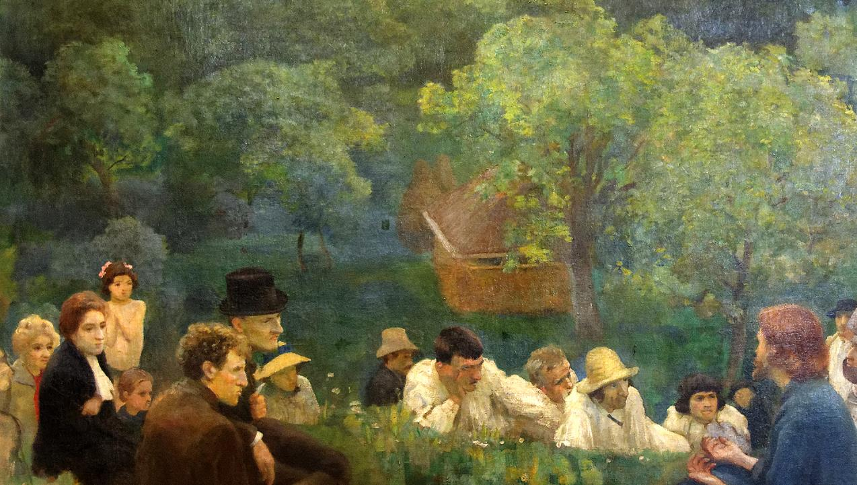
SIXTH SUNDAY AFTER THE EPIPHANY
Year C
Jeremiah 17:5-10 • Psalm 1
1 Corinthians 15:12-20 • Luke 6:17-26

Slide 2
Blessed are those who trust in the LORD, whose trust is the LORD.
Jeremiah 17:7

Slide 3
They shall be like a tree planted by water, sending out its roots by the stream. It shall not fear when heat comes, and its leaves shall stay green;
Jeremiah 17:8a

Slide 4
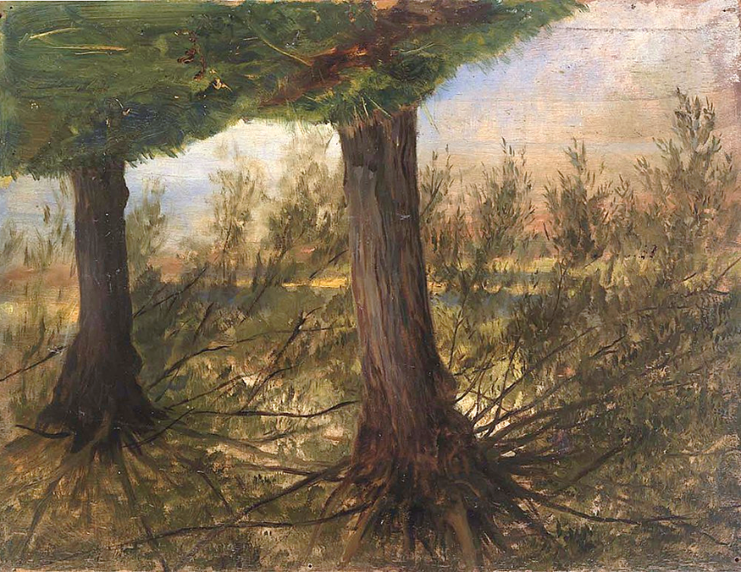
Trees Beside a Stream -- Eliphalet Andrews, Smithsonian Museum of American Art, Washington, DC

Slide 5
They are like trees planted by streams of water, which yield their fruit in its season, and their leaves do not wither.
Psalm 1:3a

Slide 6
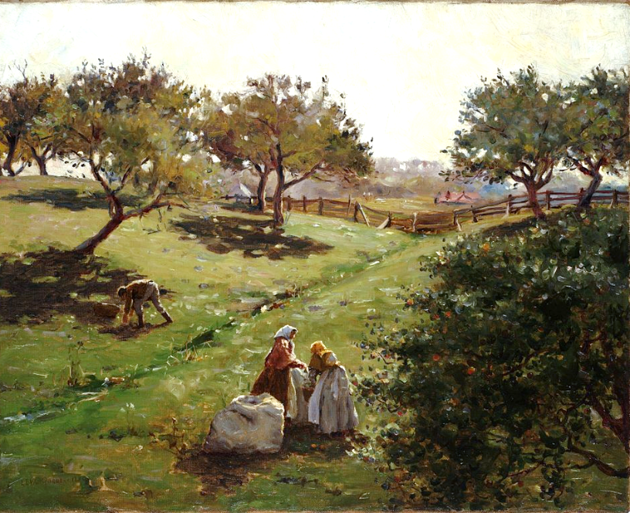
Apple Orchard -- Luther van Gorder, Huntington Library, San Marino, CA

Slide 7
But in fact Christ has been raised from the dead, the first fruits of those who have died.
1 Corinthians 15:20

Slide 8
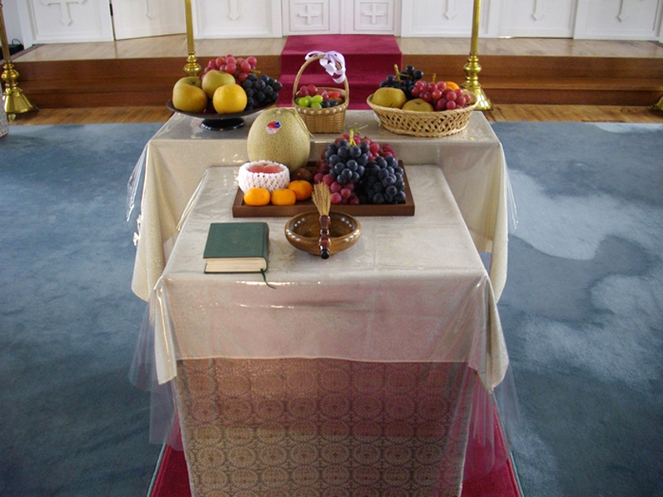
Blessing of the First Fruits -- Holy Resurrection Cathedral, Tokyo, Japan

Slide 9
He came down … with a great crowd of his disciples and a great multitude of people from all Judea, Jerusalem, and the coast of Tyre and Sidon.
Luke 6:17ac

Slide 10
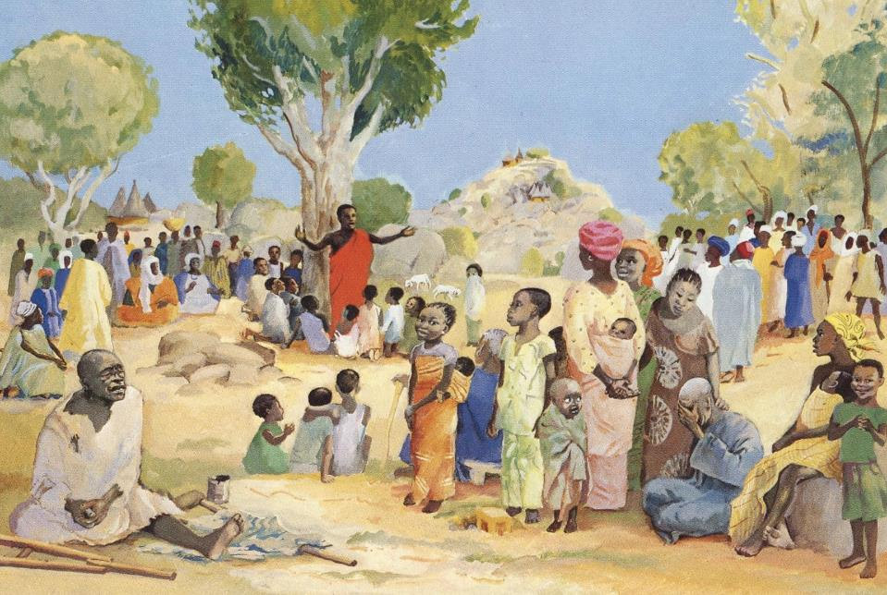
Christ Preaching (Sermon on the Mount) -- JESUS MAFA, Cameroon

Slide 11
They had come to hear him and to be healed of their diseases; and those who were troubled with unclean spirits were cured.
Luke 6:18

Slide 12
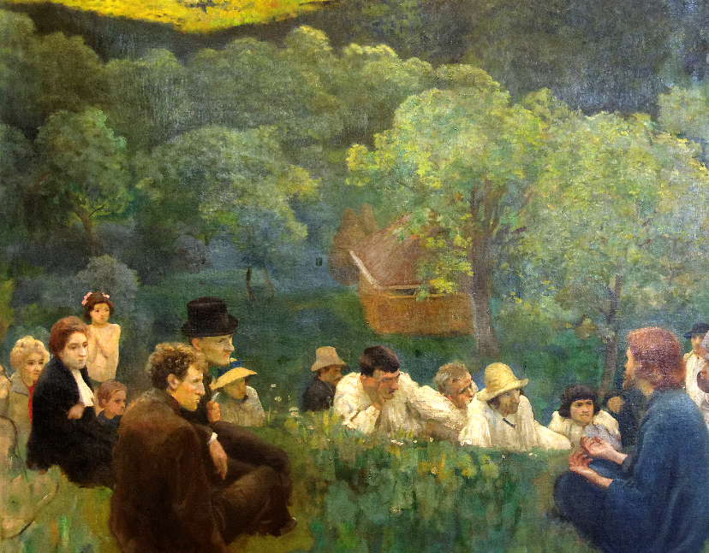
Sermon on the Mount -- Karoly Ferenczy, Hungarian National Gallery, Budapest, Hungary

Slide 13
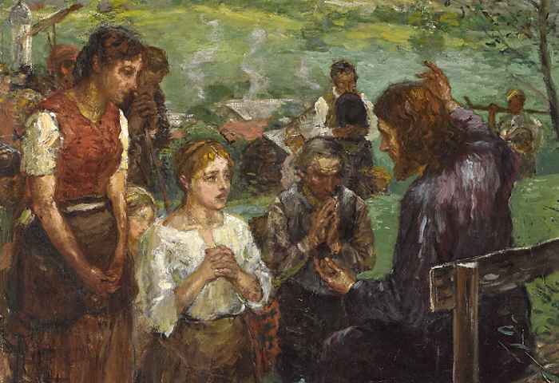
The Sermon -- Fritz von Uhde, Museum of Fine Arts, Budapest, Hungary

Slide 14
Then he looked up at his disciples and said: "Blessed are you who are poor, for yours is the kingdom of God.
Luke 6:20

Slide 15
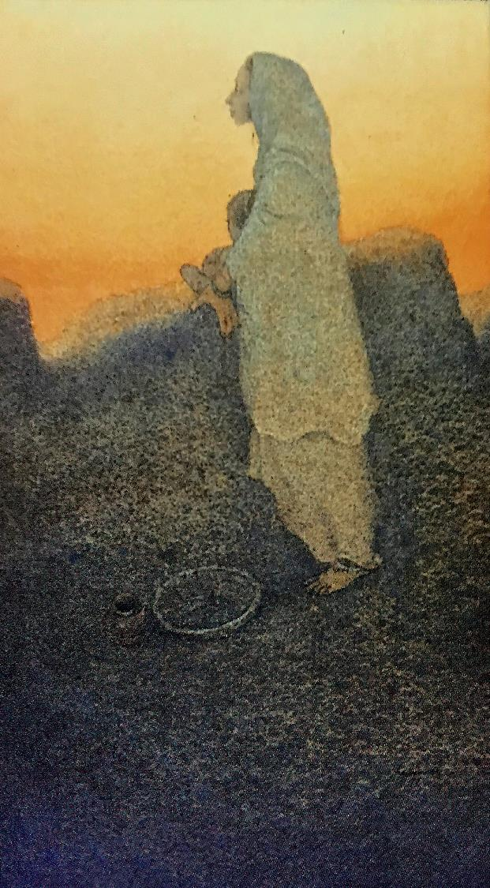
Blessed are the Poor
Frank Wesley

Slide 16
"Blessed are you who are hungry now, for you will be filled. "Blessed are you who weep now, for you will laugh.
Luke 6:21

Slide 17
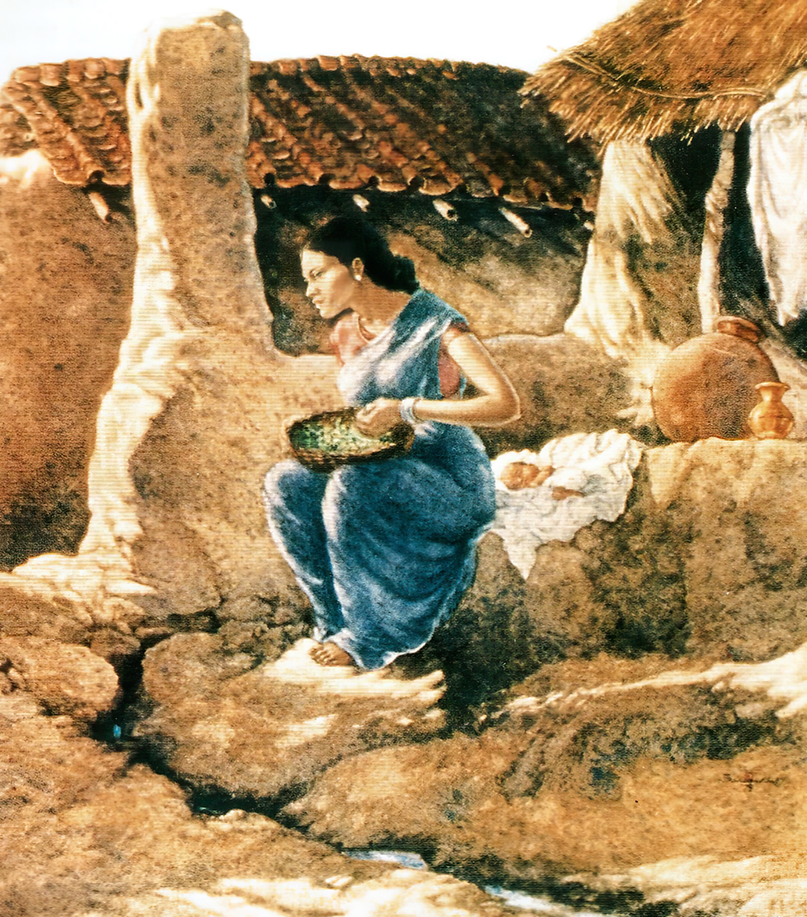
Hoping He Will Bring Something to Eat -- Frank Wesley

Slide 18
"Blessed are you when people hate you, and when they exclude you, revile you, and defame you on account of the Son of Man.
Luke 6:22

Slide 19
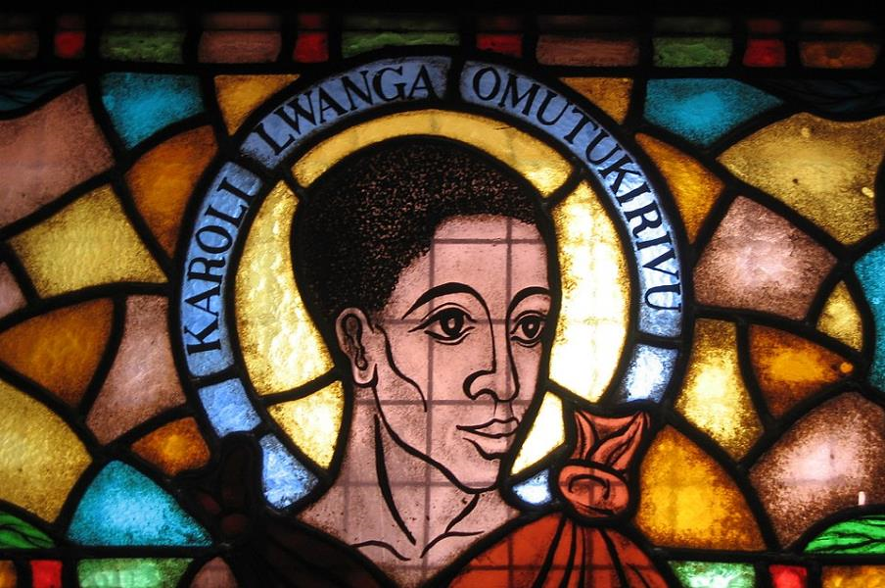
Karl Lwanga -- Basilica of the Ugandan Martyrs, Kampala, Uganda

Slide 20
Rejoice in that day and leap for joy, for surely your reward is great in heaven; for that is how their ancestors treated the prophets.
Luke 6:23

Slide 21
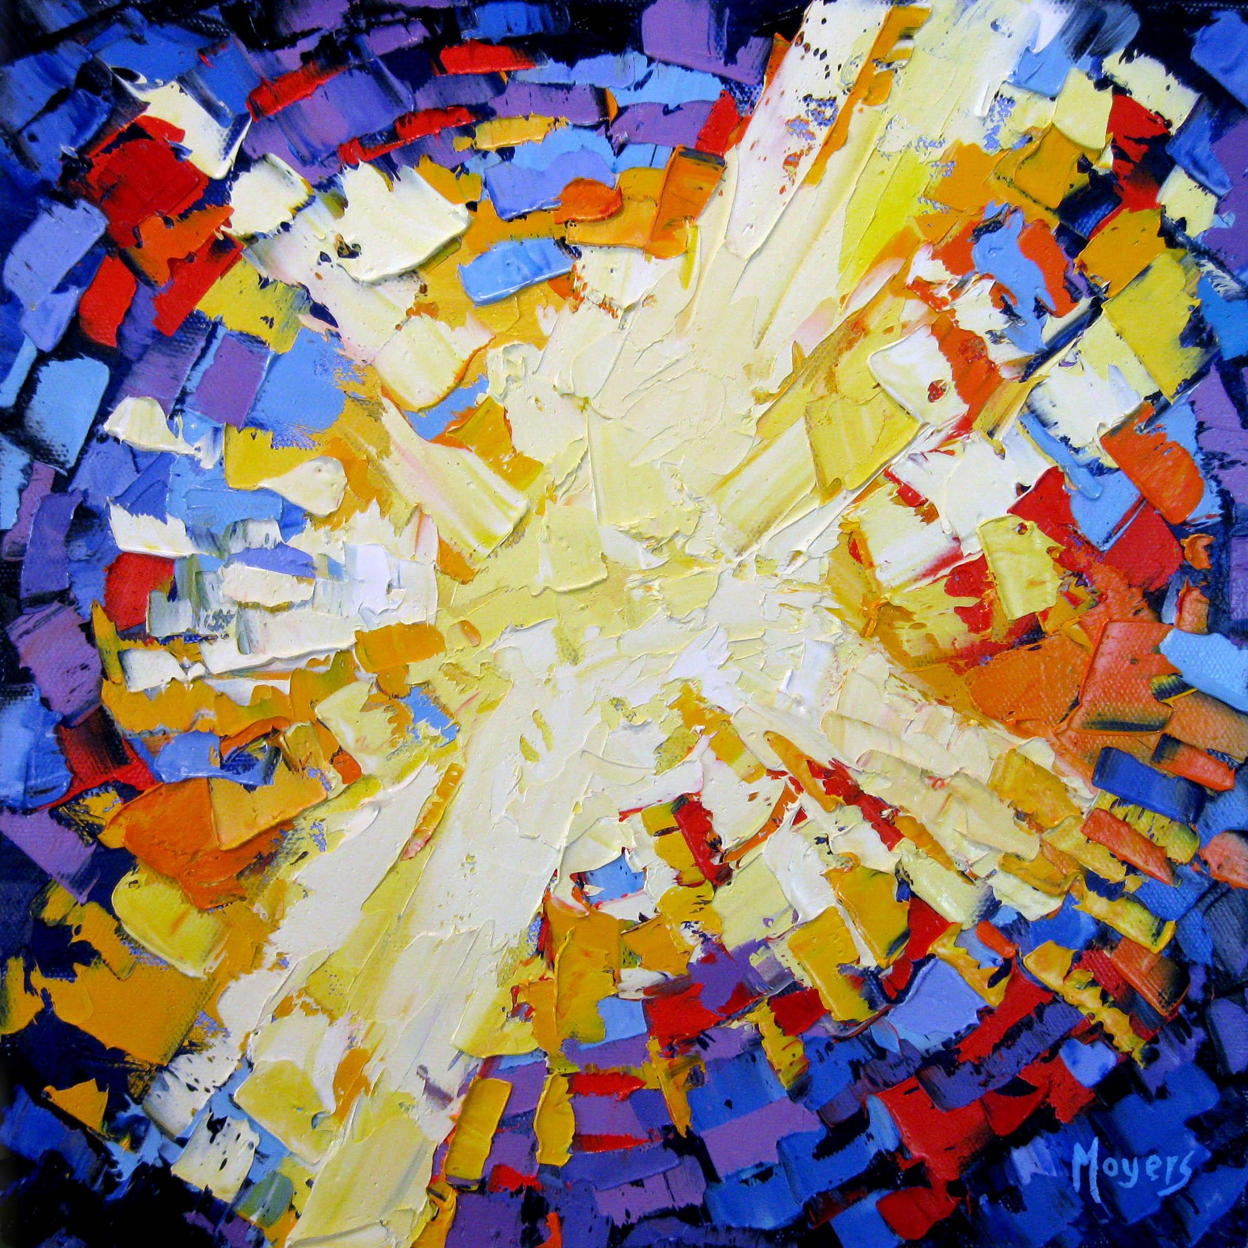
Awake My Soul -- Mike Moyers

Slide 22
Credits
New Revised Standard Version Updated Edition Bible, copyright 2022, Division of Christian Education of the National Council of the Churches of Christ in the United States of America. Used by permission. All rights reserved.
https://commons.wikimedia.org/wiki/File:Eliphalet_Fraser_Andrews_-_Trees_beside_a_Stream_-_1916.6.47_-_Smithsonian_American_Art_Museum.jpg
https://commons.wikimedia.org/wiki/File:Luther_Emerson_van_Gorder_-_Apple_orchard.jpg
https://commons.wikimedia.org/wiki/File:Fruits_Transfiguration_jp.jpg
http://diglib.library.vanderbilt.edu/act-imagelink.pl?RC=48284
http://commons.wikimedia.org/wiki/File:The_Sermon_on_the_Mount_K%C3%A1roly_Ferenczy.jpg
https://commons.wikimedia.org/wiki/File:Fritz_von_Uhde_Bergpredigt.jpg
Estate of Frank Wesley, http://www.frankwesleyart.com/main_page.htm
https://commons.wikimedia.org/wiki/File:Namugongo_Martyrs_window_Charles_Lwanga.jpg
Mike Moyers, https://www.mikemoyersfineart.com/
Additional descriptions can be found at the Art in the Christian Tradition image library, a service of the Vanderbilt Divinity Library, http://diglib.library.vanderbilt.edu/. All images available via Creative Commons 3.0 License.

