Slide 1
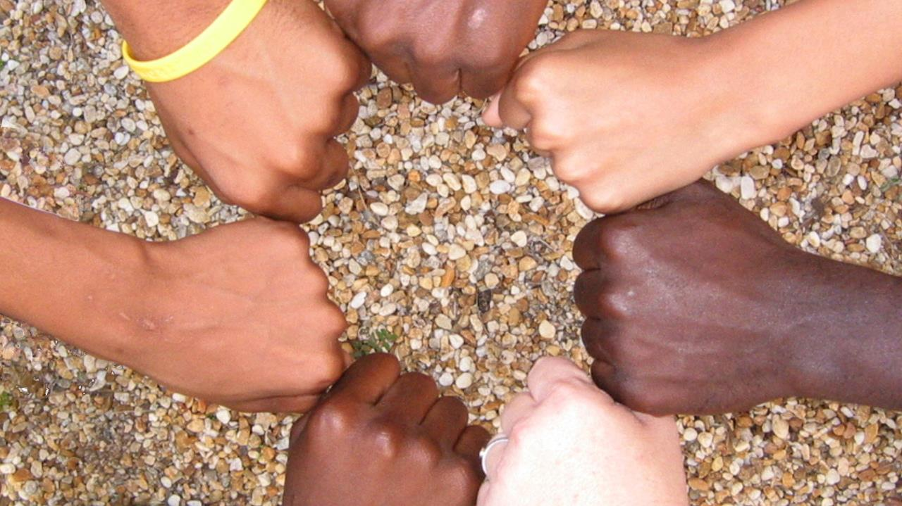
SEVENTH SUNDAY AFTER EPIPHANY
Year C
Genesis 45:3-11, 15 • Psalm 37:1-11, 39-40
1 Corinthians 15:35-38, 42-50 • Luke 6:27-38

Slide 2
Then Joseph said to his brothers, "Come closer to me." And he kissed all his brothers and wept upon them;
Genesis 45:4a, 15a

Slide 3
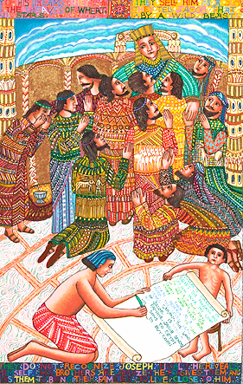
Joseph Forgives His Brothers (detail from Story of Joseph)
John August Swanson
Serigraph, 1986

Slide 4
Be still before the LORD, and wait patiently for him; … Refrain from anger, and forsake wrath. Do not fret--it leads only to evil.
Psalm 37:7a, 8

Slide 5
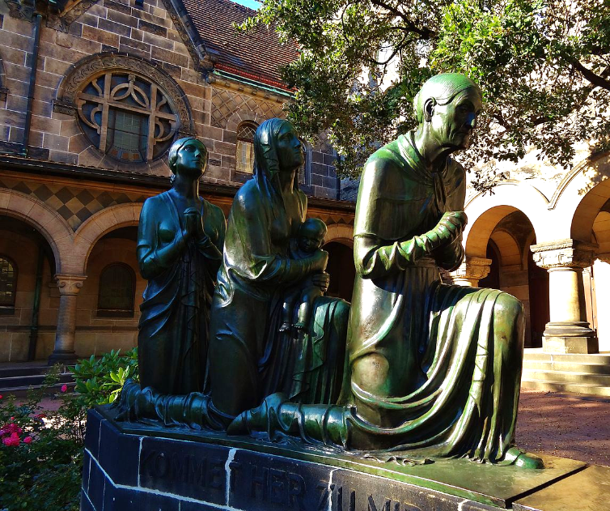
Prayers for Reconciliation (after WWII Bombings) -- Reconciliation Church, Dresden, Germany

Slide 6
you do not sow the body that is to be, but a bare seed … God gives it a body as he has chosen, and to each kind of seed its own body.
1 Corinthians 15:37b-38

Slide 7
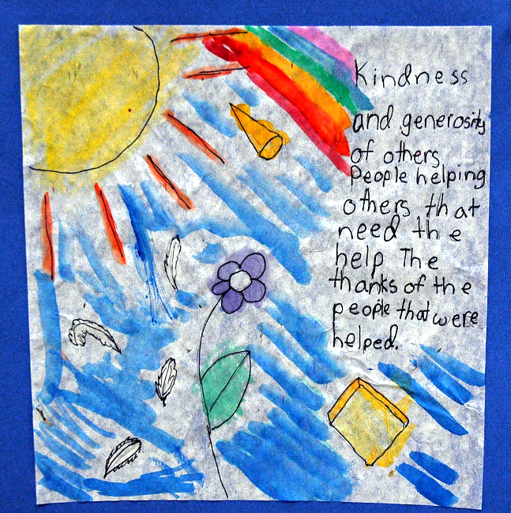
https://www.flickr.com/photos/wonderlane/4463707407 - Wonderlane
Kindness and Generosity -- Henrietta, TOPS School, Seattle, WA

Slide 8
"… Love your enemies, do good to those who hate you, bless those who curse you, pray for those who mistreat you.
Luke 6:27b-28

Slide 9
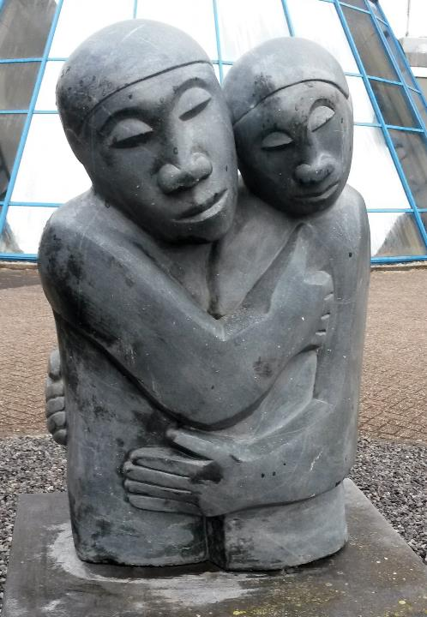
Reconciliation
Amos Supuni
Woerden, Netherlands

Slide 10
If anyone strikes you on the cheek, offer the other also; and from anyone who takes away your coat do not withhold even your shirt.
Luke 6:29

Slide 11
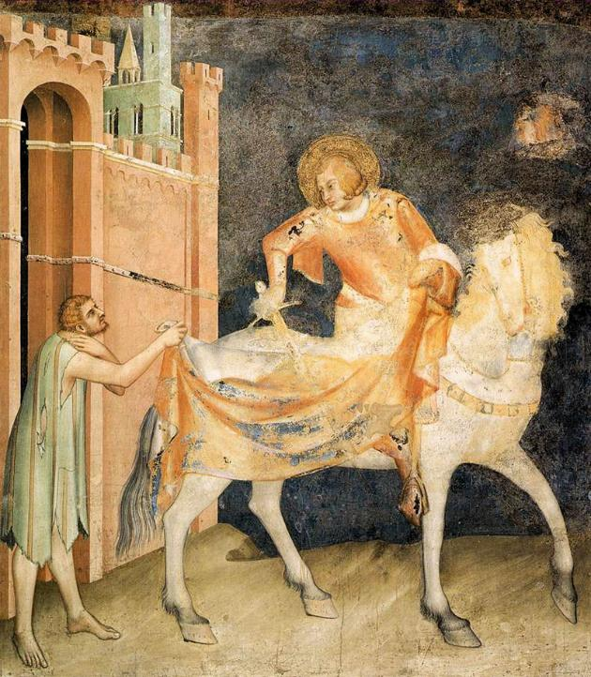
Martin and the Beggar
Simone Martini
Church of St. Francis
Assisi, Italy

Slide 12
Give to everyone who asks of you, and if anyone takes away what is yours, do not ask for it back again.
Luke 6:30

Slide 13
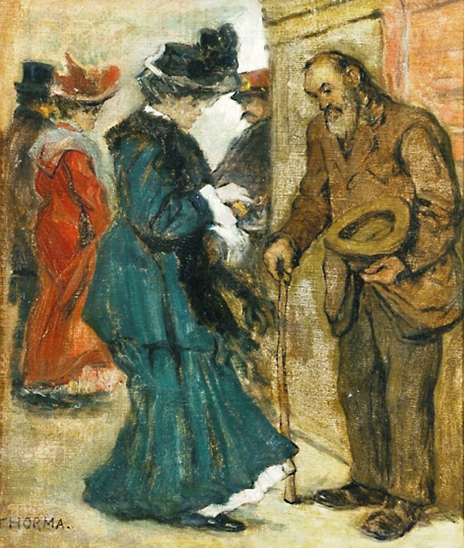
?
Alms
Janos Thorma Hungarian, first part of 20th c.

Slide 14
Do to others as you would have them do to you.
Luke 6:31

Slide 15
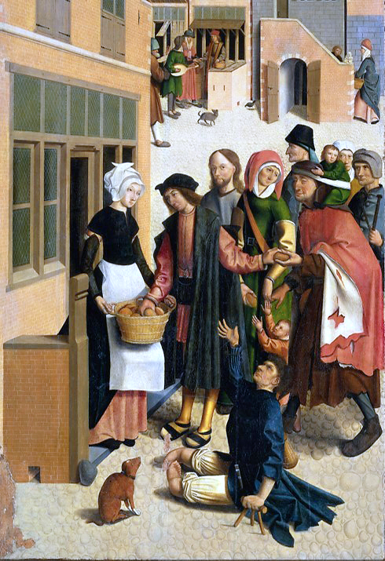
Feeding the Hungry
(Christ stands among the hungry)
Master of Aalkmaar
Rijksmuseum
Amsterdam, Netherlands

Slide 16
But love your enemies, do good … expecting nothing in return …
Luke 6:35a, c

Slide 17
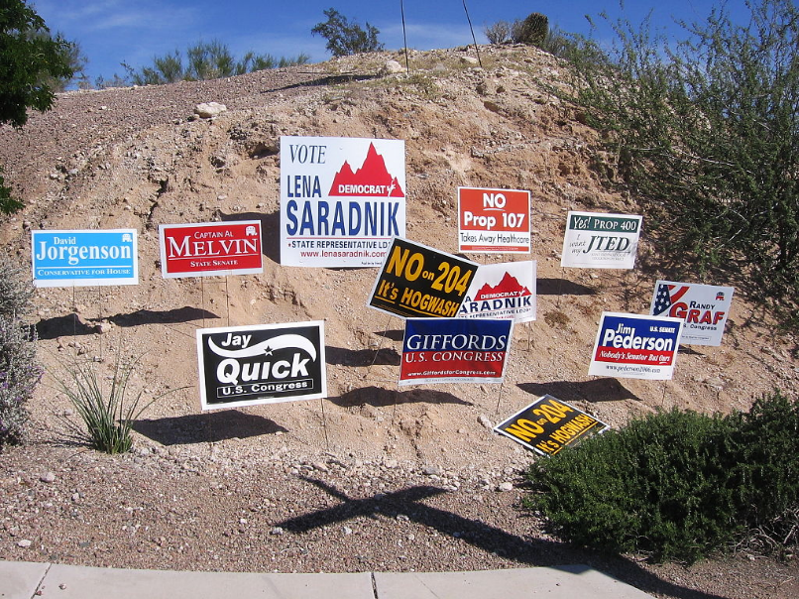
Arizona 8th district campaign signs, 2008

Slide 18
Be merciful, just as your Father is merciful. "Do not judge, and you will not be judged;
Luke 6:36-37a

Slide 19
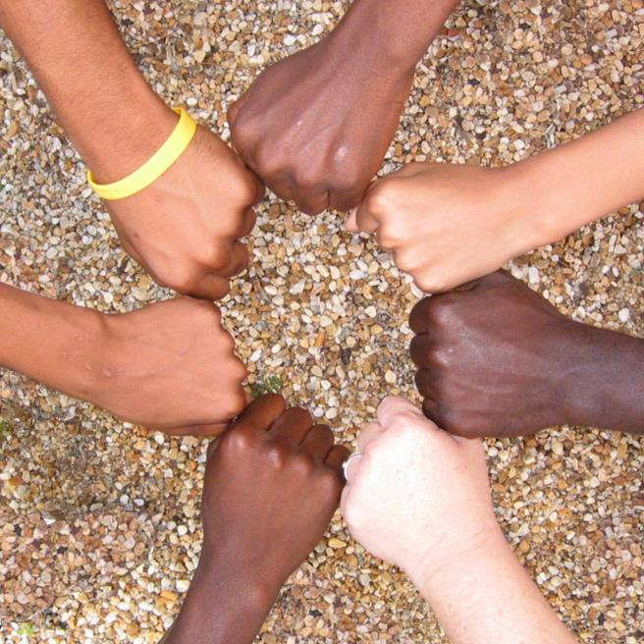
Hands, All Together
Avondale Pattillo United Methodist Church, Decatur, GA

Slide 20
do not condemn, and you will not be condemned. Forgive, and you will be forgiven; give, and it will be given to you."
Luke 6:37b-38a

Slide 21
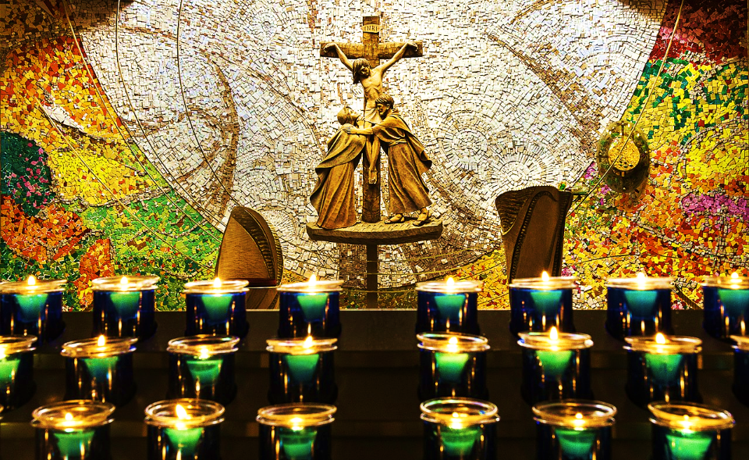
Mosaic in Chapel of Reconciliation -- Knock, County Mayo, Ireland

Slide 22
Credits
New Revised Standard Version Updated Edition Bible, copyright 2022, Division of Christian Education of the National Council of the Churches of Christ in the United States of America. Used by permission. All rights reserved.
http://www.johnaugustswanson.com/default.cfm/PID%3d1.2.9-13.html  1986 by John August Swanson
https://commons.wikimedia.org/wiki/File:Reconciliation_Church_of_Dresden_97265915.jpg - Kalispera Dell
https://commons.wikimedia.org/wiki/File:Reconciliation_Amos_Supuni_Woerden.jpg
http://www.flickr.com/photos/jimforest/986530941/
http://commons.wikimedia.org/wiki/File:Thorma_Alms.jpg
https://commons.wikimedia.org/wiki/File:De_zeven_werken_van_barmhartigheid_Rijksmuseum_SK-A-2815-1.jpeg
https://commons.wikimedia.org/wiki/File:Arizona_8th_district_campaign_signs_2006_election.jpg - GURoadrunner
http://www.flickr.com/photos/apmethodist/1678695596/
https://commons.wikimedia.org/wiki/File:Chapel_Of_Reconciliation_Candles_and_Mosaic.jpg – Michael McLaughlin
Additional descriptions can be found at the Art in the Christian Tradition image library, a service of the Vanderbilt Divinity Library, http://diglib.library.vanderbilt.edu/. All images available via Creative Commons 3.0 License.

