Slide 1
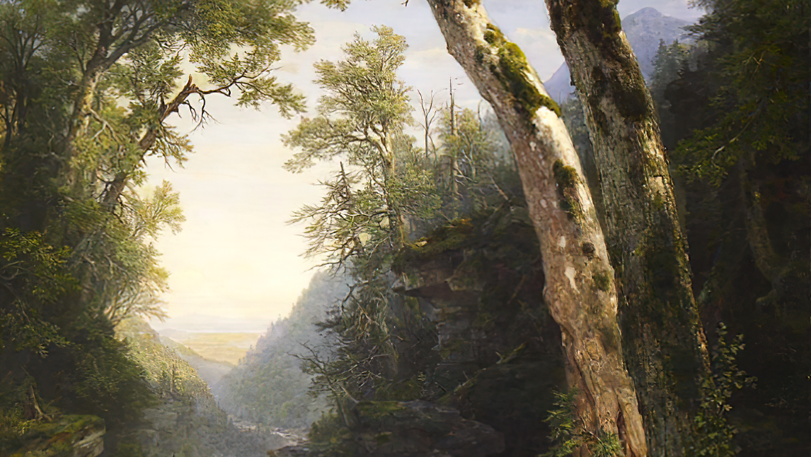
SECOND SUNDAY IN LENT
Year C
Genesis 15:1-12, 17-18 • Psalm 27 • Philippians 3:17-4:1 • Luke 13:31-35 or Luke 9:28-36, (37-43a)

Slide 2
… the word of the LORD came to Abram in a vision … "Look toward heaven and count the stars, if you are able to count them … So shall your descendants be."
Genesis 15:1b, 5b

Slide 3
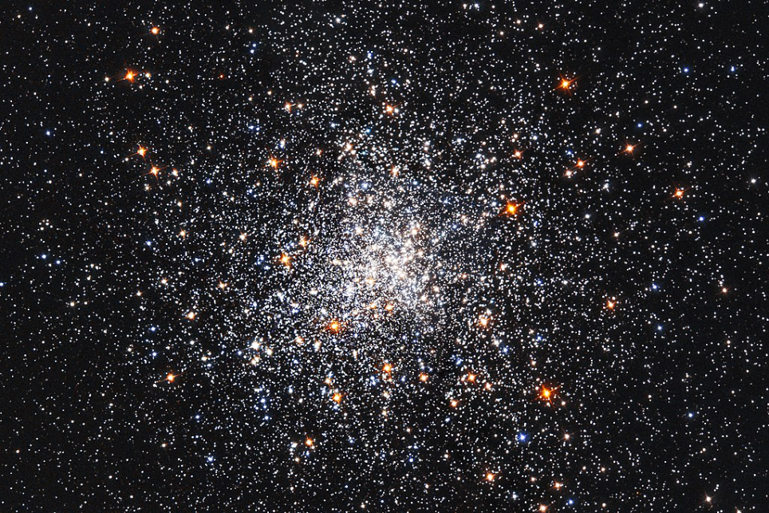
A Snowstorm of Stars -- NASA, Hubble Space Telescope, 2017

Slide 4
The LORD is my light and my salvation; whom shall I fear? The LORD is the stronghold of my life; of whom shall I be afraid?
Psalm 27:1

Slide 5
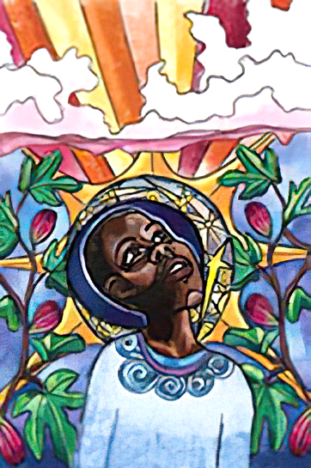
Raise Your Head
Lauren Wright Pittman

Slide 6
One thing I asked of the LORD …
to live in the house of the LORD all the days of my life, to behold the beauty of the LORD, and to inquire in his temple.
Psalm 27:4ac

Slide 7
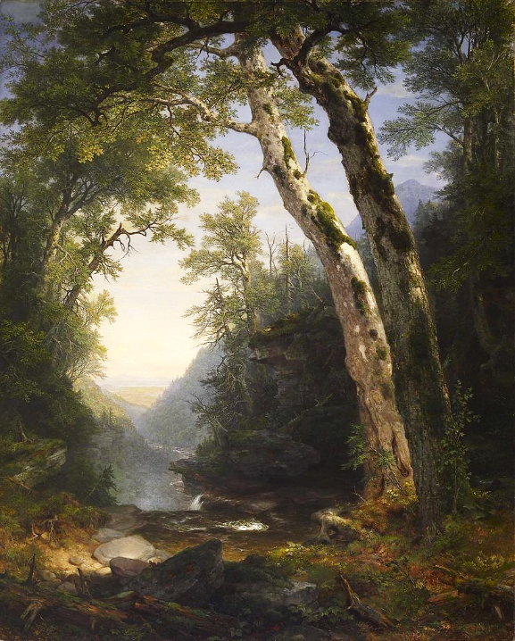
The Catskills
Asher Durand
Walters Art Museum
Baltimore, MD

Slide 8
Do not give me up to the will of my adversaries, for false witnesses have risen against me, and they are breathing out violence.
Psalm 27:12

Slide 9
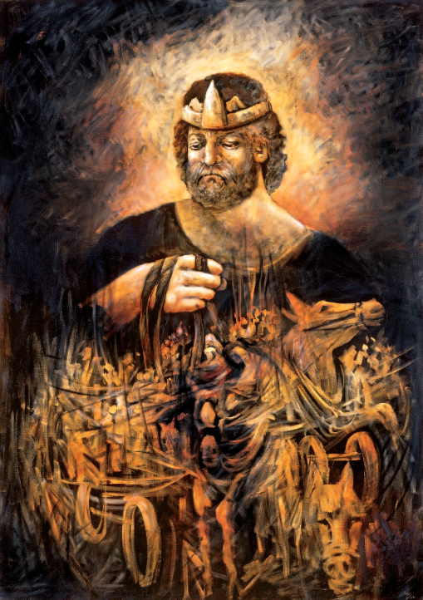
King Saul
Lidia Kozenitzky

Slide 10
I believe that I shall see the goodness of the LORD in the land of the living.
Psalm 27:13

Slide 11
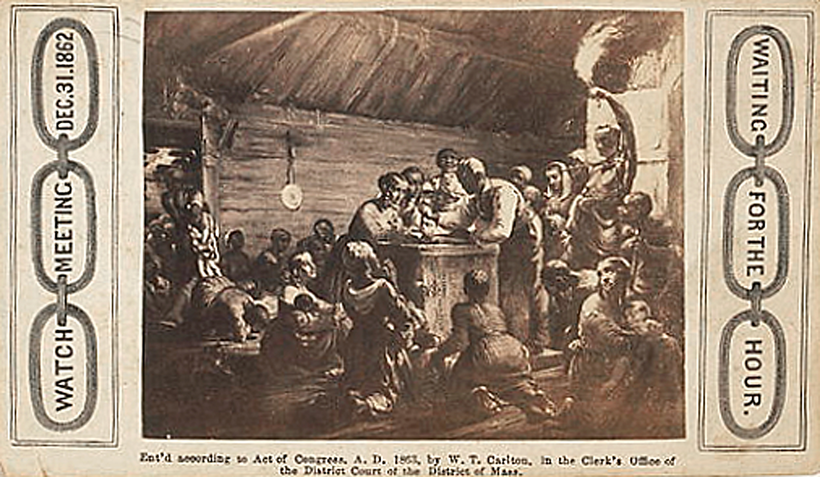
Emancipation, Waiting for the Hour -- Heard and Moseley, Library of Congress, Washington, DC

Slide 12
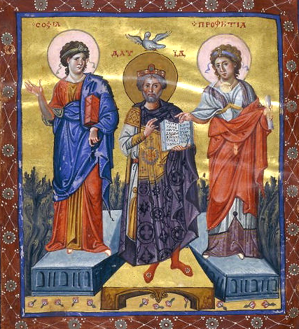
King David between Wisdom and Prophecy
Paris Psalter
Bibliothèque nationale
Paris, France

Slide 13
Wait for the LORD; be strong, and let your heart take courage;
wait for the LORD!
Psalm 27:14

Slide 14
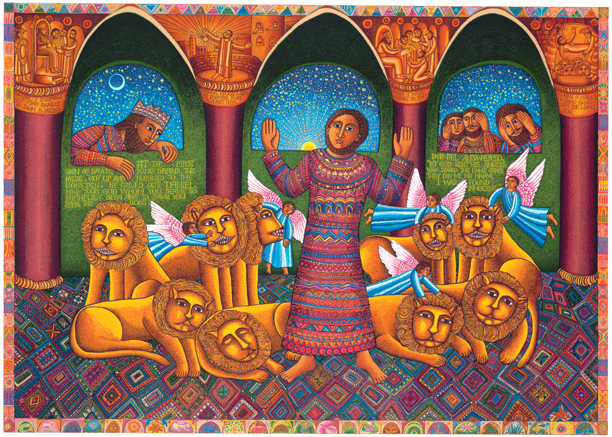
Daniel -- John August Swanson

Slide 15
Therefore, my brothers and sisters, whom I love and long for, my joy and crown, stand firm in the Lord in this way, my beloved.
Philippians 4:1

Slide 16
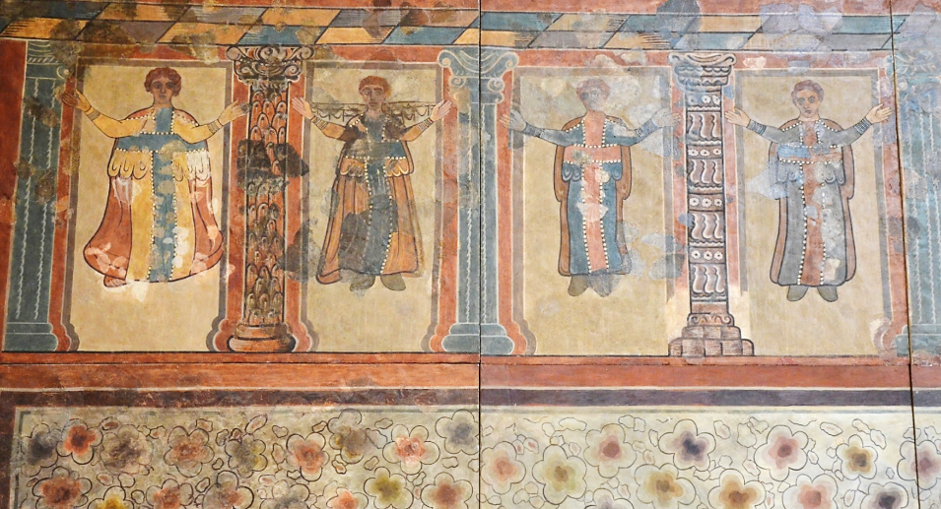
Early Christian Praying Figures -- 4th century, Lullinstone Villa, Kent, England

Slide 17
At that very hour some Pharisees came and said to him, "Get away from here, for Herod wants to kill you."
Luke 13:31

Slide 18
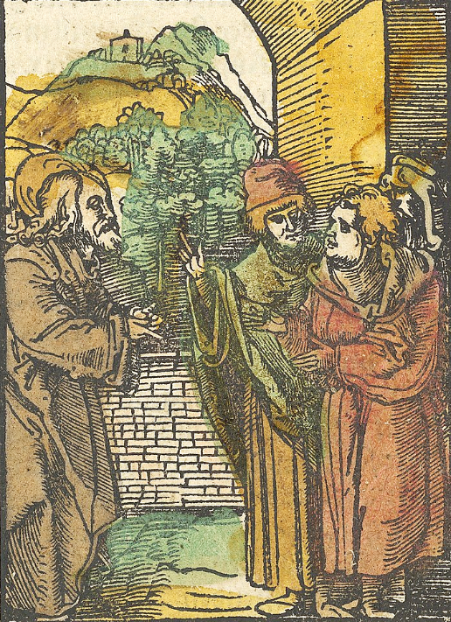
Christ and the Pharisees
Hans Schäufelein
Das Penarium Metropolitan Museum of Art, New York, NY

Slide 19
He said to them, "Go and tell that fox for me, 'Listen, I am casting out demons and performing cures today and tomorrow, and on the third day I finish my work.
Luke 13:32

Slide 20
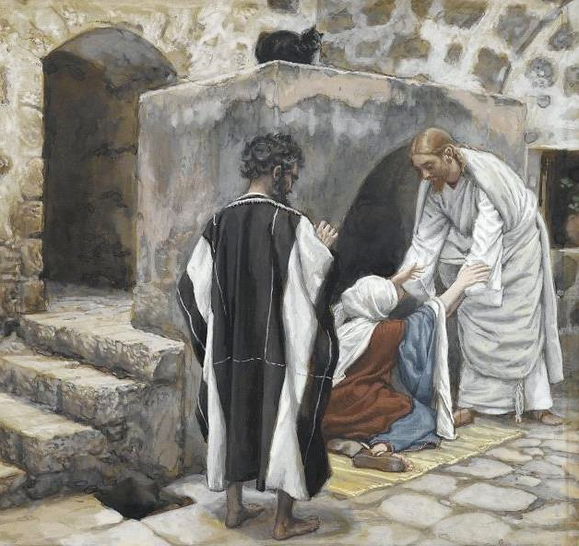
Healing of Peter's Mother-in-Law
James Tissot Brooklyn Museum New York, NY

Slide 21
Jerusalem, Jerusalem, the city that kills the prophets and stones those who are sent to it!
Luke 13:34a

Slide 22
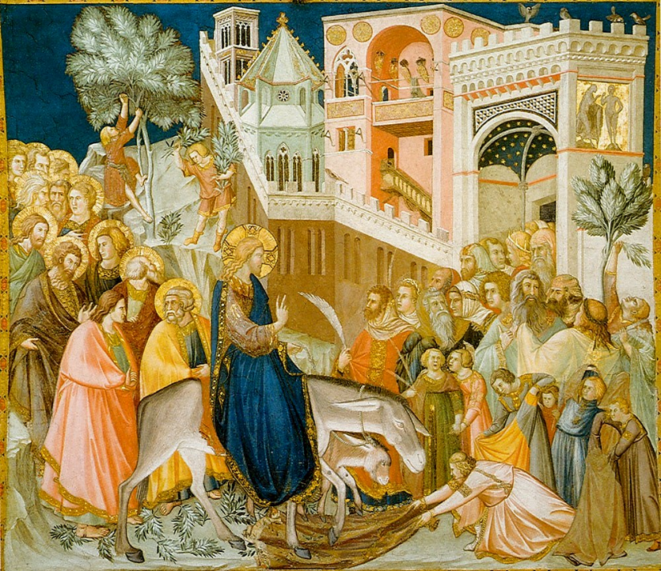
Entry Into Jerusalem
Pietro Lorenzetti
Church of St. Francis
Assisi, Italy

Slide 23
How often have I desired to gather your children together as a hen gathers her brood under her wings, and you were not willing!"
Luke 13:34b

Slide 24
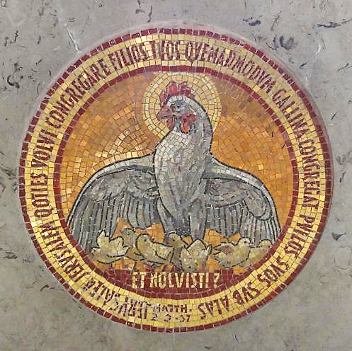
Hen Gathers Her Brood
Dominus Flevit Church
Jerusalem

Slide 25
Credits
New Revised Standard Version Updated Edition Bible, copyright 2022, Division of Christian Education of the National Council of the Churches of Christ in the United States of America. Used by permission. All rights reserved.
https://commons.wikimedia.org/wiki/File:A_snowstorm_of_stars.jpg
http://www.lewpstudio.com - copyright by Lauren Wright Pittman
https://commons.wikimedia.org/wiki/File:Asher_Brown_Durand_-_The_Catskills_-_Walters_37122.jpg
https://commons.wikimedia.org/wiki/File:TheKingSaul.jpg
https://www.loc.gov/resource/cph.3g06160/
https://commons.wikimedia.org/wiki/File:Paris_psaulter_gr139_fol7v.jpg
Estate of John August Swanson, https://www.johnaugustswanson.com/
https://commons.wikimedia.org/wiki/File:Painted_Walls_from_Lullinstone_Roman_Villa_showing_a_frieze_of_praying_figures,_4th_century_AD,_British_Museum_(16094735846).jpg
https://commons.m.wikimedia.org/wiki/File:Christ_and_the_Pharisees,_from_Das_Plenarium_MET_DP849932.jpg
https://commons.wikimedia.org/wiki/File:Brooklyn_Museum_-_The_Healing_of_Peter%27s_Mother-in-law_(La_gu%C3%A9rison_de_la_belle-m%C3%A8re_de_Pierre)_-_James_Tissot_-_overall.jpg
https://commons.wikimedia.org/wiki/File:Assisi-frescoes-entry-into-jerusalem-pietro_lorenzetti.jpg
https://commons.m.wikimedia.org/wiki/File:Israel_Batch_1_(782).JPG - Mattes
Additional descriptions can be found at the Art in the Christian Tradition image library, a service of the Vanderbilt Divinity Library, http://diglib.library.vanderbilt.edu/. All images available via Creative Commons 3.0 License.

