Slide 1
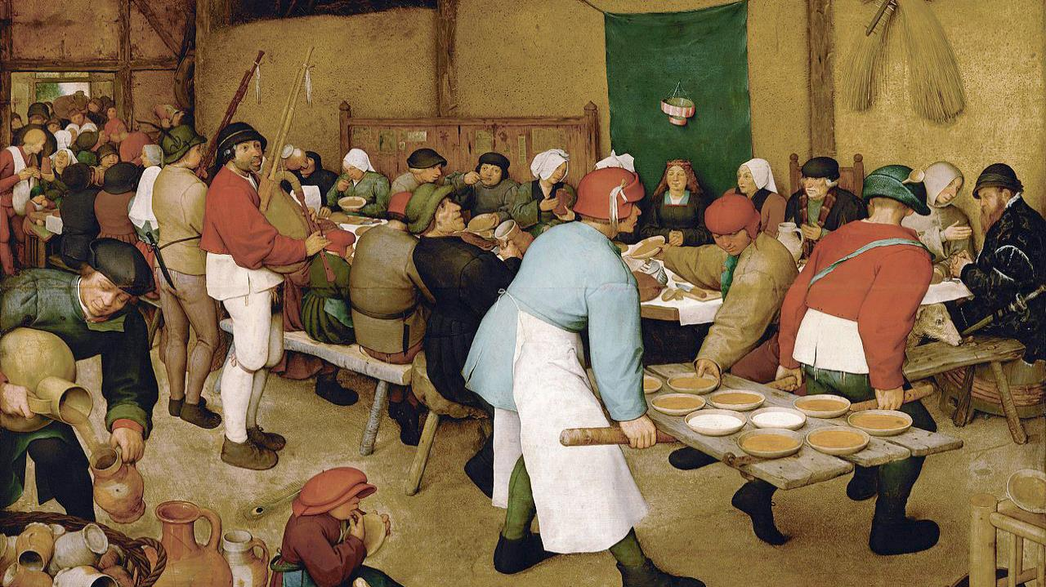
SECOND SUNDAY AFTER THE EPIPHANY
Year C
Isaiah 62:1-5 • Psalm 36:5-10
1 Corinthians 12:1-11 • John 2:1-11

Slide 2
For as a young man marries a young woman, so shall your builder marry you, and as the bridegroom rejoices over the bride, so shall your God rejoice over you.
Isaiah 62:5

Slide 3
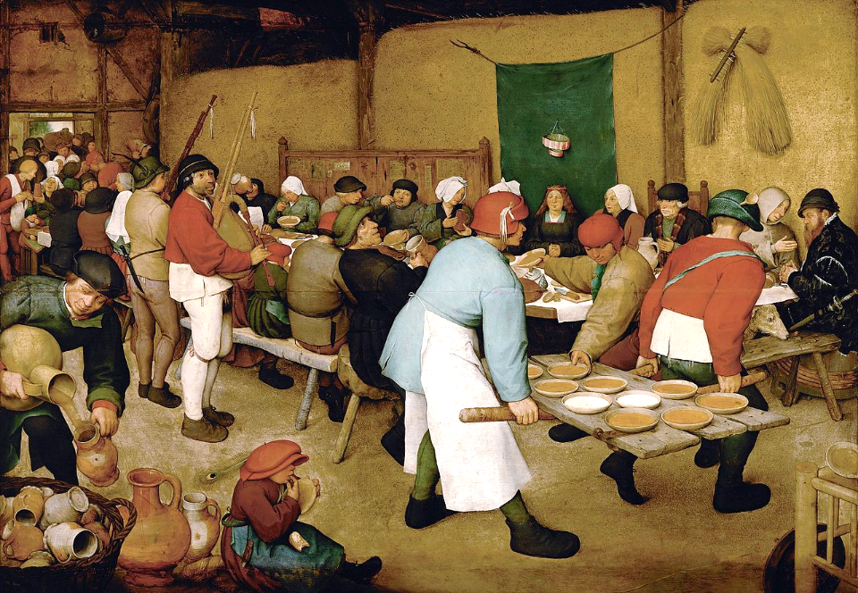
The Peasant Wedding -- Pieter Brueghel the Elder, Kunsthistorisches Museum, Vienna, Austria

Slide 4
Your righteousness is like the mighty mountains, your judgments are like the great deep; you save humans and animals alike, O LORD.
Psalm 36:6

Slide 5
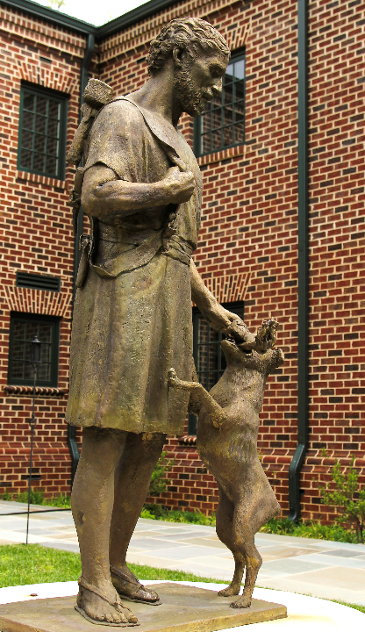
Carpenter Joseph Returning from Work
Dominican Priory
Charlottesville, VA

Slide 6
Now there are varieties of gifts, but the same Spirit;
and there are varieties of services, but the same Lord;
and there are varieties of activities, but it is the same God who activates all of them in everyone.
1 Corinthians 12:4-6

Slide 7
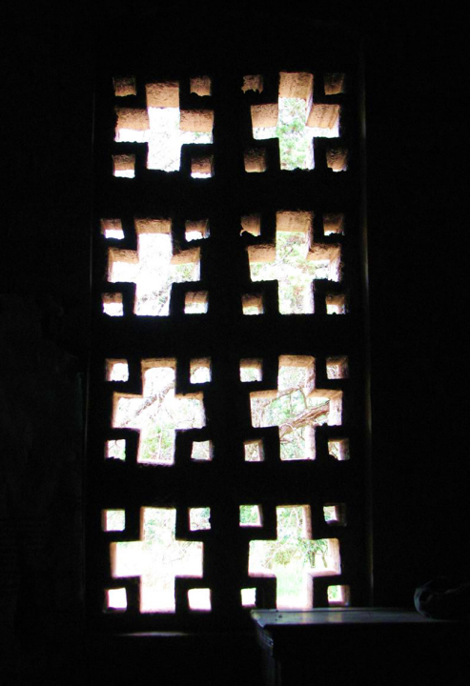
Church Window
Church of Mwenzo Mission
Nakonde, Zambia

Slide 8
On the third day there was a wedding in Cana of Galilee, and the mother of Jesus was there.
John 2:1

Slide 9
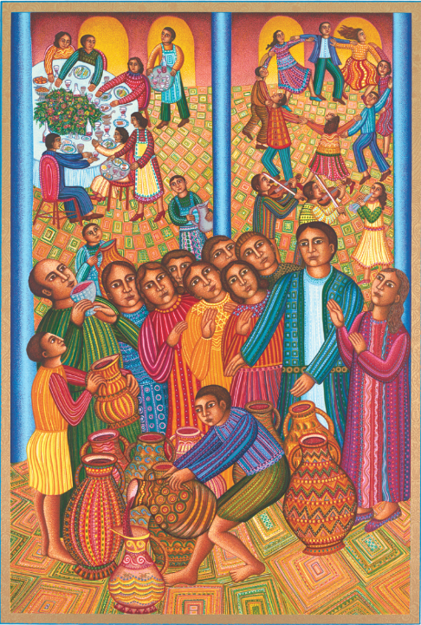
Wedding Feast
John August Swanson

Slide 10
Jesus and his disciples had also been invited …
John 2:2a

Slide 11
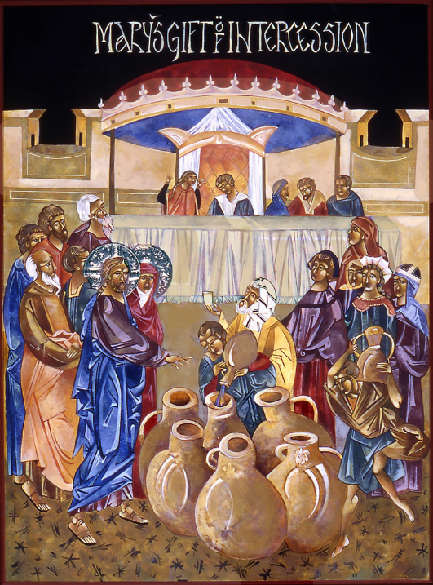
Wedding at Cana
Mary Jane Miller

Slide 12
When the wine gave out, the mother of Jesus said to him, "They have no wine."
John 2:3

Slide 13
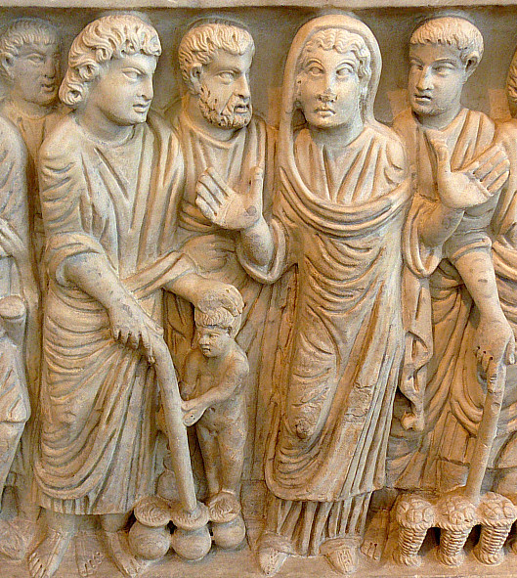
Mary and Christ (Miracle at Cana)
Sarcophagus of Marcus Claudianus, 330-335 AD, Palazzo Massimo, Rome, Italy

Slide 14
And Jesus said to her, … "My hour has not yet come." His mother said to the servants, "Do whatever he tells you."
John 2:4ac, 5

Slide 15
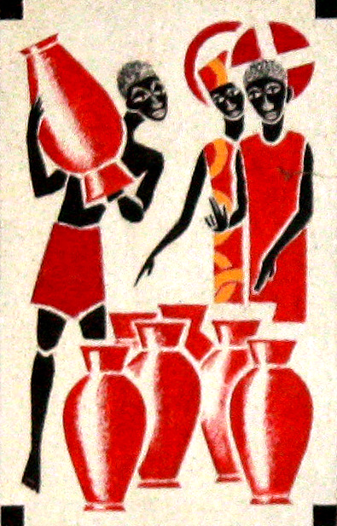
Wedding at Cana
Father Georges Saget
Keur Moussa Abbey
Keur Moussa, Senegal

Slide 16
Now standing there were six stone water jars for the Jewish rites of purification, each holding twenty or thirty gallons.
John 2:6

Slide 17
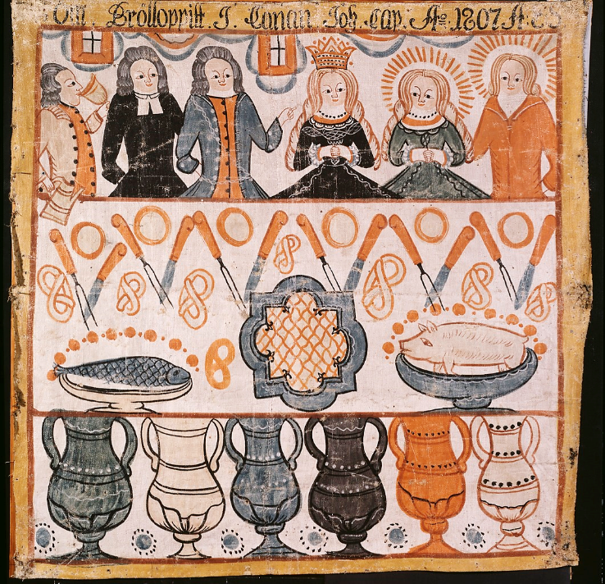
The Marriage in Cana
Anders Ericsson
Nationalmuseum
Stockholm, Sweden

Slide 18
Jesus said to them, "Fill the jars with water." And they filled them up to the brim.
John 2:7

Slide 19
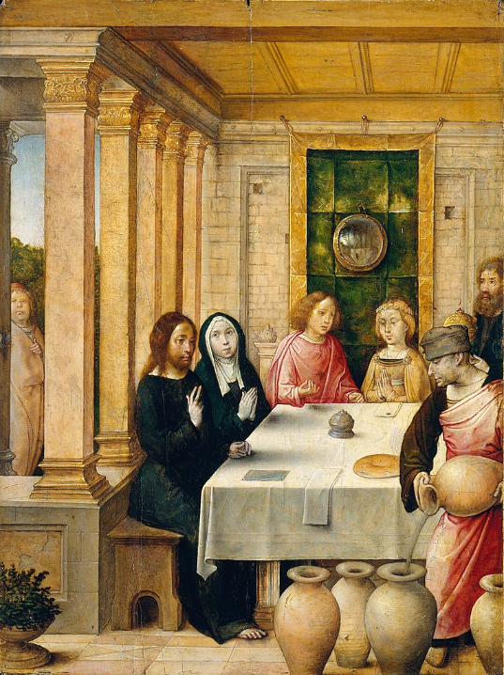
The Marriage Feast at Cana
Juan de Flandes
Metropolitan Museum of Art
New York, NY

Slide 20
He said to them, "Now draw some out, and take it to the person in charge of the banquet." So they took it.
John 2:8

Slide 21
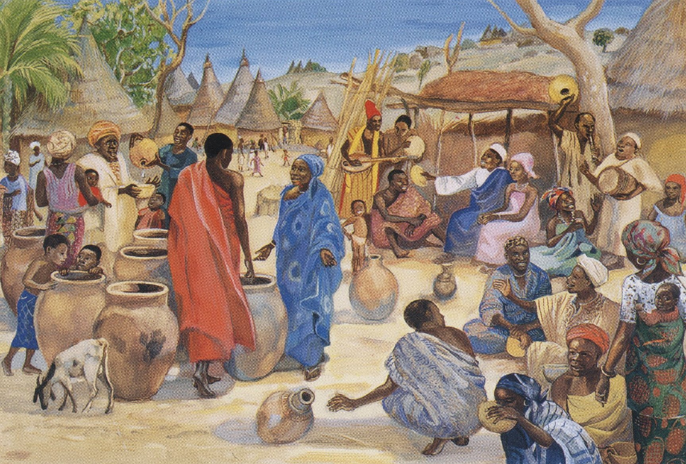
Marriage at Cana -- Duccio, Museo dell'Opera del Duomo, Siena, Italy

Slide 22
When the person in charge tasted the water that had become wine … that person called the bridegroom,
John 2:9

Slide 23
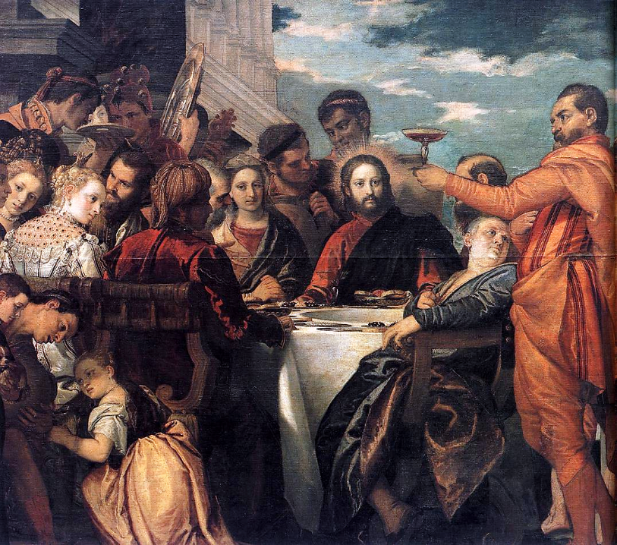
The Wedding at Cana (detail)
Paolo Veronese
Gemälde-galerie Alte Meister
Dresden, Germany

Slide 24
and said to him, "Everyone serves the good wine first, and then the inferior wine after the guests have become drunk. But you have kept the good wine until now."
John 2:10

Slide 25
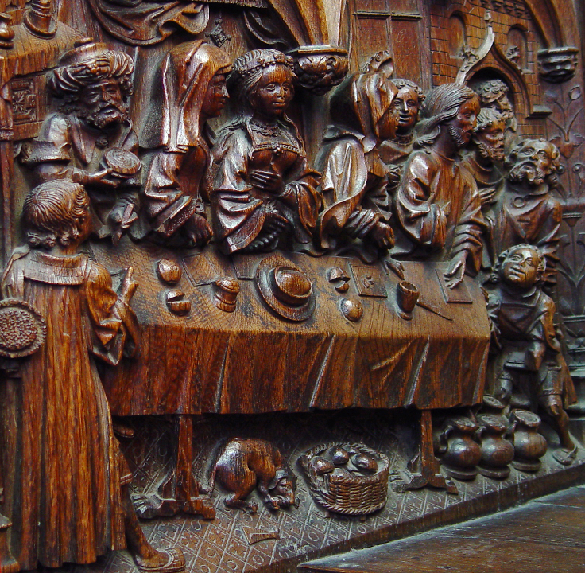
The Marriage Feast at Cana
Choirstall woodcarving
Amiens Cathedral
Amiens, France

Slide 26
Jesus did this, the first of his signs, in Cana of Galilee, and revealed his glory; and his disciples believed in him.
John 2:11

Slide 27
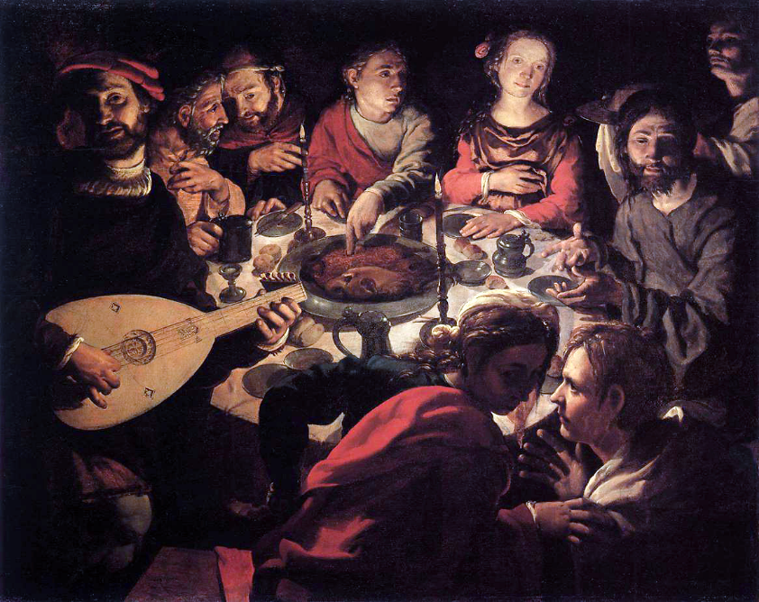
Calling of John During the Marriage at Cana -- Jan Vermeyen, Bonnefanten Museum, Maastricht, NL

Slide 28
Credits
New Revised Standard Version Updated Edition Bible, copyright 2022, Division of Christian Education of the National Council of the Churches of Christ in the United States of America. Used by permission. All rights reserved.
https://commons.wikimedia.org/wiki/File:Pieter_Bruegel_the_Elder_-_Peasant_Wedding_-_Google_Art_Project_2.jpg
https://www.flickr.com/photos/paullew/17329661475 - Fr Lawrence Lew, O.P.
http://www.flickr.com/photos/simonyyz/363731256/
Estate of John August Swanson, https://www.johnaugustswanson.com/
Mary Jane Miller, https://www.millericons.com/
https://commons.wikimedia.org/wiki/File:McSarcophagus.CanaJRS.jpg - Dick Stracke
https://commons.wikimedia.org/wiki/File:KeurMoussaAutel.jpg
https://commons.wikimedia.org/wiki/File:The_Marriage_in_Cana_(Anders_Eriksson)_-_Nationalmuseum_-_22422.tif
https://commons.wikimedia.org/wiki/File:Juan_de_Flandes_-_The_Marriage_Feast_at_Cana_-_WGA12055.jpg
http://www.librairie-emmanuel.fr (contact page: https://www.librairie-emmanuel.fr/contact)
https://commons.wikimedia.org/wiki/File:Paolo_Veronese_-_Marriage_at_Cana_(detail)_-_WGA24874.jpg
http://diglib.library.vanderbilt.edu/act-imagelink.pl?RC=51541
https://commons.wikimedia.org/wiki/File:Jan_Cornelisz._Vermeyen_006.jpg
Additional descriptions can be found at the Art in the Christian Tradition image library, a service of the Vanderbilt Divinity Library, http://diglib.library.vanderbilt.edu/. All images available via Creative Commons 3.0 License.

