Slide 1
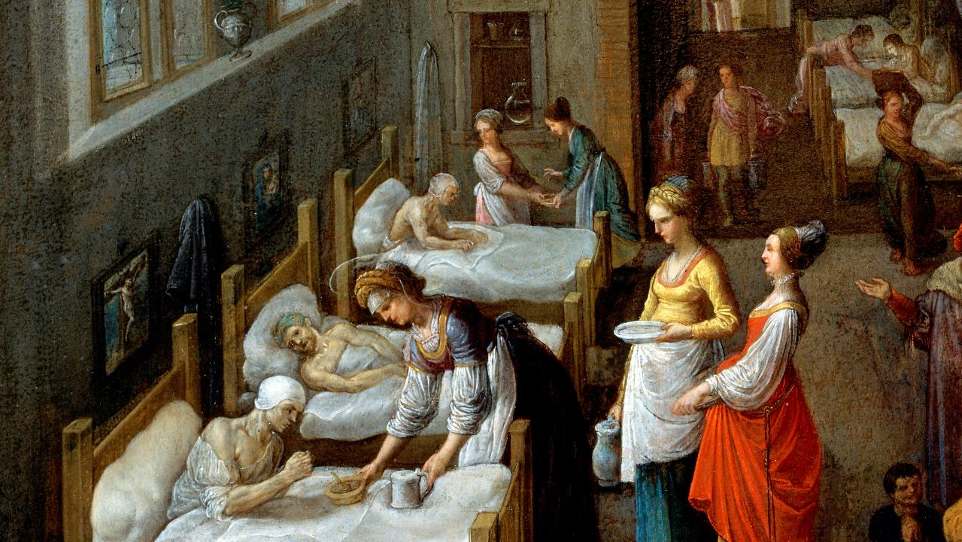
Fifth Sunday after Pentecost
Year C
2 Kings 5:1-14 and Psalm 30 • Isaiah 66:10-14 and Psalm 66:1-9 • Galatians 6:(1-6), 7-16 • Luke 10:1-11, 16-20

Slide 2
"I have sent to you my servant Naaman, that you may cure him of his leprosy."
2 Kings 5:6b

Slide 3
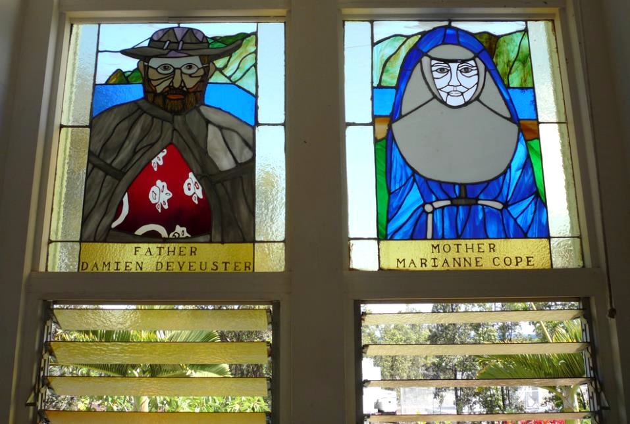
Father Damien and Mother Marianne, caregivers for Hansen's Disease sufferers, Kalaupapa, HI

Slide 4
Elisha sent a messenger to him, saying, "Go, wash in the Jordan seven times, and your flesh shall be restored and you shall be clean."
2 Kings 5:10

Slide 5
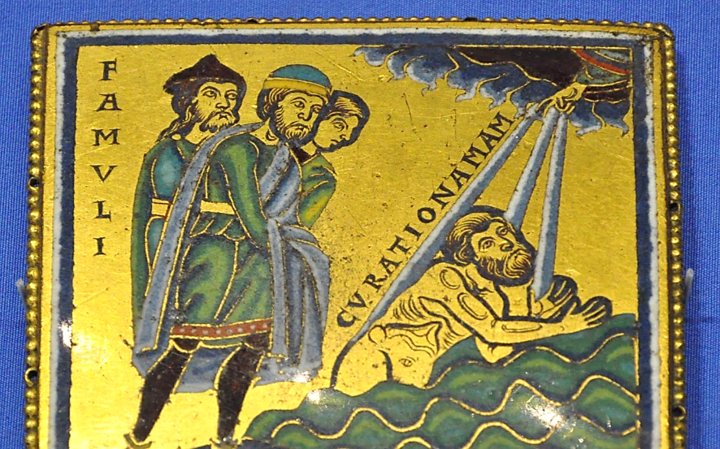
Naaman Bathing in the Jordan -- champlevé enamel, c. 1150, British Museum, London, England

Slide 6
To you, O LORD, I cried, and to the LORD I made supplication …
Hear, O LORD, and be gracious to me!
O LORD, be my helper!"
Psalm 30:8, 10

Slide 7
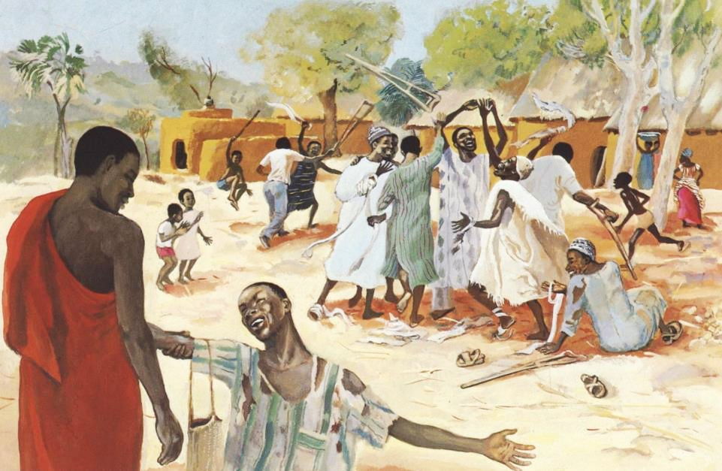
Christ Healing the Ten Lepers -- JESUS MAFA, Cameroon

Slide 8
Rejoice with Jerusalem, and be glad for her, all you who love her; rejoice with her in joy …
Isaiah 66:10a

Slide 9
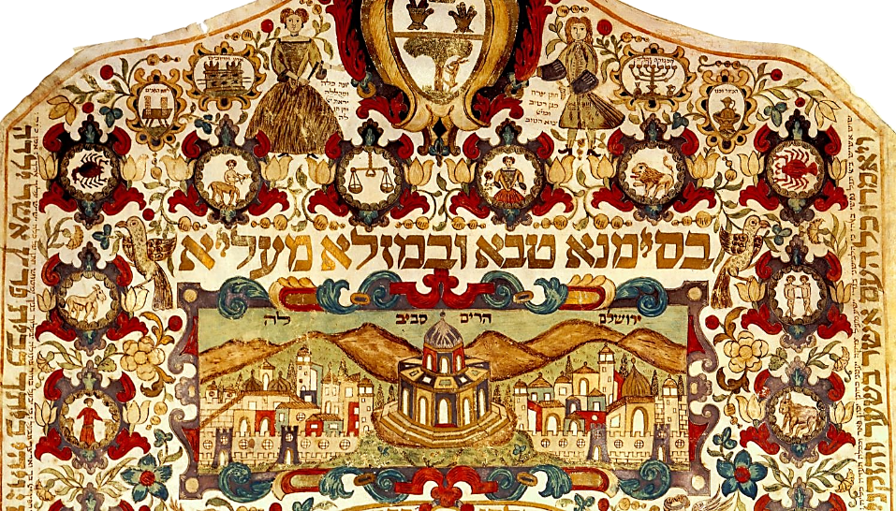
Marriage contract with a depiction of Jerusalem -- Israel Museum, Jerusalem

Slide 10
… that you may nurse and be satisfied from her consoling breast;
Isaiah 66:11a

Slide 11
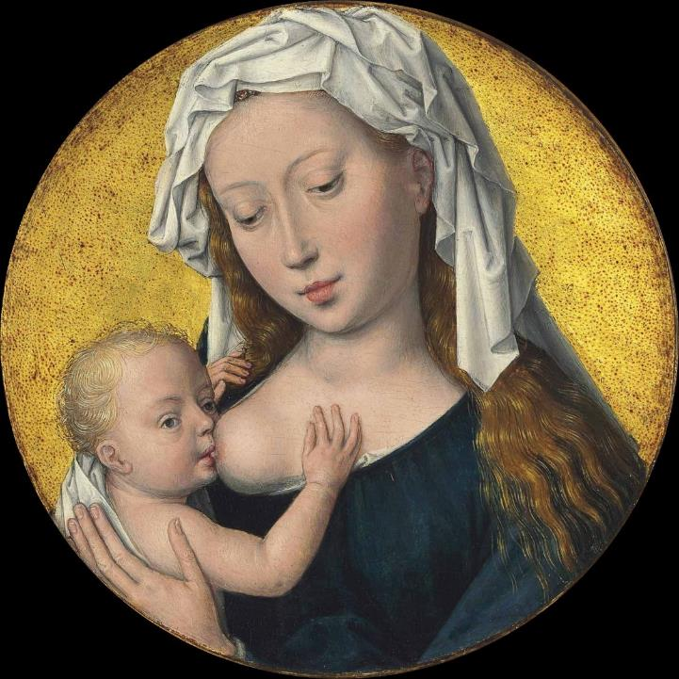
Madonna Lactans, or the Nursing Madonna
Hans Memling, c. 1488

Slide 12
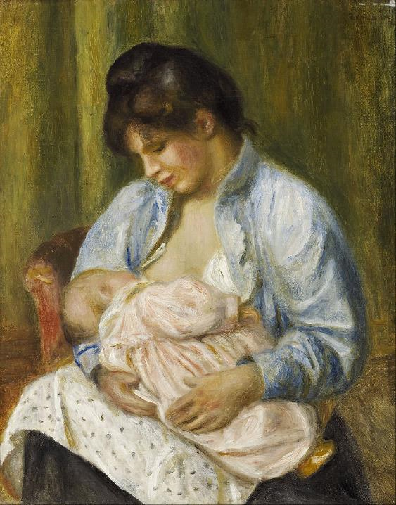
A Woman Nursing Her Child
Auguste Renoir
Scottish National Gallery
Edinburgh, Scotland

Slide 13
As a mother comforts her child, so I will comfort you … You shall see, and your heart shall rejoice …
Isaiah 66:13a, 14a

Slide 14
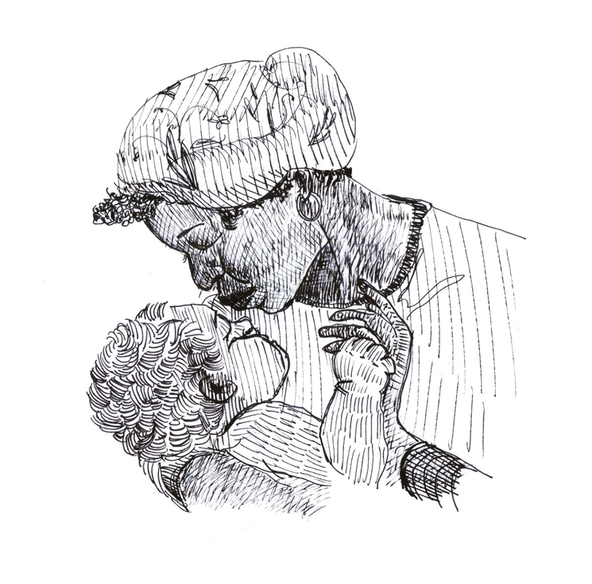
Mother's Prayer
Liz Valente

Slide 15
"All the earth worships you; they sing praises to you, sing praises to your name."
Psalm 66:4

Slide 16
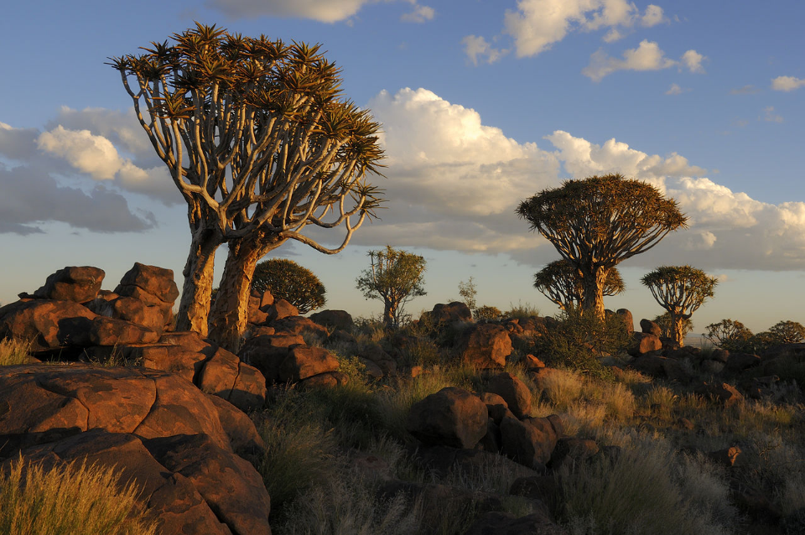
Quiver Tree Forest near Keetmanshoop, Namibia, in the evening

Slide 17
Bear one another's burdens, and in this way you will fulfill the law of Christ.
Galatians 6:2

Slide 18
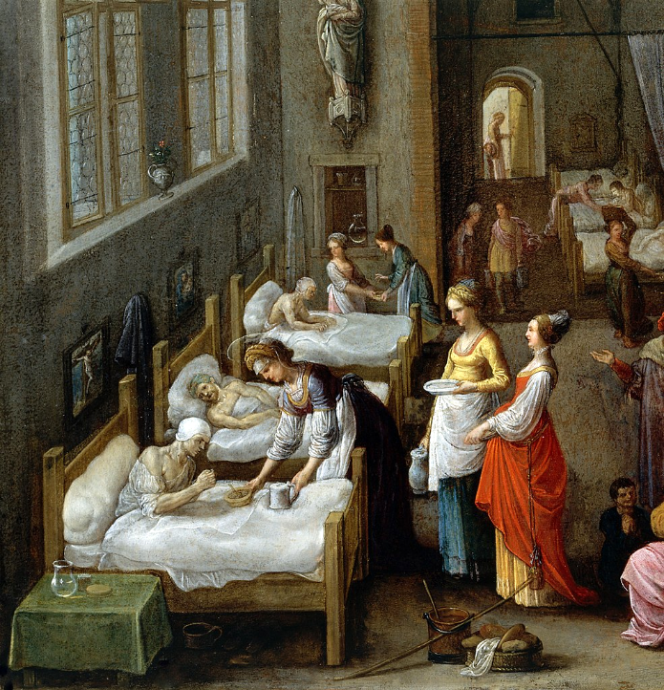
Elizabeth of Hungary Visiting the Marburg Hospital
Wellcome Library
United Kingdom

Slide 19
After this the Lord appointed seventy-two others and sent them on ahead of him in pairs to every town and place where he himself intended to go.
Luke 10:1

Slide 20
He said to them, "The harvest is plentiful, but the laborers are few; therefore ask the Lord of the harvest to send out laborers into his harvest.
Luke 10:2

Slide 21
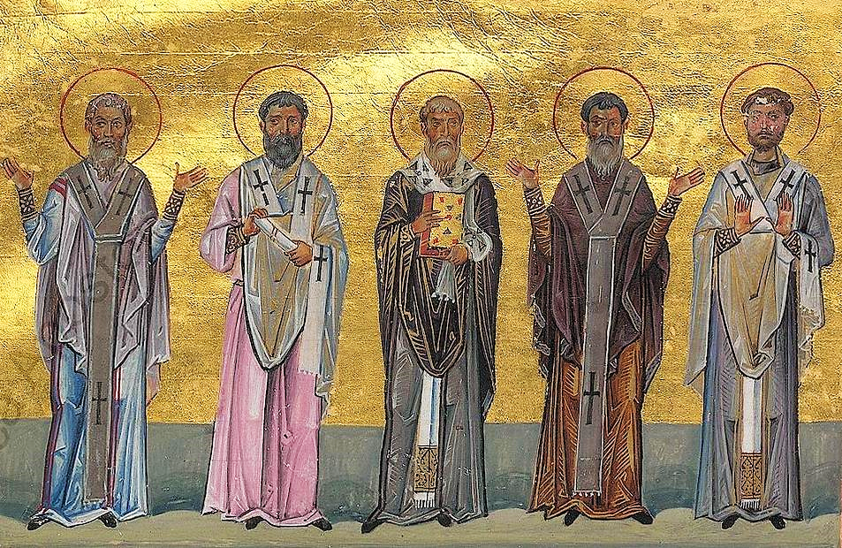
Patrobulus, Hermas, Linus, Caius, and Philologus of the 70 Disciples from the Menologion of Basil II

Slide 22
Whatever house you enter, first say, 'Peace to this house!' And if a person of peace is there, your peace will rest on that person …
Luke 10:5-6a

Slide 23

Handmade Linoleum Block Print Card

Slide 24
Whenever you enter a town … cure the sick who are there, and say to them, 'The kingdom of God has come near to you.'"
Luke 10:8a, 9

Slide 25
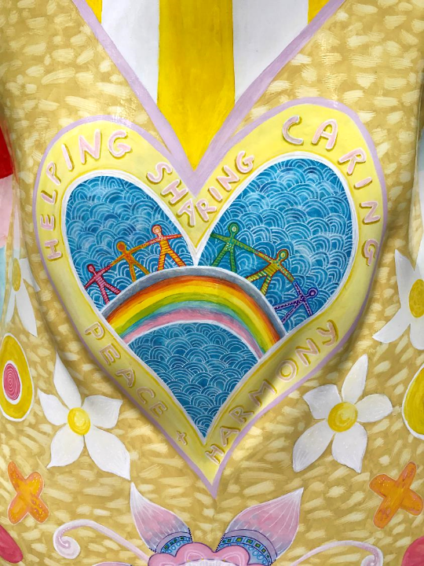
Helping, Sharing, Caring, Harmony, Peace – Children's Hospital
Claire Witcomb with the Nechells Community
Birmingham, England

Slide 26
Credits
New Revised Standard Version Updated Edition Bible, copyright 2022, Division of Christian Education of the National Council of the Churches of Christ in the United States of America. Used by permission. All rights reserved.
https://commons.wikimedia.org/wiki/File:Enamel_plaque_Naaman_BM.jpg - Andreas Praefcke
https://commons.wikimedia.org/wiki/File:Enamel_plaque_Naaman_BM.jpg
http://diglib.library.vanderbilt.edu/act-imagelink.pl?RC=48295
https://commons.wikimedia.org/wiki/File:Marriage_contract_(ketubbah)_with_a_depiction_of_Jerusalem_-_Google_Art_Project.jpg
http://commons.wikimedia.org/wiki/File:Hans_Memling_,_The_Virgin_Mary_nursing_the_Christ_Child._Oil_and_gold_on_panel,_circular,_(17.4_cm.)_diameter._Christie%27s.jpg
https://commons.wikimedia.org/wiki/File:Pierre-Auguste_Renoir_-_A_Woman_Nursing_a_Child_-_Google_Art_Project.jpg
Liz Valente, https://www.instagram.com/donalizvalente/
https://commons.wikimedia.org/wiki/File:K%C3%B6cherbaumwald-01.jpg - Hans Stieglitz
https://commons.wikimedia.org/wiki/File:St_Elizabeth_visiting_a_hospital._Wellcome_V0017201.jpg – Adam Elsheimer
https://commons.wikimedia.org/wiki/File:Patrobulus,_Hermas,_Linus,_Caius,_Philologus_of_70_disciples_(Menologion_of_Basil_II).jpg
http://www.flickr.com/photos/yardsale/76188544/
https://www.flickr.com/photos/karen_roe/36068574913/ - Karen Roe
Additional descriptions can be found at the Art in the Christian Tradition image library, a service of the Vanderbilt Divinity Library, http://diglib.library.vanderbilt.edu/. All images available via Creative Commons 3.0 License.

