Slide 1
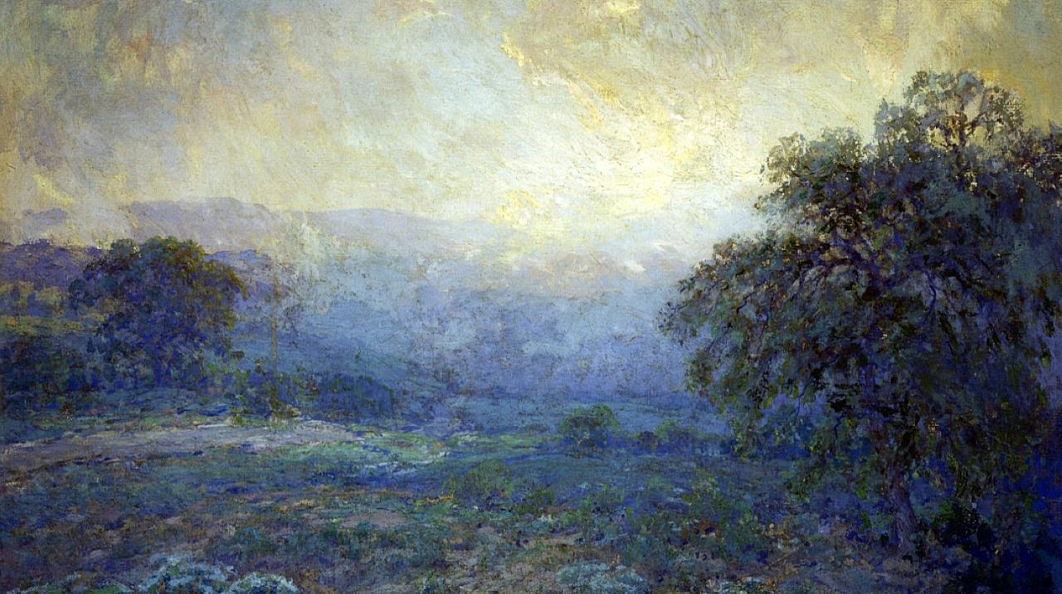
[Proper 4] Sunday after Pentecost
Year C
1 Kings 18:20-21, (22-29), 30-39 and Psalm 96 • 1 Kings 8:22-23, 41-43 and Psalm 96:1-9 • Galatians 1:1-12 • Luke 7:1-10

Slide 2
“Answer me, O LORD, answer me, so that this people may know that you, O LORD, are God, and that you have turned their hearts back."
1 Kings 18:37

Slide 3
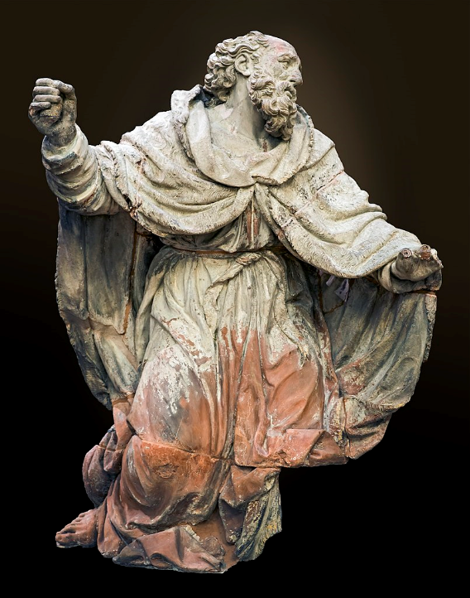
Prophet Elijah on Mount Carmel
Marc Arcis
Musée des Augustins
Toulouse, France

Slide 4
Let the heavens be glad, and let the earth rejoice … let the field exult, and everything in it.
Psalm 96:11a, 12a

Slide 5
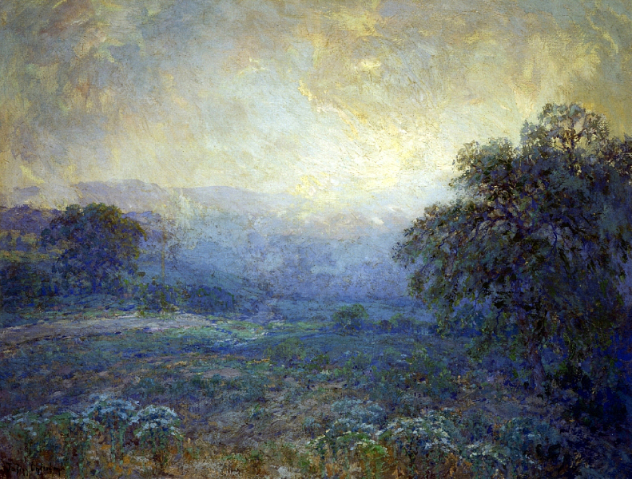
Dawn in the Hills -- Julian Onderdonk

Slide 6
when a foreigner … comes from a distant land … they shall hear of your great name, your mighty hand, and your outstretched arm.
1 Kings 8:41b, 42a

Slide 7
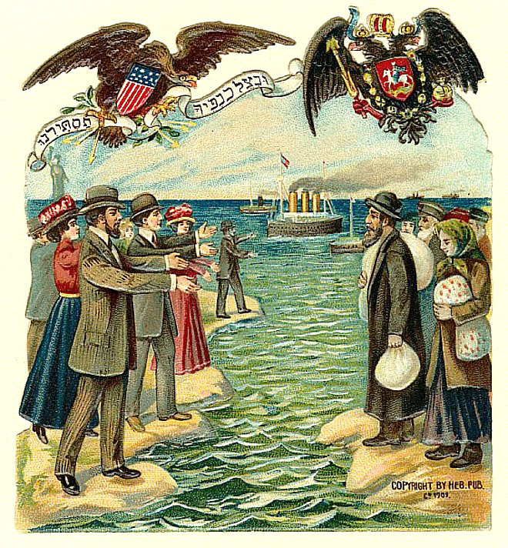
Jewish Immigration to U.S.
Hebrew Publishing Company

Slide 8
Sing to the Lord … Declare his glory among the nations, his marvelous works among all the peoples.
Psalm 96:2a, 3

Slide 9
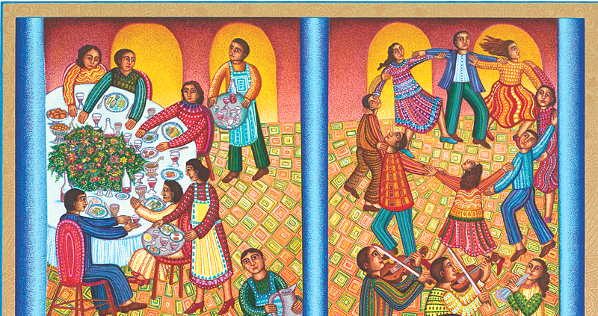
Wedding Feast -- John August Swanson

Slide 10
brothers and sisters … the gospel … proclaimed by me is not of human origin … but … received … through a revelation of Jesus Christ.
Galatians 1:11-12

Slide 11
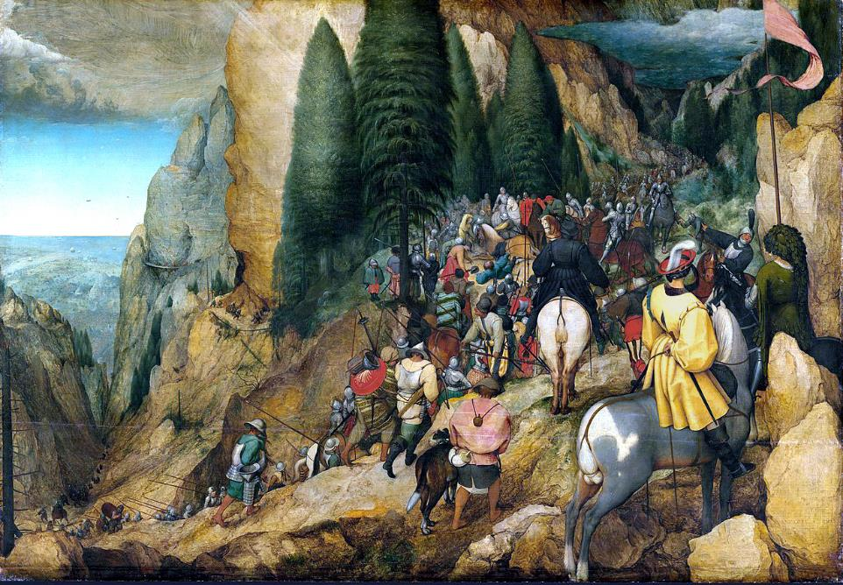
Conversion of Paul -- Pieter Bruegel the Elder, Kunsthistorische Museum, Vienna, Austria

Slide 12
And Jesus went with them, but when he was not far from the house, the centurion sent friends to say to him, "Lord, do not trouble yourself, for I am not worthy to have you come under my roof;
Luke 7:6

Slide 13
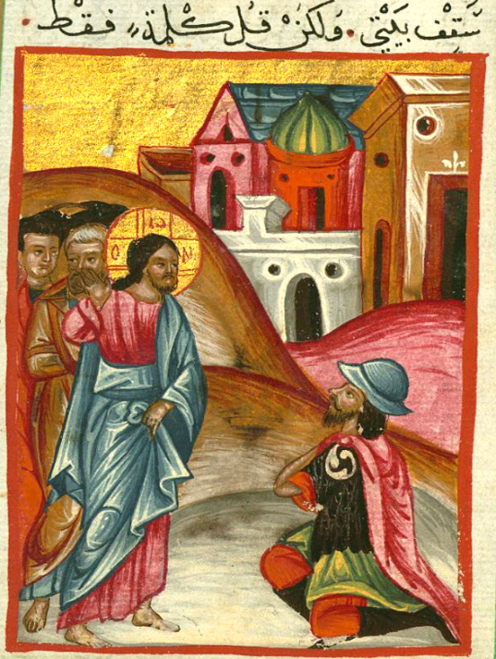
Jesus Heals the Centurion’s Servant
Ilyas Basim Khuri Bazzi Rahib
Walters Art Museum
Baltimore, MD

Slide 14
therefore I did not presume to come to you. But only speak the word, and let my servant be healed.
Luke 7:7

Slide 15
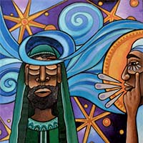
Born Again -- Lauren Wright Pittman, Liturgical artist

Slide 16
When Jesus heard this he was amazed at him, and turning to the crowd that followed him, he said, "I tell you, not even in Israel have I found such faith."
Luke 7:9

Slide 17
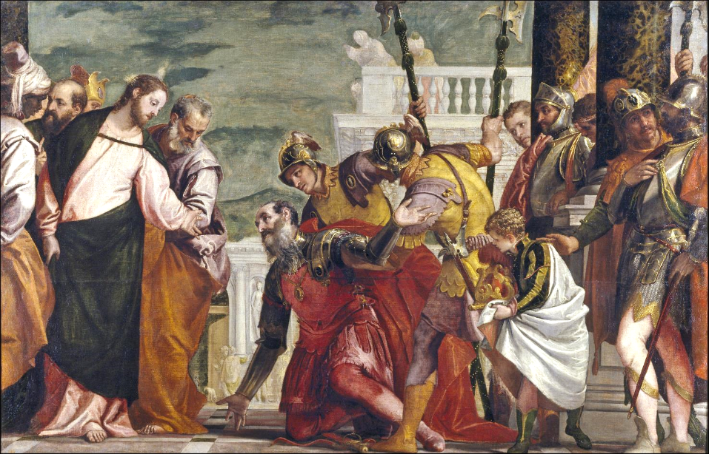
Jesus Heals the Centurion’s Servant -- Paolo Veronese, Prado, Madrid, Spain

Slide 18
Credits
New Revised Standard Version Updated Edition Bible, copyright 2022, Division of Christian Education of the National Council of the Churches of Christ in the United States of America. Used by permission. All rights reserved.
https://commons.wikimedia.org/wiki/File:Augustins_-_Le_Proph%C3%A8te_%C3%89lie_by_Marc_Arcis.jpg
https://commons.wikimedia.org/wiki/File:Julian_Onderdonk_(1882-1922)_-_Dawn_In_The_Hills_(1922).j
pg
https://commons.wikimedia.org/wiki/File:Jewish_immigration_Russia_United_States_1901.jpg
Estate of John August Swanson, https://www.johnaugustswanson.com/
https://commons.wikimedia.org/wiki/File:Conversion_of_Paul_(Bruegel).jpg
https://www.flickr.com/photos/medmss/5184968294/
http://www.lewpstudio.com - copyright by Lauren Wright Pittman
https://commons.wikimedia.org/wiki/File:Jes%C3%BAs_y_el_centuri%C3%B3n_(El_Veron%C3%A9s).jpg
Additional descriptions can be found at the Art in the Christian Tradition image library, a service of the Vanderbilt Divinity Library, http://diglib.library.vanderbilt.edu/. All images available via Creative Commons 3.0 License.

