Slide 1
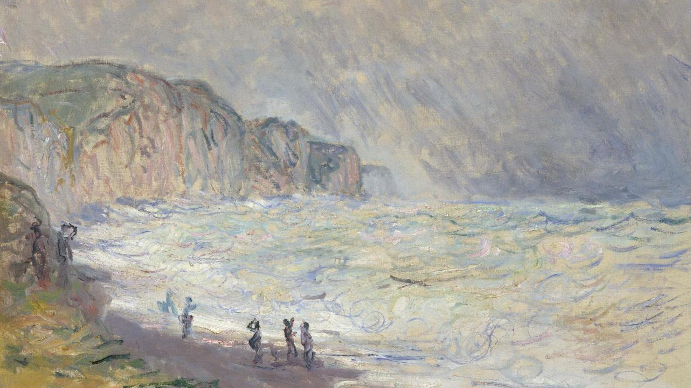
Twenty-Fourth Sunday after Pentecost
Year C
Isaiah 65:17-25 and Isaiah 12 • Malachi 4:1-2a and
Psalm 98 • 2 Thessalonians 3:6-13 • Luke 21:5-19

Slide 2
I will rejoice in Jerusalem, and delight in my people; no more shall the sound of weeping be heard in it, or the cry of distress.
Isaiah 65:19

Slide 3
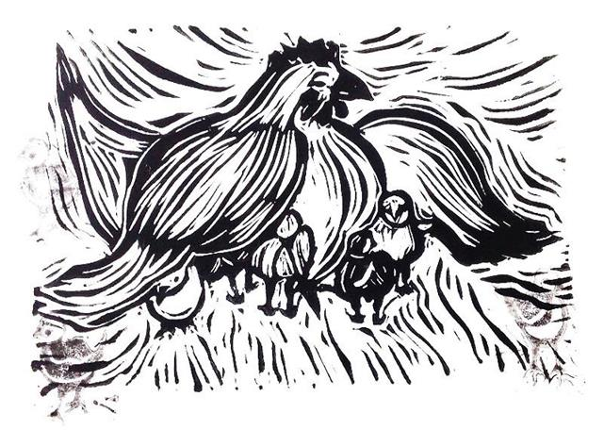
Hen Protecting Chicks -- Cara Hochhalter, liturgical artist

Slide 4
I will give thanks to you, O LORD, for though you were angry with me, your anger turned away, and you comforted me.
Isaiah 12:1b

Slide 5
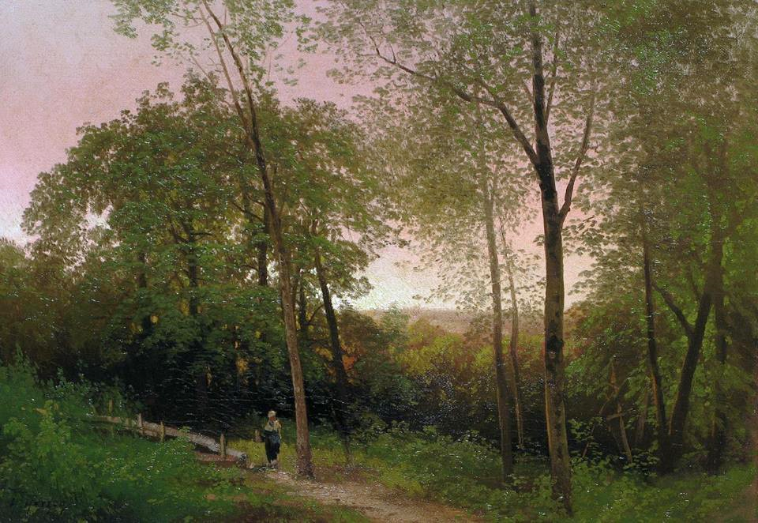
A Walk Along a Path at Sunset -- Hermann Herzog, Vose Galleries, Boston, MA

Slide 6
… for you who revere my name the sun of righteousness shall rise, with healing in its wings.
Malachi 4:2a

Slide 7
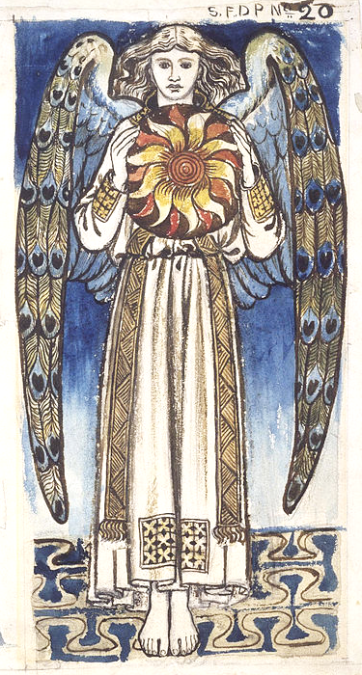
Day: Angel Holding the Sun
William Morris
Museum of Fine Arts
Houston, TX

Slide 8
Let the sea roar, and all that fills it; the world and those who live in it. Let the floods clap their hands;
let the hills sing together for joy …
Psalm 98:7-8

Slide 9
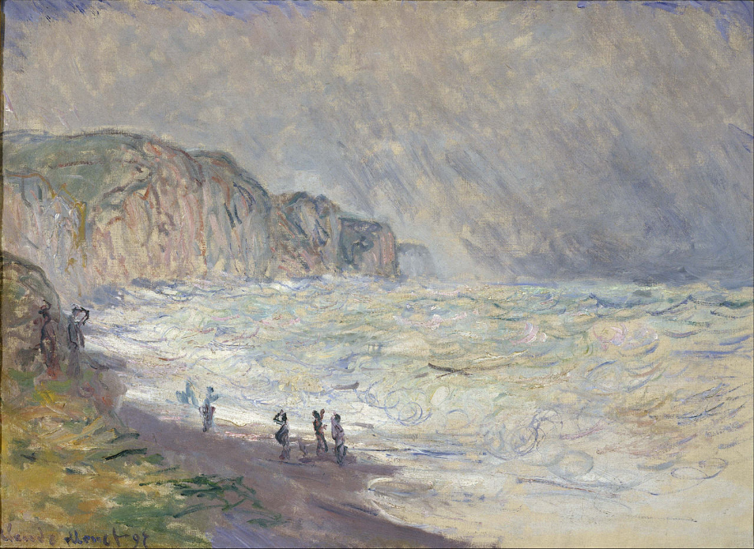
Heavy Sea at Pourville -- Claude Monet, National Museum of Western Art, Tokyo, Japan

Slide 10
Brothers and sisters, do not be weary in doing what is right.
2 Thessalonians 3:13

Slide 11
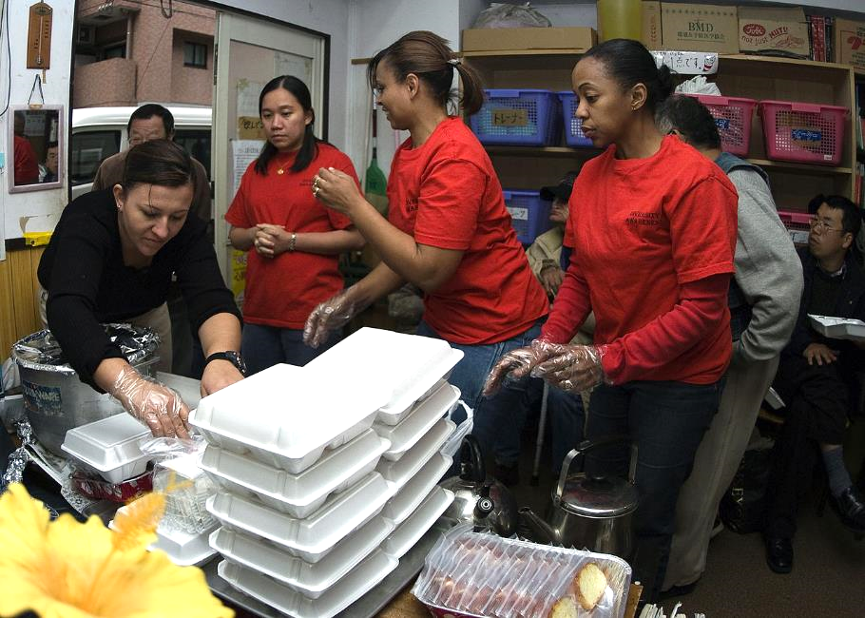
Preparing Meals for the Homeless -- U. S. Navy volunteers, Sanagi-tachi Shelter, Yokohama, Japan

Slide 12
When some were speaking about the temple, how it was adorned with beautiful stones and gifts dedicated to God, he said,
Luke 21:5

Slide 13
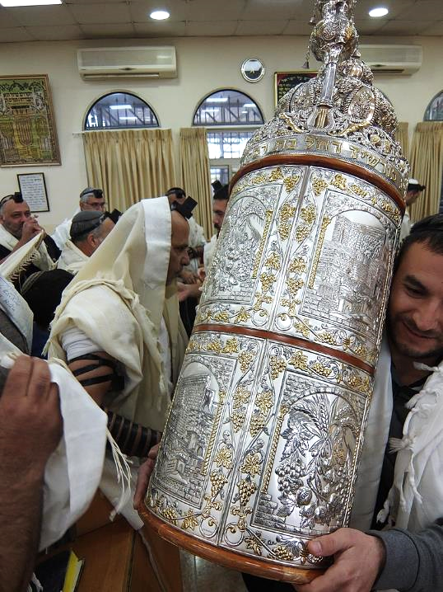
Silver and Gold Torah Case
Synagogue in Israel

Slide 14
"As for these things that you see, the days will come when not one stone will be left upon another; all will be thrown down.
Luke 21:6

Slide 15
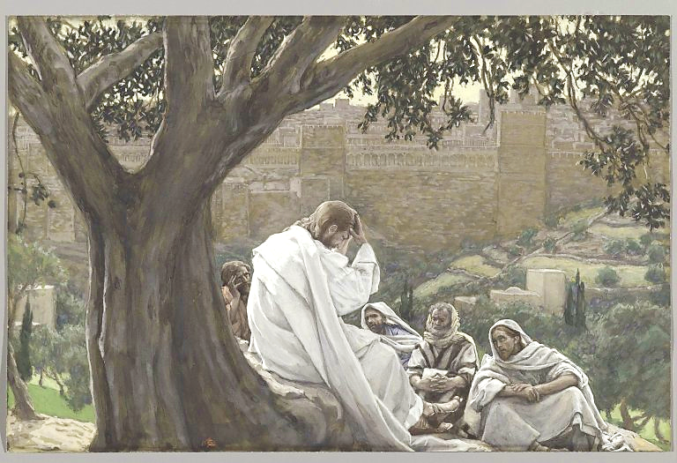
Prophecy of the Destruction of the Temple -- James Tissot, Brooklyn Museum, New York, NY

Slide 16
But before all this occurs, they will arrest you and persecute you;
Luke 21:12a

Slide 17
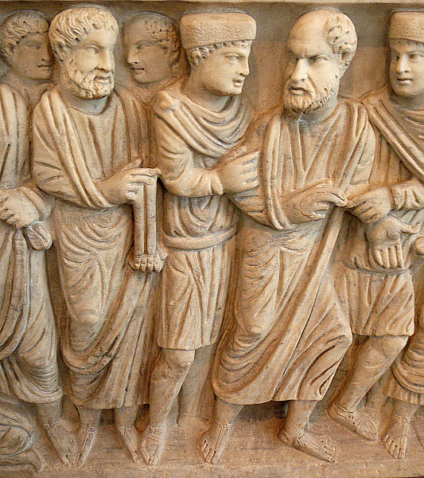
Arrest of Peter
Sarcophagus of Marcus Claudianus
Palazzo Massimo
Rome, Italy

Slide 18
… they will hand you over to … prisons, and you will be brought before kings and governors because of my name.
Luke 21:12b

Slide 19
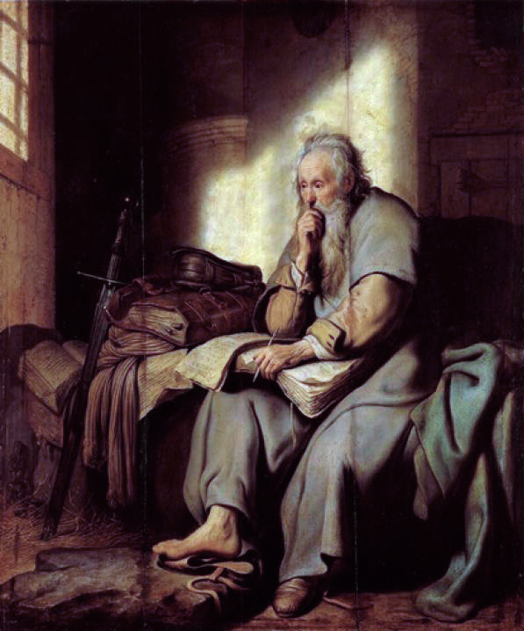
Paul in Prison
Rembrandt
Staatsgalerie Stuttgart
Stuttgart, Germany

Slide 20
You will be hated by all because of my name.
Luke 21:17

Slide 21
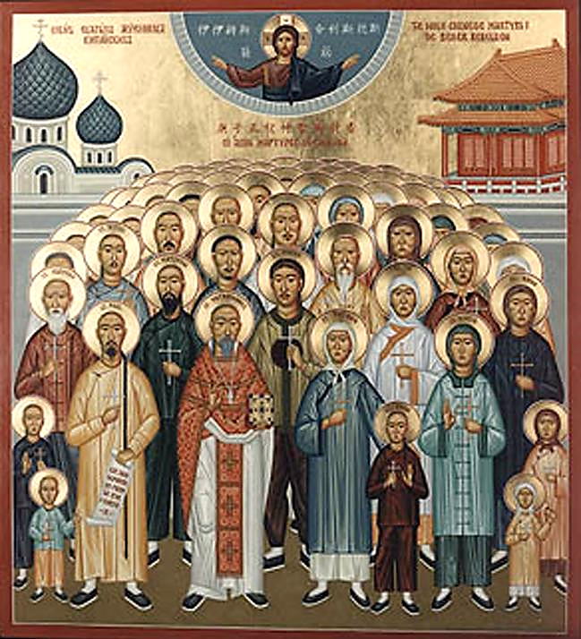
Chinese Martyrs
Orthodox Icon

Slide 22
By your endurance you will gain your souls."
Luke 21:19

Slide 23
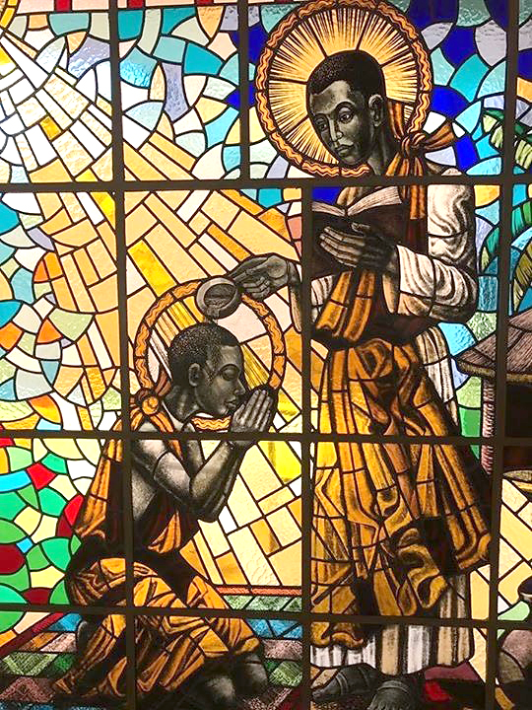
Martyr Charles Lwanga
Basilica of the Ugandan Martyrs
Namugongo, Uganda

Slide 24
Credits
New Revised Standard Version Updated Edition Bible, copyright 2022, Division of Christian Education of the National Council of the Churches of Christ in the United States of America. Used by permission. All rights reserved.
Cara B. Hochhalter, A Challenging Peace in the Life and Stories of Jesus, 2019
https://commons.wikimedia.org/wiki/File:A_Walk_along_a_Path_at_Sunset_by_Hermann_Herzog.jpg
https://commons.wikimedia.org/wiki/File:William_Morris_-_Day-_Angel_Holding_a_Sun_-_Google_Art_Project.jpg
https://commons.wikimedia.org/wiki/File:Claude_Monet_-_Heavy_Sea_at_Pourville_-_Google_Art_Project.jpg
https://commons.wikimedia.org/wiki/File:US_Navy_071119-N-5253W-004_Members_of_the_Commander_Fleet_Activities_Yokosuka_Multicultural_Committee_serve_a_hot_meal_at_the_Sanagi-tachi_Homeless_Shelter_in_Yokohama.jpg – Gabriel Weber
https://commons.wikimedia.org/wiki/File:Torah_case.jpg – Davidbena
https://commons.wikimedia.org/wiki/File:Brooklyn_Museum_-_The_Prophecy_of_the_Destruction_of_the_Temple_(La_pr%C3%A9dication_de_la_ruine_du_Temple)_-_James_Tissot.jpg
https://commons.wikimedia.org/wiki/File:McSarcophagus.peterArrestJRS.jpg – Dick Stracke
https://commons.wikimedia.org/wiki/File:Rembrandt,_%22St._Paul_in_Prison%22.jpg
https://commons.wikimedia.org/wiki/File:Chinesemartyrs-htm_sm.jpg
https://commons.wikimedia.org/wiki/File:Namugongo_Martyrs_window_Charles_Lwanga.jpg
Additional descriptions can be found at the Art in the Christian Tradition image library, a service of the Vanderbilt Divinity Library, http://diglib.library.vanderbilt.edu/. All images available via Creative Commons 3.0 License.

