Slide 1
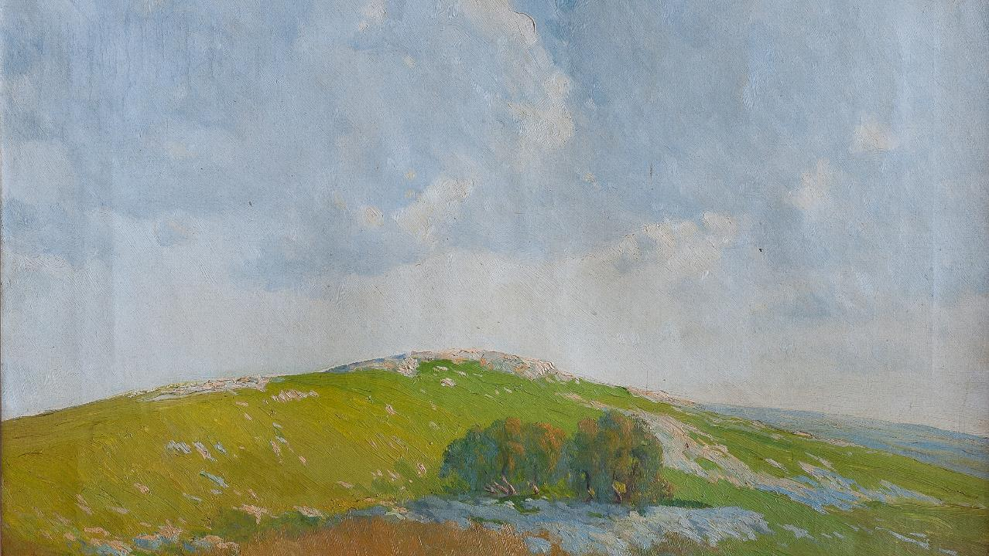
Twenty-Third
Sunday after Pentecost
Year C
Haggai 1:15b-2:9 and Psalm 145:1-5, 17-21 or Psalm 98
Job 19:23-27a and Psalm 17:1-9 • 2 Thessalonians 2:1-5, 13-17 • Luke 20:27-38

Slide 2
… I am with you … according to the promise that I made … when you came out of Egypt. My spirit abides among you; do not fear.
Haggai 2:4c, 5ac

Slide 3
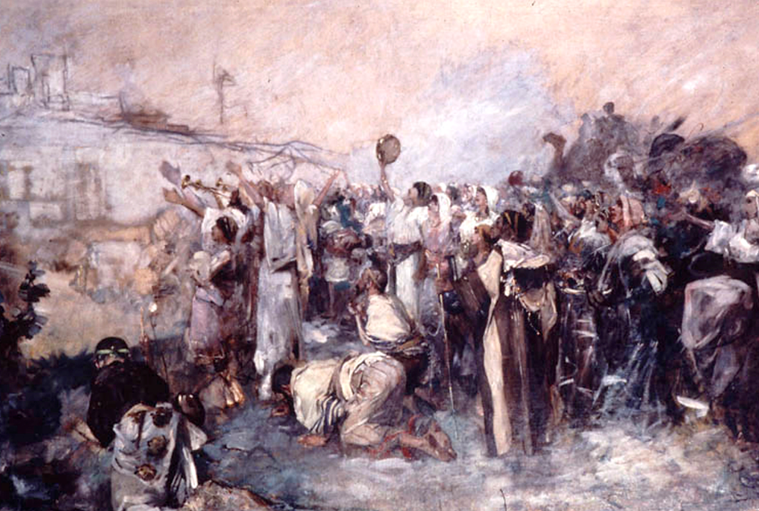
Miriam's Song after the Exodus from Egypt -- Samuel Hirszenberg, Yeshiva Museum, New York, NY

Slide 4
On the glorious splendor of your majesty, and on your wondrous works, I will meditate.
Psalm 145:5

Slide 5
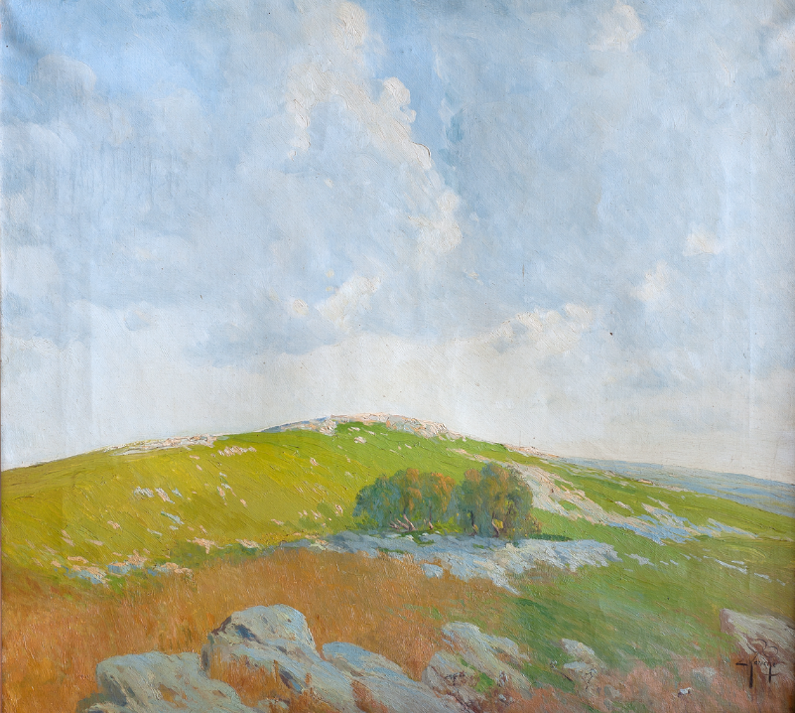
Summit of Cerro Arisco
Ernesto Laroche
National Museum of Visual Arts
Montevideo, Uruguay

Slide 6
O sing to the LORD a new song …
Let the floods clap their hands;
let the hills sing together for joy …
Psalm 98:1a, 8

Slide 7
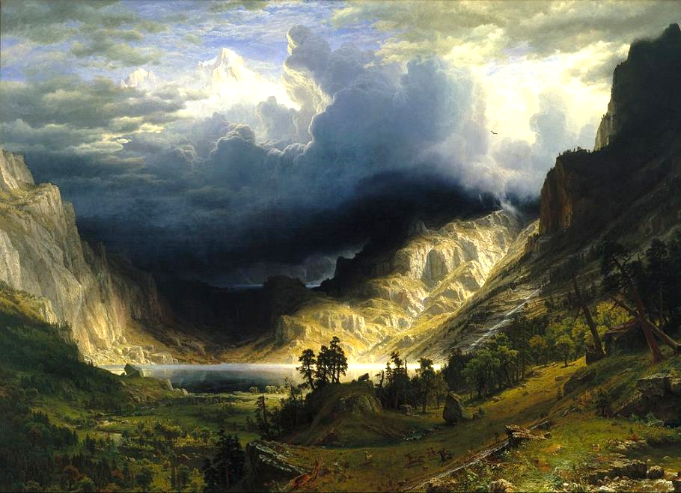
Storm in the Rocky Mountains -- Albert Bierstadt, Brooklyn Museum, New York, NY

Slide 8
For I know that my vindicator lives, and that in the end he will stand upon the earth;
Job 19:25

Slide 9
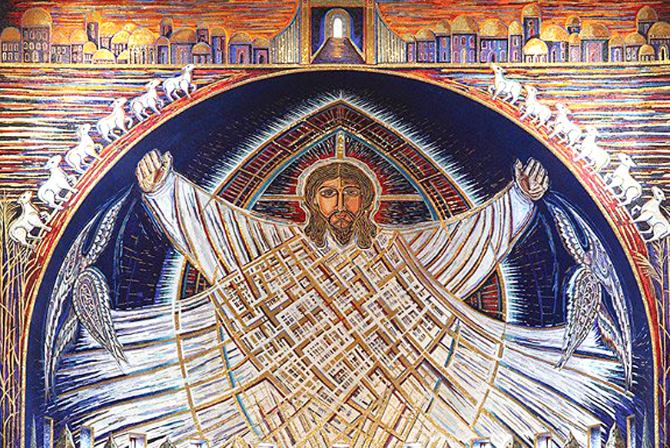
Christ Mosaic -- Church of the Transfiguration of the Community of Jesus, Orleans, MA

Slide 10
O savior of those who seek refuge … Guard me as the apple of the eye; hide me in the shadow of your wings…
Psalm 17:7b, 8

Slide 11
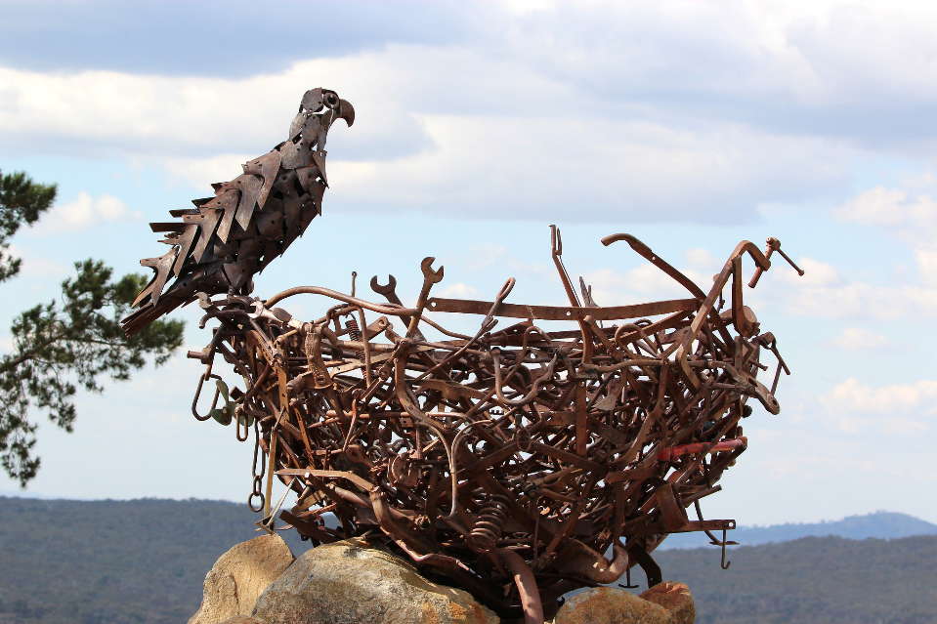
Eagle Protecting It's Nest -- National Arboretum, Canberra, Australia

Slide 12
So then, brothers and sisters …
may … Christ himself … who loved us and through grace gave us eternal comfort and good hope,
2 Thessalonians 2:15a, 16b

Slide 13
comfort your hearts and strengthen them in every good work and word.
2 Thessalonians 2:17

Slide 14
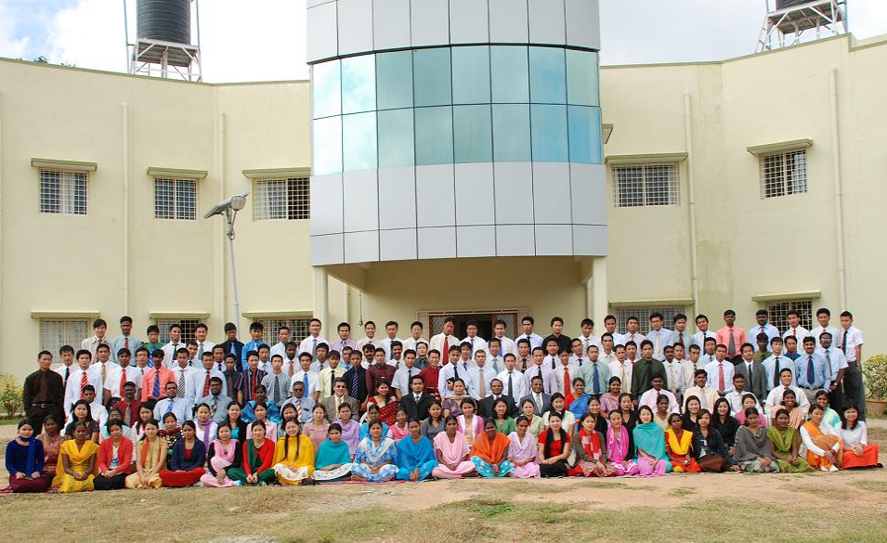
Maranatha Baptist Bible College and Seminary, Bangalore, India

Slide 15
Some Sadducees, those who say there is no resurrection, came to him and asked him a question …
Luke 20:27-28a

Slide 16
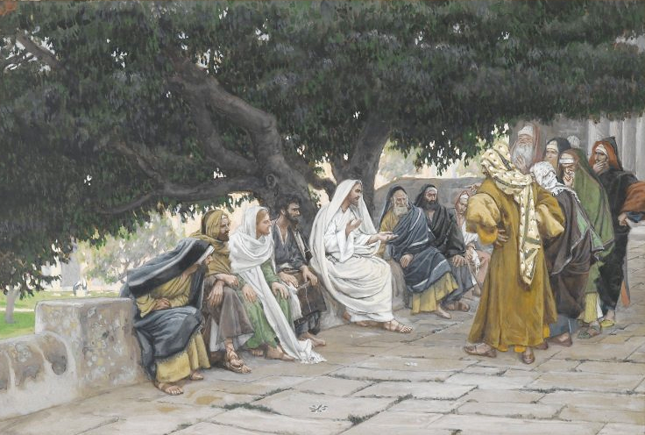
Pharisees and Sadducees Question Jesus -- James Tissot, Brooklyn Museum, New York, NY

Slide 17
"In the resurrection, therefore, whose wife will the woman be? For the seven had married her."
Luke 20:33

Slide 18
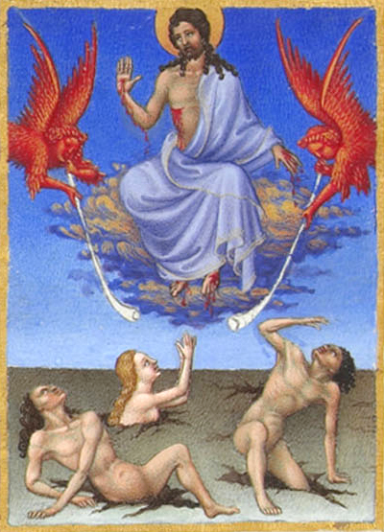
Resurrection of the Dead
Limbourg Brothers Musée Condé
Chantilly, France

Slide 19
Jesus said to them, "Those who belong to this age marry and are given in marriage; but … in the resurrection from the dead neither marry nor are given in marriage.
Luke 20:34, 35b

Slide 20
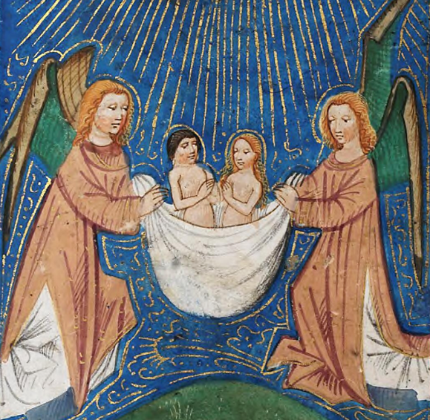
Souls Being Carried Up to Heaven
De Grey Hours
National Library of Wales
Aberystwyth, Wales

Slide 21
Indeed they cannot die anymore, because they are like angels and are children of God …
Luke 20:36

Slide 22
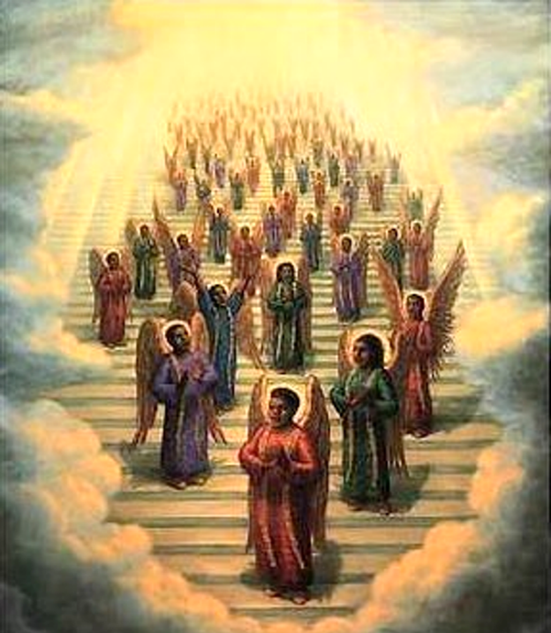
African-American Choir of Angels in Heaven
print from the 19th century

Slide 23
Credits
New Revised Standard Version Updated Edition Bible, copyright 2022, Division of Christian Education of the National Council of the Churches of Christ in the United States of America. Used by permission. All rights reserved.
https://commons.wikimedia.org/wiki/File:Miriam%27s_Song_(3560756375).jpg
https://commons.wikimedia.org/wiki/File:La_cumbre_del_Cerro_Arisco_(1912).png
https://commons.wikimedia.org/wiki/File:Albert_Bierstadt_-_A_Storm_in_the_Rocky_Mountains,_Mt._Rosalie_-_Google_Art_Project.jpg
https://commons.wikimedia.org/wiki/File:Apse_mosaic_Christ_in_Glory.jpg
https://www.flickr.com/photos/arthur_chapman/26141826460
https://commons.wikimedia.org/wiki/File:Mbbcs.JPG
https://commons.wikimedia.org/wiki/File:Brooklyn_Museum_-_The_Pharisees_and_the_Saduccees_Come_to_Tempt_Jesus_(Les_pharisiens_et_les_saduc%C3%A9ens_viennent_pour_tenter_J%C3%A9sus)_-_James_Tissot_-_overall.jpg
https://commons.wikimedia.org/wiki/File:072_MS_65_F34_V.jpg
https://commons.wikimedia.org/wiki/File:De_Grey_Hours_f.188.v_The_raising_of_souls_to_Heaven.png
https://commons.wikimedia.org/wiki/File:19th_century_black_heaven.jpg
Additional descriptions can be found at the Art in the Christian Tradition image library, a service of the Vanderbilt Divinity Library, http://diglib.library.vanderbilt.edu/. All images available via Creative Commons 3.0 License.

