Slide 1
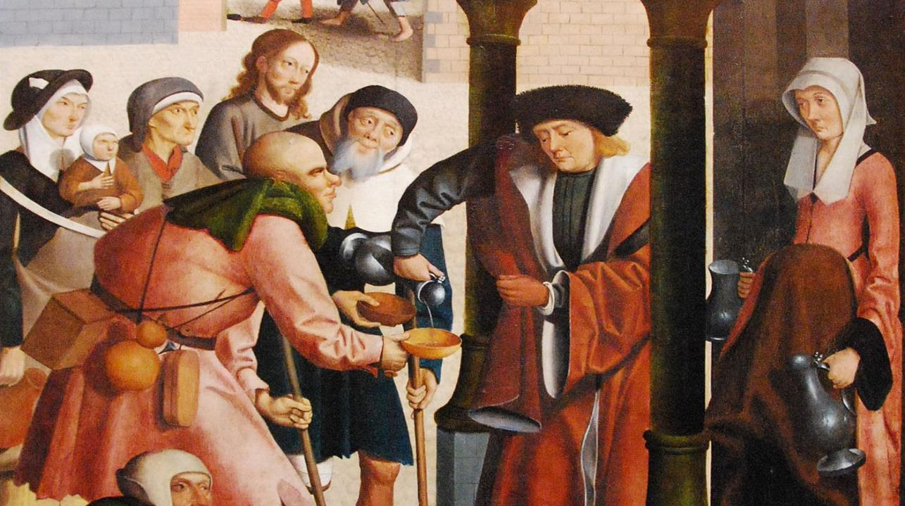
Seventeenth Sunday after Pentecost
Year C
Jeremiah 32:1-3a, 6-15 and Psalm 91:1-6, 14-16
Amos 6:1a, 4-7 and Psalm 146 • 1 Timothy 6:6-19
Luke 16:19-31

Slide 2
For thus says the LORD of hosts, the God of Israel: Houses and fields and vineyards shall again be bought in this land.
Jeremiah 32:15

Slide 3
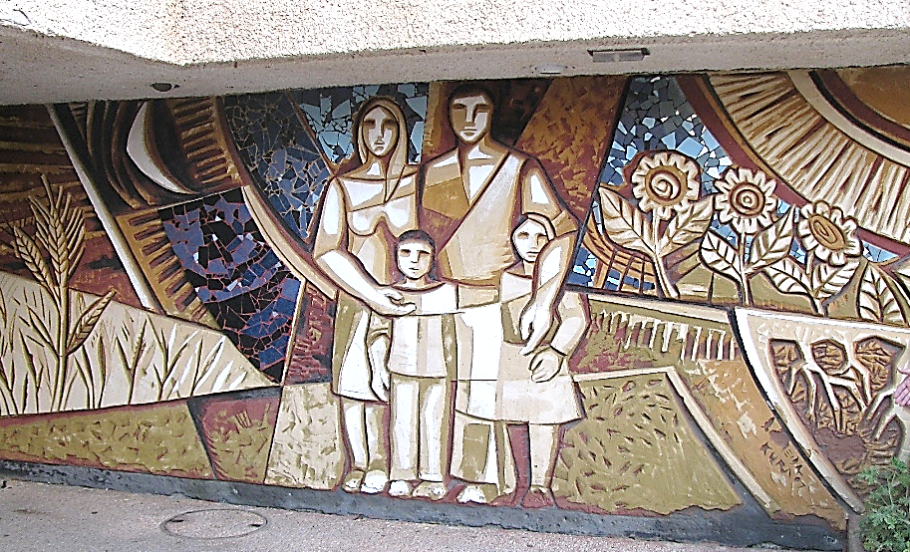
Family Mural, Kibbutz Or Haner, Israel

Slide 4
When they call to me, I will answer them; I will be with them in trouble,
I will rescue them and honor them.
Psalm 91:15

Slide 5
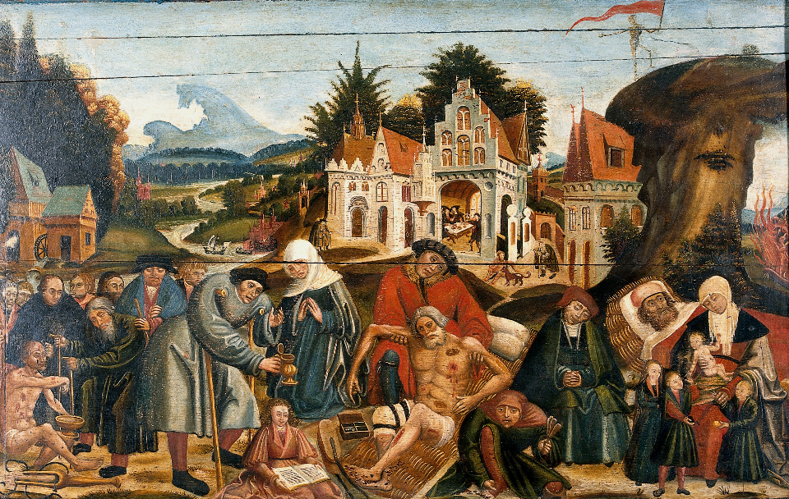
Healing Works of Mercy, with Poor Man Lazarus -- Flemish painter, c. 1550

Slide 6
Alas for those who are at ease in Zion … who drink wine from bowls, and anoint themselves with the finest oils, but are not grieved over the ruin of Joseph!
Amos 6:1a, 6

Slide 7
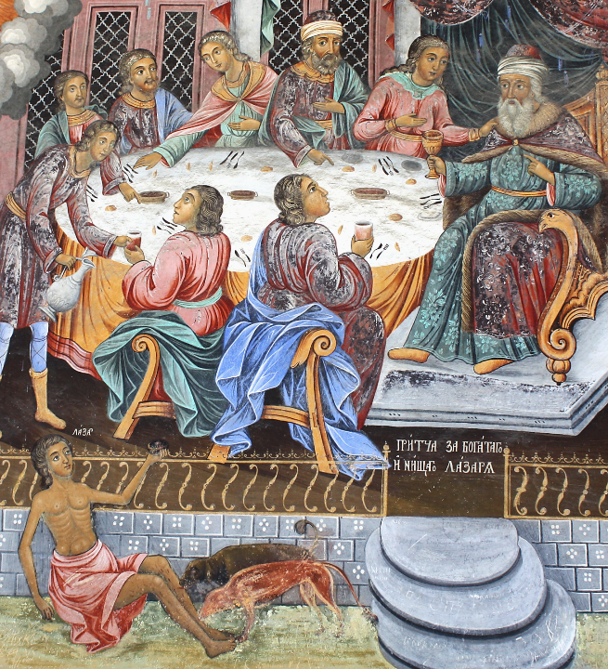
The Rich Man and the Poor Man Lazarus
Rila Monastery
Rila, Bulgaria

Slide 8
Happy are those whose help is the God of Jacob … who executes justice for the oppressed; who gives food to the hungry.
Psalm 146:5a, 7

Slide 9

USDA Food Nutrition Summer Food Service Program -- Lila Frederick School in Dorchester, MA

Slide 10
For the love of money is a root of all kinds of evil, and in their eagerness to be rich some have wandered away from the faith …
1 Timothy 6:10a

Slide 11
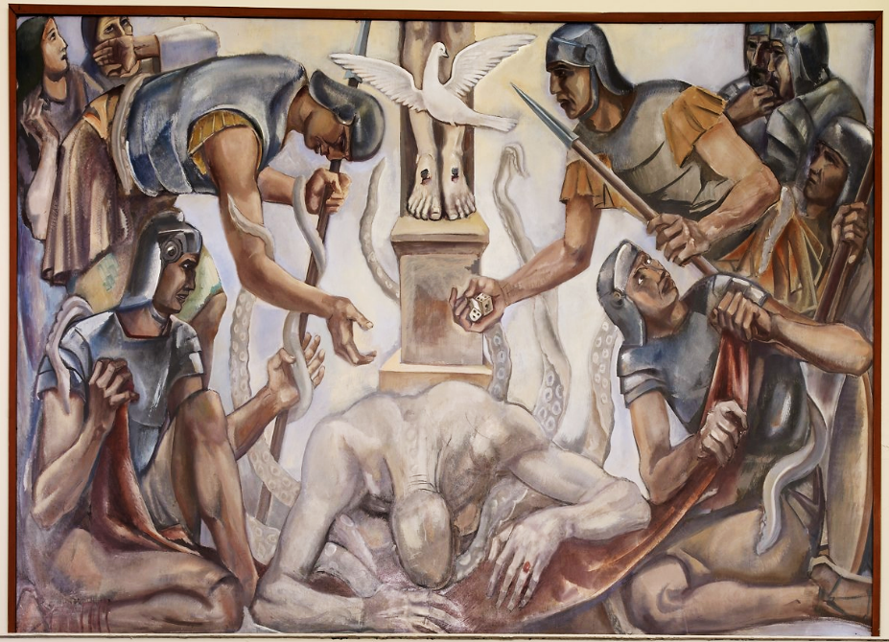
Allegory of Greed -- Mural in the Department of Justice Library, Washington, DC

Slide 12
But as for you … shun all this; pursue righteousness, godliness, faith, love, endurance, gentleness.
1 Timothy 6:11

Slide 13
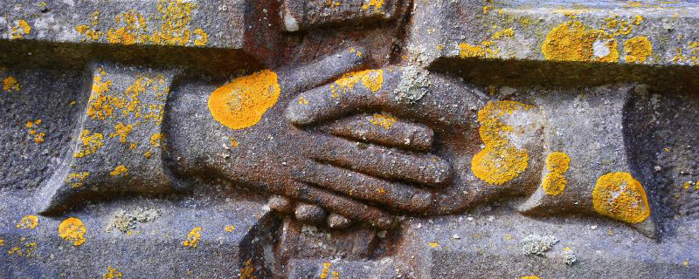
Love and Faithfulness Meet -- St. Michael's Church, Golden Grove, Wales, United Kingdom

Slide 14
As for those who in the present age are rich … set their hopes … on God who richly provides us with everything for our enjoyment.
1 Timothy 6:17ac

Slide 15
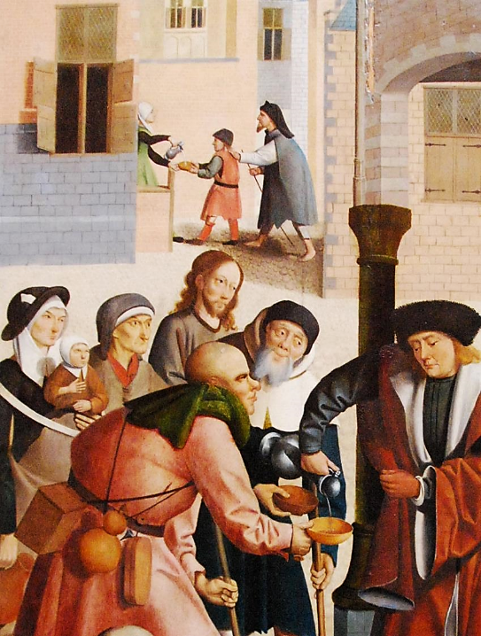
"I Was Thirsty and You Gave Me Drink"
[Christ is in the group waiting for drink]
Museum Boijmans
Amsterdam
Netherlands

Slide 16
They are … to be rich in good works, generous, and ready to share,
thus storing up for themselves the treasure of a good foundation …
1 Timothy 6:18ac, 19a

Slide 17
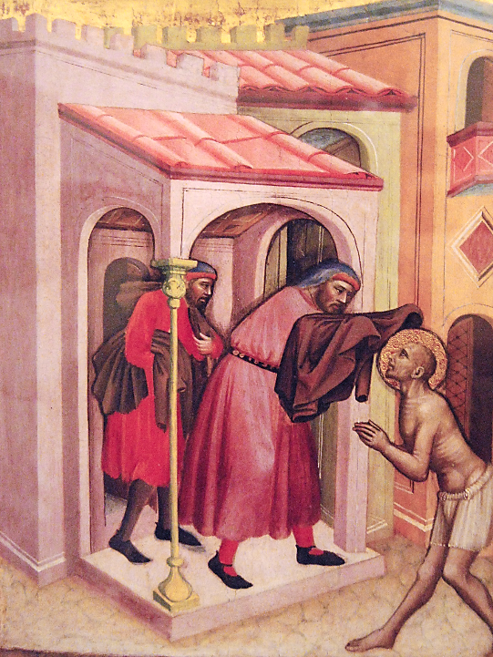
Works of Mercy
Donating Clothing
Vatican Museum
Vatican City

Slide 18
"There was a rich man who was dressed in purple and fine linen and who feasted sumptuously every day.
Luke 16:19

Slide 19
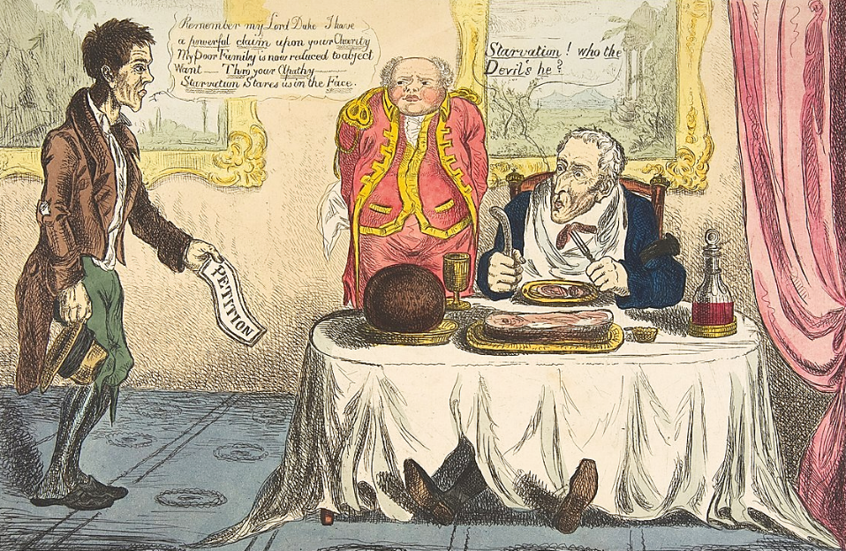
Lazarus and the Rich Man -- etching, British, c. 1830, Metropolitan Museum of Art, New York, NY

Slide 20
And at his gate lay a poor man named Lazarus, covered with sores,
Luke 16:20

Slide 21
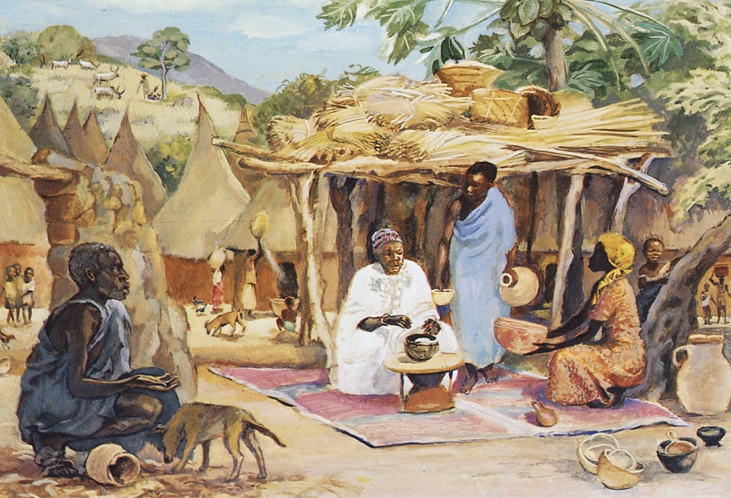
Rich Man and Lazarus -- JESUS MAFA, Cameroon

Slide 22
who longed to satisfy his hunger with what fell from the rich man's table; even the dogs would come and lick his sores.
Luke 16:21

Slide 23
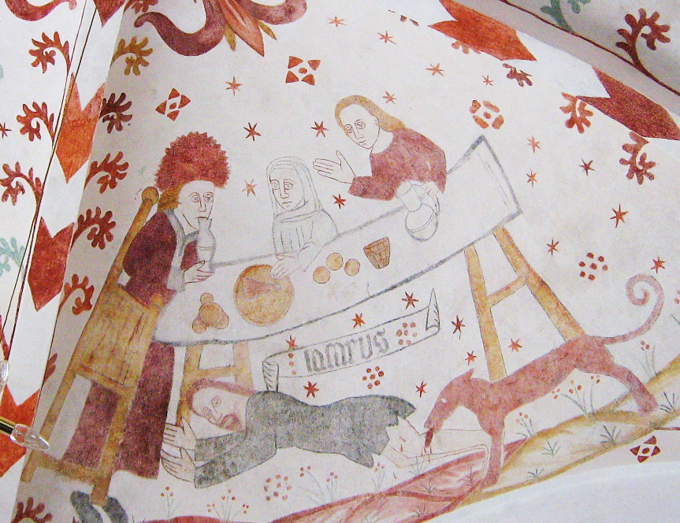
Rich Man and Lazarus -- Fanfjord Church, Mon, Denmark

Slide 24
The poor man died and was carried away by the angels to be with Abraham.
Luke 16:22a

Slide 25
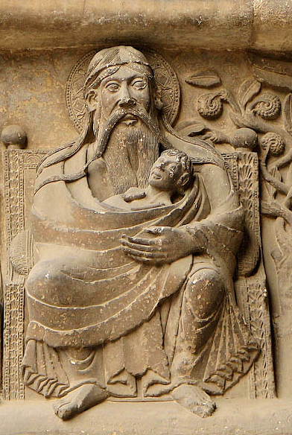
Lazarus with Abraham in Heaven
Abbey of St. Pierre, Moissac, France

Slide 26
The rich man also died … In Hades … He called out, 'Father Abraham, have mercy on me, and send Lazarus to dip the tip of his finger in water and cool my tongue; for I am in agony in these flames.'
Luke 16:22b, 23a, 24

Slide 27
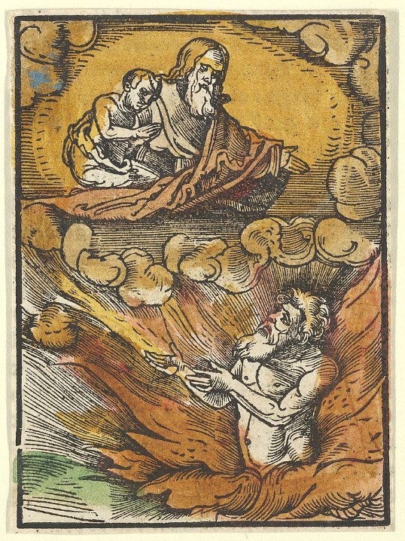
The Rich Man in Hell Asks for Help from the Poor Man in Heaven
Hans Schäufelein
Das Plenarium
Metropolitan Museum of Art
New York, NY

Slide 28
Credits
New Revised Standard Version Updated Edition Bible, copyright 2022, Division of Christian Education of the National Council of the Churches of Christ in the United States of America. Used by permission. All rights reserved.
https://commons.wikimedia.org/wiki/File:PikiWiki_Israel_11515_Art_at_Kibbutz_Or_Haner.JPG
https://commons.wikimedia.org/wiki/File:Works_of_mercy_with_Dives_and_Lazarus._Oil_painting_by_a_Fle_Wellcome_V0017623.jpg
https://commons.wikimedia.org/wiki/File:Rilakloster_Wandgem%C3%A4lde_b_20090407_018.JPG
https://www.flickr.com/photos/usdagov/7783517196/
https://commons.wikimedia.org/wiki/File:Oil_painting_%22Greed%22_located_in_fifth_floor,_main_library,_Department_of_Justice,_Washington,_D.C_LCCN2010720176.tif
https://www.flickr.com/photos/sevendipity/1410013612/
https://www.flickr.com/photos/jimforest/3238023703/ - Jim Forest
https://www.flickr.com/photos/jimforest/2555982623/ - Jim Forest
https://commons.wikimedia.org/wiki/File:Lazarus_and_the_Rich_Man_MET_DP818354.jpg
http://diglib.library.vanderbilt.edu/act-imagelink.pl?RC=48267
https://commons.wikimedia.org/wiki/File:Fanefjord_Rich_man_Lazarus.JPG
https://www.flickr.com/photos/pelegrino/2531017363 – Nick Thompson
https://commons.wikimedia.org/wiki/File:The_Rich_Man_in_Hell_and_the_Poor_Lazarus_in_Abraham%27s_Lap,_from_Das_Plenarium_MET_DP849940.jpg – Adam Petri
Additional descriptions can be found at the Art in the Christian Tradition image library, a service of the Vanderbilt Divinity Library, http://diglib.library.vanderbilt.edu/. All images available via Creative Commons 3.0 License.

