Slide 1
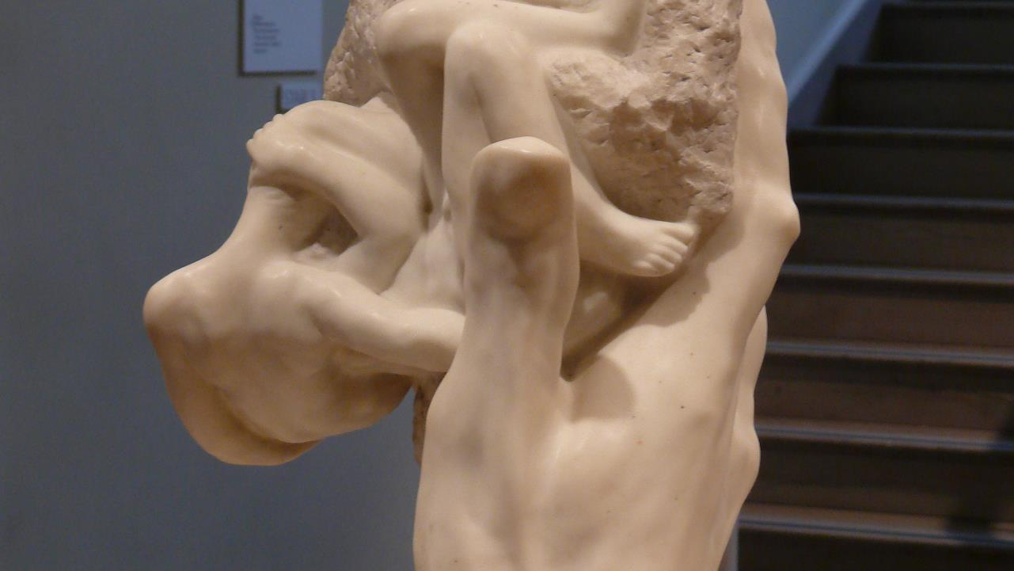
Fourteenth Sunday after Pentecost
Year C
Jeremiah 18:1-11 and Psalm 139:1-6, 13-18 • Deuteronomy 30:15-20 and Psalm 1 • Philemon 1:1-21 • Luke 14:25-33

Slide 2
I went down to the potter's house …
The vessel he was making of clay was spoiled … and he reworked it into another vessel, as seemed good to him.
Jeremiah 18:3a, 4ac

Slide 3
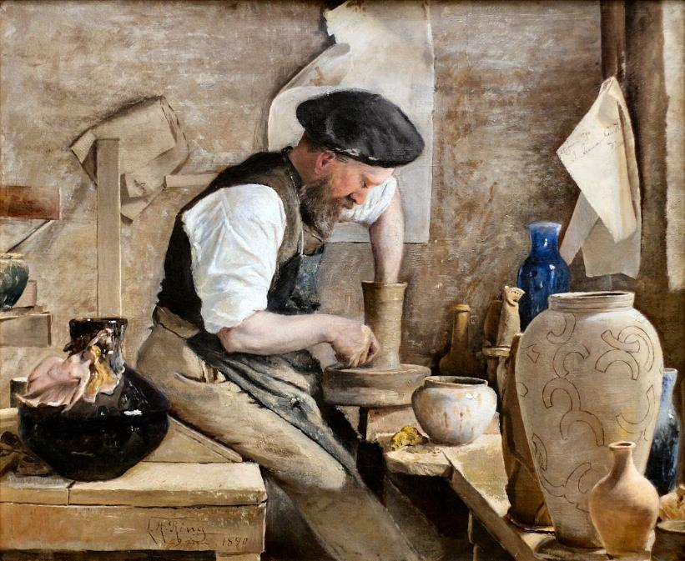
Potter Herman Kahler -- Laurits Ring, Randers Museum of Art, Jutland, Denmark

Slide 4
Can I not do with you, O house of Israel, just as this potter has done? … Just like the clay in the potter's hand, so are you in my hand …
Jeremiah 18:6

Slide 5
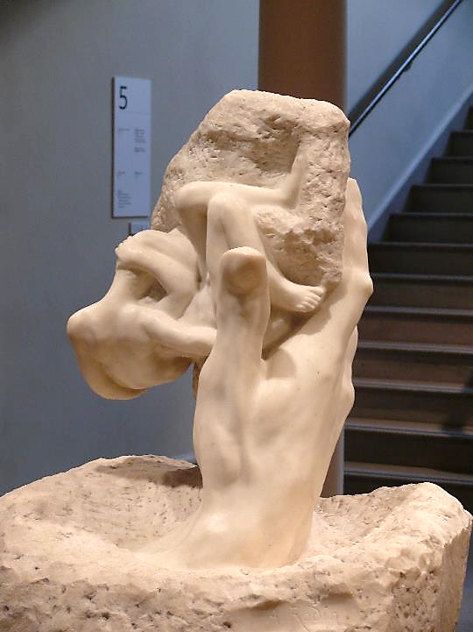
Hand of God
Auguste Rodin
RISD Museum
Providence, RI

Slide 6
You know when I sit down and when I rise up; you discern my thoughts from far away. Even before a word is on my tongue, O LORD, you know it completely.
Psalm 139:2, 4

Slide 7
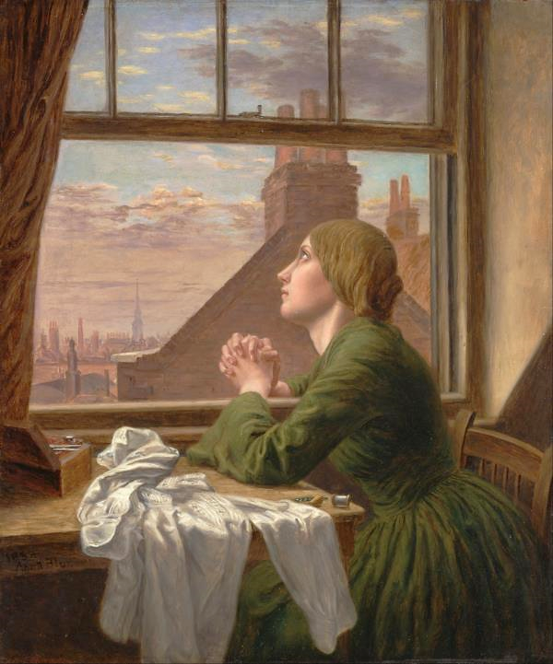
For Only One Short Hour, or, The Seamstress
Anna Blunden
Yale Centre for British Art
New Haven, CT

Slide 8
How weighty to me are your thoughts, O God! … I try to count them -- they are more than the sand; I come to the end -- I am still with you.
Psalm 139:17a, 18

Slide 9
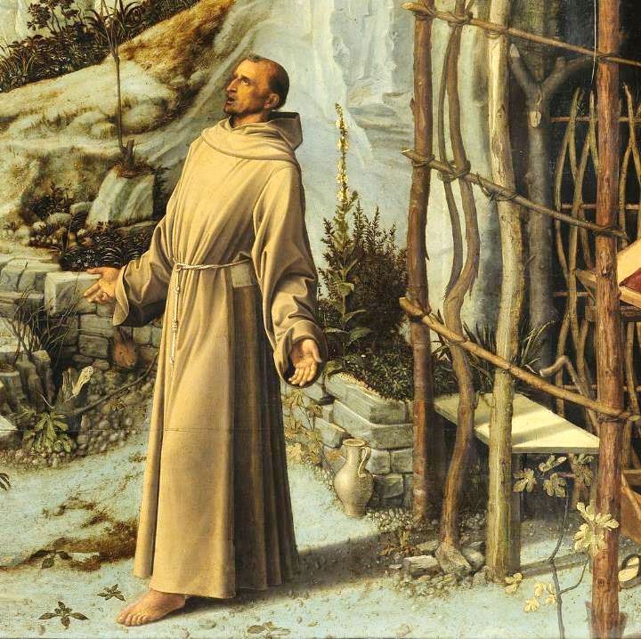
St. Francis in the Desert, detail
Giovanni Bellini
Frick Collection
New York, NY

Slide 10
Choose life … loving the LORD your God, obeying him, and holding fast to him …
Deuteronomy 30:19b, 20a

Slide 11
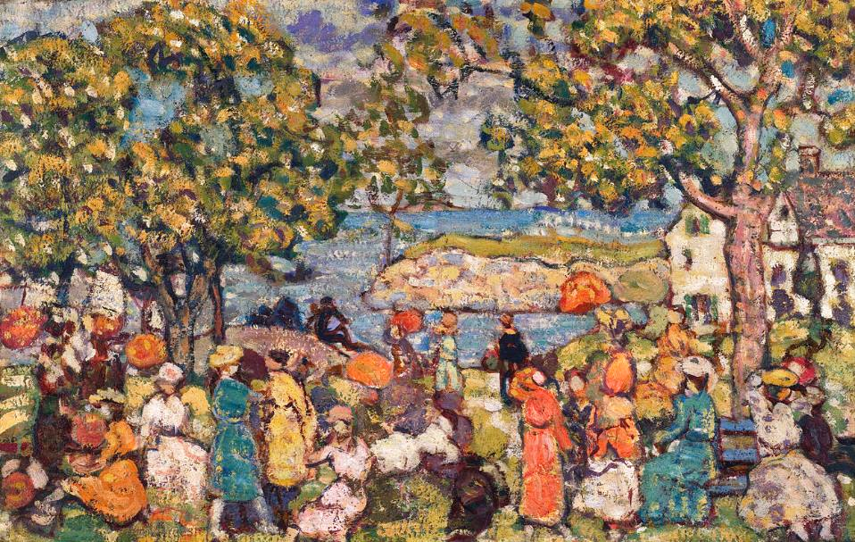
The Picnic -- Maurice Prendergast, Phillips Collection, Washington, DC

Slide 12
Happy are those who do not …sit in the seat of scoffers … their delight is in the law of the LORD, and on his law they meditate day and night.
Psalm 1:1ac, 2

Slide 13
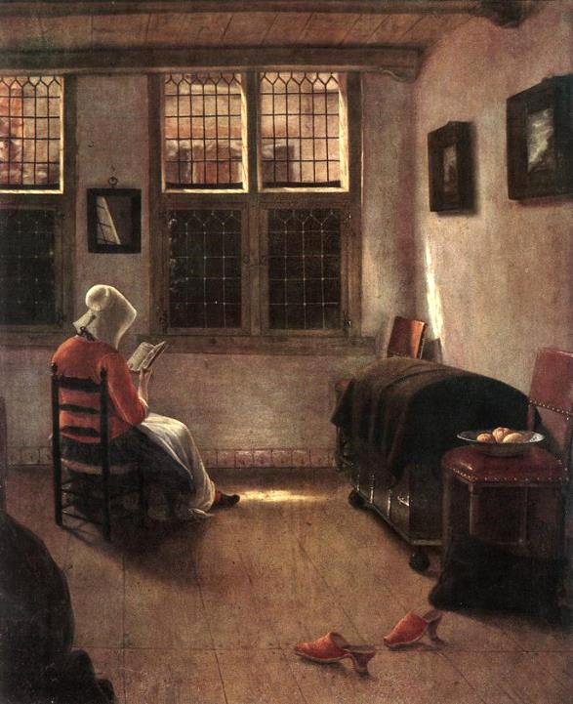
Woman Reading
Pieter Elinga
Alte Pinakotek
Munich, Germany

Slide 14
though I am bold enough in Christ to command you to do your duty,
… I would rather appeal to you on the basis of love …
Philemon 1:8b, 9a

Slide 15

"Choose Love Over Fear…" Desmond Tutu

Slide 16
I am appealing to you for my child, Onesimus, whose father I have become during my imprisonment.
Philemon 1:10

Slide 17

Sign from Onesimus Boys Centre -- Mombasa, Kenya

Slide 18
I am sending him, that is, my own heart, back to you … no longer as a slave but more than a slave, a beloved brother …
Philemon 1:12, 16a

Slide 19
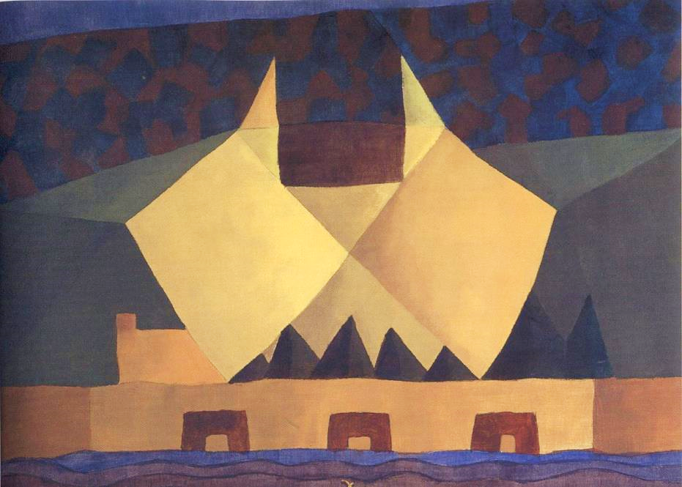
Two Brothers -- Arthur Dove, Honolulu Museum of Art, Honolulu, HI

Slide 20
Now large crowds were traveling with him; and he turned and said to them, "Whoever comes to me and does not hate father and mother,
Luke 14:25a, 26a

Slide 21
wife and children, brothers and sisters, yes, and even life itself, cannot be my disciple.
Luke 14:26b

Slide 22
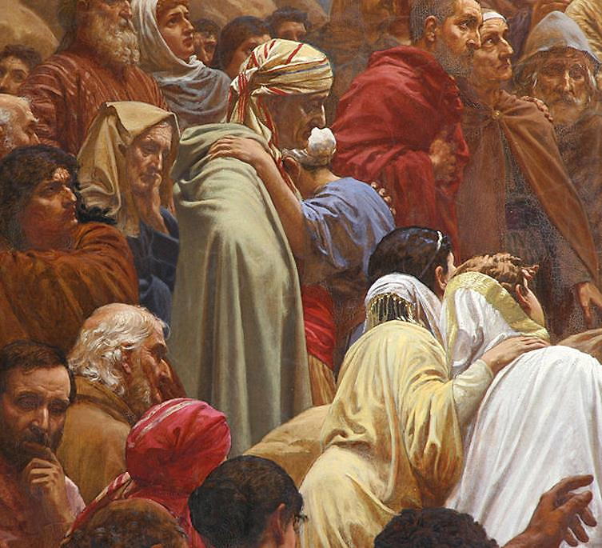
Crowd Listening, detail from Sermon on the Mount
Henrik Olrik
Sankt Matthaeus Kirke
Copenhagen, Denmark

Slide 23
Whoever does not carry the cross and follow me cannot be my disciple.
Luke 14:27

Slide 24
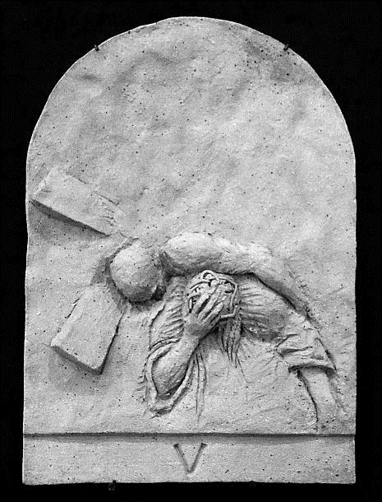
Simon of Cyrene Helps Christ, Stations of the Cross -- Good Shepherd Church, Cedar Hill, TX

Slide 25
So therefore, none of you can become my disciple if you do not give up all your possessions."
Luke 14:33

Slide 26
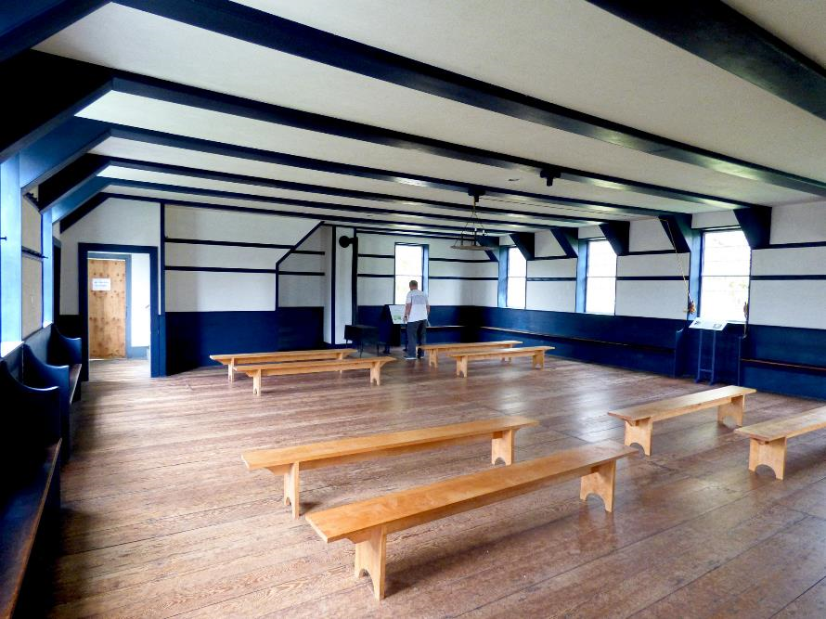
Meeting House Worship Space, Hancock Shaker Village, Pittsfield, MA

Slide 27
Credits
New Revised Standard Version Updated Edition Bible, copyright 2022, Division of Christian Education of the National Council of the Churches of Christ in the United States of America. Used by permission. All rights reserved.
https://commons.wikimedia.org/wiki/File:Herman_K%C3%A4hler_i_sit_v%C3%A6rksted.jpg
http://commons.wikimedia.org/wiki/File:RISD_Rodin_Hand_of_God.JPG
https://commons.wikimedia.org/wiki/File:Anna_Blunden_-_%22For_Only_One_Short_Hour%22_-_Google_Art_Project.jpg
https://commons.wikimedia.org/wiki/File:Giovanni_Bellini_-_Saint_Francis_in_the_Desert_-_Google_Art_Project-x1-y1.jpg
https://commons.wikimedia.org/wiki/File:Maurice_Prendergast_-_Picnic_-_Google_Art_Project.jpg
https://commons.wikimedia.org/wiki/File:Pieter_Janssens_Elinga_-_Reading_Woman_-_WGA7482.jpg
https://www.flickr.com/photos/elycefeliz/2933463061 - elycefeliz
http://commons.wikimedia.org/wiki/File:Onesimus_sign.jpg
https://commons.wikimedia.org/wiki/File:%27The_Brothers_-1%27_by_Arthur_Dove,_1941,_Honolulu_Museum_of_Art.jpg
http://commons.wikimedia.org/wiki/File:Sankt_Matthaeus_Kirke_Copenhagen_altarpiece_detail3.jpg
https://www.flickr.com/photos/ethnosax/25327867722/ - Neil Coulter
https://www.flickr.com/photos/damiavos/38033289756 - Damian Entwistle
Additional descriptions can be found at the Art in the Christian Tradition image library, a service of the Vanderbilt Divinity Library, http://diglib.library.vanderbilt.edu/. All images available via Creative Commons 3.0 License.

