Slide 1
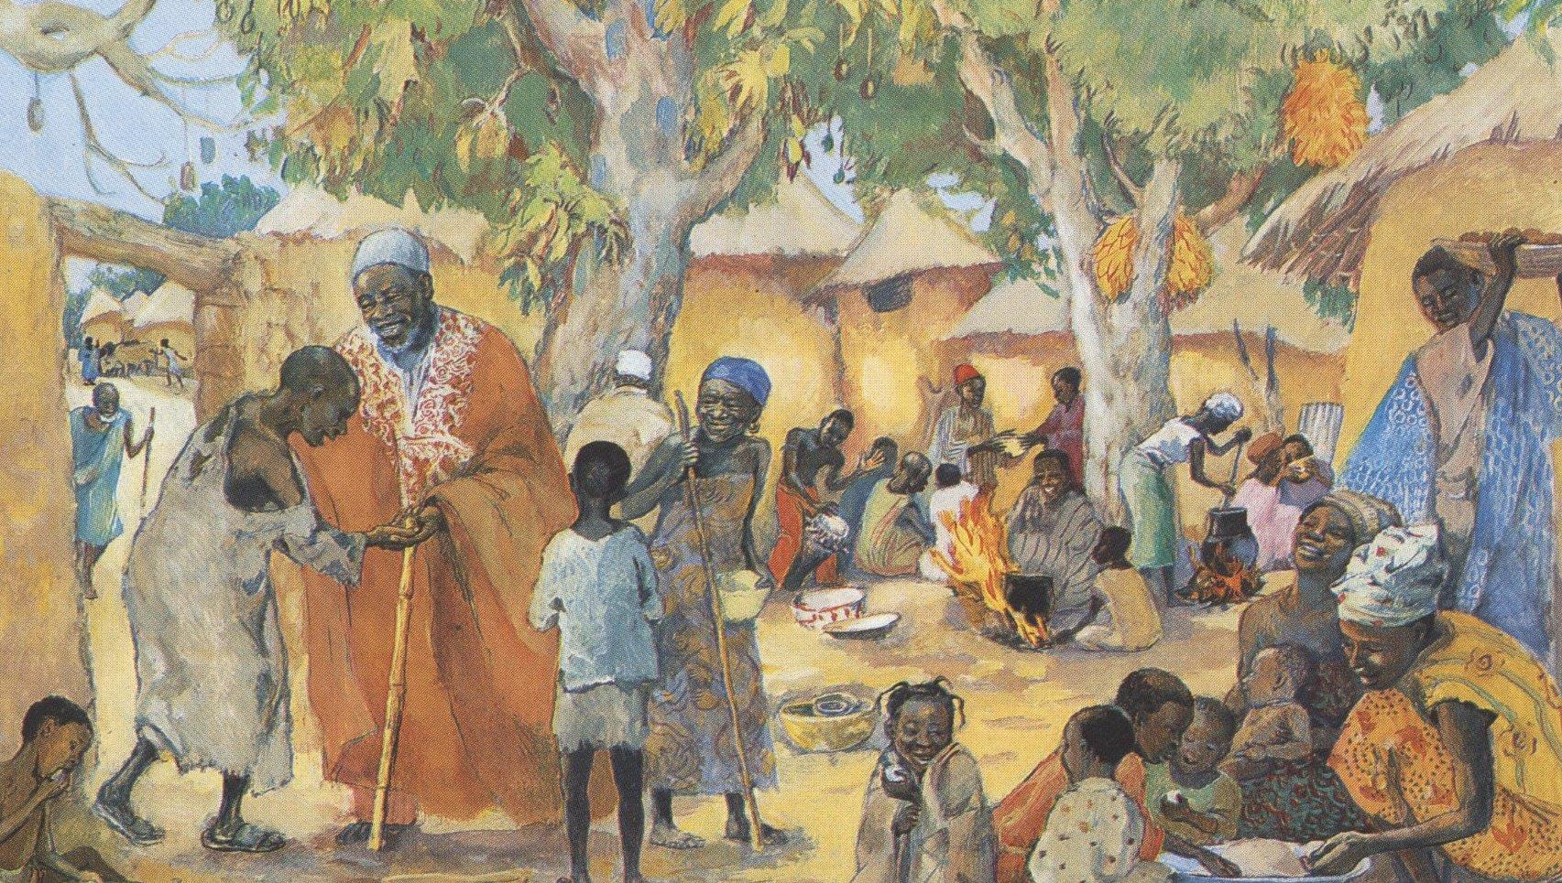
Thirteenth Sunday after Pentecost
Year C
Jeremiah 2:4-13 and Psalm 81:1, 10-16 • Sirach 10:12-18 or Proverbs 25:6-7 and Psalm 112 • Hebrews 13:1-8, 15-16 Luke 14:1, 7-14

Slide 2
for my people have committed two evils: they have forsaken me, the fountain of living water, and dug out cisterns for themselves, cracked cisterns that can hold no water.
Jeremiah 2:13

Slide 3
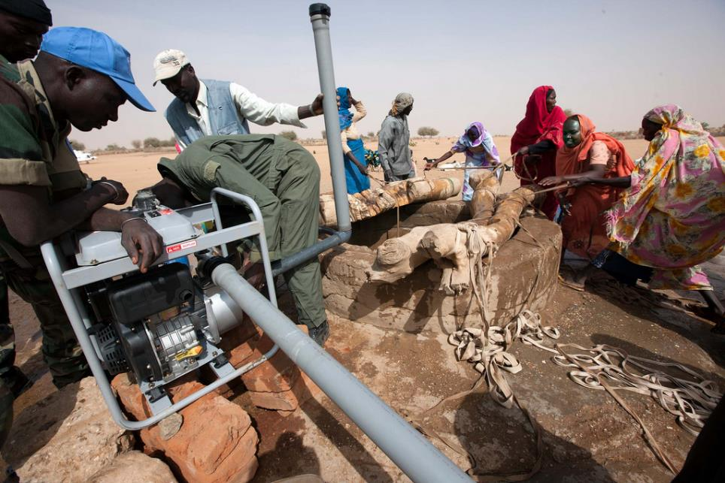
Construction of Water Pump for Well -- North Darfur, Sudan

Slide 4
Sing aloud to God our strength; shout for joy to the God of Jacob … Open your mouth wide and I will fill it … with honey from the rock …
Psalm 81:1, 10b, 16b

Slide 5
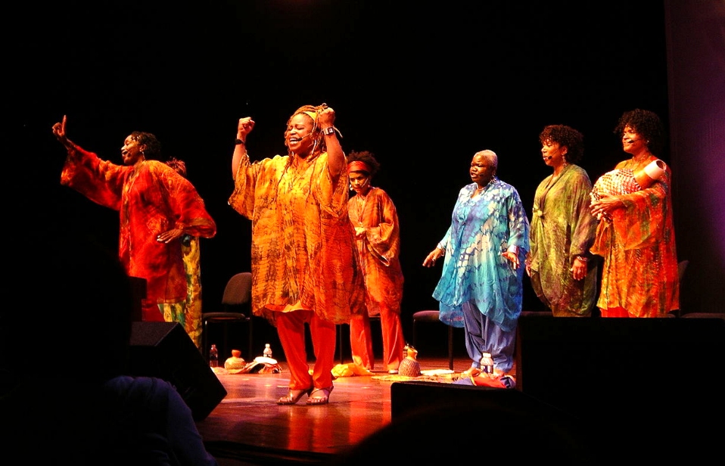
Sweet Honey in the Rock, African-American Gospel choir

Slide 6
Happy are those who fear the LORD … They rise in the darkness as a light for the upright; they are gracious, merciful, and righteous.
Psalm 112:1b, 4

Slide 7
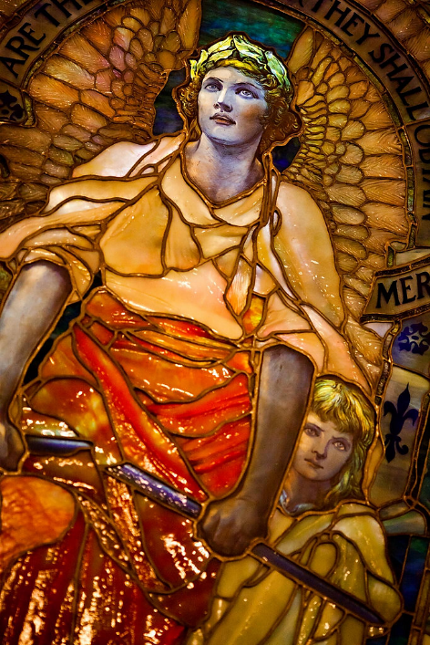
Blessed are the Merciful
Arlington Street Church
Boston, MA

Slide 8
Do not neglect to show hospitality to strangers, for by doing that some have entertained angels without knowing it.
Hebrews 13:2

Slide 9
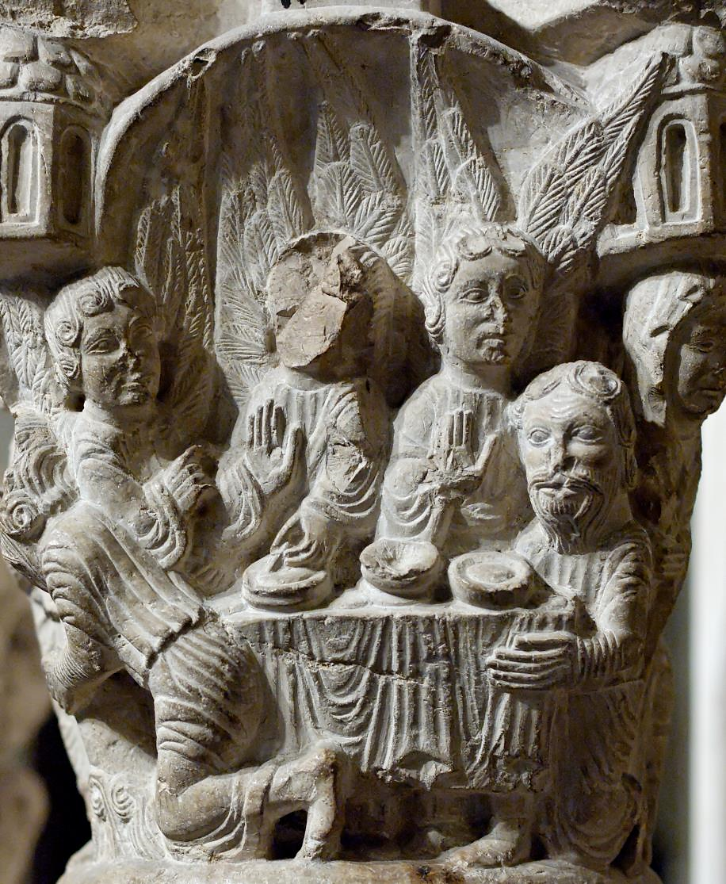
Abraham, Sarah, and the Three Visitors
Catalan Cloister
Musee du Cluny
Paris, France

Slide 10
"The Lord is my helper;
I will not be afraid."
Hebrews 13:6b

Slide 11
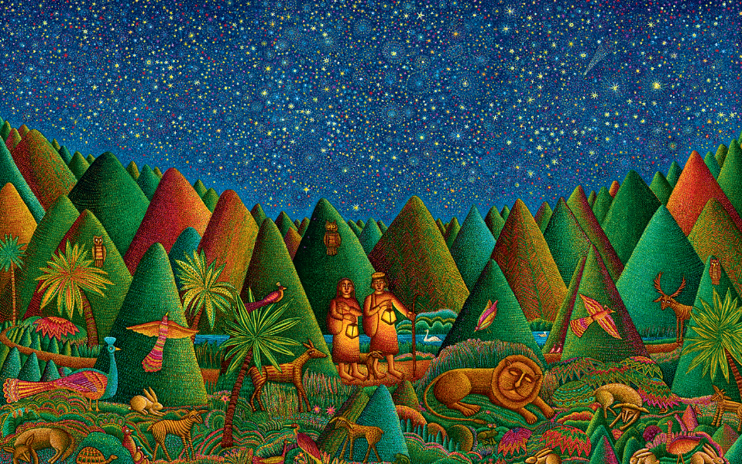
Psalm 23 -- John August Swanson, serigraph, 2010

Slide 12
On one occasion when Jesus was going to the house of a leader of the Pharisees to eat a meal on the sabbath, they were watching him closely.
Luke 14:1

Slide 13
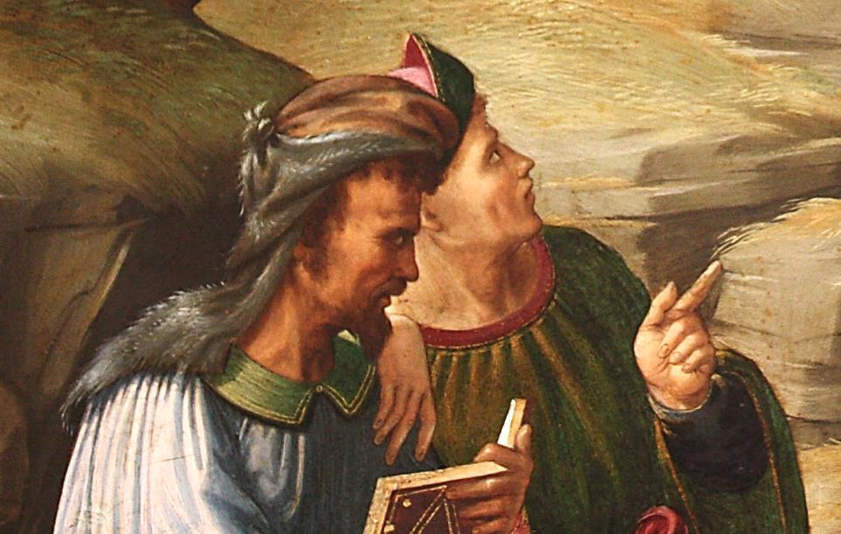
Pharisees, detail from John the Baptist Bearing Witness -- Francesco Granacci, Met Museum, New York

Slide 14
He said … to the one who had invited him, "When you give a luncheon or a dinner, do not invite your friends or your brothers or your relatives or rich neighbors …
Luke 14:12a

Slide 15
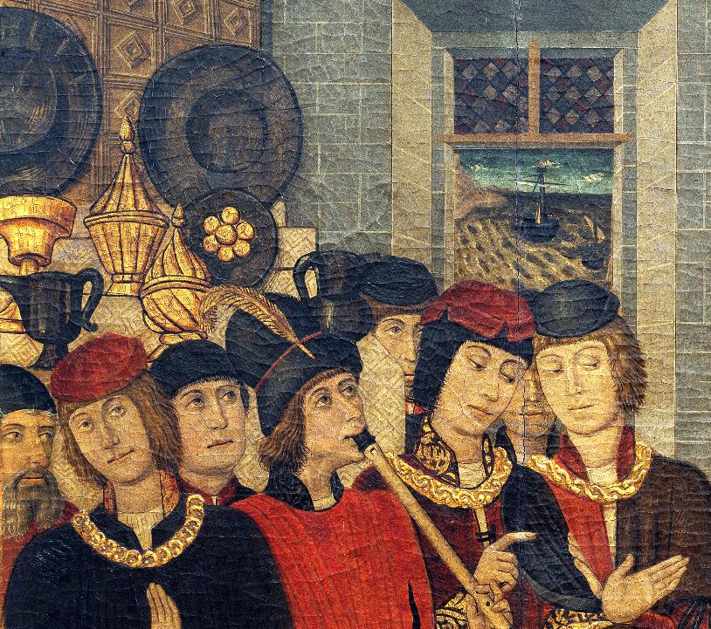
Guests, detail, Banquet of Herod
Pedro G. Benabarre
National Art Museum of Catalonia
Barcelona, Spain

Slide 16
But when you give a banquet, invite the poor, the crippled, the lame, and the blind.
Luke 14:13

Slide 17
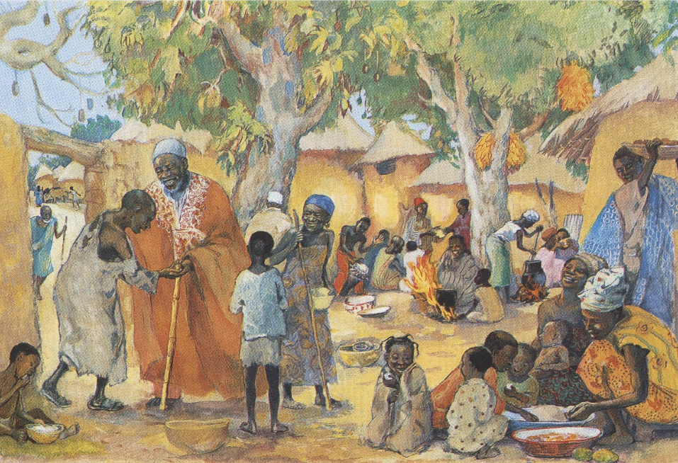
The Poor Invited to the Feast -- JESUS MAFA, Cameroon

Slide 18
And you will be blessed, because they cannot repay you, for you will be repaid at the resurrection of the righteous."
Luke 14:14

Slide 19
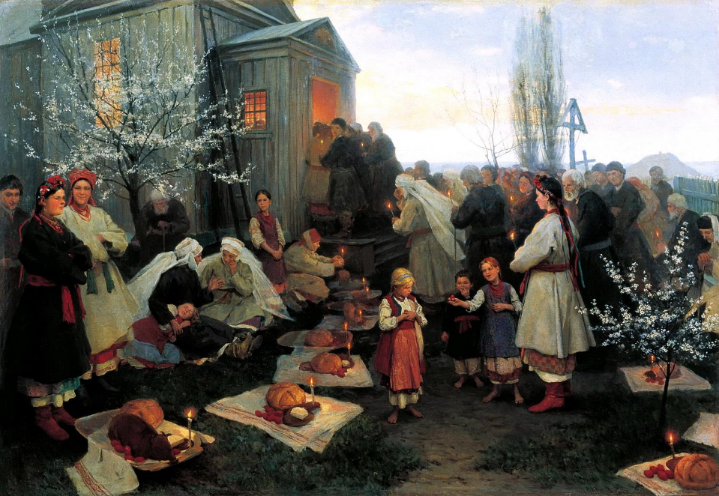
Waiting for the Blessing -- Mycola Pymonenko, Rybinsk Museum, Rybinsk, Russia

Slide 20
For all who exalt themselves will be humbled, and those who humble themselves will be exalted."
Luke 14:11

Slide 21
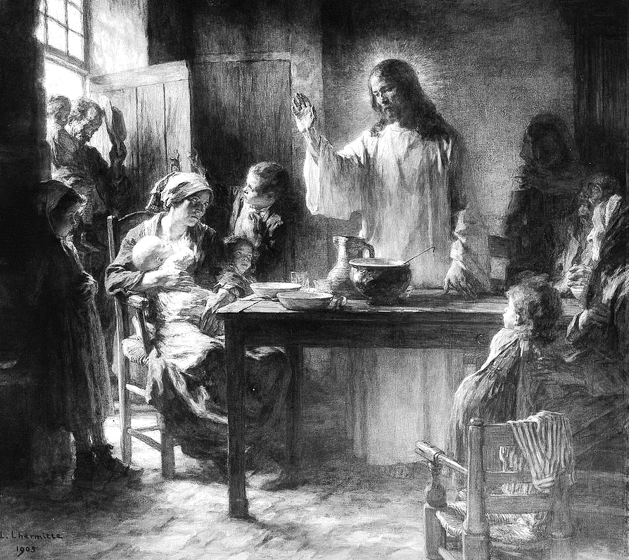
Among the Humble
Leon Lhermitte
Met Museum
New York

Slide 22
Credits
New Revised Standard Version Updated Edition Bible, copyright 2022, Division of Christian Education of the National Council of the Churches of Christ in the United States of America. Used by permission. All rights reserved.
https://www.flickr.com/photos/unamid-photo/6806932361/
https://commons.wikimedia.org/wiki/File:Sweet_Honey_in_the_Rock.jpg
https://commons.wikimedia.org/wiki/File:Abraham_entertainment_angels_MNMA_Cl19000.jpg
http://www.flickr.com/photos/leahbrooks/3966832626/
www.JohnAugustSwanson.com - copyright 2010 by John August Swanson
https://www.flickr.com/photos/peterjr1961/4826825691/ - Peter Roan
https://commons.wikimedia.org/wiki/File:Pedro_Garc%C3%ADa_de_Benabarre_and_workshop_-_Herod%27s_Banquet_-_Google_Art_Project.jpg
http://diglib.library.vanderbilt.edu/act-imagelink.pl?RC=48397
http://commons.wikimedia.org/wiki/File:PimonenkoNK_PashalZautrRYB.jpg
https://commons.wikimedia.org/wiki/File:Among_the_Humble_MET_ep05.38.bw.R.jpg
Additional descriptions can be found at the Art in the Christian Tradition image library, a service of the Vanderbilt Divinity Library, http://diglib.library.vanderbilt.edu/. All images available via Creative Commons 3.0 License.

