Slide 1
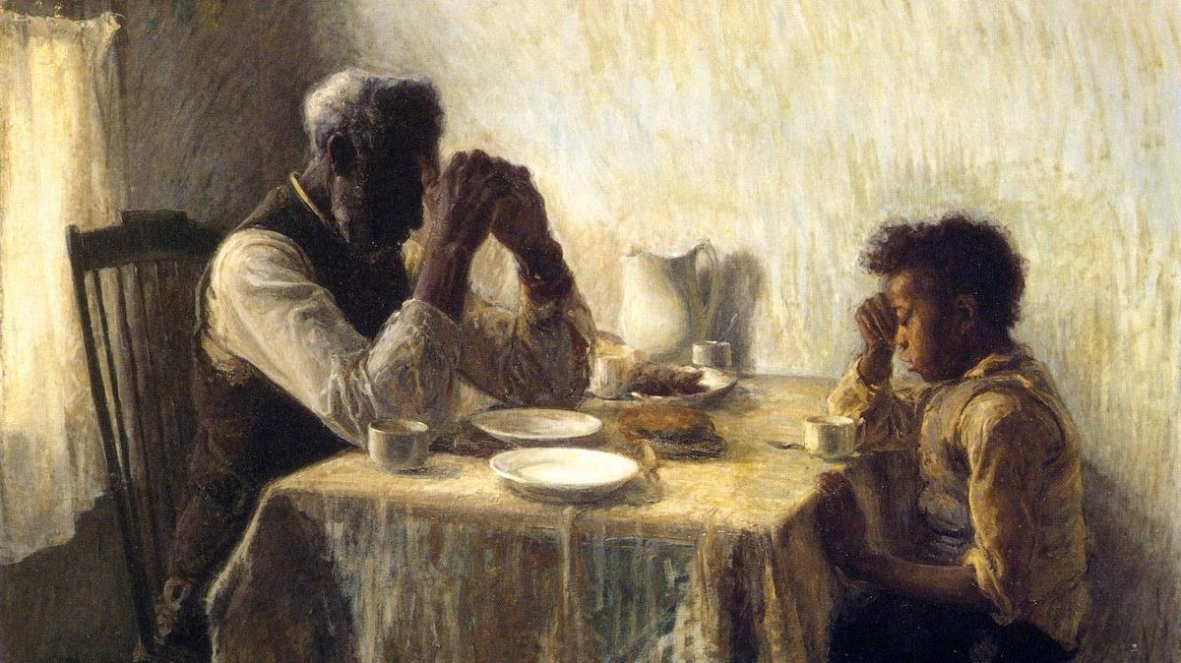
Eighth Sunday after Pentecost
Year C
Hosea 1:2-10 and Psalm 85 • Genesis 18:20-32 and Psalm 138 • Colossians 2:6-15, (16-19) • Luke 11:1-13

Slide 2
Yet the number of the people of Israel shall be like the sand of the sea … it shall be said to them, "Children of the living God."
Hosea 1:10ac

Slide 3
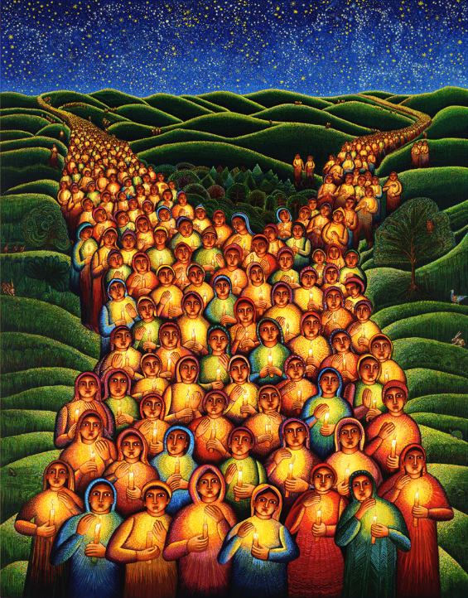
Festival of Lights
John August Swanson
Serigraph, 2000

Slide 4
Steadfast love and faithfulness will meet;
righteousness and peace will kiss each other.
Psalm 85:10

Slide 5
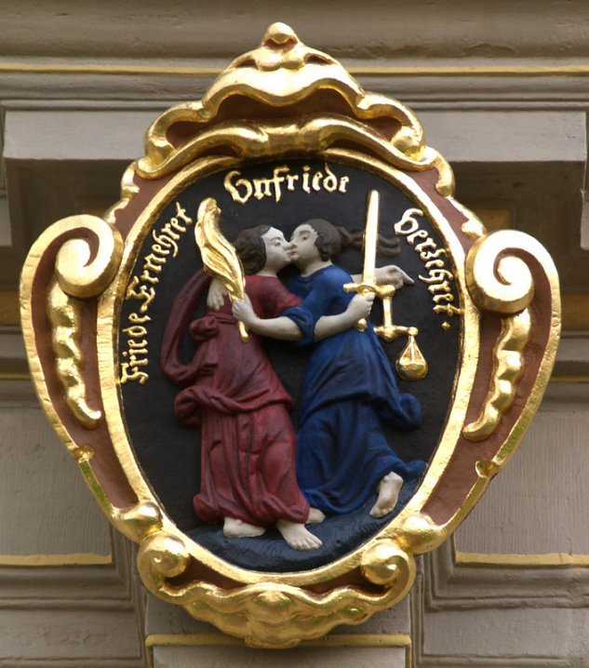
Justice and Peace Kissing
Schloss Friedenstein
Gotha, Germany

Slide 6
Abraham answered, "Let me take it upon myself to speak to the Lord, I who am but dust and ashes."
Genesis 18:27

Slide 7
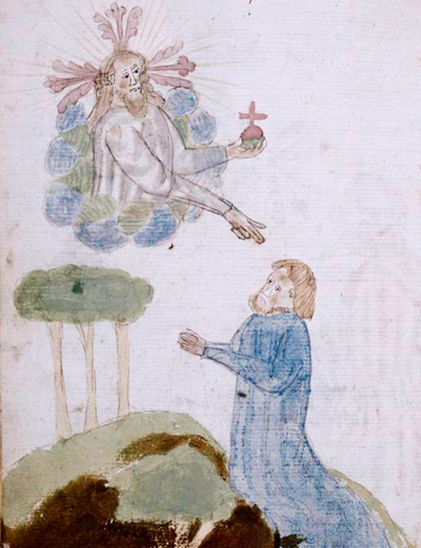
Abraham Speaks with God
Manuscript, 1445
New York Public Library
New York, NY

Slide 8
I give you thanks, O LORD, with my whole heart … On the day I called, you answered me, you increased my strength of soul.
Psalm 138:1a, 3

Slide 9
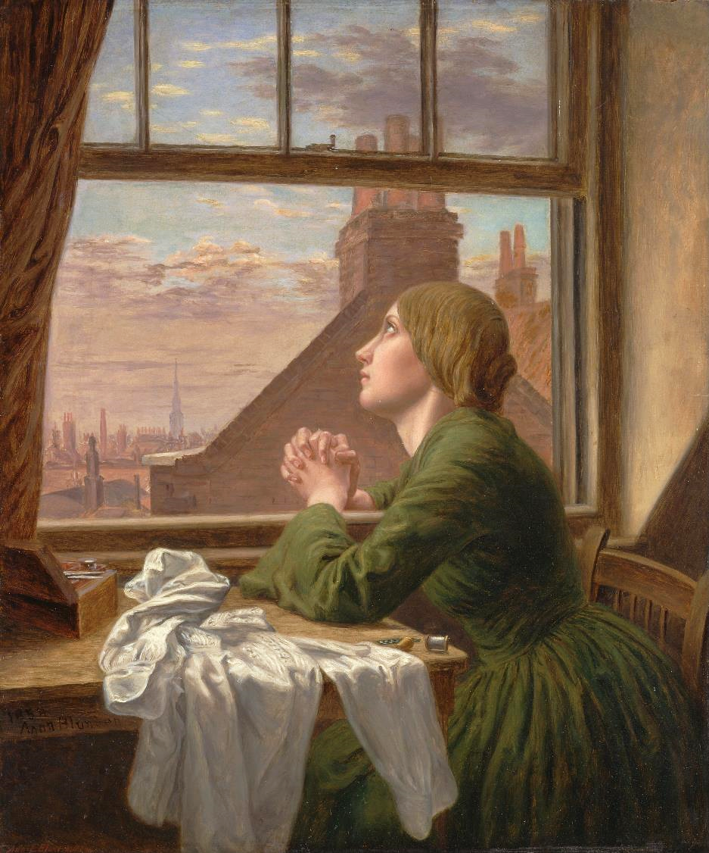
For Only One Short Hour (The Seamstress)
Anna Blunden Yale Center for British Art
New Haven, CT

Slide 10
…when you were buried with him in baptism, you were also raised with him through faith in the power of God …
Colossians 2:12a

Slide 11
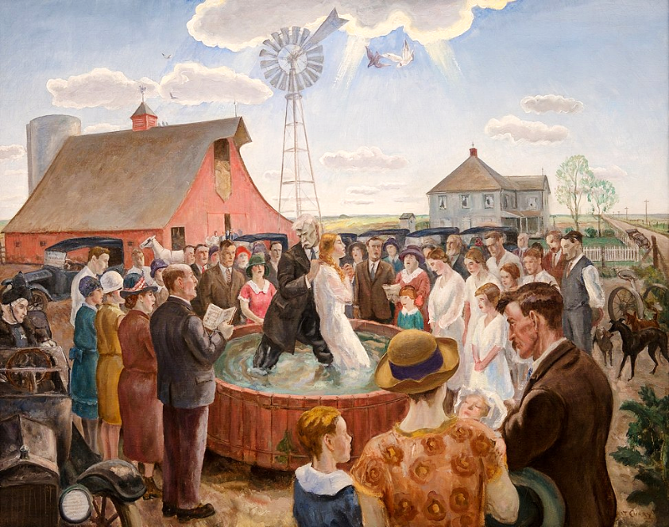
Baptism in Kansas -- John Steuart Curry, Whitney Museum, New York, NY

Slide 12
He said to them, "When you pray, say: Father, may your name be revered as holy. May your kingdom come.
Luke 11:2

Slide 13
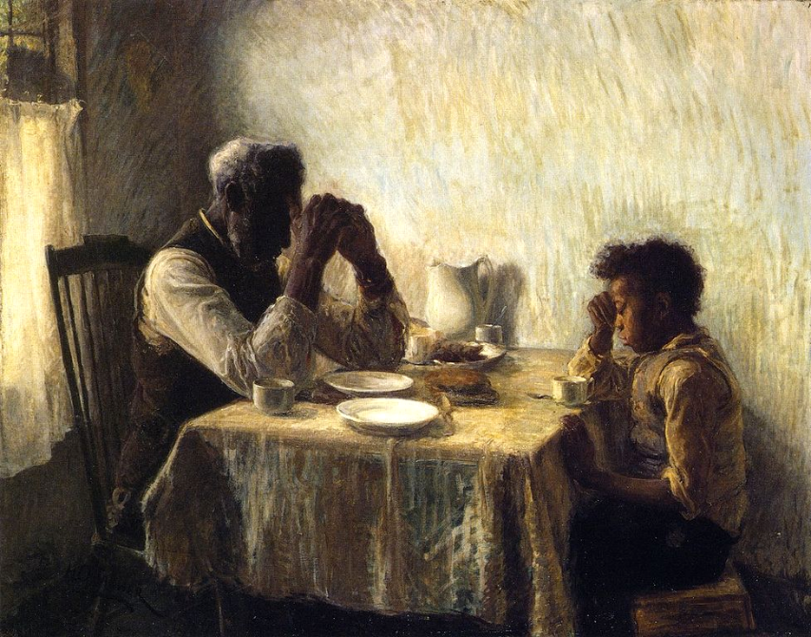
Thankful -- Henry Ossawa Tanner, 1894

Slide 14
Give us each day our daily bread.
Luke 11:3

Slide 15
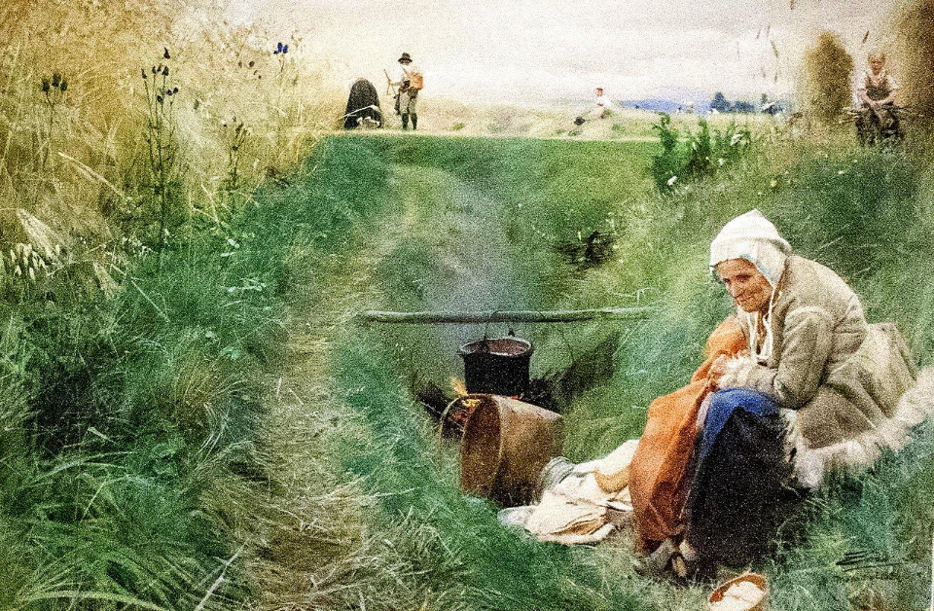
Our Daily Bread -- Anders Zorn, Nationalmuseum, Stockholm, Sweden

Slide 16
And forgive us our sins, for we ourselves forgive everyone indebted to us. And do not bring us to the time of trial."
Luke 11:4

Slide 17
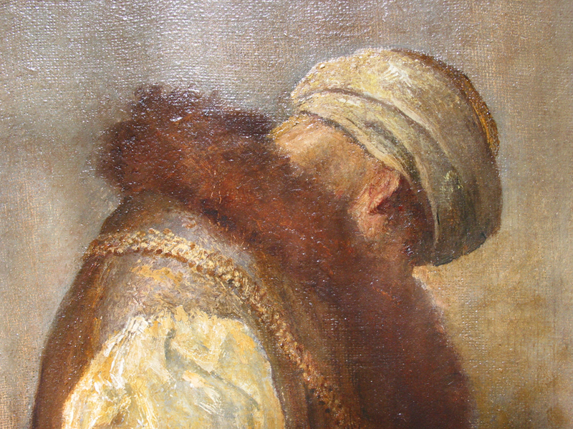
For He Had Great Possessions -- George Watts, Tate Britain, London, UK

Slide 18
"… Ask, and it will be given you; search, and you will find; knock, and the door will be opened for you.
Luke 11:9b

Slide 19
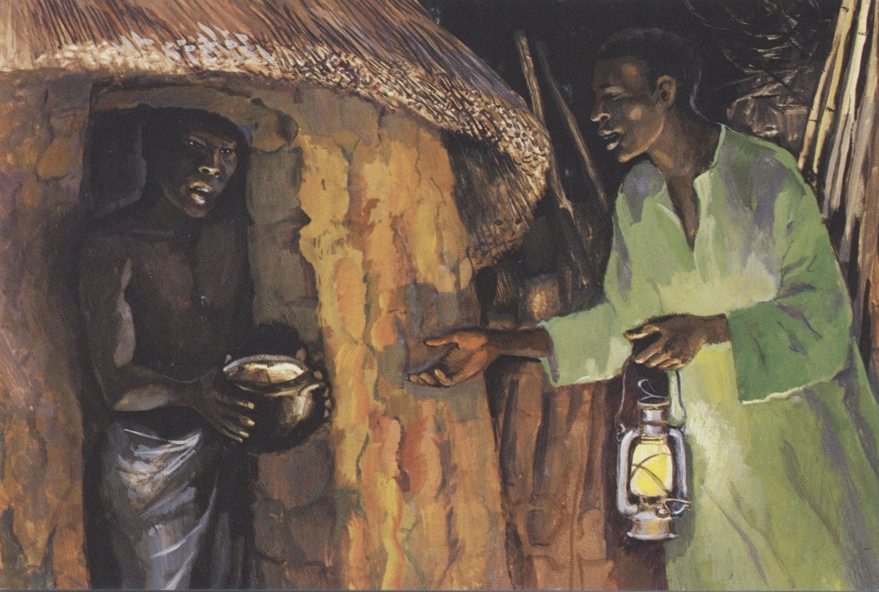
The Persistent Friend -- JESUS MAFA, Cameroon

Slide 20
For everyone who asks receives, and everyone who searches finds, and for everyone who knocks, the door will be opened."
Luke 11:10

Slide 21
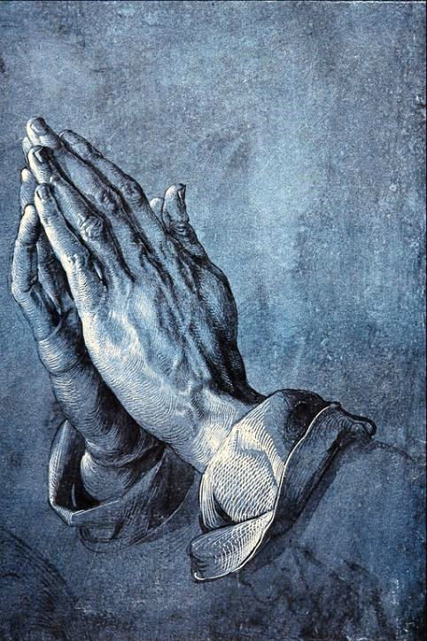
Study for Praying Apostle
Albrecht Durer
Albertina Museum
Vienna, Austria

Slide 22
Credits
New Revised Standard Version Updated Edition Bible, copyright 2022, Division of Christian Education of the National Council of the Churches of Christ in the United States of America. Used by permission. All rights reserved.
www.JohnAugustSwanson.com - copyright 2000 by John August Swanson
http://commons.wikimedia.org/wiki/File:Friedenskuss.jpg
https://commons.wikimedia.org/wiki/File:Rubric_and_full-page_miniature_of_God_and_Abraham_(NYPL_b12455533-426528).tifhttps://commons.wikimedia.org/wiki/File:Summer_evening_at_Skagen_-_P.S._Kr%C3%B8yer_-_Google_Cultural_Institute.jpg
https://commons.wikimedia.org/wiki/File:Ursula_Malbin_sculpture_garden_in_Haifa_02.jpg
https://commons.wikimedia.org/wiki/File:John_Steuart_Curry,_Baptism_in_Kansas,_1928_1_15_18_-whitneymuseum_(40349039654).jpg
https://commons.wikimedia.org/wiki/File:The_Thankful_Poor,_1894._Henry_Ossawa_Tanner.jpg
http://commons.wikimedia.org/wiki/File:Zorn_-_Our_Daily_Bread.jpg
https://www.flickr.com/photos/oxfordshire_church_photos/413448324 - Martin Beek
http://diglib.library.vanderbilt.edu/act-imagelink.pl?RC=48293
https://commons.wikimedia.org/wiki/File:Praying_Hands_-_Albrecht_Durer.png
Additional descriptions can be found at the Art in the Christian Tradition image library, a service of the Vanderbilt Divinity Library, http://diglib.library.vanderbilt.edu/. All images available via Creative Commons 3.0 License.

