Slide 1
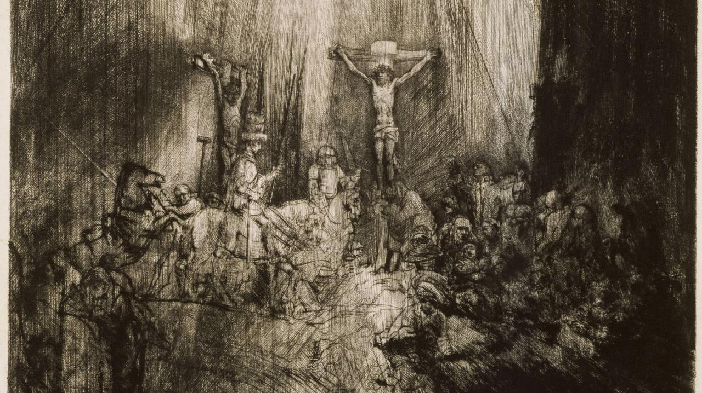
LITURGY OF THE PASSION
Year C
Isaiah 50:4-9a • Psalm 31:9-16 • Philippians 2:5-11 • Luke 22:14-23:56 or Luke 23:1-49

Slide 2
For I hear the whispering of many-- terror all around! … But I trust in you, O LORD; I say, "You are my God."
Psalm 31:13a, 14

Slide 3
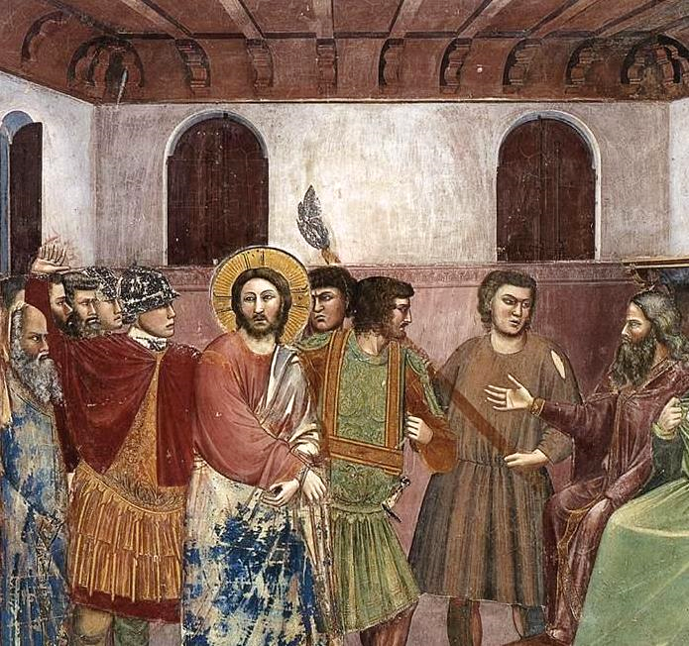
Christ before Caiaphas -- Giotto Scrovegni Chapel, Padua, Italy

Slide 4
Christ Jesus, … though he existed in the form of God, … humbled himself and became obedient to the point of death-- even death on a cross.
Philippians 2:5b, 6a, 8

Slide 5
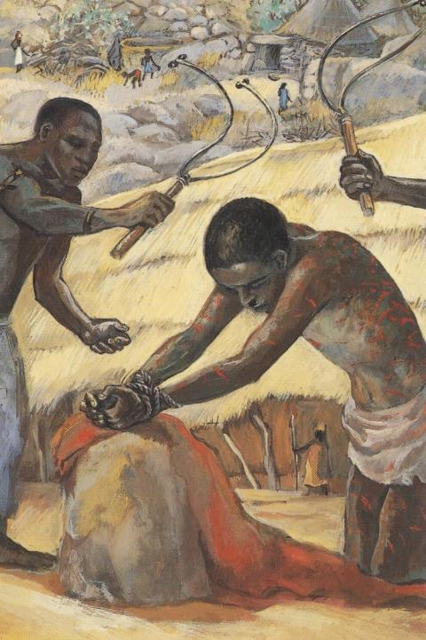
The Flagellation
JESUS MAFA
Cameroon

Slide 6
A great number of the people followed him, and among them were women who were beating their breasts and wailing for him.
Luke 23:27

Slide 7
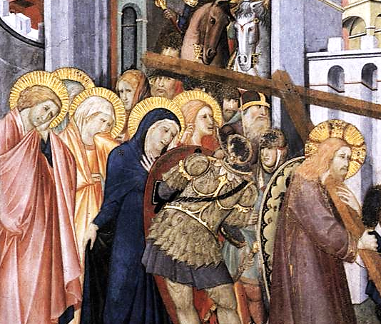
Road to Calvary -- Pietro Lorenzetti, Basilica of San Francesco, Assisi, Italy

Slide 8
But Jesus turned to them and said, "Daughters of Jerusalem, do not weep for me, but weep for yourselves and for your children."
Luke 23:28

Slide 9
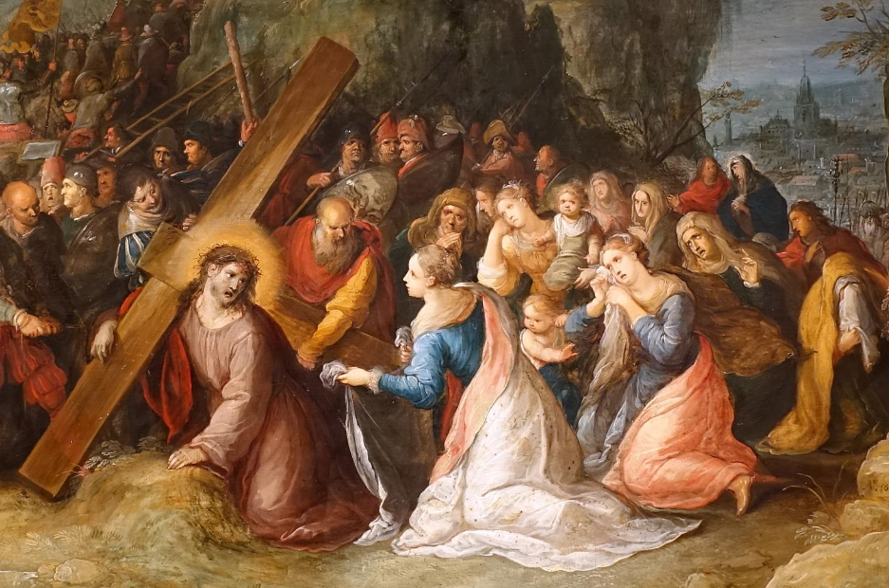
Christ on the Road to Calvary -- Frans Francken II, Princeton University Art Museum, Princeton, NJ

Slide 10
When they came to the place that is called The Skull, they crucified Jesus there with the criminals, one on his right and one on his left.
Luke 23:33

Slide 11
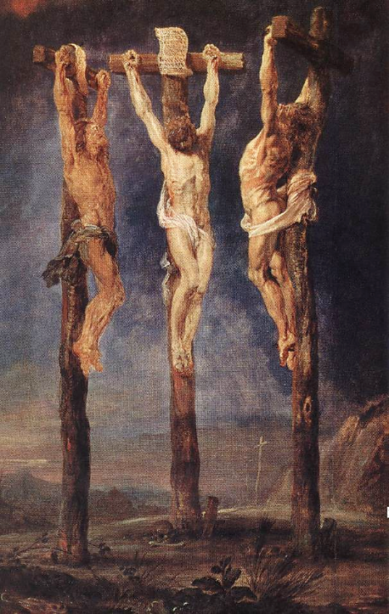
The Three Crosses
Peter Paul Rubens
Museum Boijmans Van Beuningen
Rotterdam, Netherlands

Slide 12
Then Jesus said, "Father, forgive them; for they do not know what they are doing." And they cast lots to divide his clothing.
Luke 23:34

Slide 13
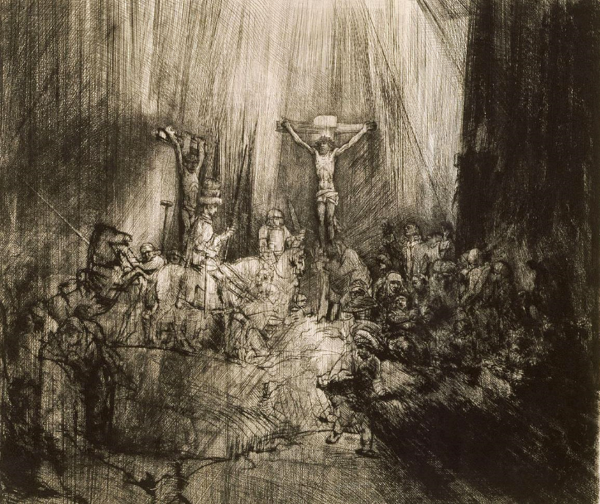
The Three Crosses
Rembrandt Princeton University Museum of Art Princeton, NJ

Slide 14
One of the criminals … said, "Jesus, remember me when you come into your kingdom."
Luke 23:39a, 42

Slide 15
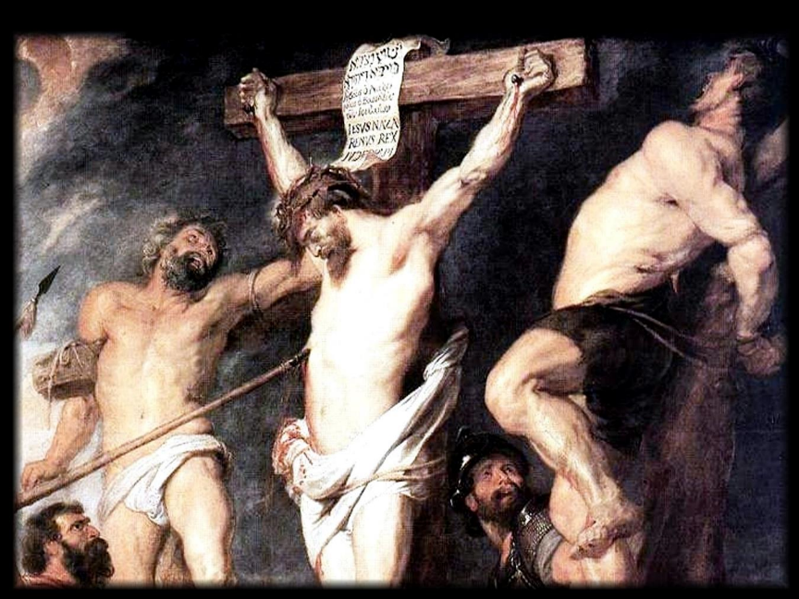
Crucifixion, detail -- Peter Paul Rubens, Royal Museum of Arts, Antwerp, Belgium

Slide 16
He replied, "Truly I tell you, today you will be with me in Paradise."
Luke 23:43

Slide 17
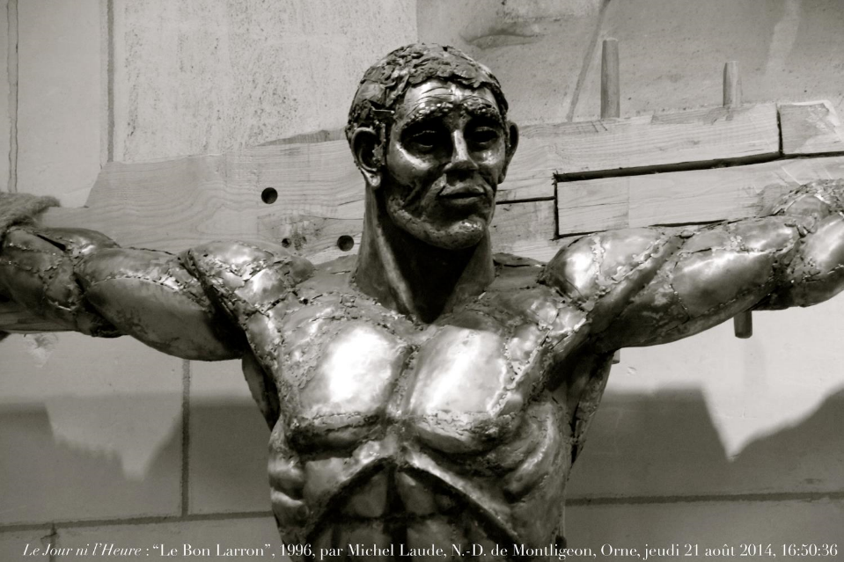
The Repentant Thief -- Michel Laude, Notre-Dame de Montligeon, Orne, France

Slide 18
It was now about noon, and darkness came over the whole land until three in the afternoon,
Luke 23:44

Slide 19
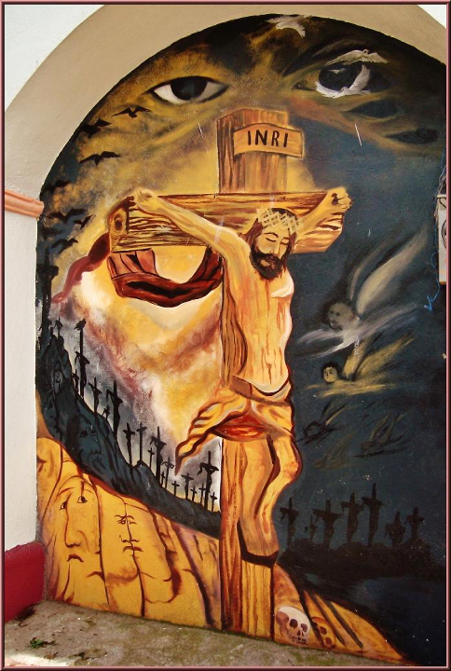
Crucifixion
Tenancingo Cathedral
Tenancingo, Mexico

Slide 20
while the sun's light failed; and the curtain of the temple was torn in two.
Luke 23:45

Slide 21
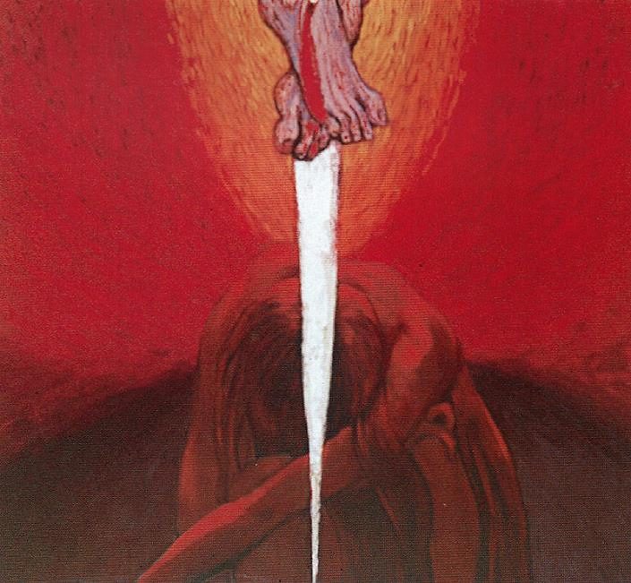
Crucifixion -- Frank Wesley

Slide 22
Then Jesus, crying with a loud voice, said, "Father, into your hands I commend my spirit."
Luke 23:46a

Slide 23
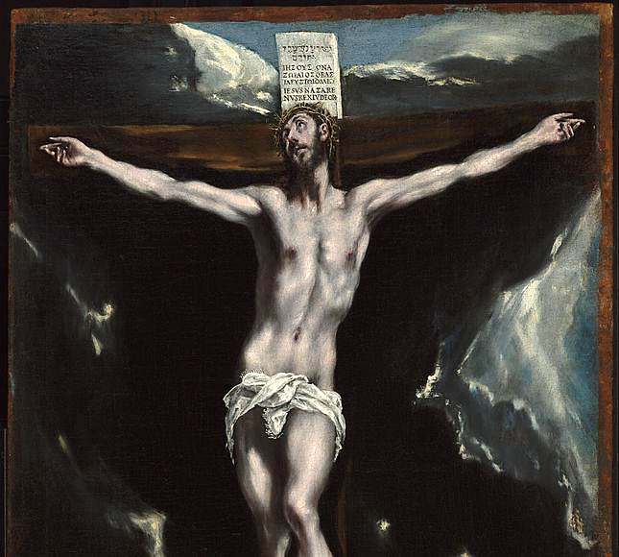
Christ on the Cross
El Greco
Getty Center
Los Angeles, CA

Slide 24
Having said this, he breathed his last.
Luke 23:46b

Slide 25
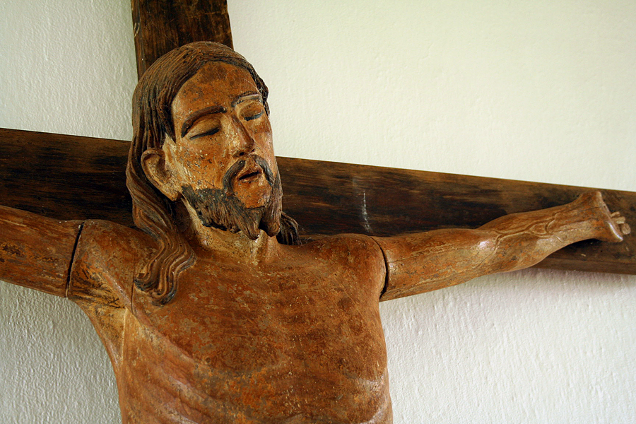
Guarani Crucifixion -- Church of St. Miguel Arcanjo, St. Miguel, Brazil
Notes:
,c

Slide 26
Credits
New Revised Standard Version Updated Edition Bible, copyright 2022, Division of Christian Education of the National Council of the Churches of Christ in the United States of America. Used by permission. All rights reserved.
https://commons.wikimedia.org/wiki/File:Giotto_di_Bondone_-_No._32_Scenes_from_the_Life_of_Christ_-_16._Christ_before_Caiaphas_-_WGA09217.jpg
http://diglib.library.vanderbilt.edu/act-imagelink.pl?RC=48274
https://commons.wikimedia.org/wiki/File:Pietro_Lorenzetti_-_The_Road_to_Calvary_-_WGA13511.jpg
https://commons.wikimedia.org/wiki/File:Road_to_Calvary,_by_Frans_Francken_II,_Flemish,_1617,_oil_on_wood_panel_-_Princeton_University_Art_Museum_-_DSC06590.jpg
https://commons.wikimedia.org/wiki/File:Peter_Paul_Rubens_The_Three_Crosses.jpg
https://commons.wikimedia.org/wiki/File:Christ_Crucified_between_the_Two_Thieves_(The_Three_Crosses).jpg
https://www.flickr.com/photos/wipipip/16955620456 - Stephen R. Dalrymple
https://www.flickr.com/photos/renaud-camus/16495273690
https://commons.wikimedia.org/wiki/File:Parroquia_de_la_Asunci%C3%B3n_de_Mar%C3%ADa_(Coatepec_Harinas)_Estado_de_M%C3%A9xico,M%C3%A9xico.jpg
Estate of Frank Wesley, http://www.frankwesleyart.com/main_page.htm
https://commons.wikimedia.org/wiki/File:El_Greco_(Domenico_Theotocopuli)_-_Christ_on_the_Cross_-_Google_Art_Project.jpg
http://www.flickr.com/photos/mathieustruck/410120430/
Additional descriptions can be found at the Art in the Christian Tradition image library, a service of the Vanderbilt Divinity Library, http://diglib.library.vanderbilt.edu/. All images available via Creative Commons 3.0 License.

