Slide 1
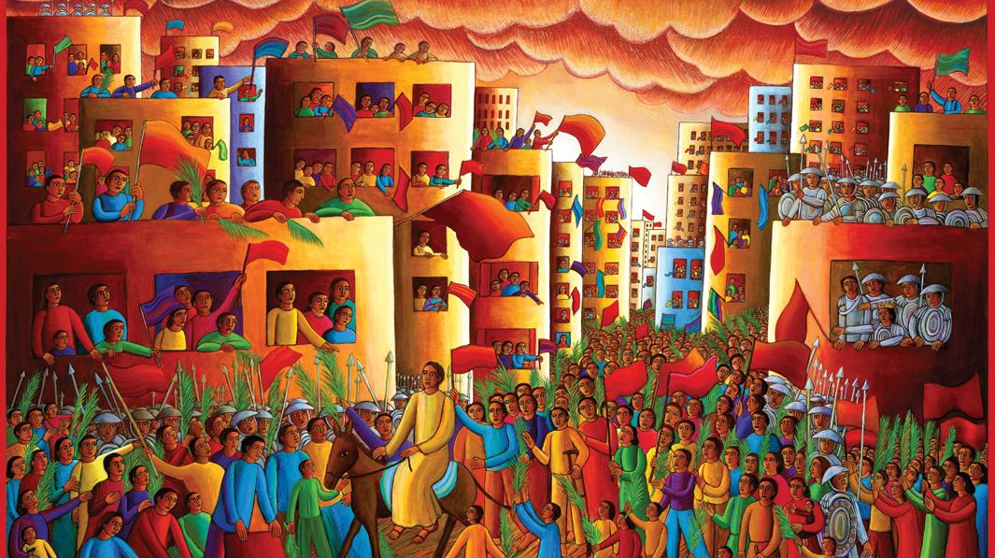
LITURGY OF THE PALMS
Year C
Psalm 118:1-2, 19-29 • Luke 19:28-40

Slide 2
Open to me the gates of righteousness, that I may enter through them and give thanks to the LORD.
Psalm 118:19

Slide 3
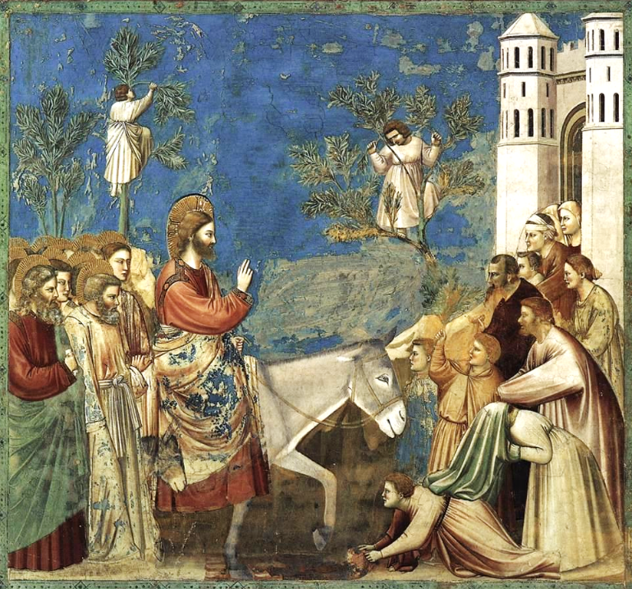
Entry into Jerusalem
Giotto
Scrovegni Chapel
Padua, Italy

Slide 4
The LORD is God, and he has given us light. Bind the festal procession with branches …
Psalm 118:27a

Slide 5
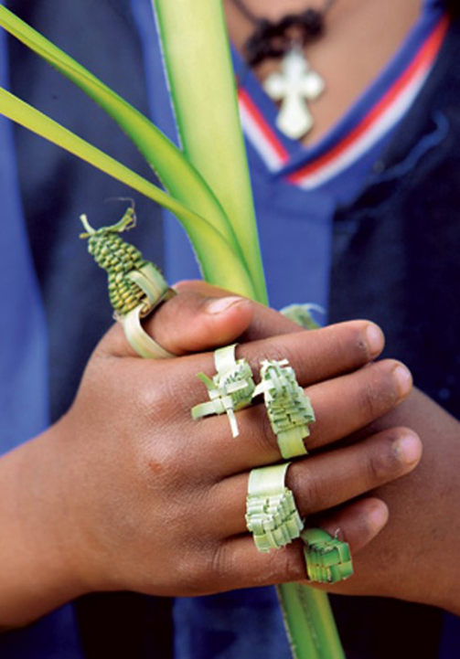
Palm Leaf Rings for Hosanna (Palm Sunday)
Ethiopia

Slide 6
"Go into the village ahead of you, and as you enter it you will find tied there a colt that has never been ridden. Untie it and bring it here."
Luke 19:30

Slide 7
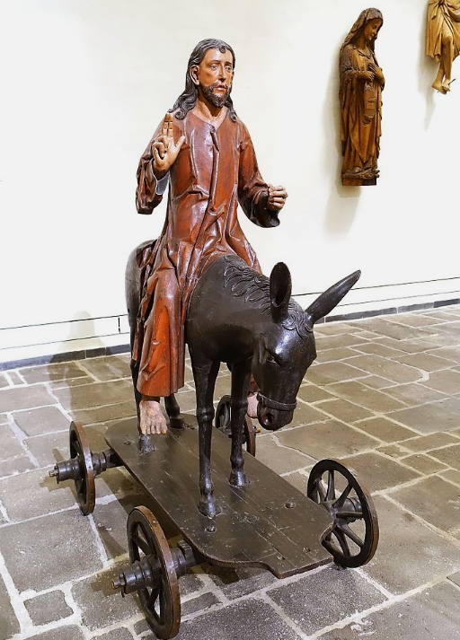
Christ on Donkey for Palm Sunday Procession
Museum Schnütgen
Cologne, Germany

Slide 8
If anyone asks you, 'Why are you untying it?' just say this, 'The Lord needs it.'"
Luke 19:31

Slide 9
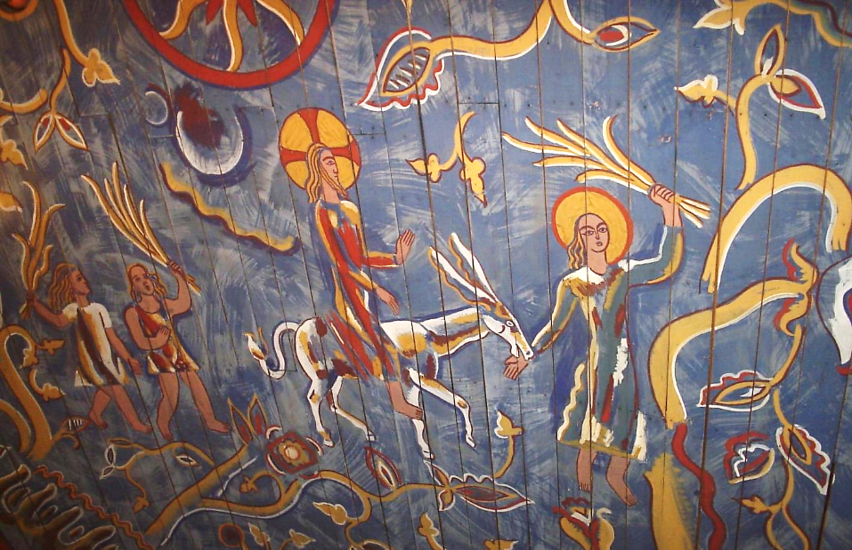
Christ on the Colt -- Church of Saint Matthew, Methodist Assembly, Goteborg, Sweden

Slide 10
Then they brought it to Jesus; and after throwing their cloaks on the colt, they set Jesus on it.
Luke 19:35

Slide 11
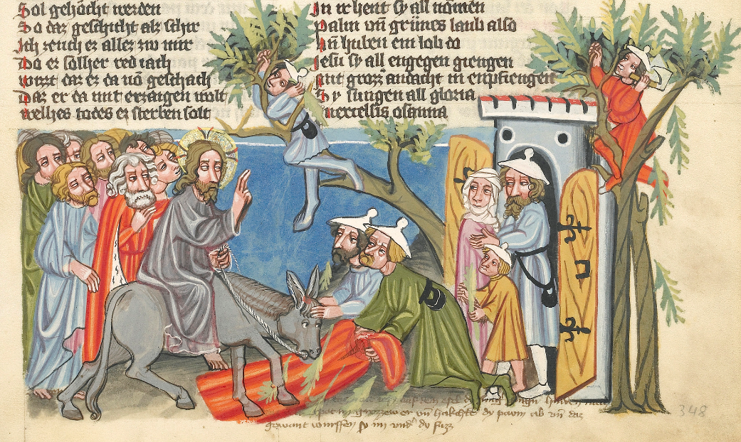
Entry into Jerusalem -- Rudolf von Ems, Weltchronik, Getty Museum, Los Angeles, CA

Slide 12
As he rode along, people kept spreading their cloaks on the road.
Luke 19:36

Slide 13
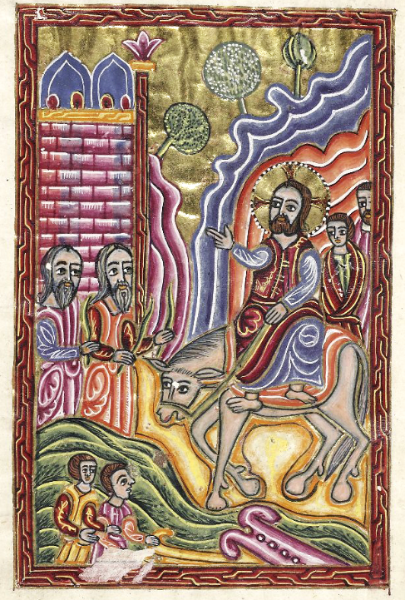
Entry into Jerusalem
Armenian 17th c. manuscript
Bodleian Library
Oxford, England

Slide 14
the whole multitude of the disciples began to praise God joyfully with a loud voice for all the deeds of power that they had seen,
Luke 19:37b

Slide 15
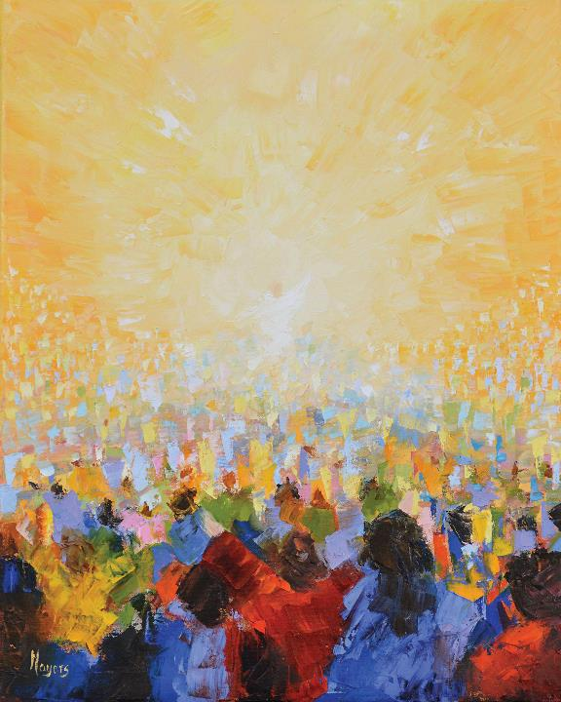
Hallelujah!
Mike Moyers

Slide 16
saying, "Blessed is the king who comes in the name of the Lord! Peace in heaven, and glory in the highest heaven!"
Luke 19:38

Slide 17
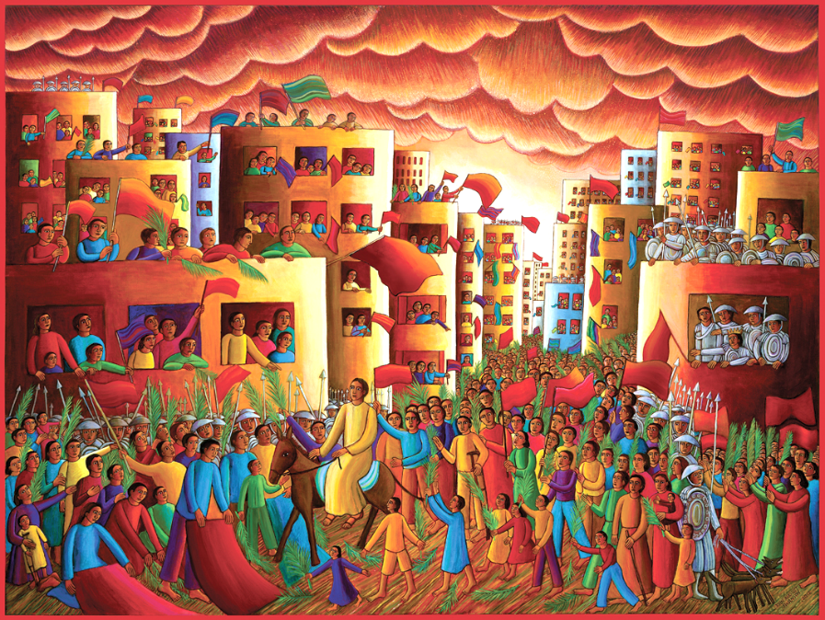
Entry into Jerusalem -- John August Swanson, Serigraph, 1990

Slide 18
Some of the Pharisees in the crowd said to him, "Teacher, order your disciples to stop."
Luke 19:39

Slide 19
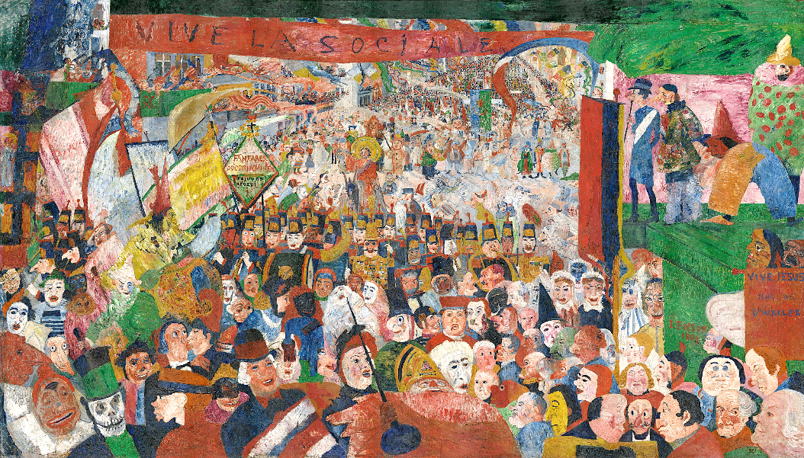
Christ's Entry into Brussels, 1889 -- James Ensor, Getty Museum, Los Angeles, CA

Slide 20
He answered, "I tell you, if these were silent, the stones would shout out."
Luke 19:40

Slide 21
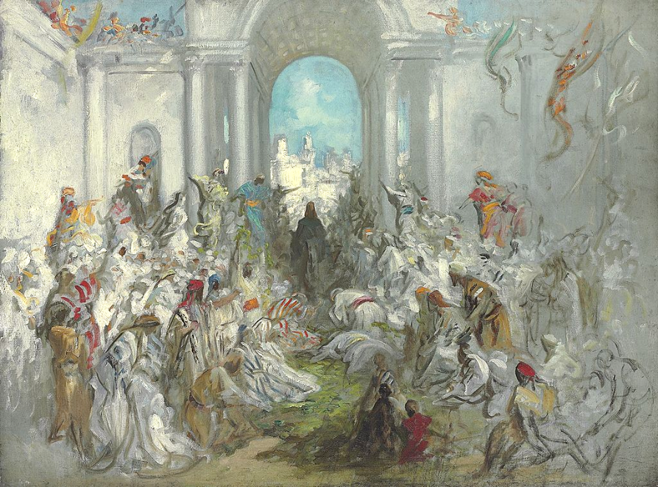
Entry into Jerusalem -- Gustave Dore, Clark Art Institute, Williamstown, MA

Slide 22
Credits
New Revised Standard Version Updated Edition Bible, copyright 2022, Division of Christian Education of the National Council of the Churches of Christ in the United States of America. Used by permission. All rights reserved.
https://commons.wikimedia.org/wiki/File:Giotto_di_Bondone_-_No._26_Scenes_from_the_Life_of_Christ_-_10._Entry_into_Jerusalem_-_WGA09206.jpg
https://commons.wikimedia.org/wiki/File:Hosana_Rings.jpg
https://commons.wikimedia.org/wiki/File:Christ_upon_the_Donkey_for_the_Palm_Procession,_Cologne,_c._1520,_limewood_and_softwood,_polychrome_-_Museum_Schn%C3%BCtgen_-_Cologne,_Germany_-_DSC00072.jpg
https://commons.wikimedia.org/wiki/File:Sankt_Matteus_kyrka_(Metodistf%C3%B6rsamling)_i_Kvillestan_p%C3%A5_Hisingen_i_G%C3%B6teborg,_den_6_sept_2006,_bild_16.JPG
https://commons.wikimedia.org/wiki/File:Folio_173v_-_The_Entry_into_Jerusalem.jpg
https://commons.wikimedia.org/wiki/File:Bodleian_Library_MS._Arm._d.13._Armenian_Gospels-0013-0.jpg
Mike Moyers, https://www.mikemoyersfineart.com/
www.JohnAugustSwanson.com - copyright 1990 by John August Swanson
https://commons.wikimedia.org/wiki/File:Christ%27s_Entry_into_Brussels_in_1889.jpg
https://commons.wikimedia.org/wiki/File:Gustave_Dor%C3%A9_-_Christ%27s_Entry_into_Jerusalem.jpg
Additional descriptions can be found at the Art in the Christian Tradition image library, a service of the Vanderbilt Divinity Library, http://diglib.library.vanderbilt.edu/. All images available via Creative Commons 3.0 License.

