Slide 1
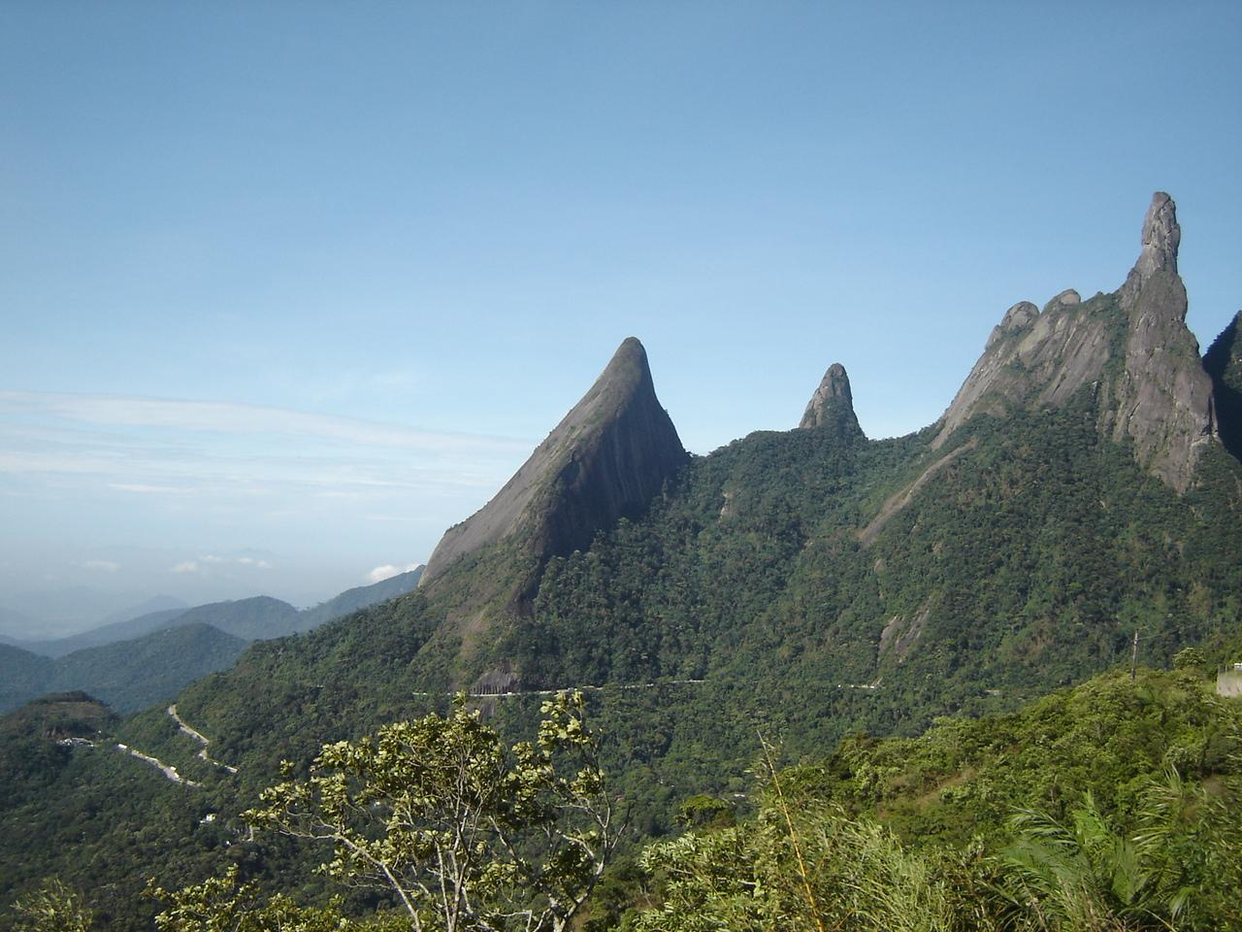
Holy Cross
Year C
Numbers 21:4b-9 and Psalm 98:1-5 or Psalm 78:1-2, 34-38 • 1 Corinthians 1:18-24 • John 3:13-17

Slide 2
The people came to Moses and said, "We have sinned by speaking against the LORD and against you" … So Moses prayed for the people.
Numbers 21:7ac

Slide 3
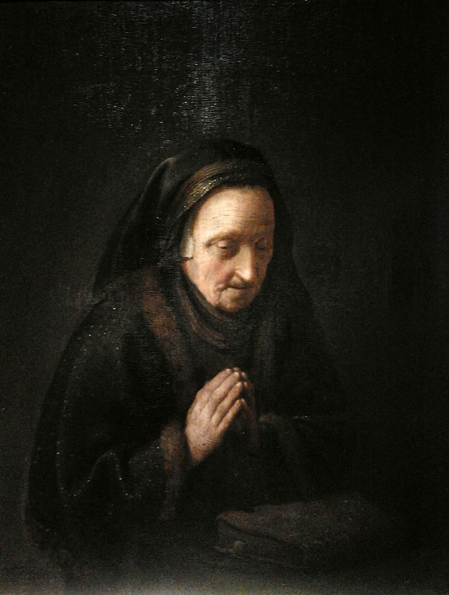
Old Woman in Prayer
Gerrit Dou
National Museum
Warsaw, Poland

Slide 4
Make a joyful noise to the LORD, all the earth; break forth into joyous song and sing praises.
Psalm 98:4

Slide 5
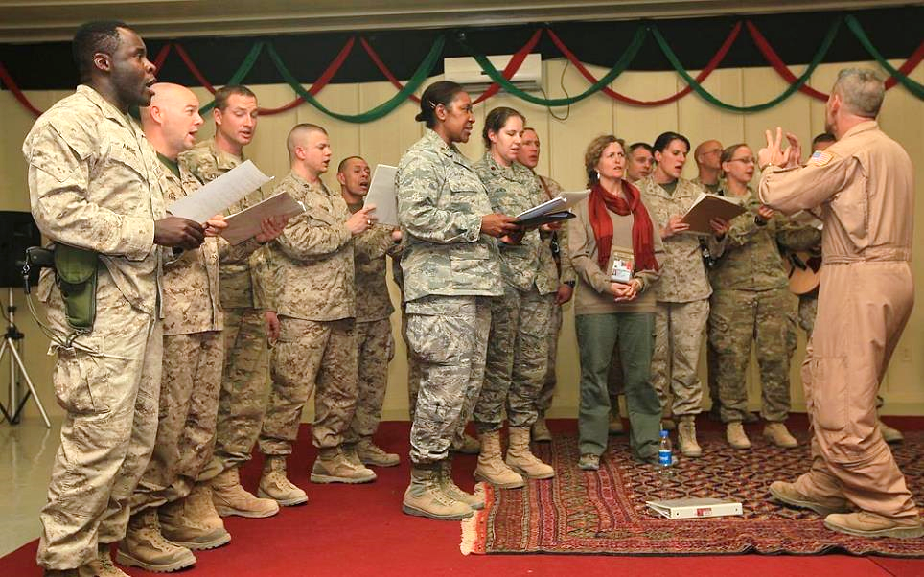
Christmas Choir, US Armed Forces -- Afghan Cultural Center, Helmand, Afghanistan

Slide 6
They remembered that God was their rock, the Most High God their redeemer.
Psalm 78:35

Slide 7
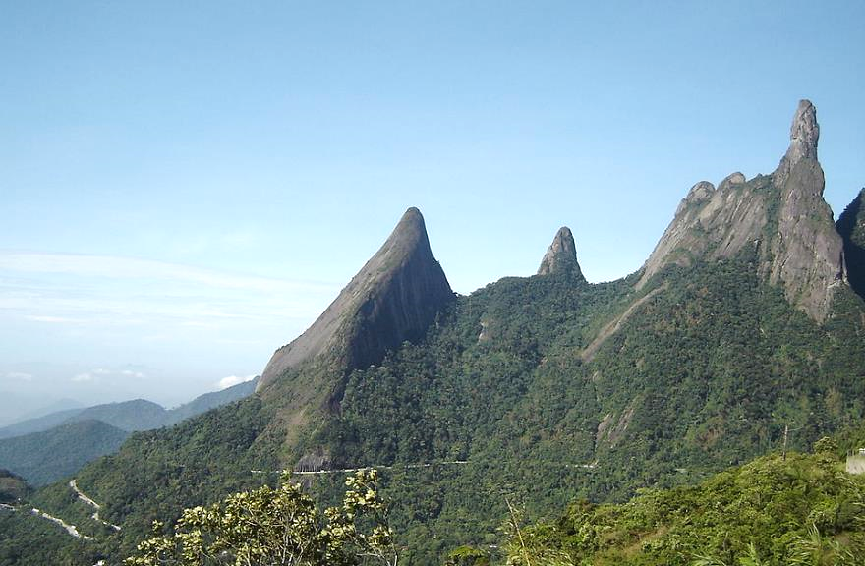
The Finger of God Rock Formation -- Teresopolis, Brazil

Slide 8
but we proclaim Christ crucified … Christ the power of God and the wisdom of God.
1 Corinthians 1:23a, 24b

Slide 9
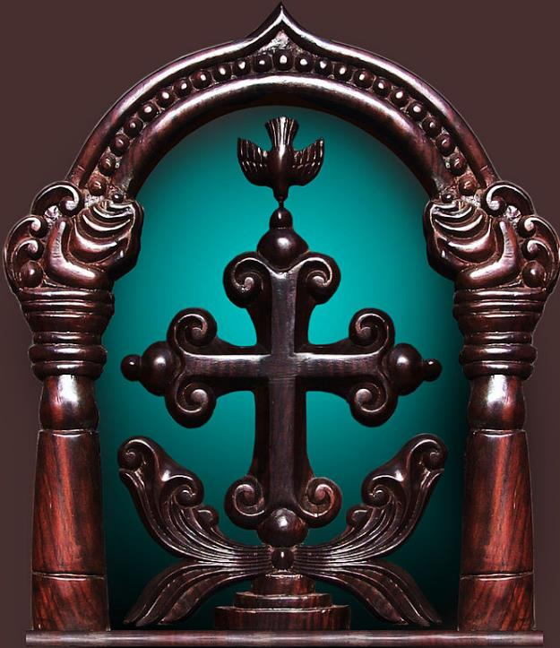
Mar Thoma Sliva Cross
Kerala, India

Slide 10
"For God so loved the world that he gave his only Son,
John 3:16a

Slide 11
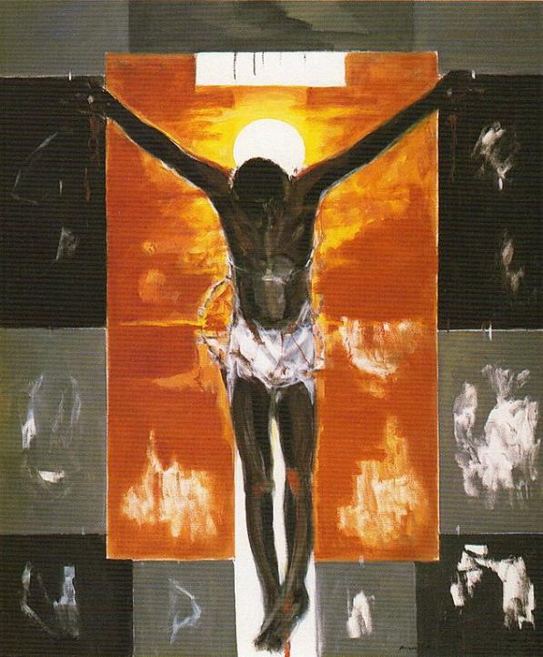
Cristo Negro
Ruiz Anglada
Sastago Palace
Zaragoza, Spain

Slide 12
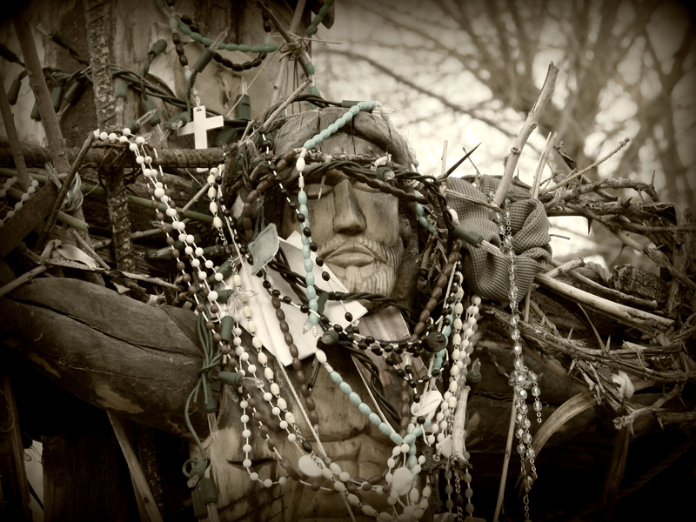
Crucifixion -- Chimayo, New Mexico

Slide 13
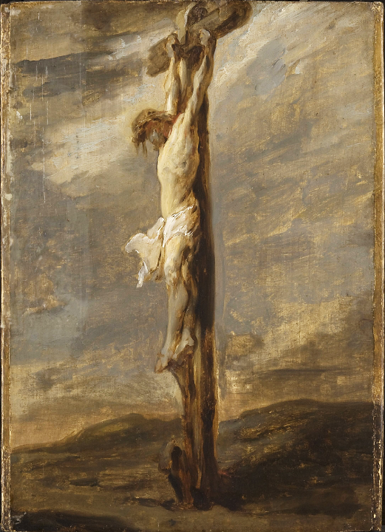
Crucifixion
Rembrandt Philadelphia Museum of Art
Philadelphia, PA

Slide 14
so that everyone who believes in him may not perish but may have eternal life.
John 3:16b

Slide 15
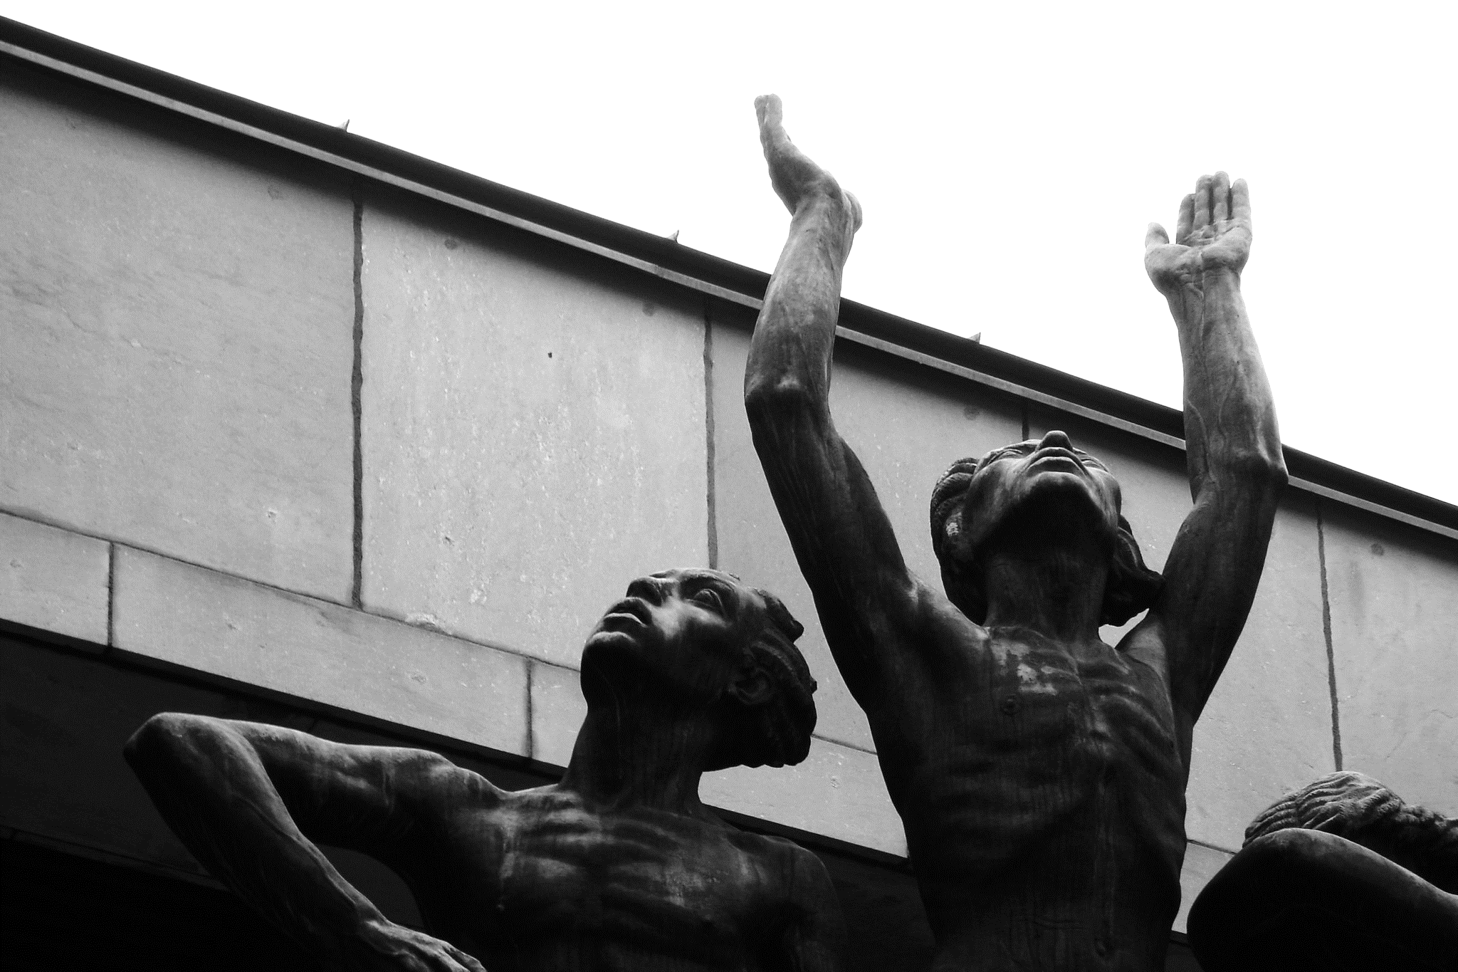
Resurrection -- John Lundquist, Stockholm, Sweden

Slide 16
Indeed, God did not send the Son into the world to condemn the world,
John 3:17a

Slide 17
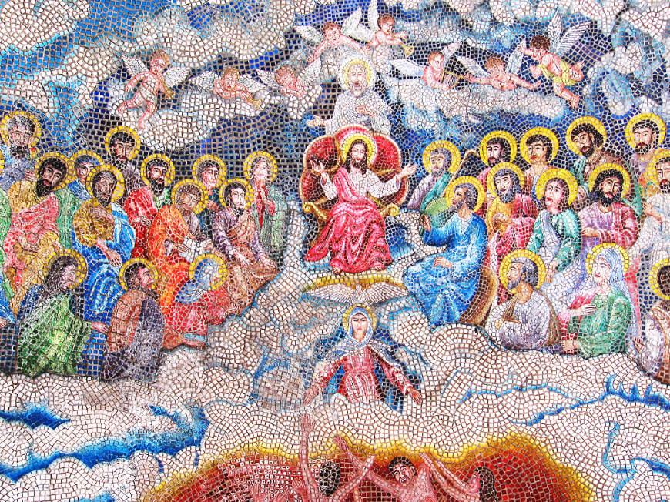
Heaven-- Tigbauan Church, Iloilo, Philippines

Slide 18
… but in order that the world might be saved through him.
John 3:17b

Slide 19
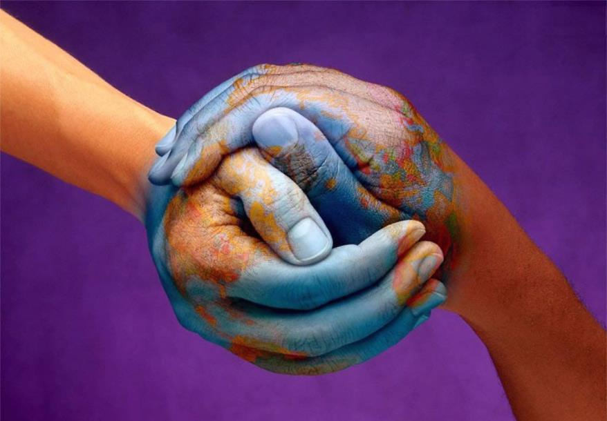
Hands of the World -- Non-profit "Movement for Peace" graphic

Slide 20
Credits
New Revised Standard Version Bible, copyright 1989, Division of Christian Education of the National Council of the Churches of Christ in the United States of America. Used by permission. All rights reserved.
https://commons.wikimedia.org/wiki/File:Dou_Old_woman_in_prayer.jpg
https://commons.wikimedia.org/wiki/File:Christmas_brings_Afghan_and_coalition_partners_together_111226-M-DF801-013.jpg
https://commons.wikimedia.org/wiki/File:Teresopolis007.jpg - FabioMr
https://commons.m.wikimedia.org/wiki/File:Mar_Thoma_Sliva.jpg
https://commons.wikimedia.org/wiki/File:Ruizanglada_-_Cristo_Negro_180x150_1995_A-L_-_Catalogo_1995_Palacio_de_Sastago_Zaragoza.jpg
http://www.flickr.com/photos/santafesweets/2386475728/
https://commons.wikimedia.org/wiki/File:Rembrandt_-_The_Crucifixion_-_Cat478.jpg
https://www.flickr.com/photos/dyntr/49998869977 - Neil MacWilliams
https://www.flickr.com/photos/quaknit/414242160/ - Mike Alda
http://www.movementforpeaceglobal.org/
Additional descriptions can be found at the Art in the Christian Tradition image library, a service of the Vanderbilt Divinity Library, http://diglib.library.vanderbilt.edu/. All images available via Creative Commons 3.0 License.

