Slide 1
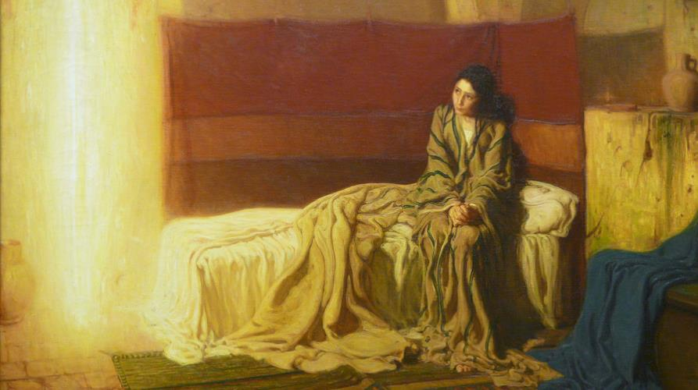
FOURTH SUNDAY OF ADVENT
Year C
Micah 5:2-5a • Luke 1:46b-55 or Psalm 80:1-7 • Hebrews 10:5-10 Luke 1:39-45, (46-55)

Slide 2
But you, O Bethlehem … when she who is in labor has brought forth … from you shall come forth … the one of peace …
Micah 5:2a, 3b, 2b, 5c

Slide 3
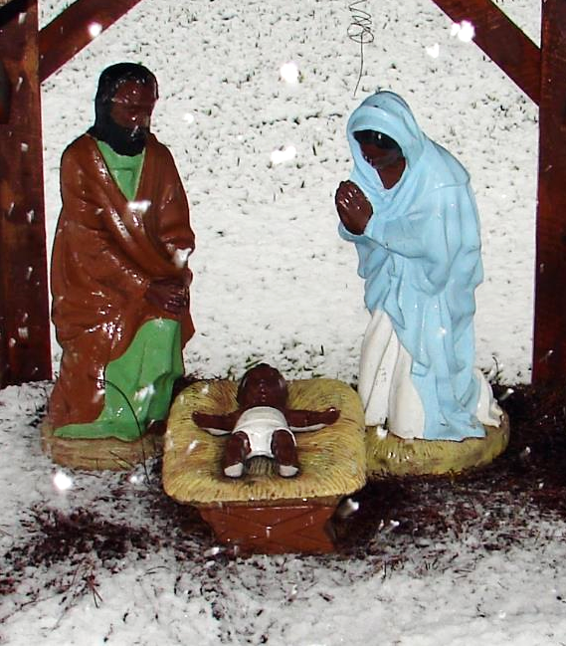
Nativity in the Snow
Church near Xavier University

Slide 4
In those days Mary set out and went with haste to a Judean town,
where she entered the house of Zechariah and greeted Elizabeth.
Luke 1:39a, 40

Slide 5
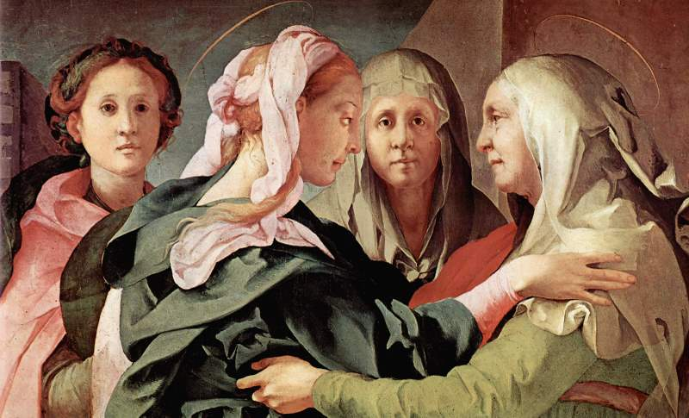
The Visitation -- Jacopo da Pontormo, Pfaarkirche, Carmignano, Italy

Slide 6
When Elizabeth heard Mary's greeting, the child leaped in her womb. And Elizabeth was filled with the Holy Spirit …
Luke 1:41

Slide 7
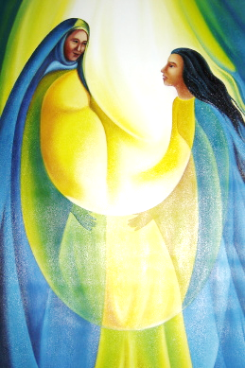
Visitation
Church of El Sitio
El Sitio, El Salvador

Slide 8
and exclaimed with a loud cry, "Blessed are you among women, and blessed is the fruit of your womb.
Luke 1:42

Slide 9
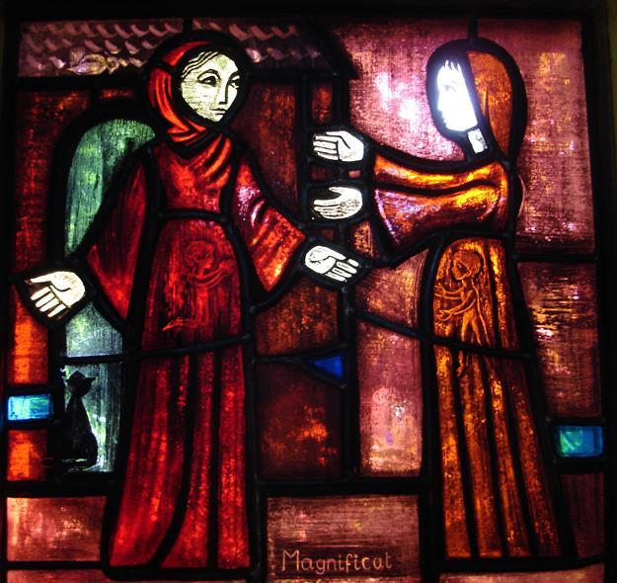
The Visitation
Brother Eric
Church of Reconciliation
Taize, France

Slide 10
And why has this happened to me, that the mother of my Lord comes to me?
Luke 1:43

Slide 11
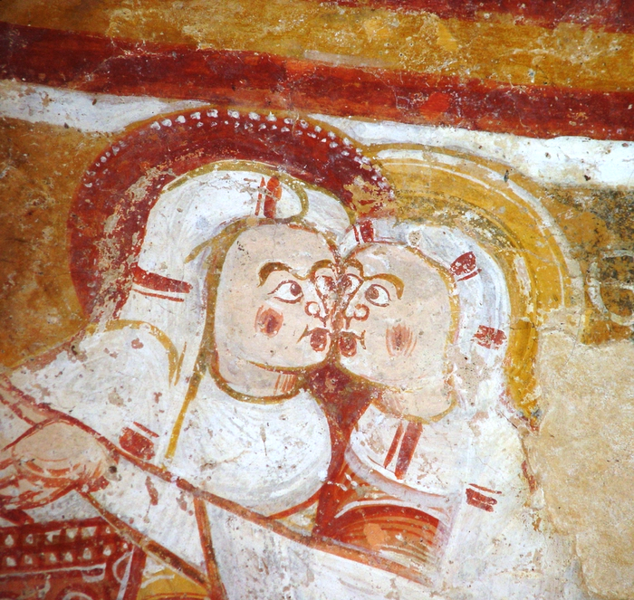
The Visitation
Church of St. Martin
Nohant-Vic, France

Slide 12
For as soon as I heard the sound of your greeting, the child in my womb leaped for joy.
Luke 1:44

Slide 13
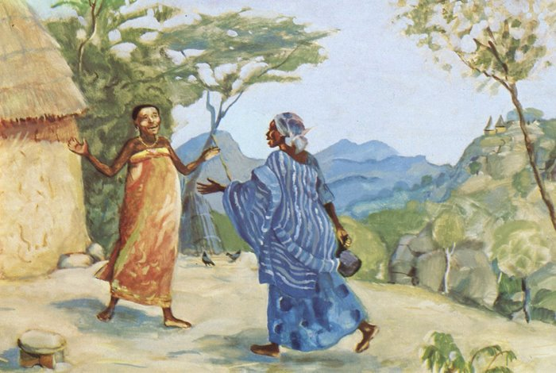
Elizabeth and Mary Greet Each Other -- JESUS MAFA, Cameroon

Slide 14
And blessed is she who believed that there would be a fulfillment of what was spoken to her by the Lord."
Luke 1:45

Slide 15
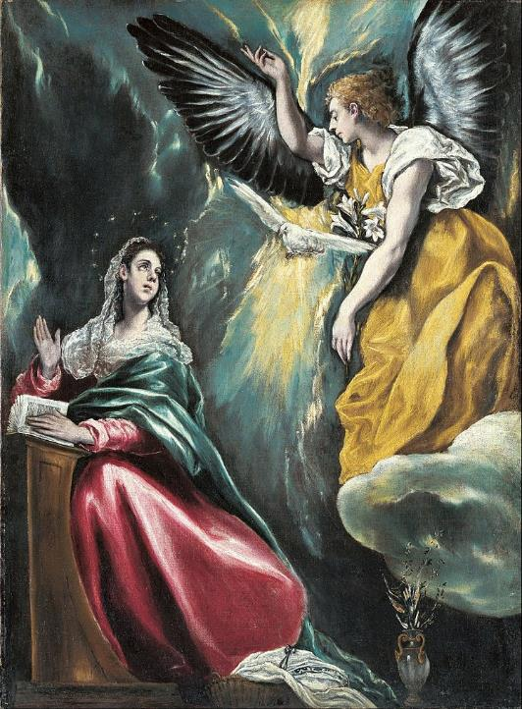
The Annunciation
El Greco
Ohara Museum of Art
Kurashiki, Japan

Slide 16
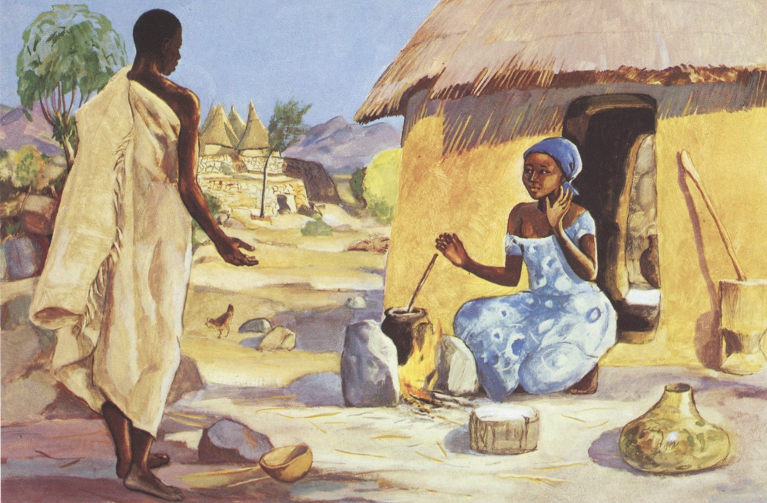
The Annunciation -- JESUS MAFA, Cameroon

Slide 17
And Mary said, "My soul magnifies the Lord, and my spirit rejoices in God my Savior,
Luke 1:46-47

Slide 18
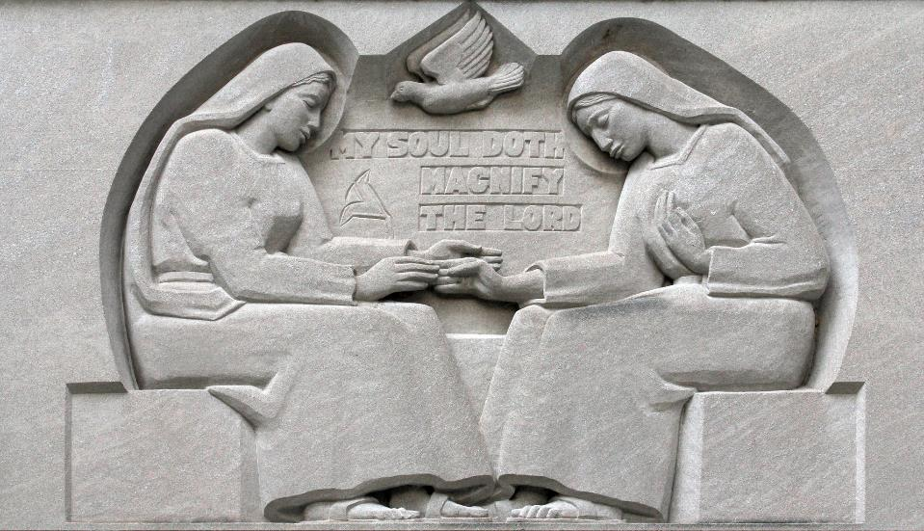
The Magnificat ("My Soul Doth Magnify the Lord") -- Baltimore Cathedral, Baltimore, MD

Slide 19
for he has looked with favor on the lowliness of his servant. Surely, from now on all generations will call me blessed;
Luke 1:48

Slide 20
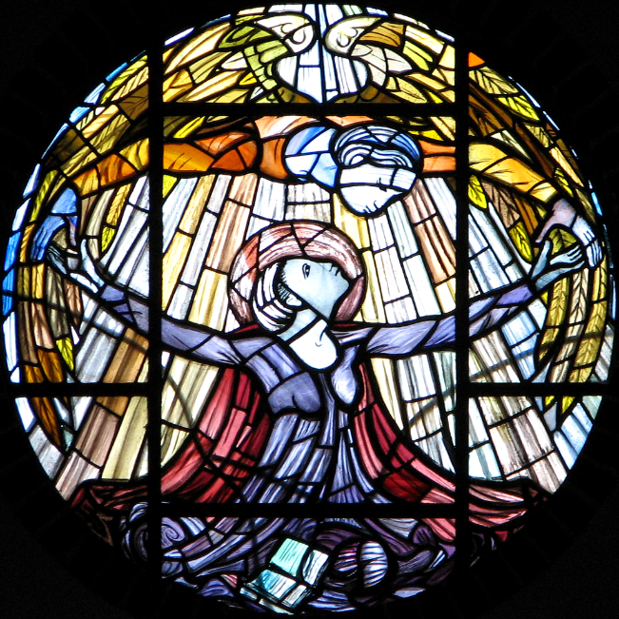
The Annunciation
Our Lady of Pity Church Swaffham, England

Slide 21
for the Mighty One has done great things for me, and holy is his name. His mercy is for those who fear him from generation to generation.
Luke 1:49-50

Slide 22
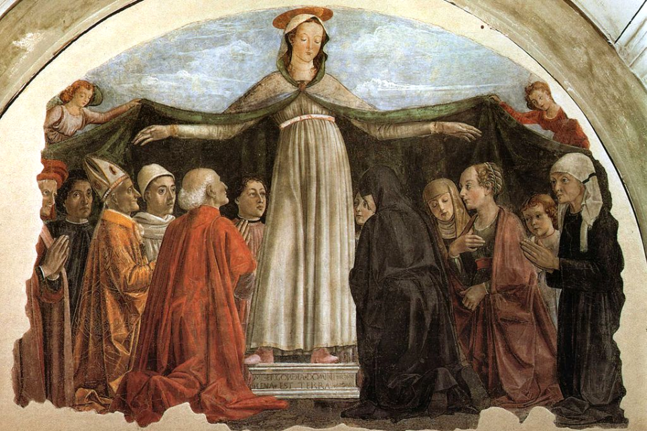
Madonna of Mercy -- Domenico Ghirlandaio, San Salvatore di Ognissanti, Florence, Italy

Slide 23
He has shown strength with his arm; he has scattered the proud in the imagination of their hearts.
Luke 1:51

Slide 24

The Visitation
Father Georges Saget
Keur Moussa Abbey
Keur Moussa, Senegal

Slide 25
He has brought down the powerful from their thrones, and lifted up the lowly;
Luke 1:52

Slide 26
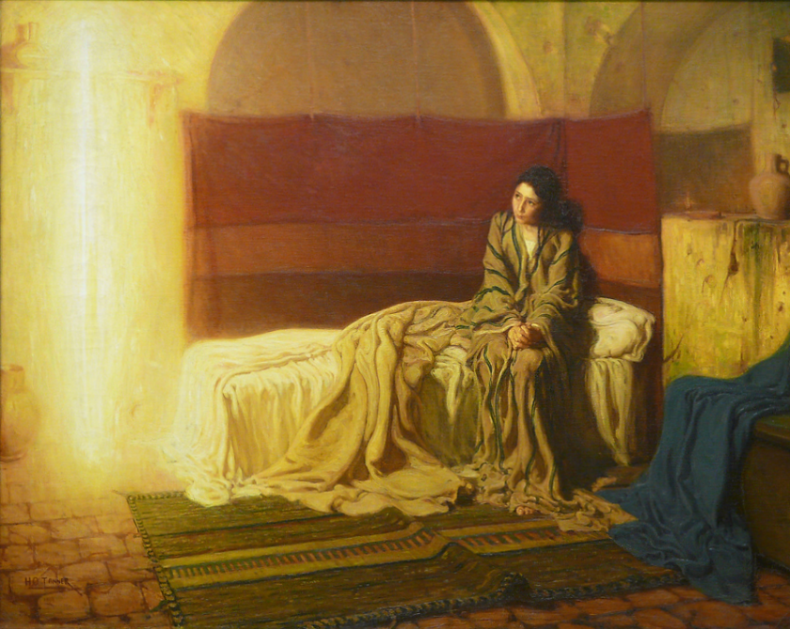
The Annunciation -- Henry Ossawa Tanner, Philadelphia Museum of Art, Philadelphia, PA

Slide 27
he has filled the hungry with good things, and sent the rich away empty.
Luke 1:53

Slide 28
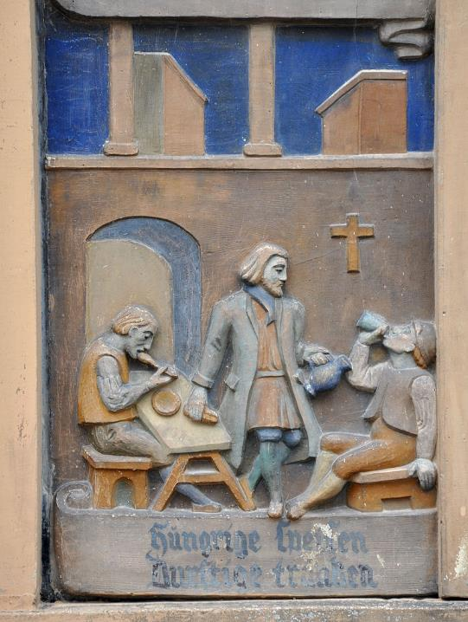
Feeding the Hungry
Biberach, Germany

Slide 29
He has come to the aid of his child Israel, in remembrance of his mercy, according to the promise he made to our ancestors, to Abraham and to his descendants forever.
Luke 1:54-55

Slide 30
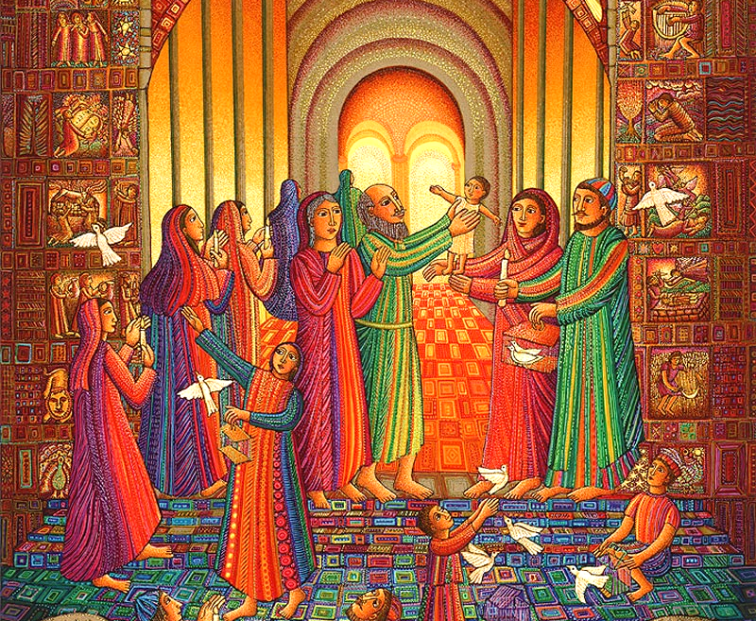
The Presentation -- John August Swanson

Slide 31
Credits
New Revised Standard Version Updated Edition Bible, copyright 2022, Division of Christian Education of the National Council of the Churches of Christ in the United States of America. Used by permission. All rights reserved.
http://www.flickr.com/photos/howieluvzus/3100071849/ - Mark Gstohl
www.yorckproject.de
https://www.flickr.com/photos/johndonaghy/22885862/ - John Donaghy
http://www.flickr.com/photos/swperman/221074981/
http://diglib.library.vanderbilt.edu/act-imagelink.pl?RC=42422
http://diglib.library.vanderbilt.edu/act-imagelink.pl?RC=48279
https://commons.wikimedia.org/wiki/File:El_GRECO_(Domenikos_Theotokopoulos)_-_Annunciation_-_Google_Art_Project.jpg
Éditions de l’Emmanuel, https://www.editions-emmanuel.com/contact/
https://www.flickr.com/photos/paullew/23612984750/ - Fr Lawrence Lew, O.P.
https://www.flickr.com/photos/paullew/2052404610/ - Fr Lawrence Lew, O.P.
https://commons.wikimedia.org/wiki/File:Domenico_ghirlandaio,_madonna_della_misericordia,_ognissanti,_Firenze.jpg
https://commons.wikimedia.org/wiki/File:KeurMoussaAutel.jpg
http://www.flickr.com/photos/ebarney/4762865759/
https://commons.wikimedia.org/wiki/File:Biberach_Spital_Relief_img04.jpg - Andreas Praefcke
www.JohnAugustSwanson.com - copyright 1988 by John August Swanson
Additional descriptions can be found at the Art in the Christian Tradition image library, a service of the Vanderbilt Divinity Library, http://diglib.library.vanderbilt.edu/. All images available via Creative Commons 3.0 License.

