Slide 1
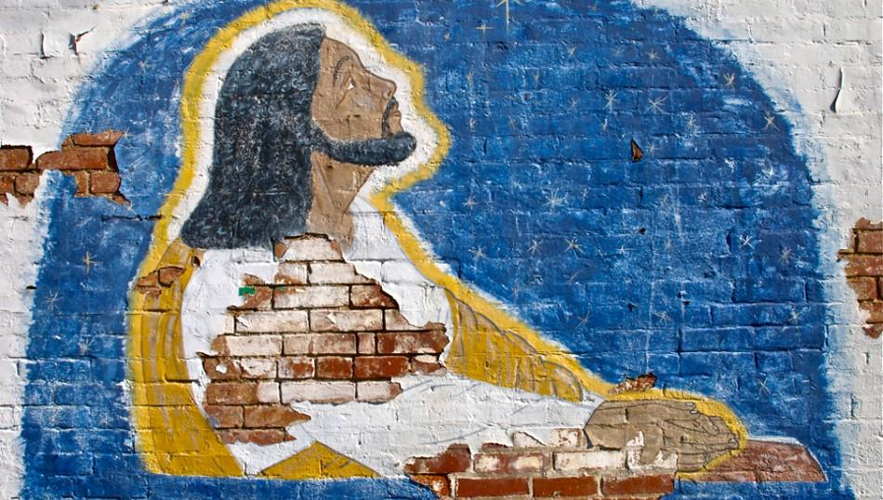
FIRST SUNDAY OF ADVENT
Year C
Jeremiah 33:14-16 • Psalm 25:1-10
1 Thessalonians 3:9-13 • Luke 21:25-36

Slide 2
The days are surely coming, says the LORD, when I will fulfill the promise I made to the house of Israel …
Jeremiah 33:14a

Slide 3
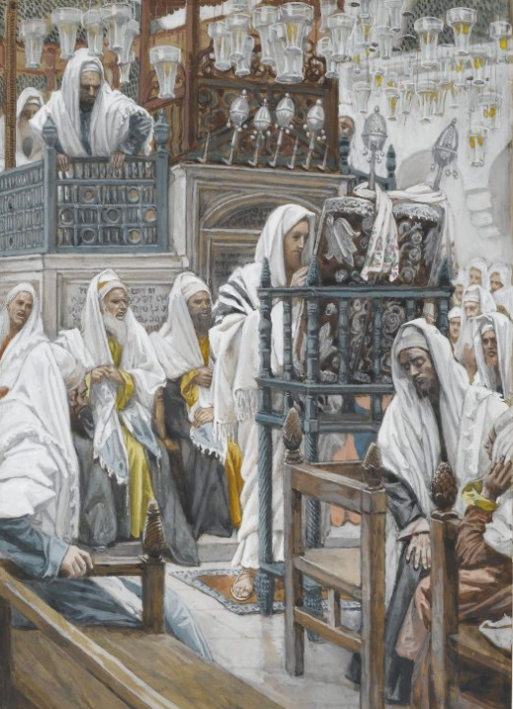
Jesus Unrolls the Book in the Synagogue
James Tissot
Brooklyn Museum
Brooklyn, NY

Slide 4
I will cause a righteous Branch to spring up for David; and he shall execute justice and righteousness in the land.
Jeremiah 33:15b

Slide 5
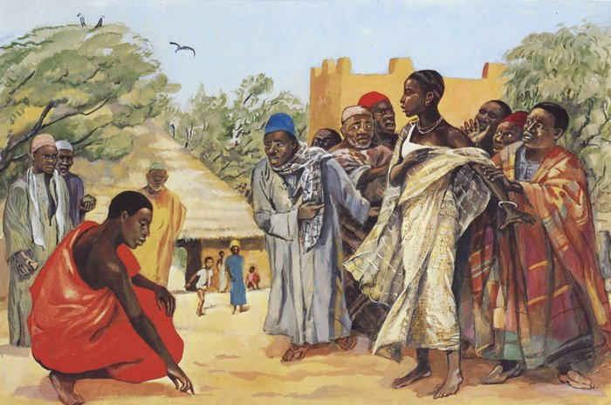
Jesus and the Unfaithful Wife -- JESUS MAFA, Cameroon

Slide 6
To you, O LORD, I lift up my soul.
Make me to know your ways …
teach me your paths.
Psalm 25:1, 4ac

Slide 7
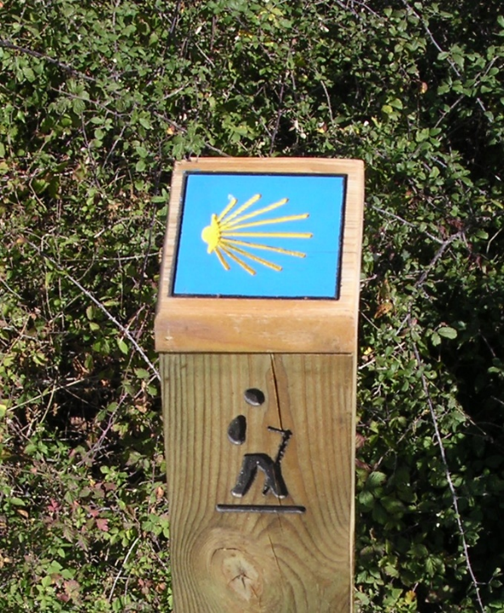
Pilgrim Signpost, Way of St. James of Santiago de Compostela
Huesca, Spain

Slide 8
Good and upright is the LORD. He leads the humble in what is right, and teaches the humble his way.
Psalm 25:8a, 9

Slide 9
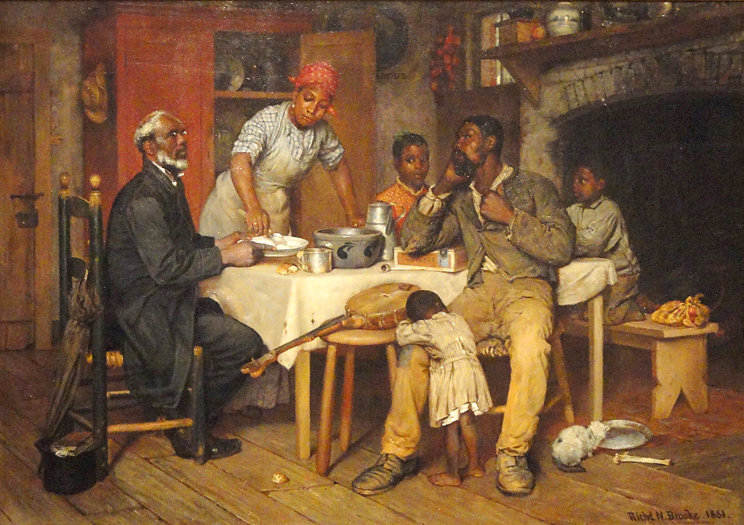
Pastoral Visit -- Richard Brooke, National Gallery of Art, Washington, DC

Slide 10
How can we thank God enough for you in return for all the joy that we feel before our God because of you?
1 Thessalonians 3:9

Slide 11
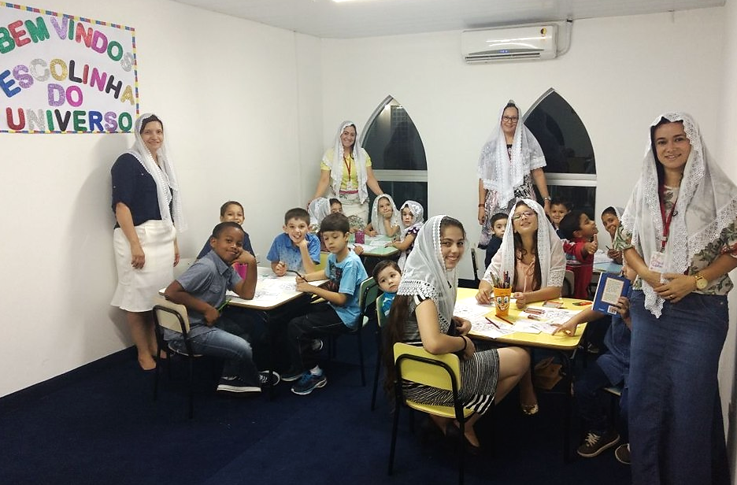
Children's Sunday School -- Pentecostal Church, Brazil

Slide 12
And may the Lord make you increase and abound in love for one another … just as we abound in love for you.
1 Thessalonians 3:12ac

Slide 13
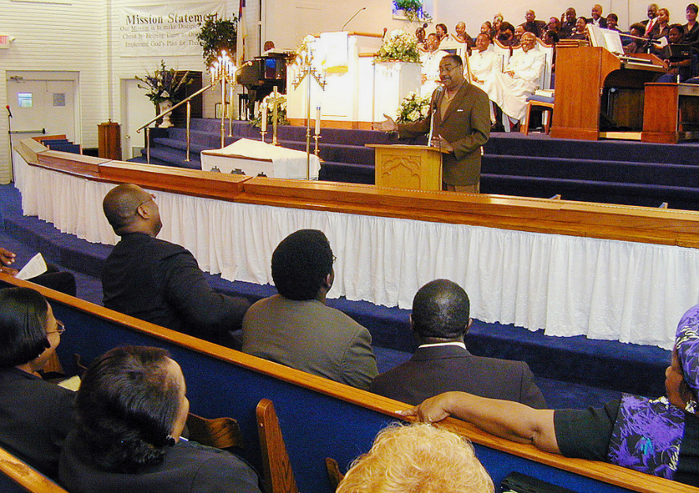
Address on Flood Relief, Payne Memorial AME Church, Houston, TX

Slide 14
"There will be signs in the sun, the moon, and the stars, and on the earth distress among nations …
Luke 21:25a

Slide 15
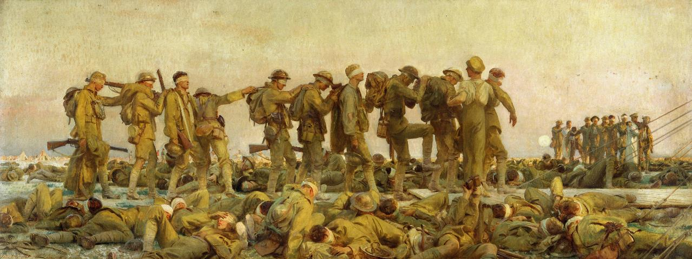
Gassed -- John Singer Sargent, Imperial War Museum, London, England

Slide 16
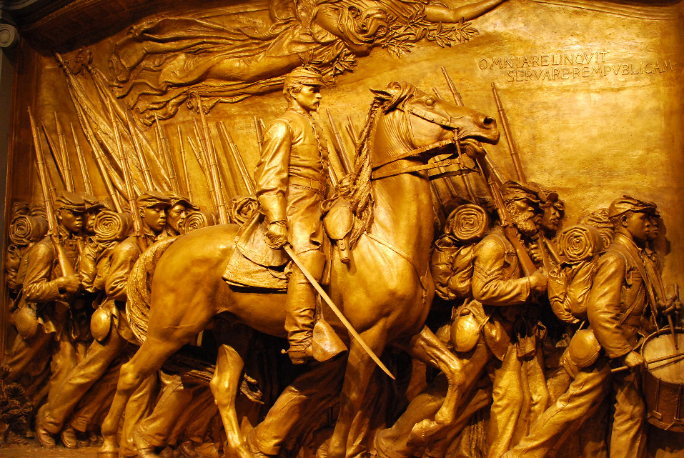
Shaw Memorial, Civil War -- Augustus Saint-Gaudens, National Gallery of Art, Washington, DC

Slide 17
Then they will see 'the Son of Man coming in a cloud' with power and great glory.
Luke 21:27

Slide 18
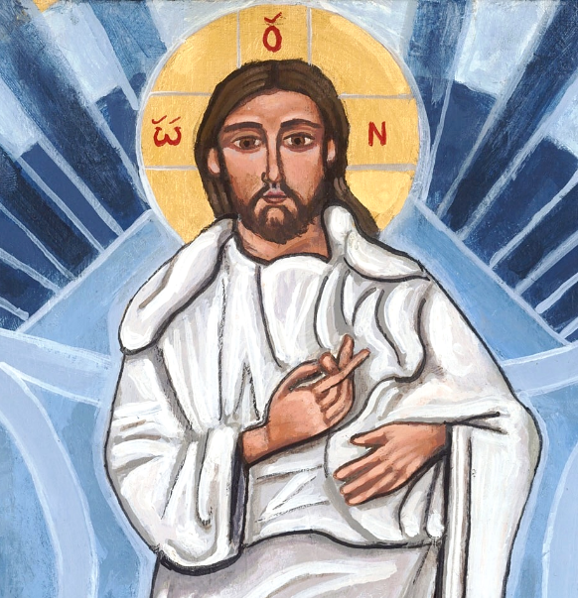
Christ Transfigured -- Kelly Latimore, Community of the Transfiguration, Glendale, OH

Slide 19
Heaven and earth will pass away, but my words will not pass away.
Luke 21:33

Slide 20
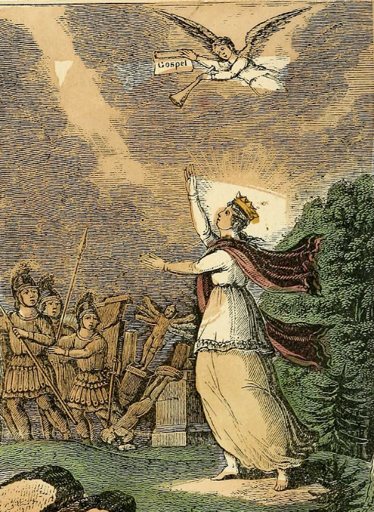
Divine Truth and the Gospel
Religious Emblems
Holmes and Barber
New York Public Library

Slide 21
Be on guard so that your hearts are not weighed down with … the worries of this life …
Luke 21:34ab

Slide 22
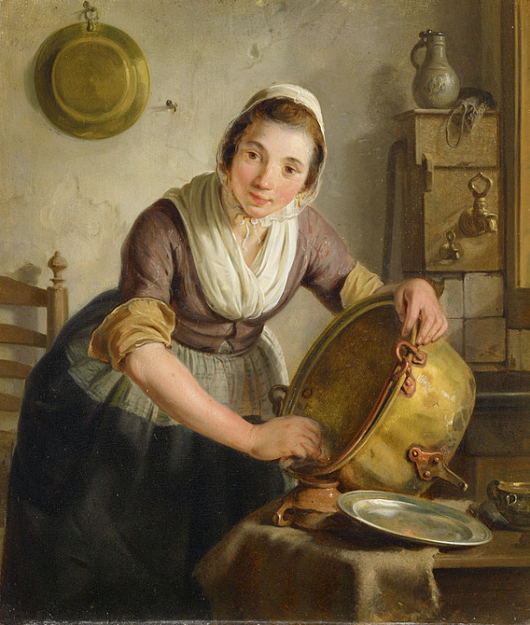
Woman Scrubbing a Kettle
Adriaan de Lelie
Amsterdam Museum
Amsterdam, Netherlands

Slide 23
… praying that you may … stand before the Son of Man."
Luke 21:36bc

Slide 24
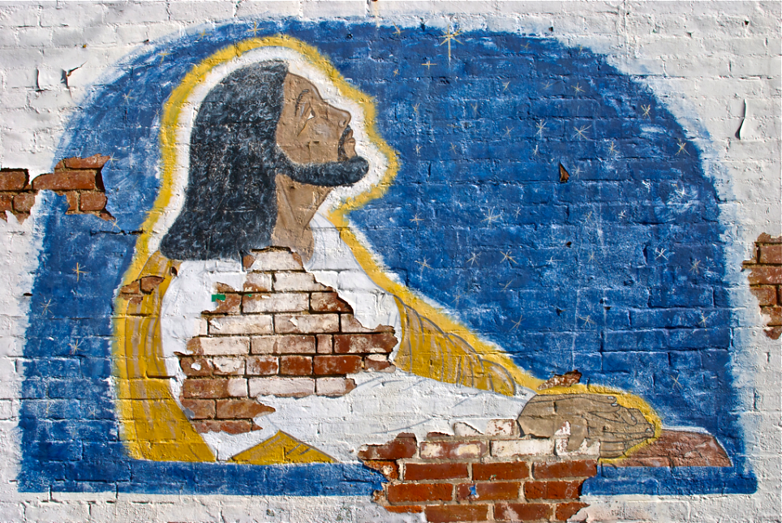
Jesus Christ -- Mural, West End, Louisville, KY

Slide 25
Credits
New Revised Standard Version Updated Edition Bible, copyright 2022, Division of Christian Education of the National Council of the Churches of Christ in the United States of America. Used by permission. All rights reserved.
https://commons.wikimedia.org/wiki/File:Brooklyn_Museum_-_Jesus_Unrolls_the_Book_in_the_Synagogue_(J%C3%A9sus_dans_la_synagogue_d%C3%A9roule_le_livre)_-_James_Tissot_-_overall.jpg
http://diglib.library.vanderbilt.edu/act-imagelink.pl?RC=48285
https://commons.wikimedia.org/wiki/File:Poste_Camino_de_Santiago.jpg
https://commons.wikimedia.org/wiki/File:A_Pastoral_Visit,_Virgina,_by_Richard_Norris_Brooke,_1881_-_Corcoran_Gallery_of_Art_-_DSC01173.JPG
https://commons.wikimedia.org/wiki/File:Sunday_School._Pentecostal..jpg - Philips.lenovo
https://commons.wikimedia.org/wiki/File:FEMA_-_5179_-_Photograph_by_Michael_Rieger_taken_on_07-01-2001_in_Texas.jpg
https://commons.wikimedia.org/wiki/File:Sargent,_John_Singer_(RA)_-_Gassed_-_Google_Art_Project.jpg
https://www.flickr.com/photos/kneoh/11198982455/
https://kellylatimoreicons.com/contact/
https://commons.wikimedia.org/wiki/File:Religious_emblems_-_being_a_series_of_emblematic_engravings,_with_written_explanations,_miscellaneous_observations_and_religious_reflections,_designed_to_illustrate_divine_truth,_in_accordance_with_(14560410120).jpg
https://commons.wikimedia.org/wiki/File:SA_1831-Ketelschuurster.jpg
https://www.flickr.com/photos/talesoftaromeet/6867087845
Additional descriptions can be found at the Art in the Christian Tradition image library, a service of the Vanderbilt Divinity Library, http://diglib.library.vanderbilt.edu/. All images available via Creative Commons 3.0 License.

