Slide 1
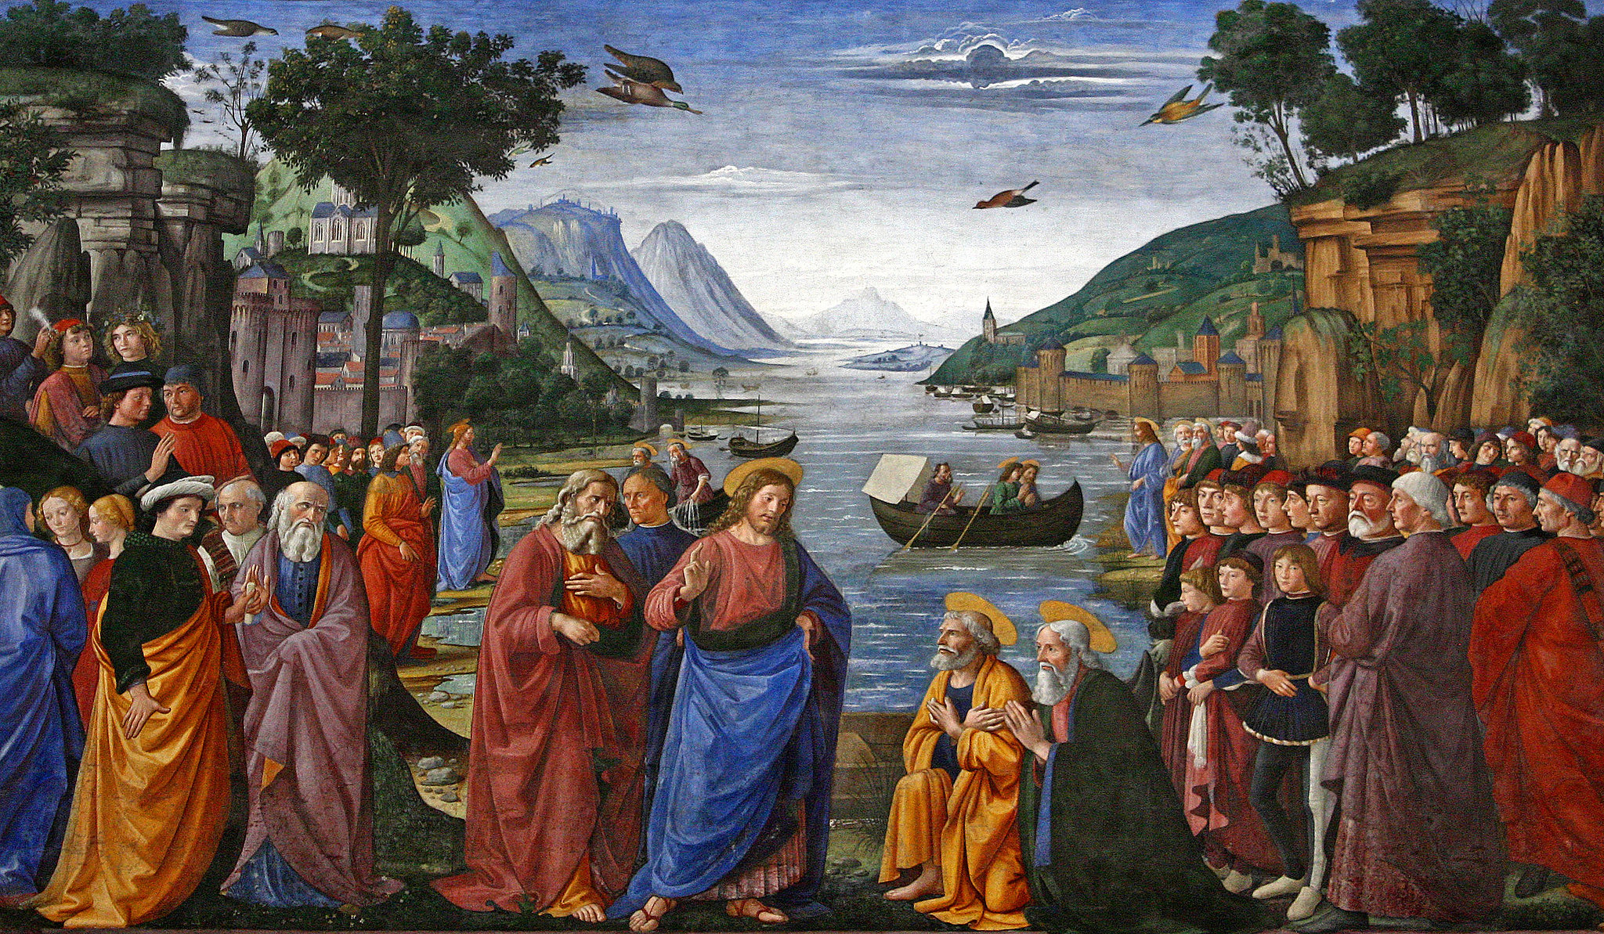
FIFTH SUNDAY AFTER THE EPIPHANY
Year C
Isaiah 6:1-8, (9-13) • Psalm 138 • 1 Corinthians 15:1-11 Luke 5:1-11

Slide 2
Then I heard the voice of the Lord saying, "Whom shall I send, and who will go for us?" And I said, "Here am I; send me!"
Isaiah 6:8

Slide 3
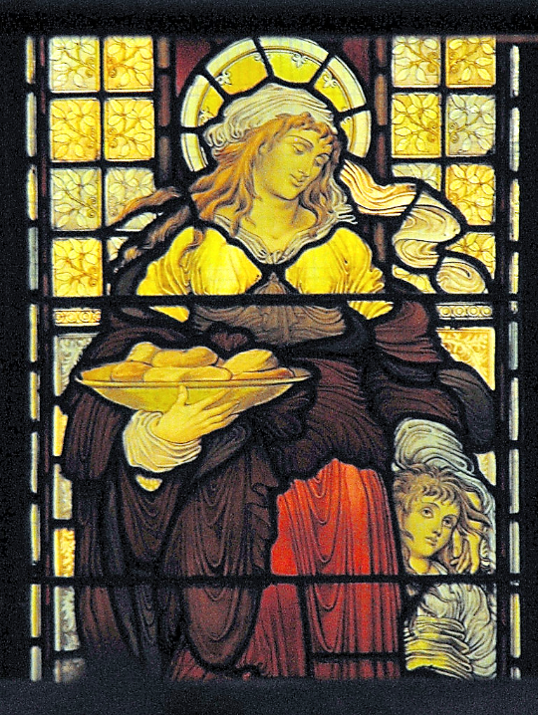
Dorcas Window
Llandaff Cathedral
Cardiff, Wales

Slide 4
On the day I called, you answered me, you increased my strength of soul.
Psalm 138:3

Slide 5
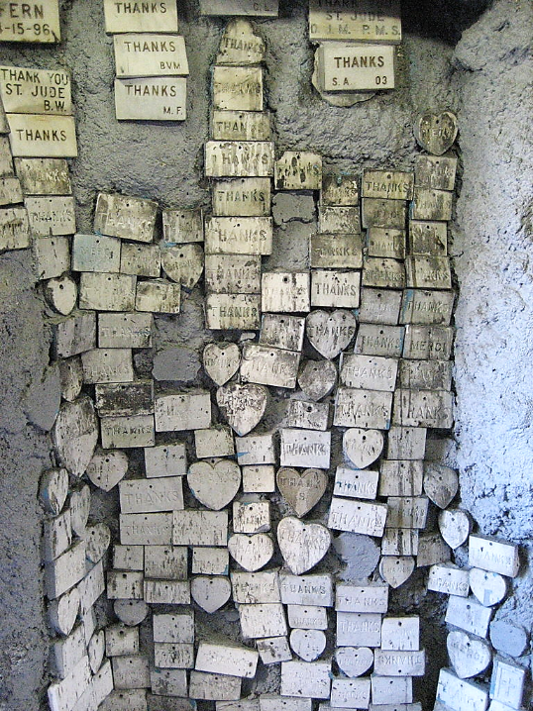
Messages of Thanks for Answered Prayers
Our Lady of Guadalupe Church
New Orleans, LA

Slide 6
For I am the least of the apostles, unfit to be called an apostle, because I persecuted the church of God.
1 Corinthians 15:9

Slide 7
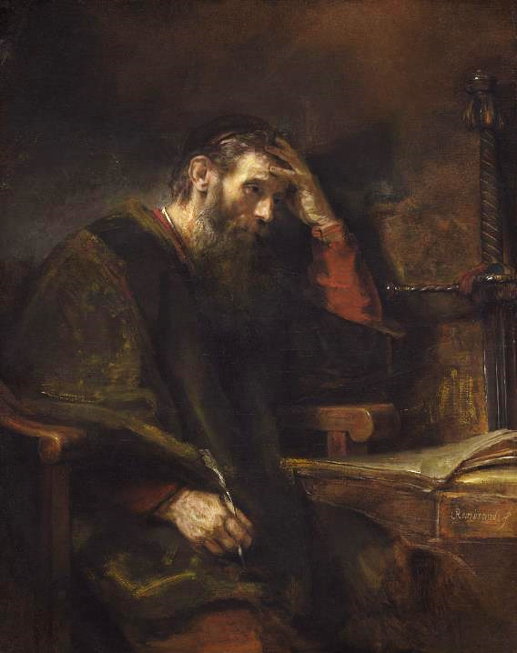
The Apostle Paul
Rembrandt (attr.)
National Gallery of Art
Washington, DC

Slide 8
Once while Jesus was standing beside the lake … and the crowd was pressing in on him to hear the word of God, he saw fishermen … washing their nets.
Luke 5:1-2ac

Slide 9
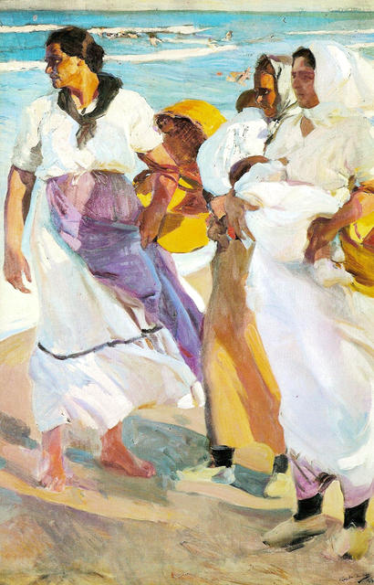
Valencian Fisherwomen
Joaquin Sorolla, Sorolla Museum, Madrid, Spain

Slide 10
He got into one of the boats, the one belonging to Simon … Then he sat down and taught the crowds from the boat.
Luke 5:3ac

Slide 11
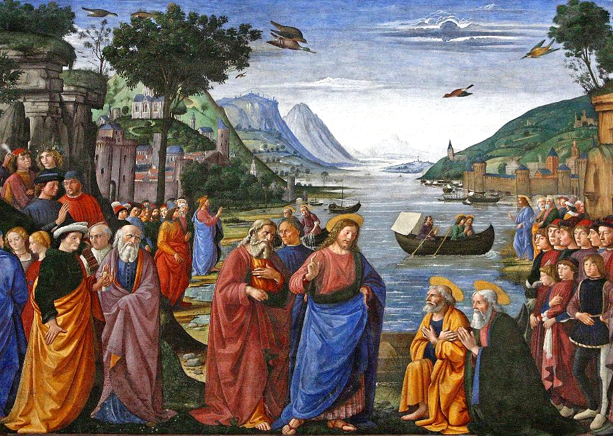
Calling of the Disciples -- Domenico Ghirlandaio, Sistine Chapel, Vatican, Vatican City, Italy

Slide 12
When he had finished speaking, he said to Simon, "Put out into the deep water and let down your nets for a catch."
Luke 5:4

Slide 13
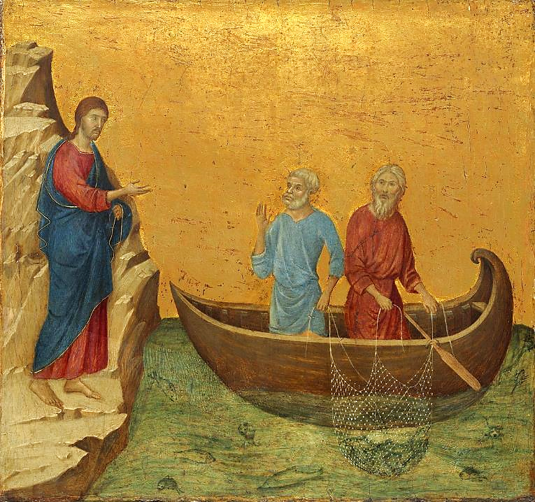
Christ Calls Simon Peter and Andrew
Duccio, National Gallery of Art, Washington, DC

Slide 14
Simon answered, "Master, we have worked all night long but have caught nothing. Yet if you say so, I will let down the nets."
Luke 5:5

Slide 15
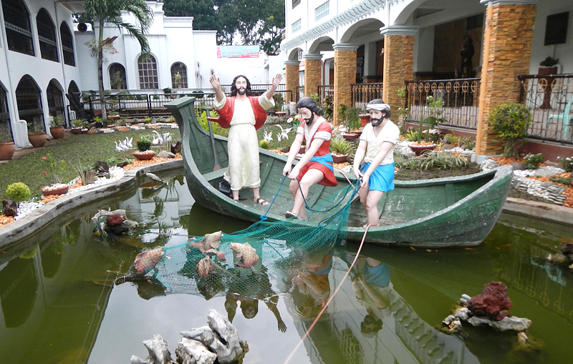
Christ and Simon Peter and Andrew -- San Pedro Bautista, Candelaria, Philippines

Slide 16
When they had done this, they caught so many fish that their nets were beginning to break.
Luke 5:6

Slide 17
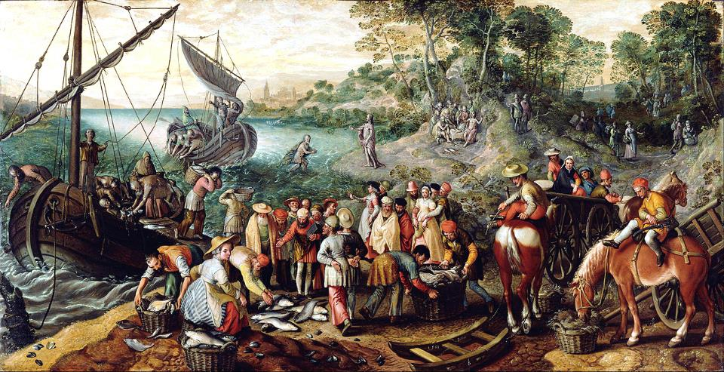
Miraculous Draught of Fishes -- Joachim Beuckelaer, Getty Center, Los Angeles, CA

Slide 18
But when Simon Peter saw it, he fell down at Jesus' knees, saying, "Go away from me, Lord, for I am a sinful man!"
Luke 5:8

Slide 19
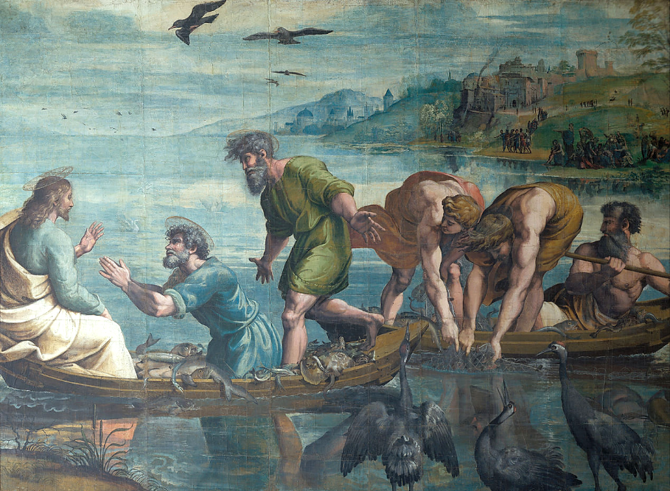
The Miraculous Draught of Fishes -- Raphael, Victoria and Albert Museum, London, England

Slide 20
Then Jesus said to Simon, "Do not be afraid; from now on you will be catching people."
Luke 5:10

Slide 21
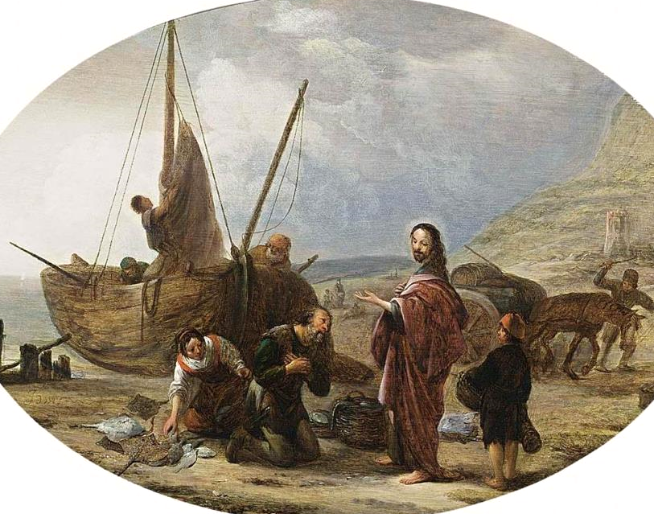
The Calling of Simon Peter -- Jacob de Wet, first half of 17th c.

Slide 22
When they had brought their boats to shore, they left everything and followed him.
Luke 5:11

Slide 23
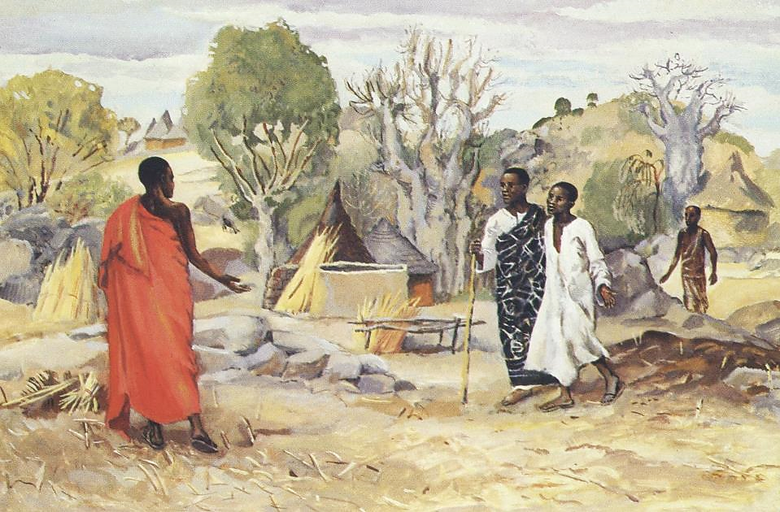
Calling of the Disciples -- JESUS MAFA, Cameroon

Slide 24
Credits
New Revised Standard Version Updated Edition Bible, copyright 2022, Division of Christian Education of the National Council of the Churches of Christ in the United States of America. Used by permission. All rights reserved.
https://www.flickr.com/photos/paullew/21511780815 - Fr Lawrence Lew, O.P.
https://www.flickr.com/photos/robin_croft/3473331055 - Robin Croft
https://commons.wikimedia.org/wiki/File:GuadalupeNOLAThanks.jpg
https://commons.wikimedia.org/wiki/File:Joaquin_Sorolla_Bastida_-_Valencian_Fisherwomen.jpg
https://www.flickr.com/photos/snarfel/4288307880
https://commons.wikimedia.org/wiki/File:Duccio_di_Buoninsegna_036.jpg
https://commons.wikimedia.org/wiki/File:CandelariaChurchjf1988_08.JPG
https://commons.wikimedia.org/wiki/File:Joachim_Beuckelaer_(Netherlandish_-_The_Miraculous_Draught_of_Fishes_-_Google_Art_Project.jpg
https://commons.wikimedia.org/wiki/File:Raphael_-_The_Miraculous_Draft_of_Fishes_-_Google_Art_Project.jpg
https://commons.wikimedia.org/wiki/File:Jacob_de_Wet_(I)_-_The_Calling_of_St_Peter_and_St_Andrew_-_WGA25565.jpg
http://diglib.library.vanderbilt.edu/act-imagelink.pl?RC=48379
Additional descriptions can be found at the Art in the Christian Tradition image library, a service of the Vanderbilt Divinity Library, http://diglib.library.vanderbilt.edu/. All images available via Creative Commons 3.0 License.

