Slide 1
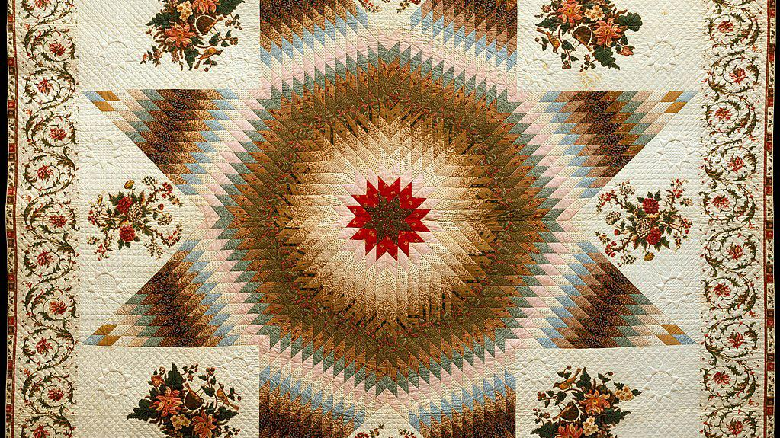
Epiphany of the Lord
Year C
Isaiah 60:1-6
Psalm 72:1-7, 10-14
Ephesians 3:1-12
Matthew 2:1-12

Slide 2
Arise, shine; for your light has come ... Nations shall come to your light, and kings to the brightness of your dawn.
Isaiah 60:1a, 3

Slide 3
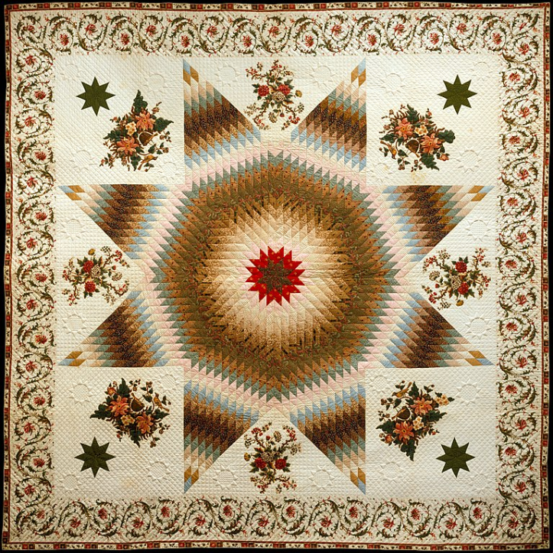
Star of Bethlehem Quilt
c. 1835
Metropolitan Museum of Art
New York, NY

Slide 4
In the time of King Herod, after Jesus was born in Bethlehem of Judea, magi from the East came to Jerusalem,
Matthew 2:1

Slide 5
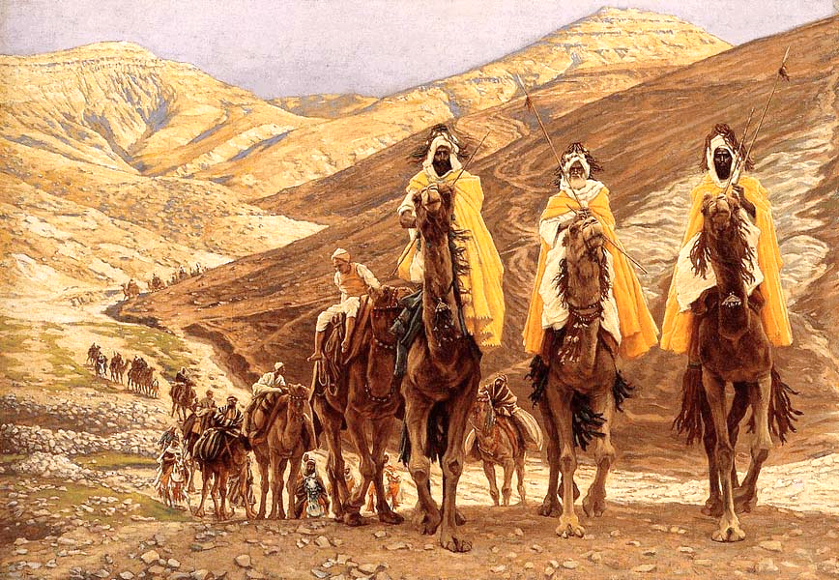
Journey of the Magi -- James Tissot, Minneapolis Institute of Art, Minneapolis, MN

Slide 6
asking, "Where is the child who has been born king of the Jews? For we observed his star in the east, and have come to pay him homage."
Matthew 2:2

Slide 7
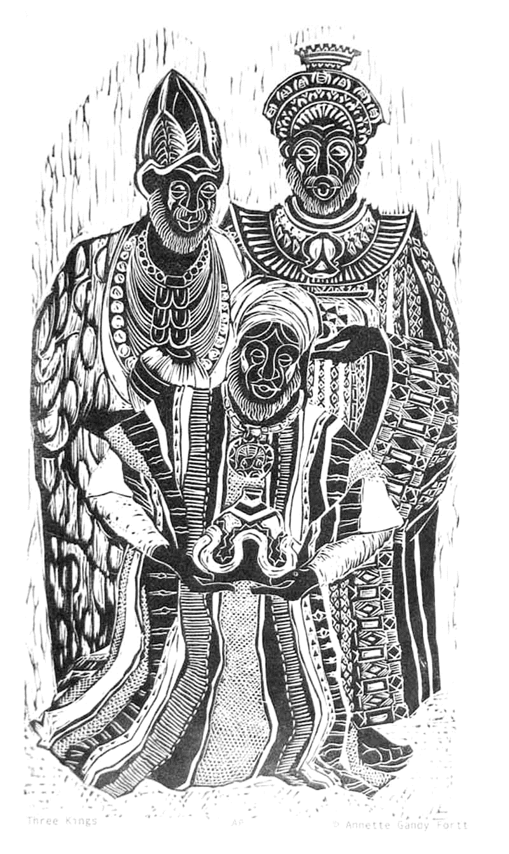
Three Kings
Annette Gandy Fortt
Silver Spring, MD

Slide 8
When King Herod heard this, he was frightened … and calling together all the chief priests and scribes …
Matthew 2:3a, 4a

Slide 9
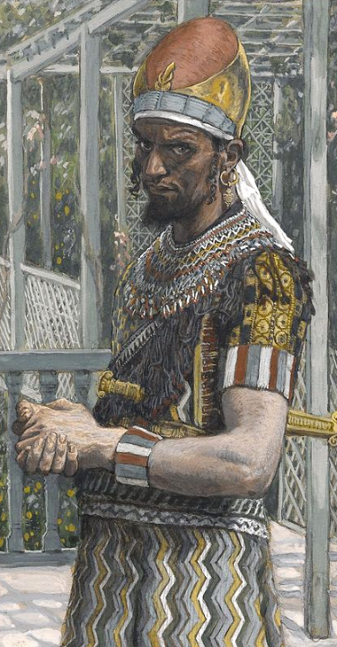
Herod
James Tissot
Brooklyn Museum
New York, NY

Slide 10
… he inquired of them where the Messiah was to be born. They told him, "In Bethlehem of Judea; for so it has been written by the prophet:
Matthew 2:4b, 5

Slide 11
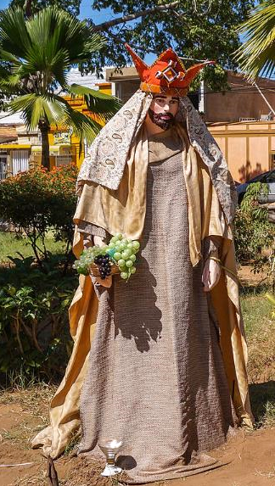
Figure of the Tres Reyes Magos Maracaibo, Venezuela

Slide 12
'And you, Bethlehem, in the land of Judah, are by no means least among the rulers of Judah; for from you shall come a ruler who is to shepherd my people Israel.'"
Matthew 2:6

Slide 13
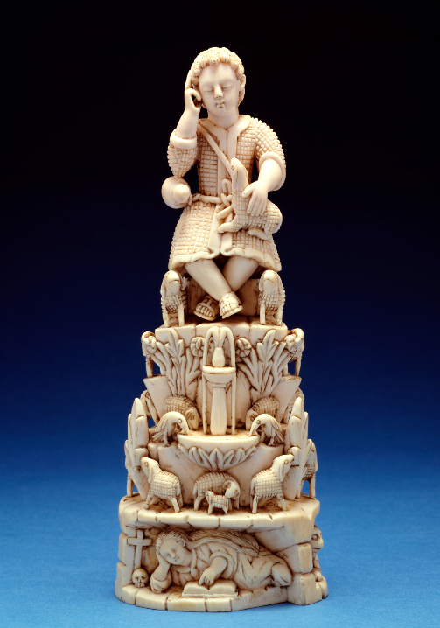
Christ Child as Good Shepherd
Goa, India
Walters Art Museum
Baltimore, MD

Slide 14
Then Herod secretly called for the magi and learned from them the exact time when the star had appeared.
Matthew 2:7

Slide 15
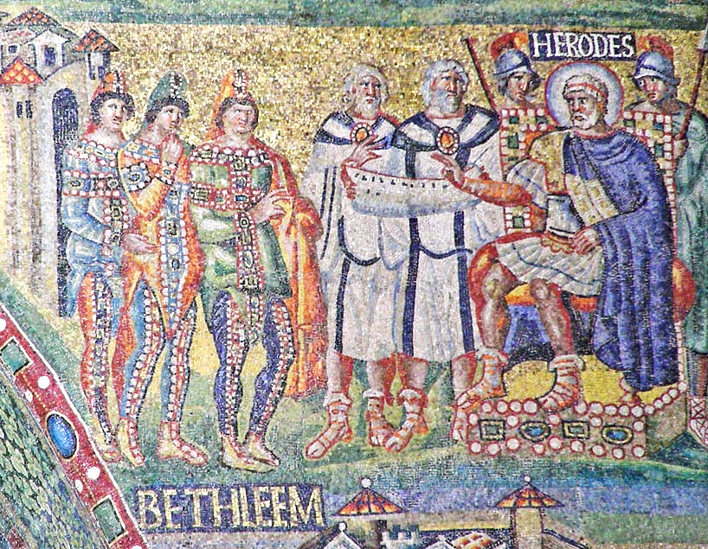
Herod Speaks with the Magi -- Mosaic, Santa Maria Maggiore, Rome, Italy

Slide 16
Then he sent them to Bethlehem, saying, "Go and search diligently for the child; and when you have found him, bring me word so that I may also go and pay him homage."
Matthew 2:8

Slide 17
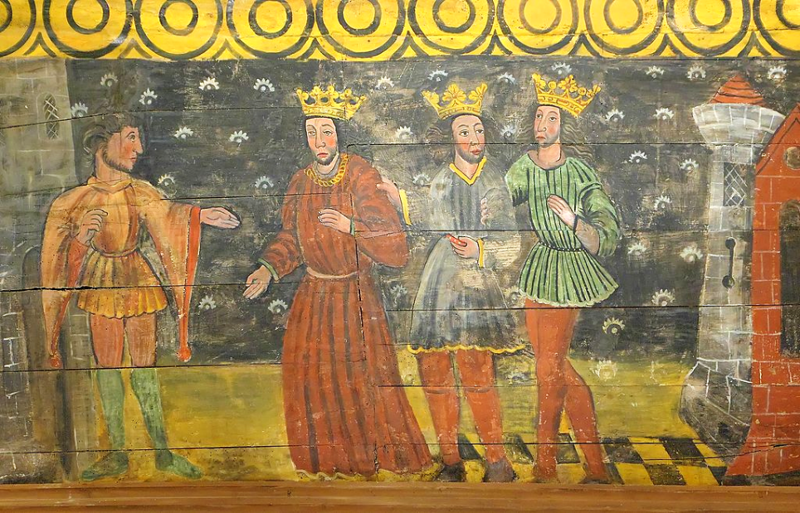
https://commons.wikimedia.org/wiki/File:Saint-Gonery.Drei.Heilige.Koenige.jpg
Herod with the Three Kings -- Church of Saint-Gonery, Plougrescant, France

Slide 18
When they had heard the king, they set out; and there, ahead of them, went the star that they had seen in the east, until it stopped over the place where the child was.
Matthew 2:9

Slide 19
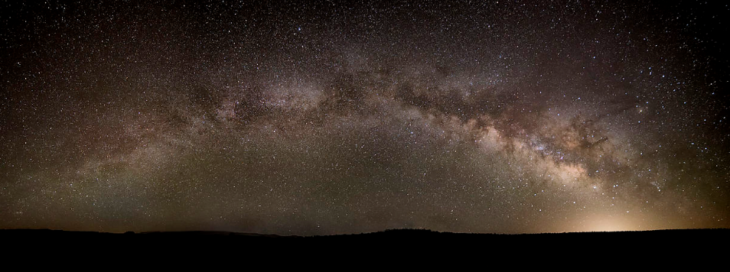
Rising Star, Milky Way -- John Fowler, Placitas, New Mexico

Slide 20
When they saw that the star had stopped, they were overwhelmed with joy.
Matthew 2:10

Slide 21
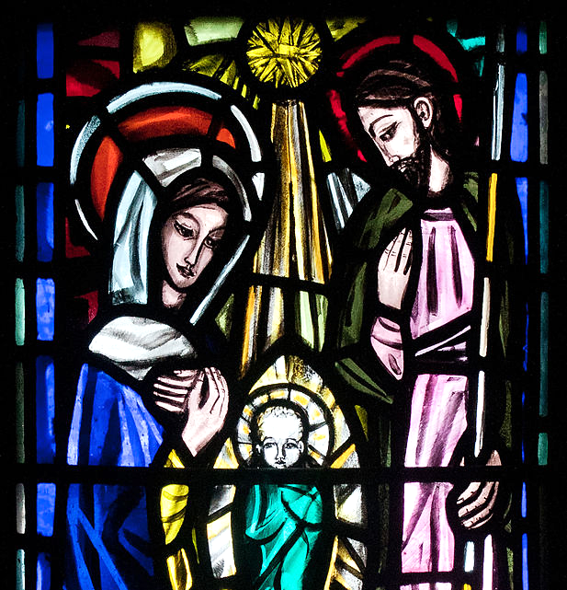
Nativity
Patrick Pollen
St. Michael's Church, Ballinasloe, Ireland

Slide 22
On entering the house, they saw the child with Mary his mother; and they knelt down and paid him homage.
Matthew 2:11a

Slide 23
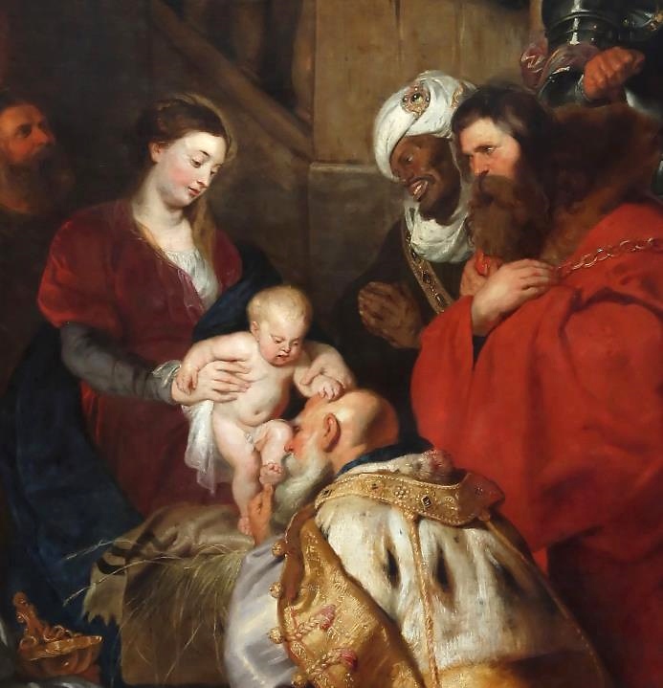
The Magi and the Christ Child
Peter Paul Reubens
Royal Museums of Fine Arts of Belgium
Brussels, Belgium

Slide 24
Then, opening their treasure chests, they offered him gifts of gold, frankincense, and myrrh.
Matthew 2:11b

Slide 25
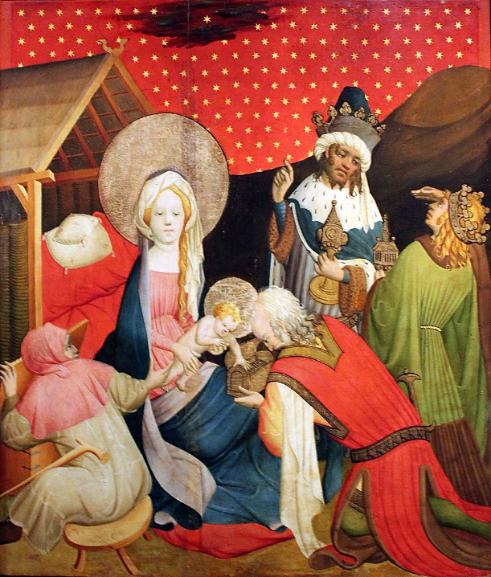
Adoration of the Magi
Master Francke Kunsthalle Hamburg
Hamburg, Germany

Slide 26
And having been warned in a dream not to return to Herod, they left for their own country by another road.
Matthew 2:12

Slide 27
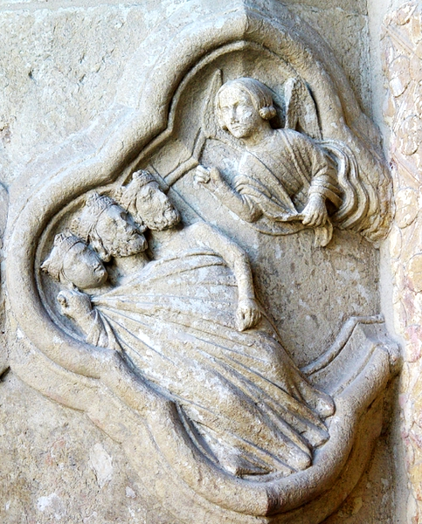
The Magi Warned in a Dream
Amiens Cathedral
Amiens, France

Slide 28
Credits
New Revised Standard Version Updated Edition Bible, copyright 2022, Division of Christian Education of the National Council of the Churches of Christ in the United States of America. Used by permission. All rights reserved.
https://commons.wikimedia.org/wiki/File:Star_of_Bethlehem_Quilt_MET_DT1820.jpg
https://commons.wikimedia.org/wiki/File:Magi_tissot.jpg
annettefortt.com
https://commons.wikimedia.org/wiki/File:Herod_tissot.jpg
https://commons.wikimedia.org/wiki/File:FiguraTres_Reyes_Magos.jpg
https://commons.wikimedia.org/wiki/File:Indian_-_The_Christ_Child_as_Good_Shepherd_-_Walters_71324.jpg
https://commons.wikimedia.org/wiki/File:RomaSantaMariaMaggioreArcoTrionfaleDxRegistro3.jpg
https://commons.wikimedia.org/wiki/File:Saint-Gonery.Drei.Heilige.Koenige.jpg
https://commons.wikimedia.org/wiki/File:Milky_Way_-_28_June_2014.jpg
https://commons.wikimedia.org/wiki/File:Ballinasloe_St._Michael%27s_Church_North_Aisle_Fourth_Window_Holy_Family_by_Patrick_Pollen_Detail_Nativity_2010_09_15.jpg
https://commons.wikimedia.org/wiki/File:Peter_Paul_Rubens_-_L%27adoration_des_Mages.jpg
https://commons.wikimedia.org/wiki/File:1426_Meister_Francke_Die_Anbetung_der_K%C3%B6nige_anagoria.JPG
http://diglib.library.vanderbilt.edu/act-imagelink.pl?RC=29202
Additional descriptions can be found at the Art in the Christian Tradition image library, a service of the Vanderbilt Divinity Library, http://diglib.library.vanderbilt.edu/. All images available via Creative Commons 3.0 License.

