Slide 1
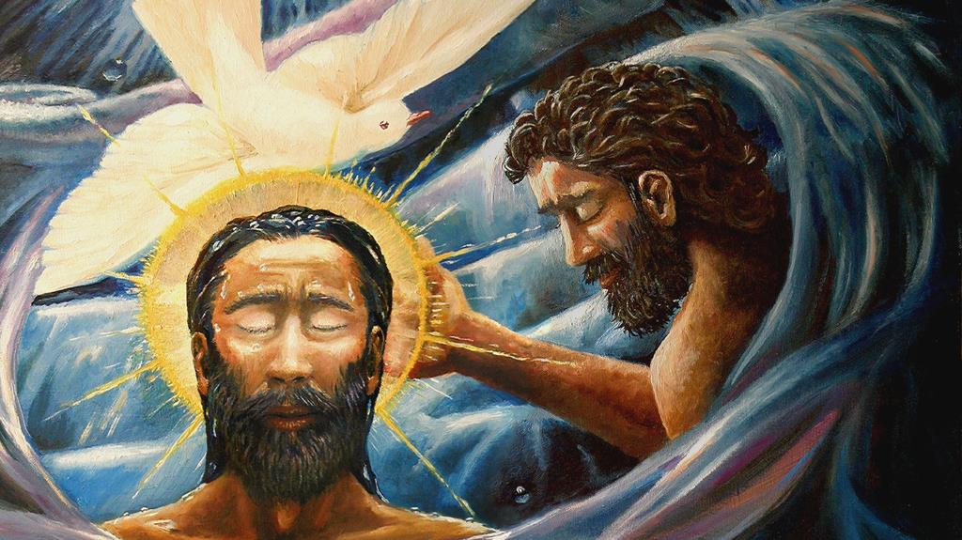
BAPTISM OF
THE LORD
Year C
Isaiah 43:1-7 • Psalm 29
Acts 8:14-17 • Luke 3:15-17, 21-22

Slide 2
… thus says the LORD … When you pass through the waters, I will be with you; and through the rivers, they shall not overwhelm you.
Isaiah 43 1a, 2a

Slide 3
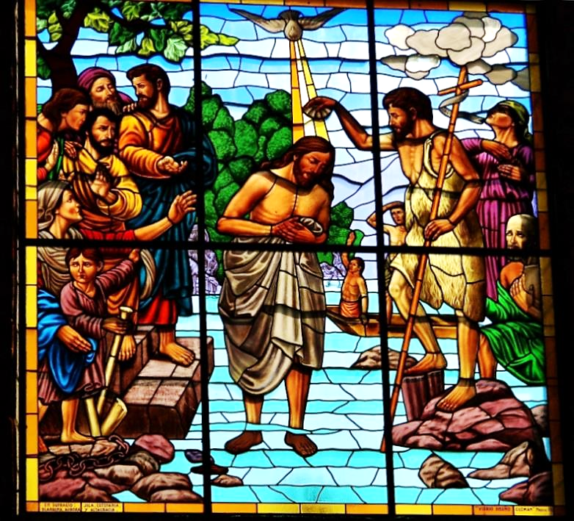
Baptism of Christ
Cathedral of San Gerardo Maria Mayela Guererro, Mexico

Slide 4
The voice of the LORD is over the waters; the God of glory thunders, the LORD, over mighty waters.
Psalm 29:3

Slide 5
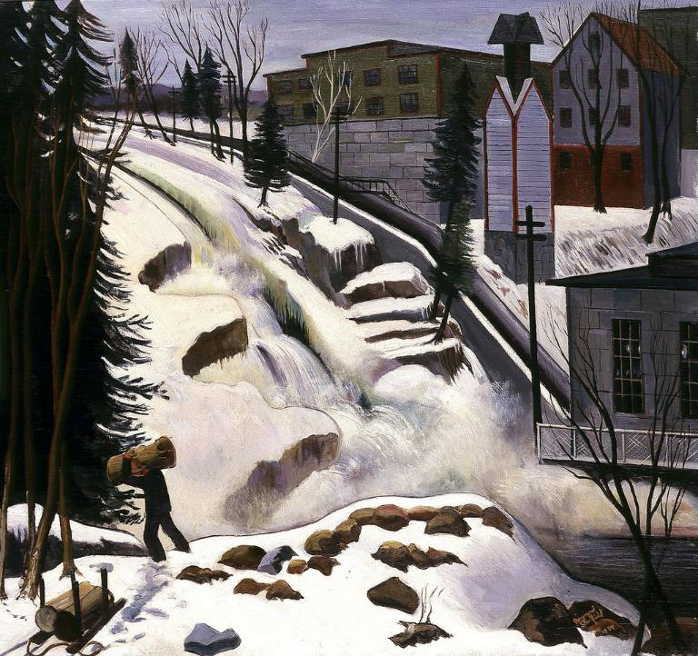
Natural Power
Ramon Skofield
Smithsonian Museum of American Art
Washington, DC

Slide 6
Then Peter and John laid their hands on them, and they received the Holy Spirit.
Acts 8:17

Slide 7
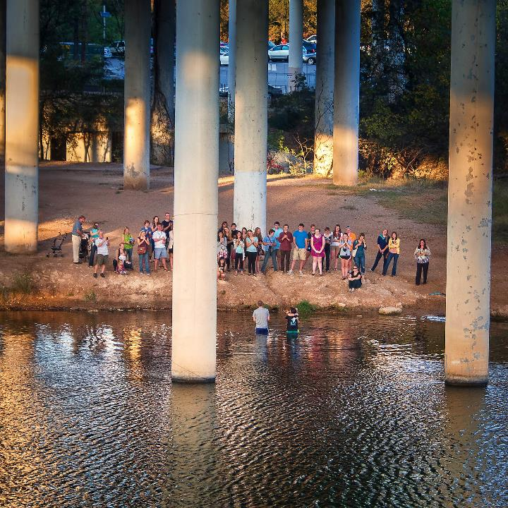
Baptism
Lady Bird Lake
Austin, TX

Slide 8
As the people were filled with expectation, and all were questioning in their hearts concerning John, whether he might be the Messiah,
Luke 3:15

Slide 9
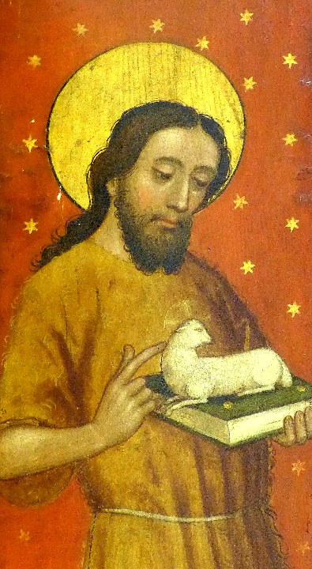
John the Baptist
St. John and St. Martin
Schwabach, Germany

Slide 10
John answered all of them by saying, "I baptize you with water; but one who is more powerful than I is coming;
Luke 3:16a

Slide 11
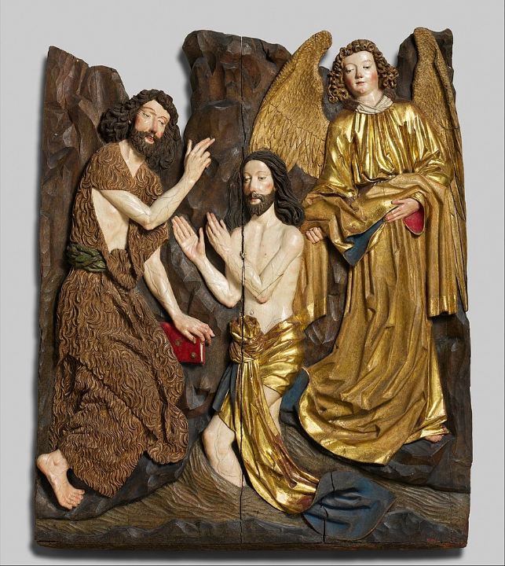
Baptism of Christ
Veit Stoss
Metropolitan Museum of Art
New York, NY

Slide 12
I am not worthy to untie the strap of his sandals. He will baptize you with the Holy Spirit and fire.
Luke 3:16b

Slide 13
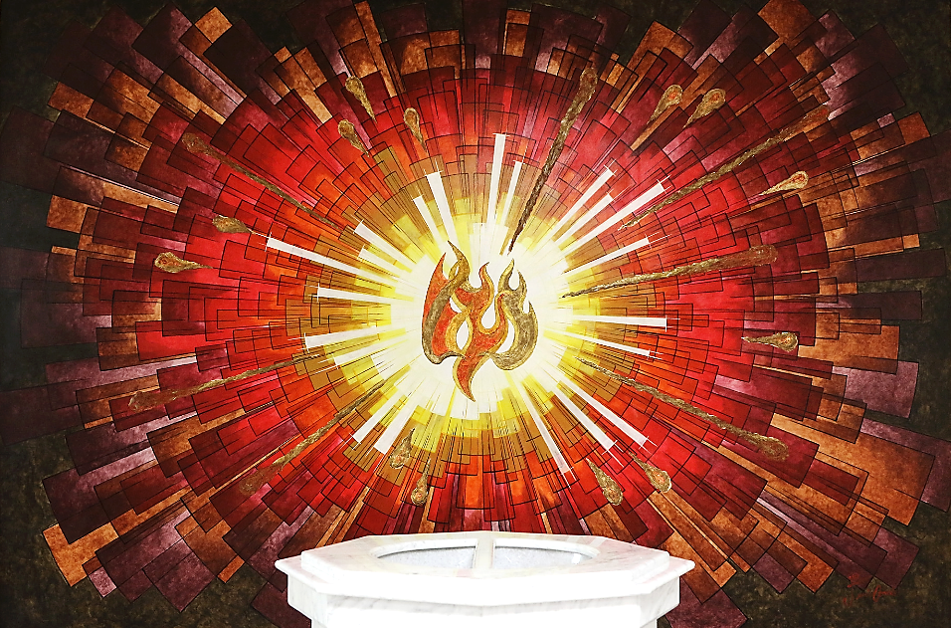
The Holy Spirit and Fire with Baptismal Font -- Church in Mexicali, Mexico

Slide 14
His winnowing fork is in his hand, to clear his threshing floor and to gather the wheat into his granary …
Luke 3:17a

Slide 15
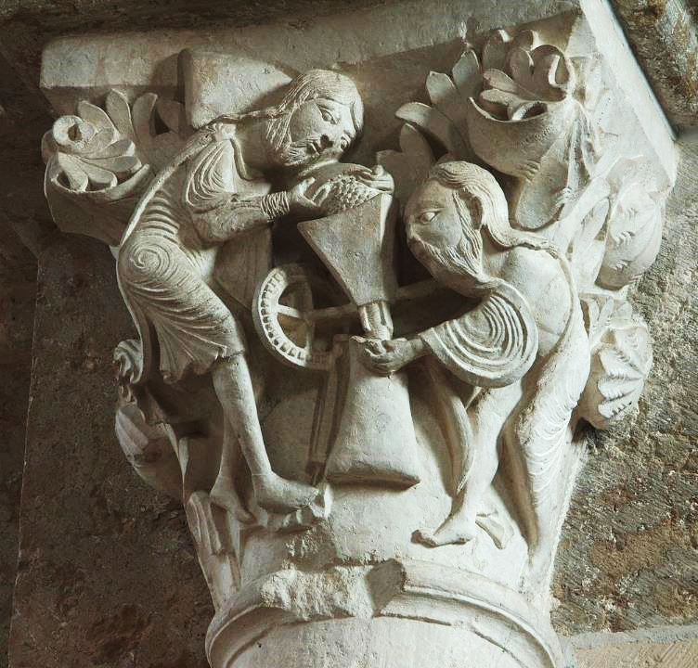
Christ Grinding Grain
"Mystic Mill" capital
Basilica of Mary Magdalene
Vezelay, France

Slide 16
Now when all the people were baptized, and when Jesus also had been baptized and was praying,
Luke 3:21a

Slide 17
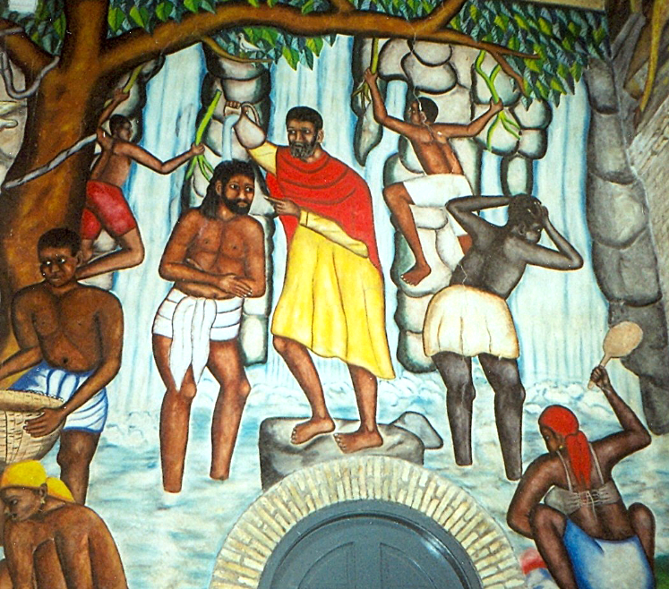
Baptism of Jesus -- Castera Bazile, Cathedrale de Sainte Trinite, Port-au-Prince, Haiti

Slide 18
the heaven was opened, and the Holy Spirit descended upon him in bodily form like a dove.
Luke 3:21b-22a

Slide 19
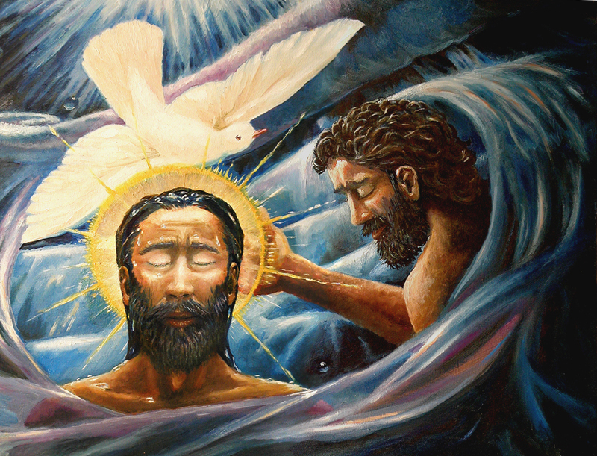
Baptism of Christ -- Dave Zelenka

Slide 20
And a voice came from heaven, "You are my Son, the Beloved; with you I am well pleased."
Luke 3:22b

Slide 21
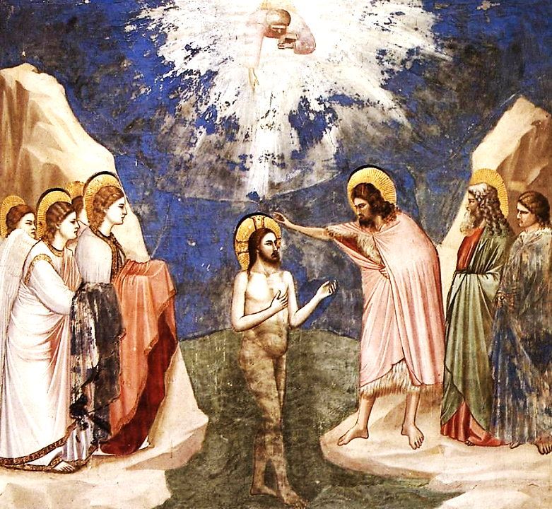
Baptism of Christ
Giotto
Scrovegni Chapel
Padua, Italy

Slide 22
Credits
New Revised Standard Version Updated Edition Bible, copyright 2022, Division of Christian Education of the National Council of the Churches of Christ in the United States of America. Used by permission. All rights reserved.
https://www.flickr.com/photos/eltb/8622862475
https://www.flickr.com/photos/americanartmuseum/3267571640
https://www.flickr.com/photos/dingatx/8244740212 - David Ingram
https://commons.wikimedia.org/wiki/File:Schwabach_Stadtkirche_-_Katharinenaltar_Fl%C3%BCgel_4a.jpg
https://www.flickr.com/photos/paullew/42622611981/ - Fr Lawrence Lew, O.P.
https://commons.wikimedia.org/wiki/File:Baptism_of_Christ_MET_DP144433.jpg
https://commons.wikimedia.org/wiki/File:Mysticmill.jpg
http://commons.wikimedia.org/wiki/File:PortAuPrinceMural.jpg
https://commons.wikimedia.org/wiki/File:Baptism-of-Christ.jpg
https://commons.wikimedia.org/wikipedia/commons/8/88/Giotto_di_Bondone_-_No._23_Scenes_from_the_Life_of_Christ_-_7._Baptism_of_Christ_-_WGA09201.jpg
Additional descriptions can be found at the Art in the Christian Tradition image library, a service of the Vanderbilt Divinity Library, http://diglib.library.vanderbilt.edu/. All images available via Creative Commons 3.0 License.

