Slide 1
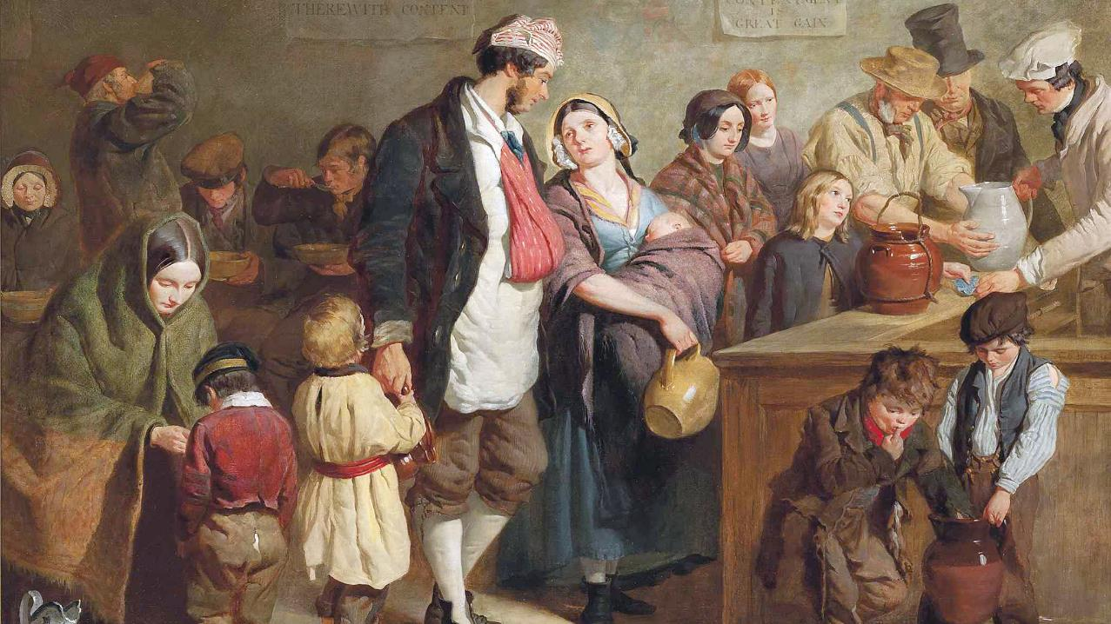
ASH WEDNESDAY
Year C
Joel 2:1-2, 12-17 or Isaiah 58:1-12 • Psalm 51:1-17
2 Corinthians 5:20b-6:10 • Matthew 6:1-6, 16-21

Slide 2
Yet even now, says the LORD, return to me with all your heart, with fasting, with weeping, and with mourning;
Joel 2:12

Slide 3
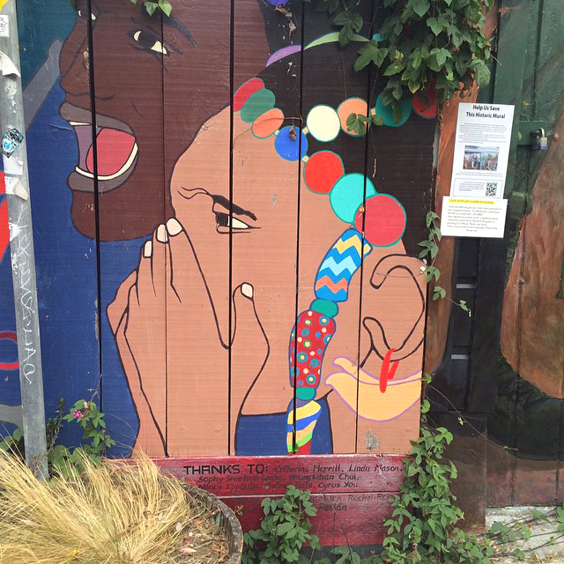
Grief
Mission District Mural
San Francisco, CA

Slide 4
Return to the LORD, your God, for he is gracious and merciful, slow to anger, and abounding in steadfast love, and relenting from punishing.
Joel 2:13b

Slide 5
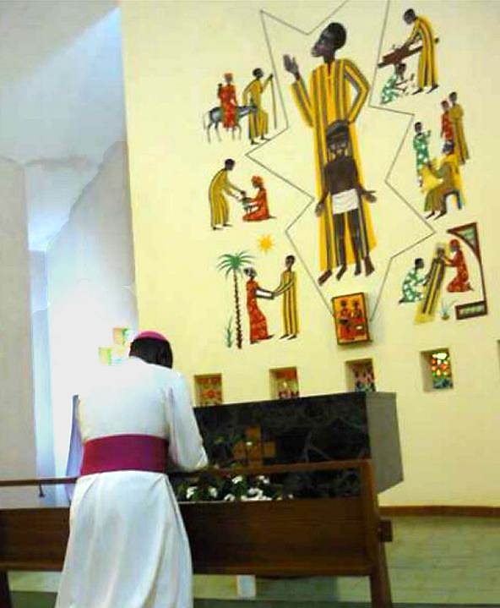
Prayer before the Life of Joseph Mural
Keur Moussa Abbey
Senegal

Slide 6
"Why do we fast … ?" Look, you serve your own interest on your fast day, and oppress all your workers.
Isaiah 58:3ac

Slide 7
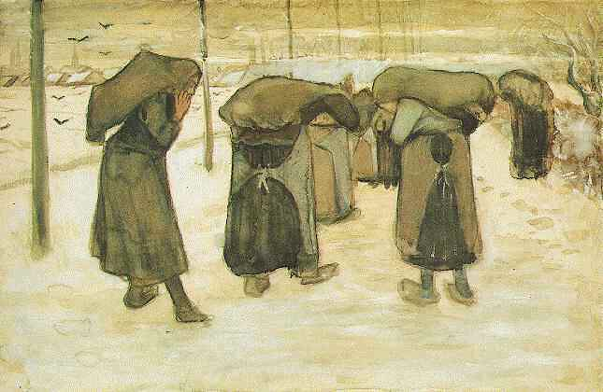
Women Miners -- Vincent Van Gogh, Kroller-Muller Museum, Otterlo, Netherlands

Slide 8
"Why do we fast … ?" Is it not to share your bread with the hungry, and bring the homeless poor into your house … and not to hide yourself from your own kin?
Isaiah 58:3a, 7ac

Slide 9
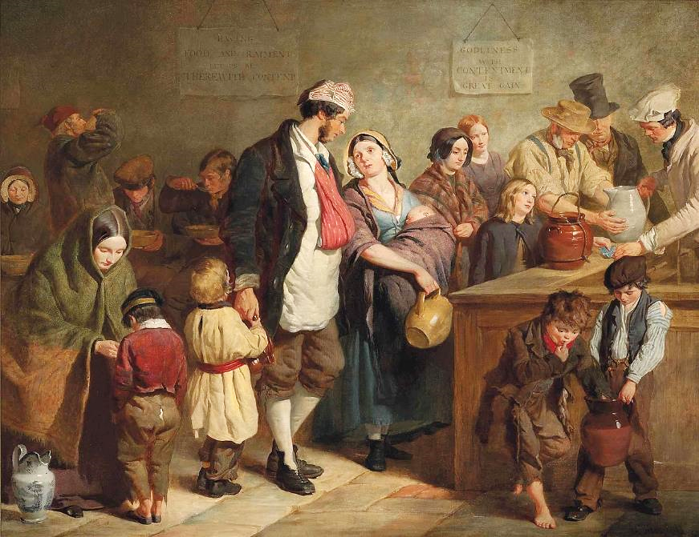
The Parish Soup Kitchen -- George Elgar Hicks, Royal Academy, London, England

Slide 10
Then your light shall break forth like the dawn, and your healing shall spring up quickly …
Isaiah 58:8a

Slide 11
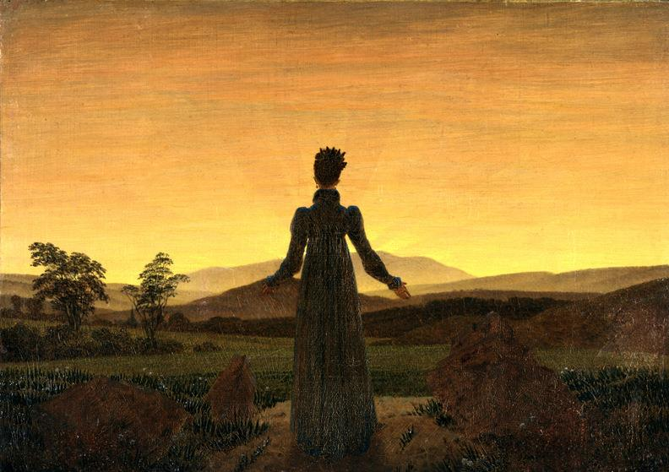
Woman Before the Rising Sun -- Caspar David Friedrich, Museum Folkwang, Essen, Germany

Slide 12
Your ancient ruins shall be rebuilt … you shall be called the repairer of the breach, the restorer of streets to live in.
Isaiah 58:12ac

Slide 13
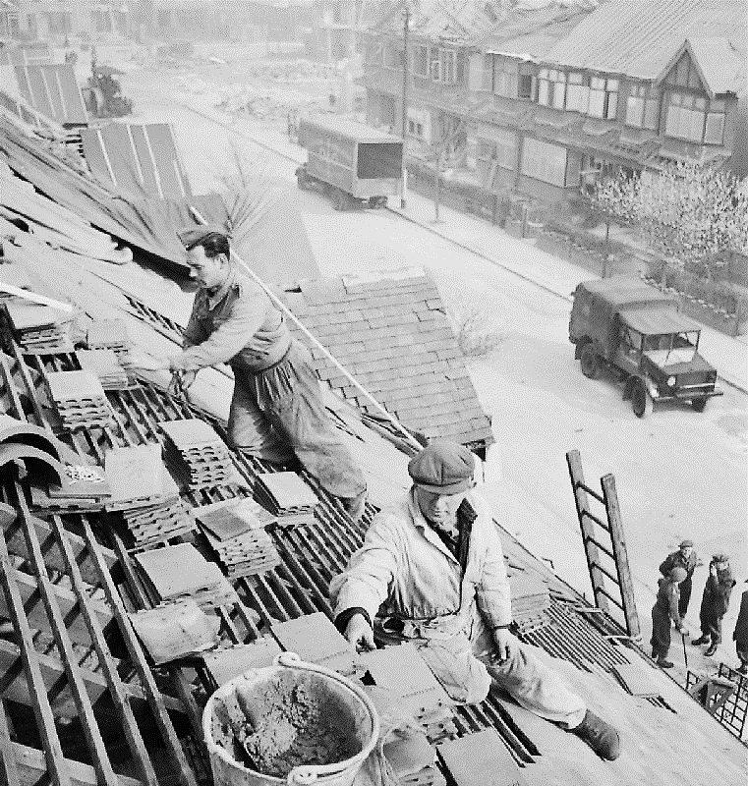
Repairing Bomb-damaged Housing, WWII
Imperial War Museum
London, England

Slide 14
Have mercy on me, O God,
according to your steadfast love; according to your abundant mercy blot out my transgressions.
Psalm 51:1

Slide 15
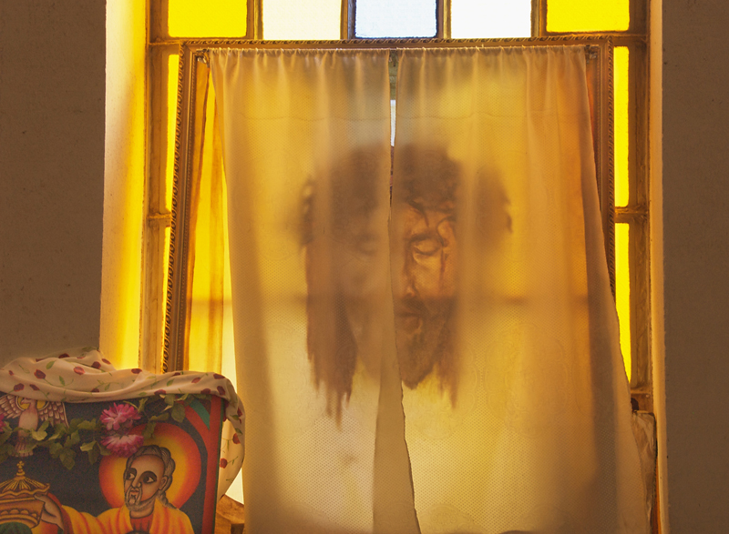
Translucence -- Church of Saint Mary of Zion, Axum, Ethiopia

Slide 16
Restore to me the joy of your salvation, and sustain in me a willing spirit.
Psalm 51:12

Slide 17
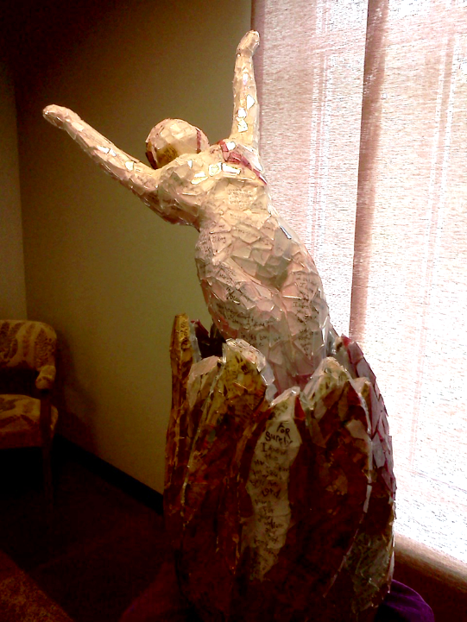
Beloved
Linda Crossan
Second Presbyterian Church
Nashville, TN

Slide 18
but as servants of God we have commended ourselves … in purity, knowledge, patience, kindness, holiness of spirit, genuine love …
2 Corinthians 6:4a, 6

Slide 19
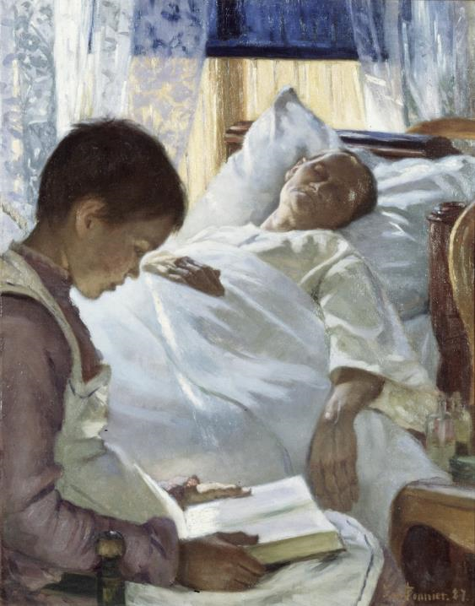
Reflection in Blue
Eva Bonnier
Nationalmuseum
Stockholm, Sweden

Slide 20
"And whenever you pray, do not be like the hypocrites; for they love to stand and pray in the synagogues and at the street corners, so that they may be seen by others."
Matthew 6:5a

Slide 21
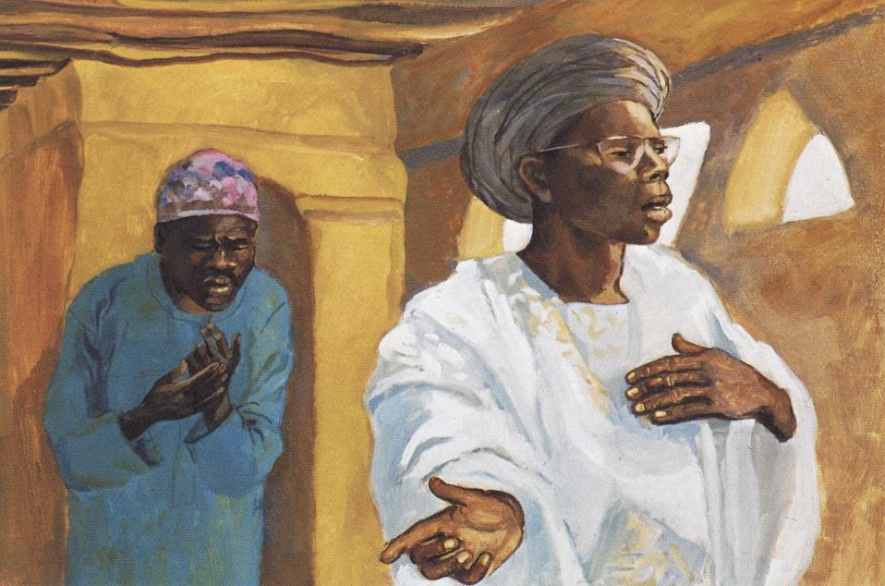
The Pharisee and the Publican -- JESUS MAFA, Cameroon

Slide 22
"Do not store up for yourselves treasures on earth … but store up for yourselves treasures in heaven … For where your treasure is, there your heart will be also."
Matthew 6:19a, 20a, 21

Slide 23
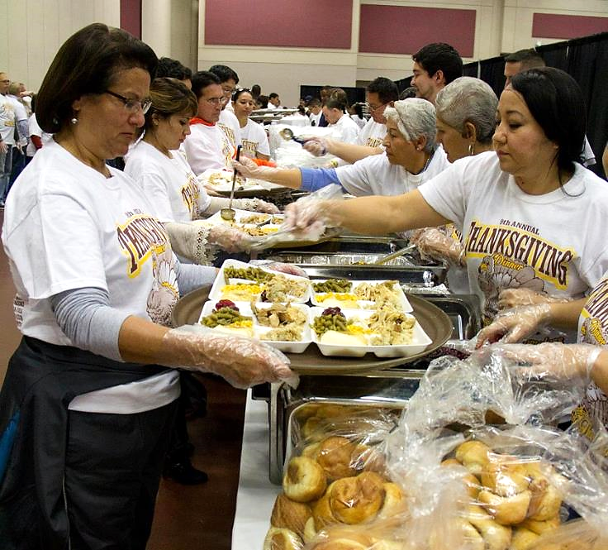
Members of the Fort Bliss and El Paso community prepare Thanksgiving dinner for El Pasoans in need

Slide 24
Credits
New Revised Standard Version Updated Edition Bible, copyright 2022, Division of Christian Education of the National Council of the Churches of Christ in the United States of America. Used by permission. All rights reserved.
https://www.flickr.com/photos/shockinglytasty/15117071790
www.robertharding.com
https://commons.wikimedia.org/wiki/File:Women_miners.jpg
https://www.flickr.com/photos/fredspoonphotos/62292168 - Philip Evans
https://commons.wikimedia.org/wiki/File:George_Elgar_Hicks_-_The_Parish_Soup_Kitchen.jpg
http://commons.wikimedia.org/wiki/File:Caspar_David_Friedrich_019.jpg
https://commons.wikimedia.org/wiki/File:Post_War_Planning_and_Reconstruction_in_Britain-_Repairing_Bomb_Damaged_Housing_D24218.jpg
https://commons.wikimedia.org/wiki/File:Transluscence_(2846120100).jpg
http://diglib.library.vanderbilt.edu/act-imagelink.pl?RC=55303
https://commons.wikimedia.org/wiki/File:Reflection_in_Blue_(Eva_Bonnier)_-_Nationalmuseum_-_18706.tif
http://diglib.library.vanderbilt.edu/act-imagelink.pl?RC=48268
https://commons.wikimedia.org/wiki/File:Fort_Bliss_soldiers,_El_Paso_community_help_feed_homeless_families_on_Thanksgiving_131128-A-JV906-214.jpg
http://diglib.library.vanderbilt.edu/act-imagelink.pl?RC=48268
Additional descriptions can be found at the Art in the Christian Tradition image library, a service of the Vanderbilt Divinity Library, http://diglib.library.vanderbilt.edu/. All images available via Creative Commons 3.0 License.

