Slide 1
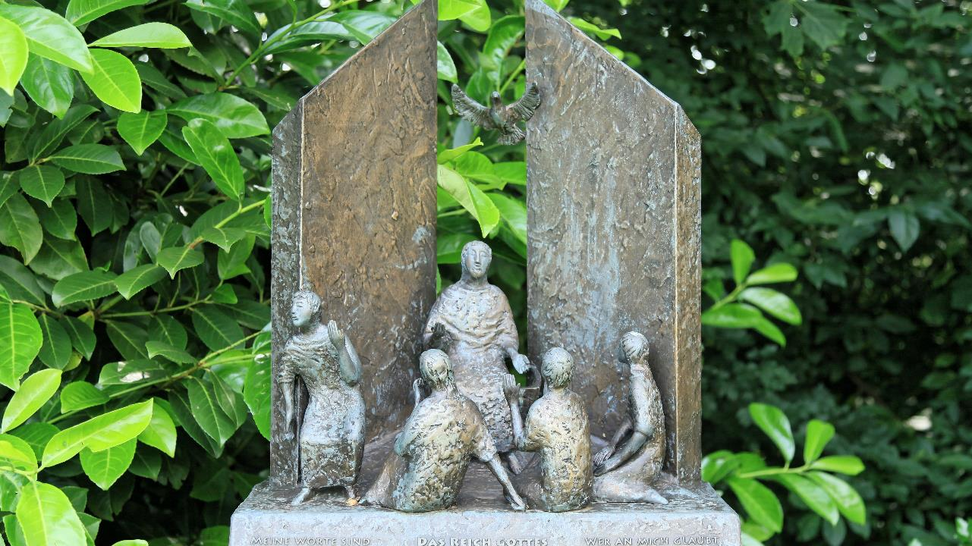
All Saints Day
Year C
Daniel 7:1-3, 15-18 and Psalm 149 • Ephesians 1:11-23 Luke 6:20-31

Slide 2
"But the holy ones of the Most High shall receive the kingdom and possess the kingdom forever--forever and ever."
Daniel 7:18

Slide 3
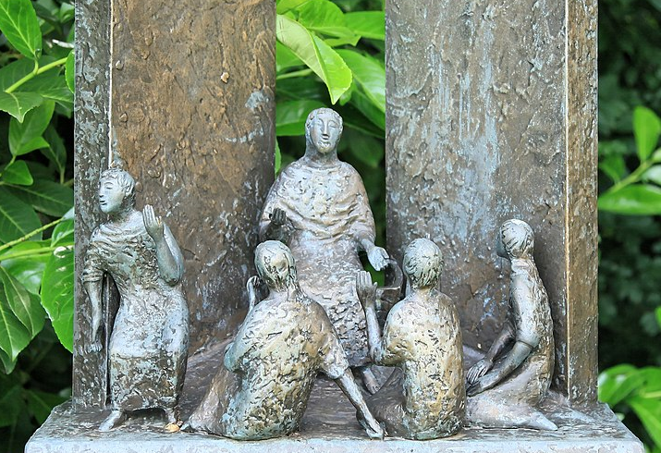
The Kingdom of God -- Michael Franke, Marienpark, Heede Germany

Slide 4
Let Israel be glad in its Maker … Let them praise his name with dancing, making melody to him with tambourine and lyre.
Psalm 149:2a, 3

Slide 5
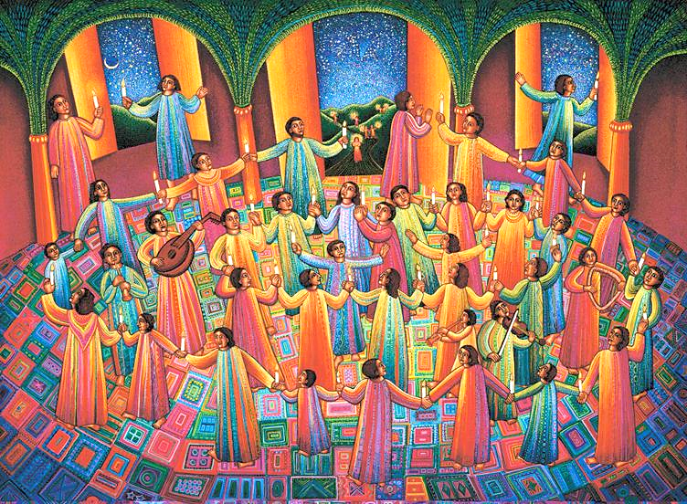
Celebration -- John August Swanson, print, 1997

Slide 6
I have heard of your faith in the Lord Jesus and your love toward all the saints, and for this reason … I remember you in my prayers.
Ephesians 1:15, 16b

Slide 7
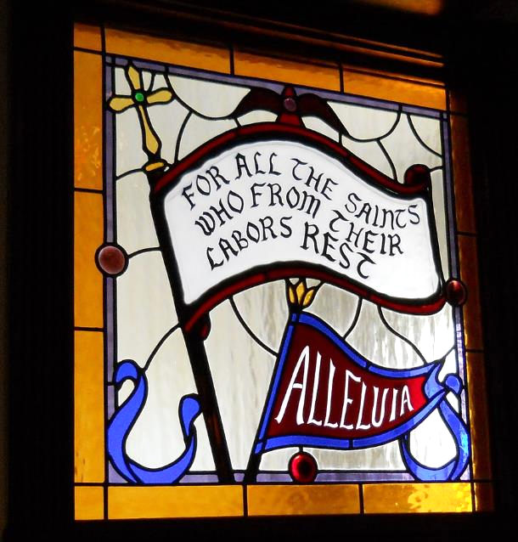
Hymn "For All the Saints" -- All Saints Episcopal Church, Jensen Beach, FL

Slide 8
Then he looked up at his disciples and said:
"Blessed are you who are poor, for yours is the kingdom of God.
Luke 6:20

Slide 9
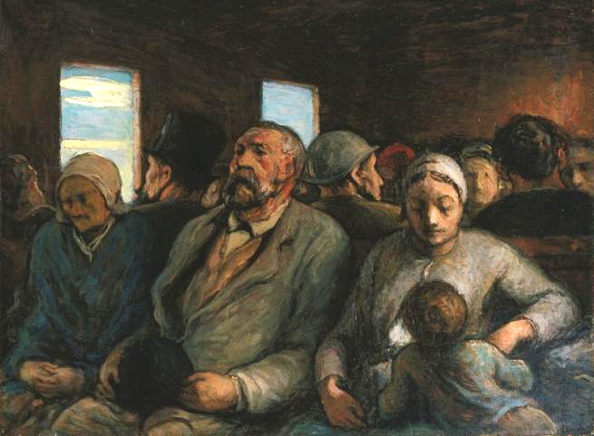
Third Class Carriage -- Honoré Daumier, Palace of Legion of Honor, San Francisco, CA

Slide 10
"Blessed are you who are hungry now, for you will be filled. "Blessed are you who weep now, for you will laugh.
Luke 6:21

Slide 11
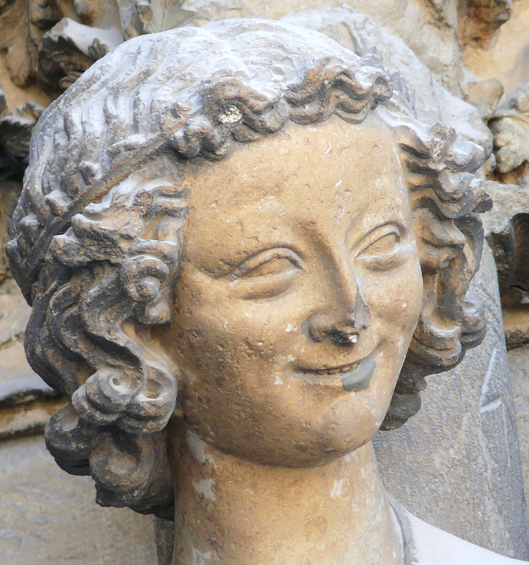
The Laughing Angel
Reims Cathedral Reims, France

Slide 12
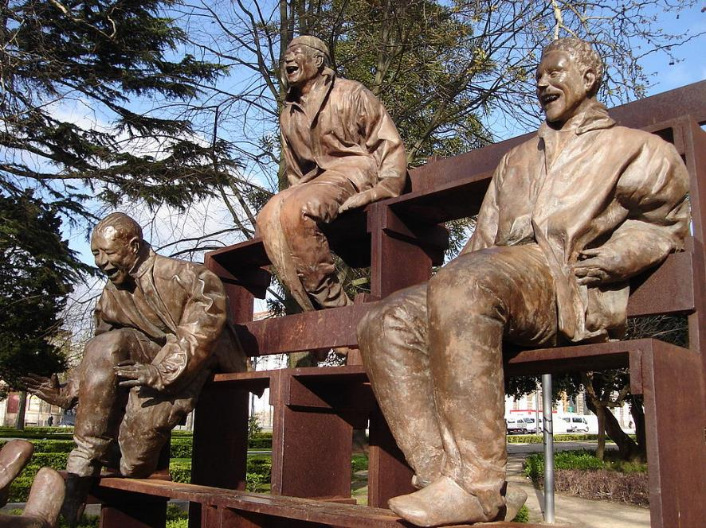
Thirteen Laughing Men -- Juan Muñoz, Porto, Portugal

Slide 13
"Blessed are you when people hate you, and when they exclude you, revile you, and defame you on account of the Son of Man.
Luke 6:22

Slide 14
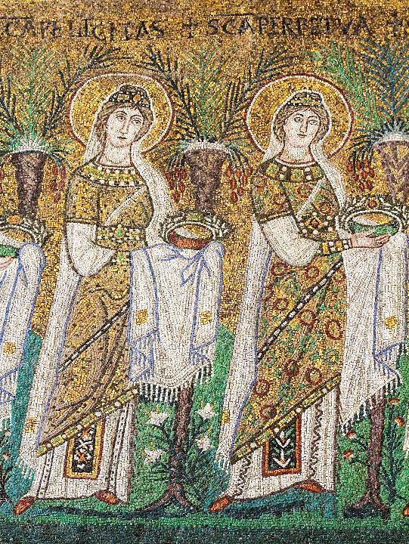
Felicitas and Perpetua
Martyrs of the early 3rd c.
Sant'Apollinare Nuovo
Ravenna, Italy

Slide 15
Rejoice in that day and leap for joy, for surely your reward is great in heaven; for that is how their ancestors treated the prophets.
Luke 6:23

Slide 16
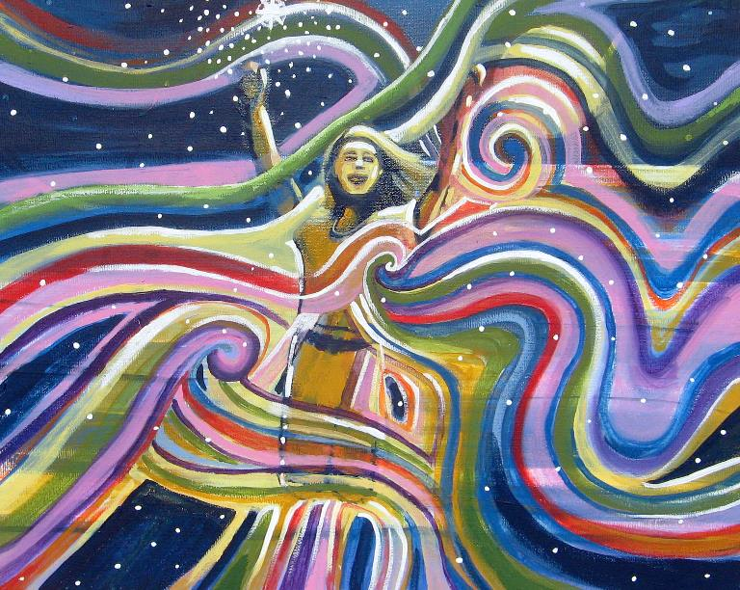
Manifest Joy -- Kori Vincent

Slide 17
"But I say to you who are listening, Love your enemies, do good to those who hate you,
Luke 6:27

Slide 18
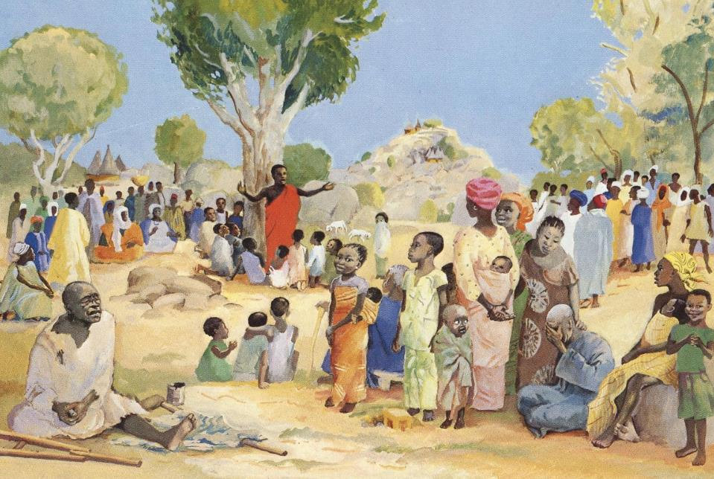
The Sermon on the Mount -- JESUS MAFA, Cameroon

Slide 19
bless those who curse you, pray for those who mistreat you.
Luke 6:28

Slide 20
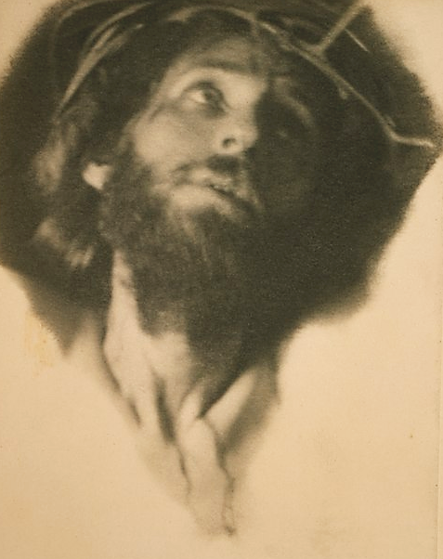
"Father Forgive Them…" -- Fred Holland, photographic print, 1898, Library of Congress

Slide 21
If anyone strikes you on the cheek, offer the other also; and from anyone who takes away your coat do not withhold even your shirt.
Luke 6:29

Slide 22
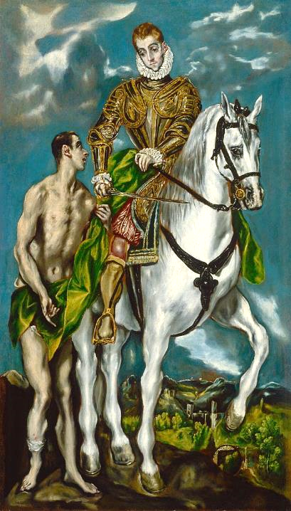
St. Martin and the Beggar
El Greco
National Gallery of Art
Washington, DC

Slide 23
Do to others as you would have them do to you.
Luke 6:31

Slide 24
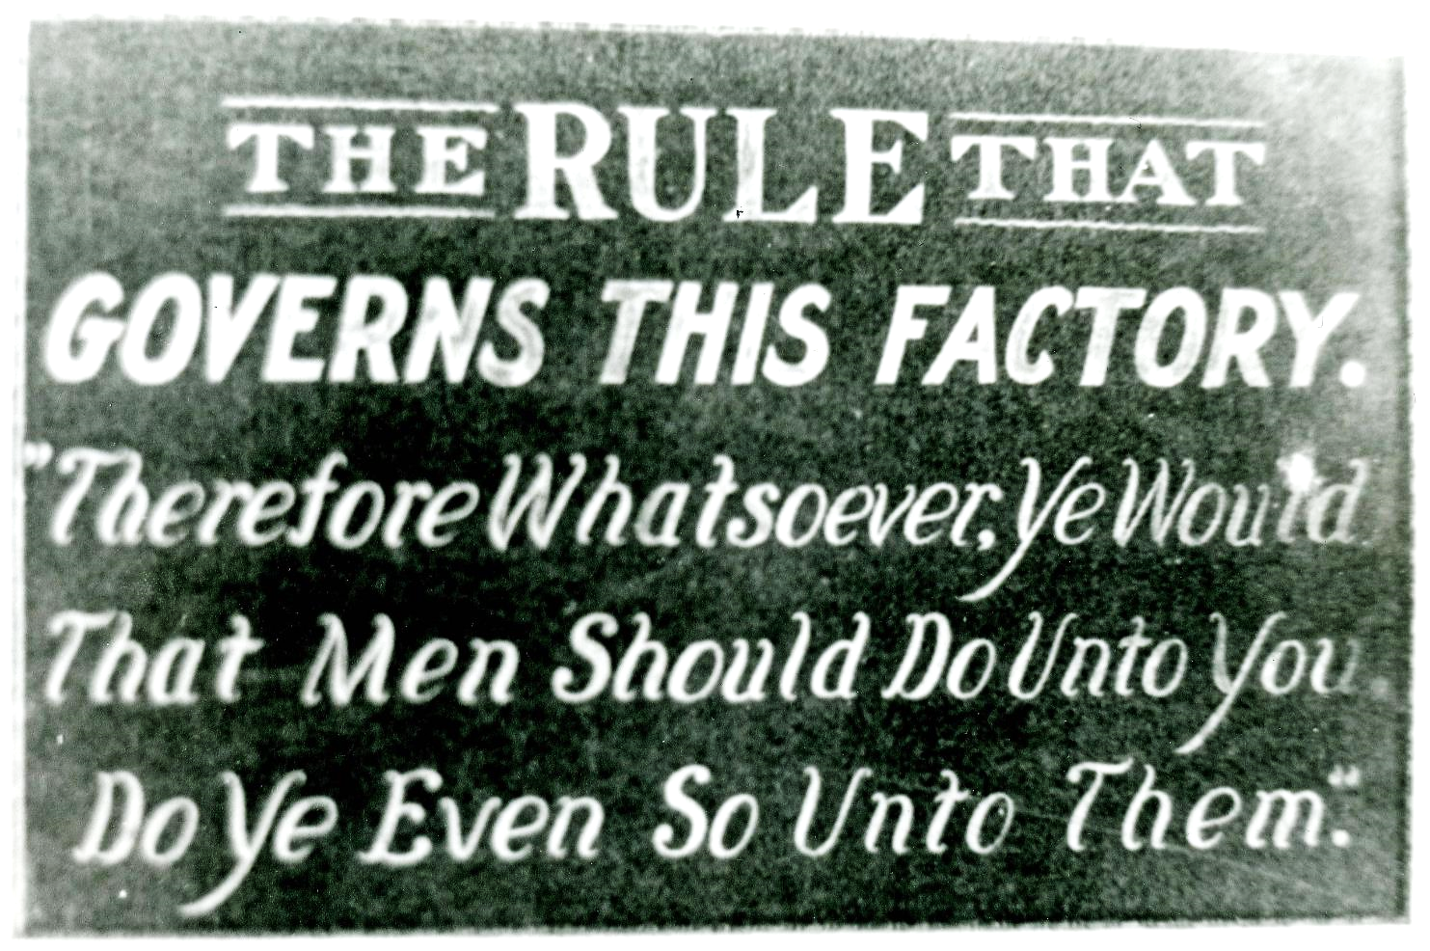
Golden Rule -- Acme Sucker Rod Factory, Toldeo, OH, 1913. Toledo-Lucas County Public Librarys

Slide 25
Credits
New Revised Standard Version Updated Edition Bible, copyright 2022, Division of Christian Education of the National Council of the Churches of Christ in the United States of America. Used by permission. All rights reserved.
https://commons.wikimedia.org/wiki/File:Heede_-_Kirchstra%C3%9Fe_-_Gebetsst%C3%A4tte_-_Marienpark_-_Rosaries_-_The_Five_Luminous_Mysteries_-_Kingdom_of_God_01_ies.jpg
www.JohnAugustSwanson.com - copyright 1997 by John August Swanson
https://commons.wikimedia.org/wiki/File:All_Saints_Episcopal_Church_Jensen_Beach_Florida_012.JPG
http://commons.wikimedia.org/wiki/File:Third_Class_Carriage_(1856-1858)_by_Honore_Daumier.jpg
https://commons.wikimedia.org/wiki/File:Laughing_angel_Reims.jpg
https://commons.wikimedia.org/wiki/File:ThirteenLaughing.JPG
https://www.flickr.com/photos/paullew/12987648725 - Fr Lawrence Lew, O.P.
https://www.flickr.com/photos/mylittlecornerdesign/8615923295/
http://diglib.library.vanderbilt.edu/act-imagelink.pl?RC=48284
https://commons.wikimedia.org/wiki/File:Christ_with_crown_of_thorns,_looking_up_LCCN98501330.tif
https://commons.wikimedia.org/wiki/File:Anonymous_after_El_Greco_-_St._Martin_and_the_Beggar_(NGA).jpg
https://commons.wikimedia.org/wiki/File:Golden_rule_sign_-_DPLA_-_dc36bf3cafa422023a790c77caebc235.jpg
Additional descriptions can be found at the Art in the Christian Tradition image library, a service of the Vanderbilt Divinity Library, http://diglib.library.vanderbilt.edu/. All images available via Creative Commons 3.0 License.

