Slide 1
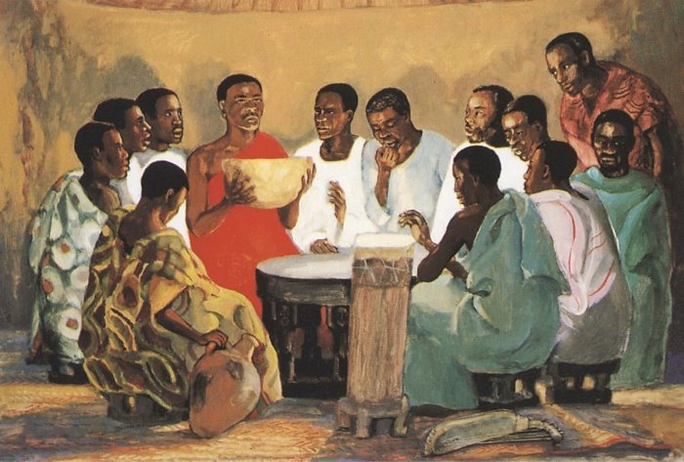
Wednesday of Holy Week
Year B
Isaiah 50:4-9a
Psalm 70
Hebrews 12:1-3
John 13:21-32

Slide 2
I gave my back to those who struck me and my cheeks to those who pulled out the beard; I did not hide my face from insult and spitting.
Isaiah 50:6

Slide 3
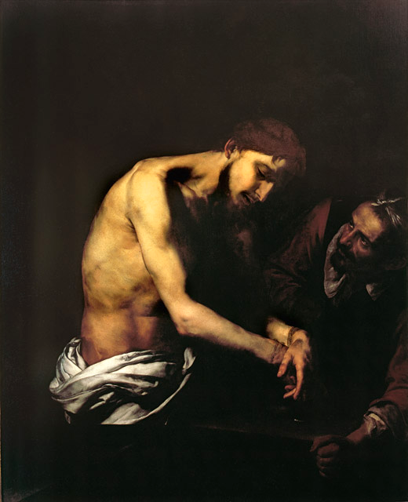
Flagellation of Christ
Jusepe de Ribera
Girolamini Gallery, Naples, Italy

Slide 4
Be pleased, O God, to deliver me. O LORD, make haste to help me!
Psalm 70:1

Slide 5
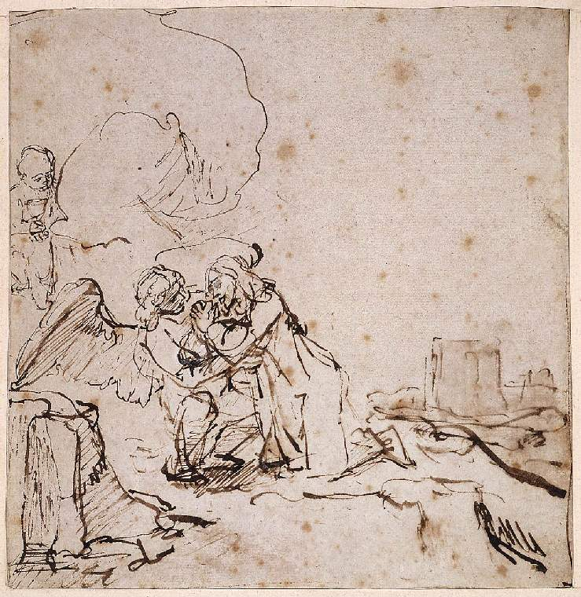
Agony in the Garden
Rembrandt
Fitzwilliam Museum
Cambridge, England

Slide 6
…since we are surrounded by so great a cloud of witnesses, …let us run with perseverance the race that is set before us…
Hebrews 12:1ac

Slide 7
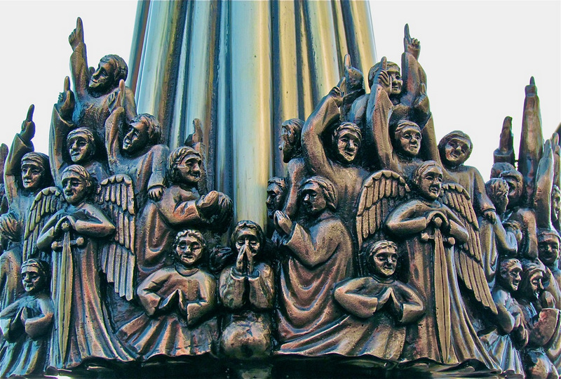
Heaven Holds a Sense of Wonder -- Famke van Wijk, The Hague, Netherlands

Slide 8
After saying this Jesus was troubled in spirit and declared, "Very truly, I tell you, one of you will betray me."
John 13:21

Slide 9

Last Supper -- JESUS MAFA, Cameroon

Slide 10
Jesus said to him, "Do quickly what you are going to do."
John 13:27b

Slide 11
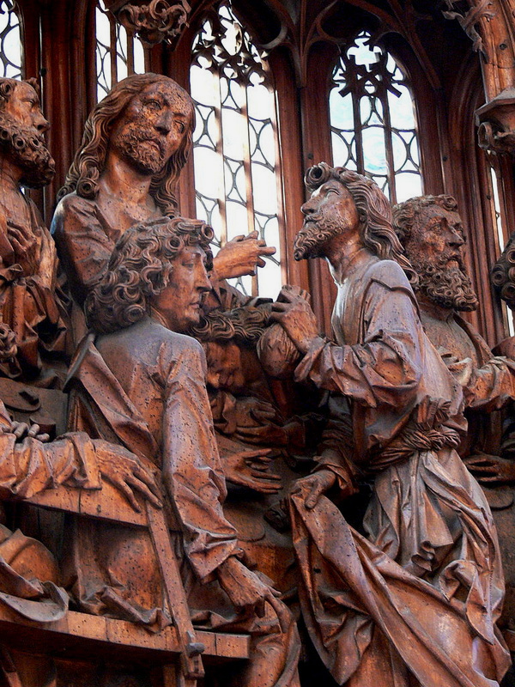
Christ Speaking to Judas,
Tilman Riemenschneider
St. James,
Rothenburg ob der Tauber, Germany

Slide 12
Some thought that, because Judas had the common purse, Jesus was telling him, "Buy what we need for the festival," or that he should give something to the poor.
John 13:29

Slide 13
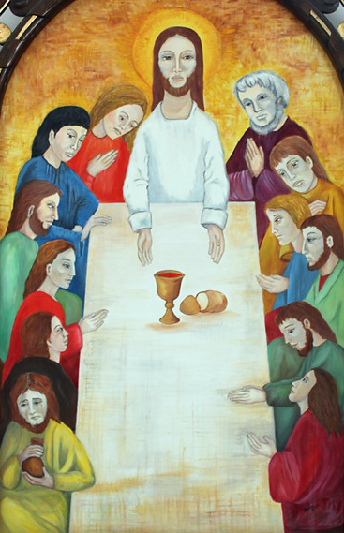
Last Supper
Cathedral of Sancti Spiritus, Sancti Spiritus, Cuba

Slide 14
...Jesus said, "Now the Son of Man has been glorified, and God has been glorified in him."
John 13:31b

Slide 15

Last Supper
Indigenous People's Weaving
Australian Museum
Sydney, Australia

Slide 16
Credits
New Revised Standard Version Updated Edition Bible, copyright 2022, Division of Christian Education of the National Council of the Churches of Christ in the United States of America. Used by permission. All rights reserved.
https://commons.wikimedia.org/wiki/File:The_Flagellation_of_ChrisSpagnGirolamNaples.jpg
https://commons.wikimedia.org/wiki/File:Rembrandt_The_Agony_in_the_Garden.jpg
http://www.flickr.com/photos/roel1943/5414772066
http://diglib.library.vanderbilt.edu/act-imagelink.pl?RC=48272
http://commons.wikimedia.org/wiki/File:Heilig-Blut-Altar_-_Abendmahl_04.jpg
http://commons.wikimedia.org/wiki/File:2012-02-Kathedrale_Sancti_Spiritus_04_anagoria.JPG
http://www.flickr.com/photos/stolenbyme/64142017/
Additional descriptions can be found at the Art in the Christian Tradition image library, a service of the Vanderbilt Divinity Library, http://diglib.library.vanderbilt.edu/. All images available via Creative Commons 3.0 License.

