Slide 1
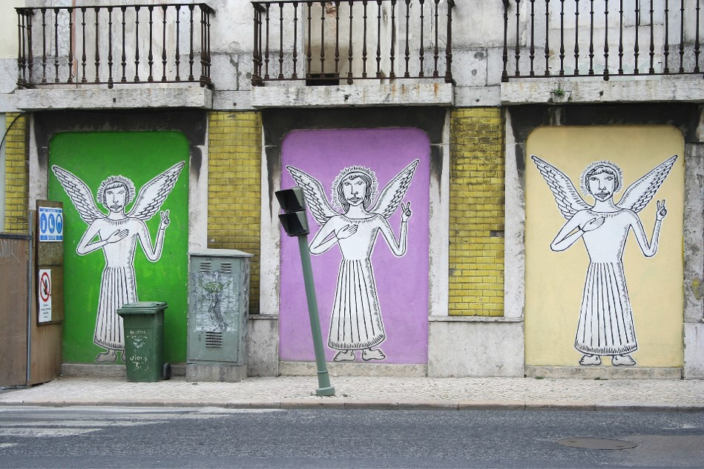
Third Sunday in Lent
Year B
Exodus 20:1-17
Psalm 19
1 Corinthians 1:18-25
John 2:13-22

Slide 2
I am the LORD your God, who brought you out of the land of Egypt, out of the house of slavery; you shall have no other gods before me.
Exodus 20:2-3

Slide 3
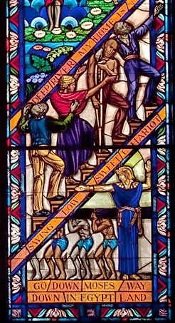
"Go Down Moses"
Singing Windows, detail
J&R Lamb
Tuskeegee University Chapel
Tuskeegee, Alabama

Slide 4
The heavens are telling the glory of God … their voice goes out through all the earth, and their words to the end of the world.
Psalm 19:1a, 4

Slide 5
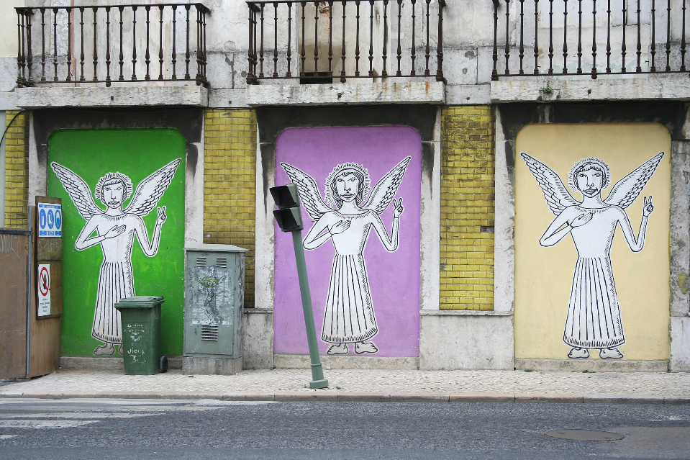
Lisbon's Angels 2 -- Lisbon, Portugal

Slide 6
Let the words of my mouth and the meditation of my heart be acceptable to you, O LORD, my rock and my redeemer.
Psalm 19:14

Slide 7
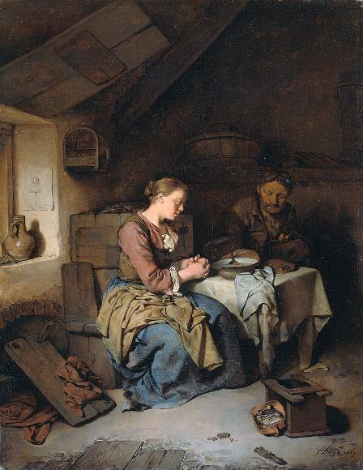
Saying Grace
Cornelis Pietersz Bega
Rijksmuseum
Amsterdam, Netherlands

Slide 8
but we proclaim Christ crucified … to those who are the called, both Jews and Greeks, Christ the power of God and the wisdom of God.
1 Corinthians 1:23a, 24

Slide 9
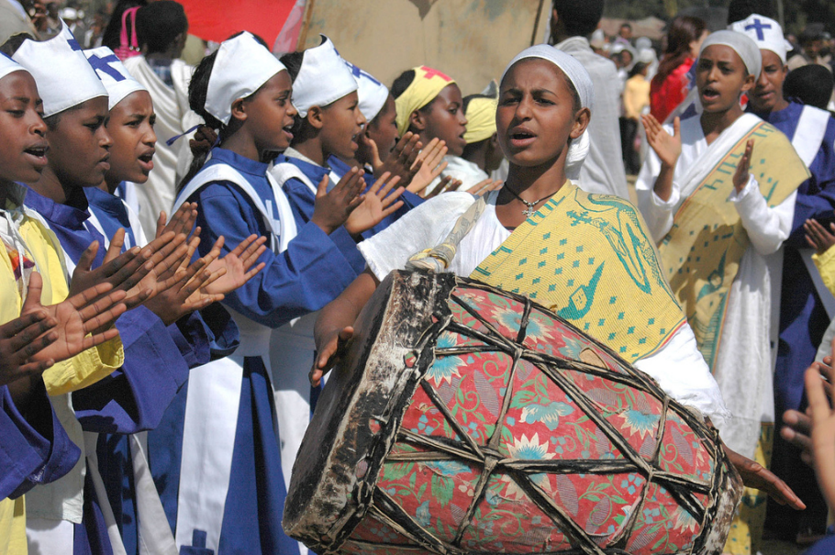
Celebration of Timket, the Ethiopian Orthodox Festival of Epiphany, Addis Ababa, Ethiopia

Slide 10
The Passover of the Jews was near, and Jesus went up to Jerusalem.
John 2:13

Slide 11
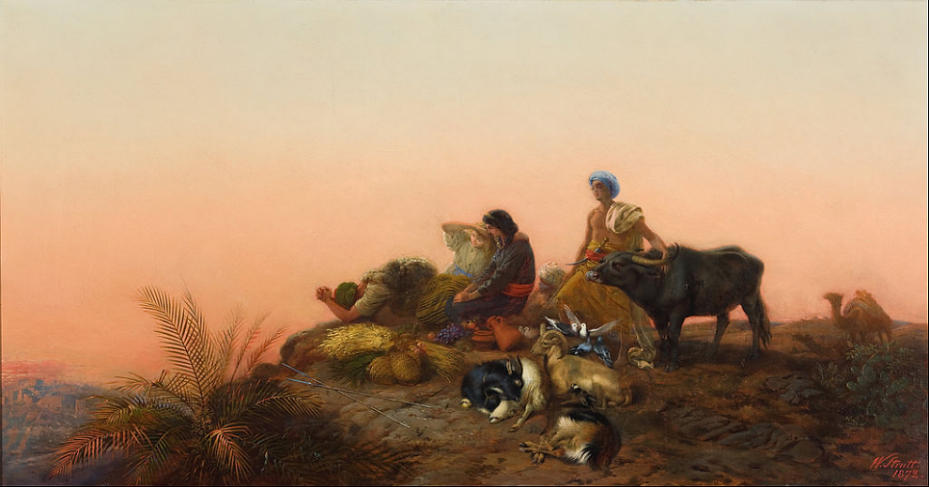
Jerusalem Pilgrims -- William Strutt, Art Gallery of South Australia, Adelaide, Australia

Slide 12
In the temple he found people selling cattle, sheep, and doves, and the money changers seated at their tables.
John 2:14

Slide 13
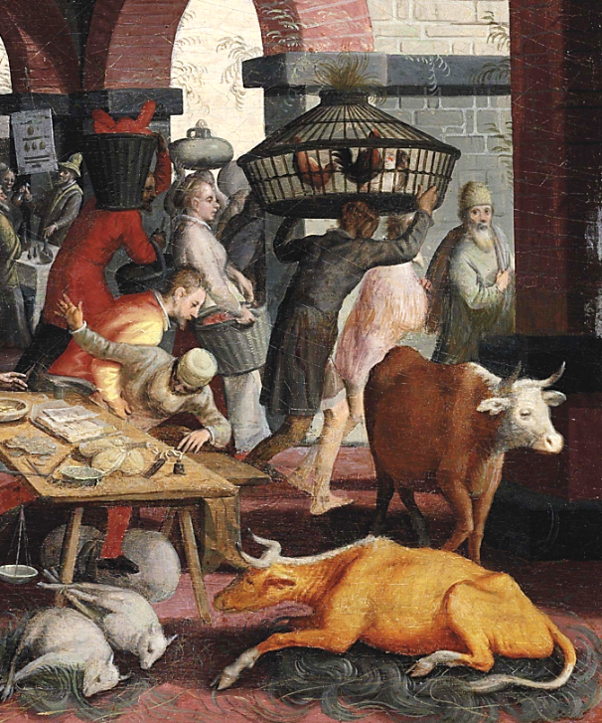
Christ and the Tradesmen and Moneychangers, detail
Pieter Aertsen
Mid 16th century

Slide 14
… he drove all of them out of the temple, both the sheep and the cattle. He also poured out the coins of the money changers and overturned their tables.
John 2:15b

Slide 15
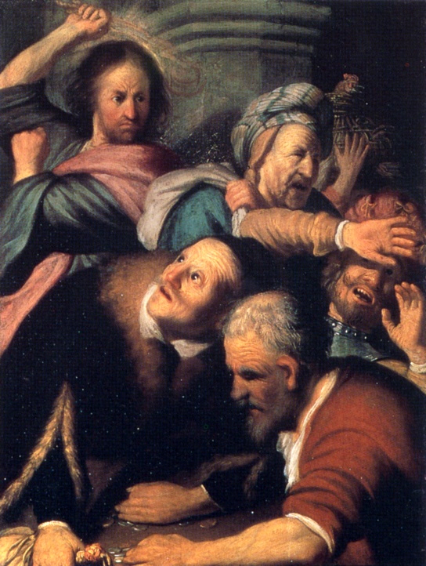
Christ Driving the Money-changers from the Temple
Rembrandt
Pushkin Museum
Moscow, Russia

Slide 16
He told those who were selling the doves, "Take these things out of here! Stop making my Father's house a marketplace!"
John 2:16

Slide 17
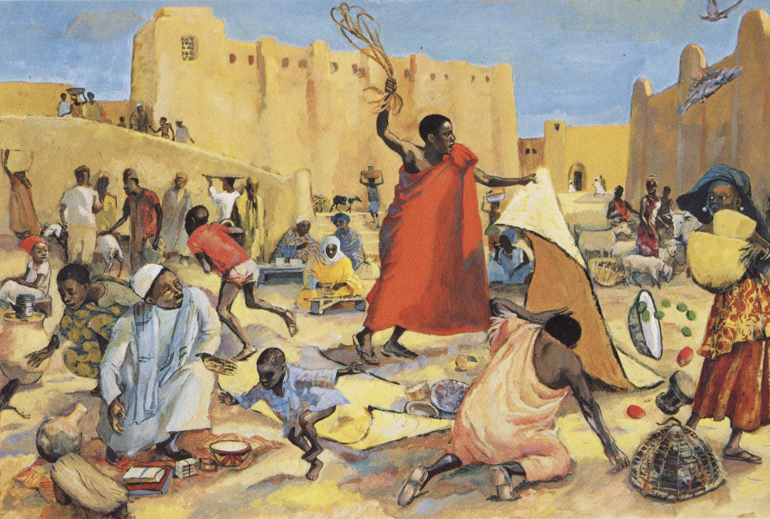
Jesus Drives Out the Merchants -- JESUS MAFA

Slide 18
The Jews then said to him, "What sign can you show us for doing this?"
John 2:18

Slide 19
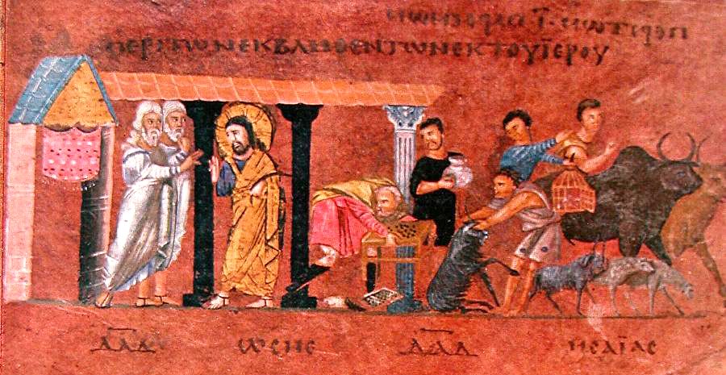
Cleansing of the Temple -- Rossano Gospels, 6th c., Rosanno Cathedral, Rosanno, Italy

Slide 20
Jesus answered them, "Destroy this temple, and in three days I will raise it up."
John 2:19

Slide 21
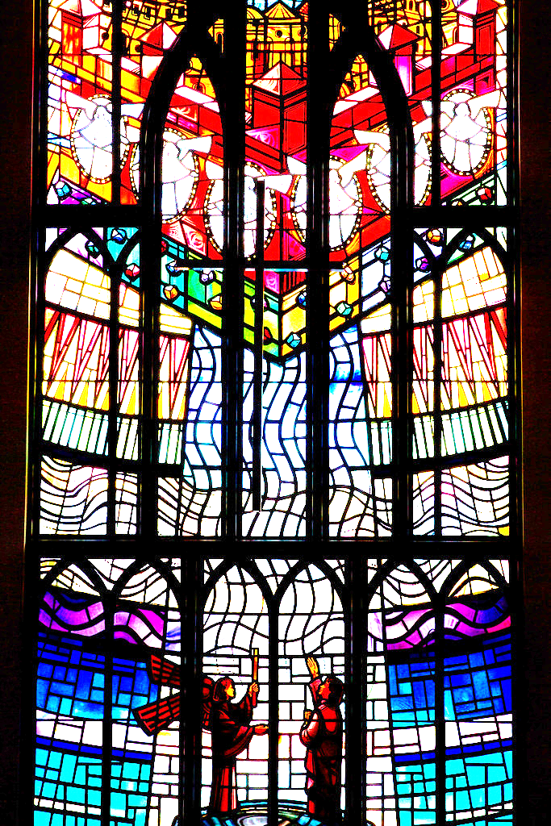
Resurrection
Christ Church Cathedral
Victoria, British Columbia

Slide 22
After he was raised from the dead, his disciples remembered that he had said this; and they believed the scripture and the word that Jesus had spoken.
John 2:22

Slide 23
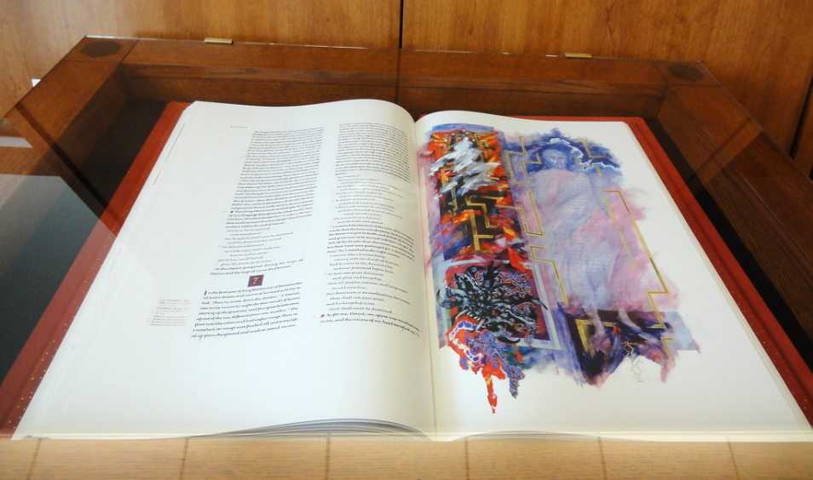
Saint John's Bible -- Saint John's Abbey and Seminary, Donald Jackson, chief scribe

Slide 24
Credits
New Revised Standard Version Updated Edition Bible, copyright 2022, Division of Christian Education of the National Council of the Churches of Christ in the United States of America. Used by permission. All rights reserved.
https://commons.wikimedia.org/wiki/File:Singing_Windows_stained_glass,_designed_by_J%26R_Lamb,_located_in_the_University_chapel_at_Tuskegee_University,_Tuskegee,_Alabama_LCCN2010637794.tif
https://www.flickr.com/photos/arteurbana/8168022869 - Manuel Faisco
http://commons.wikimedia.org/wiki/File:BegaPrayer.jpg
https://www.flickr.com/photos/andrewheavens/88544244/ - Andrew Heavens
https://commons.wikimedia.org/wiki/File:William_Strutt_-_Jerusalem_pilgrims_-_Google_Art_Project.jpg
https://commons.wikimedia.org/wiki/File:Pieter_Aertsen_Christ_cleansing_the_Temple.png
https://commons.wikimedia.org/wiki/File:Rembrandt_Christ_Driving_the_Money_Changers_from_the_Temple.jpg
http://diglib.library.vanderbilt.edu/act-imagelink.pl?RC=48271
https://commons.wikimedia.org/wiki/File:Rossano_Gospels_-_Cleansing_of_the_Temple.jpg
https://www.flickr.com/photos/eyesplash/6911549426 - Mike
https://www.flickr.com/photos/jimforest/5682093175 - Jim Forest
Additional descriptions can be found at the Art in the Christian Tradition image library, a service of the Vanderbilt Divinity Library, http://diglib.library.vanderbilt.edu/. All images available via Creative Commons 3.0 License.

