Slide 1
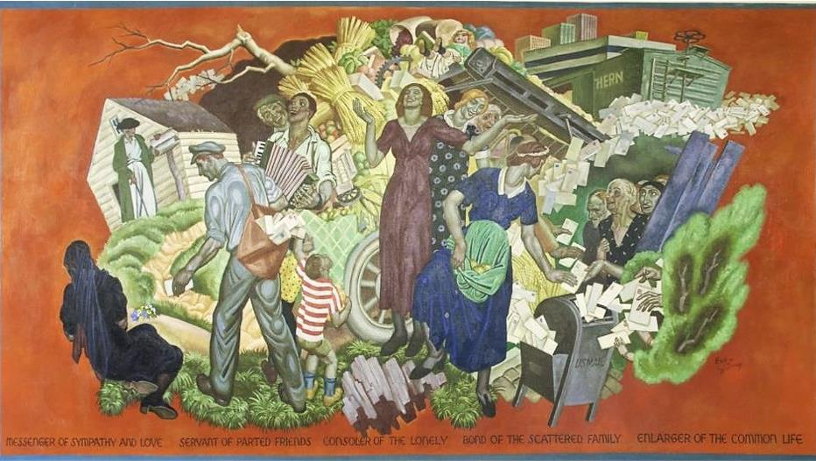
Sixth Sunday of Easter
Year B
Acts 10:44-48
Psalm 98
1 John 5:1-6
John 15:9-17

Slide 2
While Peter was still speaking, the Holy Spirit fell upon all who heard the word.
Acts 10:44

Slide 3
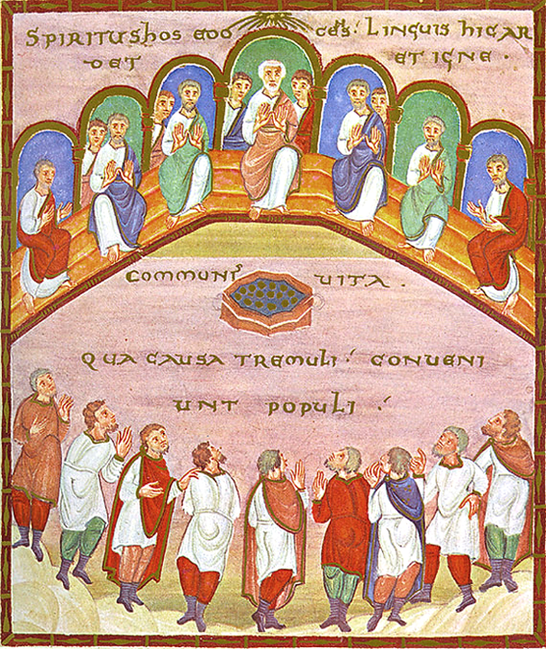
Holy Spirit Comes to the Disciples
Stadtbibliothek Trier
Trier, Germany

Slide 4
The circumcised believers…were astounded that the gift of the Holy Spirit had been poured out even on the gentiles…
Acts 10:45

Slide 5
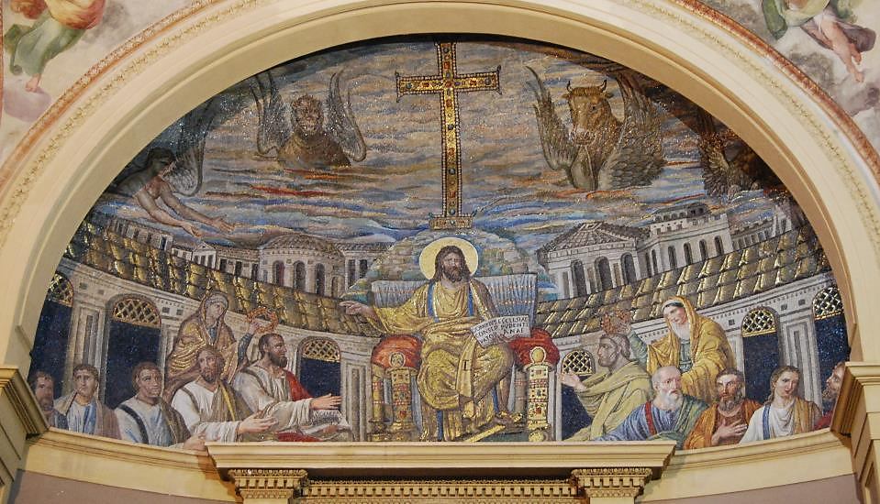
Christ with Christians, Jews, and Gentiles -- Santa Pudenziana, Rome, Italy
Notes:
Santa Pudenziana

Slide 6
Make a joyful noise to the LORD, all the earth; break forth into joyous song and sing praises.
Psalm 98:4

Slide 7
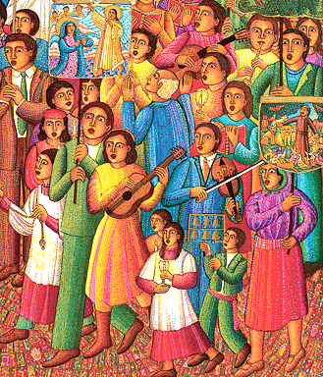
Procession, detail
John August Swanson

Slide 8
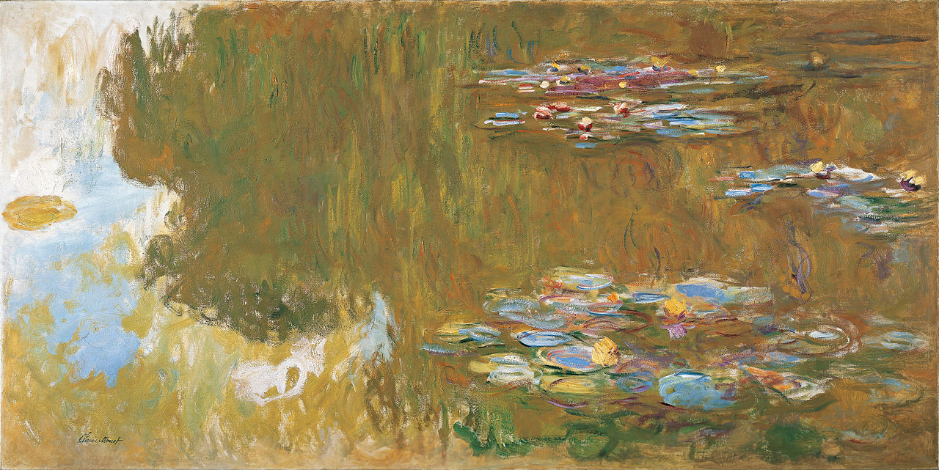
Water Lily Pond -- Claude Monet, Albertina, Vienna, Austria

Slide 9
…we love the children of God, when we love God and obey his commandments.
1 John 5:2b

Slide 10
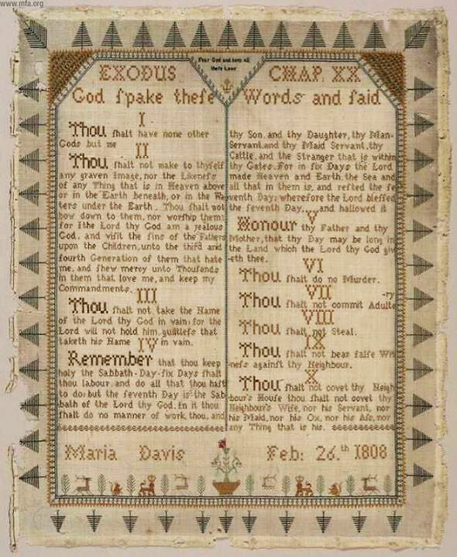
Ten Commandments
Maria Davis
Museum of Fine Arts
Boston, MA

Slide 11
...the Spirit is the one that testifies, for the Spirit is the truth.
1 John 5:6b

Slide 12
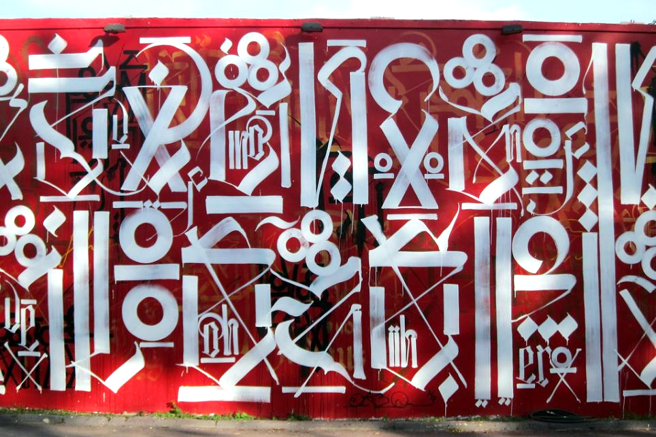
Save the Holy Spirits -- RETNA – Marcus Lewis, Miami, FL
Notes:
+

Slide 13
"As the Father has loved me, so I have loved you; abide in my love."
John 15:9

Slide 14
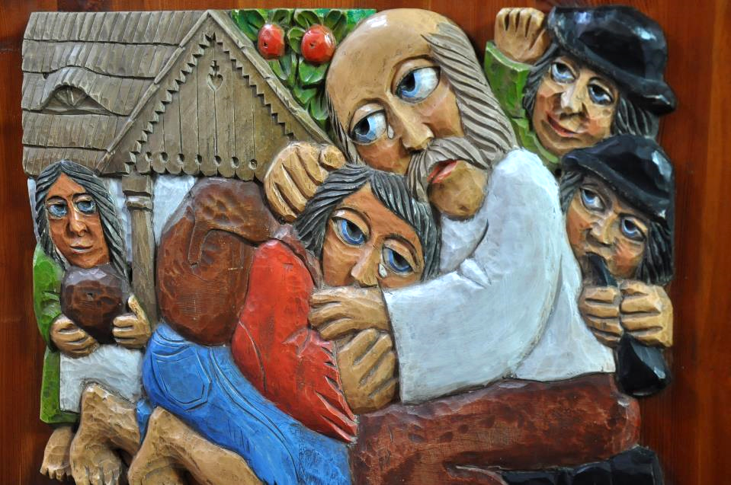
Prodigal Son -- Church carving, Poland

Slide 15
"This is my commandment, that you love one another as I have loved you."
John 15:12

Slide 16
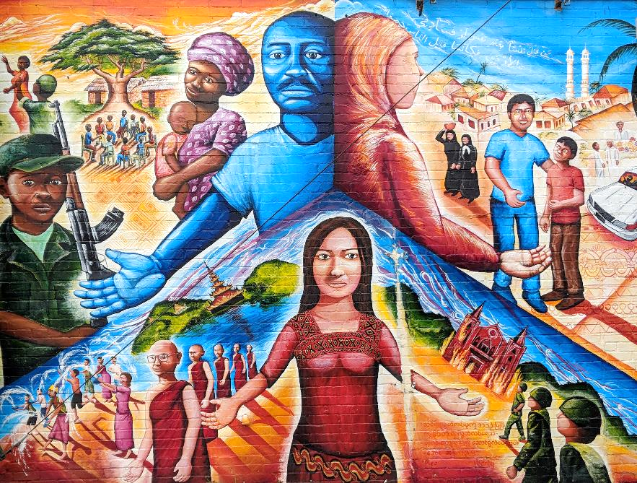
Global Refugee Mural -- Joel Bergner, Silver Spring, MD

Slide 17
"I have said these things to you so that my joy may be in you and that your joy may be complete."
John 15:11

Slide 18
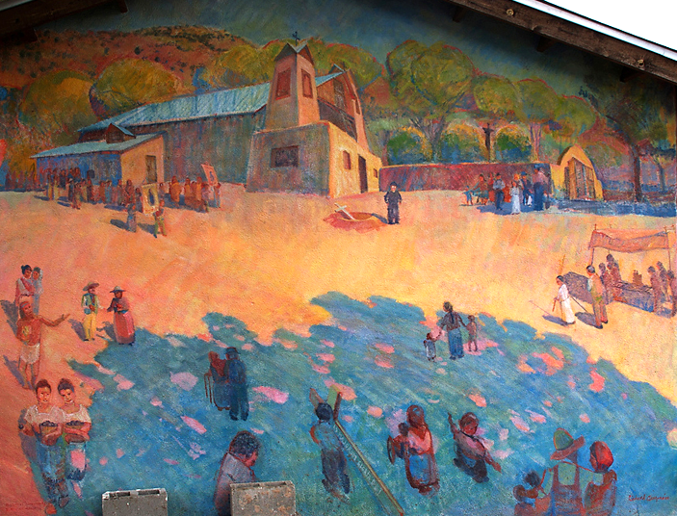
Gathering to Worship -- Sanctuario de Chimayo, Chimayo, NM

Slide 19
"...I have called you friends, because I have made known to you everything that I have heard from my Father."
John 15:15b

Slide 20
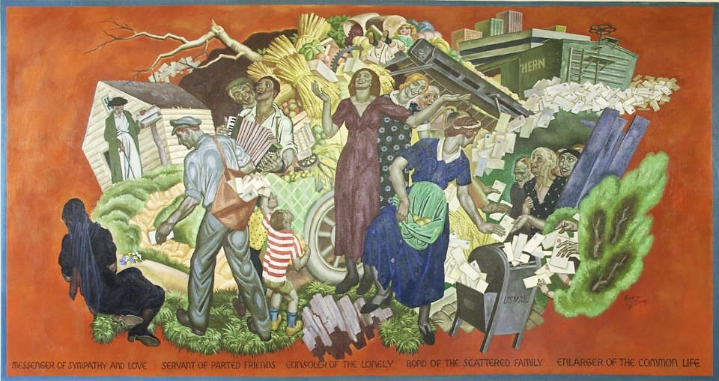
Messenger of Sympathy and Love -- Eugene Savage, Ariel Rios Federal Bldg, Washington, DC

Slide 21
"No one has greater love than this, to lay down one's life for one's friends."
John 15:13

Slide 22
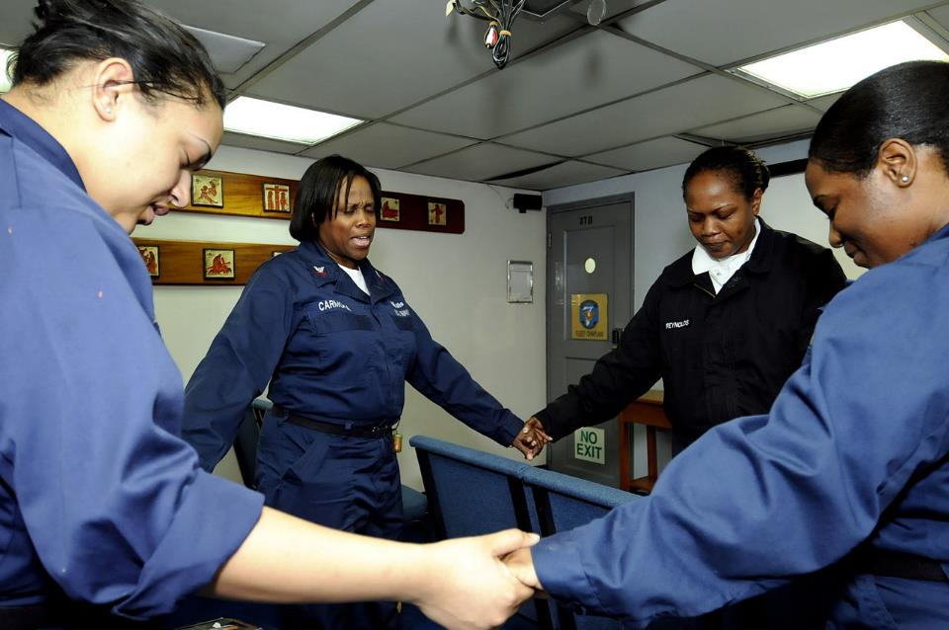
Bible Study -- Amphibious Command Ship USS Blue Ridge

Slide 23
"I am giving you these commands so that you may love one another."
John 15:17

Slide 24
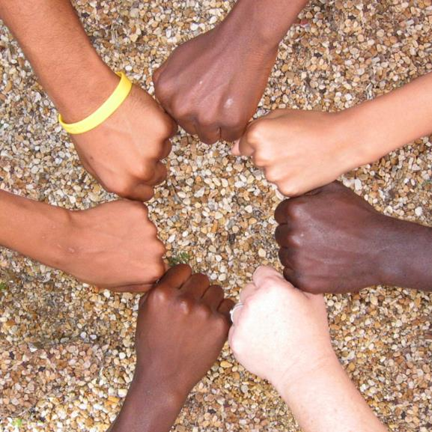
Hands All Together -- Avondale Pattillo United Methodist Church, Decatur, GA

Slide 25
Credits
New Revised Standard Version Updated Edition Bible, copyright 2022, Division of Christian Education of the National Council of the Churches of Christ in the United States of America. Used by permission. All rights reserved.
http://commons.wikimedia.org/wiki/File:CodexEgberti-Fol103-Pentecost.jpg
http://www.flickr.com/photos/swperman/221008978/
www.JohnAugustSwanson.com - copyright 2007 by John August Swanson
https://commons.wikimedia.org/wiki/File:Claude_Monet,_The_Water_Lily_Pond,_c._1917-19,_frame_cropped,_Google_Art_Project.jpg
http://www.mfa.org/
http://www.flickr.com/photos/feargal/5096170709
https://www.flickr.com/photos/wallyg/6699224589
https://joelartista.com/about/
http://www.flickr.com/photos/yourdon/2744904354/in/set-72157606611500226/
https://commons.wikimedia.org/wiki/File:Mural_%22Messanger_of_sympathy_%26_love,_servant_of_parted_friends,_consoler_of_the_lonely,_bond_of_the_scattered_family,_enlarger_of_the_common_life,_by_Eugene_Francis_Savage_at_the_Ariel_Rios_LCCN2013634517.tif
https://commons.wikimedia.org/wiki/File:US_Navy_090416-N-7478G-112_Participants_in_the_amphibious_command_ship_USS_Blue_Ridge_(LCC_19)_women%27s_Bible_study_group_pray_during_a_weekly_Bible_study_while_the_ship_is_underway.jpg
http://www.flickr.com/photos/apmethodist/1678695596/
Additional descriptions can be found at the Art in the Christian Tradition image library, a service of the Vanderbilt Divinity Library, http://diglib.library.vanderbilt.edu/. All images available via Creative Commons 3.0 License.

