Slide 1
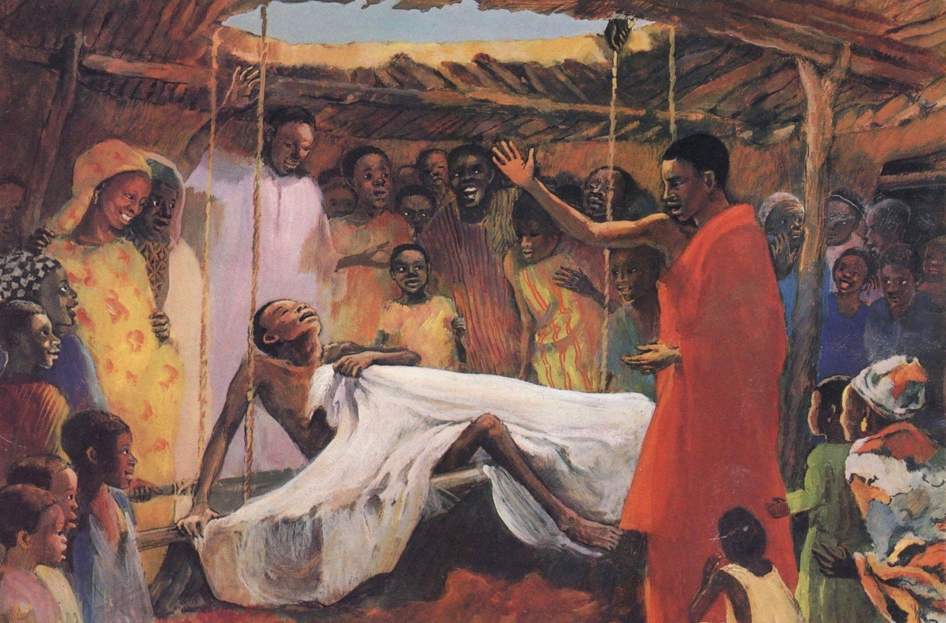
Seventh Sunday after the Epiphany
Year B
Isaiah 43:18-25 • Psalm 41
2 Corinthians 1:18-22 • Mark 2:1-12

Slide 2
I am about to do a new thing; now it springs forth; do you not perceive it? I will make a way in the wilderness and rivers in the desert.
Isaiah 43:19

Slide 3
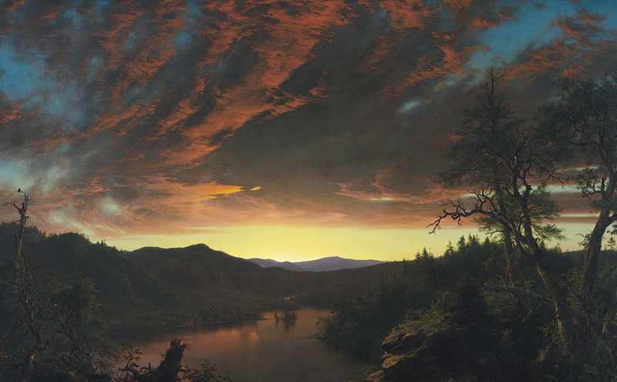
Twilight in the Wilderness, Frederic Edwin Church, 1860

Slide 4
Happy are those who consider the poor...
Psalm 41:1a

Slide 5
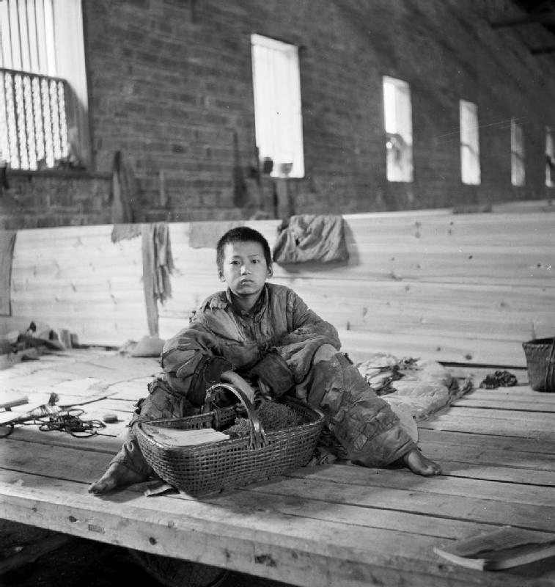
China 1944: A destitute boy with a wicker basket in the Poor People’s Refuge in Changsa
Cecil Beaton, 1944

Slide 6
But you have upheld me because of my integrity and set me in your presence forever.
Psalm 41:12

Slide 7
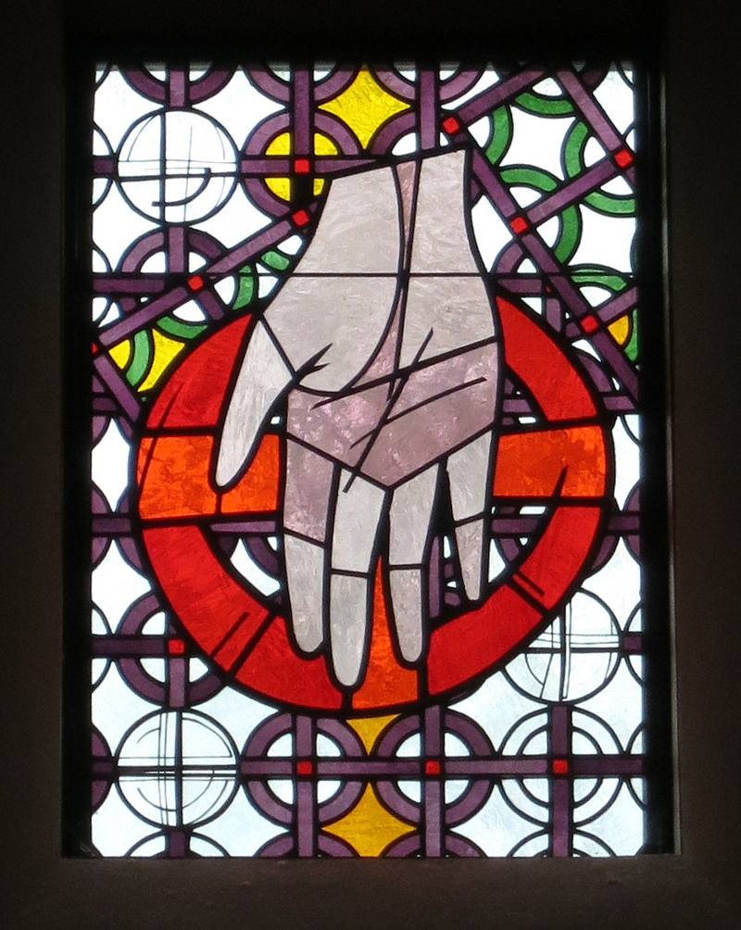
Hand of God
St. Elizabeth Ann Seton Parish, 1992

Slide 8
For this reason it is through him that we say the “Amen,” to the glory of God.
2 Corinthians 1:20b

Slide 9

Amen, 2019

Slide 10
Then some people came, bringing to him a paralyzed man, carried by four of them.
Mark 2:3

Slide 11
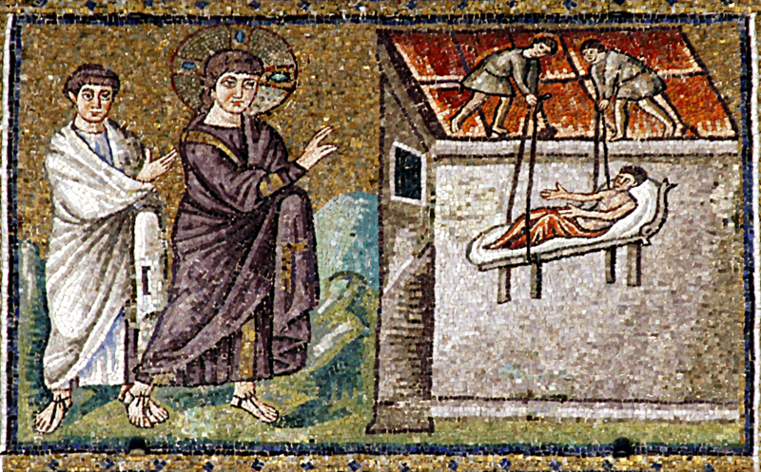
Jesus Healing the Paralytic, Sant’Apollinare Nuovo, 504

Slide 12
And when they could not bring him to Jesus because of the crowd, they removed the roof above him, and after having dug through it, they let down the mat on which the paralytic lay.
Mark 2:4

Slide 13
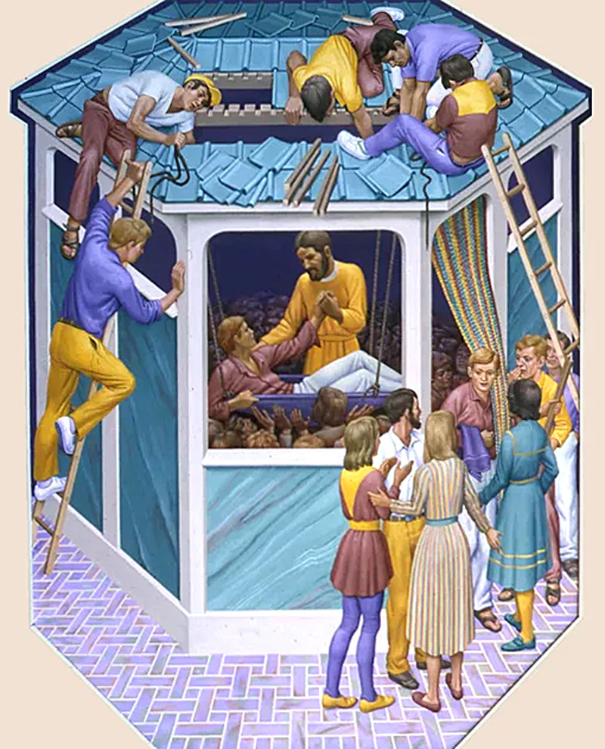
Paralytic at Capernaum
Peter Koenig, 20th century

Slide 14
When Jesus saw their faith, he said to the paralytic, “Child, your sins are forgiven.”
Mark 2:5

Slide 15
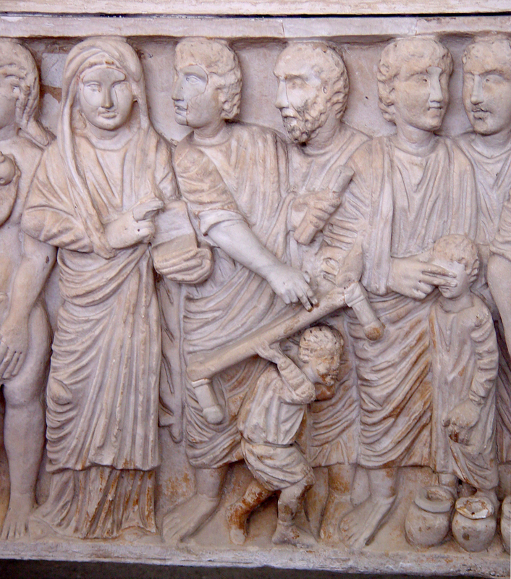
Healing the Paralytic
Vatican City, 3rd-4th centuries

Slide 16
“But so that you may know that the Son of Man has authority on earth to forgive sins...”
Mark 2:10

Slide 17
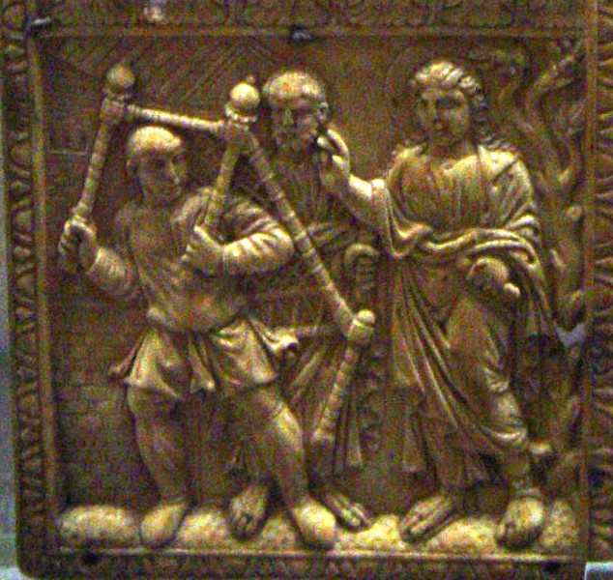
Christ’s Miracles on the Andrews diptych (Bottom Left)
Victoria and Albert Museum, 450-460

Slide 18
“I say to you, stand up, take your mat, and go to your home.”
Mark 2:11

Slide 19
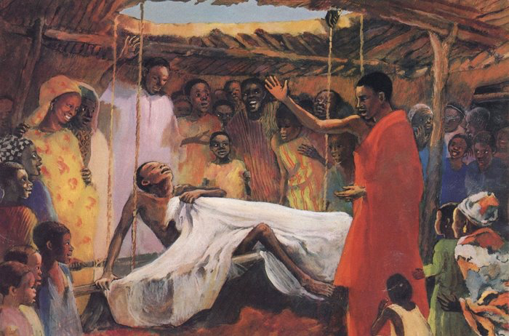
Jesus Heals a Paralyzed Man, JESUS MAFA, 1973

Slide 20
And he stood up and immediately took the mat and went out before all of them...
Mark 2:12a

Slide 21
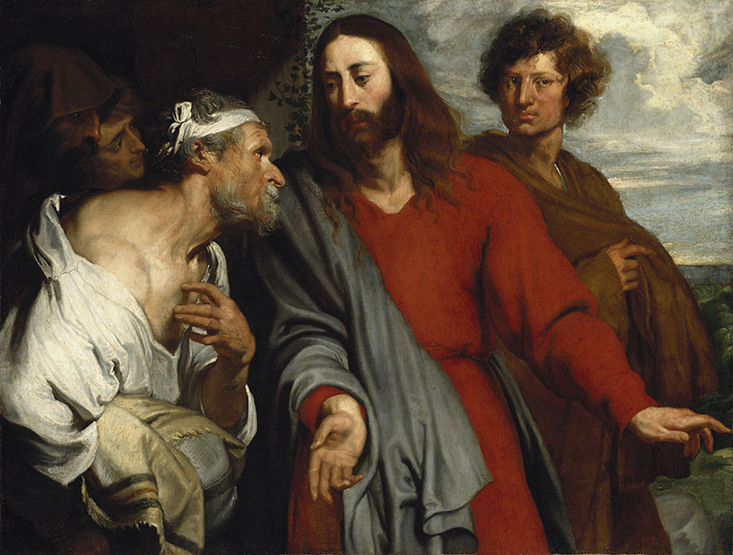
Healing of the Paralytic, Anthony Van Dyck, 1599-1641

Slide 22
Credits
New Revised Standard Version Updated Edition Bible, copyright 2022, Division of Christian Education of the National Council of the Churches of Christ in the United States of America. Used by permission. All rights reserved.
https://commons.wikimedia.org/wiki/File:Twilight_in_the_Wilderness_by_Frederic_Edwin_Church_(3).jpg
http://commons.wikimedia.org/wiki/File:Cecil_Beaton_Photographs-_General_IB4152C.jpg
https://commons.wikimedia.org/wiki/File:Saint_Elizabeth_Ann_Seton_Parish_(Pickerington,_Ohio)_-_stained_glass,_The_Father.jpg
https://commons.wikimedia.org/wiki/File:Amen_-_Logo.png
https://commons.wikimedia.org/wiki/File:Jesus_healing_the_paralytic_in_Cafarnaum_-_Sant%27Apollinare_Nuovo_-_Ravenna_2016.jpg
https://www.pwkoenig.co.uk/
https://diglib.library.vanderbilt.edu/diglib-fulldisplay.pl?SID=20211129539318411&code=act&RC=52006&Row=3
https://diglib.library.vanderbilt.edu/diglib-fulldisplay.pl?SID=20211129539318411&code=act&RC=31768&Row=13
https://diglib.library.vanderbilt.edu/diglib-fulldisplay.pl?SID=20211129539318411&code=act&RC=48306&Row=1
https://commons.wikimedia.org/wiki/File:Anthony_van_Dyck_-_The_healing_of_the_paralytic.jpg
Additional descriptions can be found at the Art in the Christian Tradition image library, a service of the Vanderbilt Divinity Library, http://diglib.library.vanderbilt.edu/. All images available via Creative Commons 3.0 License.

