Slide 1
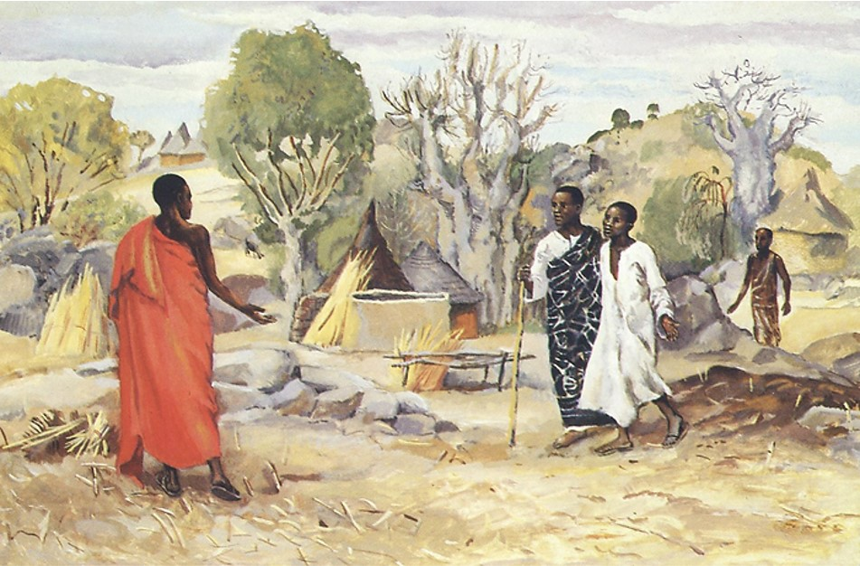
Second Sunday after the Epiphany
Year B
1 Samuel 3:1-10, (11-20) • Psalm 139:1-6, 13-18
1 Corinthians 6:12-20 • John 1:43-51

Slide 2
The LORD called again, "Samuel!" Samuel got up and went to Eli….
But he said, "I did not call, my son…"
1 Samuel 3:6

Slide 3
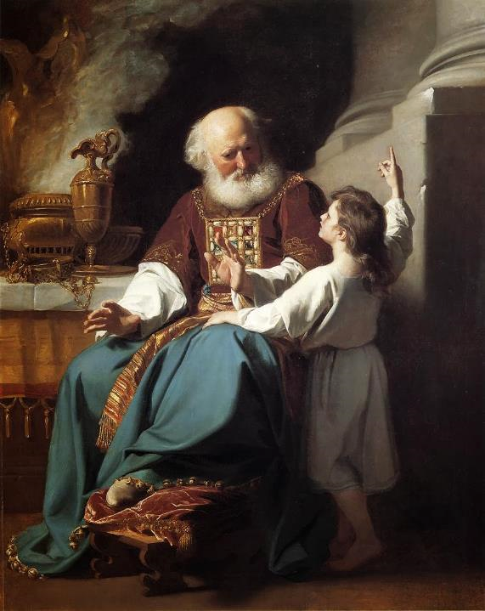
Samuel Speaks to Eli
John Singleton Copley
Wadwsorth Atheneum
Hartford, CT

Slide 4
For it was you who formed my inward parts; you knit me together in my mother's womb.
Psalm 139:13

Slide 5
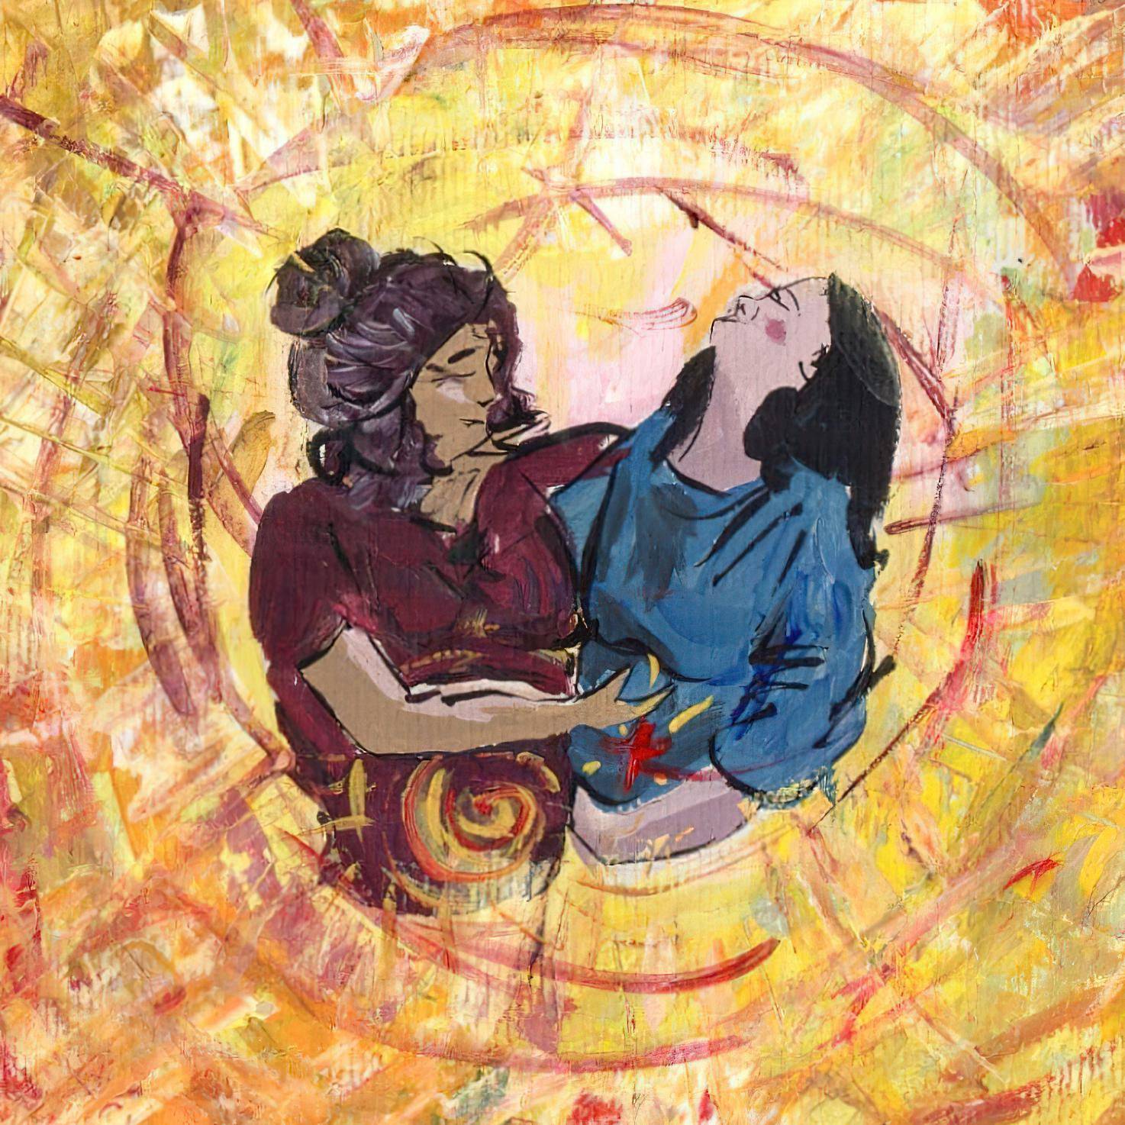
Visitation -- Liz Valente

Slide 6
But anyone united to the Lord becomes one spirit with him. ...your body is a temple of the Holy Spirit within you…
1 Corinthians 6:17, 19b

Slide 7

Fruits of the Holy Spirit – Gentleness -- Margaret Almon, Nutmeg Designs

Slide 8
The next day Jesus decided to go to Galilee. He found Philip and said to him, "Follow me."
John 1:43

Slide 9

Calling of the Disciples -- JESUS MAFA, Cameroon

Slide 10
Philip found Nathanael and said to him, "We have found him about whom Moses in the Law and also the Prophets wrote, Jesus son of Joseph from Nazareth."
John 1:45

Slide 11
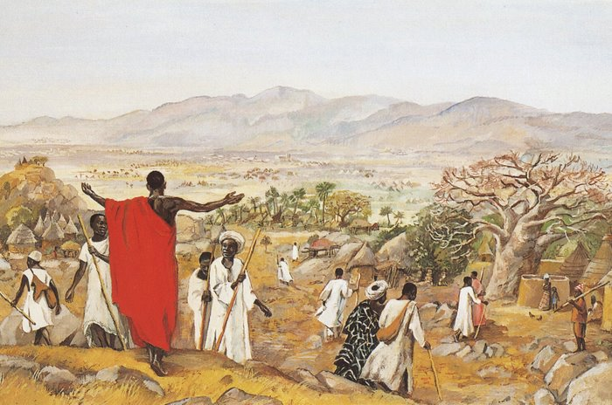
The Mission to the World -- JESUS MAFA, Cameroon

Slide 12
When Jesus saw Nathanael coming toward him, he said of him, "Here is truly an Israelite in whom there is no deceit!"
John 1:47

Slide 13
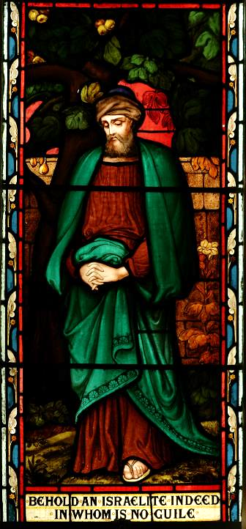
Nathanael
St. John’s Anglican Church
Ashfield, Australia

Slide 14
Nathanael asked him, "Where did you get to know me?" Jesus answered, "I saw you under the fig tree before Philip called you."
John 1:48

Slide 15
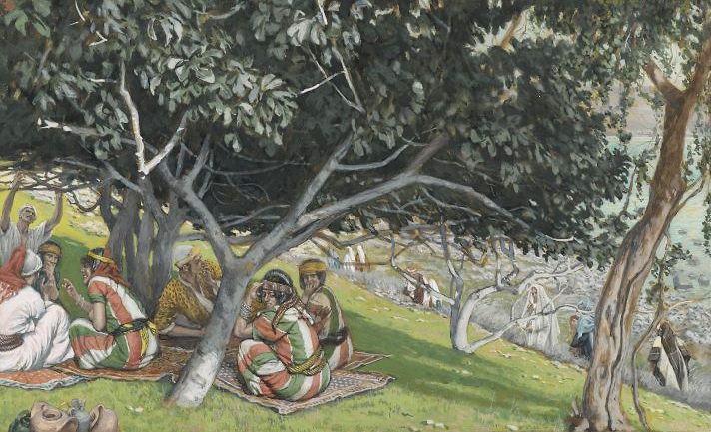
Nathanael Under the Fig Tree -- James Tissot, Brooklyn Museum, New York, NY

Slide 16
Nathanael replied, "Rabbi, you are the Son of God! You are the King of Israel!"
John 1:49

Slide 17
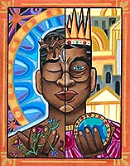
A Choice
Lauren Wright Pittman
Liturgical Artist

Slide 18
Jesus answered, "Do you believe because I told you that I saw you under the fig tree?"
John 1:50a

Slide 19
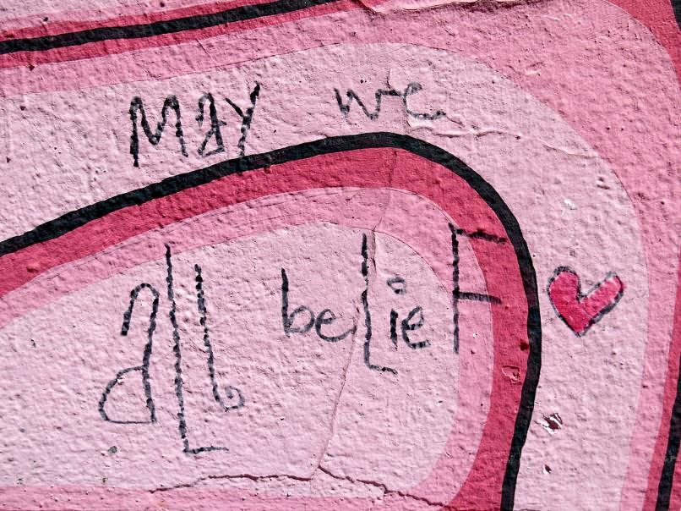
May We All Belief -- Mural, San Francisco, CA

Slide 20
"You will see greater things than these."
John 1:50b

Slide 21
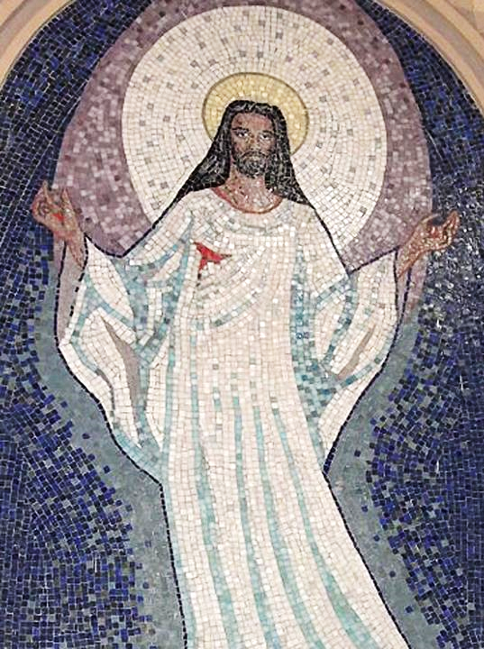
Resurrection of Christ
Church of Saint Sebastian
Porto Alegre,
Brazil

Slide 22
And he said to him, "Very truly, I tell you, you will see heaven opened and the angels of God ascending and descending upon the Son of Man."
John 1:51

Slide 23
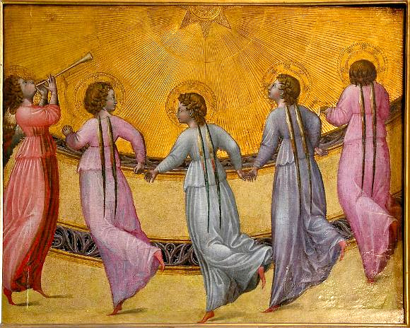
Giovanni di Paolo -- Five Angels Dancing Before the Glory of God, Musee Condee, Chantilly, France

Slide 24
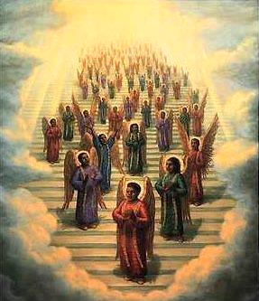
Choir of Angels in Heaven -- late 19th century print

Slide 25
Credits
New Revised Standard Version Updated Edition Bible, copyright 2022, Division of Christian Education of the National Council of the Churches of Christ in the United States of America. Used by permission. All rights reserved.
https://commons.m.wikimedia.org/wiki/File:Eli_and_Samuel.jpg
Liz Valente, https://www.instagram.com/donalizvalente/
https://www.flickr.com/photos/nutmegdesigns/6209753202
http://diglib.library.vanderbilt.edu/act-imagelink.pl?RC=48379
http://diglib.library.vanderbilt.edu/act-imagelink.pl?RC=48314
https://commons.m.wikimedia.org/wiki/File:StJohnsAshfield_StainedGlass_Nathanael.jpg
https://commons.m.wikimedia.org/wiki/File:Brooklyn_Museum_-_Nathaniel_Under_the_Fig_Tree_(Nathana%C3%ABl_sous_le_figuier)_-_James_Tissot_-_overall.jpg
http://www.lewpstudio.com - copyright by Lauren Wright Pittman
https://www.flickr.com/photos/gazeronly/8658800531
https://commons.wikimedia.org/wiki/File:0000_Mosaics_of_Resurrection_of_Christ.JPG - Eugenio Hansen, OFS
https://commons.m.wikimedia.org/wiki/File:Angels_dancing_sun_Giovanni_di_Paolo_Cond%C3%A9_Chantilly.jpg
https://commons.wikimedia.org/wiki/File:19th_century_black_heaven.jpg
Additional descriptions can be found at the Art in the Christian Tradition image library, a service of the Vanderbilt Divinity Library, http://diglib.library.vanderbilt.edu/. All images available via Creative Commons 3.0 License.

