Slide 1
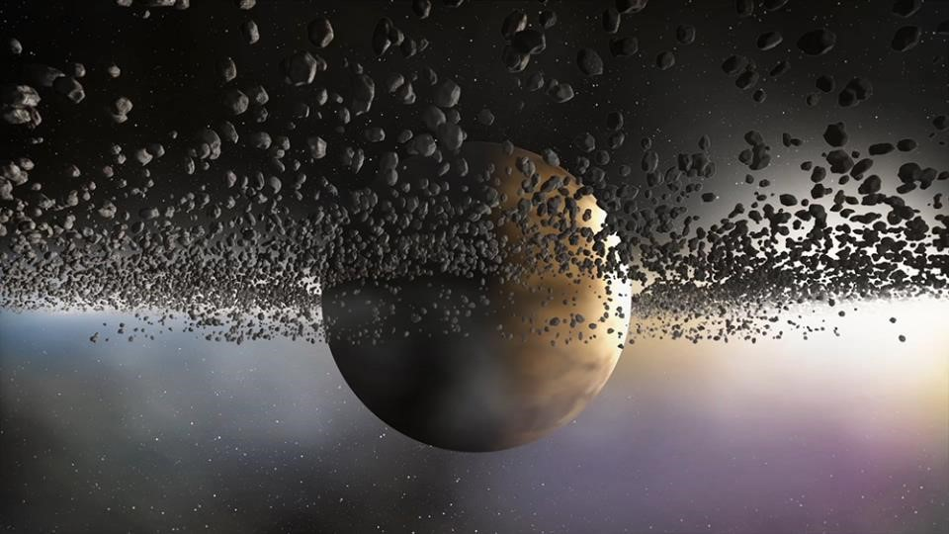
Second Sunday after Christmas Day
Year B
Jeremiah 31:7-14 or Sirach 24:1-12
Psalm 147:12-20 or Wisdom of Solomon 10:15-21
Ephesians 1:3-14
John 1:(1-9), 10-18

Slide 2
Then shall the young women rejoice in the dance, and the young men and the old shall be merry. I will turn their mourning into joy; I will comfort them and give them gladness for sorrow.
Jeremiah 31:13

Slide 3
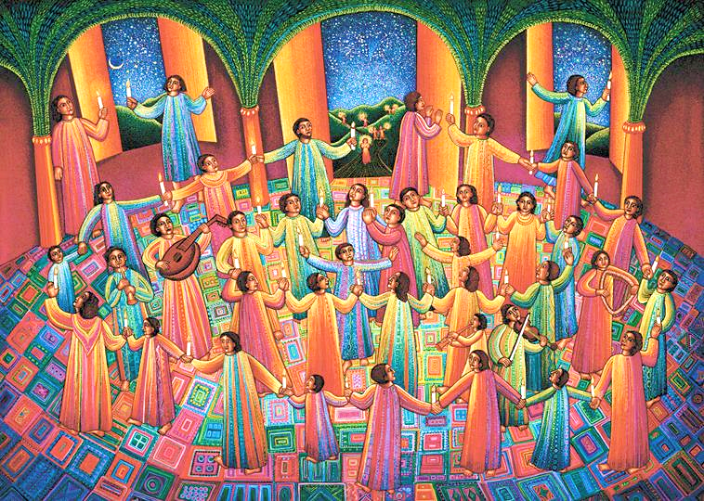
Celebration -- John August Swanson, Los Angeles, CA

Slide 4
He gives snow like wool; he scatters frost like ashes. …
He sends out his word and melts them…
Psalm 147:16, 18a

Slide 5
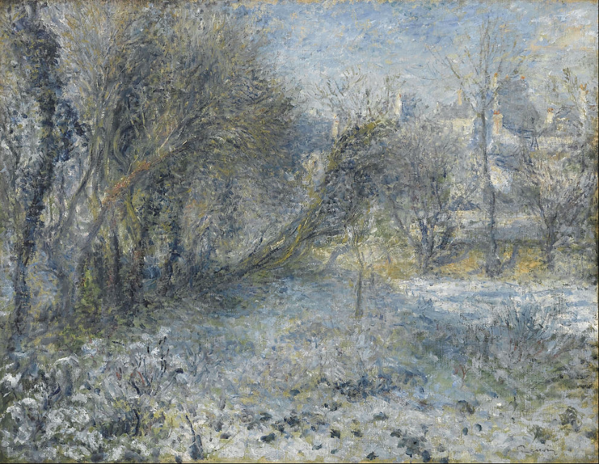
Snow-covered Landscape -- Pierre-Auguste Renoir, Musee de l'Orangerie, Paris, France

Slide 6
In him you also…were marked with the seal of the promised Holy Spirit…
Ephesians 1:13ac

Slide 7
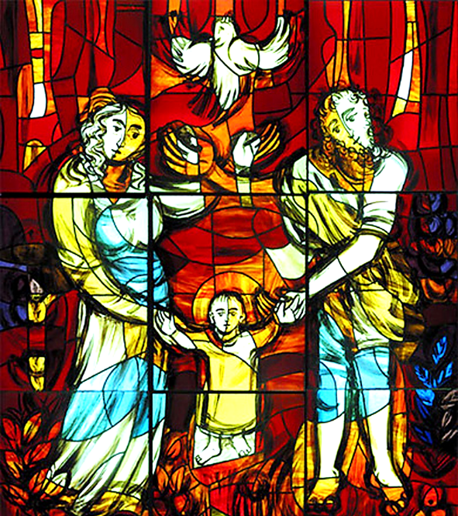
Holy Spirit with the Child Jesus and Mary and Joseph
Stained glass
Warsaw, Poland

Slide 8
In the beginning was the Word, and the Word was with God,
and the Word was God.
John 1:1

Slide 9

God’s Authority – “In the beginning …” – Seth Drum, graphic art

Slide 10
…in him was life, and the life was the light of all people.
John 1:4

Slide 11
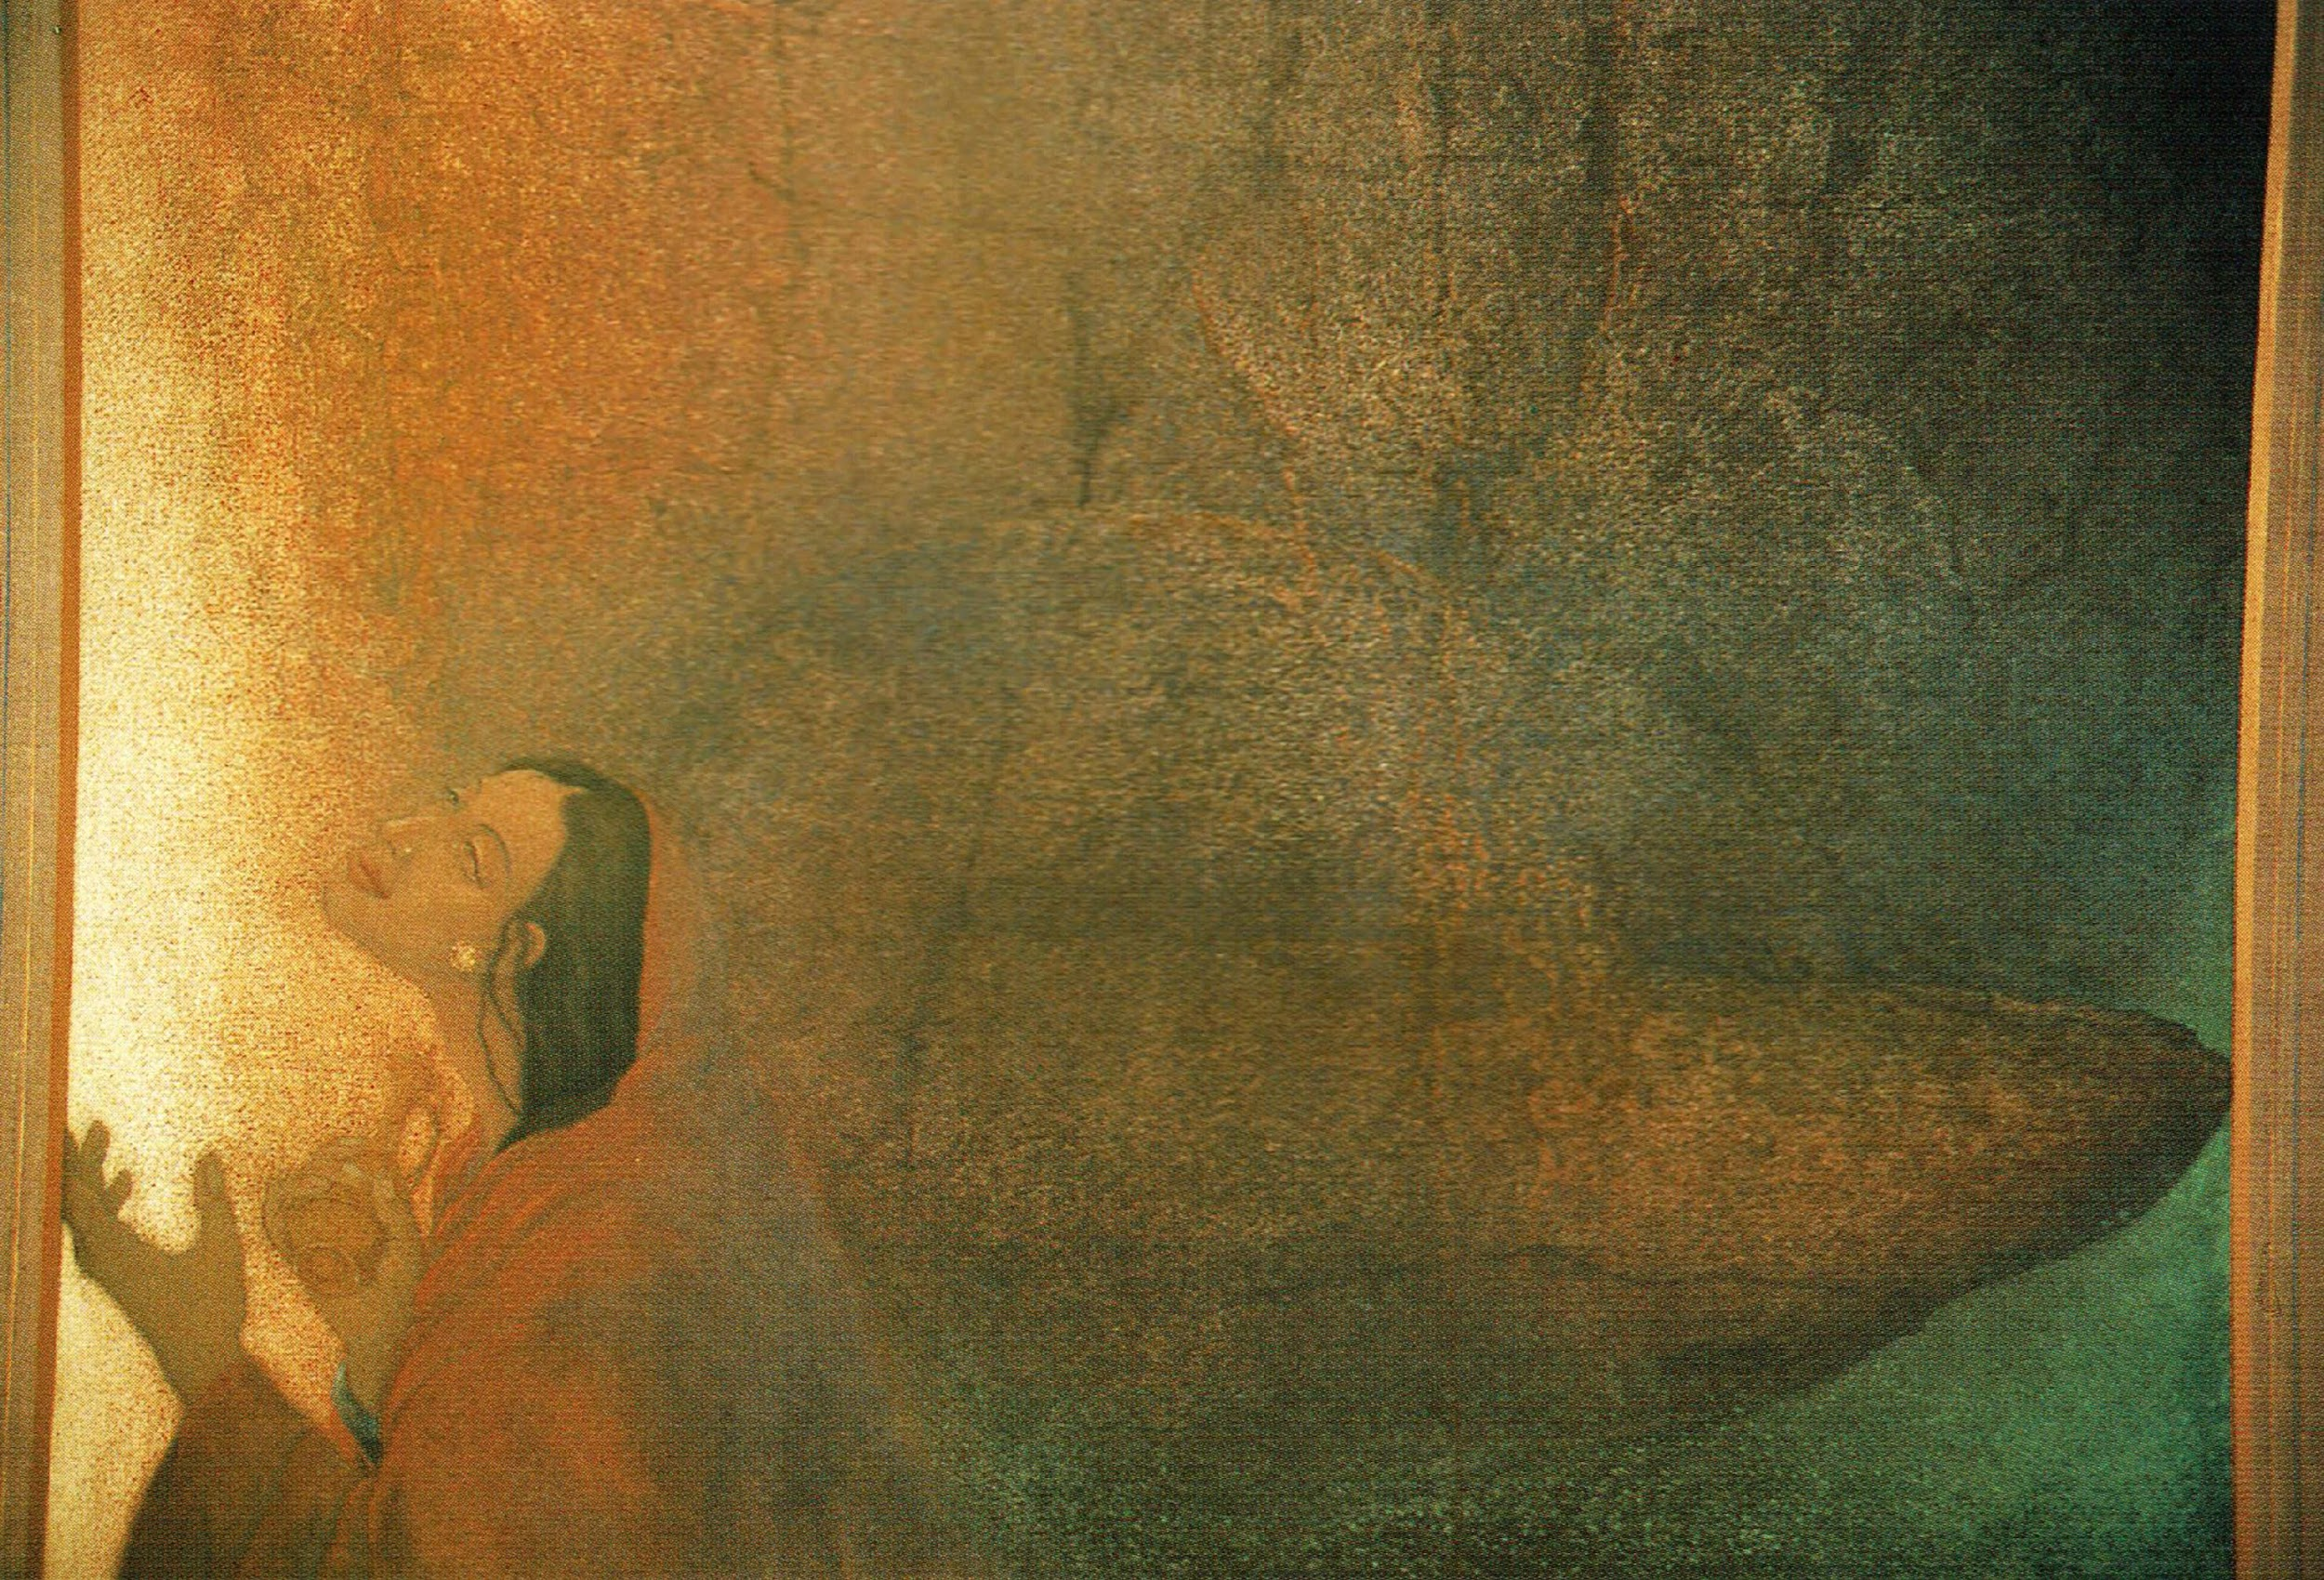
Altar of God -- Frank Wesley

Slide 12
The true light, which enlightens everyone, was coming into the world.
John 1:9

Slide 13
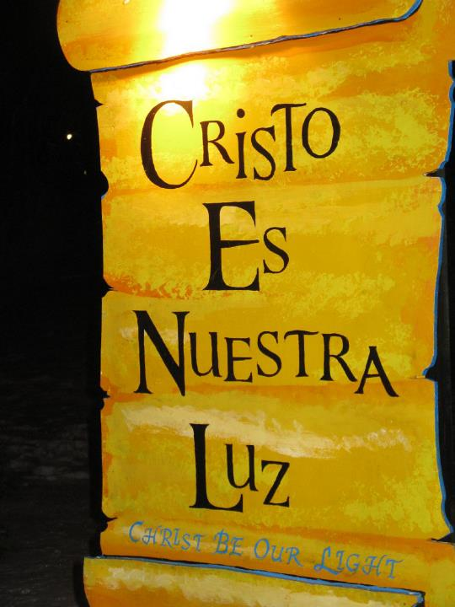
Christ Be Our Light
LaSalette Festival
Attleboro, MA

Slide 14
And the Word became flesh and lived among us…, full of grace and truth.
John 1:14ac

Slide 15
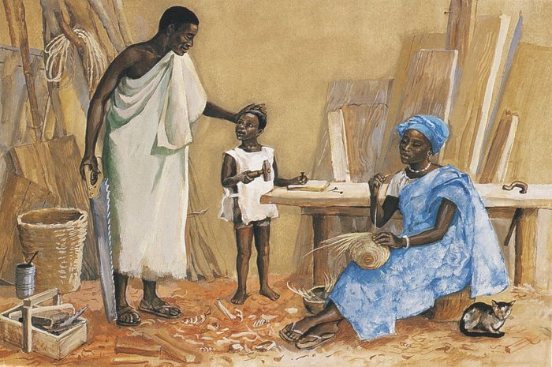
Jesus as a Child -- JESUS MAFA, Cameroon

Slide 16
Credits
New Revised Standard Version Updated Edition Bible, copyright 2022, Division of Christian Education of the National Council of the Churches of Christ in the United States of America. Used by permission. All rights reserved.
www.JohnAugustSwanson.com - copyright 1997 by John August Swanson
https://commons.wikimedia.org/wiki/File:Auguste_Renoir_-_Snow-covered_Landscape_-_Google_Art_Project.jpg
http://www.flickr.com/photos/tomasz_tuszko/68776812/
https://www.flickr.com/photos/seth_drum/34308713902 - Seth Drum
Estate of Frank Wesley, http://www.frankwesleyart.com/main_page.htm
http://www.flickr.com/photos/heartlover1717/4141462290/
http://diglib.library.vanderbilt.edu/act-imagelink.pl?RC=48304
Additional descriptions can be found at the Art in the Christian Tradition image library, a service of the Vanderbilt Divinity Library, http://diglib.library.vanderbilt.edu/. All images available via Creative Commons 3.0 License.

