Slide 1
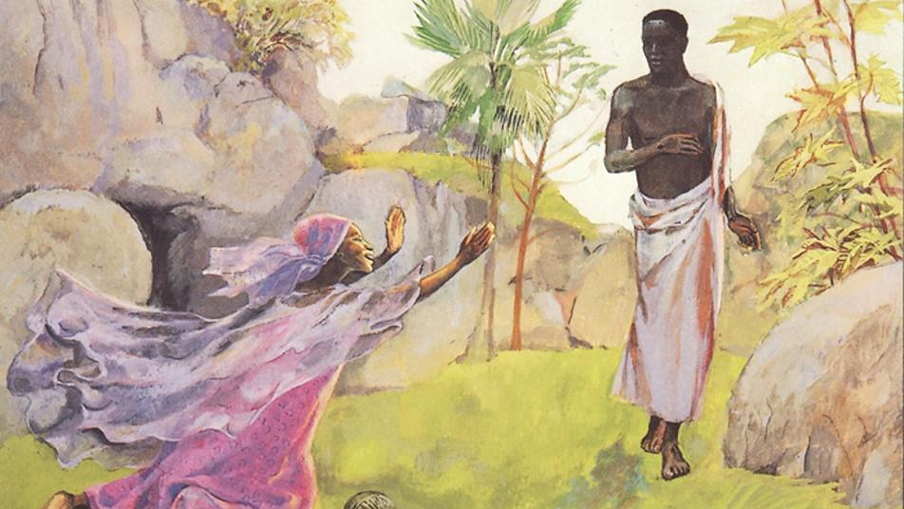
Resurrection of the Lord
Year B
Acts 10:34-43
or Isaiah 25:6-9
Psalm 118:1-2, 14-24
1 Corinthians 15:1-11
or Acts 10:34-43
John 20:1-18
or Mark 16:1-8

Slide 2
"They put him to death by hanging him on a tree, but God raised him on the third day…."
Acts 10:39b-40a

Slide 3
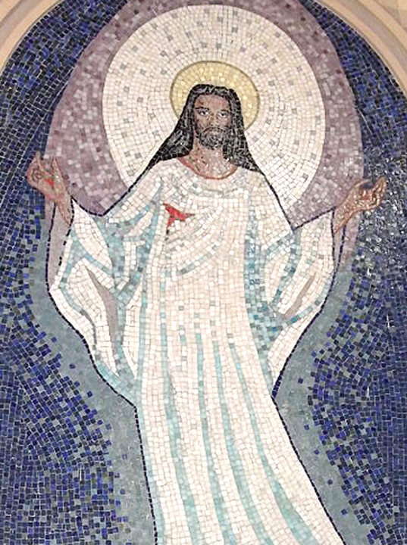
Resurrection
Church of St Sebastian
Porto Alegre,
Brazil

Slide 4
Then the Lord GOD will wipe away the tears from all faces…
Isaiah 25:8b

Slide 5
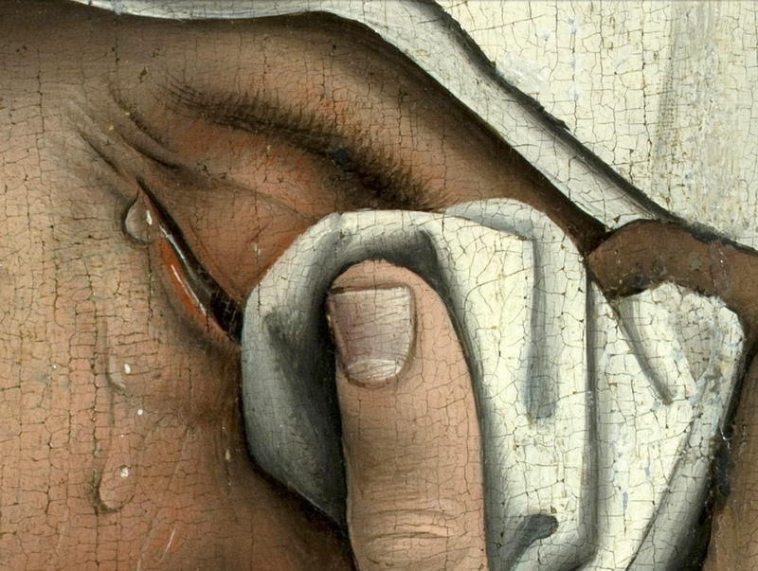
Mother Mary's Tears, detail from Descent from the Cross -- Rogier van der Weyden, Prado, Madrid

Slide 6
The stone that the builders rejected has become the chief cornerstone. This is the LORD's doing; it is marvelous in our eyes.
Psalm 118:22-23

Slide 7
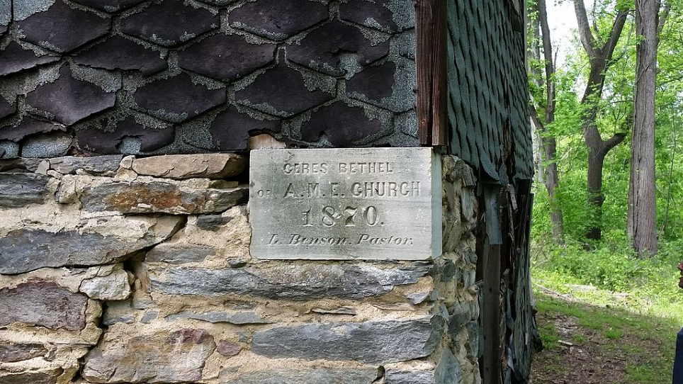
Cornerstone of Ceres Bethel African Methodist Episcopal Church, near Harper's Ferry, MD

Slide 8
"You know the message he sent to the people of Israel, preaching peace by Jesus Christ—he is Lord of all."
Acts 10:36

Slide 9
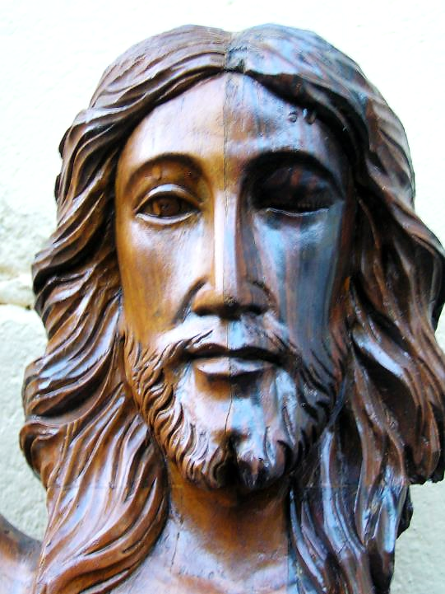
Christ Crucified, Risen
Baguio, Philippines

Slide 10
Early on the first day of the week, while it was still dark, Mary Magdalene came to the tomb and saw that the stone had been removed from the tomb.
John 20:1

Slide 11
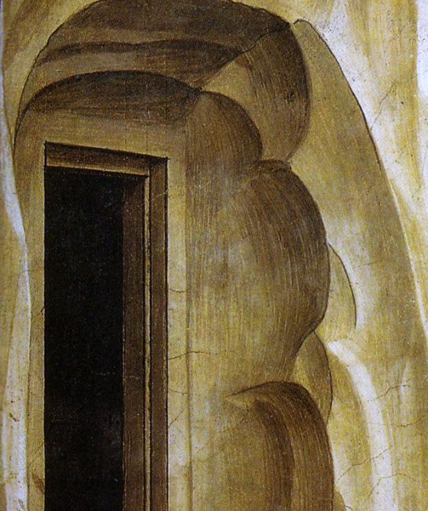
Detail of Empty Tomb
Fra Angelico
San Marco
Florence, Italy

Slide 12
So she ran and went to Simon Peter and the other disciple, ...and said to them, "They have taken the Lord out of the tomb, and we do not know where they have laid him."
John 20:2

Slide 13
Then Peter and the other disciple set out.… The two were running together….
John 20:3a, 4a

Slide 14
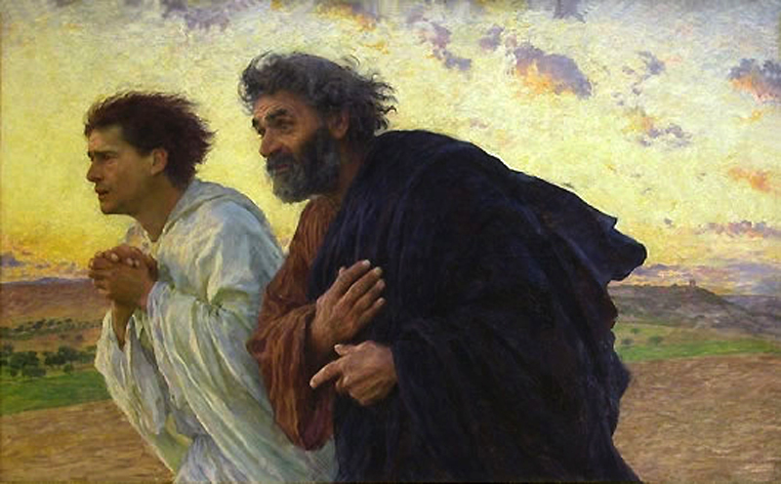
The Disciples Running to the Tomb -- Eugene Burnand, Musee D'Orsay, Paris, France

Slide 15
Then Simon Peter…went into the tomb. … Then the other disciple...also went in, and he saw and believed..."
John 20:6ac, 8ac

Slide 16
Then the disciples returned to their homes. But Mary stood weeping outside the tomb.
John 20:10-11a

Slide 17
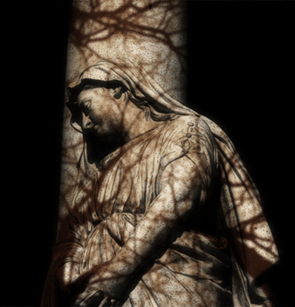
Weeping Mary
Photograph by
K Feldein

Slide 18
As she wept, she bent over to look into the tomb, and she saw two angels in white...
John 20:11b-12a

Slide 19
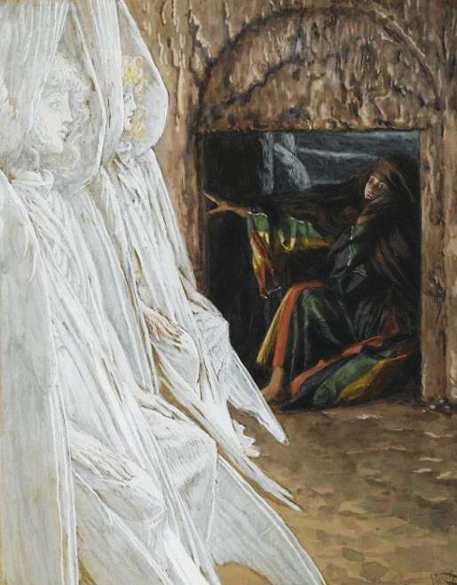
Mary and the Two Angels
James Tissot
Brooklyn Museum, New York, NY

Slide 20
They said to her, "Woman, why are you weeping?" She said to them, "They have taken away my Lord, and I do not know where they have laid him."
John 20:13

Slide 21
When she had said this, she turned around and saw Jesus standing there, but she did not know that it was Jesus.
John 20:14

Slide 22
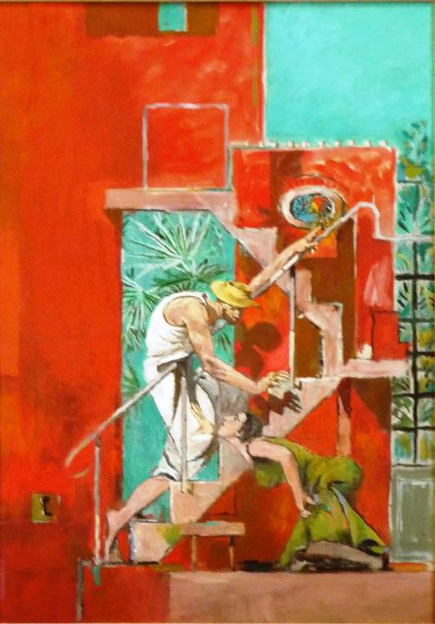
Christ and Mary
Graham Sutherland
Chichester Cathedral
Chichester, England
?

Slide 23
Jesus said to her, "Woman, why are you weeping? Whom are you looking for?"
John 20:15a

Slide 24
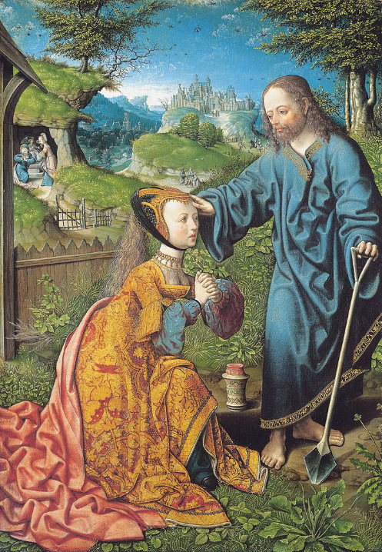
Christ Appears to Mary
J. C. van Oostsanen
Gemäldegalerie Alte Meister
Kassel, Germany

Slide 25
Supposing him to be the gardener, she said to him, "Sir, if you have carried him away, tell me where you have laid him, and I will take him away."
John 20:15b

Slide 26
Jesus said to her, "Mary!" She turned and said to him in Hebrew, "Rabbouni!"
John 20:16

Slide 27
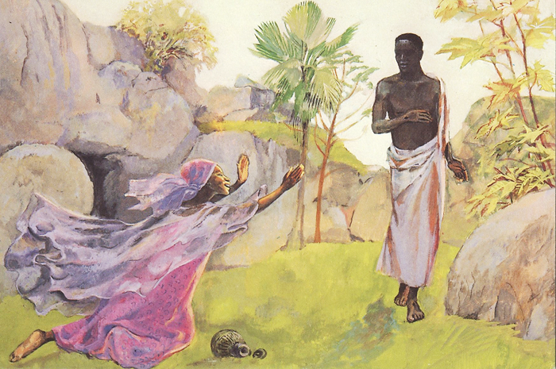
Christ Reveals Himself to Mary -- JESUS MAFA, Cameroon

Slide 28
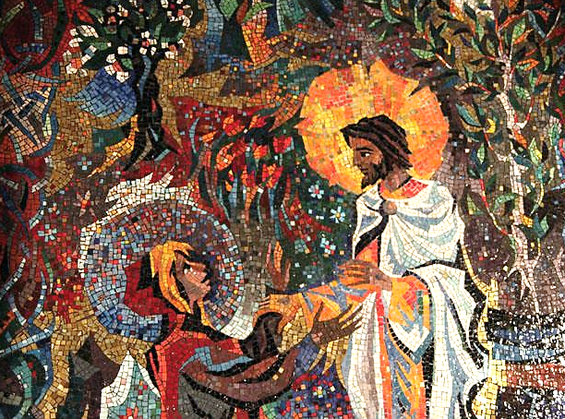
Christ Appears to Mary -- Resurrection Chapel, National Cathedral, Washington, DC

Slide 29
Jesus said to her, "Do not touch me, because I have not yet ascended to the Father."
John 20:17a

Slide 30
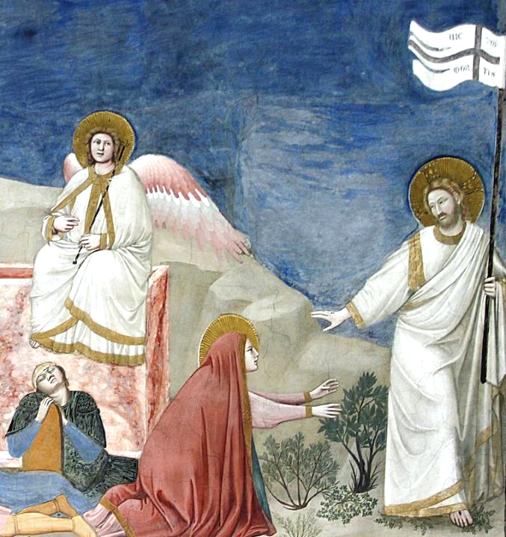
Do Not Hold Me
Giotto
Scrovegni Chapel
Padua, Italy

Slide 31
Mary Magdalene went and announced to the disciples, "I have seen the Lord!"
John 20:18a

Slide 32
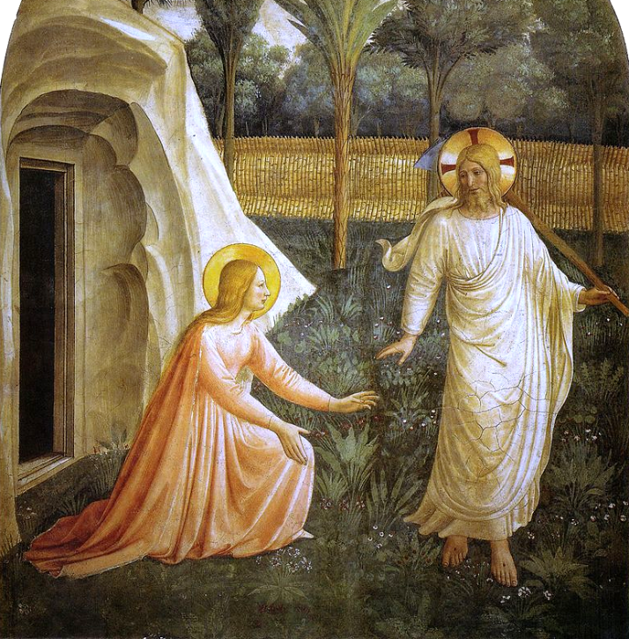
Noli Me Tangere
Fra Angelico San Marco Florence, Italy

Slide 33
Credits
New Revised Standard Version Updated Edition Bible, copyright 2022, Division of Christian Education of the National Council of the Churches of Christ in the United States of America. Used by permission. All rights reserved.
https://commons.wikimedia.org/wiki/File:0000_Mosaics_of_Resurrection_of_Christ.JPG - Eugenio Hansen, OFS
https://commons.wikimedia.org/wiki/File:Weyden,_Rogier_van_der_-_Descent_from_the_Cross_-_Detail_women_(left).jpg
https://commons.wikimedia.org/wiki/File:Ceres_Bethel_African_Methodist_Church,_cornerstone_(21604465715).jpg
https://www.flickr.com/photos/jardek/804315429/ - Joshua Jardekah Aguilar
http://commons.wikimedia.org/wiki/File:BurnandJeanPierre.jpg
http://www.flickr.com/photos/kwerfeldein/110099808/
https://commons.wikimedia.org/wiki/File:Brooklyn_Museum_-_Mary_Magdalene_Questions_the_Angels_in_the_Tomb_(Madeleine_dans_le_tombeau_interroge_les_anges)_-_James_Tissot.jpg
https://www.flickr.com/photos/yellowbookltd/5637909675
https://commons.wikimedia.org/wiki/File:Jacob_Cornelisz._van_Oostsanen_001.jpg
http://diglib.library.vanderbilt.edu/act-imagelink.pl?RC=48389
https://www.flickr.com/photos/timevanson/6623028421
https://commons.wikimedia.org/wiki/File:Noli_me_tangere_-_Capella_dei_Scrovegni_-_Padua_2016.jpg
https://commons.wikimedia.org/wiki/File:Angelico,_noli_me_tangere.jpg
Art in the Christian Tradition image library, a service of the Vanderbilt Divinity Library, http://diglib.library.vanderbilt.edu/. All images available via Creative Commons 3.0 License.

