Slide 1
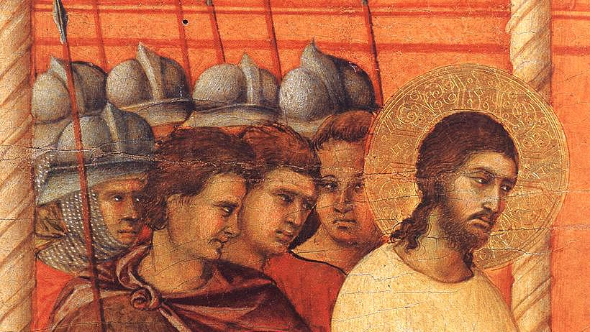
REIGN OF CHRIST
Year B
2 Samuel 23:1-7 and Psalm 132:1-12, (13-18)
Daniel 7:9-10, 13-14 and Psalm 93 • Revelation 1:4b-8 John 18:33-37

Slide 2
"One who rules over people justly, …
is like the light of morning, like the sun rising on a cloudless morning, gleaming from the rain on the grassy land."
2 Samuel 23:3b-4

Slide 3
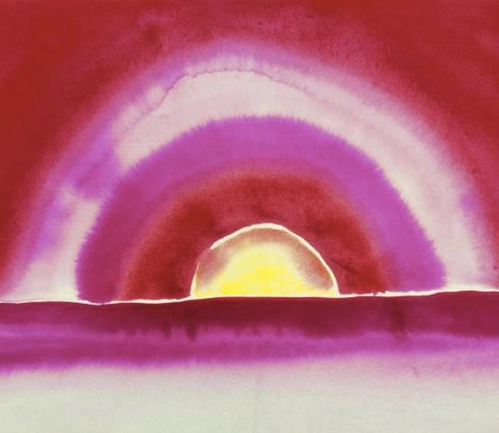
Sunrise -- Georgia O'Keeffe, Watercolor, 1916

Slide 4
...an Ancient One took his throne; …the hair of his head like pure wool; his throne was fiery flames, and its wheels were burning fire.
Daniel 7:9b

Slide 5
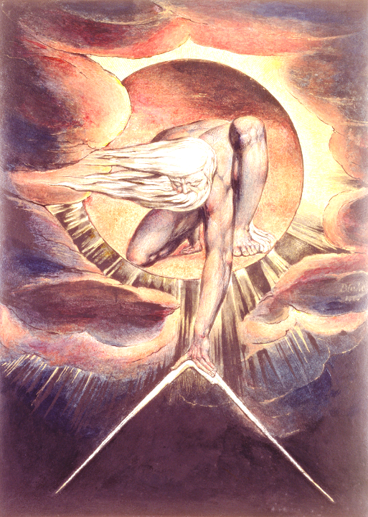
Ancient of Days
William Blake
Whitworth Institute
Manchester, England

Slide 6
The floods have lifted up, O LORD, the floods have lifted up their voice; the floods lift up their roaring.
Psalm 93:3

Slide 7
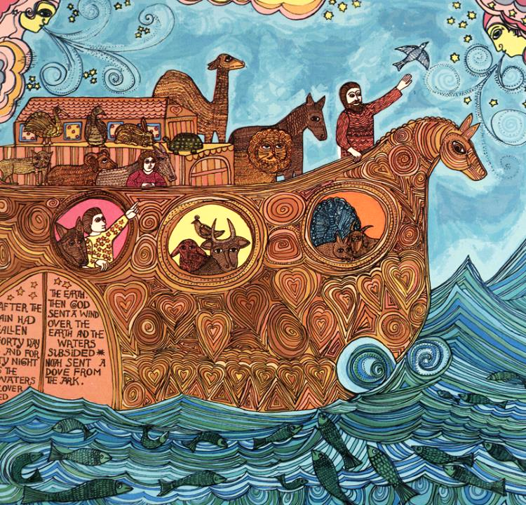
The Waters Recede
Noah Triptych
John August Swanson
Serigraph, 1974

Slide 8
"I am the Alpha and the Omega," says the Lord God, who is and who was and who is to come, the Almighty.
Revelation 1:8

Slide 9
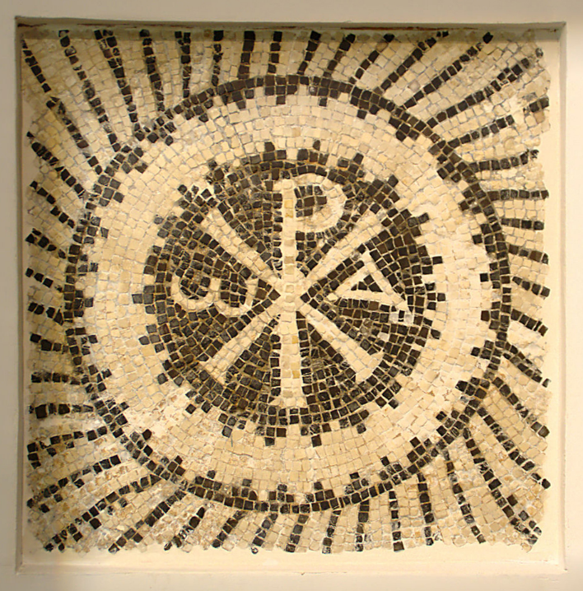
Christ Monogram with Alpha and Omega
Christian Catacombs
Sousse, Tunisia

Slide 10
Then Pilate entered the headquarters again, summoned Jesus, and asked him, "Are you the King of the Jews?"
John 18:33

Slide 11
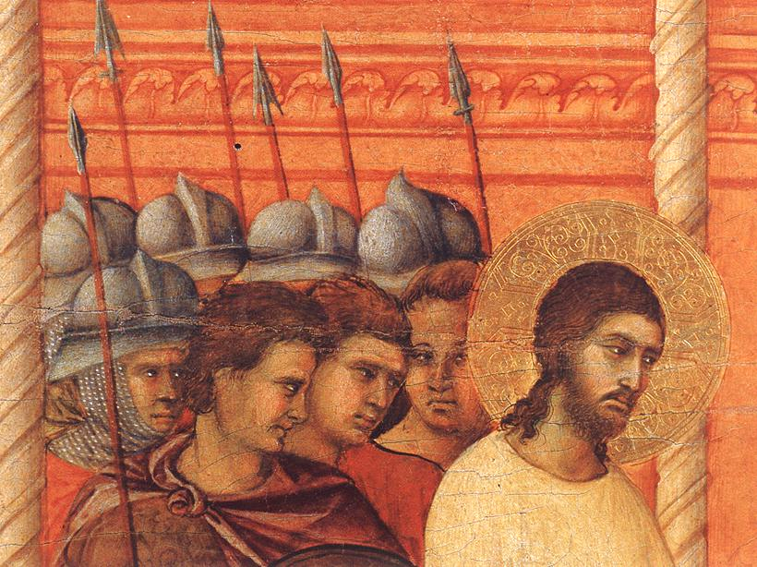
Christ Before Pilate Again -- Duccio, Museo dell'Opera del Duomo, Siena, Italy

Slide 12
Jesus answered, "Do you ask this on your own, or did others tell you about me?"
John 18:34

Slide 13
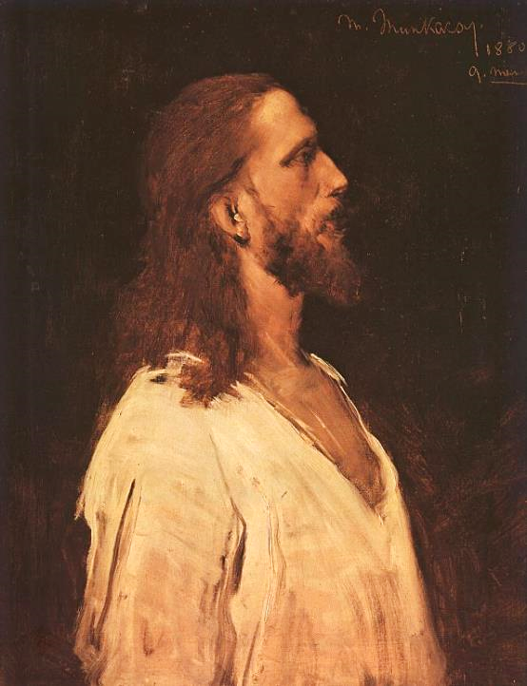
Christ Before Pilate, study
Mihály Munkácsy

Slide 14
Pilate replied, "I am not a Jew, am I? Your own nation and the chief priests have handed you over to me. What have you done?"
John 18:35

Slide 15
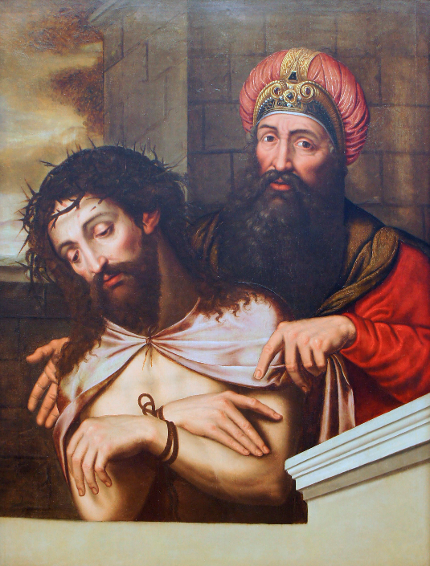
Christ and Pilate
Musée des beaux-arts et d'archéologie
Châlons-en-Champagne, France

Slide 16
Jesus answered, "My kingdom does not belong to this world. If my kingdom belonged to this world, my followers would be fighting to keep me from being handed over…."
John 18:36a

Slide 17
"But as it is, my kingdom is not from here." Pilate asked him, "So you are a king?"
John 18:36b-37a

Slide 18
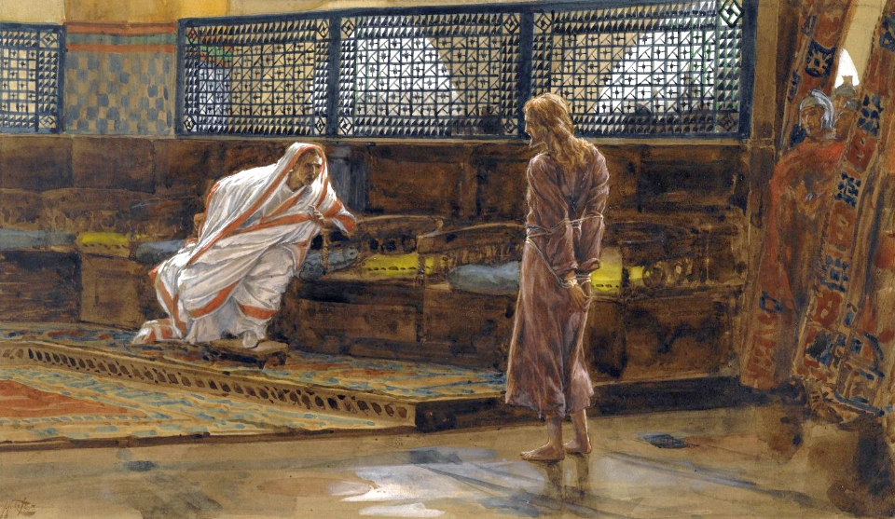
The Examination by Pilate -- James Tissot, Brooklyn Museum, Brooklyn, NY

Slide 19
Jesus answered, "You say that I am a king. For this I was born, and for this I came into the world, to testify to the truth."
John 18:37b

Slide 20
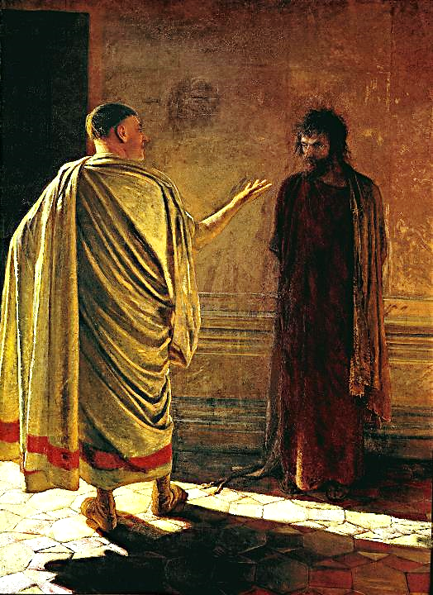
"What is Truth?"
Nikolai Ge
Tretyakov Gallery
Moscow, Russia

Slide 21
"Everyone who belongs to the truth listens to my voice."
John 18:37c

Slide 22
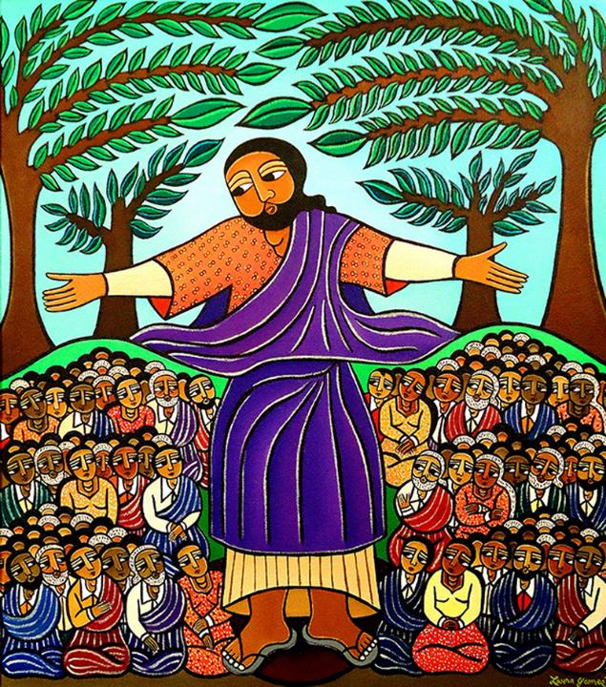
Sermon on the Mount
Laura James

Slide 23
Credits
New Revised Standard Version Updated Edition Bible, copyright 2022, Division of Christian Education of the National Council of the Churches of Christ in the United States of America. Used by permission. All rights reserved.
https://commons.wikimedia.org/wiki/File:Georgia_O%27Keeffe,_Sunrise,_watercolor,_1916.tif
https://commons.wikimedia.org/wiki/File:The_Ancient_of_Days_-_etching_with_pen_%26_ink_wc_Whitworth_Art_Gallery_The_University_of_Manchester_UK_The_Bridgeman_Art_Library.jpg
www.JohnAugustSwanson.com – copyright 1974 by John August Swanson, Serigraph 17 ½” x 18 ½”, with permission
https://commons.wikimedia.org/wiki/File:Catacombes_chr%C3%A9tiennes,_Sousse,_23_septembre_2013,_(24).jpg- Habib M’henni
https://commons.wikimedia.org/wiki/File:Duccio_di_Buoninsegna_-_Christ_Before_Pilate_Again_(detail)_-_WGA06806.jpg
https://commons.wikimedia.org/wiki/File:Munkacsy_jesus.jpg
https://commons.wikimedia.org/wiki/File:Christ_et_Pilate_9098.JPG
https://commons.wikimedia.org/wiki/File:Jesus_Before_Pilate,_First_Interview.jpg
https://commons.wikimedia.org/wiki/File:What_is_truth.jpg
https://www.laurajamesart.com/collections/religious/
Additional descriptions can be found at the Art in the Christian Tradition image library, a service of the Vanderbilt Divinity Library, http://diglib.library.vanderbilt.edu/. All images available via Creative Commons 3.0 License.

