Slide 1
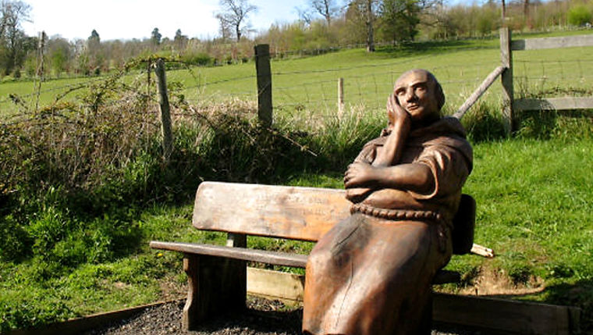
Seventh Sunday after Pentecost
Year B
2 Samuel 5:1-5, 9-10 and Psalm 48 • Ezekiel 2:1-5 and Psalm 123 • 2 Corinthians 12:2-10 • Mark 6:1-13

Slide 2
So all the elders of Israel came to the king at Hebron, and King David made a covenant with them…before the LORD...
2 Samuel 5:3a

Slide 3
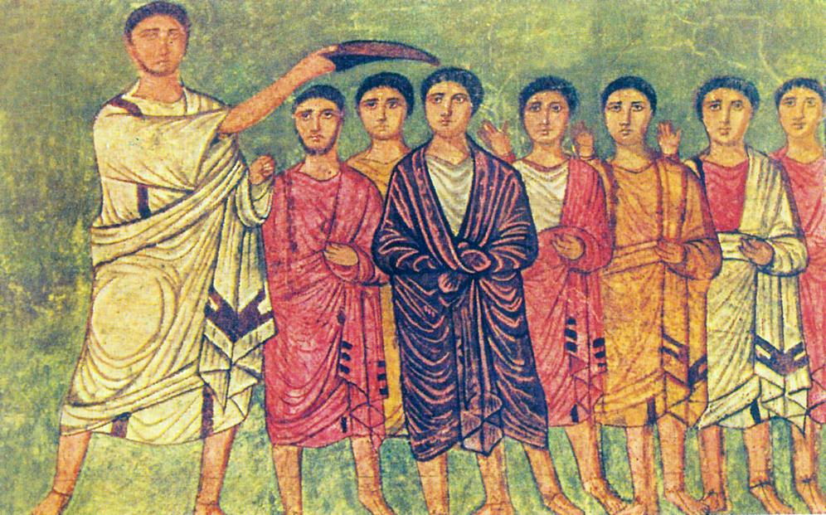
David is Anointed and Affirmed as King -- Dura Europos Synagogue, Syria

Slide 4
…you may tell the next generation that this is God, our God forever and ever. He will be our guide forever.
Psalm 48:13b-14

Slide 5
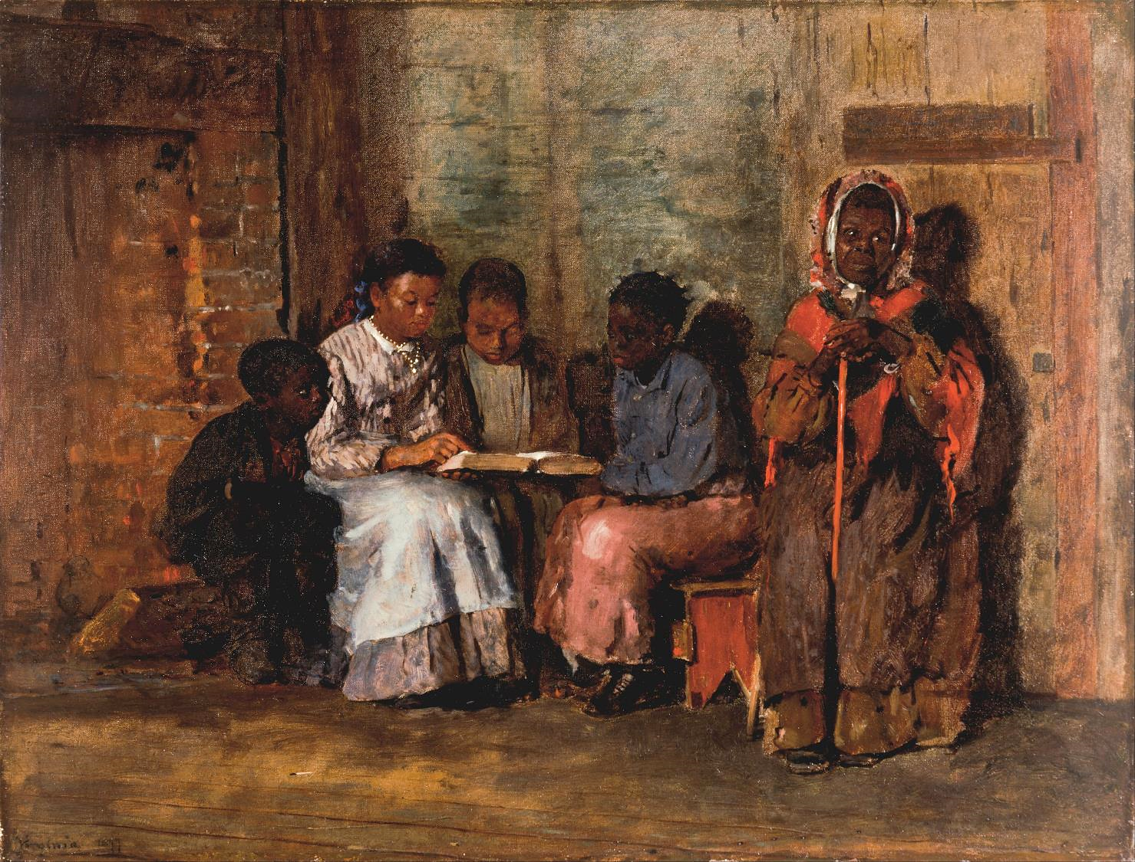
Sunday Morning
Winslow Homer
Cincinnati Art Museum
Cinncinnati, OH

Slide 6
Whether they hear or refuse to hear…, they shall know that there has been a prophet among them.
Ezekiel 2:5ac

Slide 7
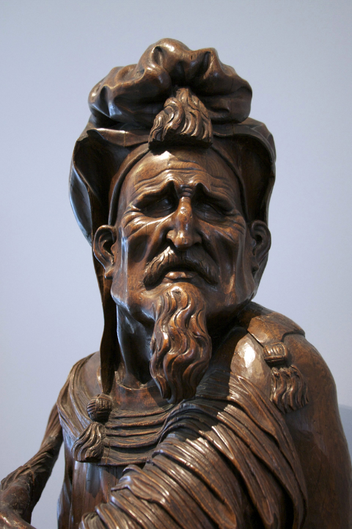
Old Testament Prophet
Detroit Institute of the Arts
Detroit, MI

Slide 8
Our soul has had more than its fill of the scorn of those who are at ease, of the contempt of the proud.
Psalm 123:4

Slide 9
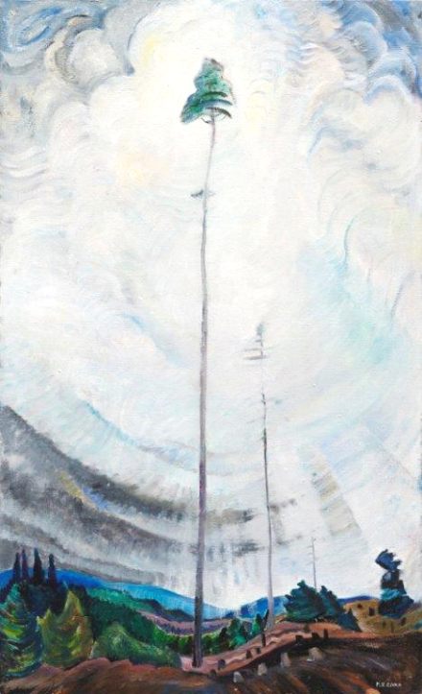
Scorned as Timber, Beloved of the Sky
Emily Carr
Vancouver Art Gallery, Canada

Slide 10
...I appealed to the Lord…, but he said to me, "My grace is sufficient for you, for power is made perfect in weakness."
2 Corinthians 12:8b-9a

Slide 11
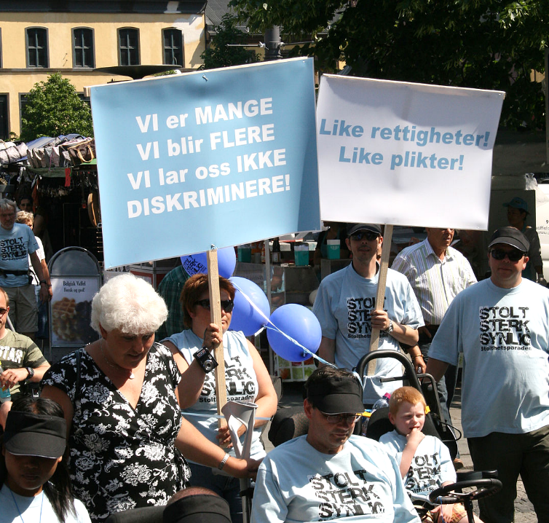
Proud – Strong – Visible
Disability Rights March
Oslo,
Norway

Slide 12
He…came to his hometown, and his disciples followed him. On the Sabbath he began to teach in the synagogue…
Mark 6: 1b-2a

Slide 13
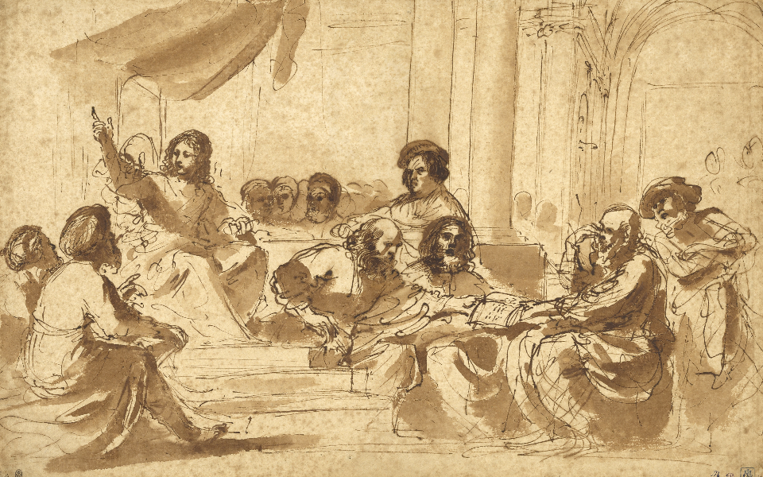
Christ Preaching in the Temple -- Guercino, J. Paul Getty Museum, Los Angeles, CA

Slide 14
…many who heard him were astounded. They said, "Where did this man get all this? … Is not this the carpenter, the son of Mary…?
Mark 6:2b, 3a

Slide 15
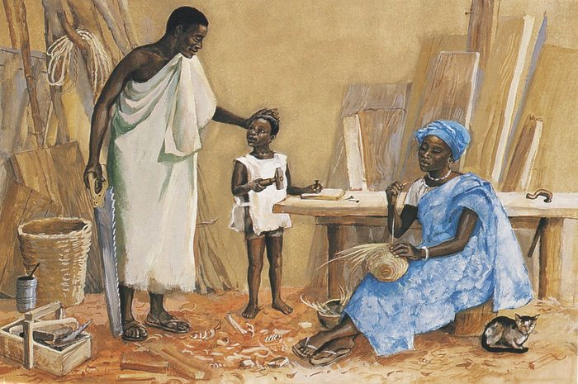
Jesus as a Child in Nazareth -- JESUS MAFA

Slide 16
Then Jesus said to them, "Prophets are not without honor, except in their hometown…"
Mark 6:4a

Slide 17
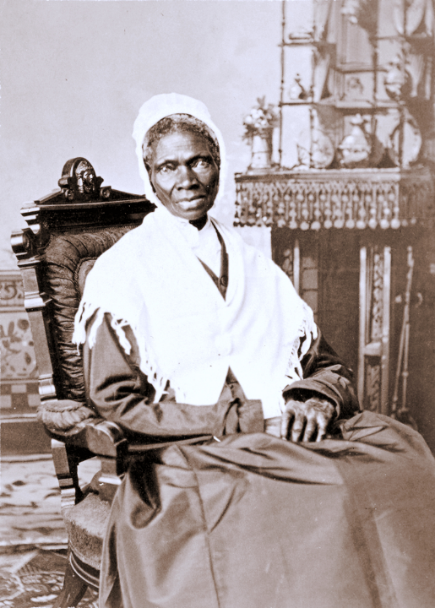
Sojourner Truth
National Portrait Gallery
Washington, DC

Slide 18
He called the twelve and began to send them out two by two and gave them authority over the unclean spirits.
Mark 6:7

Slide 19
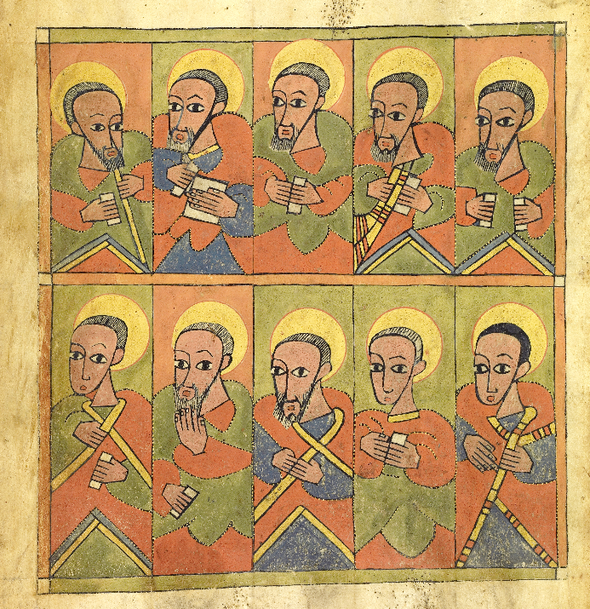
The Seventy-Two Disciples
Ethiopian
about 1480 – 1520
Getty Museum
Los Angeles, CA

Slide 20
He ordered them to take nothing for their journey except a staff: no bread, no bag, no money in their belts...
Mark 6:8

Slide 21
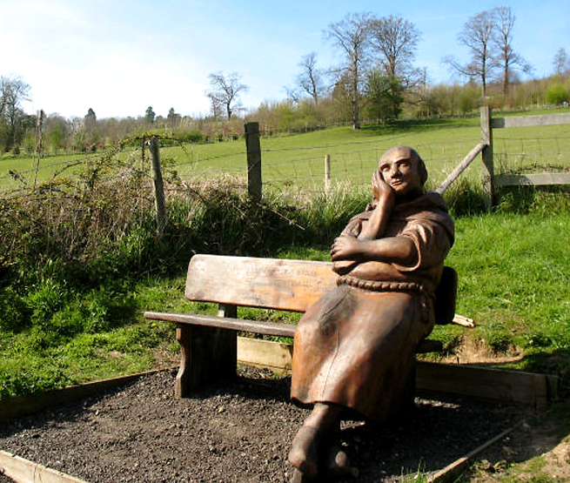
"Pilgrim bound by staff and faith, rest thy bones" -- Wood sculpture, Harrietsham, England

Slide 22
So they went out and proclaimed that all should repent. They cast out many demons and anointed with oil many who were sick and cured them.
Mark 6:12-13

Slide 23
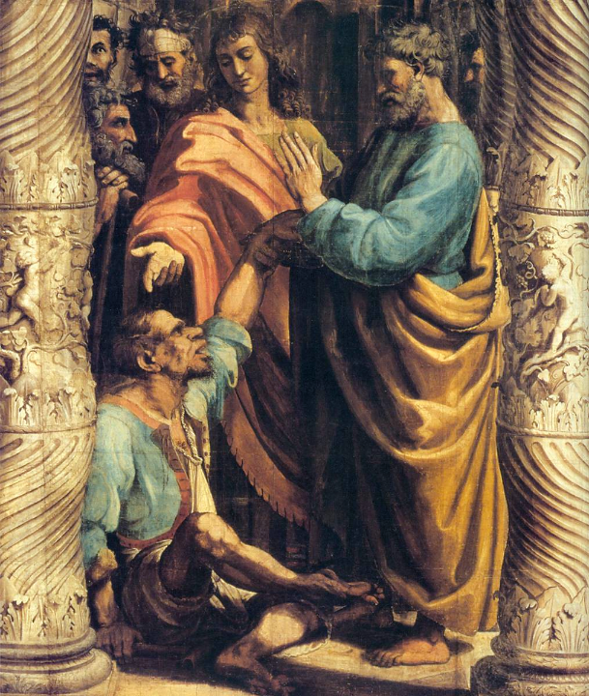
Healing of the Lame Man
Raphael
Tempera on paper
Victoria and Albert Museum
London, England

Slide 24
Credits
New Revised Standard Version Updated Edition Bible, copyright 2022, Division of Christian Education of the National Council of the Churches of Christ in the United States of America. Used by permission. All rights reserved.
https://commons.wikimedia.org/wiki/File:Dura_Synagogue_WC3_David_anointed_by_Samuel.jpg
https://commons.wikimedia.org/wiki/File:Winslow_Homer_-_Sunday_Morning_in_Virginia_-_Google_Art_Project.jpg
http://www.flickr.com/photos/librarygeek/4455148104/
https://commons.wikimedia.org/wiki/File:Carr,Emily_-_Scorned_as_timber.jpg
https://commons.wikimedia.org/wiki/File:Stolt_sterk_synlig.jpg
http://www.getty.edu/art/collection/objects/68/guercino-giovanni-francesco-barbieri-christ-preaching-in-the-temple-italian-1625-to-1627/ - Getty Open Content
https://commons.wikimedia.org/wiki/File:Sojourner_truth_c1870.jpg
http://diglib.library.vanderbilt.edu/act-imagelink.pl?RC=48304
http://www.getty.edu/art/collection/objects/250590/unknown-maker-the-seventy-two-disciples-ethiopian-about-1480-1520/
http://commons.wikimedia.org/wiki/File:Wooden_pilgrim_-_geograph.org.uk_-_778390.jpg
https://commons.wikimedia.org/wiki/File:Arazzi_di_raffaello,_cartone_05.1.jpg
Additional descriptions can be found at the Art in the Christian Tradition image library, a service of the Vanderbilt Divinity Library, http://diglib.library.vanderbilt.edu/. All images available via Creative Commons 3.0 License.

