Slide 1
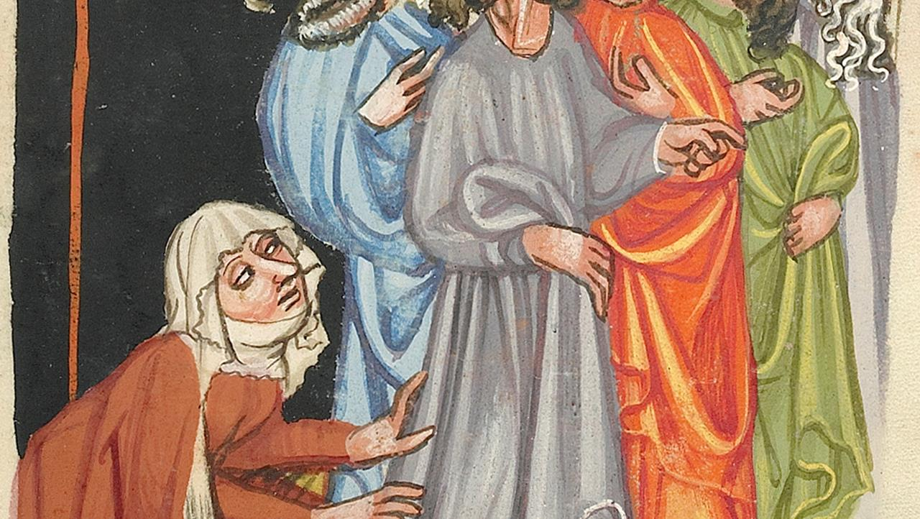
Sixth Sunday after Pentecost
2 Samuel 1:1, 17-27 and Psalm 130 Wisdom of Solomon 1:13-15, 2:23-24 or Lamentations 3:22-33 and Psalm 30
2 Corinthians 8:7-15 Mark 5:21-43
Year B

Slide 2
"Saul and Jonathan…they were swifter than eagles; they were stronger than lions. … How the mighty have fallen!"
2 Samuel 1:23b, 19b

Slide 3
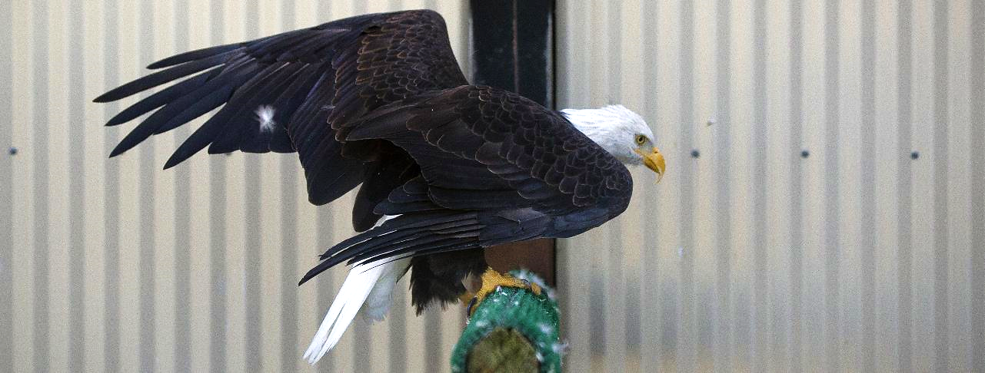
Rescued, Disabled Eagle -- Memorial Park, Joint Base Elmendorf-Richardson, Alaska

Slide 4
The steadfast love of the LORD never ceases, his mercies never come to an end; they are new every morning; great is your faithfulness.
Lamentations 3:22-23

Slide 5
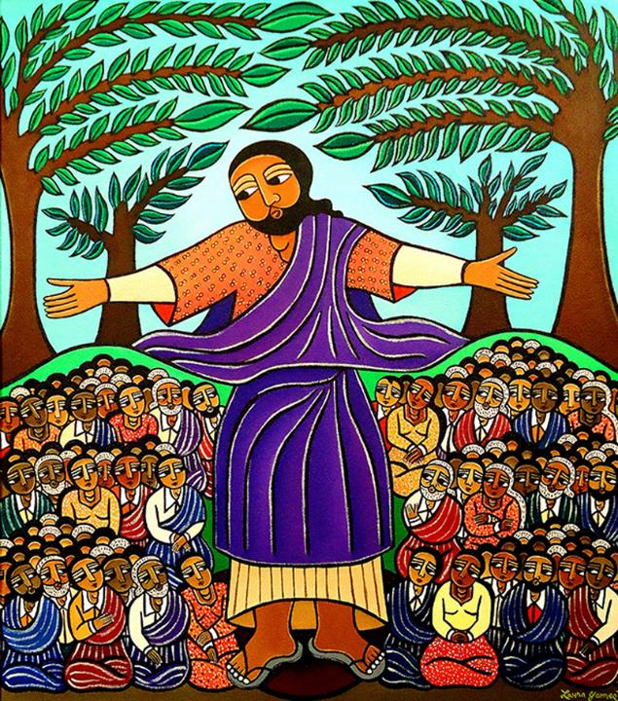
Sermon on the Mount
Laura James
New York, NY

Slide 6
You have turned my mourning into dancing; you have taken off my sackcloth and clothed me with joy…
Psalm 30:11

Slide 7
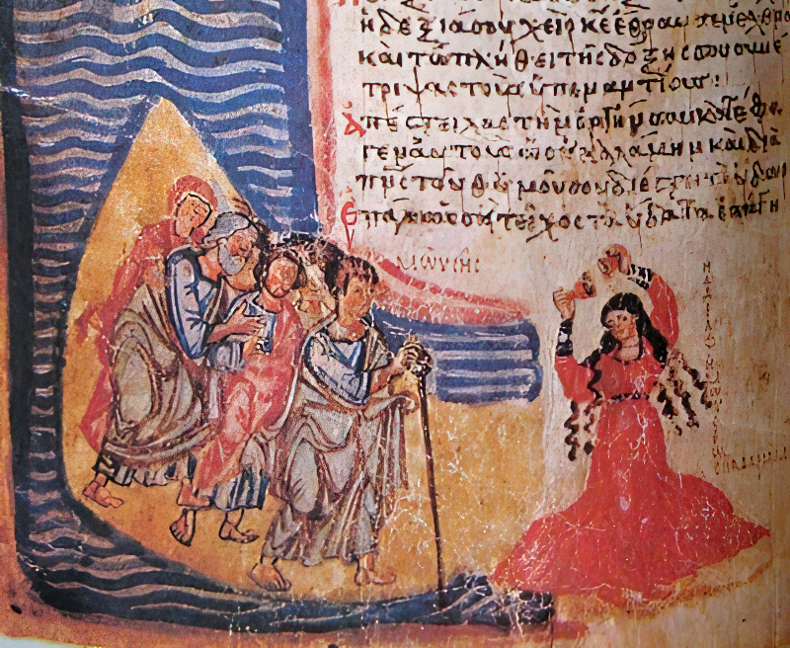
Song of Miriam -- Chludov Psalter, State Historical Museum, Moscow

Slide 8
...I do not mean that there should be relief for others and hardship for you, but it is a question of equality between your present abundance and their need…
2 Corinthians 8:13-14a

Slide 9
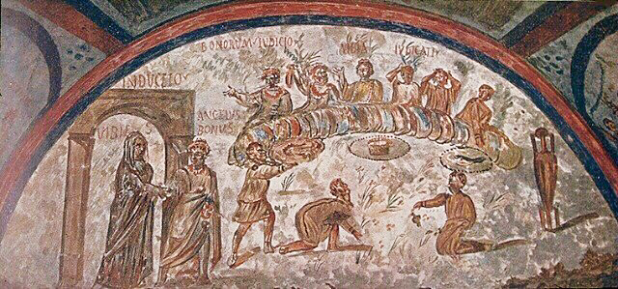
Agape Meal -- 3rd century, Catacomb of Domitilla, Rome, Italy

Slide 10
Then one of the leaders of the synagogue, named Jairus. …pleaded with him…, "My little daughter is at the point of death. Come and lay your hands on her…"
Mark 5:22a, 23b

Slide 11
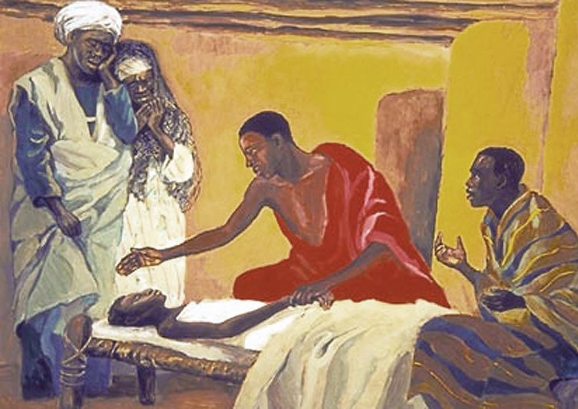
Healing of the Daughter of Jairus -- JESUS MAFA

Slide 12
…he said to them, "Why do you make a commotion and weep?
The child is not dead but sleeping."
Mark 5:39b

Slide 13
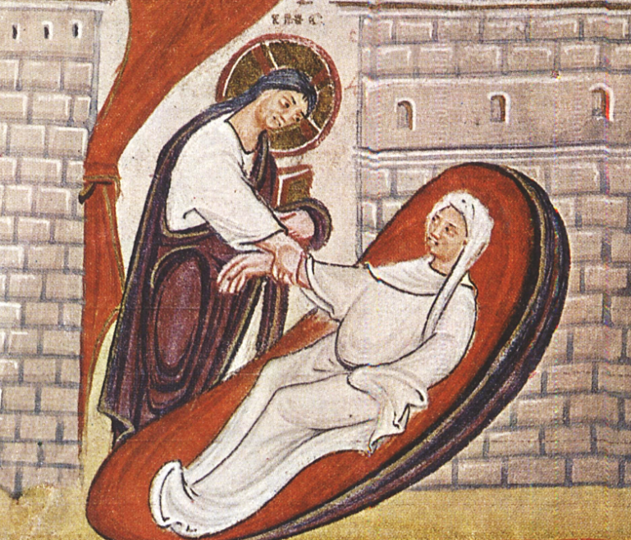
Christ Raising the Daughter of Jairus -- Codex Egberti, 10th c., Stadtbibliotheque, Trier, Germany

Slide 14
Taking her by the hand, he said to her, "Talitha koum," which means, "Little girl, get up!"
Mark 5:41

Slide 15
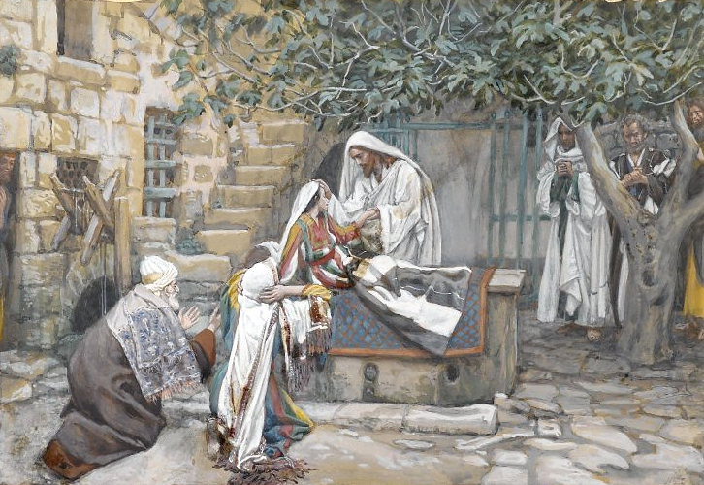
The Daughter of Jairus -- James Tissot, Brooklyn Museum, New York, NY

Slide 16
And immediately the girl stood up and began to walk about…
Mark 5:42a

Slide 17
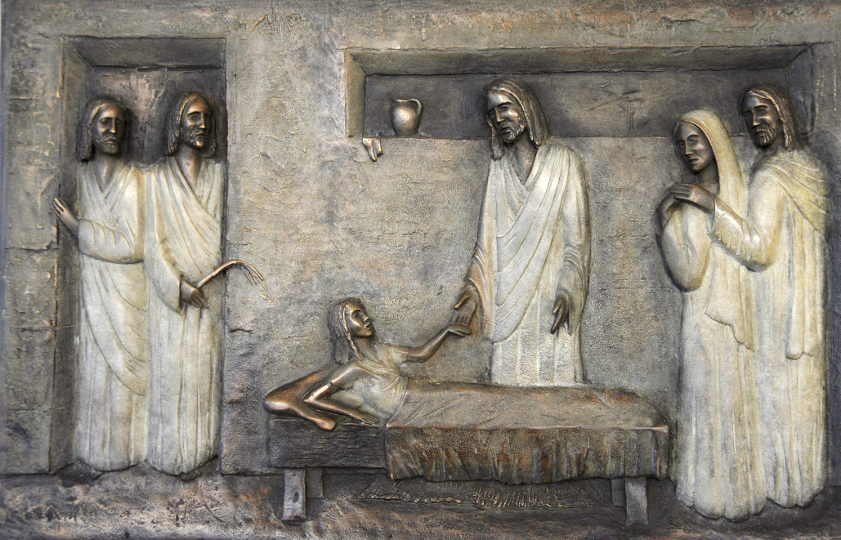
Jairus' Daughter -- National Children's Hospital, Dublin, Ireland

Slide 18
Now there was a woman who had been suffering from a flow of blood for twelve years.
Mark 5:25

Slide 19
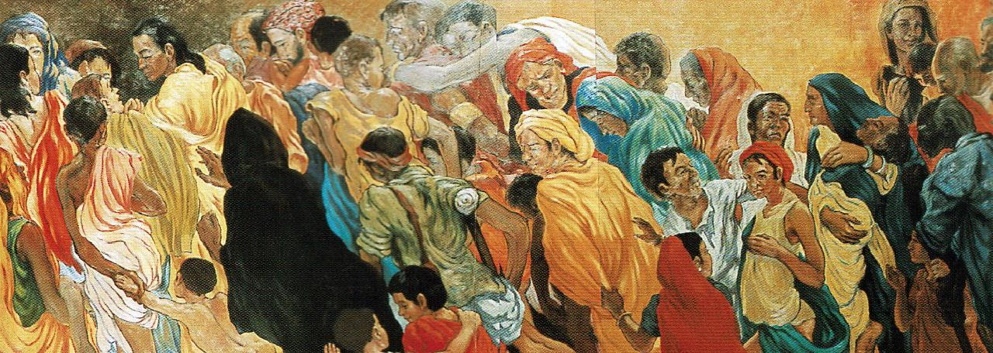
Woman with the Flow of Blood -- Frank Wesley

Slide 20
She had heard about Jesus and came up behind him in the crowd and touched his cloak, for she said, "If I but touch his cloak, I will be made well."
Mark 5:27-28

Slide 21
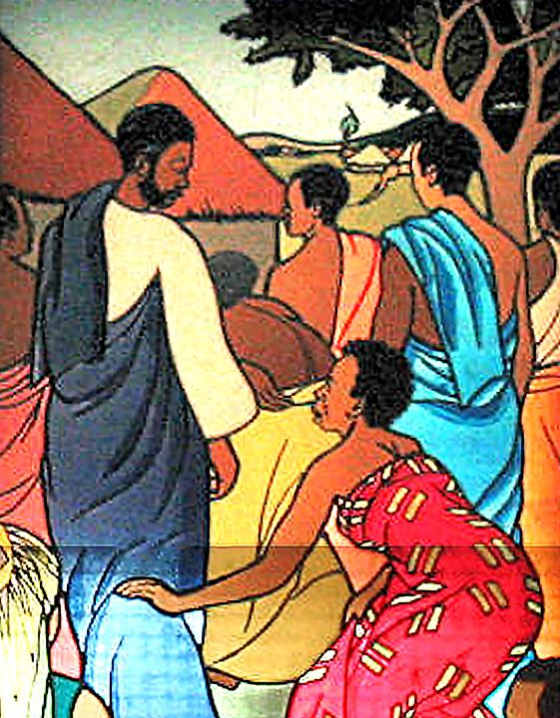
The Woman Who Touched the Cloak of Jesus
Mulungwishi Stained Glass Windows
DRCongo

Slide 22
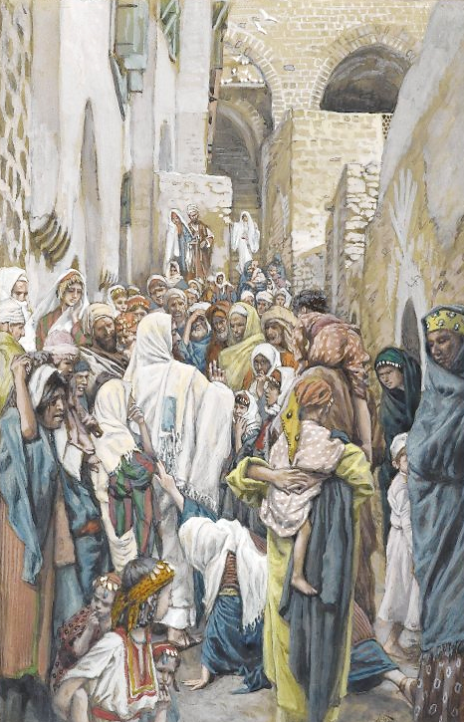
Christ and the Woman with the Issue of Blood
James Tissot
Brooklyn Museum
New York, NY

Slide 23
Immediately her flow of blood stopped, and.... aware that power had gone forth from him, Jesus turned about in the crowd and said, "Who touched my cloak?"
Mark 5:29a, 30

Slide 24
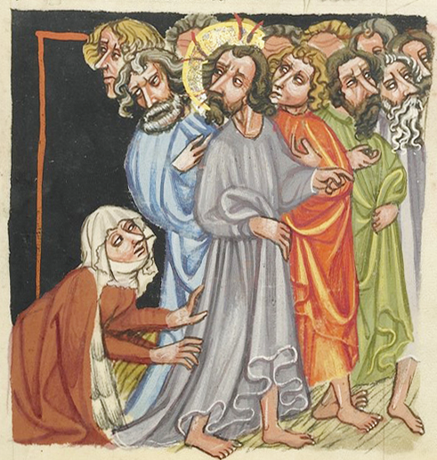
Healing of the Woman with an Issue of Blood
15th c. manuscript
Getty Open Content Program

Slide 25
...the woman, knowing what had happened to her, came in fear and trembling.… He said to her, "Daughter, your faith has made you well; go in peace…"
Mark 5:33a, 34a

Slide 26
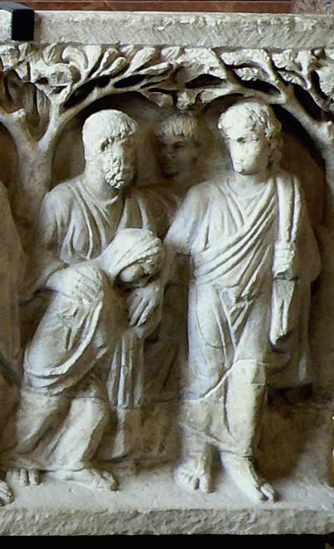
Christ and the Woman with an Issue of Blood
Louvre Museum
Paris, France

Slide 27
Credits
New Revised Standard Version Updated Edition Bible, copyright 2022, Division of Christian Education of the National Council of the Churches of Christ in the United States of America. Used by permission. All rights reserved.
https://commons.wikimedia.org/wiki/File:Eagle_nests_at_Memorial_to_fallen_Airmen_141006-F-LX370-063.jpg
https://www.laurajamesart.com/collections/religious/
http://commons.wikimedia.org/wiki/File:Chludov_Miriam.jpg
http://diglib.library.vanderbilt.edu/act-imagelink.pl?RC=49628
http://diglib.library.vanderbilt.edu/act-imagelink.pl?RC=56455
https://commons.wikimedia.org/wiki/File:CodexEgberti-Fol025-RessurectionOfJairusDaughter.jpg
https://commons.wikimedia.org/wiki/File:Brooklyn_Museum_-_The_Daughter_of_Jairus_(La_fille_de_Z%C3%A4ire)_-_James_Tissot_-_overall.jpg
http://www.flickr.com/photos/feargal/6410830967/
Estate of Frank Wesley, http://www.frankwesleyart.com/main_page.htm
https://www.flickr.com/photos/umccongo/2188556416
https://commons.wikimedia.org/wiki/File:Brooklyn_Museum_-_The_Woman_with_an_Issue_of_Blood_(L%27h%C3%A9moro%C3%AFsse)_-_James_Tissot.jpg
Digital image courtesy of the Getty's Open Content Program. http://www.getty.edu/art/collection/objects/2048/unknown-maker-the-healing-of-a-woman-with-an-issue-of-blood-german-about-1400-1410/
https://commons.wikimedia.org/wiki/File:Sarcophage_%C3%A0_arbres,_Louvre_00.JPG
Additional descriptions can be found at the Art in the Christian Tradition image library, a service of the Vanderbilt Divinity Library, http://diglib.library.vanderbilt.edu/. All images available via Creative Commons 3.0 License.

