Slide 1
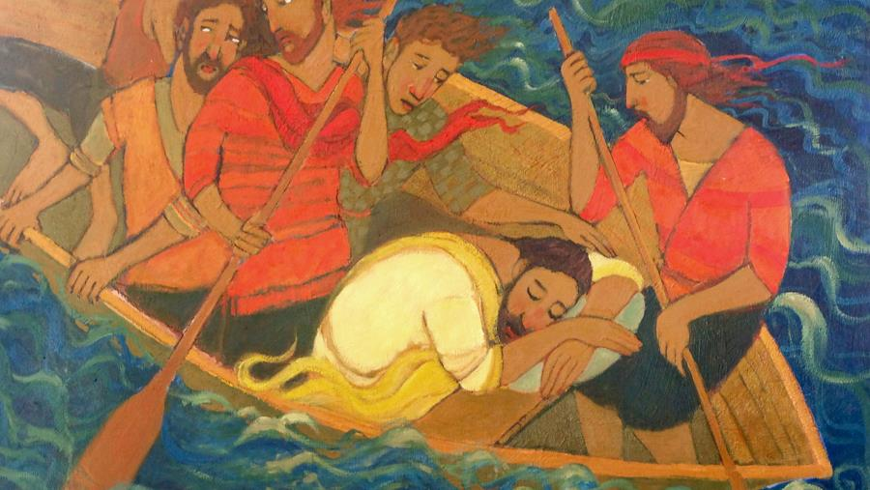
Fifth Sunday after Pentecost
Year B
1 Samuel 17:(1a, 4-11, 19-23), 32-49 and Psalm 9:9-20 or 1 Samuel 17:57-18:5, 18:10-16 and Psalm 133
Job 38:1-11 and Psalm 107:1-3, 23-32
2 Corinthians 6:1-13 • Mark 4:35-41

Slide 2
…there came from…the Philistines a champion named Goliath…. When the Philistine looked and saw David, he disdained him, for he was only a youth…
1 Samuel 17: 4a, 42a

Slide 3
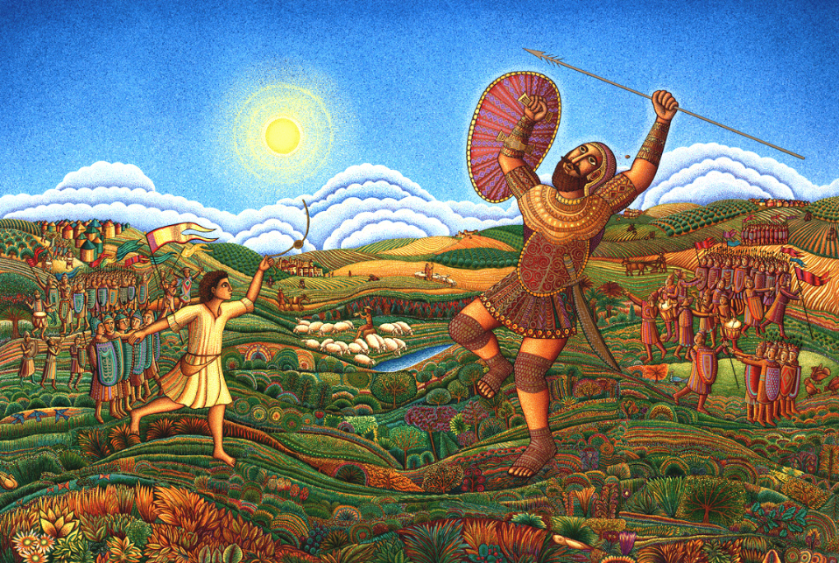
David and Goliath -- John August Swanson, Serigraph, 2009

Slide 4
Then Jonathan made a covenant with David because he loved him as his own soul.
1 Samuel 18:3

Slide 5
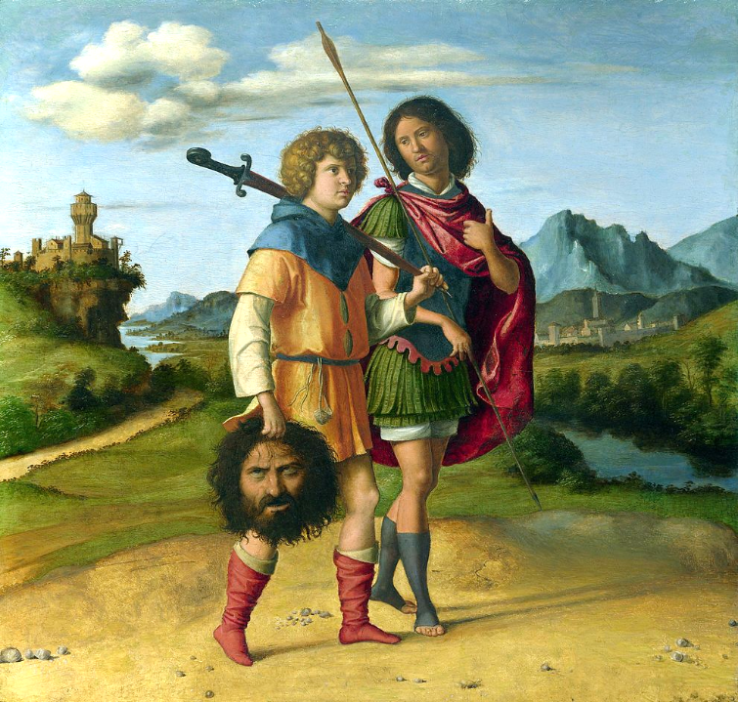
David and Jonathan
Cima da Conegliano
National Gallery
London, England

Slide 6
Then the LORD answered Job…:
...
"Where were you when I laid the foundation of the earth?"
Job 38:1a, 4a

Slide 7
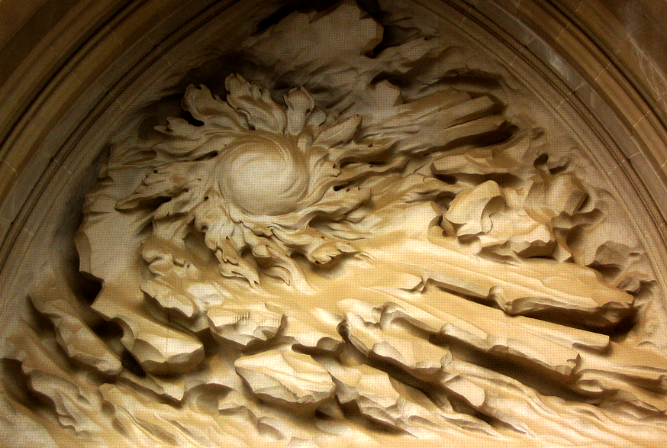
Separation of Light from Darkness -- Frederick Hart, National Cathedral, Washington, DC

Slide 8
"Or who shut in the sea…when it burst out from the womb, when I made the clouds its garment and thick darkness its swaddling band…?"
Job 38:8-9

Slide 9
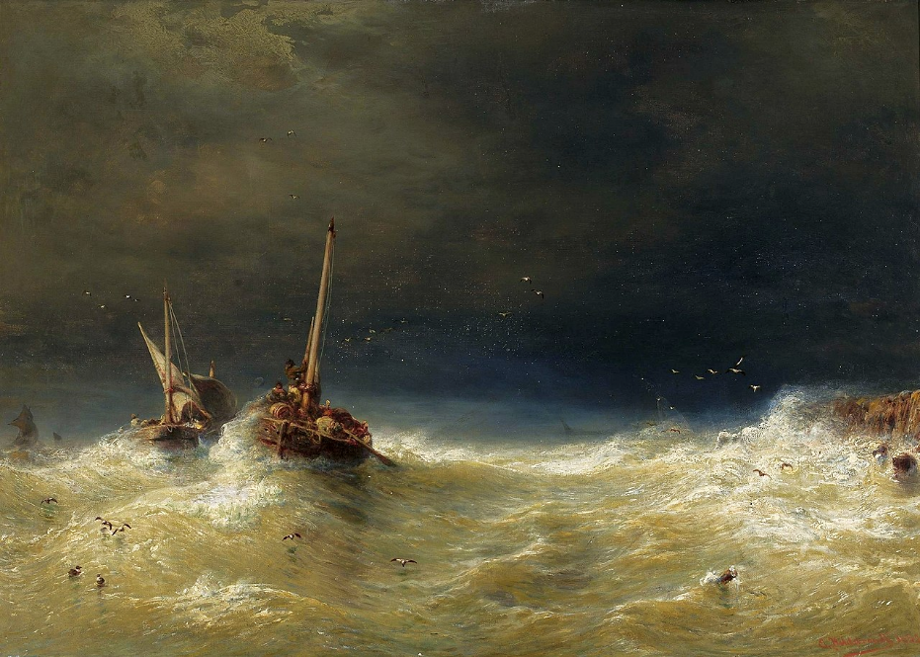
Sea Storm -- Eduard Hildebrandt, National Museum in Warsaw, Warsaw, Poland

Slide 10
…he brought them out from their distress; he made the storm be still, and the waves of the sea were hushed.
Psalm 107:28b-29

Slide 11
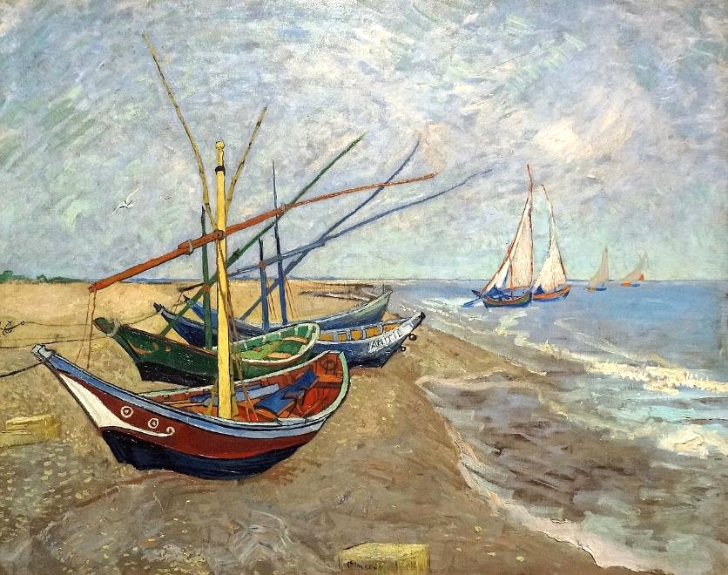
Fishing Boats on the Beach -- Vincent Van Gogh, Van Gogh Museum, Amsterdam

Slide 12
We are treated…as sorrowful, yet always rejoicing, as poor yet making many rich, as having nothing and yet possessing everything.
2 Corinthians 6:8b, 10

Slide 13

Holy Sacrament Monastery of the Poor Clares
Canidé, Brazil

Slide 14
…they took him with them in the boat…. A great windstorm arose...so that the boat was already being swamped.
Mark 4:36b, 37ac

Slide 15
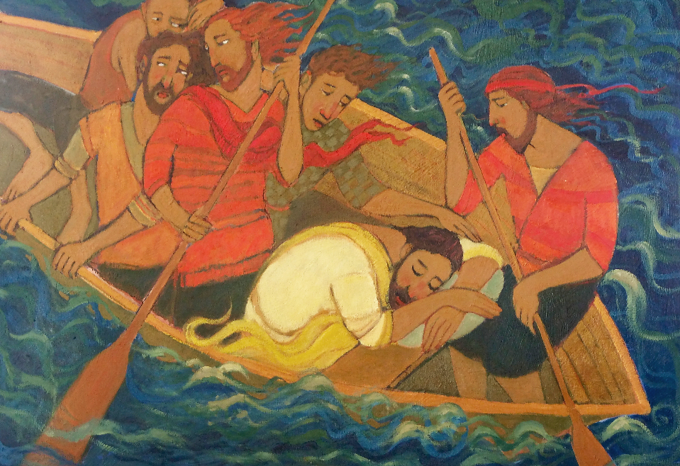
Tempest -- Kathleen Peterson, Spring City, Utah

Slide 16
But he was…asleep on the cushion, and they woke him up and said to him, "Teacher, do you not care that we are perishing?"
Mark 4:38b

Slide 17
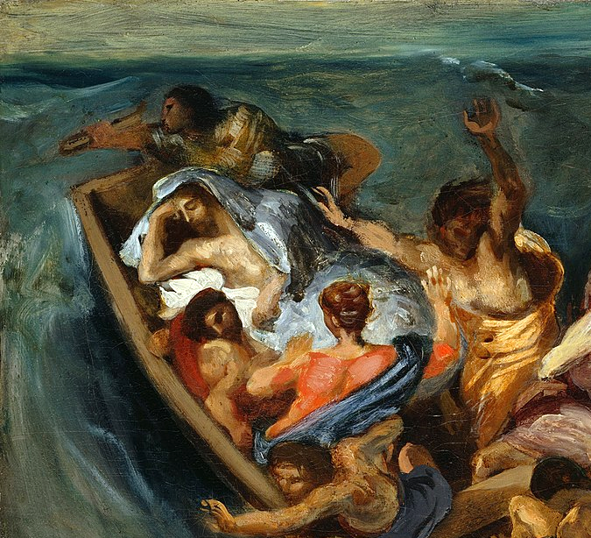
Christ on the Sea of Galilee, detail -- Eugene Delacroix, Nelson-Atkins Museum of Art, Kansas City, MO

Slide 18
And waking up, he rebuked the wind and said to the sea, "Be silent! Be still!" Then the wind ceased, and there was a dead calm. 4He woke up and rebuked the wind, and said to the sea, "Peace! Be still!" Then the wind ceased, and there was a dead calm.
Mark 4:39

Slide 19
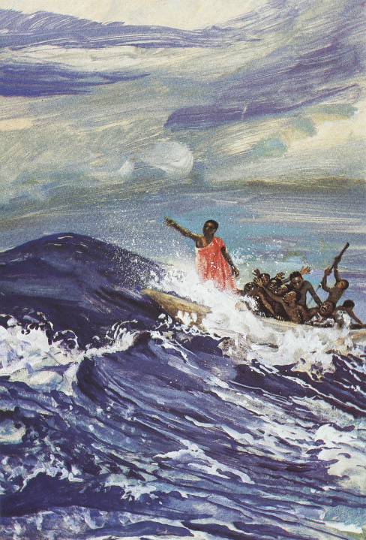
Jesus Lulls the Storm
JESUS MAFA

Slide 20
He said to them, "Why are you afraid? Have you still no faith?"
Mark 4:40

Slide 21
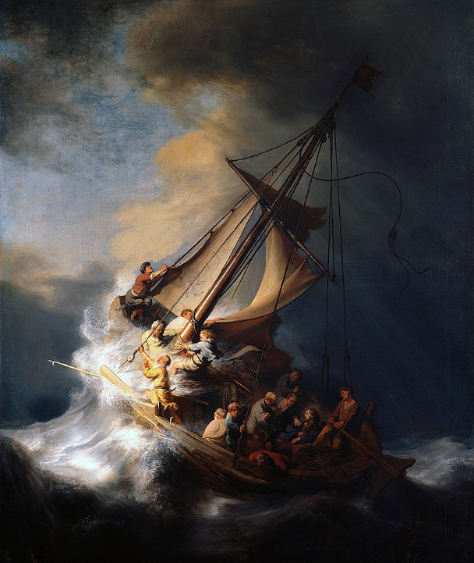
Storm on the Sea of Galilee
Rembrandt
Location unknown

Slide 22
And they were filled with great fear and said to one another, "Who then is this, that even the wind and the sea obey him?"
Mark 4:41

Slide 23
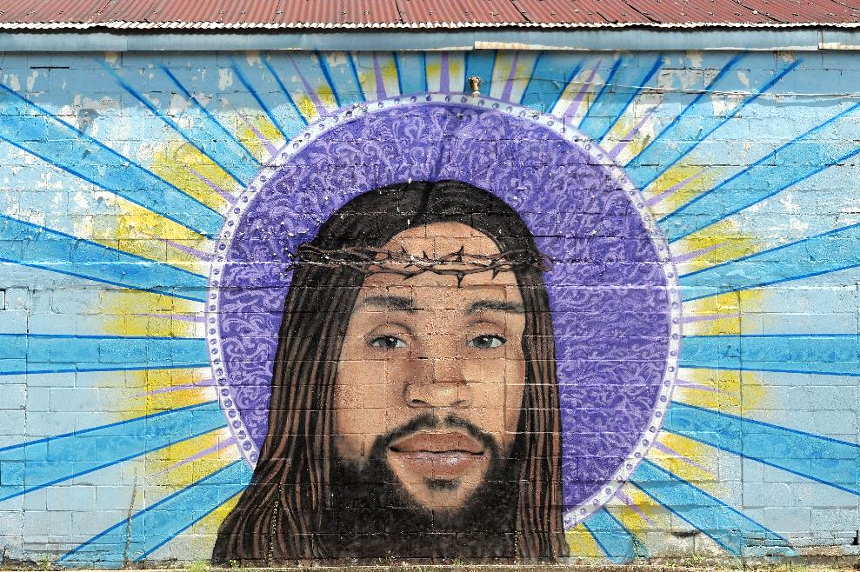
Jesus, the Holy Mural -- The Way Jesus Christ Christian Church, New Orleans

Slide 24
Credits
New Revised Standard Version Updated Edition Bible, copyright 2022, Division of Christian Education of the National Council of the Churches of Christ in the United States of America. Used by permission. All rights reserved.
http://www.johnaugustswanson.com – copyright 2009 by John August Swanson
https://commons.wikimedia.org/wiki/File:Cima_da_Conegliano_-_Gionata_e_david_con_la_testa_di_Golia.jpg
http://www.flickr.com/photos/shindotv/2552425891/
https://commons.wikimedia.org/wiki/File:Hildebrandt_Sea_storm.jpg
https://commons.wikimedia.org/wiki/File:Netherlands-4036_-_Fishing_Boats_(11612343343).jpg
http://diglib.library.vanderbilt.edu/act-imagelink.pl?RC=48310
https://commons.wikimedia.org/wiki/File:Holy_Sacrament_Monastery,_Canind%C3%A9,_Brazil_(Poor_Clares)_031.JPG
https://www.kathleenpetersonart.com/ - with permission
https://commons.wikimedia.org/wiki/File:Eug%C3%A8ne_Delacroix_-_Christ_on_the_Sea_of_Galilee_-_Google_Art_Project.jpg
https://commons.wikimedia.org/wiki/File:Rembrandt_Christ_in_the_Storm_on_the_Lake_of_Galilee.jpg
https://www.flickr.com/photos/volvob12b/48740737607
Additional descriptions can be found at the Art in the Christian Tradition image library, a service of the Vanderbilt Divinity Library, http://diglib.library.vanderbilt.edu/. All images available via Creative Commons 3.0 License.

