Slide 1
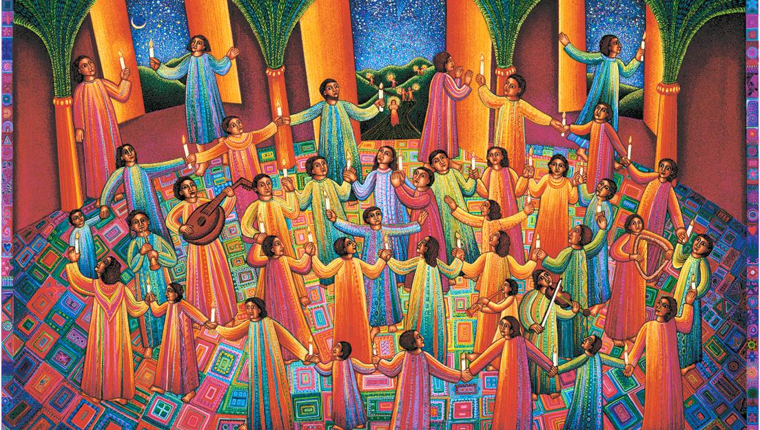
Fourth Sunday after Pentecost
Year B
1 Samuel 15:34 - 16:13 and Psalm 20
Ezekiel 17:22-24 and Psalm 92:1-4, 12-15
2 Corinthians 5:6-10, (11-13), 14-17 • Mark 4:26-34

Slide 2
The LORD said, "Rise and anoint him, for this is the one." …and the spirit of the LORD came mightily upon David from that day forward.
1 Samuel 16:12b, 13b

Slide 3
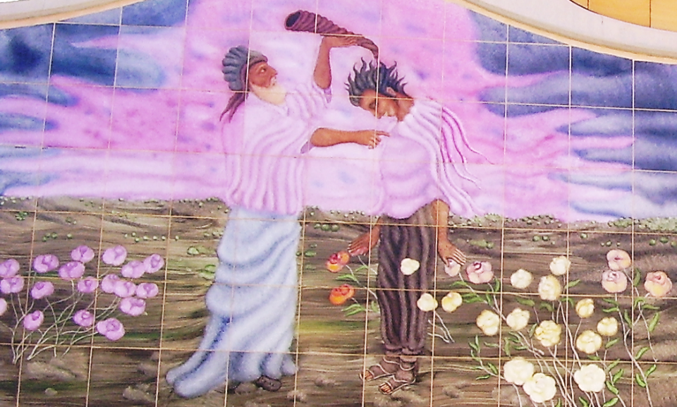
Samuel Anoints David -- Castra center, Haifa, Israel

Slide 4
Some take pride in chariots and some in horses, but our pride is in the name of the LORD our God.
Psalm 20:7

Slide 5
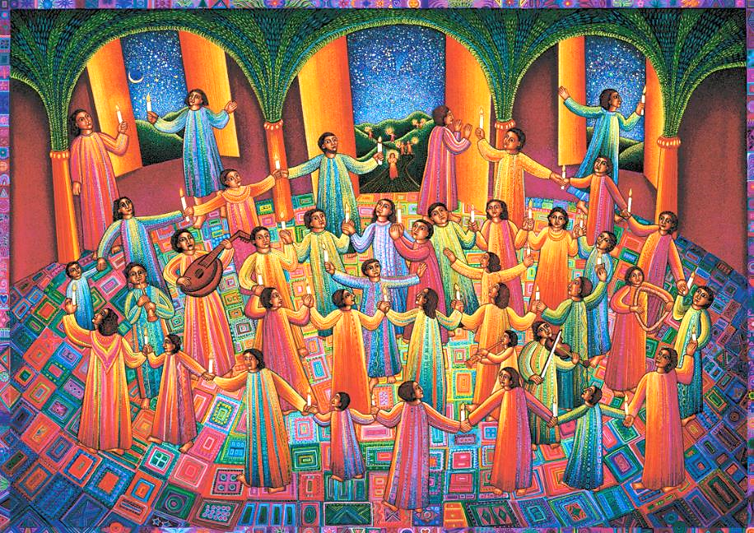
Celebration -- John August Swanson, Serigraph, 2009

Slide 6
Thus says the Lord GOD:
I myself will take a sprig…. it will produce boughs and bear fruit and become a noble cedar.
Ezekiel 17:22a, 23a

Slide 7
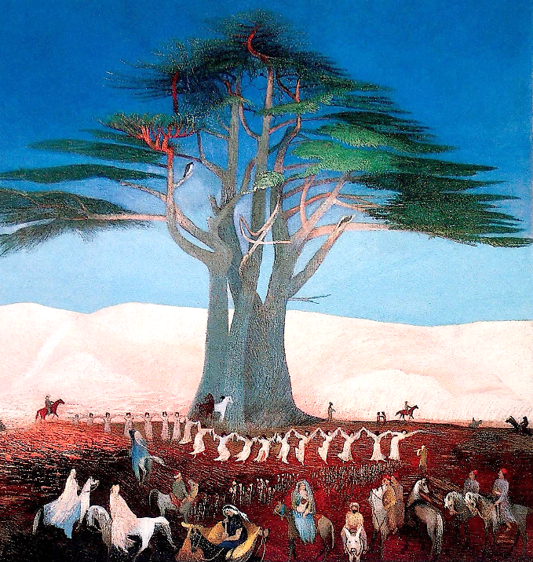
Pilgrimage to the Cedar of Lebanon
Tivadar Kosztka, Hungarian National Gallery
Budapest, Hungary

Slide 8
Under it every kind of bird will live; in the shade of its branches will nest winged creatures of every kind.
Ezekiel 17:23b

Slide 9
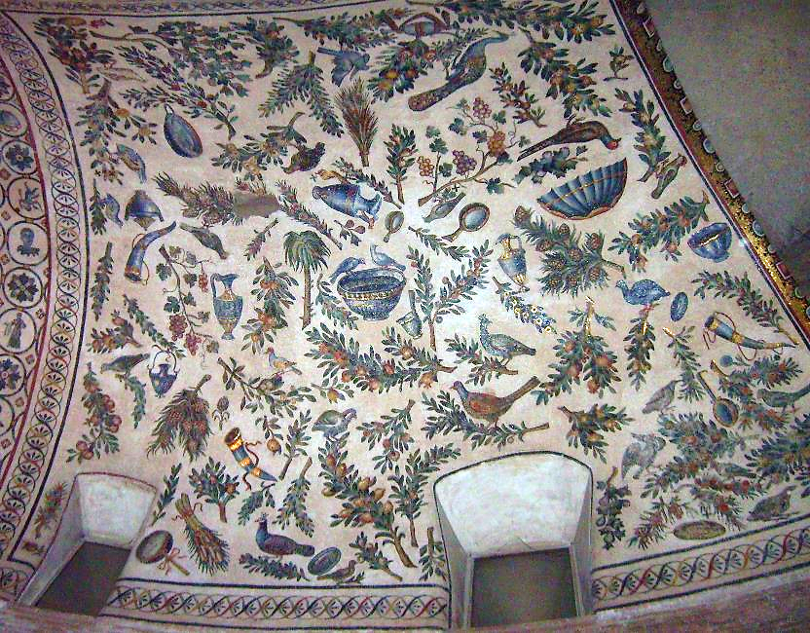
Early Christian Bird Mosaic -- 4th c. Mausoleum of Santa Costanza, Rome , Italy

Slide 10
It is good to give thanks to the LORD, …to declare your steadfast love in the morning and your faithfulness by night…
Psalm 92:1a, 2

Slide 11
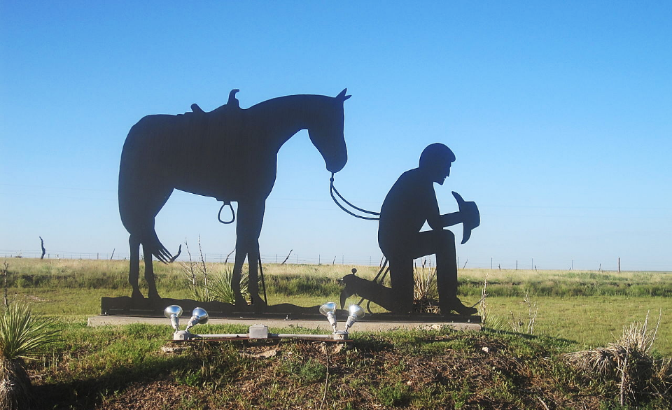
Cowboy at Prayer -- Clayton, NM

Slide 12
So if anyone is in Christ, there is a new creation: everything old has passed away; look, new things have come into being!
2 Corinthians 5:17

Slide 13
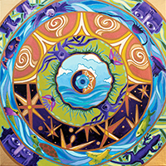
Let There Be -- Lauren Wright Pittman

Slide 14
"The kingdom of God is as if someone would scatter seed on the ground…"
Mark 4:26

Slide 15
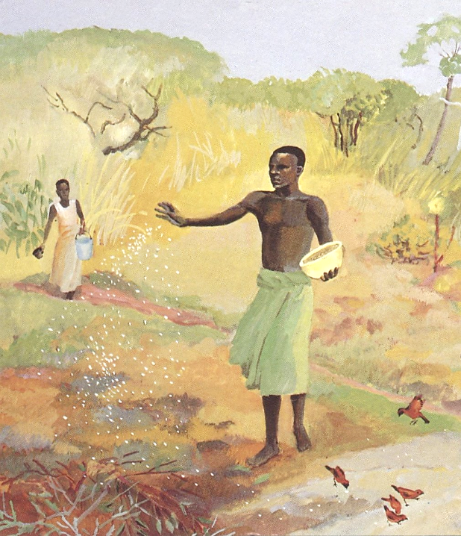
The Sower
JESUS MAFA

Slide 16
"The earth produces of itself first the stalk, then the head, then the full grain in the head."
Mark 4:28

Slide 17
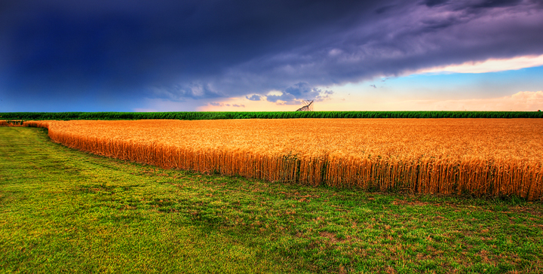
Kansas Summer Wheat -- James Swanson, photographer

Slide 18
"But when the grain is ripe, at once he goes in with his sickle because the harvest has come."
Mark 4:29

Slide 19
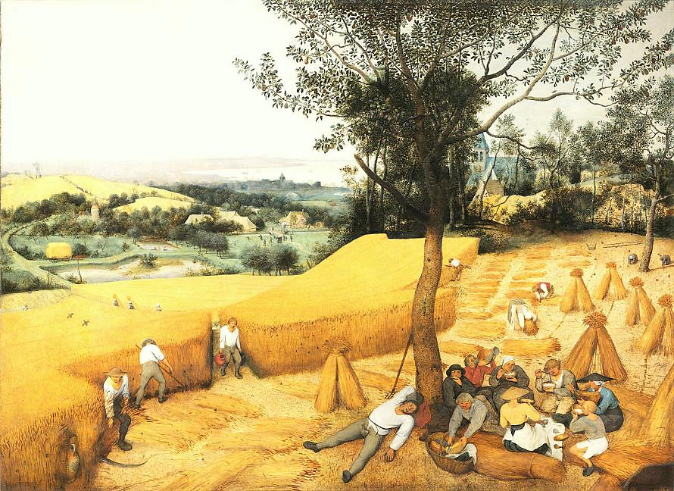
Harvesters -- Pieter Brueghel, Metropolitan Museum of Art, New York, NY

Slide 20
"It is like a mustard seed, which, when sown upon the ground, is the smallest of all the seeds on earth..."
Mark 4:31

Slide 21
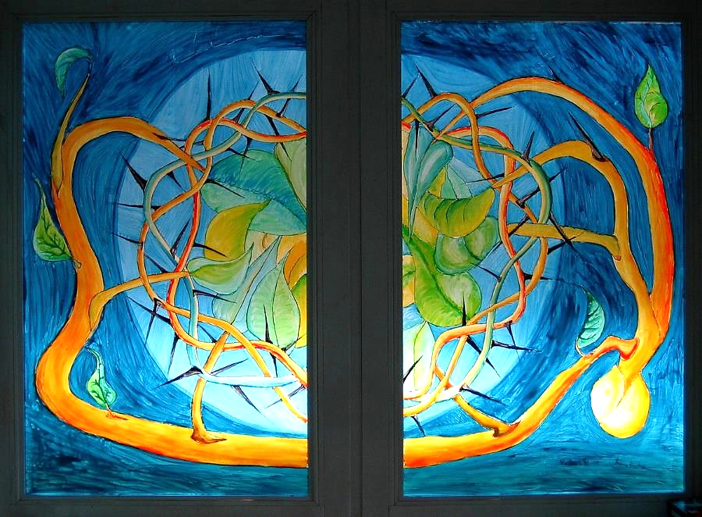
Parable of the Mustard Seed -- Window at the YMCA training center, Kassel, Germany

Slide 22
"...yet when it is sown it grows up...and puts forth large branches, so that the birds of the air can make nests in its shade."
Mark 4:32

Slide 23
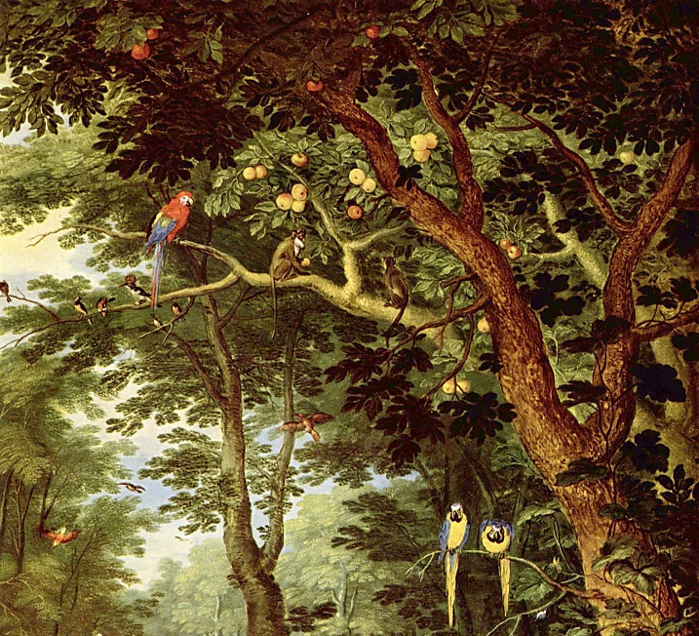
Jan Bruegel -- Paradise, Gemaldegalerie, Berlin, Germany

Slide 24
With many such parables he spoke the word to them as they were able to hear it...
Mark 4:33

Slide 25
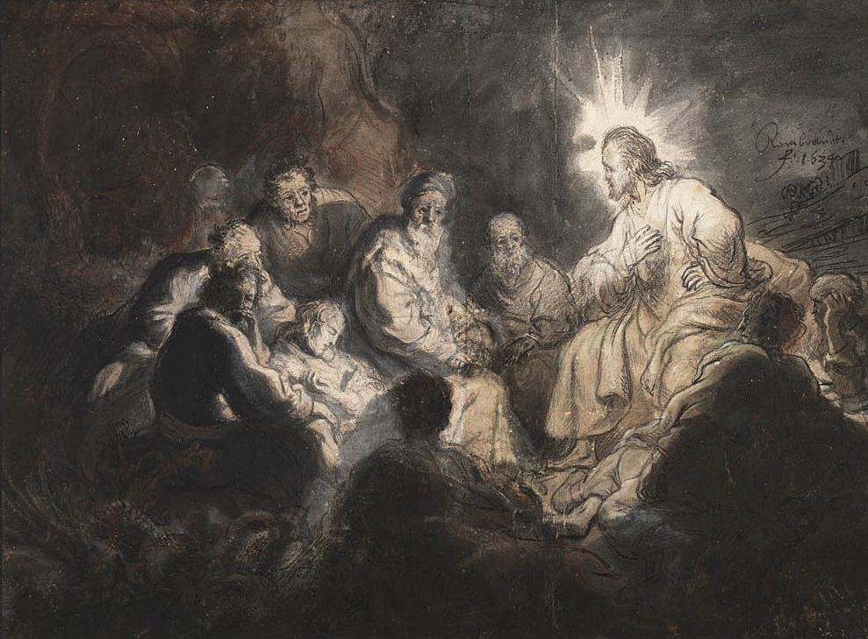
Christ and His Disciples -- Rembrandt, Teylers Museum, Haarlem, Netherlands

Slide 26
Credits
New Revised Standard Version Updated Edition Bible, copyright 2022, Division of Christian Education of the National Council of the Churches of Christ in the United States of America. Used by permission. All rights reserved.
https://commons.wikimedia.org/wiki/File:PikiWiki_Israel_28199_Bible_paintings_in_Castra_center_Haifa.JPG
http://www.johnaugustswanson.com – copyright 2009 by John August Swanson
https://commons.wikimedia.org/wiki/File:Csontv%C3%A1ry_Kosztka,_Tivadar_-_Pilgrimage_to_the_Cedars_of_Lebanon_-_Google_Art_Project.jpg
https://commons.wikimedia.org/wiki/File:Santa_Costanza_mosaic.jpg
https://commons.wikimedia.org/wiki/File:Cowboy_at_Prayer,_near_Clayton,_NM_IMG_4952.JPG
Lauren Wright Pittman, http://www.lewpstudio.com/
http://diglib.library.vanderbilt.edu/act-imagelink.pl?RC=48309
https://www.flickr.com/photos/23737778@N00/7115229223 - James Watkins
http://commons.wikimedia.org/wiki/File:Pieter_Bruegel_the_Elder-_The_Harvesters_-_Google_Art_Project.jpg
https://www.flickr.com/photos/tin-g/90272565
http://commons.wikimedia.org/wiki/File:Jan_Brueghel_the_Younger_Paradise.jpg
https://commons.wikimedia.org/wiki/File:Rembrandt_Jesus_and_his_Disciples.jpg
Additional descriptions can be found at the Art in the Christian Tradition image library, a service of the Vanderbilt Divinity Library, http://diglib.library.vanderbilt.edu/. All images available via Creative Commons 3.0 License.

