Slide 1
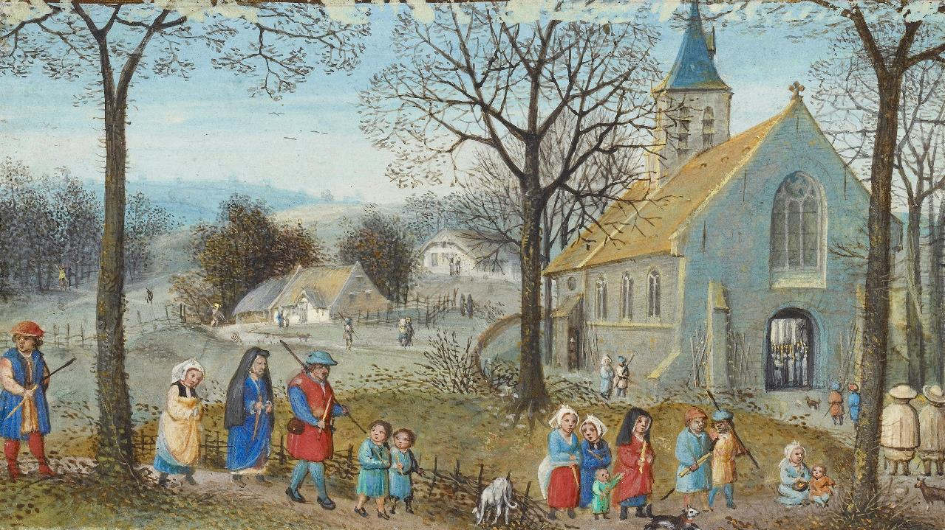
Second Sunday after Pentecost
Year B
1 Samuel 3:1-10, (11-20) and Psalm 139:1-6, 13-18 Deuteronomy 5:12-15 and Psalm 81:1-10
2 Corinthians 4:5-12 • Mark 2:23-3:6

Slide 2
The LORD called again, "Samuel!" Samuel got up and went to Eli….
But he said, "I did not call, my son…"
1 Samuel 3:6

Slide 3
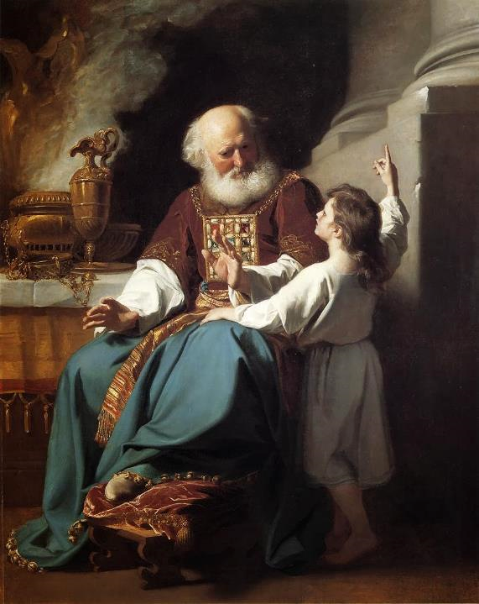
Samuel Speaks to Eli
John Singleton Copley
Wadwsorth Atheneum
Hartford, CT

Slide 4
For it was you who formed my inward parts; you knit me together in my mother's womb.
Psalm 139:13

Slide 5
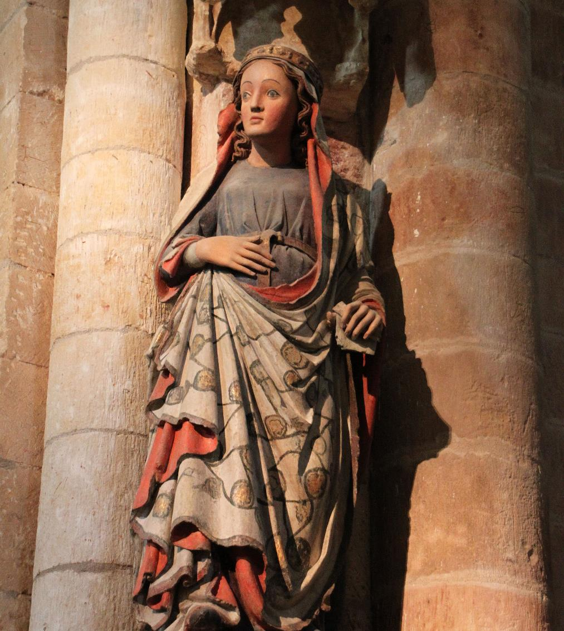
Mary with Child
Collegiate Church Of St Mary Major
Toro, Spain

Slide 6
"'Observe the Sabbath day and keep it holy, as the LORD your God commanded you.'"
Deuteronomy 5:12

Slide 7
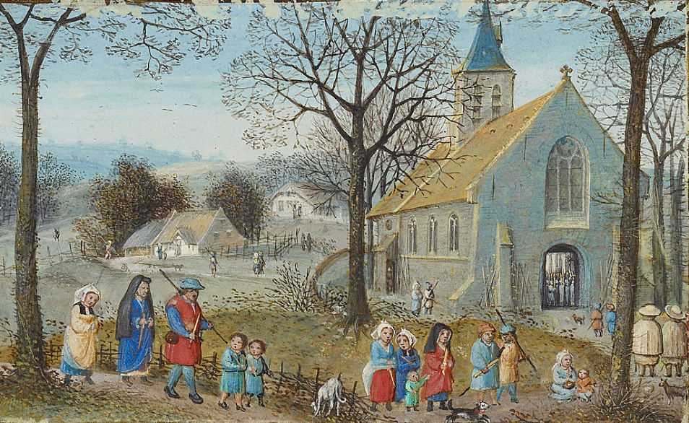
Villagers on Their Way to Church -- Simon Bening, Getty Center, Los Angeles, CA

Slide 8
Blow the trumpet at the new moon, at the full moon, on our festal day.
Psalm 81:3

Slide 9
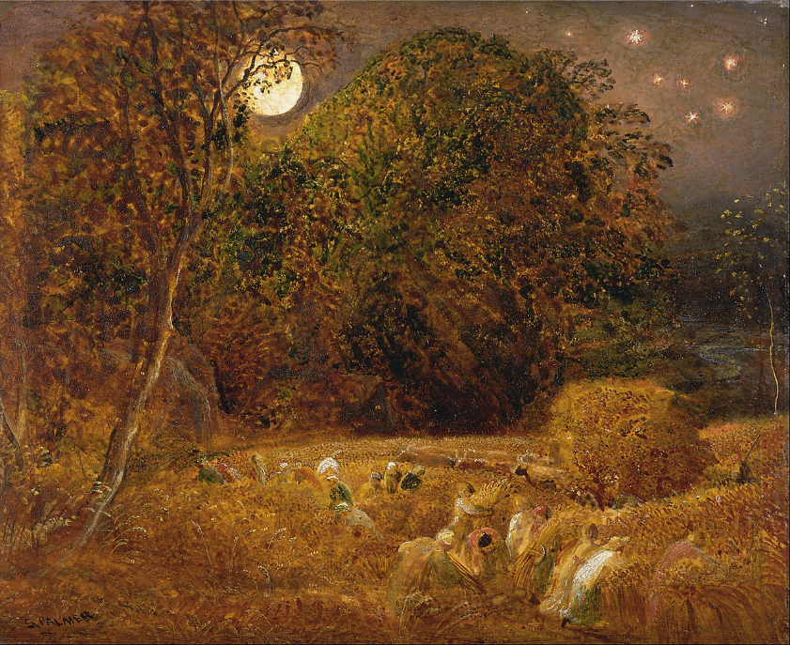
The Harvest Moon -- Samuel Palmer, Yale Center for British Art, New Haven, CT

Slide 10
"Let light shine out of darkness," …the light of the knowledge of the glory of God in the face of Christ.
2 Corinthians 4:6b

Slide 11
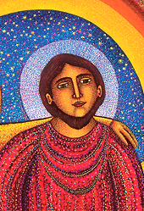
Christ, Last Supper, detail -- John August Swanson, Serigraph, 2009

Slide 12
One Sabbath he was going through the grain fields, and as they made their way his disciples began to pluck heads of grain.
Mark 2:23

Slide 13
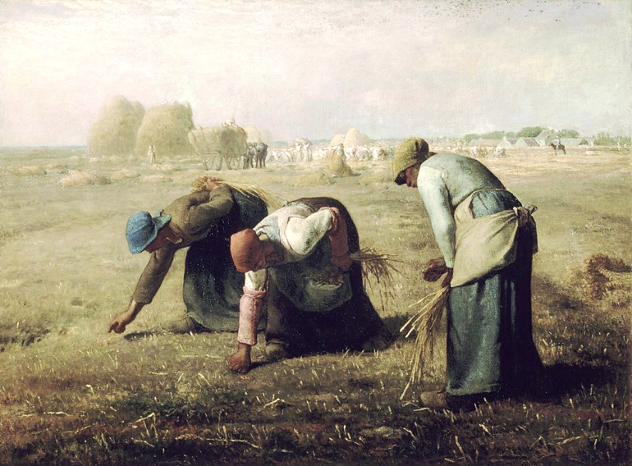
The Gleaners -- Jean Francois Millet, Musée d'Orsay, Paris, France

Slide 14
The Pharisees said to him, "Look, why are they doing what is not lawful on the Sabbath?"
Mark 2:24

Slide 15
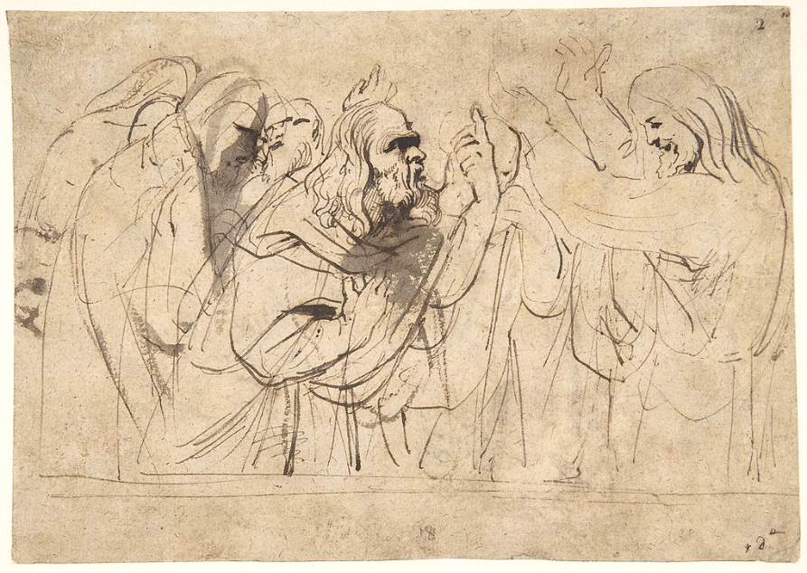
Christ and the Pharisees -- Anthony van Dyck, Metropolitan Museum of Art, NY

Slide 16
Then he said to them, "The Sabbath was made for humankind and not humankind for the Sabbath..."
Mark 2:27

Slide 17
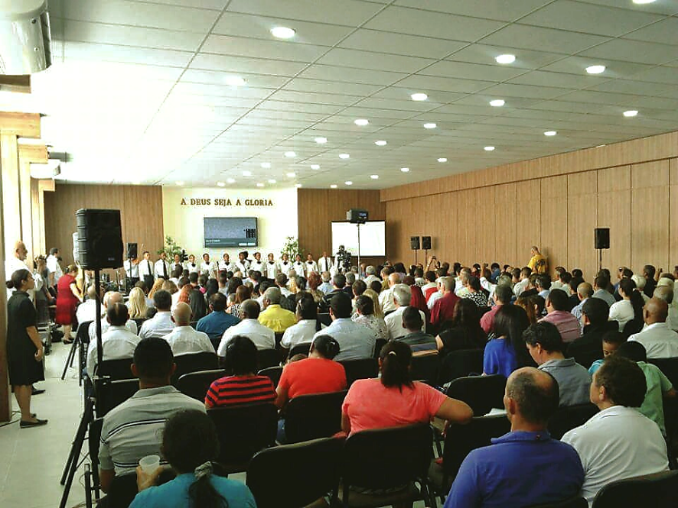
Church of God International Worship service, Sao Paolo, Brazil

Slide 18
…he entered the synagogue, and a man was there who had a withered hand.
Mark 3:1

Slide 19
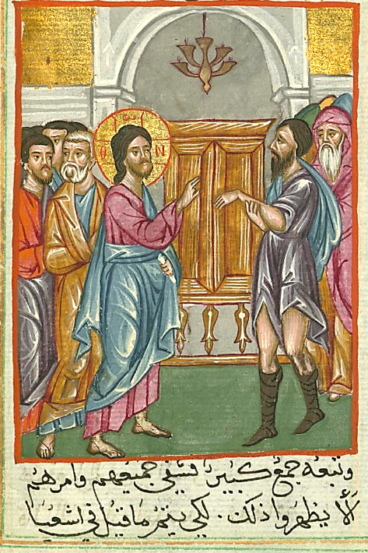
Healing of Man with a Withered Hand
Ilyas Basim Khuri Bazzi Rahib
Walters Museum of Art, Baltimore, MD

Slide 20
They were watching him to see whether he would cure him on the Sabbath, so that they might accuse him.
Mark 3:2

Slide 21
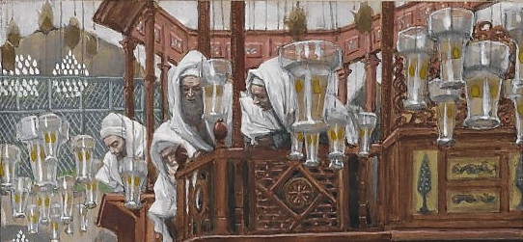
Jesus and the Man with the Withered Hand, detail -- James Tissot, Brooklyn Museum of Art
New York, NY

Slide 22
Then he said to them, "Is it lawful to do good or to do harm on the Sabbath, to save life or to kill?"
But they were silent.
Mark 3:4

Slide 23
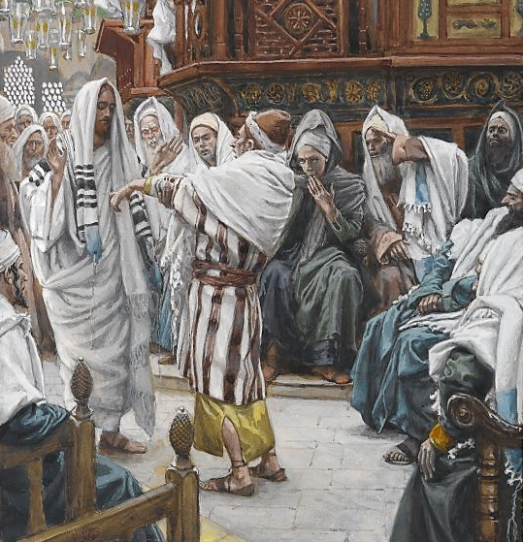
Jesus and the Man with the Withered Hand, detail
James Tissot, Brooklyn Museum of Art
New York, NY

Slide 24
He…said to the man, "Stretch out your hand." He stretched it out, and his hand was restored.
Mark 3:5b

Slide 25
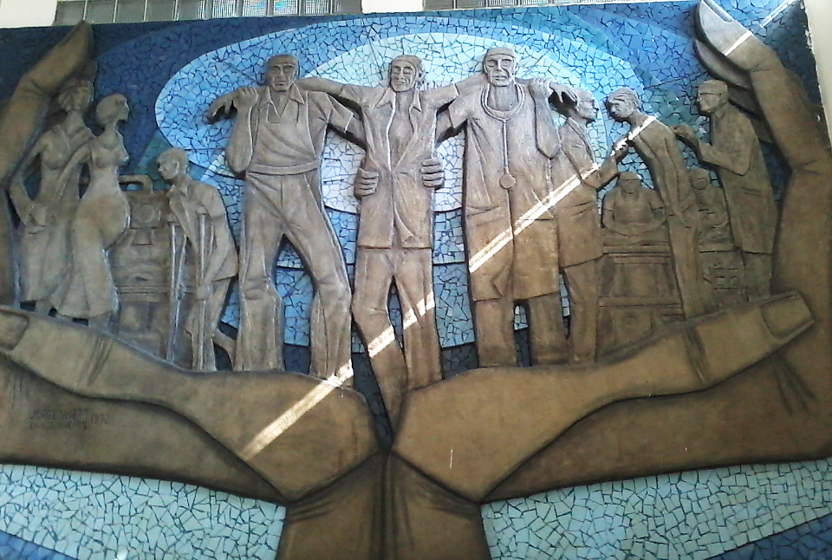
Healing Mural -- Hospital Teodoro Maldonado Carbo, Guayaquil, Ecuador

Slide 26
Credits
New Revised Standard Version Updated Edition Bible, copyright 2022, Division of Christian Education of the National Council of the Churches of Christ in the United States of America. Used by permission. All rights reserved.
https://commons.m.wikimedia.org/wiki/File:Eli_and_Samuel.jpg
https://commons.wikimedia.org/wiki/File:Virgen_encinta,_Colegiata_de_Sta_M%C2%AA_La_Mayor,_Toro.JPG
https://commons.wikimedia.org/wiki/File:Simon_Bening_(Flemish_-_Villagers_on_Their_Way_to_Church_-_Google_Art_Project.jpg
https://commons.wikimedia.org/wiki/File:Samuel_Palmer_-_The_Harvest_Moon_-_Google_Art_Project.jpg
http://www.johnaugustswanson.com – copyright 2009 by John August Swanson
https://commons.wikimedia.org/wiki/File:Jean-Fran%C3%A7ois_Millet_-_Gleaners_-_Google_Art_Project_2.jpg
https://commons.wikimedia.org/wiki/File:Christ_and_the_Pharisees;_verso;_Christ_and_a_Pharisee_MET_DP802093.jpg
https://commons.wikimedia.org/wiki/File:MCGI_Worship_Service_Sao_Paolo_2016.jpg
https://commons.wikimedia.org/wiki/File:Ilyas_Basim_Khuri_Bazzi_Rahib_-_Jesus_Heals_the_Man_with_a_Withered_Hand_-_Walters_W59231B_-_Full_Page.jpg
https://commons.wikimedia.org/wiki/File:Brooklyn_Museum_-_The_Man_with_the_Withered_Hand_(L%27homme_%C3%A0_la_main_dess%C3%A9ch%C3%A9e)_-_James_Tissot_-_overall.jpg
https://commons.wikimedia.org/wiki/File:Brooklyn_Museum_-_The_Man_with_the_Withered_Hand_(L%27homme_%C3%A0_la_main_dess%C3%A9ch%C3%A9e)_-_James_Tissot_-_overall.jpg
https://commons.wikimedia.org/wiki/File:Mural_en_el_Hospital_Teodoro_Maldonado_Carbo.jpg
Additional descriptions can be found at the Art in the Christian Tradition image library, a service of the Vanderbilt Divinity Library, http://diglib.library.vanderbilt.edu/. All images available via Creative Commons 3.0 License.

