Slide 1
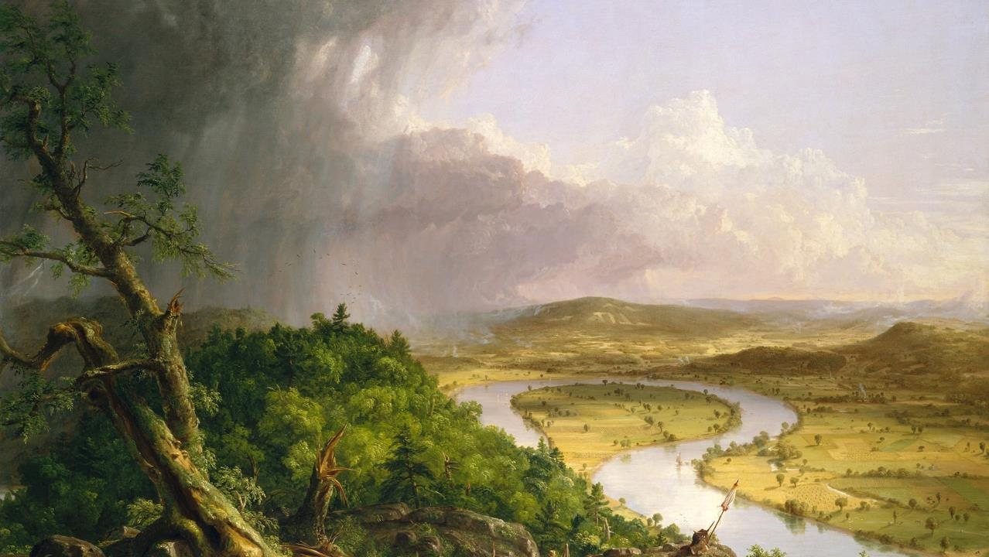
Twenty-Sixth Sunday after Pentecost
Year B
1 Samuel 1:4-20 and 1 Samuel 2:1-10 • Daniel 12:1-3 and Psalm 16 • Hebrews 10:11-14, (15-18), 19-25
Mark 13:1-8

Slide 2
…Peninnah…. used to provoke her severely, to irritate her, because the LORD had closed her womb. Therefore Hannah wept and would not eat.
1 Samuel 1:4b, 6b, 7b

Slide 3
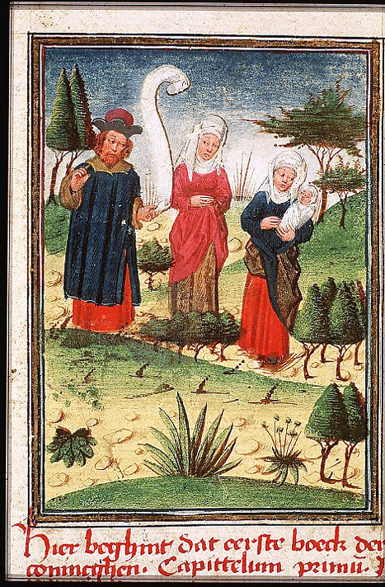
Elkanah and His Two Wives
Master of the Feathery Clouds

Slide 4
But Hannah answered, "No, my lord, I am a woman deeply troubled; …I have been pouring out my soul before the LORD."
1 Samuel 1:15

Slide 5
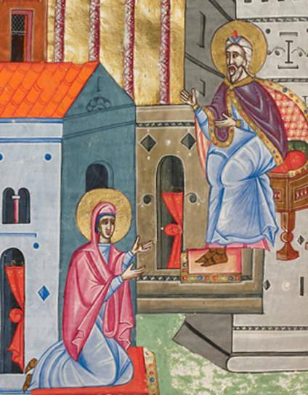
Hannah Before Eli the High Priest
Malnazar
Getty Center, Los Angeles, CA

Slide 6
In due time Hannah conceived and bore a son.
1 Samuel 1:20a

Slide 7
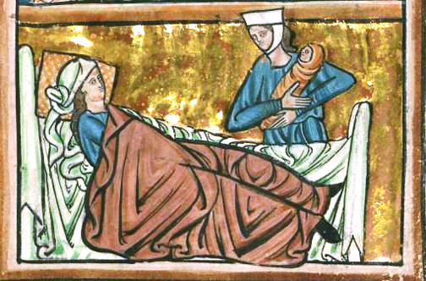
Hannah Bears a Child -- William de Brailes, Walters Art Gallery, Baltimore, MD

Slide 8
She named him Samuel, for she said, "I have asked him of the LORD."
1 Samuel 1:20b

Slide 9
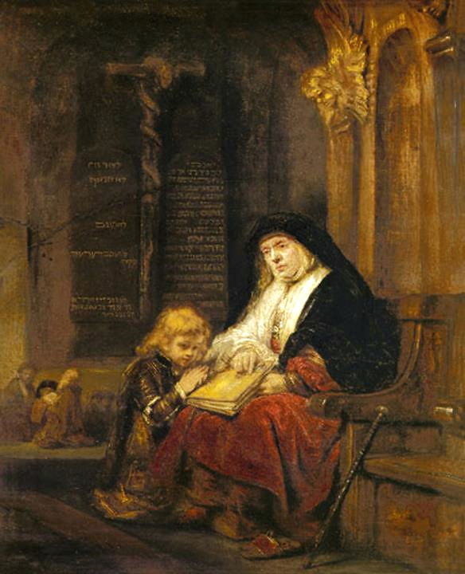
Hannah with Samuel in the Temple
Workshop of Rembrandt

Slide 10
"There is no Holy One like the LORD…. For the pillars of the earth are the LORD's, and on them he has set the world."
1 Samuel 2:2a, 8b

Slide 11
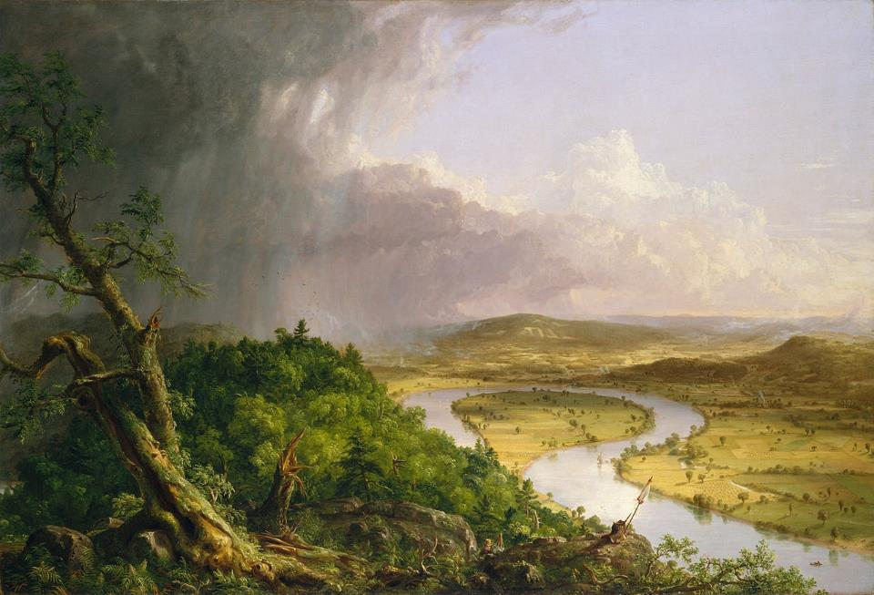
After the Thunderstorm - The Oxbow -- Thomas Cole, Metropolitan Museum of Art, New York, NY

Slide 12
Those who are wise shall shine like the brightness of the sky, and those who lead the many to righteousness, like the stars forever and ever.
Daniel 12:3

Slide 13
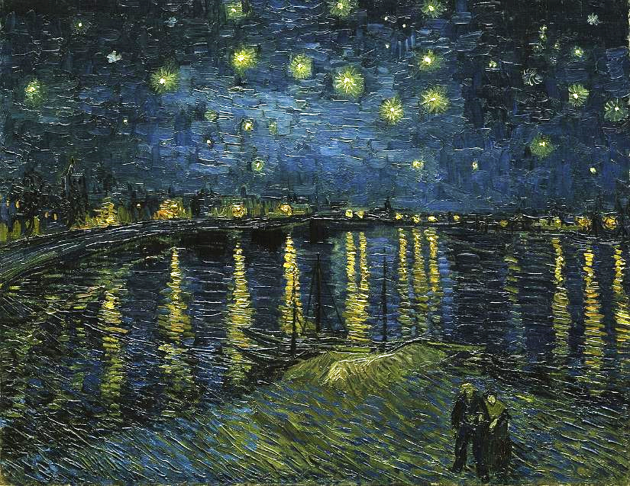
Starry Night on the Rhone -- Vincent van Gogh, Musée d'Orsay, Paris, France

Slide 14
You show me the path of life. In your presence there is fullness of joy...
Psalm 16:11a

Slide 15

Complete Joy -- Lauren Wright Pittman, liturgical artist

Slide 16
"I will remember their sins and their lawless deeds no more." Where there is forgiveness of these, there is no longer any offering for sin.
Hebrews 10:17b-18

Slide 17
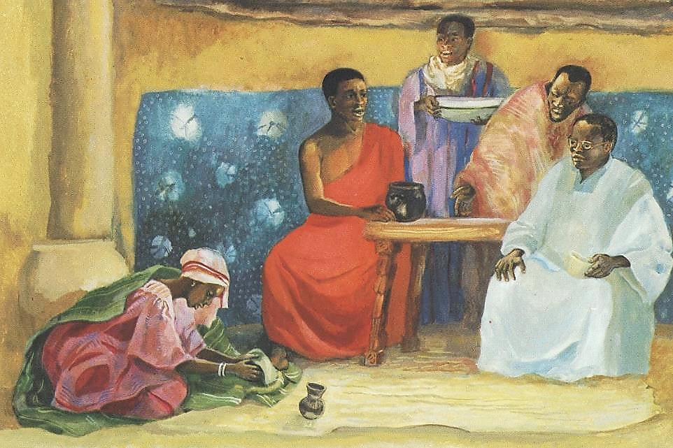
Jesus Speaks About Forgiveness -- JESUS MAFA, Cameroon

Slide 18
Then Jesus asked him, "Do you see these great buildings? Not one stone will be left here upon another; all will be thrown down."
Mark 13:2

Slide 19
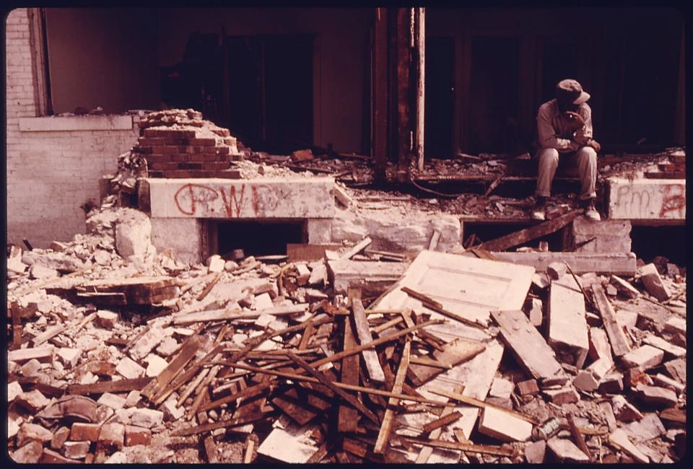
Demolition of Housing in Low Income Neighborhood -- Kenneth Palk, Kansas City, KS

Slide 20
"For nation will rise against nation and kingdom against kingdom; there will be earthquakes in various places; there will be famines. This is but the beginning of the birth pangs."
Mark 13:8

Slide 21
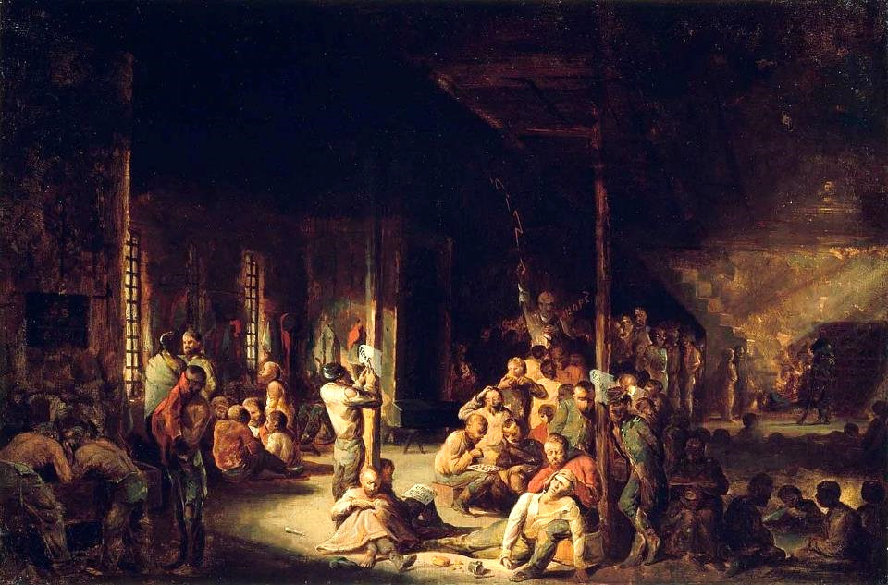
Libby Prison (U. S. Civil War, Richmond, VA) -- David Blythe, Boston Museum of Fine Arts, Boston, MA

Slide 22
Credits
New Revised Standard Version Updated Edition Bible, copyright 2022, Division of Christian Education of the National Council of the Churches of Christ in the United States of America. Used by permission. All rights reserved.
https://commons.wikimedia.org/wiki/File:Elkanah_and_his_two_wives.jpg
https://commons.wikimedia.org/wiki/File:Malnazar_-_Hannah_before_Eli_the_High_Priest_-_Google_Art_Project.jpg
https://commons.wikimedia.org/wiki/File:William_de_Brailes_-_Top_-_Hannah_Prays_in_the_Temple_(1_Samuel_1_-9-17)_-_Walters_W10617R_-_Full_Page.jpg
http://commons.wikimedia.org/wiki/File:Hannah_in_the_temple,_Samuel%27s_prayer_testing.jpg
https://commons.wikimedia.org/wiki/File:Cole_Thomas_The_Oxbow_(The_Connecticut_River_near_Northampton_1836).jpg
https://commons.wikimedia.org/wiki/File:Vincent_van_Gogh_-_Starry_Night_-_Google_Art_Project.jpg
https://commons.wikimedia.org/wiki/File:Snap_the_Whip_1872_Winslow_Homer.jpg
http://diglib.library.vanderbilt.edu/act-imagelink.pl?RC=48384 – with permission
https://commons.wikimedia.org/wiki/File:MEMBER_OF_A_WRECKING_CREW_RESTS_DURING_DEMOLITION_OF_HOUSING_IN_THE_MULKEY_SQUARE_AREA._MANY_OF_THE_LOW_INCOME..._-_NARA_-_557351.jpg
https://commons.wikimedia.org/wiki/File:Libby_Prison_by_David_Gilmour_Blythe,_1863.jpg
Additional descriptions can be found at the Art in the Christian Tradition image library, a service of the Vanderbilt Divinity Library, http://diglib.library.vanderbilt.edu/. All images available via Creative Commons 3.0 License.

