Slide 1
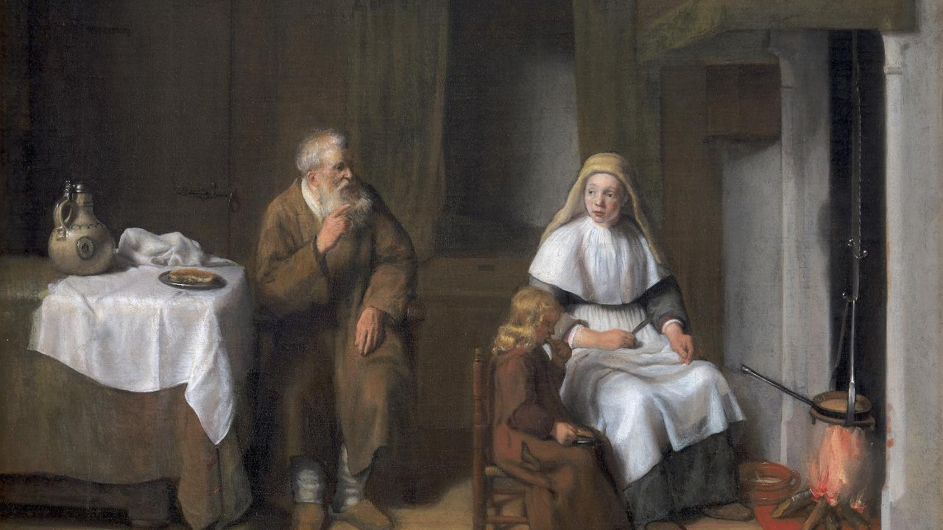
Twenty-Fifth Sunday after Pentecost
Year B
Ruth 3:1-5; 4:13-17 and Psalm 127 • 1 Kings 17:8-16 and Psalm 146 • Hebrews 9:24-28 • Mark 12:38-44

Slide 2
Naomi…said to her, "…here is our kinsman Boaz, with whose young women you have been working."
Ruth 3:1a, 2a

Slide 3
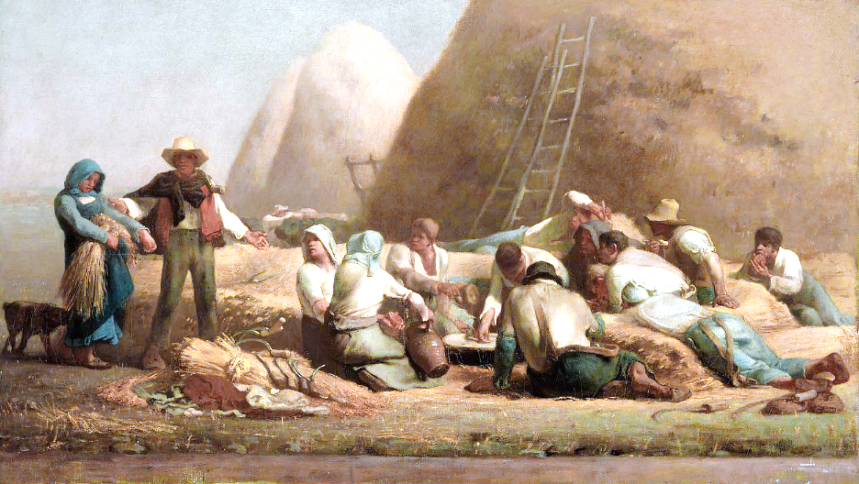
Ruth and Boaz -- Nicolas Poussin, Louvre Museum, Paris, France

Slide 4
So Boaz took Ruth and she became his wife. … Then Naomi took the child and laid him in her bosom and became his nurse.
Ruth 4:13a, 16

Slide 5
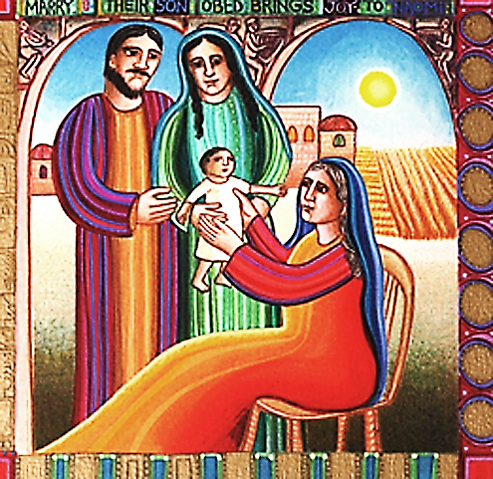
Ruth, Boaz, Naomi, and Obed -- John August Swanson, Serigraph, 1991

Slide 6
When he came to the gate of the town, a widow was there gathering sticks; he called to her and said, "Bring me a little water in a vessel, so that I may drink."
1 Kings 17:10b

Slide 7
But she said, "As the LORD your God lives, I have nothing baked, only a handful of meal in a jar and a little oil in a jug..."
1 Kings 17:12a

Slide 8
"...I am now gathering a couple of sticks, so that I may go home and prepare it for myself and my son, that we may eat it and die."
1 Kings 17:12b

Slide 9
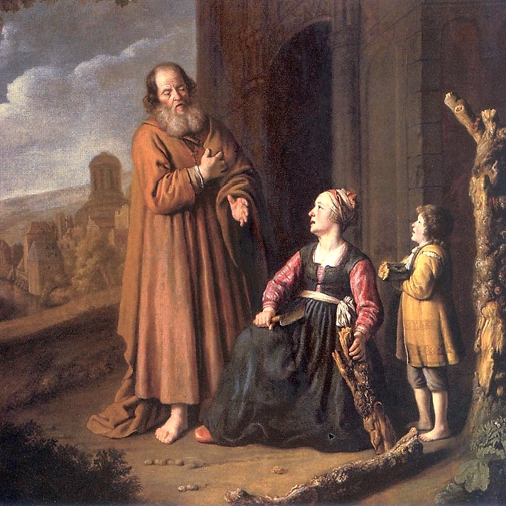
Elijah and the Widow of Zarephath
Jan Victors
Museum of John Paul II
Warsaw, Poland

Slide 10
Elijah said to her, "Do not be afraid…make me a little cake…and afterward make something for yourself and your son."
1 Kings 17:13

Slide 11
She went and did as Elijah said, so that she as well as he and her household ate for many days.
1 Kings 17:15

Slide 12
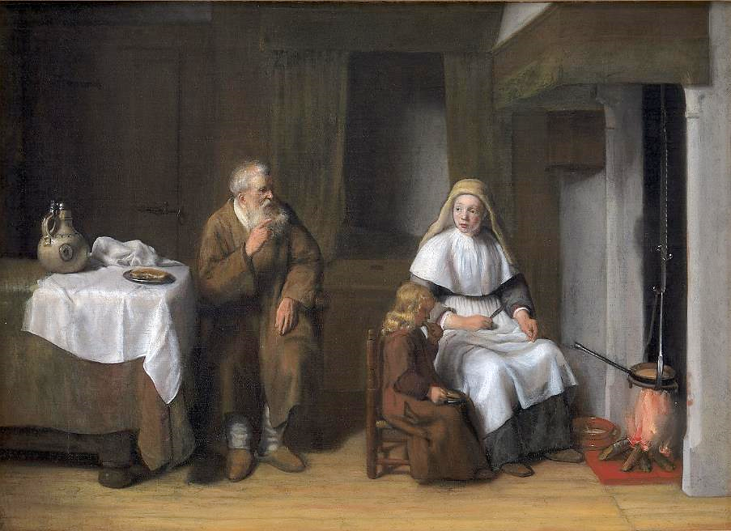
Elijah with the Widow of Zarephath and her Son -- Abraham van Dyck, Statens Museum, Copenhagen

Slide 13
The LORD watches over the strangers; he upholds the orphan and the widow…
Psalm 146:9a

Slide 14
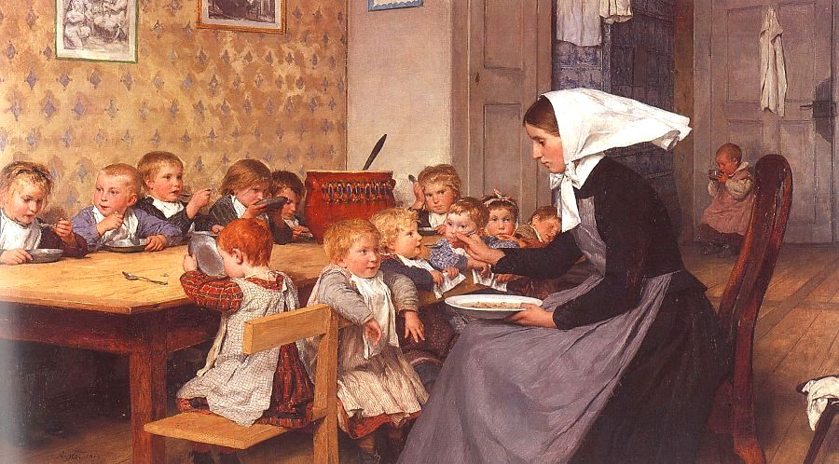
Creche -- Albert Anker

Slide 15
...so Christ…will appear a second time, not to deal with sin but to save those who are eagerly waiting for him.
Hebrews 9:28

Slide 16
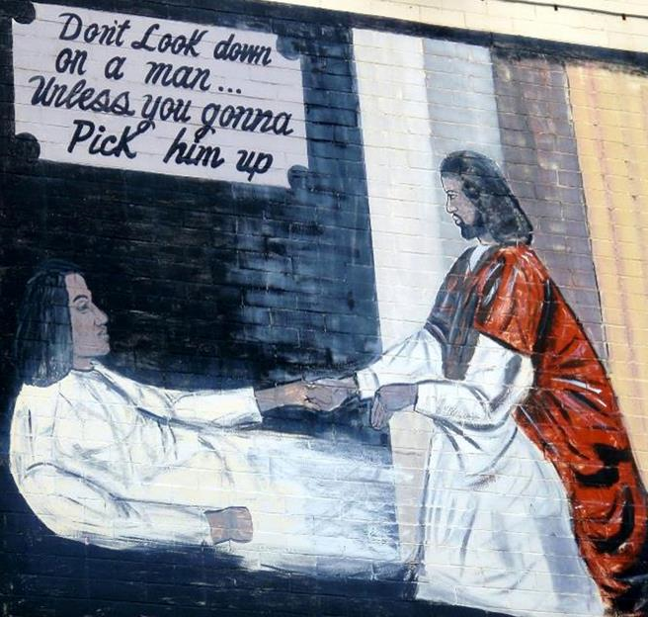
Jesus Lends a Helping Hand
Street Mural
Washington, DC

Slide 17
He sat down opposite the treasury and watched the crowd putting money into the treasury. Many rich people put in large sums.
Mark 12:41

Slide 18
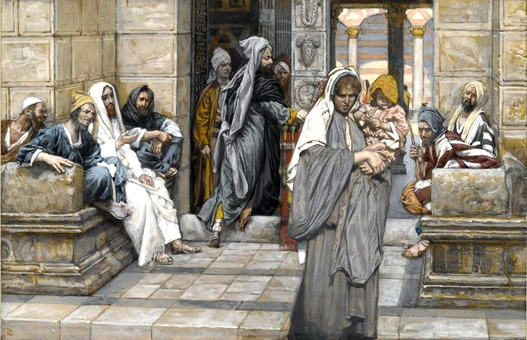
The Widow's Mite -- James Tissot, Brooklyn Museum, Brooklyn, NY

Slide 19
A poor widow came and put in two small copper coins, which are worth a penny.
Mark 12:42

Slide 20
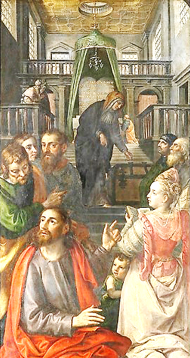
The Poor Widow
Maerten de Vos
Royal Museum of Fine Arts
Antwerp, Belgium

Slide 21
Then he called his disciples and said to them, "Truly I tell you, this poor widow has put in more than all those who are contributing to the treasury."
Mark 12:43

Slide 22
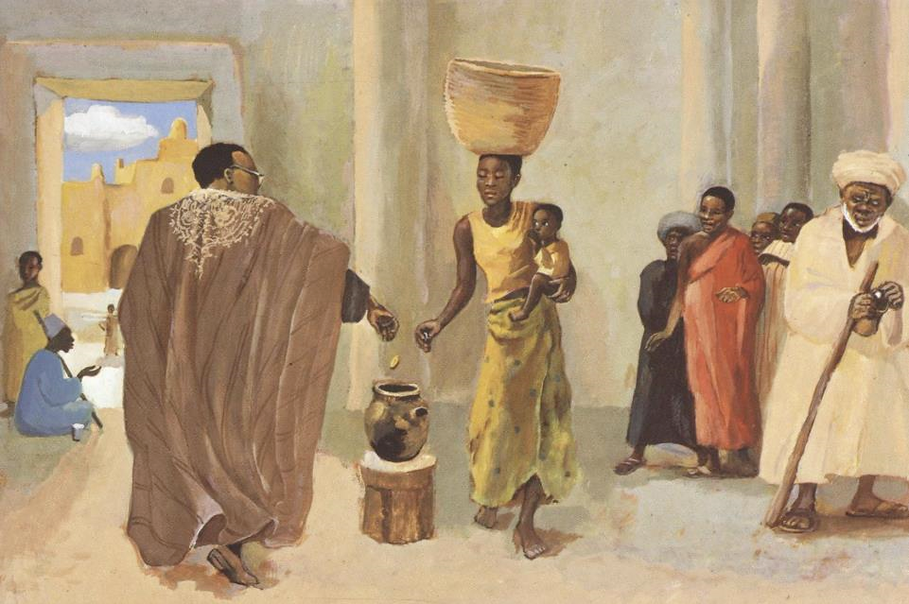
The Widow's Coin -- JESUS MAFA, Cameroon

Slide 23
"For all of them have contributed out of their abundance, but she out of her poverty has put in everything she had, all she had to live on."
Mark 12:44

Slide 24
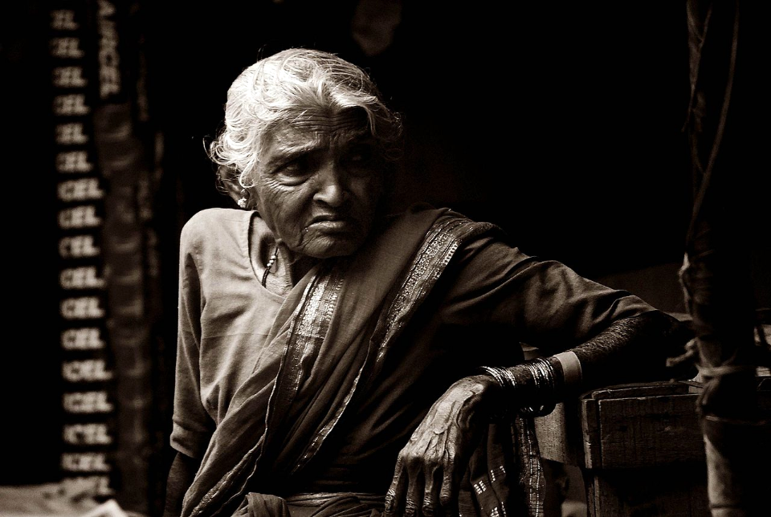
The Generous Vegetable Seller -- Vedant Gulati

Slide 25
Credits
New Revised Standard Version Updated Edition Bible, copyright 2022, Division of Christian Education of the National Council of the Churches of Christ in the United States of America. Used by permission. All rights reserved.
https://commons.wikimedia.org/wiki/File:Harvesters_Resting_(Ruth_and_Boaz),_Jean-Fran%C3%A7ois_Millet.jpg
http://www.johnaugustswanson.com/default.cfm/PID%3d1.2.9-7.html – copyright by John August Swanson, 1991 – with permission
https://commons.wikimedia.org/wiki/File:Victors_Elijah_and_the_widow_of_Zarephath.JPG
https://commons.wikimedia.org/wiki/File:Abraham_van_Dijck_-_The_Prophet_Elijah_with_the_Widow_of_Zarephath_and_her_Son_-_KMS3578_-_Statens_Museum_for_Kunst.jpg
http://www.flickr.com/photos/53970289@N06/5452268146/
http://commons.wikimedia.org/wiki/File:The_Cr%C3%A8che.jpg
https://www.flickr.com/photos/daquellamanera/3994554964
https://commons.wikimedia.org/wiki/File:Brooklyn_Museum_-_The_Widow%27s_Mite_(Le_denier_de_la_veuve)_-_James_Tissot.jpg
https://commons.wikimedia.org/wiki/File:Maerten_de_Vos_-_The_poor_widow.jpg
http://diglib.library.vanderbilt.edu/act-imagelink.pl?RC=48392 – with permission
https://commons.wikimedia.org/wiki/File:The_Generous_Vegetable_Seller.JPG - Vedant Gulati
Additional descriptions can be found at the Art in the Christian Tradition image library, a service of the Vanderbilt Divinity Library, http://diglib.library.vanderbilt.edu/. All images available via Creative Commons 3.0 License.

