Slide 1
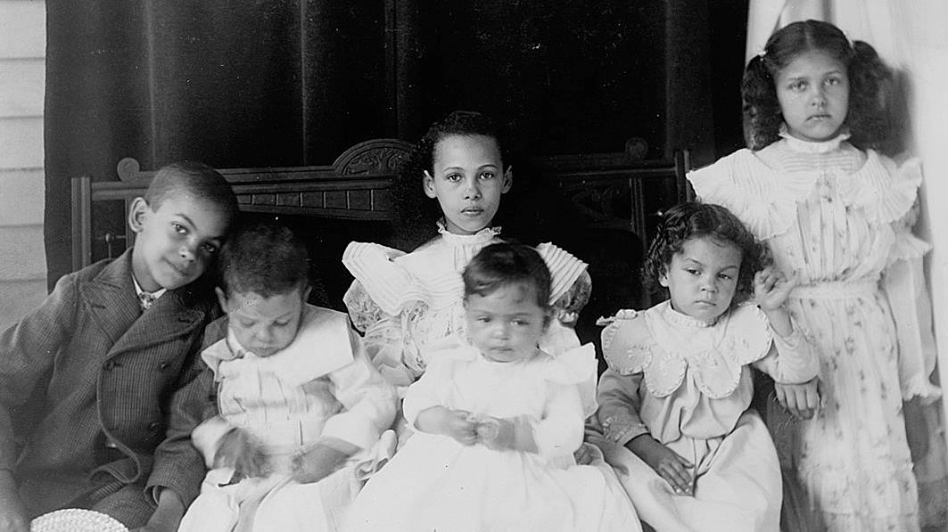
Twentieth Sunday after Pentecost
Year B
Job 1:1, 2:1-10 and Psalm 26 • Genesis 2:18-24 and Psalm 8 • Hebrews 1:1-4, 2:5-12 • Mark 10:2-16

Slide 2
The LORD said to the accuser, "Have you considered my servant Job? There is no one like him on the earth, a blameless and upright man who fears God…."
Job 2:3a

Slide 3
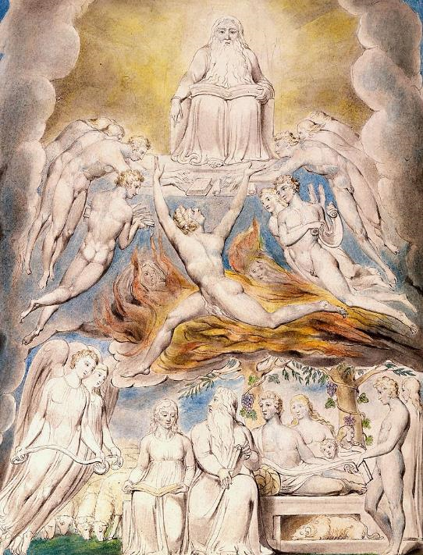
Satan Before the Throne of God with Job on Earth
William Blake
Morgan Library
New York, NY

Slide 4
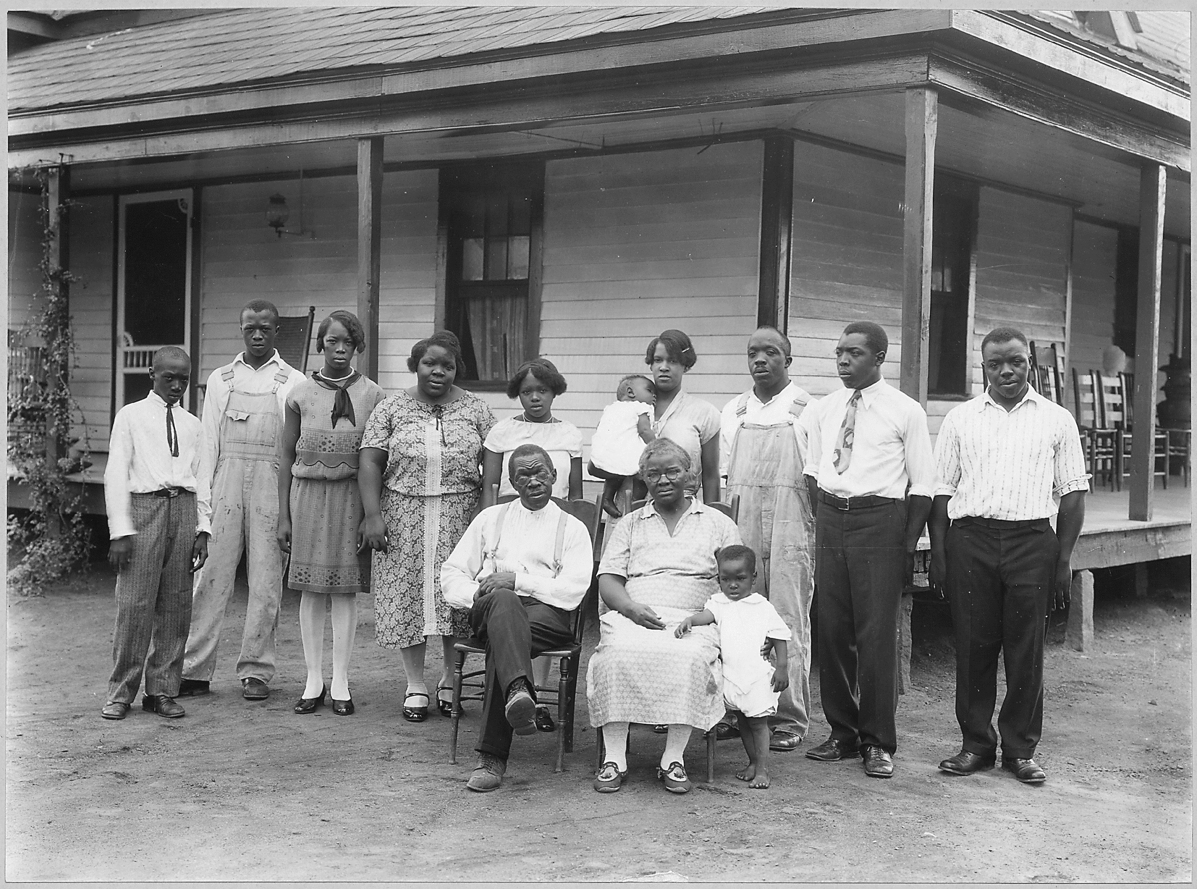
African-American Family, 1928 -- Spartanburg, SC

Slide 5
So the accuser…inflicted loathsome sores on Job from the sole of his foot to the crown of his head.
Job 2:7

Slide 6
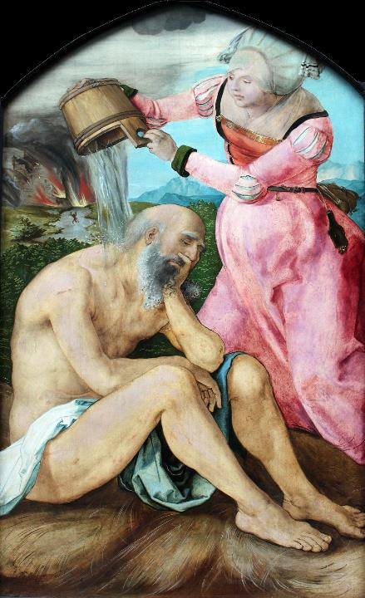
Job on the Dunghill
Albrecht Durer
Stadel Museum
Frankfurt, Germany
Unidentified sculptor
Israel

Slide 7
Then the man said, "This at last is bone of my bones and flesh of my flesh; this one shall be called Woman…"
Genesis 2:23

Slide 8
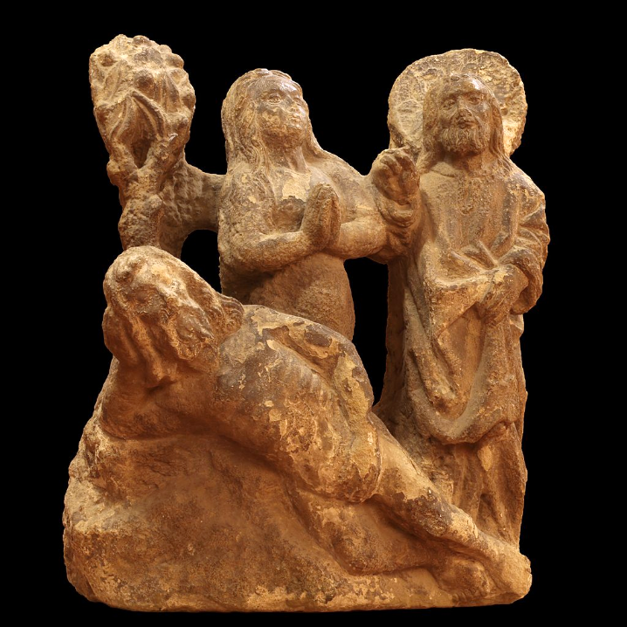
Creation of Eve
Musée historique de Lausanne
Switzerland

Slide 9
O LORD, our Sovereign, how majestic is your name in all the earth!
…
Out of the mouths of babes and infants you have founded a bulwark…
Psalm 8:1a, 2a

Slide 10
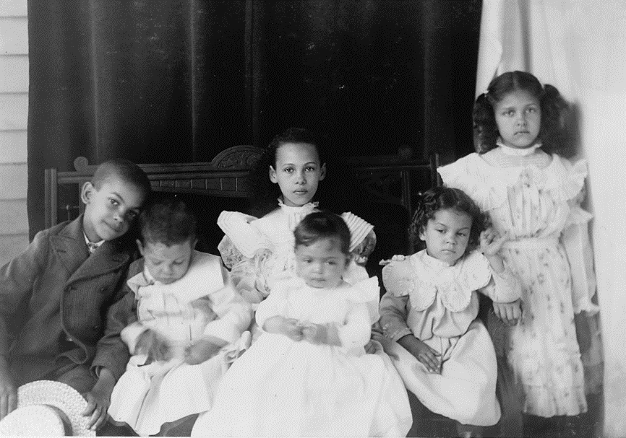
African-American Children, Portrait -- 1900 Paris Exposition, Library of Congress, Washington, DC

Slide 11
"What are human beings that you are mindful of them or mortals that you care for them?"
Hebrews 2:6b

Slide 12
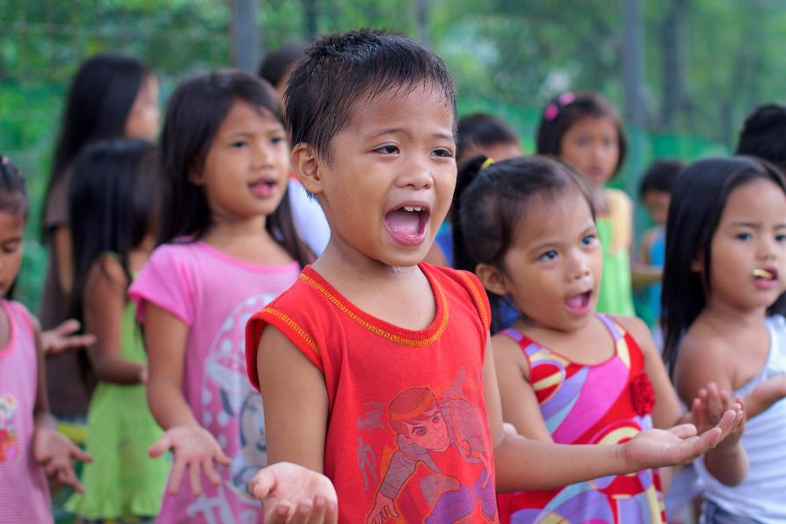
Children's Worship in Manila Slums, Philippines

Slide 13
People were bringing little children to him in order that he might touch them, and the disciples spoke sternly to them.
Mark 10:13

Slide 14
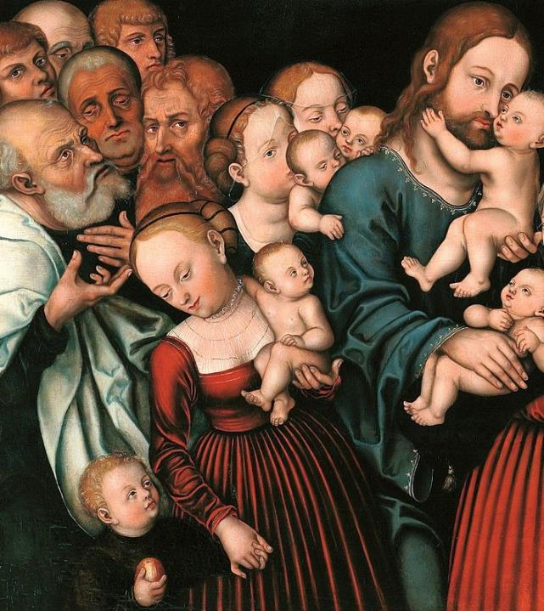
Christ Blessing the Children, detail
Lucas Cranach the Elder
Wawel Castle, Krakow, Poland

Slide 15
But when Jesus saw this, he was indignant and said to them...
Mark 10:14a

Slide 16
"Let the little children come to me; do not stop them; for it is to such as these that the kingdom of God belongs."
Mark 10:14b

Slide 17
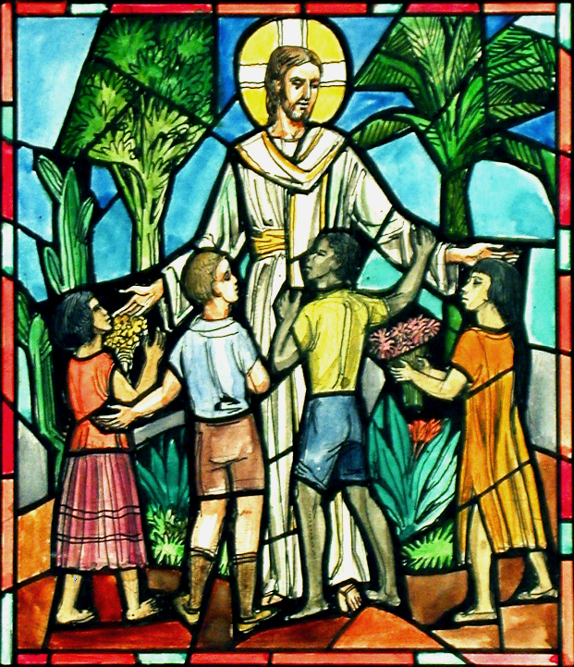
Jesus with the Children
Lamb Studios
Design for Life of Christ Windows

Slide 18
"Truly I tell you, whoever does not receive the kingdom of God as a little child will never enter it."
Mark 10:15

Slide 19
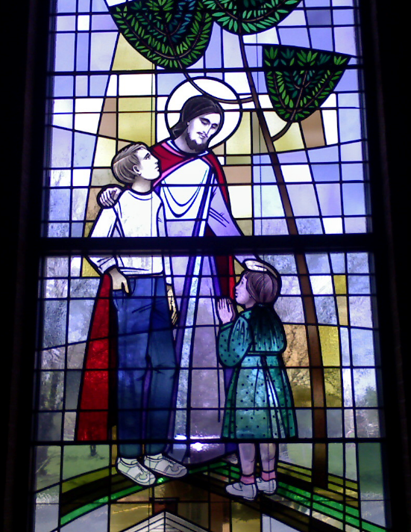
Christ Welcomes the Children
E. I. Sanchez, photographer

Slide 20
And he took them up in his arms, laid his hands on them, and blessed them.
Mark 10:16

Slide 21
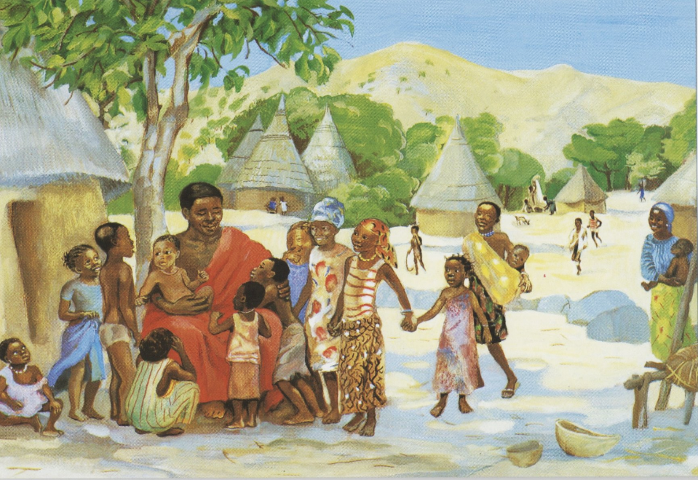
Jesus Welcomes the Children -- Jesus MAFA, Cameroon

Slide 22
Credits
New Revised Standard Version Updated Edition Bible, copyright 2022, Division of Christian Education of the National Council of the Churches of Christ in the United States of America. Used by permission. All rights reserved.
https://commons.wikimedia.org/wiki/File:William_Blake_-_Satan_Before_the_Throne_of_God.jpg
https://commons.wikimedia.org/wiki/File:Photograph_of_African-American_Family,_Spartanburg_County,_South_Carolina_-_NARA_-_512798.tif
https://commons.wikimedia.org/wiki/File:1505_D%C3%BCrer_Hiob_auf_dem_Misthaufen_anagoria.JPG
https://commons.wikimedia.org/wiki/File:Creation_of_Eve_by_Giusto_de_Menabuoi_(Padua_baptistery).jpg
https://commons.wikimedia.org/wiki/File:African_American_children_posed_for_portrait_on_a_porch_LCCN99472390.tif
https://www.flickr.com/photos/jkfjellestad/15805538259 - John Christian Fjellestad
https://commons.wikimedia.org/wiki/File:Lucas_Cranach_d.J._-_Christus_segnet_die_Kinder_(ca.1540).jpg
https://www.flickr.com/photos/waitingfortheword/8410214875
https://www.flickr.com/photos/thechristianalert/2499465520/ - E. I. Sanchez
http://diglib.library.vanderbilt.edu/act-imagelink.pl?RC=48395
Additional descriptions can be found at the Art in the Christian Tradition image library, a service of the Vanderbilt Divinity Library, http://diglib.library.vanderbilt.edu/. All images available via Creative Commons 3.0 License.

