Slide 1
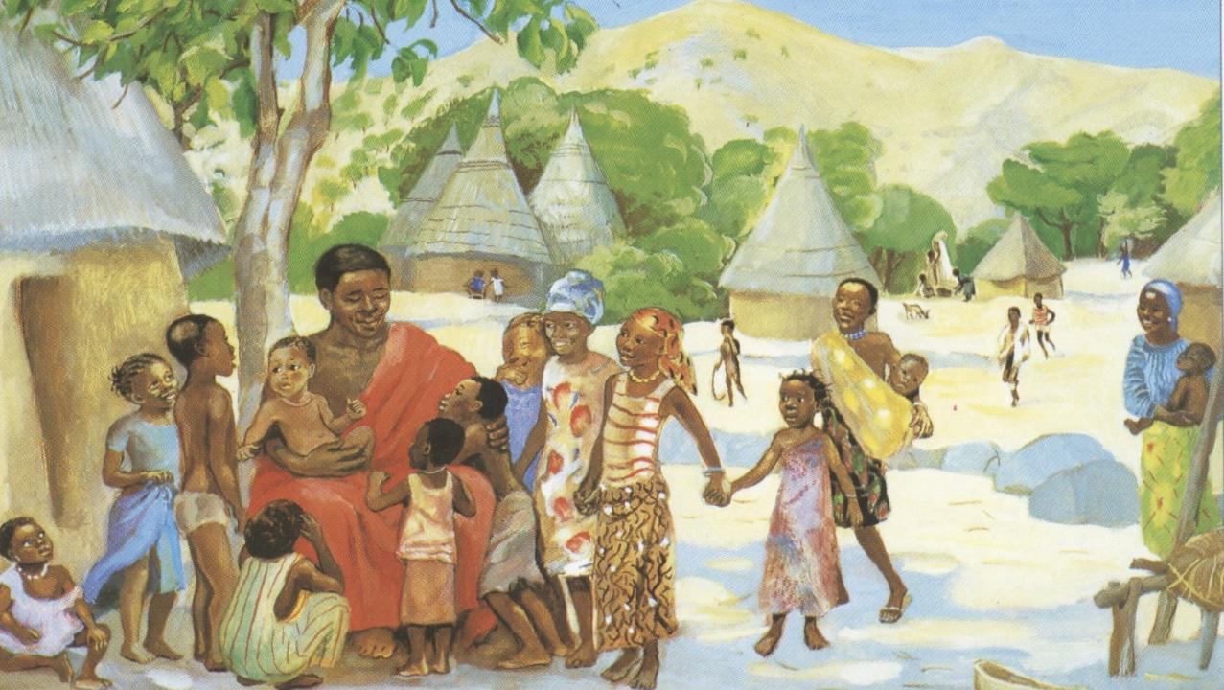
Eighteenth Sunday after Pentecost
Year B
Proverbs 31:10-31 and Psalm 1 • Wisdom of Solomon 1:16-2:1, 12-22 or Jeremiah 11:18-20 and Psalm 54 James 3:13 - 4:3, 7-8a • Mark 9:30-37

Slide 2
She opens her hand to the poor and reaches out her hands to the needy. ….
She opens her mouth with wisdom, and the teaching of kindness is on her tongue.
Proverbs 31:20, 26

Slide 3
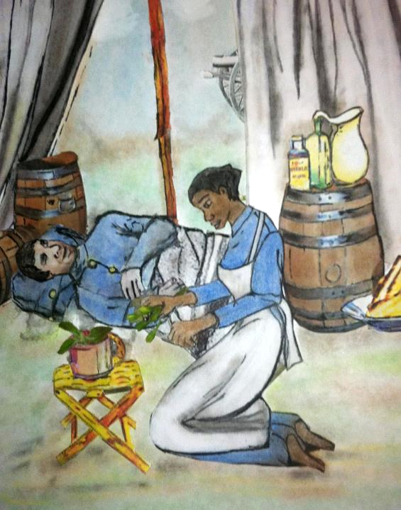
Lucy Higgs, Union Civil War Nurse
Kathy Grant

Slide 4
Happy are those who do not…sit in the seat of scoffers.... They are like trees planted by streams of water, which yield their fruit in its season.…
Psalm 1:1ac, 3a

Slide 5
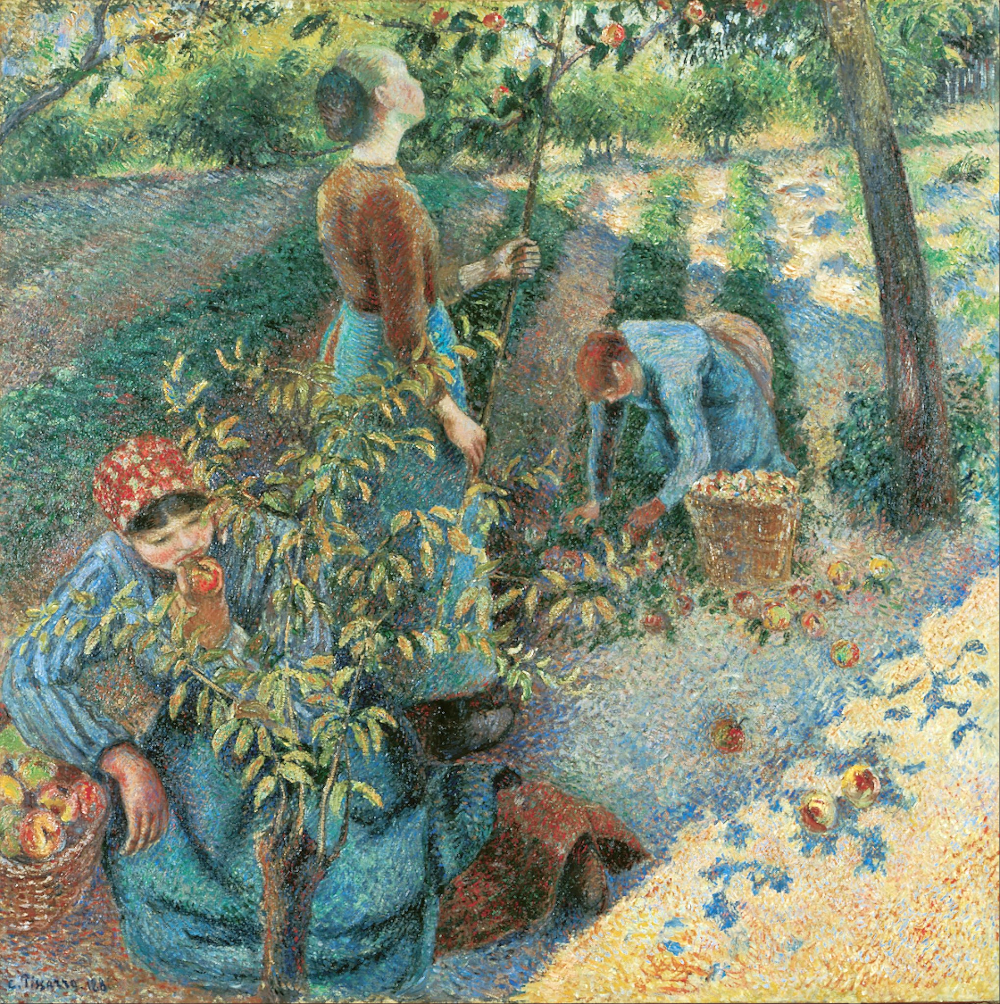
Apple Picking
Camille Pissaro
Ohara Museum of Art
Kurashiki, Japan

Slide 6
...I was like a gentle lamb led to the slaughter. And I did not know…that they devised schemes, saying, "Let us destroy the tree with its fruit; let us cut him off from the land of the living…."
Jeremiah 11:19a

Slide 7

Lamb of God
Father George Saget
Keur Moussa Abbey
Senegal

Slide 8
Who is wise and understanding among you? Show by your good life that your works are done with gentleness born of wisdom.
James 3:13

Slide 9
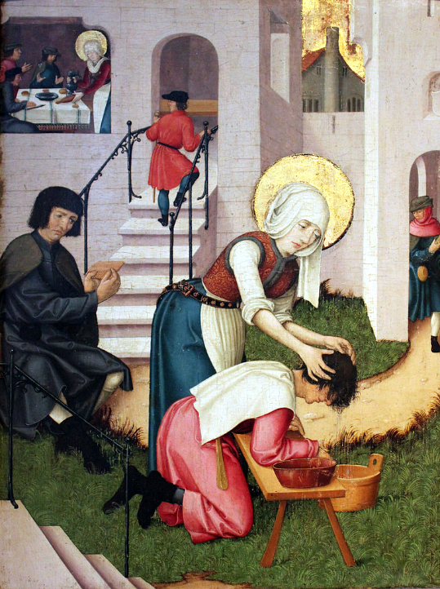
Saint Verena Washing the Hair of a Plague Patient
Landesmuseum
Württemberg, Germany

Slide 10
But the wisdom from above is first pure, then peaceable, gentle, willing to yield, full of mercy and good fruits…
James 3:17a

Slide 11
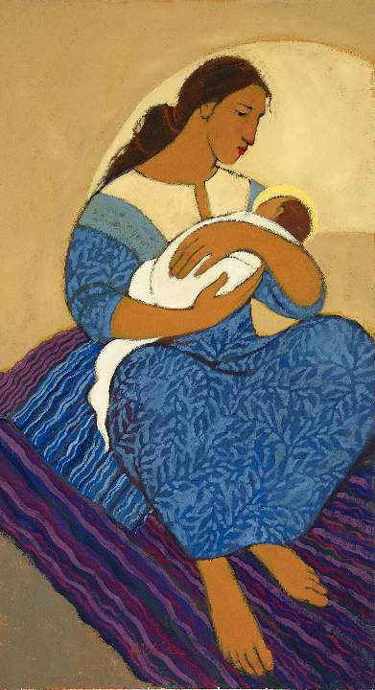
Mary and Jesus
Kathleen Peterson

Slide 12
Then they came to Capernaum, and when he was in the house he asked them, "What were you arguing about on the way?"
Mark 9:33

Slide 13
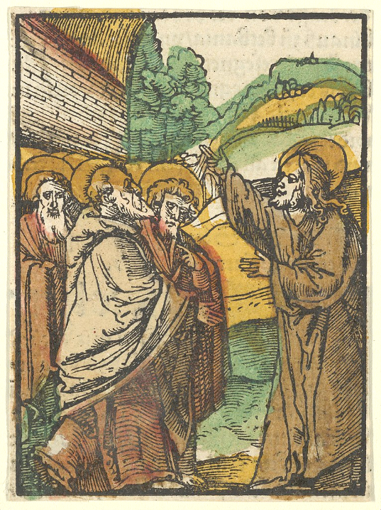
Christ Teaching the Disciples
Hans Schäufelein
Metropolitan Museum of Art
New York, NY

Slide 14
But they were silent, for on the way they had argued with one another who was the greatest.
Mark 9:34

Slide 15
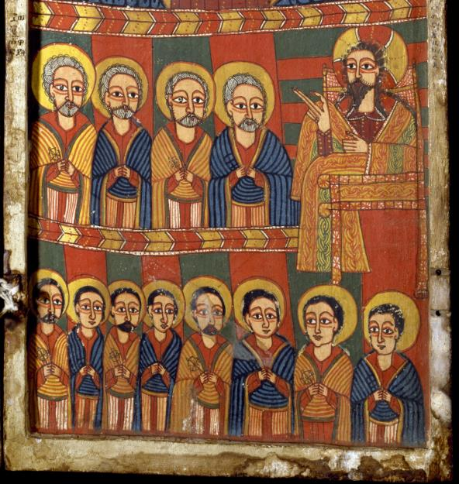
Christ Teaching the Apostles -- Ethiopia, Walters Art Museum, Baltimore, MD

Slide 16
He sat down, called the twelve, and said to them, "Whoever wants to be first must be last of all and servant of all."
Mark 9:35

Slide 17
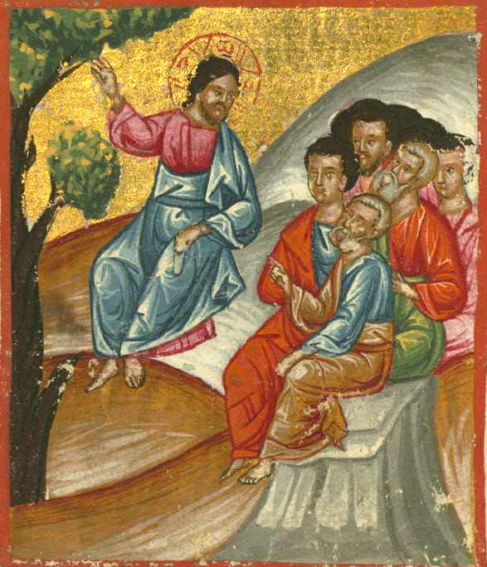
Jesus Teaching the Disciples
Ilyas Basim Khuri Bazzi Rahib
Walters Art Museum, Baltimiore, MD

Slide 18
Then he took a little child and put it among them, and taking it in his arms he said to them...
Mark 9:36

Slide 19
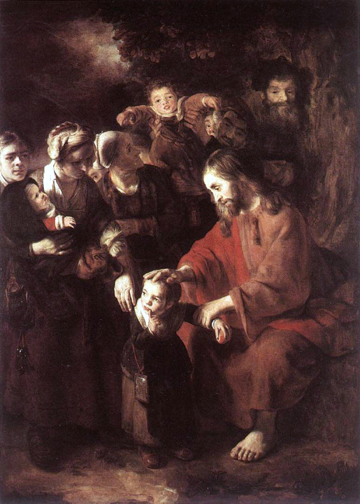
Jesus Blessing the Children
Nicolaes Maes
National Gallery
London, England

Slide 20
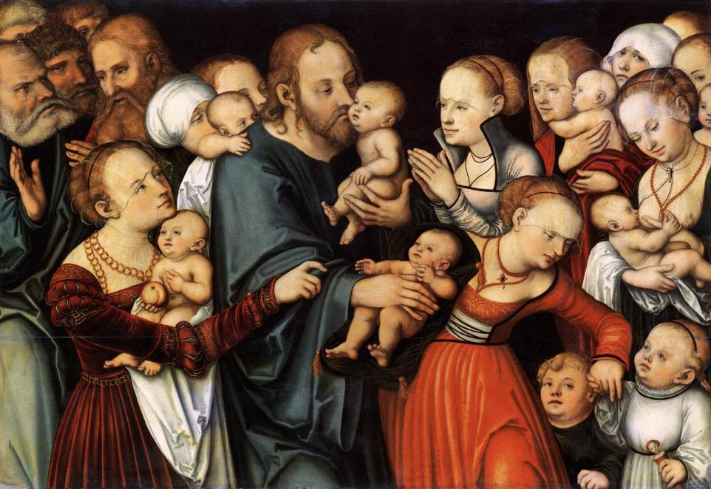
Christ Blessing the Children -- Lucas Cranach, Stadel Museum, Frankfurt, Germany

Slide 21
"Whoever welcomes one such child in my name welcomes me, and whoever welcomes me welcomes not me but the one who sent me."
Mark 9:37

Slide 22
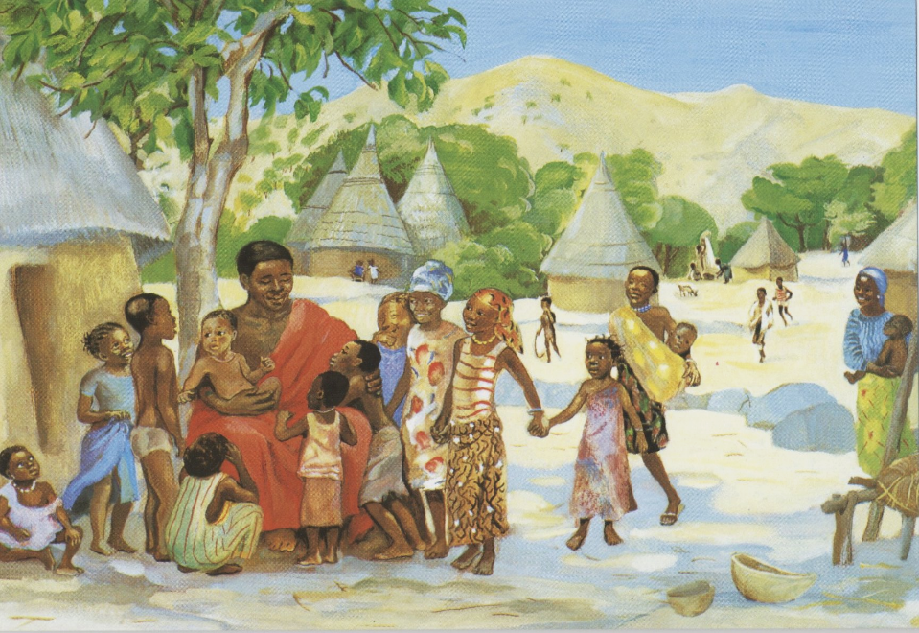
Jesus Welcomes the Children -- Jesus MAFA, Cameroon

Slide 23
Credits
New Revised Standard Version Updated Edition Bible, copyright 2022, Division of Christian Education of the National Council of the Churches of Christ in the United States of America. Used by permission. All rights reserved.
https://commons.wikimedia.org/wiki/File:Lucy_Higgs_Union_Civil_War_Nurse.JPG
https://commons.wikimedia.org/wiki/File:Camille_Pissarro_-_Apple_Picking_-_Google_Art_Project.jpg
www.robertharding.com
https://commons.wikimedia.org/wiki/File:1525_Heilige_Verena_w%C3%A4scht_einem_Pestkranken_die_Haare_anagoria.JPG
https://www.kathleenpetersonart.com/ - with permission
https://commons.wikimedia.org/wiki/File:Christ_Teaching_the_Disciples,_2,_from_Das_Plenarium_MET_DP849939.jpg – Adam Petri
https://commons.wikimedia.org/wiki/File:Ethiopian_-_Right_Diptych_Panel_with_Virgin_and_Child_Flanked_by_Archangels_-_Walters_363_-_Open.jpg
https://commons.wikimedia.org/wiki/File:Jesus_teaching_his_disciples.jpg
https://commons.wikimedia.org/wiki/File:Nicolaes_Maes_-_Christ_Blessing_the_Children_-_WGA13814.jpg
https://commons.wikimedia.org/wiki/File:Lucas_Cranach_the_Elder_Christ_blessing_the_Children,_Frankfurt_am_Main,_St%C3%A4del_Museum.jpg
http://diglib.library.vanderbilt.edu/act-imagelink.pl?RC=48395
Additional descriptions can be found at the Art in the Christian Tradition image library, a service of the Vanderbilt Divinity Library, http://diglib.library.vanderbilt.edu/. All images available via Creative Commons 3.0 License.

