Slide 1
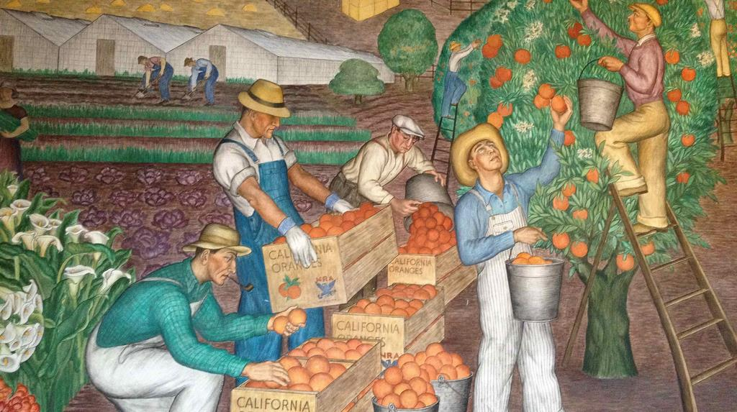
Sixteenth Sunday after Pentecost
Year B
Proverbs 22:1-2, 8-9, 22-23 and Psalm 125
Isaiah 35:4-7a and Psalm 146
James 2:1-10, (11-13), 14-17 • Mark 7:24-37

Slide 2
Do not…crush the afflicted at the gate, for the LORD pleads their cause…
Proverbs 22:22b-23a

Slide 3
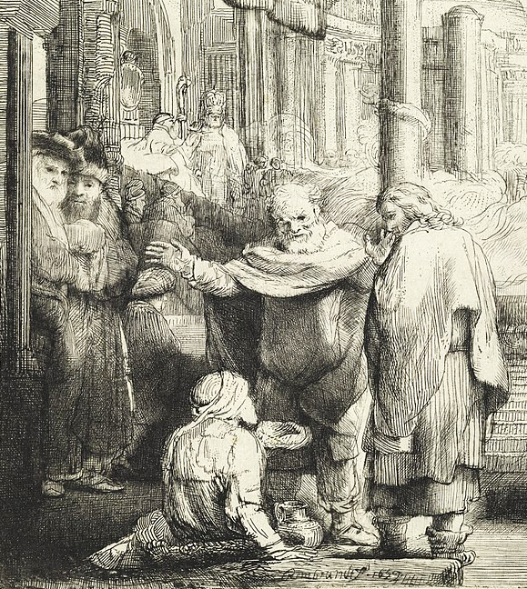
Peter and John Healing the Cripple at the Temple Gate, detail
Rembrandt
Cooper-Hewitt
New York, NY

Slide 4
Then the eyes of the blind shall be opened,
and the ears of the deaf shall be opened;
then the lame shall leap like a deer,
and the tongue of the speechless sing for joy.
Isaiah 35:5-6a

Slide 5
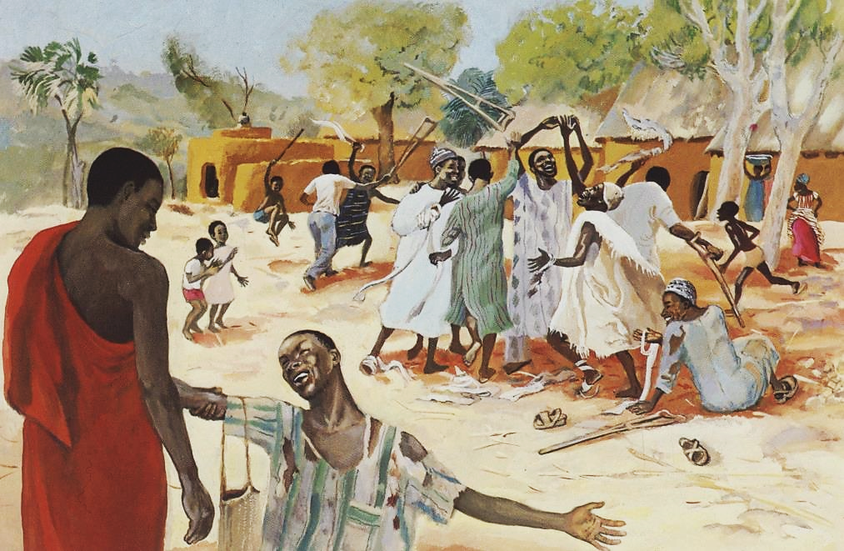
Healing of the Ten Lepers -- JESUS MAFA, Cameroon

Slide 6
The LORD watches over the strangers; he upholds the orphan and the widow.… Praise the LORD!
Psalm 146:9a, 10b

Slide 7

Charity Bazaar for Widows and Orphans
Library of Congress
Washington, DC

Slide 8
My brothers and sisters…. if a person with gold rings and in fine clothes comes into your assembly, and if a poor person in dirty clothes also comes in...
James 2:1a, 2

Slide 9
...and if you take notice of the one wearing the fine clothes and say, "Have a seat here in a good place, please," while to the one who is poor you say, "Stand there..."
James 2:3a

Slide 10
...have you not made distinctions among yourselves and become judges…?
James 2:4a

Slide 11
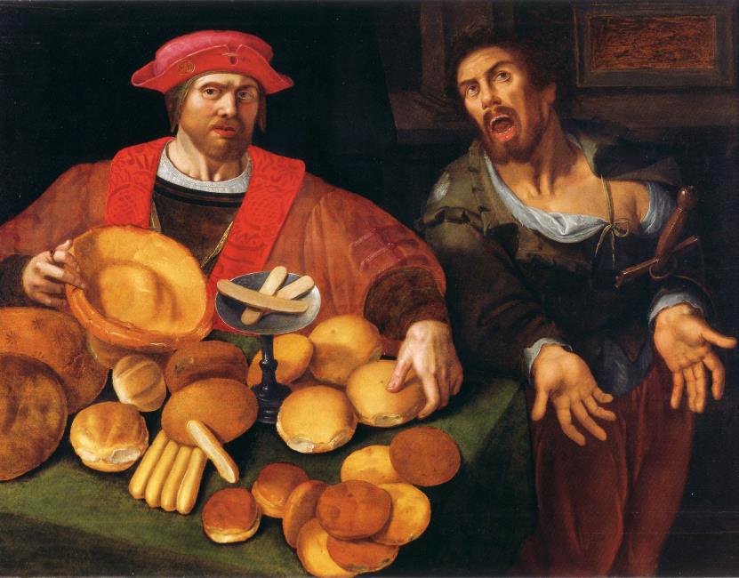
Rich and Poor, or War and Peace -- Museum Brot und Kunst, Ulm, Germany

Slide 12
Has not God chosen the poor in the world to be rich in faith and to be heirs of the kingdom…?
James 2:5b

Slide 13
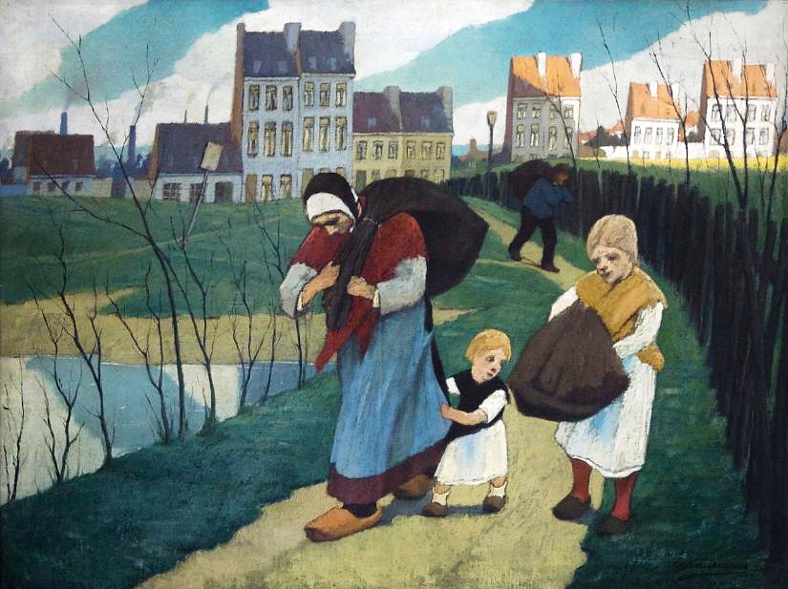
The Rag Collectors -- Eugène Laermans, Museum Dhondt-Dhaenens, Deurle, Belgium

Slide 14
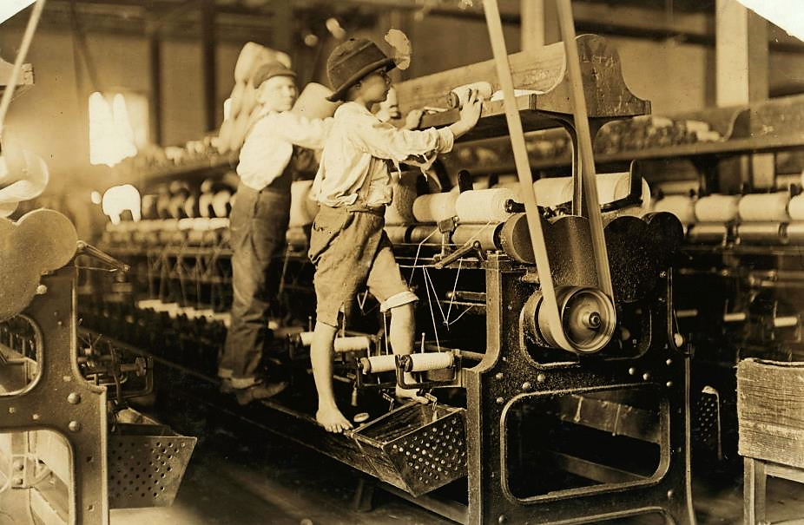
Mill Children in Macon -- Lewis Hine, Library of Congress, Washington, DC

Slide 15
If you really fulfill the royal law according to the scripture, "You shall love your neighbor as yourself," you do well.
James 2:8

Slide 16
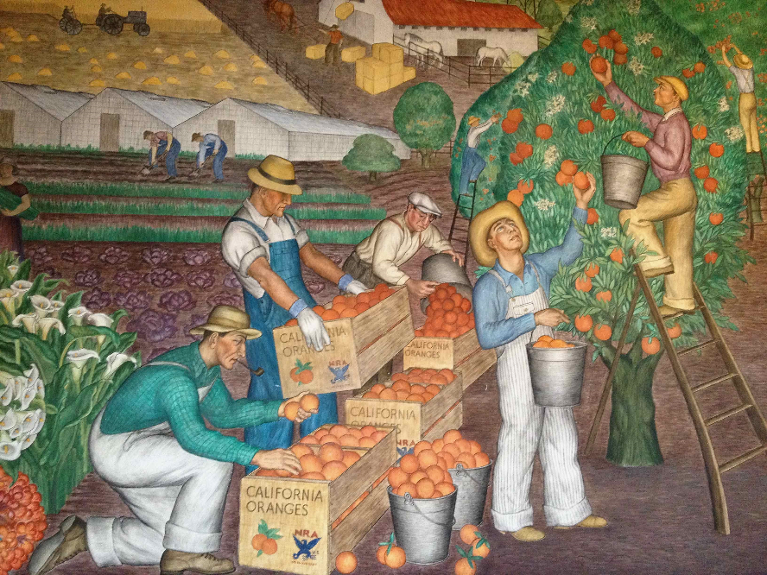
Migrant Farm Workers -- Mural, Coit Tower, San Francisco, CA

Slide 17
If a brother or sister is naked and lacks daily food and one of you says to them, "Go in peace; keep warm and eat your fill," and yet you do not supply their bodily needs, what is the good of that?
James 2:15-16

Slide 18
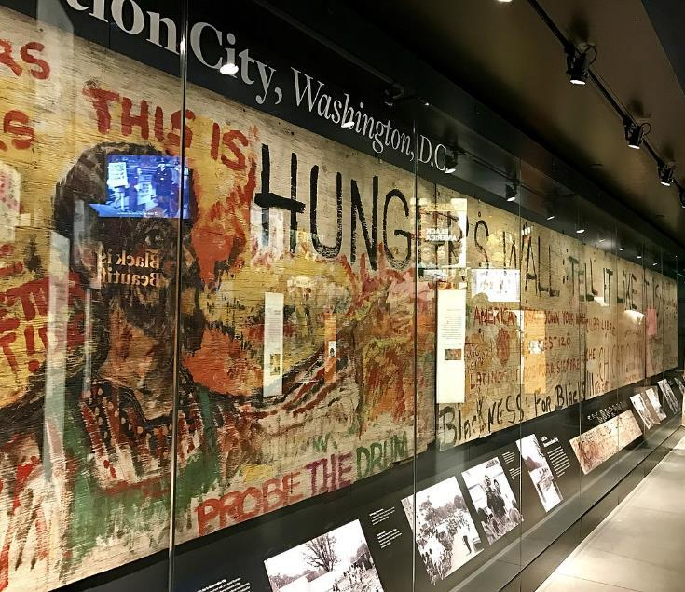
Hunger Mural from Resurrection City, 1968, Washington, DC – National Museum of African-American History and Culture

Slide 19
So faith by itself, if it has no works, is dead.
James 2:17

Slide 20
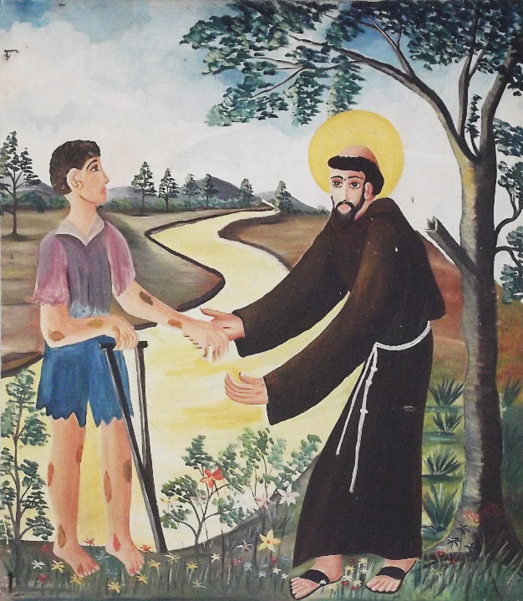
Priest reaching out to help a man with leprosy
Basílica de São Francisco das Chagas
Caninde, Brazil

Slide 21
…a woman…a gentile…whose little daughter had an unclean spirit...came and...begged him to cast the demon out of her daughter.
Mark 7:25a, 26a, 25b, 26b

Slide 22
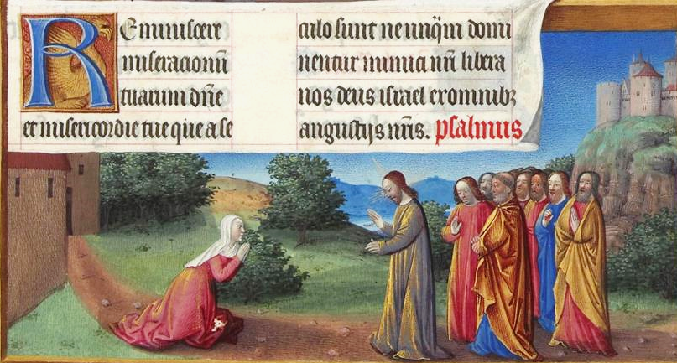
The Cannanite Woman -- Tres Riches Heures du duc de Berry, Musée Condé, Chantilly, France

Slide 23
He said to her, "Let the children be fed first, for it is not fair to take the children's food and throw it to the dogs."
Mark 7:27

Slide 24
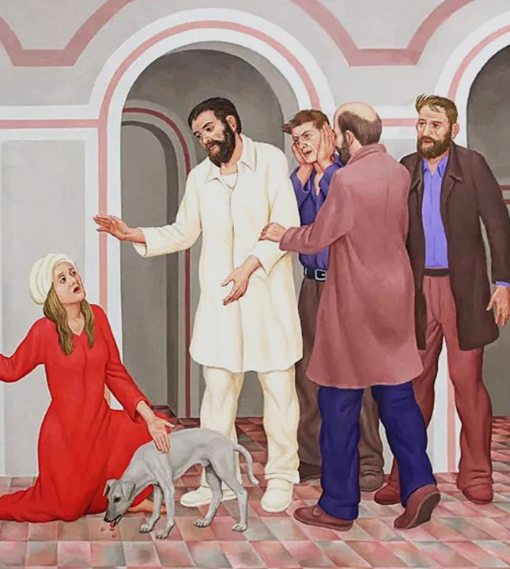
Jesus and the Canaanite Woman
Peter Koenig

Slide 25
But she answered him, "Sir, even the dogs under the table eat the children's crumbs."
Mark 7:28

Slide 26
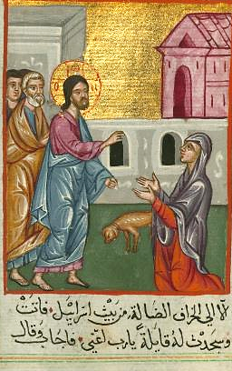
Jesus and the Canaanite Woman
Ilyas Basim Khuri Bazzi Rahib
Walters Art Museum
Baltimore, MD

Slide 27
Then he said to her, "For saying that, you may go—the demon has left your daughter."
Mark 7:29

Slide 28
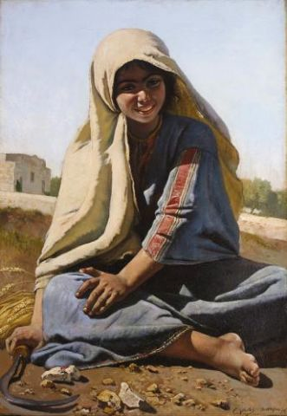
Young Girl of Bethlehem
Charles Verlat
Painting, 1876

Slide 29
Credits
New Revised Standard Version Updated Edition Bible, copyright 2022, Division of Christian Education of the National Council of the Churches of Christ in the United States of America. Used by permission. All rights reserved.
https://commons.wikimedia.org/wiki/File:Print,_Peter_and_John_Healing_the_Cripple_at_the_Gate_of_the_Temple,_1659_(CH_18384731).jpg
http://www.librairie-emmanuel.fr (contact page: https://www.librairie-emmanuel.fr/contact)
http://www.flickr.com/photos/stephenr/2296612588/https://commons.wikimedia.org/wiki/File:Charity_bazar_(i.e.,_bazaar)_for_the_widows_and_orphans_of_German,_Austrian,_Hungarian_and_their_allied_soldiers_LCCN2002722436.tif
http://commons.wikimedia.org/wiki/File:Arm_und_Reich_(fl%C3%A4misch_17_Jh).jpg
https://commons.wikimedia.org/wiki/File:Eug%C3%A8ne_Laermans_De_voddenrapers_(1914)_12-02-2010_15-07-38.jpg
http://commons.wikimedia.org/wiki/File:Mill_Children_in_Macon.jpg
https://commons.wikimedia.org/wiki/File:NMAAHC_(33628525655).jpg
http://commons.wikimedia.org/wiki/File:Bas%C3%ADlica_de_S%C3%A3o_Francisco_das_Chagas_(Canind%C3%A9)_-_Casa_dos_Milagres_008.JPG
https://commons.wikimedia.org/wiki/File:Folio_164r_-_The_Canaanite_Woman.jpg
https://commons.wikimedia.org/wiki/File:Ilyas_Basim_Khuri_Bazzi_Rahib_-_Jesus_and_the_Canaanite_Woman_-_Walters_W59243A_-_Full_Page.jpg
https://www.pwkoenig.co.uk/
https://commons.wikimedia.org/wiki/File:Charles_Verlat_-_Jeune_fille_de_Bethlehem.jpg
Additional descriptions can be found at the Art in the Christian Tradition image library, a service of the Vanderbilt Divinity Library, http://diglib.library.vanderbilt.edu/. All images available via Creative Commons 3.0 License.

