Slide 1
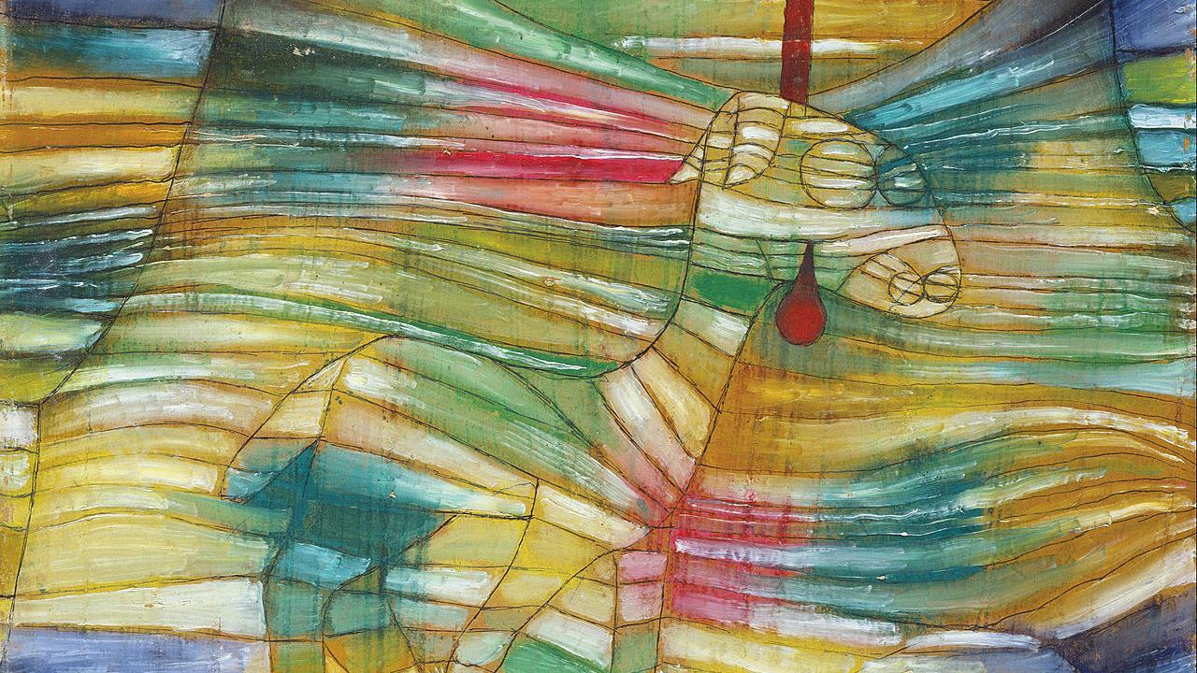
Eleventh Sunday after Pentecost
Year B
2 Samuel 11:26 - 12:13a and Psalm 51:1-12
Exodus 16:2-4, 9-15 and Psalm 78:23-29
Ephesians 4:1-16 • John 6:24-35

Slide 2
…the LORD sent Nathan to David. He…said to him, "…. The rich man had very many flocks and herds, but the poor man had nothing but one little ewe lamb…"
2 Samuel 12:1-3a

Slide 3
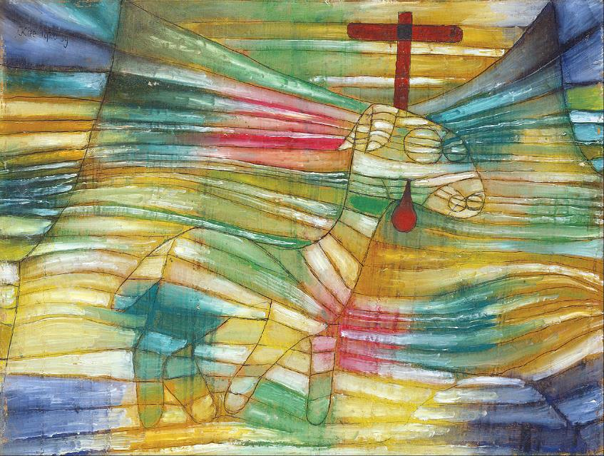
The Lamb -- Paul Klee, Stadel, Frankfurt, Germany

Slide 4
"…it grew up with him and with his children; it used to eat of his meager fare and drink from his cup…, and it was like a daughter to him."
2 Samuel 12:3b

Slide 5
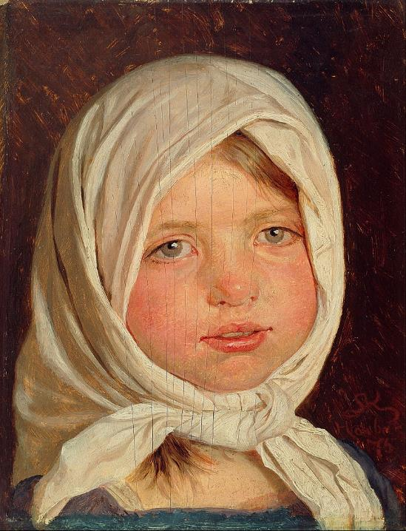
Little Girl from Hornbaeck
Peder Severin Krøyer
Hirschsprung Collection
Copenhagen, Denmark

Slide 6
"…the rich man…took the poor man's lamb…"
2 Samuel 12:4b

Slide 7
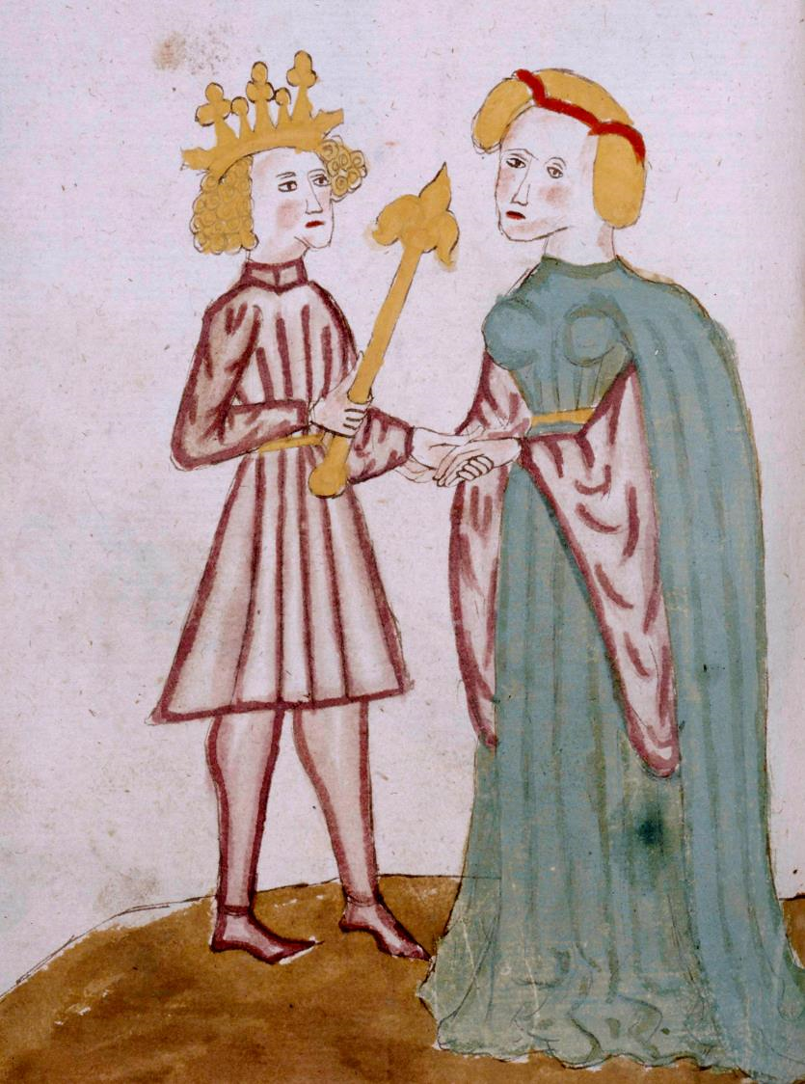
David and Bathsheba
Manuscript, ca. 1330
New York Public Library
New York, NY

Slide 8
Then David…said to Nathan, "As the LORD lives, the man who has done this deserves to die…." Nathan said to David, "You are the man!"
2 Samuel 12:5b, 7a

Slide 9
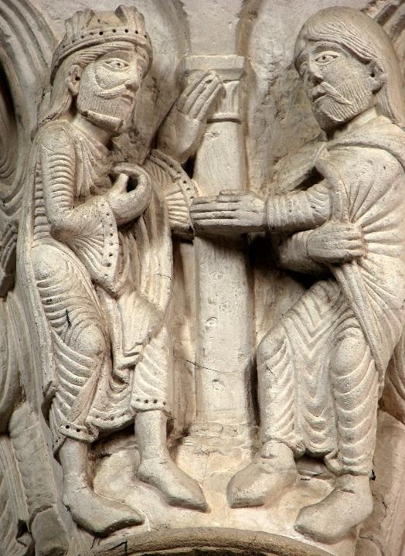
Nathan Rebukes David
Basilica of the Magdalene
Vezelay, France

Slide 10
…on the surface of the wilderness was a fine flaky substance…. Moses said to them, "It is the bread that the LORD has given you to eat."
Exodus 16:14b, 15b

Slide 11
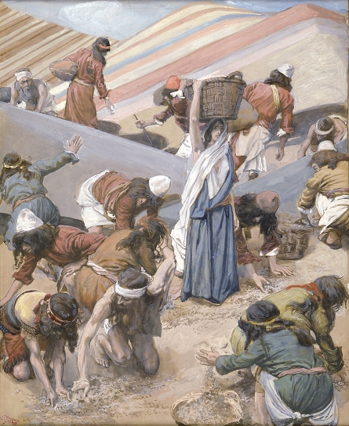
Gathering of Manna
James Tissot
Jewish Museum New York, NY

Slide 12
We must no longer be children, …blown about by every wind of doctrine…but speaking the truth in love, we must grow up…into Christ...
Ephesians 4:14a, 15b

Slide 13
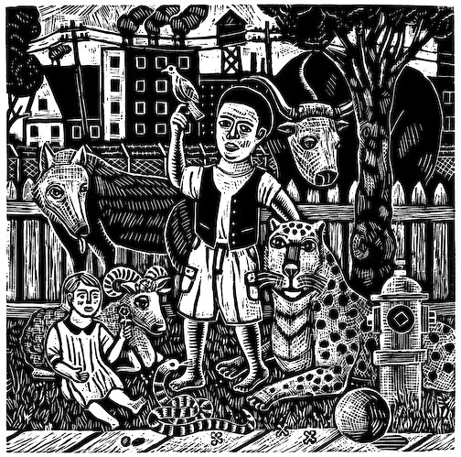
Peaceable Kingdom -- Rick and Brenda Beerhorst

Slide 14
"Do not work for the food that perishes but for the food that endures for eternal life…"
John 6:27a

Slide 15
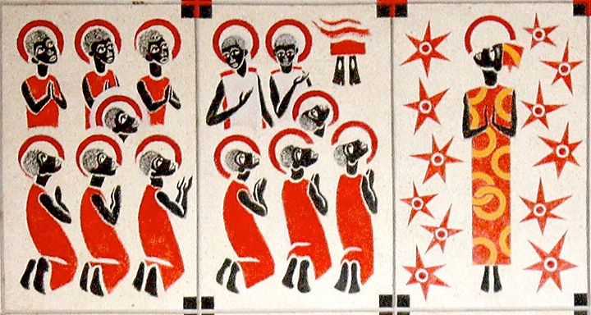
Ascension -- Father Georges Saget, Keur Moussa Abbey, Keur Moussa, Senegal

Slide 16
"…it was not Moses who gave you the bread from heaven, but it is my Father who gives you the true bread from heaven."
John 6:32b

Slide 17
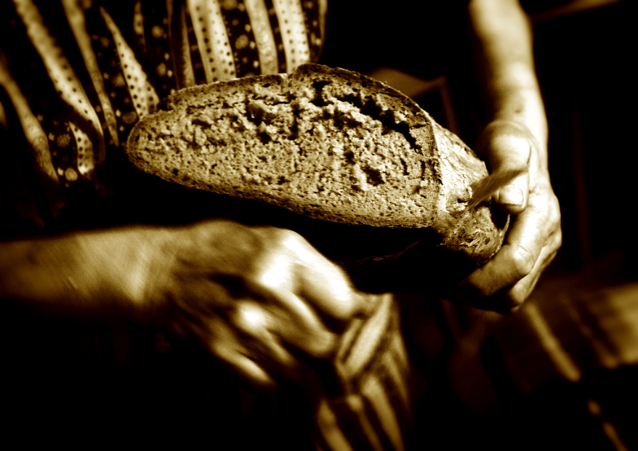
Bread of Life

Slide 18
"For the bread of God is that which comes down from heaven and gives life to the world."
John 6:33

Slide 19
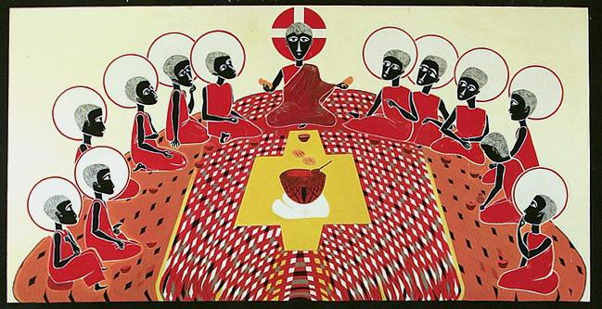
Last Supper, Father George Saget, Keur Moussa Abbey, Senegal

Slide 20
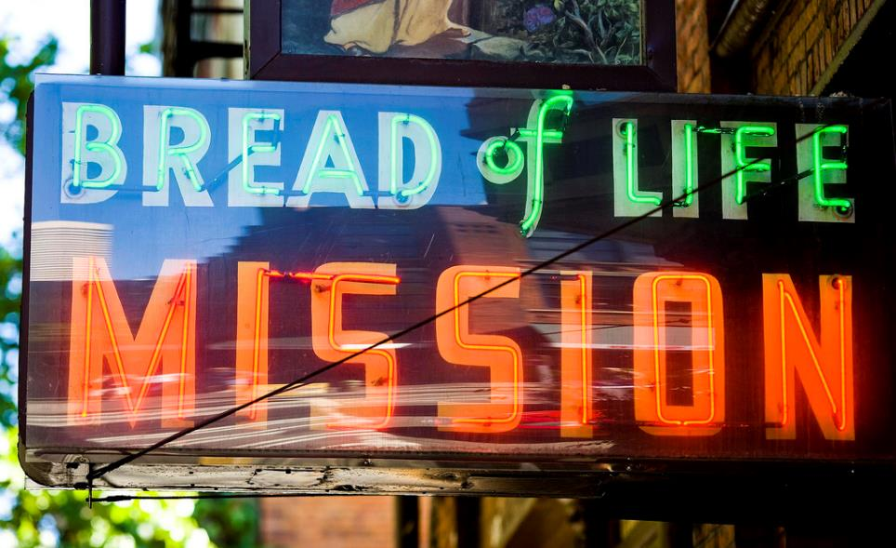
Bread of Life Mission, Seattle, WA

Slide 21
"I am the bread of life. Whoever comes to me will never be hungry, and whoever believes in me will never be thirsty."
John 6:35b

Slide 22
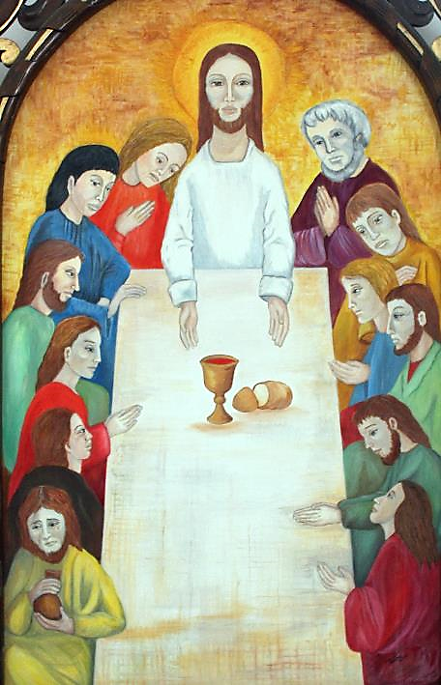
Last Supper
Cathedral of Sancti Spiritus
Sancti Spiritus
Cuba

Slide 23
Credits
New Revised Standard Version Updated Edition Bible, copyright 2022, Division of Christian Education of the National Council of the Churches of Christ in the United States of America. Used by permission. All rights reserved.
https://commons.wikimedia.org/wiki/File:Paul_Klee_-_The_Lamb_-_Google_Art_Project.jpg
https://commons.wikimedia.org/wiki/File:Peder_Severin_Kr%C3%B8yer_-_Little_girl_from_Hornb%C3%A6k_-_Google_Art_Project.jpg
https://commons.wikimedia.org/wiki/File:Rubric_and_full-page_miniature_of_David_and_Bathsheba_(NYPL_b12455533-426564).tif
http://commons.wikimedia.org/wiki/File:V%C3%A9zelay_Narthex_Chapiteau_220608_03.jpg
https://commons.wikimedia.org/wiki/File:Tissot_The_Gathering_of_the_Manna_(color).jpg
http://www.flickr.com/photos/74782490@N00/5816094892
https://commons.wikimedia.org/wiki/File:KeurMoussaAutel.jpg
http://www.flickr.com/photos/wolfgangfoto/2337441318/
www.robertharding.com
https://www.flickr.com/photos/thomashawk/2695836016 - Thomas Hawk
http://commons.wikimedia.org/wiki/File:2012-02-Kathedrale_Sancti_Spiritus_04_anagoria.JPG
Additional descriptions can be found at the Art in the Christian Tradition image library, a service of the Vanderbilt Divinity Library, http://diglib.library.vanderbilt.edu/. All images available via Creative Commons 3.0 License.

