Slide 1
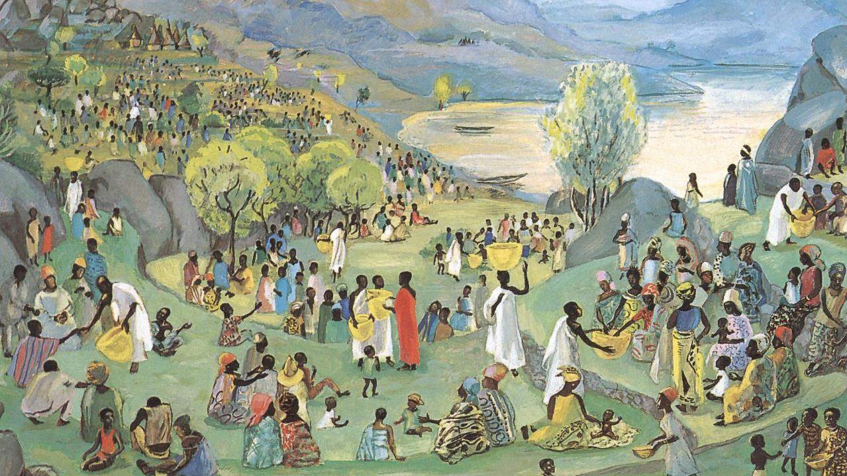
Tenth Sunday after Pentecost
Year B
2 Samuel 11:1-15 and Psalm 14 • 2 Kings 4:42-44 and Psalm 145:10-18 • Ephesians 3:14-21 • John 6:1-21

Slide 2
...David wrote a letter to Joab.… "Set Uriah in the forefront of the hardest fighting…so that he may be struck down and die."
2 Samuel 11:14a, 15b

Slide 3
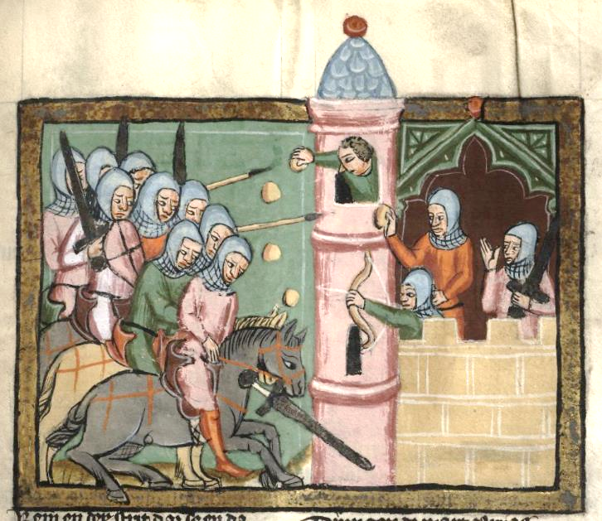
Uriah Falls at the Siege of Rabbas -- Rudolf von Ems, World Chronicle, Fulda University Library, Germany

Slide 4
"Give it to the people and let them eat, for thus says the LORD: They shall eat and have some left."
2 Kings 4:43b

Slide 5
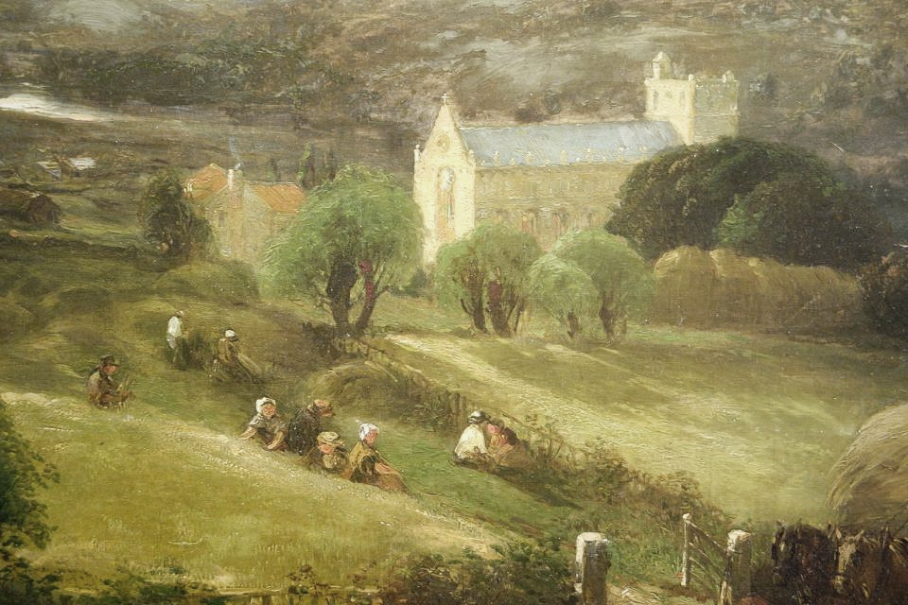
Peace and Plenty -- William Hart, New Britain Museum of American Art, New Britain, CT

Slide 6
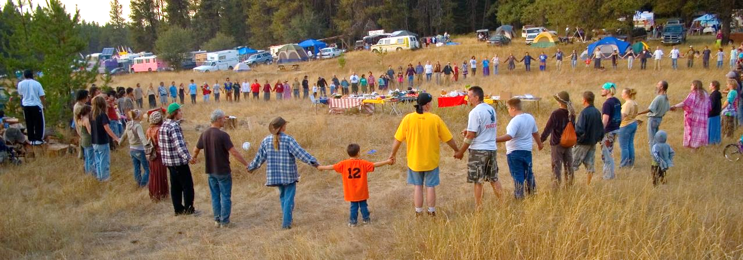
Potluck, First Lutheran Church -- Tyson Creek Station, Idaho

Slide 7
The LORD upholds all who are falling and raises up all who are bowed down.
Psalm 145:14

Slide 8
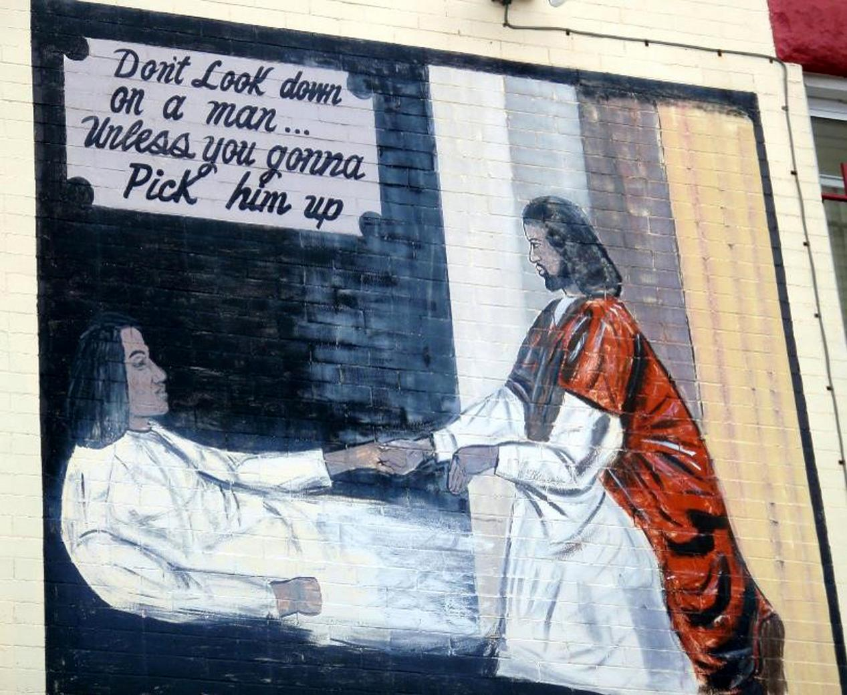
"Don't Look Down…" -- Mural, Washington, DC

Slide 9
I pray…that Christ may dwell in your hearts through faith, as you are being rooted and grounded in love.
Ephesians 3:16a, 17

Slide 10

Peace Begins with Love -- Peace Wall, Hamilton, New Zealand

Slide 11
When he looked up and saw a large crowd coming toward him, Jesus said to Philip, "Where are we to buy bread for these people to eat?"
John 6:5

Slide 12
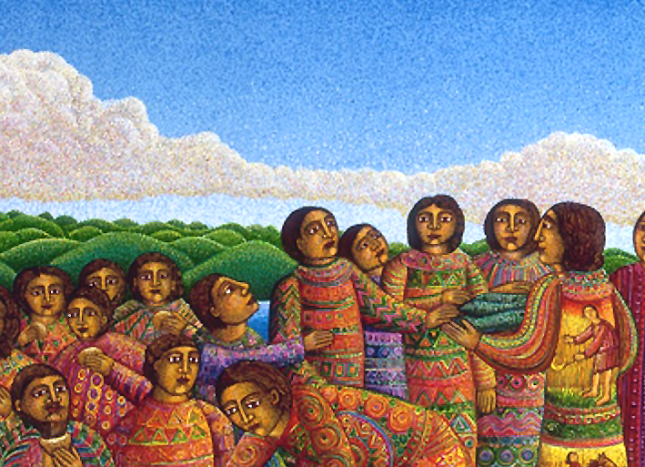
"Where are we to buy bread?" Loaves and Fishes, detail -- John August Swanson, print, 2003

Slide 13
"There is a boy here who has five barley loaves and two fish. But what are they among so many people?"
John 6:9

Slide 14
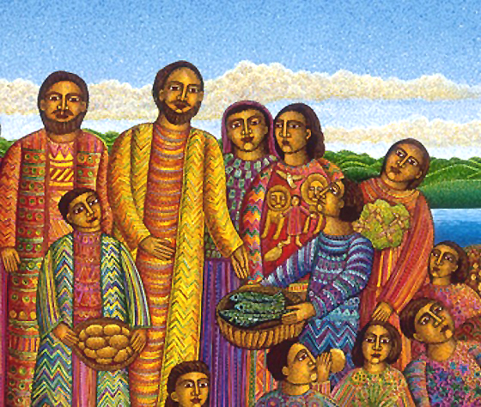
Jesus with Boys, Loaves and Fishes, detail -- John August Swanson, print, 2003

Slide 15
Then Jesus took the loaves, and when he had given thanks he distributed them…; so also the fish, as much as they wanted.
John 6:11

Slide 16
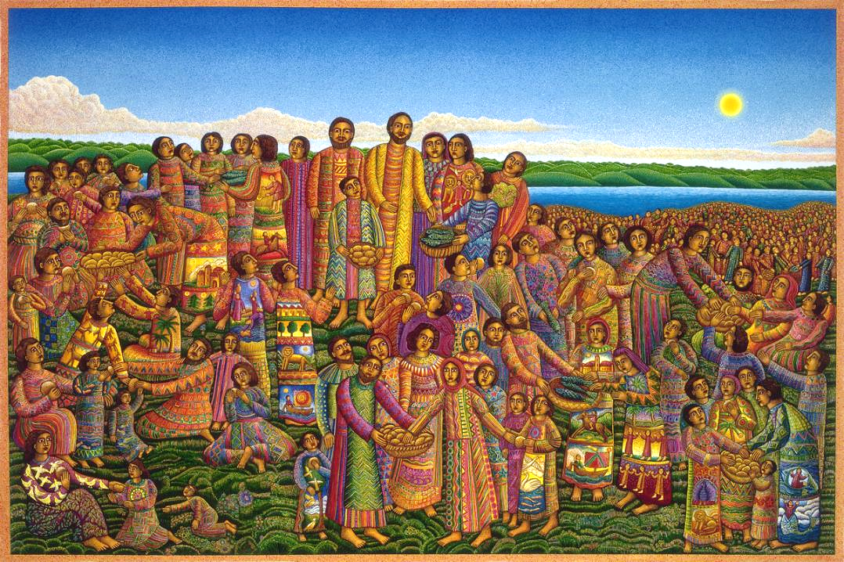
Miracle of the Loaves and Two Fish
Lucas Cranach the Elder
Nationalmuseum Stockholm, Sweden
?

Slide 17
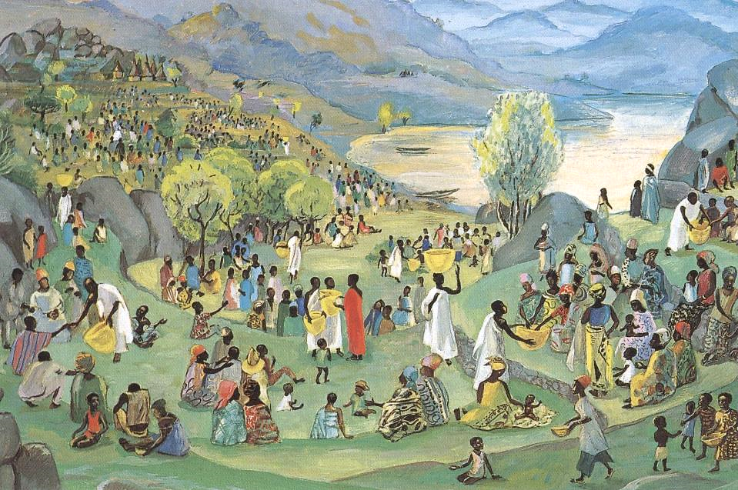
Jesus Multiplies the Loaves and Fish -- JESUS MAFA

Slide 18
When Jesus realized that they were about to come and…make him king, he withdrew again to the mountain by himself.
John 6:15

Slide 19
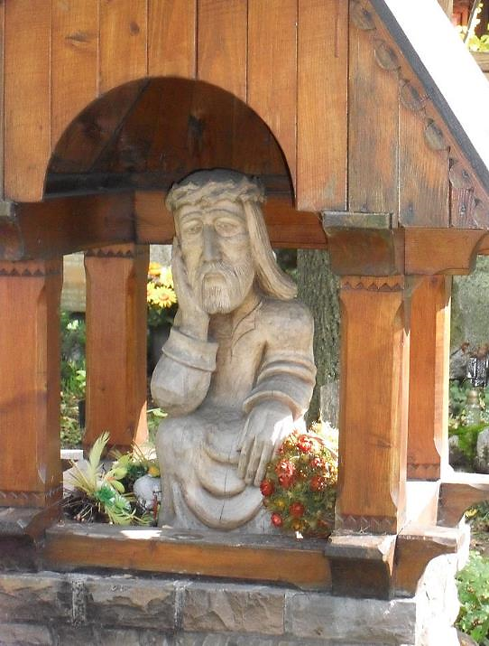
The Contemplative Christ
Peksow Brzyzek Cemetery
Zakopane, Poland

Slide 20
…his disciples went down to the sea, got into a boat, and started across the sea…. It was now dark, and Jesus had not yet come to them.
John 6:16b, 17b

Slide 21
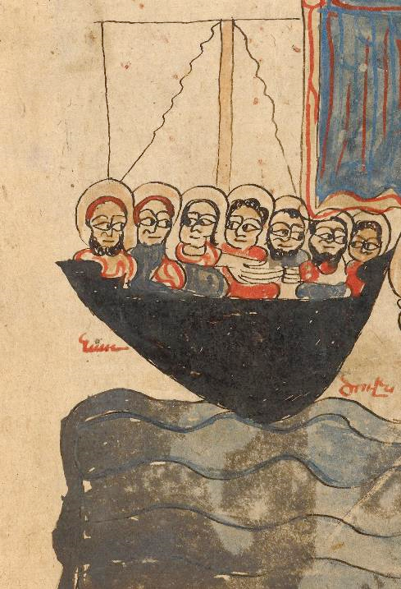
Disciples in the Boat (Jesus Walking on the Water)
Manuscript from 1386
Getty Museum
Los Angeles, CA

Slide 22
When they had rowed about three or four miles, they saw Jesus walking on the sea…, and they were terrified.
John 6:19ac

Slide 23
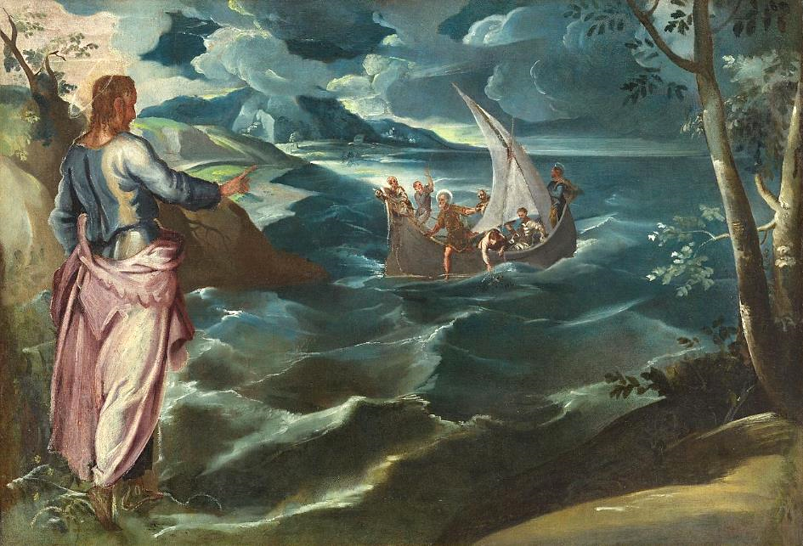
Christ at the Sea of Galilee -- Tintoretto, National Gallery of Art, Washington, DC

Slide 24
But he said to them, "It is I; do not be afraid."
John 6:20

Slide 25
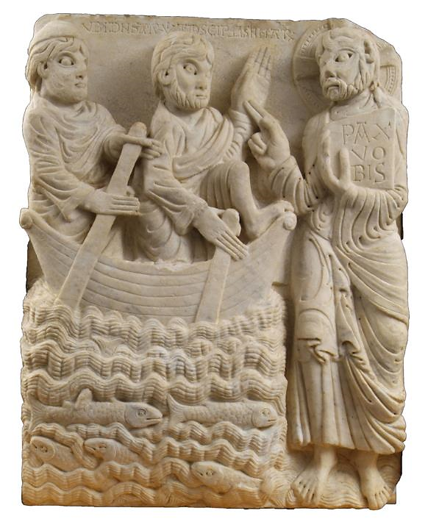
Christ Walking on the Water
Museu Frederic Marès
Barcelona, Spain

Slide 26
Credits
New Revised Standard Version Updated Edition Bible, copyright 2022, Division of Christian Education of the National Council of the Churches of Christ in the United States of America. Used by permission. All rights reserved.
https://commons.wikimedia.org/wiki/File:Weltchronik_Fulda_Aa88_274r_detail.jpg
https://commhttps://www.flickr.com/photos/zenmama/5429643508ons.wikimedia.org/wiki/File:Peace_and_Plenty_by_William_McDougal_Hart,_detail,_1855,_oil_on_canvas_-_New_Britain_Museum_of_American_Art_-_DSC09212.JPG
https://www.flickr.com/photos/daquellamanera/3994554964
https://www.flickr.com/photos/nebarnix/240137145
http://commons.wikimedia.org/wiki/File:RISD_Rodin_Hand_of_God.JPG
http://www.flickr.com/photos/taniwha/7186831/
www.JohnAugustSwanson.com - copyright 2003 by John August Swanson
www.JohnAugustSwanson.com - copyright 2003 by John August Swanson
www.JohnAugustSwanson.com - copyright 2003 by John August Swanson
http://diglib.library.vanderbilt.edu/act-imagelink.pl?RC=48287
https://commons.wikimedia.org/wiki/File:The_contemplative_Christ_of_Zakopane.JPG
https://commons.wikimedia.org/wiki/File:The_Feeding_of_the_Five_Thousand;_Jesus_Walking_on_the_Water_-_Google_Art_Project.jpg
https://commons.wikimedia.org/wiki/File:Tintoretto,_Jacopo_-_Christ_at_the_Sea_of_Galilee.jpg
https://commons.wikimedia.org/wiki/File:Mestre_de_cabestany.jpg - Guillem F-H
Additional descriptions can be found at the Art in the Christian Tradition image library, a service of the Vanderbilt Divinity Library, http://diglib.library.vanderbilt.edu/. All images available via Creative Commons 3.0 License.

