Slide 1
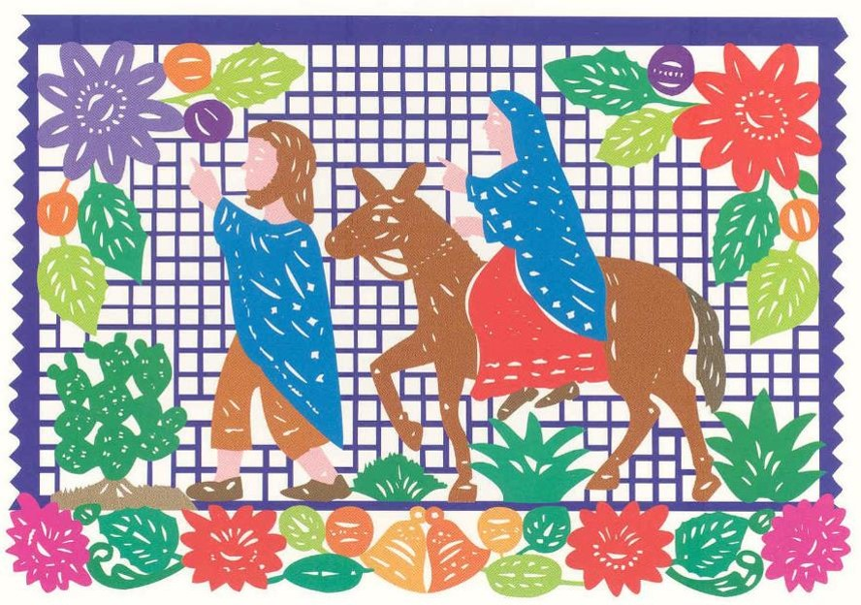
Nativity of the Lord I
Year B
Isaiah 9:2-7
Psalm 96
Titus 2:11-14
Luke 2:1-14, (15-20)

Slide 2
The people who walked in darkness have seen a great light; those who lived in a land of deep darkness—
on them light has shined.
Isaiah 9:2

Slide 3
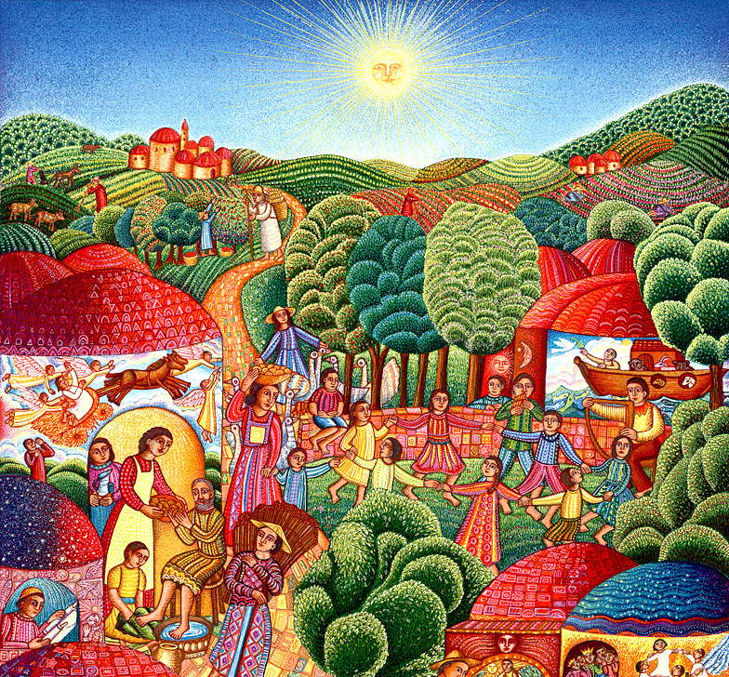
A Visit
John Swanson
Los Angeles, CA

Slide 4
For a child has been born for us…and he is named Wonderful Counselor, Mighty God, Everlasting Father, Prince of Peace.
Isaiah 9:6

Slide 5
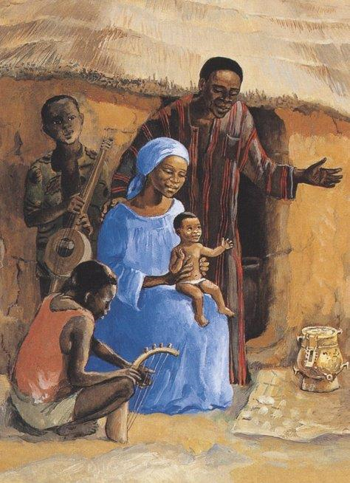
Holy Family
JESUS MAFA
Cameroon

Slide 6
Let the heavens be glad,
and let the earth rejoice;
let the sea roar and all that fills it...
Psalm 96:11

Slide 7
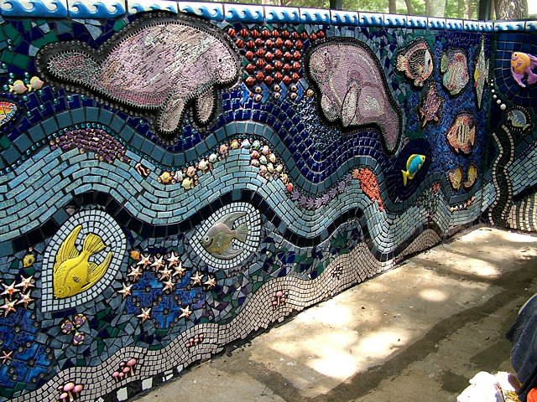
Fish Wall East -- Mosaic with Creation motif, Apopka, FL

Slide 8
For the grace of God has appeared, bringing salvation to all…
Titus 2:11

Slide 9
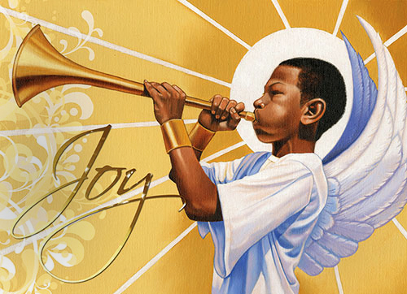
Joy to the World, the Lord is Come -- Illustration from Dem. Republic of Congo

Slide 10
In those days a decree went out from Caesar Augustus that all the world should be registered.
Luke 2:1

Slide 11
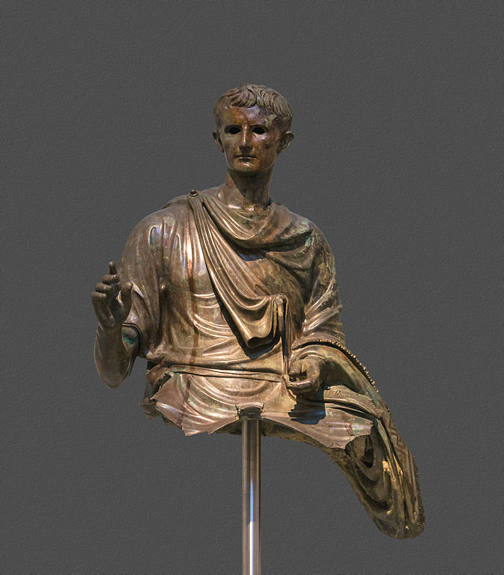
Emperor Augustus
National Archaeological Museum
Athens, Greece

Slide 12
Joseph also went from the town of Nazareth in Galilee to Judea, to the city of David called Bethlehem, because he was descended from the house and family of David.
Luke 2:4

Slide 13
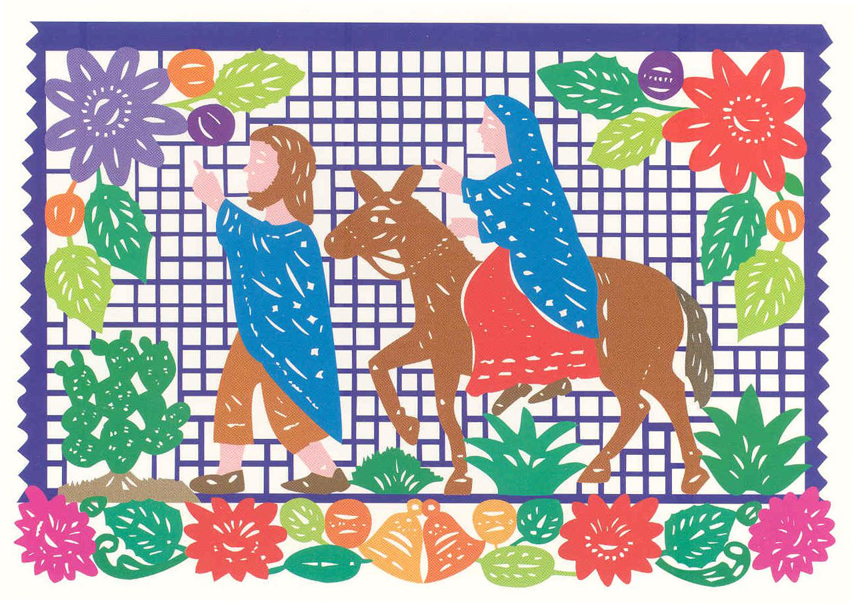
Traveling to Bethlehem -- Mexican cut paper art

Slide 14
He went to be registered with Mary, to whom he was engaged and who was expecting a child.
Luke 2:5

Slide 15
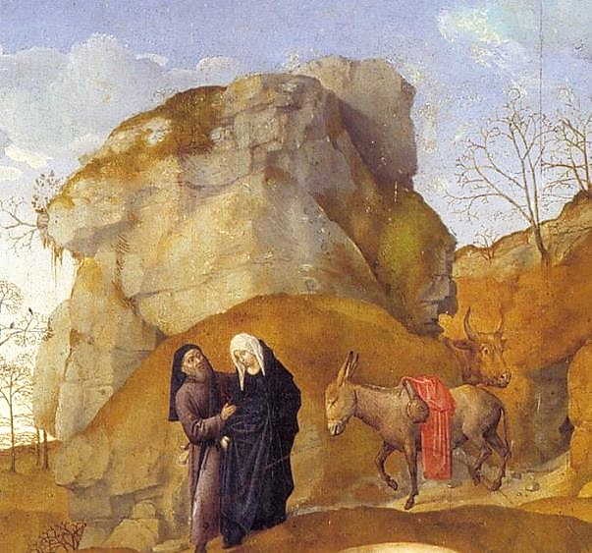
Journey to Bethlehem, detail
Hugo van der Goes Uffizi Gallery Florence, Italy

Slide 16
While they were there, the time came for her to deliver her child.
Luke 2:6

Slide 17
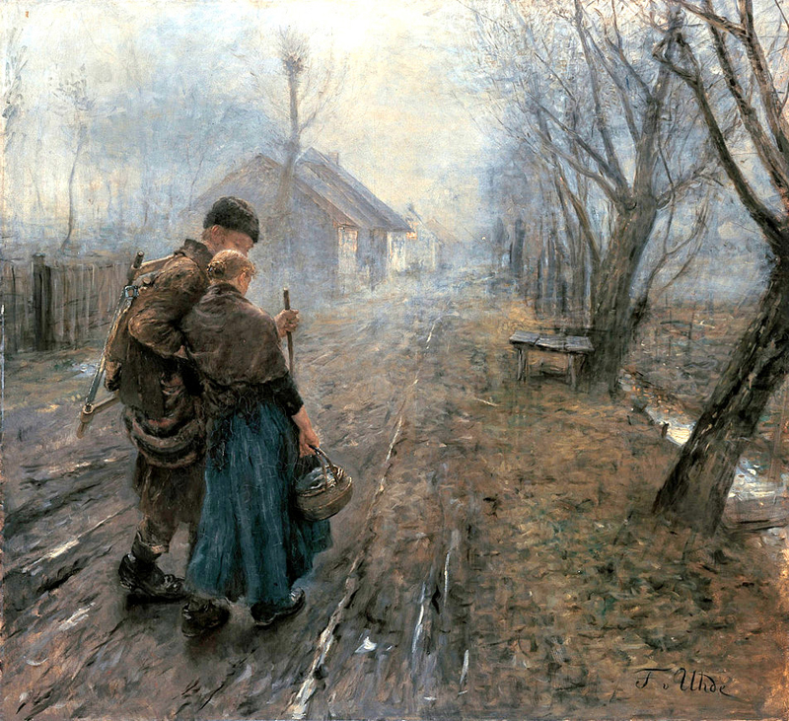
Difficult Journey
Fritz von Uhde
Neue Pinakothek
Munich, Germany

Slide 18
And she gave birth to her firstborn son and wrapped him in bands of cloth and laid him in a manger...
Luke 2:7a

Slide 19
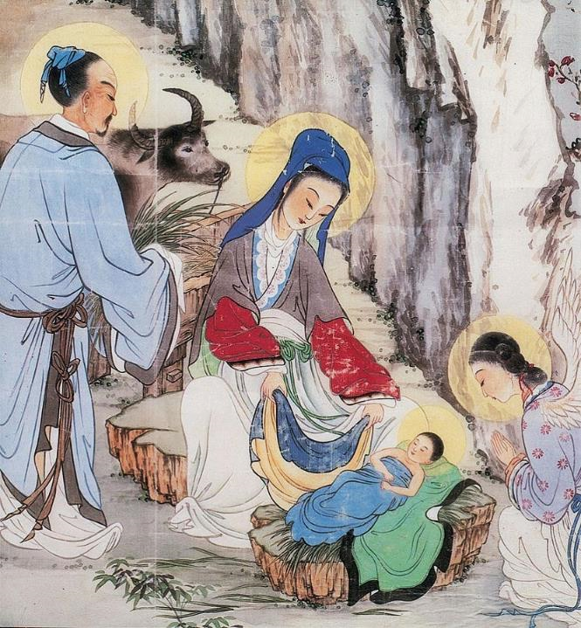
The Birth of Jesus
Chinese print from painting

Slide 20
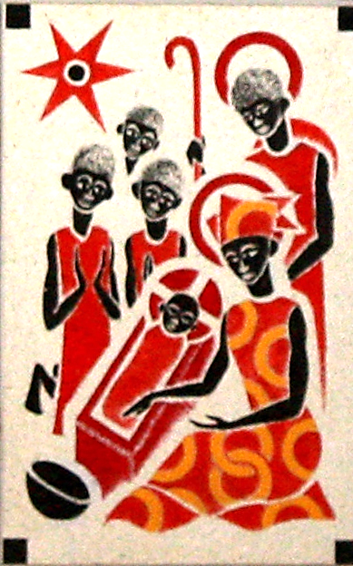
Christ is Born
Father Georges Saget
Keur Moussa Abbey
Keur Moussa, Senegal

Slide 21
...because there was no place in the guest room.
Luke 2:7b

Slide 22
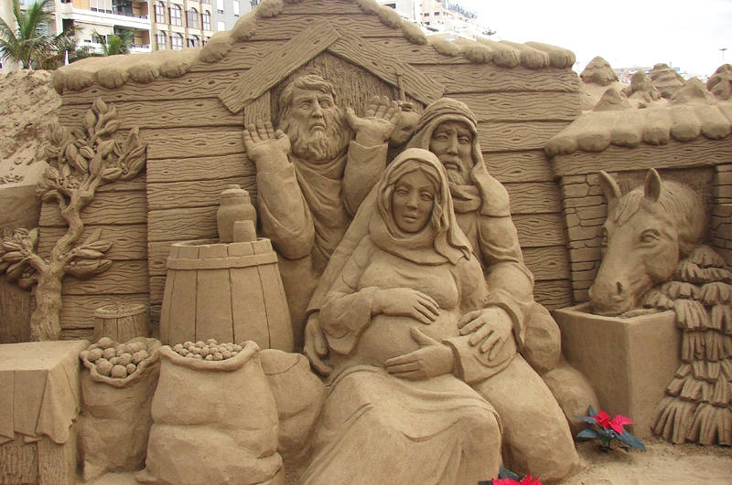
No Room in the Inn -- Peter Busch, Sand sculpture, Canary Islands, Spain

Slide 23
Credits
New Revised Standard Version Updated Edition Bible, copyright 2022, Division of Christian Education of the National Council of the Churches of Christ in the United States of America. Used by permission. All rights reserved.
www.JohnAugustSwanson.com - copyright 1995 by John August Swanson
http://diglib.library.vanderbilt.edu/act-imagelink.pl?RC=47583
https://www.flickr.com/photos/mosaicsbychris/1007750608
https://www.flickr.com/photos/babasteve/31844535845/
https://commons.wikimedia.org/wiki/File:Augustus_Bronze_X23322_NAMAthens.jpg
https://www.flickr.com/photos/citlali/3113359893/
https://commons.wikimedia.org/wiki/File:Fritz_v_Uhde_Schwerer_Gang_(1).jpg
https://commons.wikimedia.org/wiki/File:Chinese_painting_of_birth_of_Christ.jpg
https://commons.wikimedia.org/wiki/File:KeurMoussaAutel.jpg
http://www.flickr.com/photos/mercywatch/2095491207/
Additional descriptions can be found at the Art in the Christian Tradition image library, a service of the Vanderbilt Divinity Library, http://diglib.library.vanderbilt.edu/. All images available via Creative Commons 3.0 License.

