Slide 1
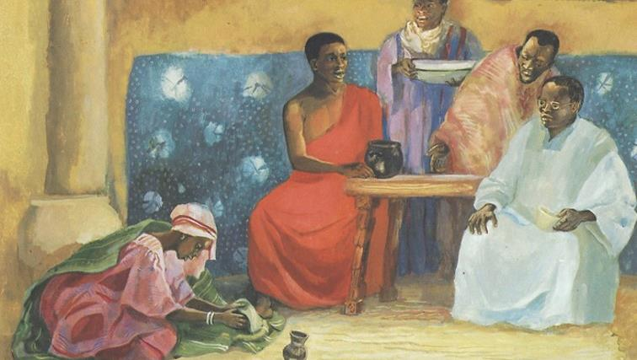
Monday of Holy Week
Year A
Isaiah 42:1-9
Psalm 36:5-11
Hebrews 9:11-15
John 12:1-11

Slide 2
"It is too light a thing…to raise up the tribes of Jacob…; I will give you as a light to the nations…"
Isaiah 49:6

Slide 3
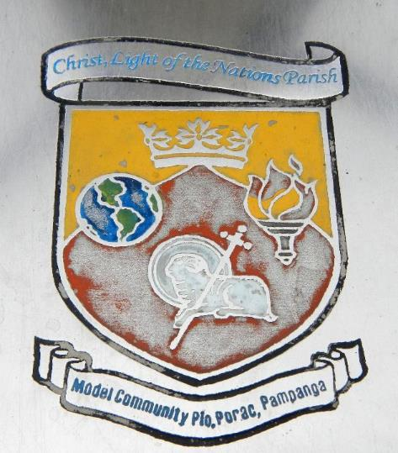
Christ, Light of the Nations
Porac, Philippines

Slide 4
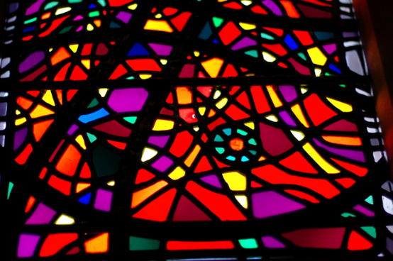
Light and Color -- Washington National Cathedral, Washington, DC

Slide 5
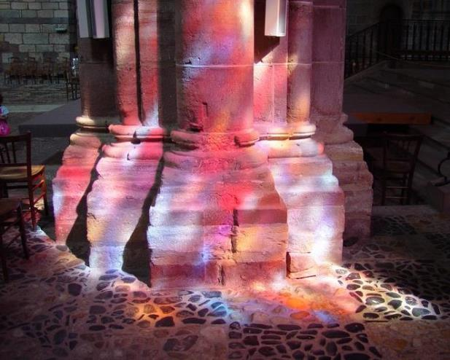
Interior Light -- Saint-Julien, Brioude, France

Slide 6
Do not cast me off in the time of old age; do not forsake me when my strength is spent.
Psalm 71:9

Slide 7
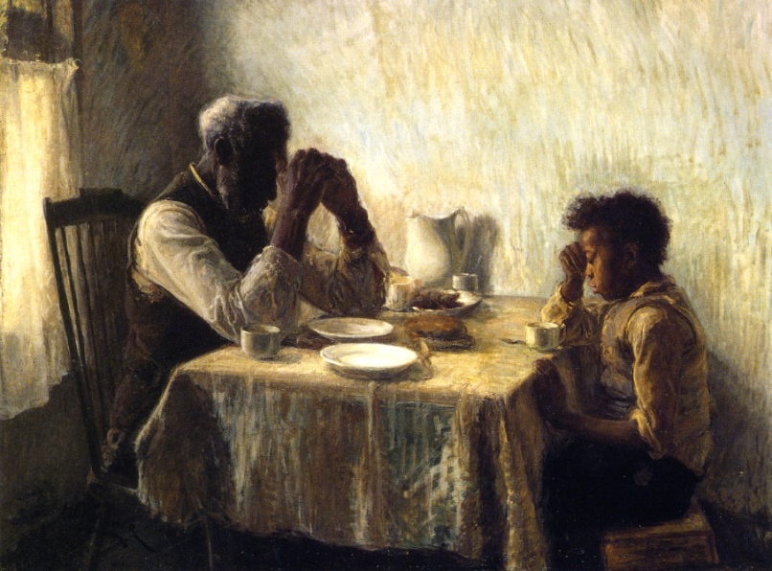
Giving Thanks -- Henry Ossawa Tanner

Slide 8
Where is the one who is wise? … Where is the debater of this age? Has not God made foolish the wisdom of the world?
1 Corinthians 1:20

Slide 9
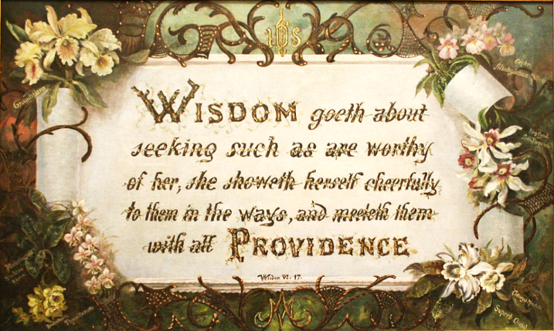
Wisdom -- Sister Maurice Schnell, Saint-Mary-of-the-Woods Archives, Saint Mary, Indiana

Slide 10
Six days before the Passover Jesus came to Bethany, the home of Lazarus, whom he had raised from the dead.
John 12:1

Slide 11
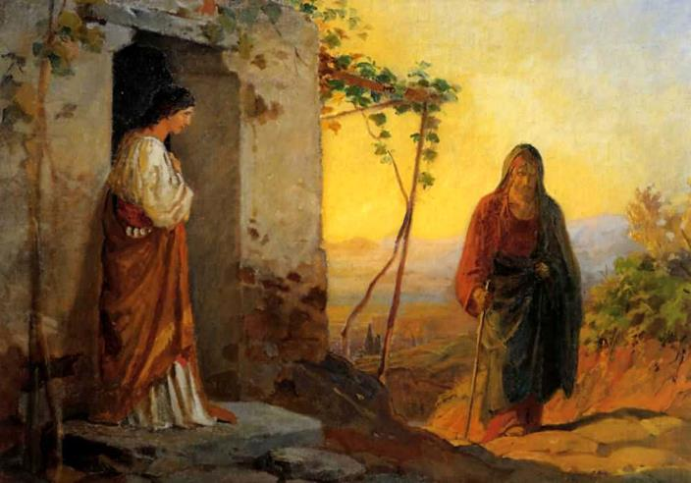
Mary Greets Jesus -- Nikolas Ge

Slide 12
There they gave a dinner for him. Martha served, and Lazarus was one of those at the table with him.
John 12:2

Slide 13
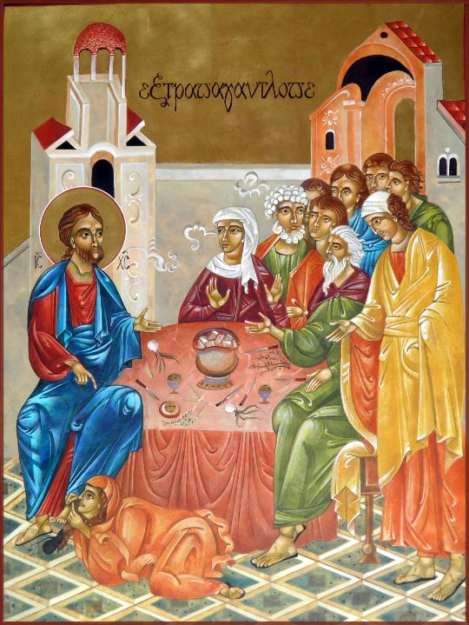
Extravagant Love
Mary Jane Miller

Slide 14
Mary took a pound of costly perfume made of pure nard, anointed Jesus's feet, and wiped them with her hair.
John 12:3a

Slide 15
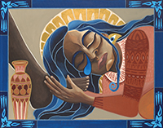
Mary Wipes Christ's Feet -- Lauren Wright Pittman

Slide 16
But Judas…said, "Why was this perfume not sold for three hundred denarii and the money given to the poor?"
John 12:4a, 5

Slide 17
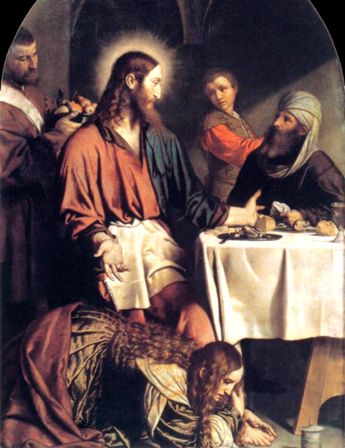
Feast in the House of Simon
Moretto da Brescia
Church of Saint Mary, Calchera
Brescia, Italy

Slide 18
Jesus said, "Leave her alone. She bought it so that she might keep it for the day of my burial."
John 12:7

Slide 19
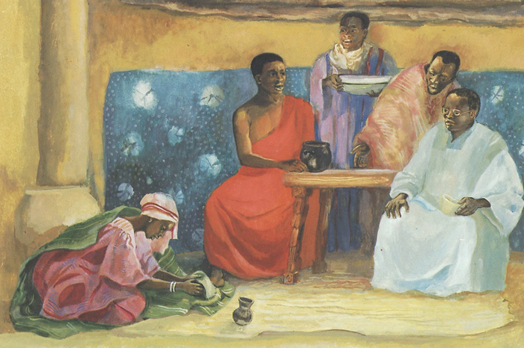
Anointing of Jesus' Feet -- JESUS MAFA, Cameroon

Slide 20
"You always have the poor with you, but you do not always have me."
John 12:8

Slide 21
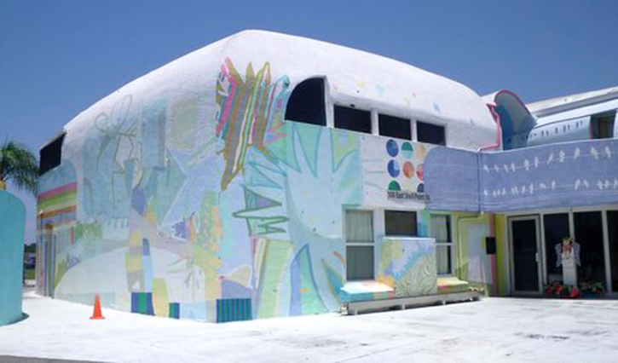
Mary and Martha House -- Domestic Violence Homeless Shelter for Women in Ruskin, FL

Slide 22
Credits
New Revised Standard Version Updated Edition Bible, copyright 2022, Division of Christian Education of the National Council of the Churches of Christ in the United States of America. Used by permission. All rights reserved.
https://commons.wikimedia.org/wiki/File:Jf3049Christ_Light_Nations_Church_Porac_Pampangafvf_35.jpg
http://www.flickr.com/photos/kubina/32453710/
http://diglib.library.vanderbilt.edu/act-imagelink.pl?RC=47117
https://commons.wikimedia.org/wiki/File:The_Thankful_Poor,_1894._Henry_Ossawa_Tanner.jpg
https://commons.wikimedia.org/wiki/File:Wisdom_-_Sister_Maurice_Schnell.jpg
https://commons.wikimedia.org/wiki/File:Nikolay_Ge_015.jpeg
Mary Jane Miller, https://www.millericons.com/
https://commons.wikimedia.org/wiki/File:Lucas_Moser_001.jpg
http://www.lewpstudio.com - copyright by Lauren Wright Pittman
https://commons.wikimedia.org/wiki/File:Moretto_da_Brescia_-_Supper_in_the_House_of_Simon_Pharisee_-_WGA16229.jpg
https://commons.wikimedia.org/wiki/File:Accademia_-_Convito_in_casa_di_Simeone_by_Bernardo_Strozzi_cat777.jpg
http://www.librairie-emmanuel.fr (contact page: https://www.librairie-emmanuel.fr/contact)
https://commons.m.wikimedia.org/wiki/File:2009_-_COMMUNITY_MURAL-in-the-Round_PROJECT_Big_Draw_at_Mary_Martha_House_Store.JPG
Additional descriptions can be found at the Art in the Christian Tradition image library, a service of the Vanderbilt Divinity Library, http://diglib.library.vanderbilt.edu/. All images available via Creative Commons 3.0 License.

