Slide 1
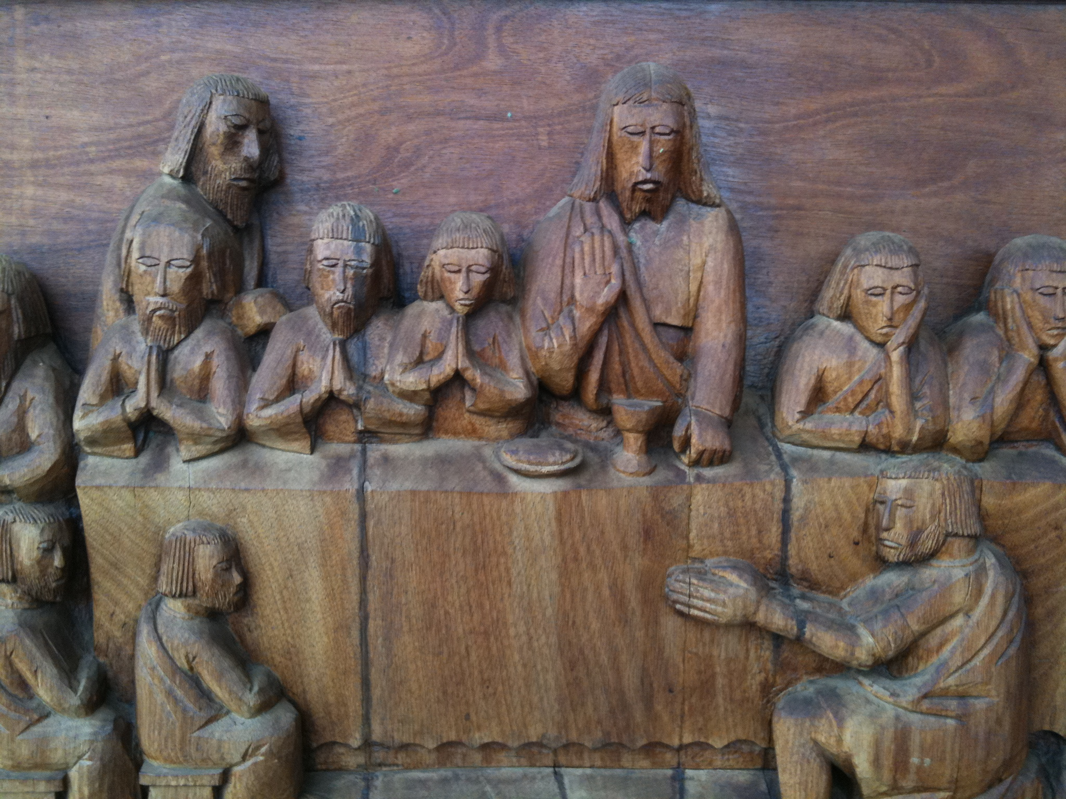
Maundy Thursday
Year A
Exodus 12:1-4, (5-10), 11-14
Psalm 116:1-2, 12-19
1 Corinthians 11:23-26
John 13:1-17, 31b-35

Slide 2
Your lamb shall be without blemish.…the whole assembled congregation of Israel shall slaughter it at twilight. … It is the Passover of the LORD.
Exodus 12:5a, 6b, 11b

Slide 3
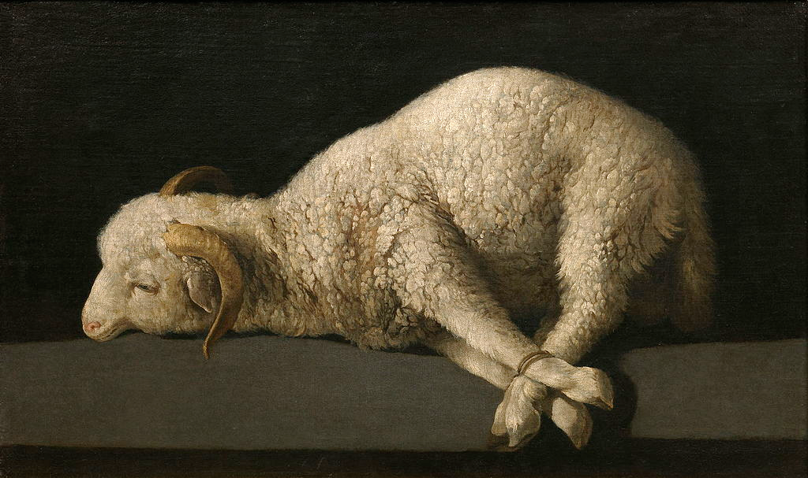
Lamb of God -- Francisco de Zurbaran, Prado, Madrid, Spain

Slide 4
I will offer to you a thanksgiving sacrifice and call on the name of the LORD.
Psalm 116:17

Slide 5
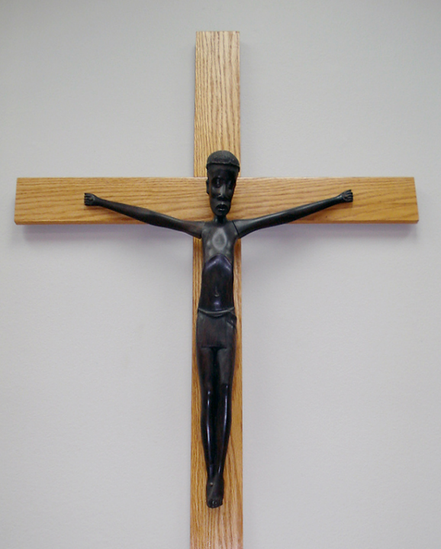
Christ on the Cross
Clerics of Saint Viateur Montreal, Canada

Slide 6
…the Lord Jesus on the night when he was betrayed took a loaf of bread,
and when he had given thanks, he broke it and said, "This is my body that is for you. Do this in remembrance of me."
1 Corinthians 11:23b-24

Slide 7
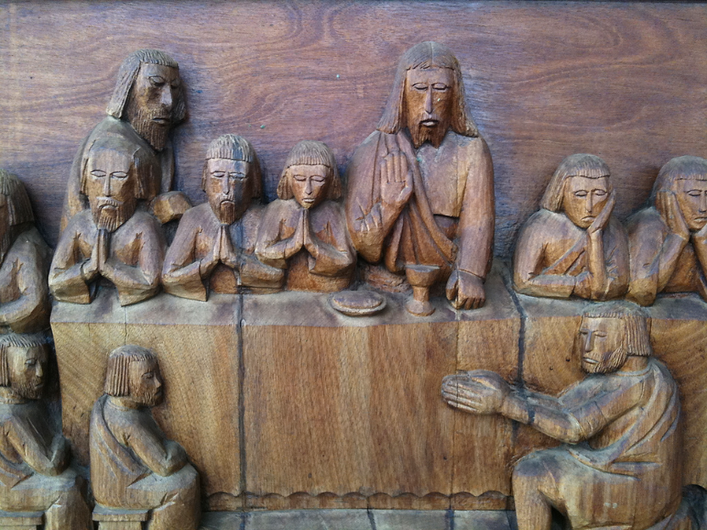
Last Supper -- Capetown, South Africa

Slide 8
In the same way he took the cup also, after supper, saying, "This cup is the new covenant in my blood. Do this, as often as you drink it, in remembrance of me."
1 Corinthians 11:25

Slide 9
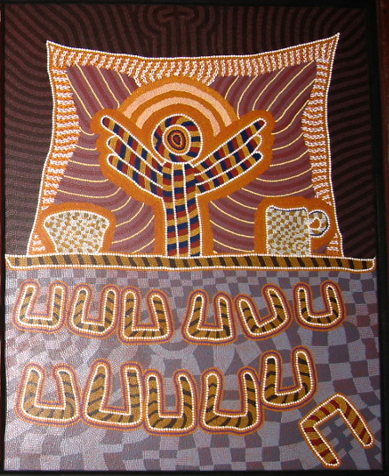
Last Supper
Australian Museum
Sydney, Australia

Slide 10
For as often as you eat this bread and drink the cup, you proclaim the Lord's death until he comes.
1 Corinthians 11:26

Slide 11
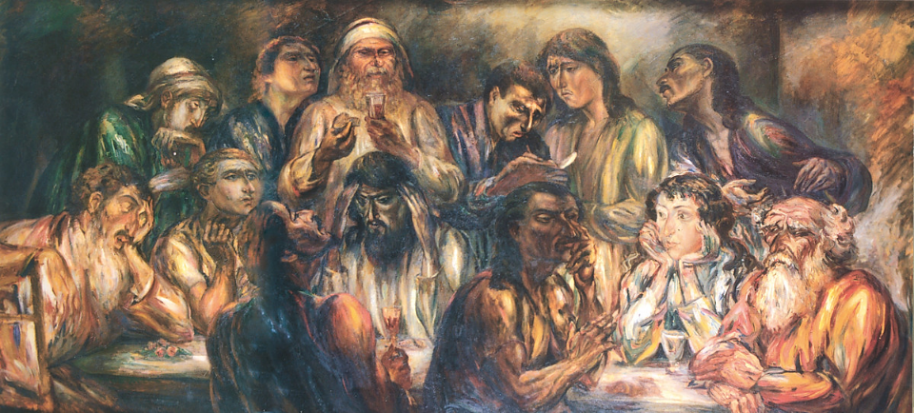
Last Supper -- Karoly Kernstok, Hungarian National Gallery, Budapest, Hungary

Slide 12
…he poured water into a basin and began to wash the disciples' feet and to wipe them with the towel that was tied around him.
John 13:5

Slide 13
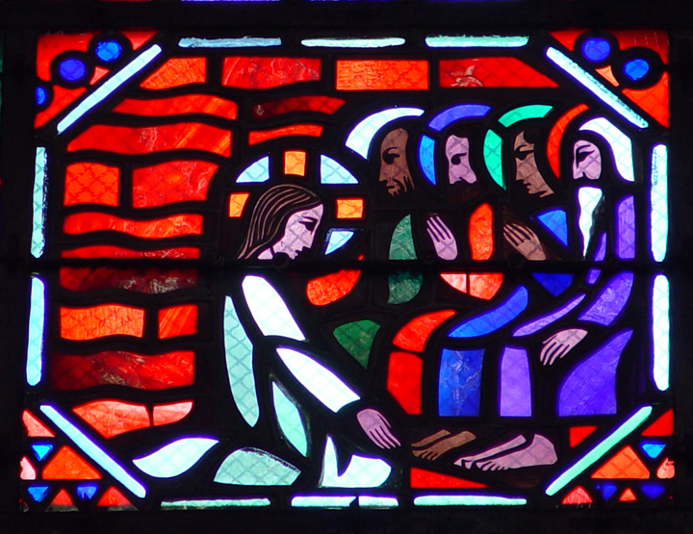
Christ Washes the Disciples’ Feet -- Gaudin and Le Breton, Amiens Cathedral, Amiens, France

Slide 14
Peter said to him, "You will never wash my feet."
John 13:8a

Slide 15
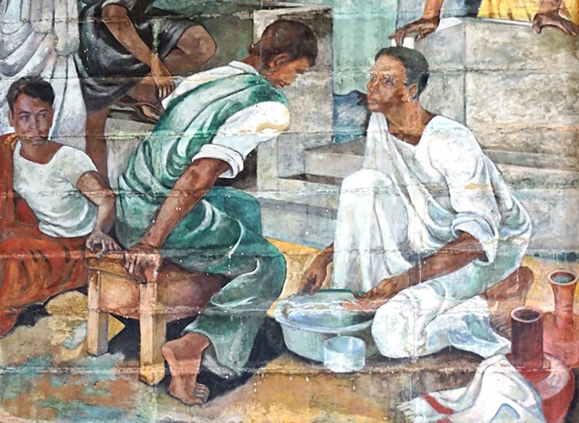
Christ Washes Peter’s Feet -- David Paynter, Trinity College Chapel, Kandy, Sri Lanka

Slide 16
“...if I, your Lord and Teacher, have washed your feet, you also ought to wash one another's feet."
John 13:14

Slide 17
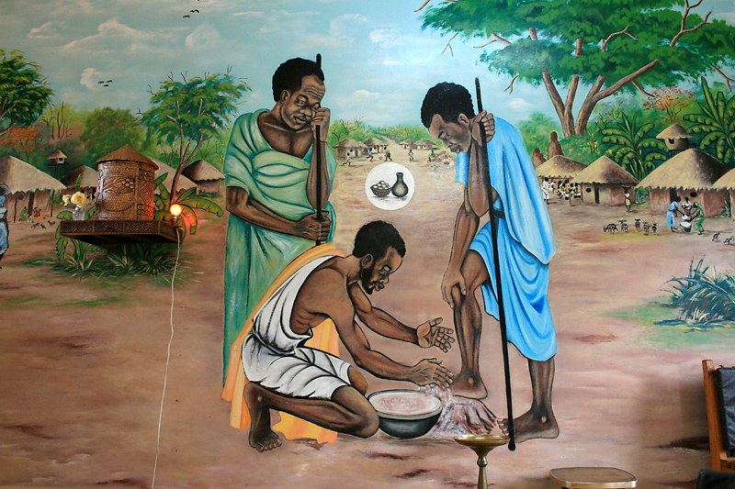
Jesus Washes His Disciples’ Feet -- Victoria Falls, Zambia

Slide 18
"I give you a new commandment, that you love one another. Just as I have loved you, you also should love one another."
John 13:34

Slide 19
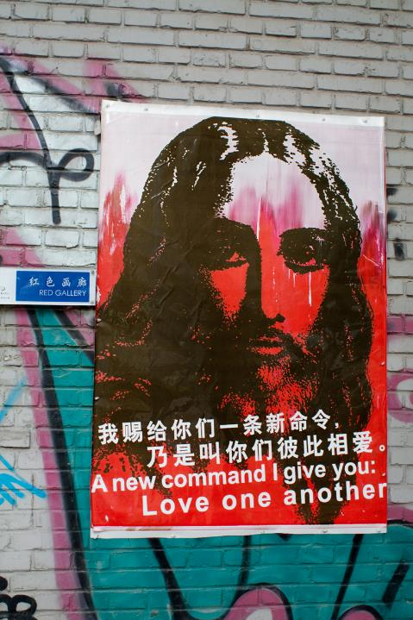
“A new command I give you: Love one another”
Poster, Beijing, China

Slide 20
"By this everyone will know that you are my disciples, if you have love for one another."
John 13:35

Slide 21
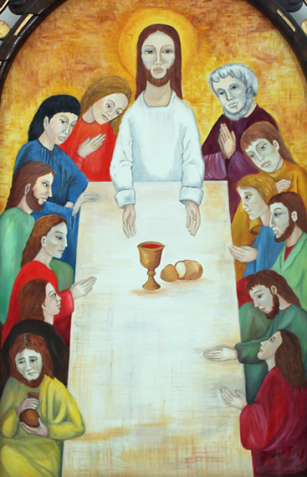
Last Supper
Cathedral of Sancti Spiritus
Sancti Spiritus, Cuba

Slide 22
Credits
New Revised Standard Version Updated Edition Bible, copyright 2022, Division of Christian Education of the National Council of the Churches of Christ in the United States of America. Used by permission. All rights reserved.
https://commons.wikimedia.org/wiki/File:Francisco_de_Zurbar%C3%A1n_006.jpg
https://www.flickr.com/photos/zazie/5177003555 - Catherine Roy
https://www.flickr.com/photos/14538835@N00/3909846049/ - Namronpeter
http://www.flickr.com/photos/stolenbyme/64142017/
https://commons.wikimedia.org/wiki/File:Kernstok_The_Last_Supper_1921.jpg
http://diglib.library.vanderbilt.edu/act-imagelink.pl?RC=29387
http://www.flickr.com/photos/gillpoole/182397726/
http://www.flickr.com/photos/toddhiestand/2628057856/
http://commons.wikimedia.org/wiki/File:2012-02-Kathedrale_Sancti_Spiritus_04_anagoria.JPG
http://www.flickr.com/photos/portablematthew/3491085679/
Additional descriptions can be found at the Art in the Christian Tradition image library, a service of the Vanderbilt Divinity Library, http://diglib.library.vanderbilt.edu/. All images available via Creative Commons 3.0 License.

