Slide 1
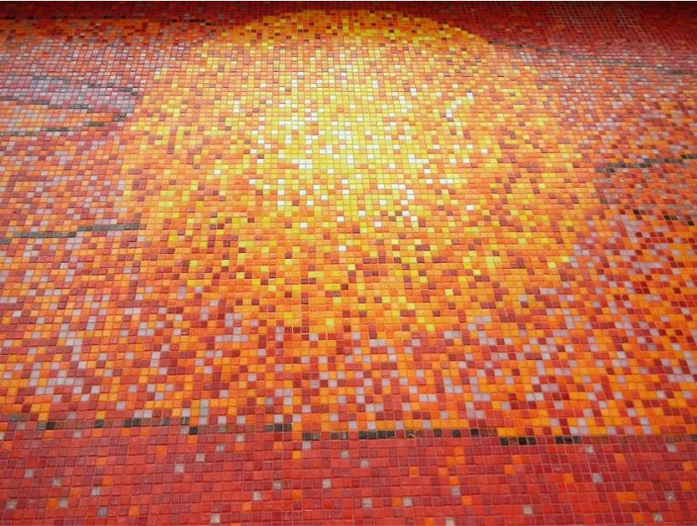
Holy Name of Jesus
Year B
Numbers 6:22-27
Psalm 8
Galatians 4:4-7
or Philippians 2:5-11
Luke 2:15-21

Slide 2
The LORD bless you and keep you...
Numbers 6:24

Slide 3
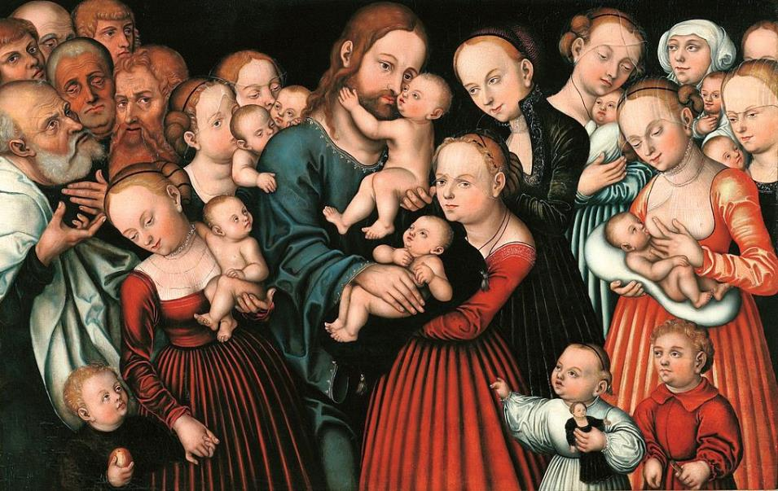
Christ Blessing the Children -- Lucas Cranach, Wawel Castle, Krakow, Poland

Slide 4
...the LORD make his face to shine upon you and be gracious to you...
Numbers 6:25

Slide 5
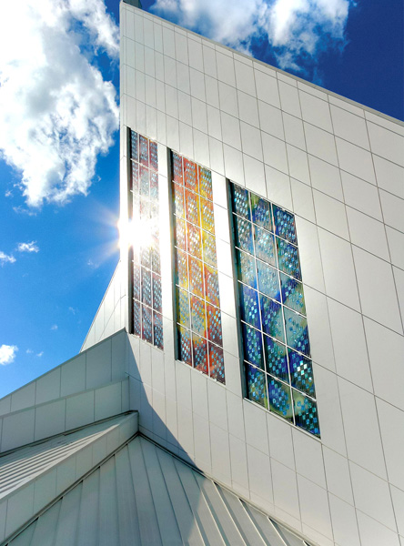
Lux Gloria
solar glass art
Sarah Hall Cathedral of the Holy Family, Saskatoon, Saskatchewan

Slide 6
…the LORD lift up his countenance upon you and give you peace.
Numbers 6:26

Slide 7
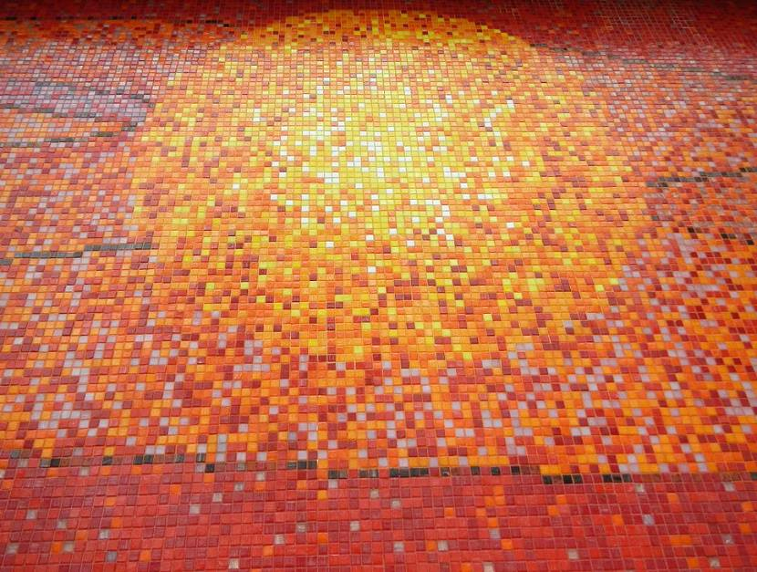
Ang Pagbabago: Peace-Love, detail -- Jose Datuin, Rizal Park, Manila, Philippines

Slide 8
When I look at your heavens, the work of your fingers, the moon and the stars…; what are humans that you are mindful of them…?
Psalm 8:3a, 4a

Slide 9
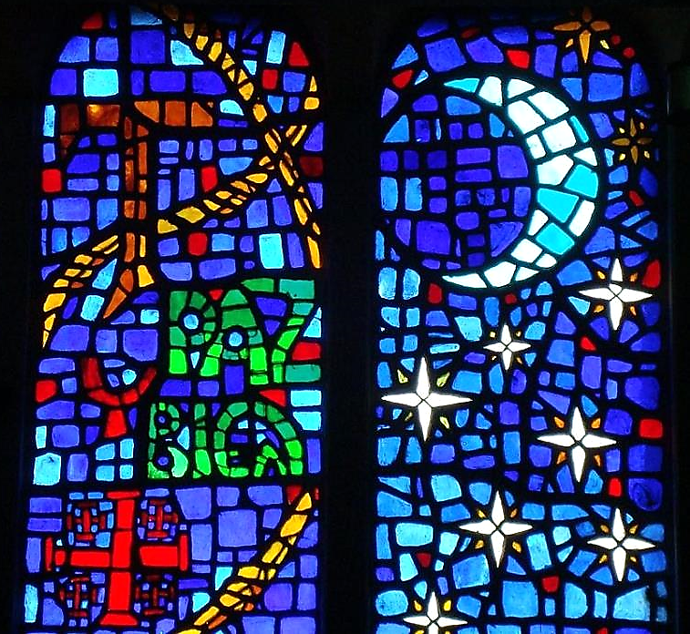
Moon and the Stars Window
Saints Kings Church Mexico City, Mexico

Slide 10
And because you are children, God has sent the Spirit of his Son into our hearts, crying, "Abba! Father!"
Galatians 4:6

Slide 11
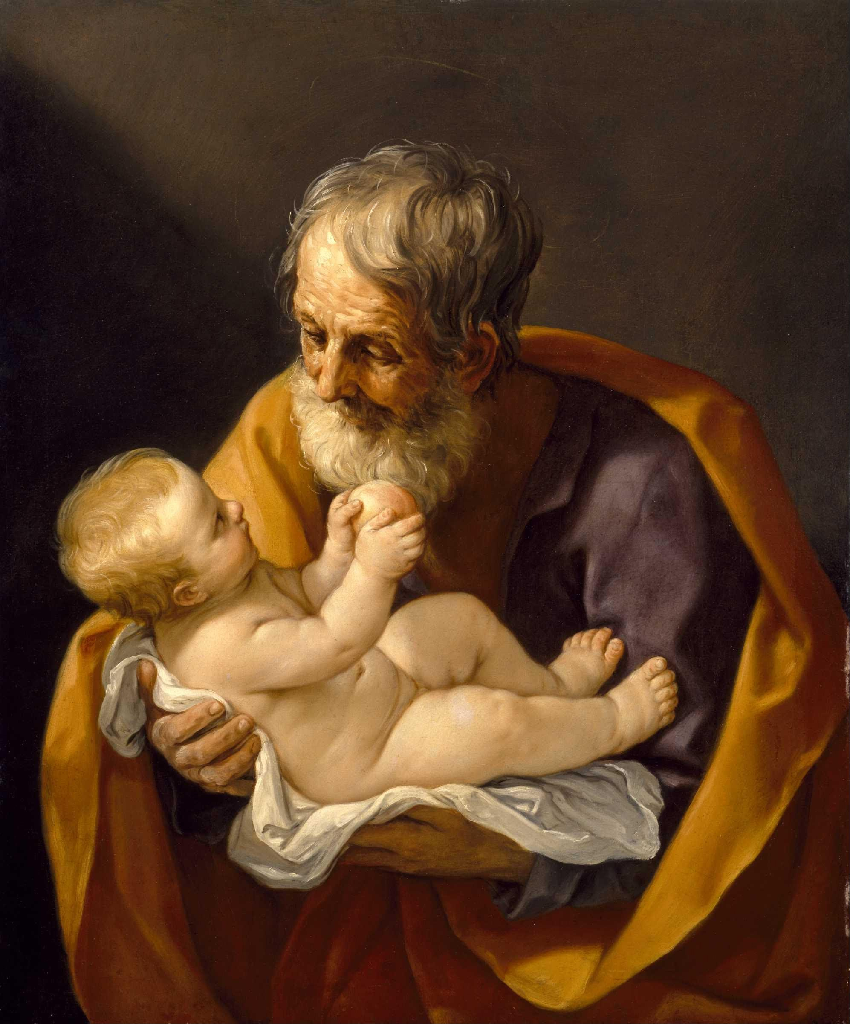
Joseph and the Christ Child
Guido Reni
MFA Houston

Slide 12
…at the name given to Jesus every knee should bend, in heaven and on earth and under the earth...
Philippians 2:10

Slide 13
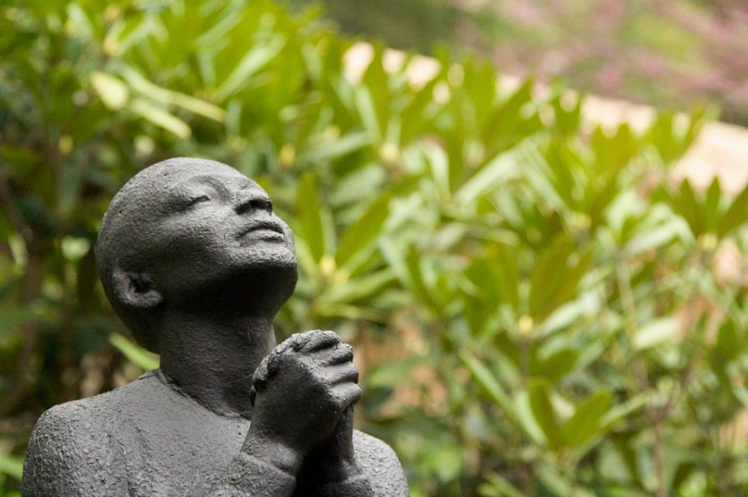
Rose McClendon in Prayer -- Richmond Barthe, Fallingwater, PA

Slide 14
...and every tongue should confess that Jesus Christ is Lord, to the glory of God the Father.
Philippians 2:11

Slide 15
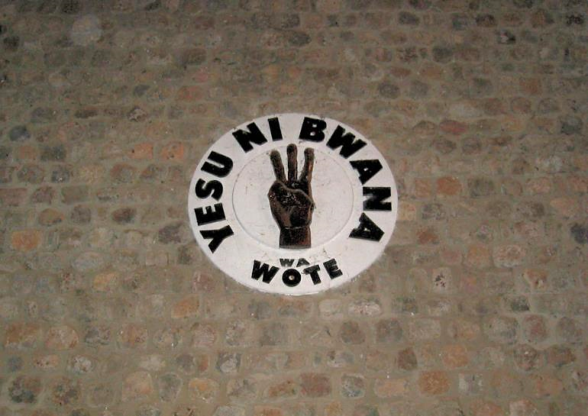
Jesus is Lord of All -- Panel in Chapel, Mulungwishi Mission, D. R. Congo

Slide 16
...and Mary treasured all these words and pondered them in her heart.
Luke 2:19

Slide 17
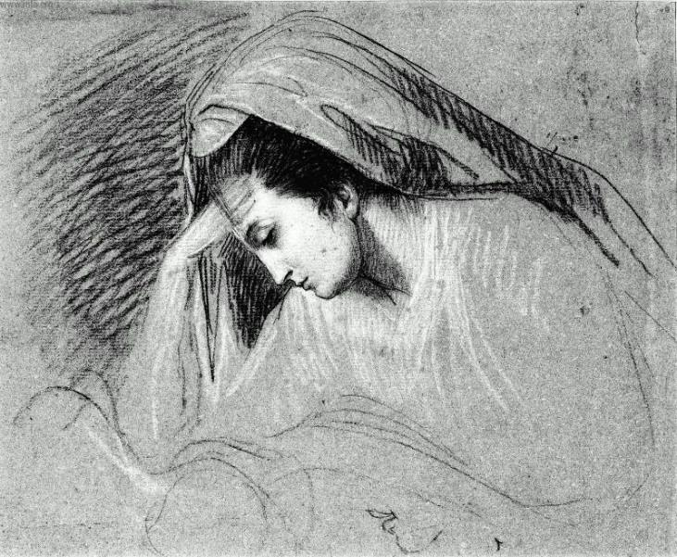
Study for the Head of the Virgin -- John Singleton Copley, Museum of Fine Arts, Boston, MA

Slide 18
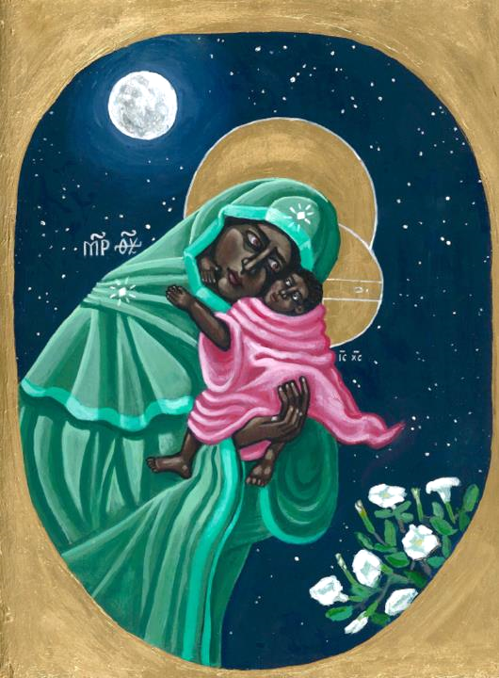
Mary and Jesus
Kelly Latimore
St. Louis, MO

Slide 19
Credits
New Revised Standard Version Updated Edition Bible, copyright 2022, Division of Christian Education of the National Council of the Churches of Christ in the United States of America. Used by permission. All rights reserved.
https://commons.wikimedia.org/wiki/File:Cranach_the_Elder_Christ_blessing_the_children.jpg
https://en.wikipedia.org/wiki/File:Lux_Gloria_by_Sarah_Hall.jpg
https://commons.wikimedia.org/wiki/File:09900jfDancing_Rings_Rizal_Park_Manilafvf_11.jpg
https://commons.wikimedia.org/wiki/File:Saints_Kings_Church,_3000_R%C3%ADo_Consulado_Avenue,_Venustiano_Carranza,_Federal_District,_Mexico06_-_Paz_y_bien.jpg
https://commons.wikimedia.org/wiki/File:Guido_Reni_-_Saint_Joseph_and_the_Christ_Child_-_Google_Art_Project.jpg
https://www.flickr.com/photos/via/2483710127
https://www.flickr.com/photos/umccongo/2188556374
http://www.mfa.org/
https://kellylatimoreicons.com/contact/
Additional descriptions can be found at the Art in the Christian Tradition image library, a service of the Vanderbilt Divinity Library, http://diglib.library.vanderbilt.edu/. All images available via Creative Commons 3.0 License.

